Slide 1
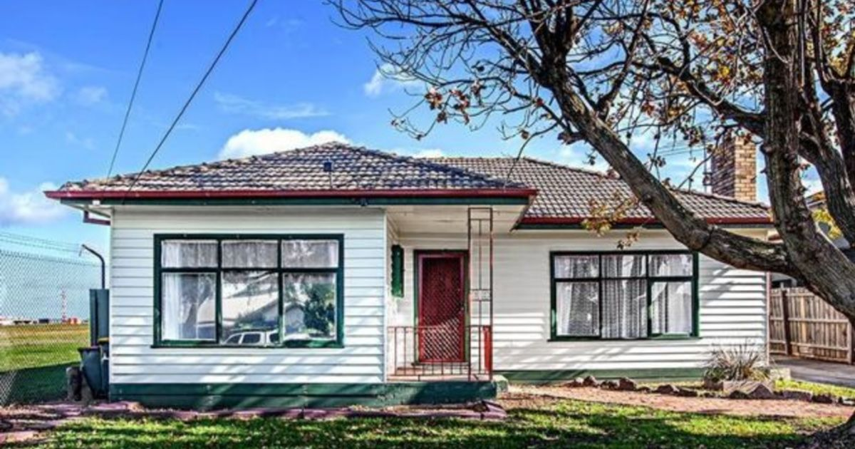

Slide 2
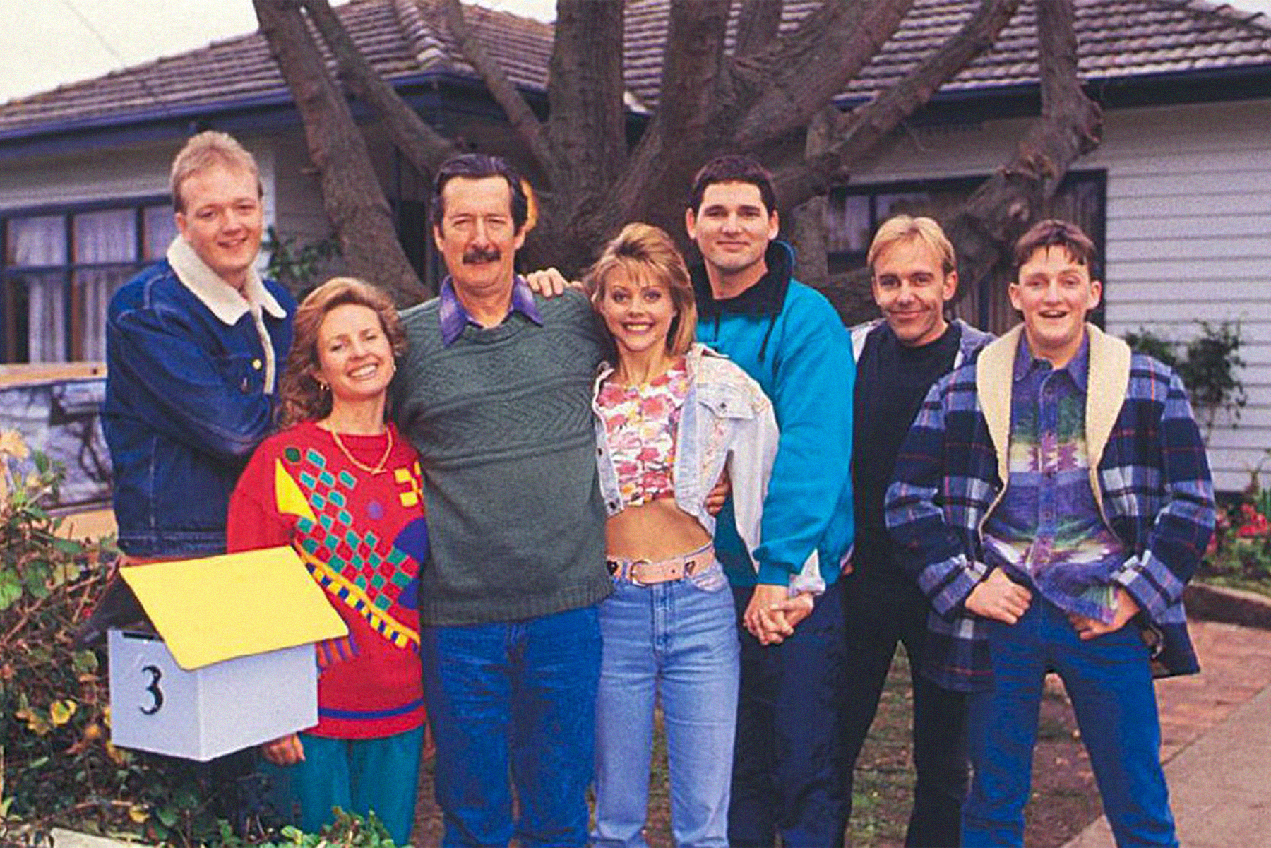
“Tell ‘em to get stuffed.” (Darryl Kerrigan)
Notes:
Michael Caton plays Darryl Kerrigan in The Castle (1997) – an Australian movie about a man who stands up to the authorities who want his home. He sees the injustice in the government wanting to take his home and he makes a stand. The reality is there has been injustice in the world since sin entered the world.

Slide 3
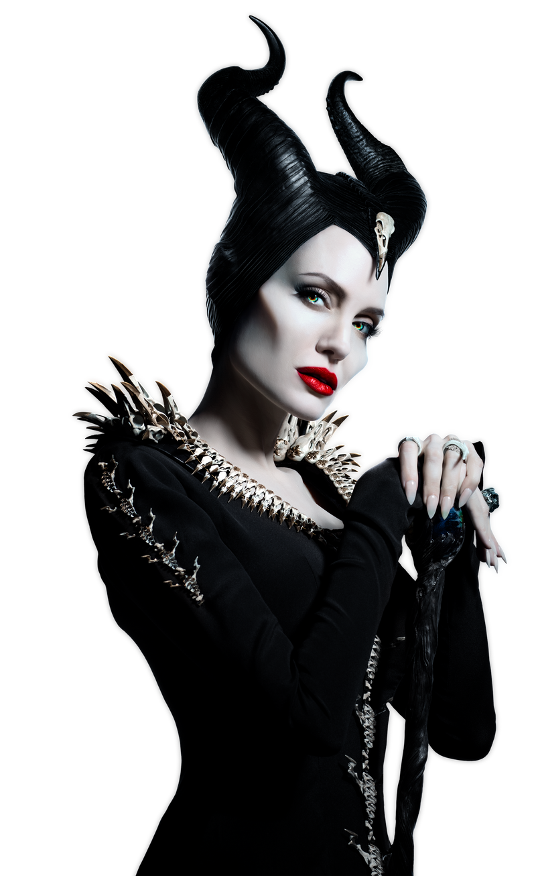
1. BE PREPARED TO SUFFER FOR THE SAKE OF RIGHTEOUNESS.
2. BE WILLING TO STAND FOR THE OPPRESSED.
3. THERE WILL BE A PAYDAY SOMEDAY.
1 KINGS 21
CONFRONTING
Notes:
There is a similar story in the OT – this time related to a vineyard. There are four main characters in this story – five if we include God who is sovereign over all that happens. There is Naboth the farmer, Ahab the wicked king, Jezebel his evil wife and Elijah the prophet. As we go through this story I was us to focus on three truths that are still very real today. This is not just a drama from another place and time in history – these truths play out even in our time and our place today.

Slide 4
1. BE PREPARED TO SUFFER FOR THE SAKE OF RIGHTEOUSNESS
Ahab wanted Naboth’s vineyard – Naboth’s response was “The Lord forbids it..” (v3)
a) Naboth worshipped God – vineyard vs vegetable garden = kingdom of God vs kingdom of darkness (Deut 11:10-13)
b) Naboth obeyed God – land belonged to God & a gift to each family. (Lev 25)
Emergency sale only, always redeemable (Lev 25).
Notes:
Naboth owned a vineyard adjoining Ahab’s palace in Jezreel. Ahab wanted it to expand his property portfolio and approached Naboth to attempt to buy it from him. He offered him an exchange for a better vineyard or outright purchase but Naboth refused. Why? Ahab seemed to be offering a fair deal (he could have become rich) and it wouldn’t hurt to get in the good books of the king. But just because our culture says its good, doesn’t mean it is. As Romans 12:9 reminds as that as believers we must hate evil and cling to what is good. So Naboth chose to stand and suffer for honouring and obeying God. The Lord forbids it = standing for righteousness, preferring to find favour with god, then with man. By refusing the king I am sure he knew that he would suffer. The people would have known of Ahab and Jezebel’s wickedness, he knew that Ahab wouldn’t just take no for an answer. So why make a stand? Two reasons. Ahab’s desire was to turn the vineyard into his vegetable garden – interesting detail which has a lot of symbolism. In Deuteronomy 11:10-13 uses a vegetable garden and a vineyard to describe the difference between Egypt and the Promised Land, a symbol of working hard, relying on our own strength to survive or being blessed in abundance, relying on God for life. God often referred to the nation of Israel, to his people as the vine. Not only in the OT ((Ps 80:8) but also the NT (Mark 12:1-12). In a sense it highlighted Ahab’s desire to lead the nation away from God. The second reason why Naboth refused to sell was he obeyed God. It wasn’t his land to sell. The land belonged to God and he gave it as a gift to each family. It was only to be sold in extreme circumstances (poverty) but never permanently. The land holder could buy it back whenever they could afford to do so (at a reduced price) and after fifty years (year of Jubilee) all land reverted back to the family.

Slide 5
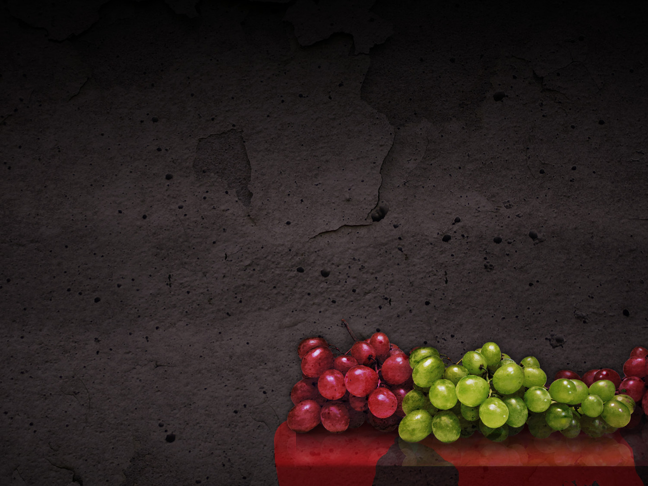
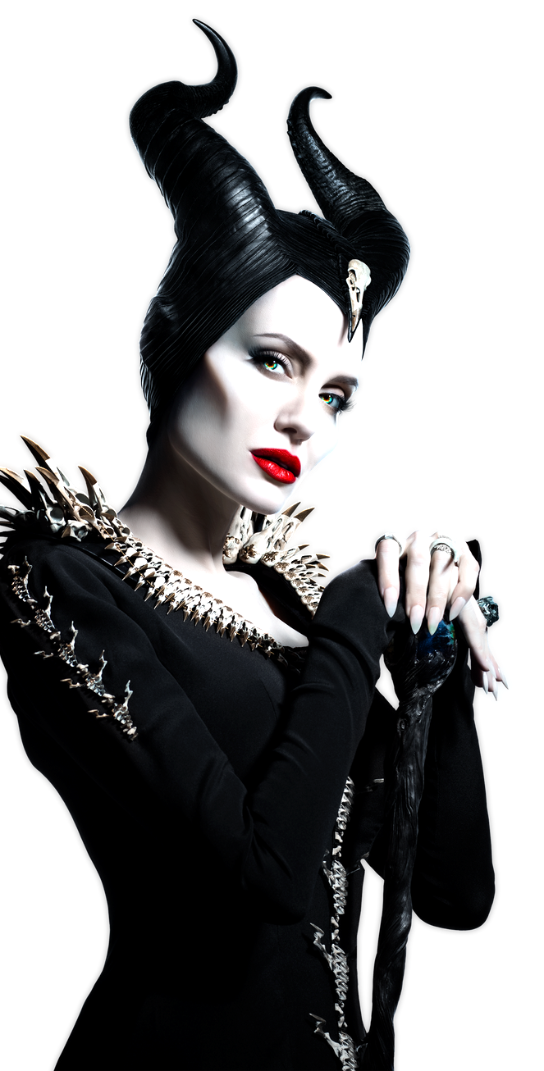
“So Ahab went home angry & sullen..” (v4) – filled with greed, coveting Naboth’s land.
“Our desires give birth to sinful actions. And when sin is allowed to grow, it gives birth to death.” (James 1:15)
“Your theology determines your biography.” Naboth = “God forbids.” Ahab = “I want.”
Ahab sulks & does nothing. Jezebel schemes & murders (with the help of the town leaders) & Ahab gets the vineyard.
Notes:
As a result of Naboth’s refusal Ahab threw a tantrum (very immature), went to bed and refused to eat. He was coveting, filled with greed and James highlights the dangers of letting sinful desires remain and grow. We must guard against sin in our lives. Its been said that your theology determines your biography (Tony Merida). What we believe drives what we do, how we live. We see the vast difference between Naboth and Ahab. A picture of those who truly live for Jesus and those who don’t. But as bad as Ahab is, Jezebel is worse. She sees her husband sulking and takers matters into her own evil hands. She invites Naboth to a dinner and tells the town leaders to arrange for two scoundrels to be seated near him so they could falsely claim to overhear him cursing God and the king. They do this and then the town leaders take Naboth and his sons (2 Kings 9:26) outside the town and stone them to death. Killing the sons lessens claim the family may make on the land in the future.

Slide 6
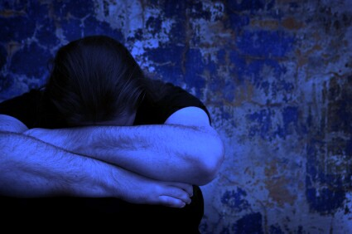
2. BE WILLING TO STAND FOR THE OPPRESSED
“All that is necessary for the triumph of evil is that good men do nothing.” (Edmund Burke)
Living for God = inconvenience, risk, cost (money, time, relationships, reputation, freedom, life….) & opposition.
Elijah – confronts his enemy & tells him that he, his wife, family & kingdom will be destroyed. (vs17-24)
Notes:
When Naboth and his sons were being wrongly accused and murdered no one stood up for them. There was no opposition from the town leaders and the community – just compliance with evil. We don’t know why but can assume they were fearful of what would happen. Not the case for Elijah. God asks him to come out of hiding (remember Jezebel put a death warrant on him) and confronted the king. Ahab regarded him as an enemy (v20) so very bold to confront him. Not only did he confront him, he tells him that God is bringing judgment on him, his wife and his family. That’s pretty tough news for him to share – wasn’t asking him to repent. Telling him that God has had enough and will now destroy him – not a nice death either. They will be eaten by dogs, no nice funeral foIt was too risky – afraid of the consequences.

Slide 7
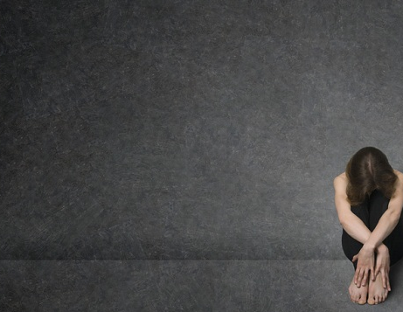
Poverty, injustice, greed, abuse, abortion, gender issues, spiritual lostness.. - Do we do nothing, or do we stand? Who do we fear?
“The opposite of love is not hatred. Its indifference.” Don’t confuse sympathy with love - love acts. (James 4:17)
Standing = opposition & cost, but God is with us (as he was with Elijah).
Jesus guarantees to bring us safely into His Kingdom, even if we suffer here on earth.
Notes:
We must be careful that we don’t shake our head at the leaders and people in Naboth’s city and think we would all be like Elijah. Do we fear the consequences and blend in, or do we fear God and stand up, alone if necessary. Oppressed is not just about the poor, widows, the defenceless, social issues. The oppressed is also those who are lost, slave to sin. The reality is that serving God will cost us – time, money, relationships, reputation, promotions, friendship – perhaps even our life. But we have a promise that God is always with us and nothing can separate us from his love. We may suffer on earth but we have guaranteed joy in heaven. Jenny and Lynne doing RI – a bit scary but willing to do it. Kaden doing soccer camp. Giving up income to serve.

Slide 8
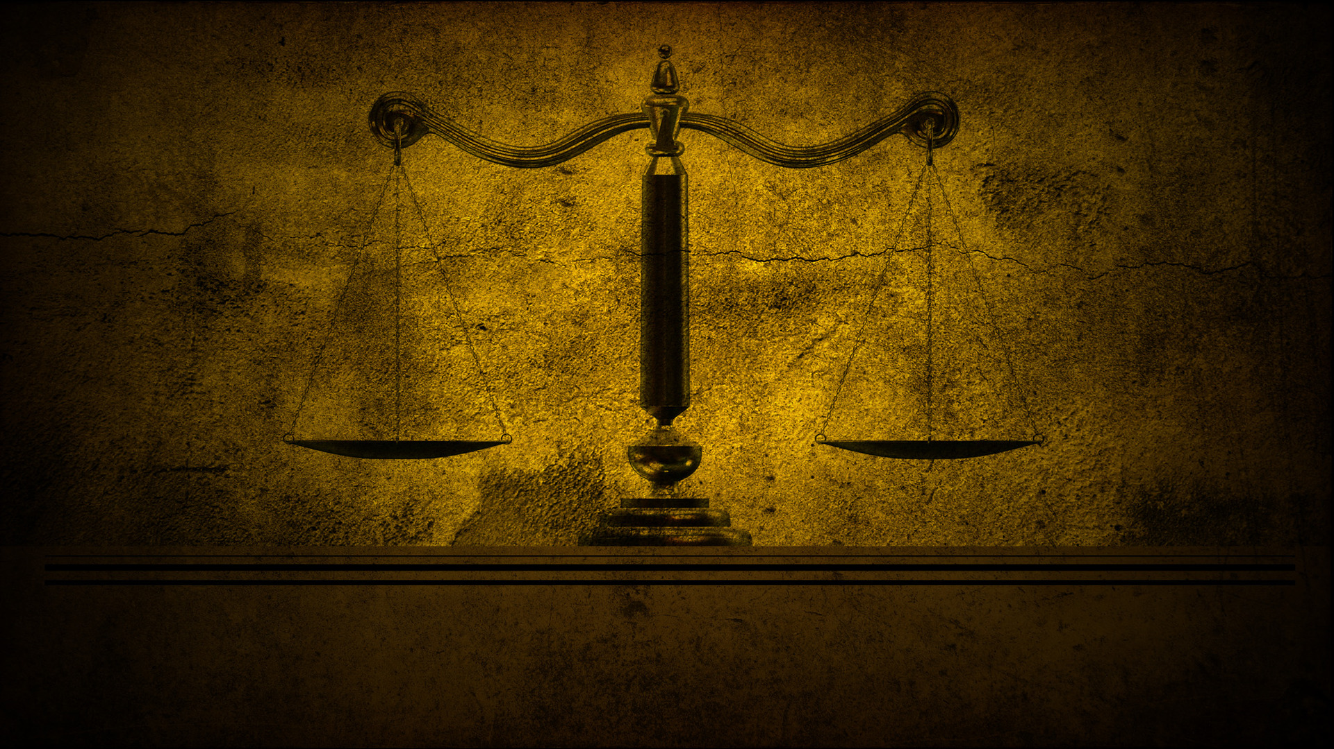
3. THERE WILL BE A PAYDAY SOMEDAY
“The Lord is compassionate & merciful, slow to get angry & filled with unfailing love.” (Ps 103:8)
There comes a time when God says ‘enough’ – don’t know when – but it will come.
“I’m going to destroy you.. you have made me very angry & have led Israel into sin.” (v22)
God keeps his word & no-one can stop it – we all sin (Rom 3:23) & deserve death (Rom 6:23). No injustice or sin escapes Him.
Notes:
Time and time again the Bible tells us that God is patient, merciful and loving. While we celebrate that, there are also times that it frustrates us – particularly when it comes to evil – we just want him to step in and stop it. But God’s mercy and patience have a divine limit – one day he will say enough, and we don’t know when that is. After all the evil that Ahab and Jezebel had done god now says he has had enough. Why did he wait so long? We don’t know! But when he says His word is final – he keeps it and no one can stop it. Even kings and queens will be held accountable. God defends and protects the weak and the helpless. Not a single sin goes without consequence. This truth is powerful in sharing the gospel in third world nations where the weak and helpless often see injustice go unpunished. To think that God of the universe cares about them and holds rulers to account blows them away.

Slide 9
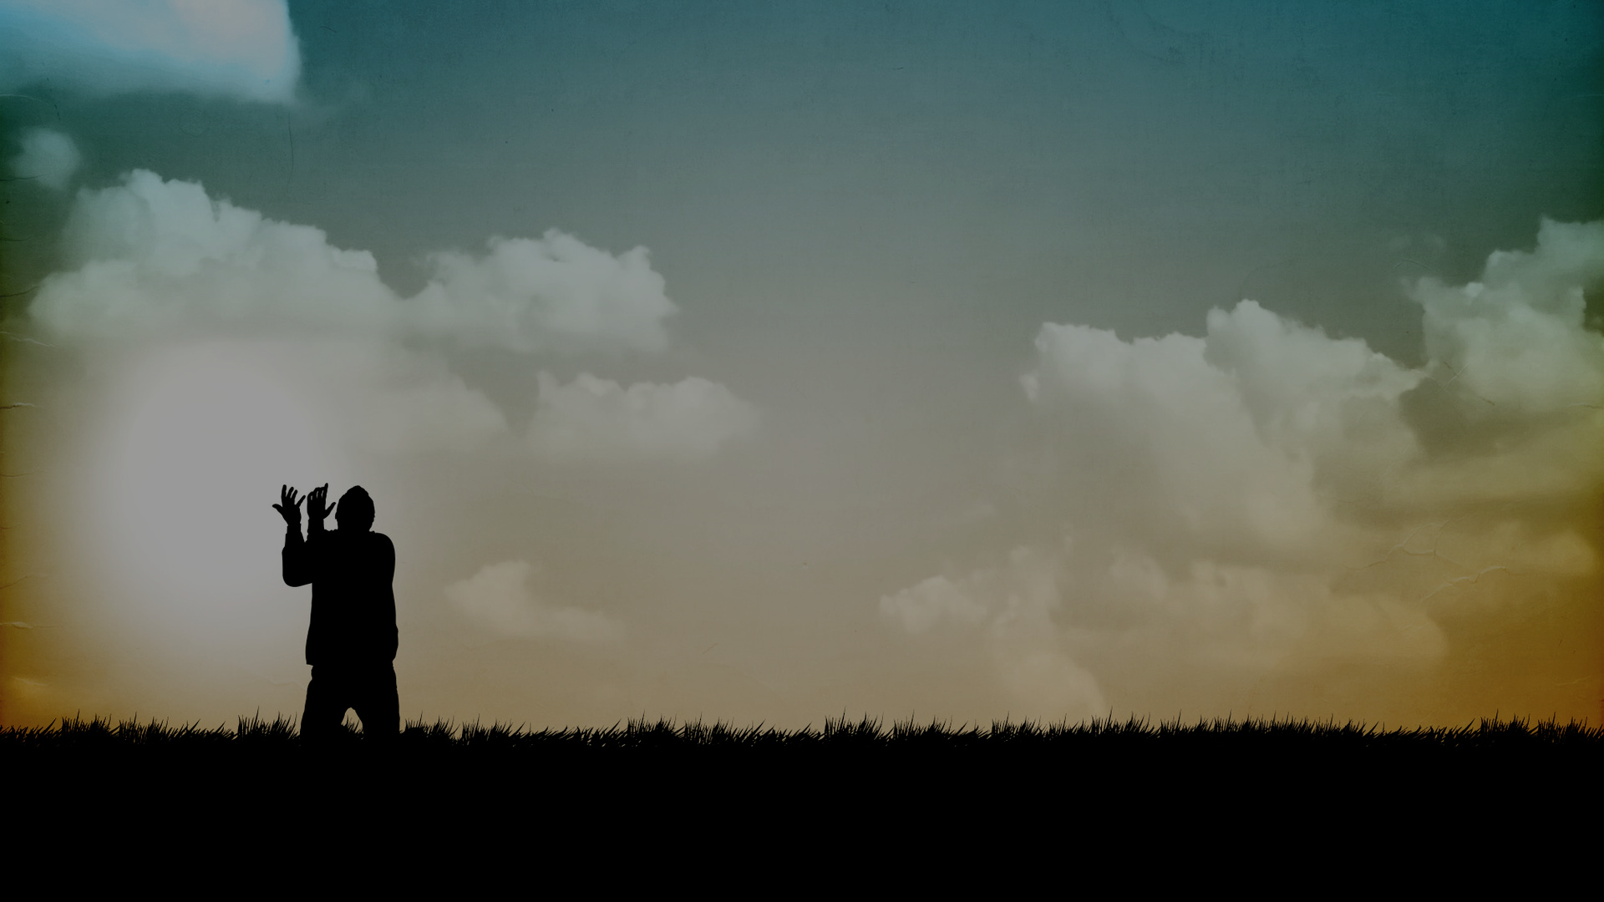
What about those who belong to God?
If you are holding onto or justifying sin (comparison, procrastination, complacency) he will also reach a point & say ‘enough’.
He loves you too much to ignore your sin – won’t cast you out of his kingdom but he can remove you from this life or take joy from you. (1 Cor 11:30)
God is kind and patient in order to give us time to turn from our sin. (Rom 2:4-5)
Notes:
We can justify sin in our life – by comparing with others and saying I’m not as bad as them or by procrastination, thinking that you will deal with it later (God understands) or by complacency (thinking that God hasn’t dealt with it yet, so maybe not that worried about it) – these are all tools of the devil. When God says enough for a believer it doesn’t result in being cast out of his kingdom. Nothing can separate us from his love and promises. But he loves you too much to ignore your sin – remember love acts. You won’t lose your salvation but he can remove joy from this life or even remove you from this world. The Corinthian church was intentionally sinning and it resulted in ill health, lack of energy and joy and some even died.

Slide 10
A SURPRISING CONCLUSION – Ahab responds to God’s judgment & humbles himself & God shows mercy (vs 27-28).
Was it true repentance? No – didn’t involve restoration or turning to God. More like grief and terror.
What sort of God would show mercy to such a sinner as Ahab?
Thankfully, the same God who shows us mercy & offers us a way to escape his wrath.
Notes:
Upon hearing God’s judgment Ahab tore his clothes, fasted and mourned. God took notice and delayed the destruction of his dynasty until after he died – his sons would see it happen. Was it true repentance? No I don’t think so. True repentance is turning to God, restoring all that you have taken from people (like Zaccheus in Luke 19:8) – we don’t see Ahab restore the vineyard to Naboth’s family, or get rid of the idols or pray to God. He is just terrified of what what God said would happen. I think God’s mercy was inviting him to go deeper into repentance but sadly it never happened. So what sort of God would show mercy to Ahab? He deserved all he got. Same God who shows us mercy - we are all sinners deserving death. We might not be as wicked or sin “as bad as” Ahab did but we all need salvation.

Slide 11
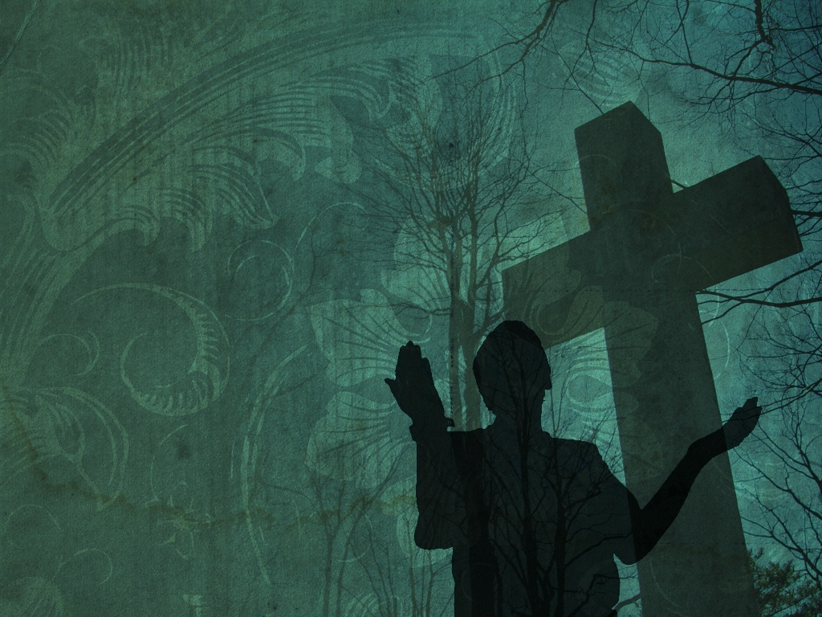
Naboth’s story points to Jesus’ story – falsely accused, taken out of the city & killed.
Naboth’s death brings God’s vengeance BUT Jesus’ death brings God’s forgiveness.
Ahab & Jezebel’s story teaches us the folly of rejecting God’s Word & His forgiveness.
There will be a payday someday – either we take it, or Jesus takes it for us = Gospel.
Stand for Jesus – fill your mind with the glorious future we have in Him.
Notes:
None of us can hide from God. We are all sinners and God’s judgment and payday will come for us all. The good news is that we don’t have to take it because Jesus took it for us on the cross. He took our sin so we can get his righteousness. For those who haven’t accepted Christ as their Saviour payday is coming and you don’t know when. He will say enough and then it will be too late Let us think of the world to come as we faithfully live for Christ in this on.

