Slide 1

GOD’S COMMISSIONING OF ISAIAH
(Isaiah 6:8-13)
Notes:
Good morning everyone. I hope you are all doing well
Well because it is school holidays we are taking a break from our series going through the gospel of Mark
And last time I preached a stand-alone sermon, I preached on Isaiah 6:1-7, and so I thought I would just pick up from where I left off last time and finish off the chapter
So if you could open your Bibles, if you haven’t already, to Isaiah 6
As we go through today’s passage there are two main things that are brought to our attention
- The character of God, and the single-mindedness of Isaiah in doing the will of God
There were perhaps, out of all the Old Testament prophets, none who had a more awful and solemn mission than the prophet Isaiah
And yet it was a desperately needed message then, and is perhaps one we need to desperately hear today in our day and age
But before we jump into verses 8-13, to help us in understanding those verses and to give context, we will do a quick run through of verses 1-7

Slide 2
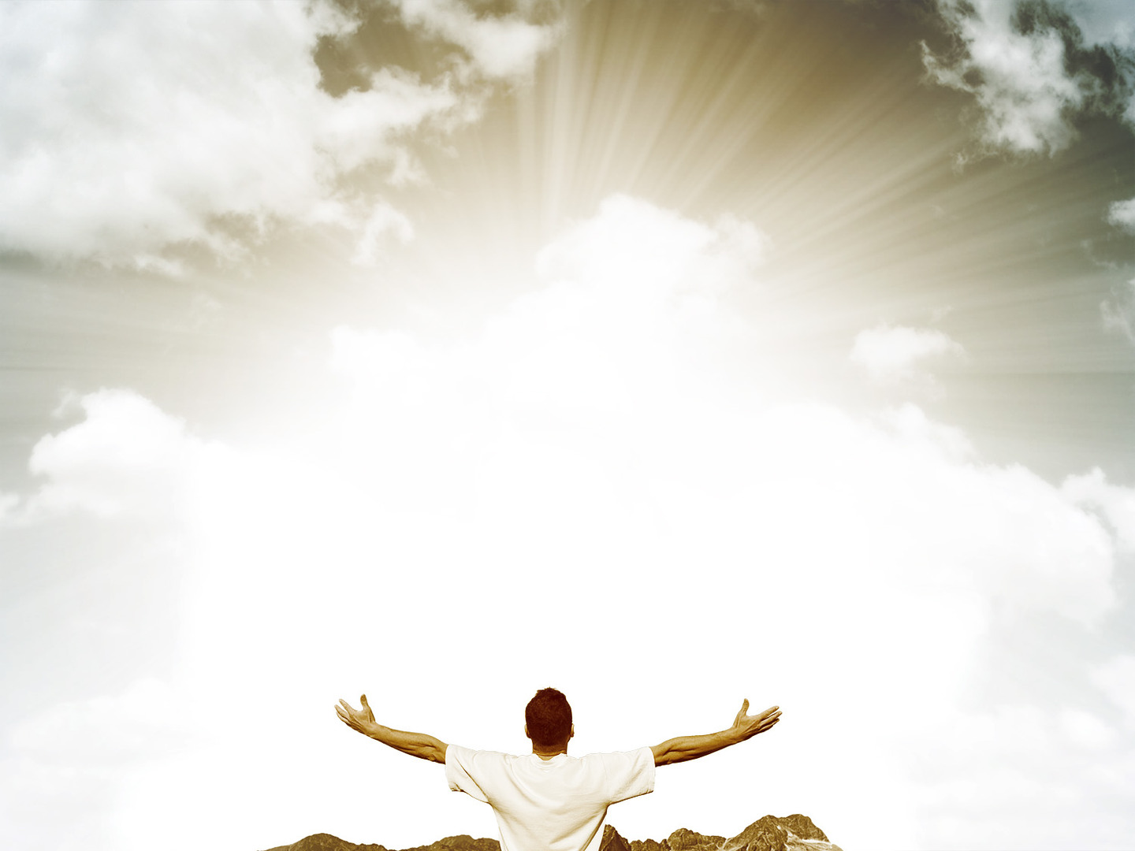
ISAIAH SEES THE LORD (vs 1-7)
Vs 1-3 – “And one called to another and said: ”Holy, holy, holy, is the Lord of hosts; the whole earth is full of his glory!”
Vs 4-5 – “Woe is me! For I am lost; for I am a man of unclean lips, and I dwell in the midst of a people of unclean lips; for my eyes have seen the King, the Lord of hosts”
Vs 6-7 – “Behold, this has touched your lips; your guilt is taken away, and your sin atoned for.”
Notes:
Vs 1-3 – “And one called to another and said: “Holy, holy, holy, is the Lord of hosts; the whole earth is full of his glory!”
- Read verses 1-3 – King Uzziah was a good king who did a considerable amount for the nation of Israel
- He was a great leader of their army, during his time there was economic prosperity, and general progress in the land
- But he became prideful which caused him to be unfaithful to the Lord, and as a result was struck with leprosy until the day he died
- In the year that Israel’s earthly king died, Isaiah saw Adonai, the Lord, the Sovereign, the one true king of Israel and of all creation
- And he heard the seraphim, the burning ones calling out holy, holy, holy, is the Lord of hosts, the whole earth is full of his glory
- Nowhere else in Scripture is an attribute of God spoken 3 times like this.
- God is thrice holy. He is so set apart, so unique, so above our comprehension
- So much so that He is in a category of His own.
- His holiness is not just one of His attributes, but is something that radiates through all His attributes
- God’s love, justice, mercy, wrath, grace are all holy
- Every single act and decree of God flows forth from His perfect holy nature
Vs 4-5 – “Woe is me! For I am lost; for I am a man of unclean lips, and I dwell in the midst of people of unclean lips; for my eyes have seen the King, the Lord of hosts.”
- Read vs 4-5 –God has revealed Himself to Isaiah, and as a result, Isaiah is lost, undone, is basically a dead man walking on the brink of destruction
- Because he sees just how sinful he is, and in light of God’s perfect holiness
- His impurity is so offensive to God it is as though he might die
- He feels naked and exposed
- But Isaiah not only notices and comes to grips with his own sinfulness but he sees that the people of Israel are also unclean
- They are sinful and are in desperate need of beholding God as Isaiah is right here
- He sees that God’s judgement and wrath will fall upon Israel
Vs 6-7 – “Behold, this has touched your lips; your guilt is taken away, and your sin atoned for.”
- Read vs 6-7 – Isaiah on the brink of destruction is shown the grace of God.
- For he declared his lips were unclean, so the seraphim took a coal, as represented in Leviticus on the Day of Atonement
- And it is so holy that the seraphim picks it up with tongs, and touches it to his lips, to show Isaiah, his sins had been forgiven
- Isaiah is forgiven all his sins, past, present, and future by God’s mercy and grace
- He was on the brink of being ruined, and now his guilt is removed
- Isaiah has gone from being unholy, to holy, not as God is holy, but set apart and consecrated unto God
- Why? Was it something Isaiah did?
- No it was by nothing that Isaiah did, but by the grace of God alone
- This is imperative to keep in mind as we go into verse 8, because it is these events, it is God’s grace that moves Isaiah into the sacrificial privilege of serving God

Slide 3

ISAIAH HEARS THE LORD (vs 8)
“And I heard the voice of the Lord saying” (Isa 6:8a)
“Whom shall I send, and who will go for us?” (Isa 6:8b)
“Then I said, “Here I am! Send me.” (Isa 6:8c)
Notes:
“And I heard the voice of the Lord saying” (Isa 6:8a)
- In the first 7 verses we get this feeling as if the Lord is far off in a distance, and Isaiah in his sinfulness and impurity can only get so close
- No longer is Isaiah simply a spectator of the heavenly scene, but one who is accepted into the presence of God
- But now having been cleansed and having had his guilt taken away and all his sins atoned for, its as if he has able to get but a little bit closer to hear the Lord speak
- This is the first time that God himself speaks in the vision.
- The word here for Lord again is Adonai, as in verse 1 meaning that the Sovereign one, the King of kings is speaking, and He speaks with authority
- God appears to Isaiah in such glorious majesty and holiness because He wants to speak to Isaiah, He has a message for Isaiah to deliver
- And if someone is going to go and speak for God, should they not first hear God
- And for us, should we not first hear God through His Word. Should we not know His Word
- If we are going to say thus says the Lord to the world, then we need to know what He says, and be in His Word, and studying Scripture
- Not so that we might become smarter than the next guy
- But that we might know God more and more, and that His Spirit might be constantly working and conforming us to the image of Jesus through the application of the Scriptures.
- God’s voice does not bellow forth a command per se, but a question, perhaps a rhetorical question, but a question nonetheless
“Whom shall I send, and who will go for us?” (Isa 6:8b)
- God is looking for a messenger, one who will go in His name, for that is the requirement of all who go out and proclaim the gospel, and particularly for pastors and elders.
- We cannot and dare not go out in our own authority or name
- To do that would be to set ourselves up for failure and to sin greatly in the sight of God
- Because when we do that, we seek to get all the glory for ourselves.
- So, the first qualification that we see here is that the messenger must be sent by the King
- The Lord here refers to “us”. There is some debate over what the “us” is
- Some say God is addressing the heavenly court, others think he may be talking to the angels or the seraphim.
- I think based on Scripture that the “us” here is in fact the Trinity, this is the Triune God asking Himself who will go for them.
- The first reason I think this is that in 1 Corinthians 2:16 it says, “For who has understood the mind of the Lord so as to instruct him?”. Or in Romans 11:33-34, “How unsearchable are his judgements and how inscrutable his ways! For who has known the mind of the Lord, or who has been his counselor?”
- What need does an all-knowing, completely sufficient God have in consulting anyone else outside of the Trinity
- The second reason being that when these verses are referred to in the New Testament, we see that it is Jesus who is seen as being present as well as the Holy Spirit
- John 12:41 in referencing the verses that we are about to deal with says, “Isaiah said these things because he saw his glory and spoke of him”.
- In its context here in John, the glory that Isaiah saw was also Jesus Christ the second member of the Trinity
- Then right at the end of the book of Acts 28:25, it says, “The Holy Spirit was right in saying to your fathers through Isaiah the prophet…” and it then goes on to give a direct citation of verses 9-10 of Isaiah 6
- Meaning that the ”us” here is referring to the Trinity
- The reason I want to make this clear is because many people will say, the God of the New Testament as shown in Jesus, was much nicer and kinder than the one in the Old Testament
- Firstly, that is a clear lack of understanding of how the Trinity works,
- Secondly, does not Jesus talk more about hell more than anyone else in the New Testament
- Thirdly, this judgement that is about to be pronounced is proclaimed by the one God in Three persons.
- It is the same God from Genesis to Revelation, and we must never fall into that trap of thinking they are two different God’s shown in the Old and New Testaments, because they are not
- One God, three Persons
“Then I said, “Here I am! Send me.” (Isa 6:8c)
- The “Here I am! Translates as lo! Behold!. He wants God to send him, not because he is deserving or thinks he is the best fit for the job
- Simply because, having received complete and full pardon for his sins, and is saved by grace and is now moved by grace.
- It’s almost a, “Lord how can I do anything else but serve you! If you would have me send me!”
- God could have used an angel, but He used men.
- God would send one who speaks their language, one that could treat them in a familiar way, an ambassador in an ordinary way
- God will take men and women with all our infirmities, yet purged from the pollutions of this world, made holy, though not perfectly and He uses us for the purposes of His kingdom
- My dear Christian, do we not consider that a great privilege? The King beckons us, weak as we are, and equips us, and seals us with the Holy Spirit, and finds use for us to bring Him glory
- I mean Isaiah, but a dead man walking, had unclean lips, with the last thing on his mind being to use those lips to deliver a message for God Almighty.
- Yet God’s grace cleanses His lips, and is sent out as His messenger and is used mightily of God
- The first qualification of the prophet was that they must be sent by the king. The second is that they must be willing
- They must be broken people, who are deeply convicted of their own sin, and having also experienced the depths of the grace of God.
- Robert Leighton, an old commentator puts it like this, “How can I, who am so filthy, so vile, speak of God? Yet has he shown me mercy? How can I be silent?”
- Is it not fitting of every pardoned sinner to respond like this. To be ready and joyful to do much and suffer much for Him who has shown such depths of love and forgiven us of so much
- It is the person who knows these truths in depths of their soul who is fit to be a messenger of God

Slide 4
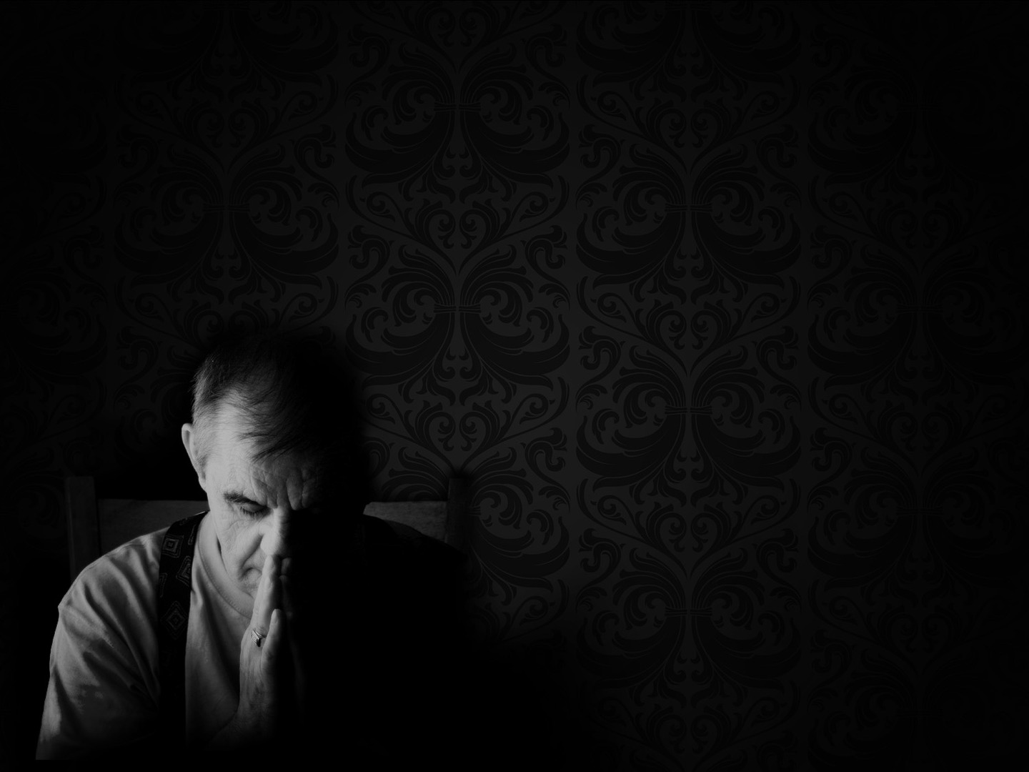
Notice Isaiah doesn’t say “as long as it is successful”.
God no longer appoints and sends His preachers by visions.
“The harvest is plentiful, but the labourers are few; therefore pray earnestly to the Lord to send out labourers into his harvest.”
(Matt 9:37-38)
Notes:
Notice Isaiah doesn’t say, “as long as it is successful”
- Lord I will go for you, as long as it successful, as long as it is easy, as long as the people like me
- Nor did he ask what the message would entail, or for how many years he would have to do it.
- Or as long as there is a clause that allows me to get out when I need to
- No, there is none of that. He basically says, “the God who saved me by His mercy and grace calls, He sends me, and so for the glory of God alone I go”
- We too ought to be like this. Lord it is by your grace alone that I am saved, whatever you would have me do, I’ll do it.
- We were but dead men and women, with no hope, no promise of salvation or eternal life, only condemnation and eternity in hell
- Let us not put limits on our service to God. “Jesus paid it all, all to him I owe”. Do we really mean that?
- Because when God’s Spirit stirs up in us such a great conviction to serve Him all the days of our life, with all that we have
- Though trials and temptations may come our way. Though you may stumble and fall
– Though you may feel as though you cannot go on, press onwards to Jesus Christ, because it is His grace, and His strength that will get you to glory
- For the glory of God alone we go!
God no longer appoints and sends His preachers by visions
- Perhaps many look at this, and think well that’s all good and well for Isaiah to know that he is sent, he received a vision. So until God does that for me, I will remain seated in my chair
- But for the elders and pastors in churches, God no longer appoints through dreams and visions, for He has given us His Word which is sufficient
- 1 Timothy 3:1 says “If anyone aspires to the office of overseer, he desires a noble task”,
- So it will begin with a deep desire within the person to do the work of an elder
- They then must be able to meet the character requirements as well as be able to rightly divide the truth and teaching sound doctrine, and then that gift is affirmed by the local church.
- When we go out as evangelists we ought be people who are broken over sin, rightly understand the gospel, are saved and born again in accordance with the Scriptures
- And are accountable to a local church and submit to the elders in that local church
“The harvest is plentiful, but the labourers are few; therefore pray earnestly to the Lord to send out labourers into his harvest”
- Coolum Beach Baptist Church, my fellow brothers and sisters.
- God’s elect are out there, but will we heed the call of the great commission to go and proclaim the gospel, not just to unreached people groups in other nations
- But to the lost who are going past our church right now? Will we be faithful to God no matter what the world may do, no matter what persecution may come our way?
- Will you be obedient to the King’s Great Commission? Let us be single-minded and heed the call of God right here in Coolum Beach, and in your work places, and even in your families
- Parents, we must tell our kids the gospel and tell it to them often
- We may not see any fruit from proclaiming the gospel, but our call is not, “as long as people’s souls are saved, tell them the gospel”.
- No, our call is to proclaim the gospel, to be faithful unto God, and then step aside and watch as the Spirit of God goes forth and does His work
- Let us not be a church that is happy to pay other people to preach the gospel so that we don’t have to.
- The end draws near, let us go to battle, with the great privilege of spreading the gospel as far and wide as we can
- But remaining single-minded in our approach, for we have one message, one Saviour, one Lord to present to the lost
- It is the gospel which is power of God unto salvation to everyone who believes

Slide 5

ISAIAH IS COMMISSIONED BY THE LORD (vs 9-10)
“And he said, “Go and say to this people: “Keep on hearing, but do not understand; keep on seeing, but do not perceive” (Isa 6:9)
“Make the heart of this people dull, and their ears heavy, and blind their eyes” (Isa 6:10a)
“For we are the aroma of Christ to God among those who are being saved and among those who are perishing, to one a fragrance from death to death, to the other a fragrance from life to life” (2 Cor 2:15-16a)
Notes:
“And he said, “Go and say to this people: “Keep on hearing, but do not understand; keep on seeing, but do not perceive” (Isa 6:9)
- Isaiah heeds the call of the Triune God and says, “Here I am! Send me! And immediately God speaks and gives Isaiah His commission
- Notice God does not say, ‘my people’, as he so often addresses them in the Old Testament, but ‘this people’
- They have already wandered away from Him. It is a phrase given to express God’s displeasure and contempt for their unclean lips, their sinful ways of living
- Verse 9 is the message that Isaiah is to preach, it is a message of judgement and condemnation
- The words here for keep on hearing and keep on seeing literally translate to hear hearing, and see seeing
- Meaning this is a continual ongoing activity.
- They will continue to hear the words that Isaiah preaches, but their outer faculties will not comprehend, nor will they understand or perceive anything
- Referring to their spiritual, inner faculties
- This lack of understanding and perception did not come about because Isaiah spoke in words that were too hard to understand.
- Isaiah 28:9-10 tells us that he spoke as if to infants, to kindergarteners, line upon line, precept upon precept
- The prophet did nothing but preach and they were stupefied by it. By human standards his preaching ministry would be a complete and utter failure
- But His first concern was being faithful to the one who saved Him, Adonai, the Lord
“Make the heart of this people dull, and their ears heavy, and blind their eyes” (Isa 6:10a)
- The word here for dull is fat, he would render their hearts fat, their ears heavy, and blind or smear something over their eyes
- Verse 9 is what Isaiah is to say
- But verse 10 is the effect of his preaching. Imagine being given this commission, to go and preach, but it would bear no fruit that you can see
- By human standards you would be seen as a failure as a preacher. And so you can imagine, as many preachers do today, Isaiah could have taken off some of the rough edges of the message
- He could have altered the truth of the message to make it more palatable for people, so that he might be liked, or people might come to a false conversion
– Yet that conversion would be a mockery, for what can bring life but the truth of God’s Word
- It’s as though Isaiah would be telling them they need not to see God, think of God, behold God as He did
- All it would do is affirm them in their sin, and make a mockery of the message of God’s Word
- We must not alter the truth, but preach the whole truth in love.
- And if we claim to love people as we ought to, then what they need is the truth.
- And when they reject it, we tell them again, and again, and again, for it is the only message that we have, there is only one way, through Jesus Christ, the way, the truth and the life
- And our preaching today has the same effect, it will either harden or soften hearts
“For we are the aroma of Christ to God among those who are being saved and among those who are perishing, to one a fragrance from death to death, to the other a fragrance from life to life” (2 Cor 2:15-16a)
- This happened in Jesus preaching.
- Jesus preached the truth boldly, and yet the Pharisees did not soften but their hearts became hard, and callous, and their hearts remained as stone
- It happens now. Whenever you come into church and the Bible is proclaimed it is either a savour of death to death, and your hearts become harder.
- Or it is a sweet aroma, softening the heart drawing you closer to God.
- There is no in-between. This is why we insist on taking the preaching of God’s Word seriously, and every single one of us also ought to take it seriously
- A biblical, godly preacher is either a great blessing or curse, a blessing to those being saved, and a curse to the perishing
- Paul Washer puts it like this, "Preaching is a dangerous thing. It's dangerous for the man if he preaches wrong, because he'll stand before God one day and give an answer for every word.
- But it's dangerous for the congregation if he preaches right, because they will have to stand before God and have to give an answer for every word. Preaching is dangerous; we need dangerous men.”
- So, you may ask, if it’s so dangerous and so costly, why do it? Why bother? Why risk it?
- Firstly, because it is commanded of our God
- Secondly, because if there is no preacher how can they hear? How can a person be saved if they do not hear the gospel.
- Oh, if but one more soul would be saved by the preaching of the gospel would it not all be worth it?
- But most importantly, to bring God glory. We do it for Him, we live for Him, we love deeply for Him, we preach for Him, we evangelise for Him, we are persecuted for Him
- In everything that we do, we do it that God might get the glory. We do it for him

Slide 6

“Lest they see with their eyes, and hear with their ears, and understand with their hearts, and turn and be healed.” (Isa 6:10b)
Heart, ears, eyes, eyes, ears, hearts = Chiastic Structure
Why would God do that?
Notes:
“Lest they see with their eyes, and hear with their ears, and understand with their hearts, and turn and be healed.” (Isa 6:10b)
- The word here for turn, is convert. Lest the people of Israel repent and be healed.
- There will be no repentance and conversion. Not only have the people hardened their own hearts in their own natural, sinful state, in being slaves to sin
- But we see in John 12:40, that God is hardening their hearts also in His divine justice and judgement against sin.
- John 12:40 says, “He has blinded their eyes and hardened their heart, lest they see with their eyes, and understand with their heart, and turn, and I would heal them”
- God in His divine justice is rendering the people of Israel, as a result of all their iniquity, blind, deaf, and gives them callous hearts
- Isaiah is to preach them callous, and God places upon them a judicial blindness
- In order for these people to be turned and healed, they would need to behold their true condition as Isaiah did, and repent of sin as a result of seeing who they truly are as a sinner
- Yet such understanding, such perception, is a gift of God, and that gift would be withheld because of their own wickedness
- The only thing that differentiates the Christian from the unbeliever is grace, and sovereign grace alone
- Something else I think is worth noting here in verse 10 is the chiastic structure
Heart, ears, eyes, eyes, ears, hearts = chiastic structure
- A Chiastic structure is where something is repeated but in a mirrored fashion. So we have here in this verse in this order, heart, ears, eyes
- Then it says those three again but they are mirrored, eyes, ears, hearts.
- This is sometimes used in Scripture to really emphasise a point that is trying to be communicated. For example:
- We see it in 2 Tim 3:16-17 in talking about Scripture, “All Scripture is breathed out by God and profitable for teaching, for reproof, for correction and for training in righteousness”
- We have a positive attribute of Scripture, a negative, and then it is mirrored with a negative and positive.
- This is done to demonstrate that Scripture is sufficient, it is enough for godliness and teaching sound doctrine as applied by the Holy Spirit
- Back in our Isaiah text, I believe this chiastic structure is used to emphasise and demonstrate the complete hardness of Israel’s hearts as a result of their own rebellion and God’s judgement upon them
- That there is no way out and that this judgement will come to pass
- Many of us perhaps would ask…
Why would God do that?
- Well firstly, when God made a covenant with Moses and with His people Israel, as is most fleshed out in Deuteronomy
- God gave covenant blessings for obedience and curses for disobedience
- Deut 28:15, and then 21 say, “But if you will not obey the voice of the Lord your God or be careful to do all his commandments and his statutes that I command to you today, then all these curses shall come upon you and overtake you… The Lord will make the pestilence stick to you until he has consumed you off the land that you are entering to take possession of it”
- If you continue to read all of Deuteronomy God laid it out very clearly what the covenant curses would be.
- And it wasn’t as if he didn’t give them plenty of chances, and showed them grace upon grace, and mercy after mercy. But still they would not listen
- Now perhaps you are still thinking was it really that bad?
- Well 3 times in Isaiah, Isaiah has declared that this people have become like Sodom in character and conduct.
- Zephaniah, Amos, Jeremiah and Ezekiel also make the comparison with Israel to Sodom
- The line between holy and worldly had been obliterated. They flirted with the line of what they thought they could get away with and still be called a follower of God
- And we must not do that, do not try to find the line, and if you do run from it.
- They had become lawless, hyper-sexualised, ungodly.
- They still came and brought their sacrifices, but never with the right intent or heart.
- In Isaiah chapter 1 God had said how these things of observing the sacrifices and the Sabbath had become an abomination to Him
- Because they did not come with a broken and contrite heart
- Folks do we come to church to tick a box so we can get to heaven, or do we come to behold the glory of God with the bride of Christ?
- That we might be convicted of sin and brought nearer to God by His Spirit
- And so God now judges Israel that His holiness and hatred for sin might be on display, that people might see He is a just God, and we dare not diminish the vileness of sin
- Perhaps you are still sitting there wondering if this is really just, if this is fair? Let us read Romans 9:14-23
- So let us ask again, is it just? Perhaps the better question is, is it unjust of God to give us what we deserve?
- My dear friends, we do not want justice, we do not want fair, for if we get justice and fair we all die. What we need is grace
- What’s not fair is that even one sinner might be saved, which is only by God’s grace
- I deserve the same judgement as the people of Israel in this passage, but for Jesus taking on the full wrath and justice of God, and dying in the place of my sin
- And but for the grace of God, I would be condemned to an eternity in hell.
- We do not want justice, we need grace

Slide 7
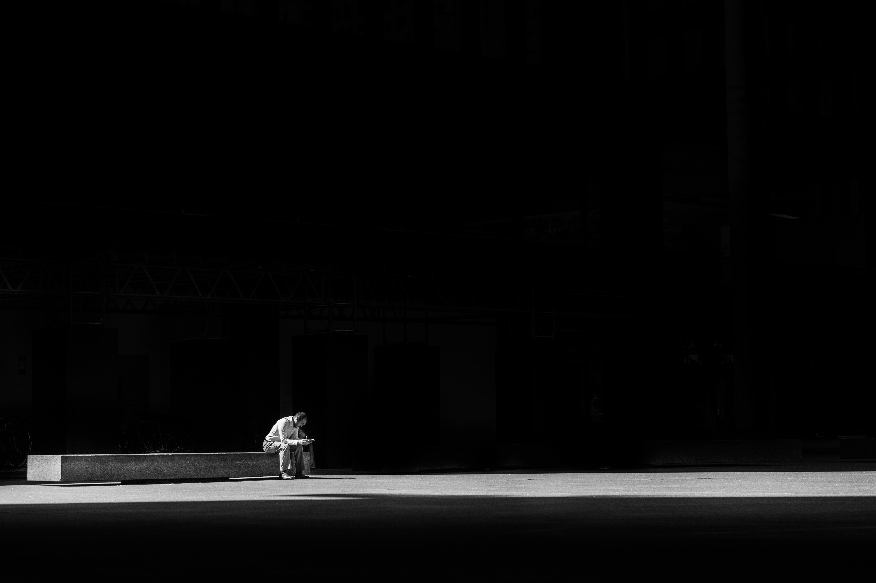
ISAIAH QUESTIONS THE LORD (vs 11-12)
“Then I said, “How long, O Lord?” (Isa 6:11a)
“Until cities lie waste without inhabitant, and houses without people, and the land is a desolate waste” (Isa 6:11b)
“And the LORD removes people far away, and the forsaken places are many in the midst of the land.” (Isa 6:12)
Notes:
“Then I said, “How long, O Lord?” (Isa 6:11a)
- This question that Isaiah asks of God could be taken as to be saying, “How long must I preach this message of judgement”
- And perhaps there is some truth to that, but given the context in the previous verses 8-10, and in verse 5 where we see Isaiah’s heart for the unclean lips of the people of Israel
- I believe what we are seeing here is Isaiah’s compassionate heart for the people of Israel.
- He is asking God, how long will this judgement and hardness of heart continue, how long until they will be granted soft hearts?
- How long until some would repent and believe? How long until they see the wickedness of their ways
- What we are seeing here is a preacher’s heart for the people which have been given to him to look after
- The preacher ought to care deeply about those whom he preaches to.
- He ought labour over the care of the flock, to preach the truth to them, to pray for them, to be willing to lay down his life for them
- Genuine love demands that we tell the truth.
- And so a prophet must proclaim God’s judgement and wrath, and so too the preacher when it arises in the text
- But we do so out of a great love and desire to see the people saved and sanctified and conformed to the image of Christ
- The other thing to note here is the word for Lord again is Adonai, sovereign one, the true King.
- Meaning, it’s as though Isaiah is saying, “God you are in control, though this pains me to see the state of the hearts of your chosen people, still I will be faithful, for what can save them but the truth of the whole counsel of God”
“Until cities lie waste without inhabitant, and houses without people, and the land is a desolate waste” (Isa 6:11b)
- The answer to Isaiah’s ”How long, O Lord?”, is given here. God’s answer is that this judgement is final and it will be harsh
- But what we will see is there is a limit to the process of judgement, that it will not go on forever in this passage
- But the consequences of God’s judgement would be utter ruin.
- What God is describing here is the eventual collapse of Judah and Israel in bringing Assyrians and Babylonians against them, as the Lord’s instruments of judgement
- He is talking about the exile
“And the LORD removes people far away, and the forsaken places are many in the midst of the land.” (Isa 6:12)
- Again, notice at whose hand are people removed far away, it is God’s hand
- In Leviticus 18 God tells Israel of how the nation’s inhabitants before them, the Canaanites, were vomited out for their uncleanness, and the now the same thing is happening to them
- Some would flee, others driven into banishment and others would perish by the sword
- But now there is a switch, the word here used for LORD is Yahweh, God’s covenant name between Him and Israel
- By doing this He is saying to Isaiah, that yes I am sovereign, yes I am the King of Kings, and yes I am holy and will not tolerate sin
- But I am also the faithful covenant keeping God, and I will not forget my covenant with my people Israel
- He is saying to Isaiah, keep preaching, yes it is hard, and yes you preach to a stubborn hard-hearted people, but judgement is coming, and there will be a limit to it
- Christians keep proclaiming the gospel.
- Pastors, elders, preachers, we must keep preaching the whole counsel of the Scriptures, for the Day of Judgement is coming, and salvation is only to be found in the gospel of Jesus Christ

Slide 8

ISAIAH IS GIVEN HOPE (vs 13)
“And though a tenth remain in it, it will be burned again like a terebinth or an oak, whose stump remains when it is felled.” (Isa 6:13a)
“The holy seed is its stump” (Isa 6:13b)
“There shall come forth a shoot from the stump of Jesse, and a branch from his roots shall bear fruit.” (Isa 11:1)
Notes:
“And though a tenth remain in it, it will be burned again like a terebinth or an oak, whose stump remains when it is felled.” (Isa 6:13a)
- God’s judgement and desolation will not be final, there will be a tenth that will remain that will be preserved, yet even they will be burned again, consumed, eaten up
- George Morgan, the preacher who preceded Martyn Lloyd Jones said it like this, “The destruction of the tenth is to be like that of the terebinth or an oak whose stock, or substance, or life principle remains even when the oak is felled”
- Meaning the destruction of the people will not result in the annihilation of the people.
- Though the stump looks dead, as if there is no hope for it ever coming back to life, there will still be life left in it
- Job 14:7 says, “For there is hope for a tree; if it be cut down, that it will sprout again, and that its shoots will not cease.
- Thus, there will still be life left in Israel, God is not finished with them, there is still hope, for Yahweh is a covenant keeping God.
- God would relent, and God would show mercy and grace. God would accomplish his purposes of peace, even through judgement
– And is that not what we see on the cross, where God’s justice and mercy both meet
“The holy seed is its stump” (Isa 6:13b)
- Seed here can also be translated as offspring.
- Israel would hear this word offspring and would not be able to help but think of the Patriarchs, Abraham, Isaac, and Jacob, and the covenant made with them
- God to Abraham, Genesis 15:5, “And he brought him outside and said, “Look toward heaven, and number the stars, if you are able to number them.” Then he said to him, “So shall your offspring be”
- God to Isaac, Genesis 26:4 “I will multiply your offspring as the stars of heaven and will give to your offspring all these lands. And in your offspring all the nations of the earth shall be blessed”
- God to Jacob, Genesis 35:11-12, “And God said to him, “I am God Almighty: be fruitful and multiply. A nation and a company of nations shall come from you… The land that I gave to Abraham and Isaac I will give to you, and I will give the land to your offspring after you”
- This holy seed, these holy offspring would be the stump by which the life of Israel and through whom the covenant of God would carry on
- They shall return from sin to God, and shall return out of captivity to their own land
- God will turn them, grant them repentance, and they shall be healed.
- Did this remnant deserve it? No. Were they better than the rest of Israel? No.
- So why? Because Yahweh, Adonai, is a faithful, gracious God
- And through this remnant God would accomplish His redemptive purposes
“There shall come forth a shoot from the stump of Jesse, and a branch from his roots shall bear fruit.” (Isa 11:1)
- Let me read Isaiah 10:33-11:2.
- The holy seed not only talks about God preserving Israel, but through God’s preserving of the remnant
- Through them would come the offspring foretold in Genesis 3:15, talking to the serpent, “I will put enmity between you and the woman, and between your offspring and her offspring; he shall bruise your head, and you shall bruise his heel”
- From this holy seed, this offspring would come the snake crusher, would come Jesus Christ.
- From this holy seed would come the one prophesied in Isaiah 53, the one who “was pierced for our transgressions, he was crushed for our iniquities; upon him was the chastisement that brought us peace, and with his wounds we are healed. All we like sheep have gone astray; we have turned – every one – to his own way; and the Lord has laid upon him the iniquity of us all”
- In today’s passage we see the justice of God, the wrath of God, and God is still just in that Christ bore the full weight of our punishment on the cross
- He lived the perfect, spotless, sinless, blameless life before the Father
- And he would go to the cross, and suffer under the judgement of God, for our sins, so that God could be just.
- And all those who repent and believe in Jesus Christ, receive the perfection, the perfect righteousness of Jesus Christ
- And our sinfulness is imputed, accredited onto Jesus
- So that God can be both just and the justifier of the one who places faith in Jesus Christ
- How can you be sure of this? Because Christ rose from the grave, for our justification, he rose to say “payment accepted”
- To every child of God, “your debt has been paid in full”, by the all-sufficient sacrifice of Jesus Christ, by his blood are your sins washed away.
- So now all who come to him are now given new life
- And we can rely on these promises as we go through this world as foreigners, strangers, going about the will of God
- As we look forward to the day, when our faith becomes sight and we behold the fullness of the glory of God, and we spend forever in His presence where sin will be no more.
- The holy seed, is about God’s covenant with Israel, but most importantly, it is about the New Covenant which is accomplished in the Holy Seed, Jesus Christ

Slide 9
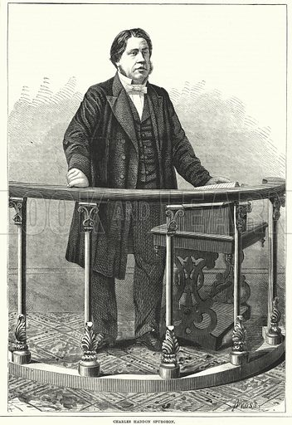
Sunday, April 22nd, 1877. Charles Spurgeon delivers a sermon entitled ‘The Divine Call for Missionaries’ from Isaiah 6:8. Hear his opening line:
“Brethren, the heathen are perishing, and there is but one way of salvation for them, for there is but one name given under heaven among men whereby they must be saved” – Charles Spurgeon
Notes:
Sunday, April 22nd, 1877. Charles Spurgeon delivers a sermon entitled ‘The Divine Call for Missionaries’ preaching from Isaiah 6:8. Hear his opening line:
“Brethren, the heathen are perishing, and there is but one way of salvation for them, for there is but one name given under heaven among men whereby they must be saved”
Christian, Coolum Beach Baptist Church, we have been given a divine commission by the king of kings
God is asking, “Whom shall I send, who will go for us?” Will you heed the call of the Triune God?
The heathen are perishing, the unbelievers are on the doorstep of an eternity spent in hell, will you warn them and tell them of the gospel of Jesus Christ
And will you do so like Isaiah? Will you do so regardless of the persecution, regardless of how the message is taken? Will you do so with a single-mind, fixated on one purpose:
- That God might be glorified, and that we might remain faithful to the one who saved us for a relationship and an eternity spent with Himself and all of the bride of Christ
Unbeliever. Will you today repent and believe in Jesus Christ as Lord and Saviour?
- Will you see yourself as sinful and wicked as you are, and turn to Christ, and see your sin on the cross being paid for and believe, trust only in Him for your salvation
- For it is the name of Jesus Christ, the name given under heaven whereby you must be saved
Judgement is coming and your eternity rests upon this. Judgement is coming, so today is the day of salvation.
On his death bed, the writer of Amazing grace, John Newton, finished his earthy life with these words, “I am a great sinner, but Christ is a great Saviour”.
- May that be our testimony, “I am a great sinner, but Christ is a great Saviour”
May God open your eyes, render your heart soft, and give you ears to hear.
To God alone be the glory
Let’s pray
- Lord we acknowledge that you are holy, and we pray that your name would be hallowed, and considered holy throughout the world
- I pray that as Christians we would be bold, and faithful to you, in clearly proclaiming the gospel to this lost world
Pray that we would have the grace, humility and compassion as Isaiah did
And that our hearts would break for what breaks yours
We praise and thank you that you are a just God, for we know that when we are with you in eternal glory, there will be no sin, because in your presence it will cease to exist
We pray for those who don’t know Jesus Christ as Lord and Saviour, that by your grace you would soften their hearts, give them ears to hear, and eyes to see
We thank you for sending Jesus Christ to die on the cross so that all who would believe might be saved
You are ultimately sovereign and completely good and for this we are ever grateful
So we thank you for hearing our prayers, in Jesus name we pray amen

