Slide 1

JESUS IS LORD OF THE SABBATH
Mark 2:23-3:6
Notes:
Good morning everyone. I hope you are all doing well
Well today we carry on in our series on Mark, once again looking at the authority of Jesus
We have seen already, Jesus demonstrate his authority over demons, over temptation, over Satan, over disease, over sin, and over sinners
We will also see later on in the gospel of Mark that Jesus even has authority over death
And it is imperative that Christ have authority over all these things, because it is essential that as the Saviour he is able overcome all the effects of the fall
In today’s verses Jesus goes into a full attack on the Pharisees works righteousness religion
And we will see today that when it comes to confronting error with truth, Jesus pulls no punches, and he goes after the most sacred day, the Sabbath
You see the Sabbath is a shadow, and we have the reality in Christ
These 2 episodes concern Jewish law and the Pharisees interpretation of the sanctity of the Sabbath
In Mark 2:23-28 the Pharisees take issue with the picking of grain on the Sabbath
And then in Mark 3:1-6 it deals with healing on the Sabbath, both of which were forbidden according to the Pharisees interpretation
But what we will see today is that not only do the Pharisees misinterpret and twist and add to Scripture for their own purposes
But Jesus by asking 2 simple questions exposes the ugliness and wickedness and compassionless nature of their false man-made religion

Slide 2
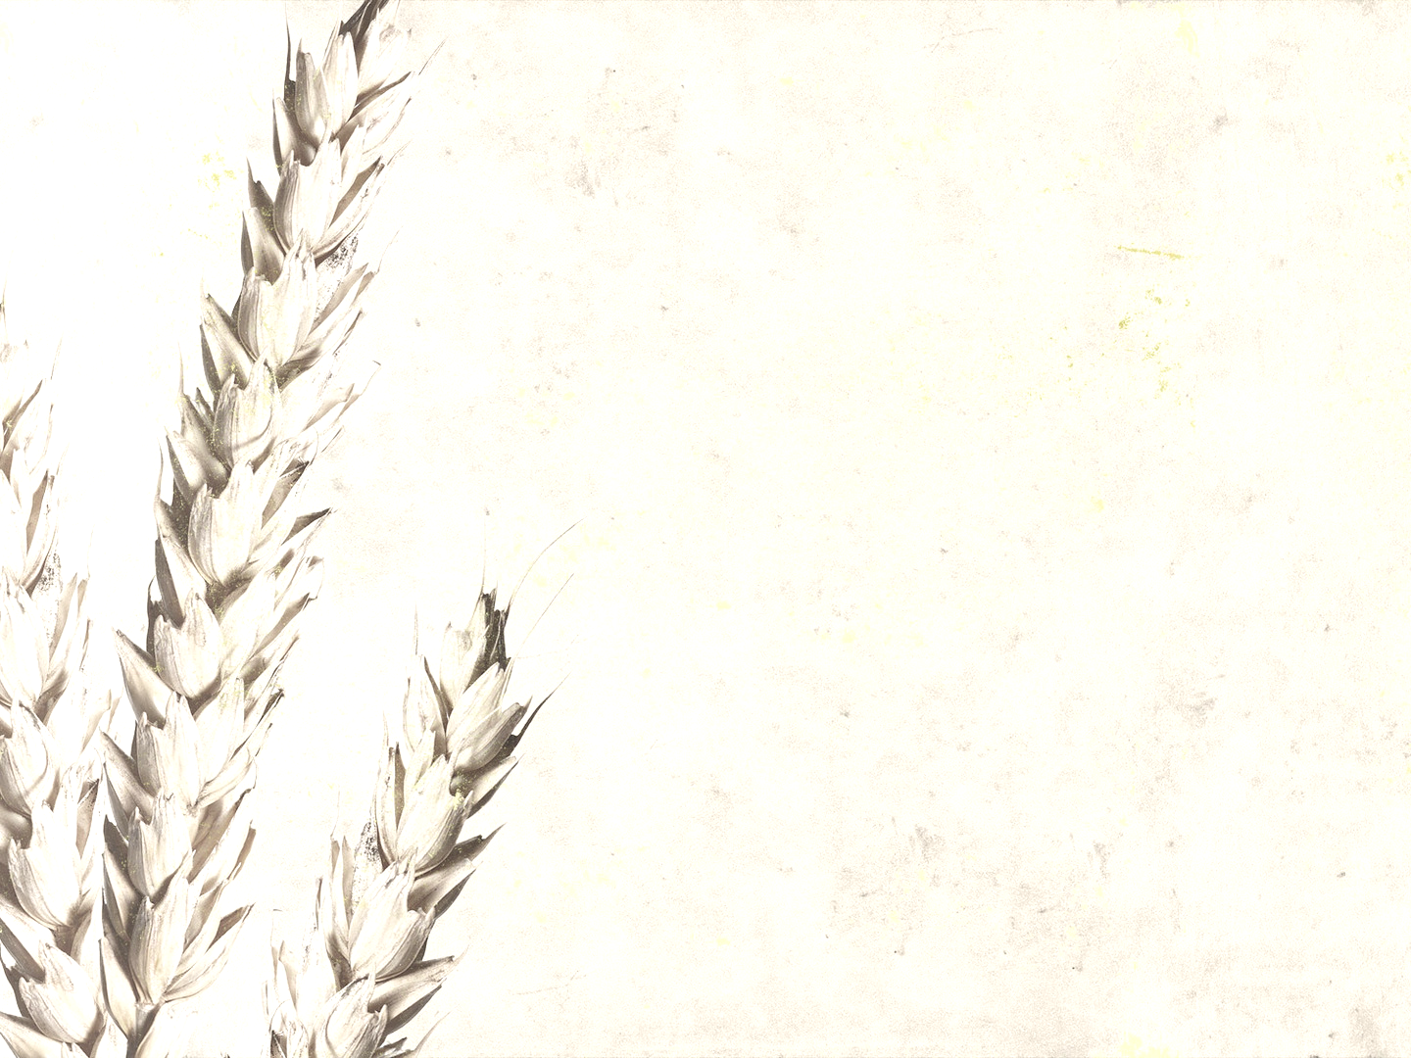
PHARISEES TAKE ISSUE (vs. 23-24)
“One Sabbath he was going through the grainfields, and as they made their way, his disciples began to pluck heads of grain” (Mark 2:23)
“And the Pharisees were saying to him, “Look, why are they doing what is not lawful on the Sabbath?” (Mark 2:24)
The problem with legalism, is that it adds to the Word of God
Notes:
“One Sabbath he was going through the grainfields, and as they made their way, his disciples began to pluck heads of grain” (Mark 2:23)
- Matthew, Mark, and Luke all have an account of this story
- Matthew’s account informs us that the disciples do this because they were hungry
- Luke’s account makes note of the fact that they were also rubbing them in their hands, both are important to keep in mind
- Now of course the Sabbath was to be a day kept holy, a day given unto the Lord, a day that would last from sunset Friday until sunset Saturday.
- And as expressed in the 10 commandments and the law of God as a whole, it was to be a day that the people would cease from work
- In order that they might rest and fixate their hearts and minds on God.
- But of course over time the rabbis began to make laws about the law of God
- These can be found in what is known as the Mishnah, which contained 39 prohibitions of what a person could and could not do on the Sabbath
- And the Talmud, which contained 24 chapters of what a person can and cannot do on the Sabbath
- And in here there are details which cannot be found in Scripture
- For example, you could not walk any further than 1999 paces, to take the 2000th step would be a violation of the Sabbath
- Which perhaps Jesus and his disciples were also in violation of
- And the one which is in focus in this particular instance is the reaping, for the disciples to be picking food and rubbing it was deemed work on the Sabbath
- The Pharisees took major issue with this,
“And the Pharisees were saying to him, “Look, why are they doing what is not lawful on the Sabbath?” (Mark 2:24)
- Notice that the Pharisees didn’t address the disciples, no instead they turn to their leader, their king, Jesus and address him instead
- Among scribes it was assumed that a teacher was responsible for the behaviour of the disciples, which is why the Pharisees bring their critique of the disciples directly to Jesus
- And what do they say, they say look, or better translated perhaps as behold
- Which adds a note of admiration at the strange reality which is unfolding before their eyes, something that is hard for them to believe
- Behold, why are they doing what is not lawful on the Sabbath? Why, with what right, by whose authority do they break these man-made laws and traditions
- They ask Jesus, who do you think you are, challenging our authority, challenging our religion, on our sacred day, on our day which we get to shine most
- They wanted to protect their hypocritical religion, which was only focused on the outward, of appearing to be clean on the outside, meanwhile they were dead on the inside
- My dear friends, let us watch and be on guard against similar behaviour, let us watch and be careful that we do not slide into becoming legalistic and like the Pharisees
- We ought to care deeply about obedience and holiness, but not to man-made false religions but being obedient to the Word of God
- Not concerned about all the pomp and ceremony where we get the glory
- But concerned with repentance and faith, about loving God and loving others, about doing everything to the glory of God. That I might decrease and he might increase.
- But the Pharisees wanted all the glory for themselves, and they call out the disciples for breaking these laws
The problem with legalism, is that it adds to the Word of God
- You see the Sabbath was established and is rooted in Creation, and was then given to the nation of Israel on Mount Sinai and was restated again in Deuteronomy
- With the overarching and basically only prohibition being, keep the day holy by not working
- And then throughout history the rabbis committed themselves to fine tuning that law and coming up with specific prohibitions, which are found in the Mishnah and Talmud
- But in getting to Deuteronomy 5 where the 10 commandments are given again to the nation of Israel
- The rabbis had to first read Deuteronomy 4:1-2 which says, “And now, O Israel, listen to the statutes and rules that I am teaching you, and do them, that you may live, and go in and take possession of the land that the Lord, the God of your fathers, is giving you. You shall not add to the word that I command you, nor take from it, that you may keep the commandments of the Lord your God that I command you”
- But here’s the Pharisees the experts in the Old Testament doing what? Adding to the Word of God
- Legalism says do this and you will get to heaven, obey this and then you will be saved, dress like this and then you will be forgiven
- The gospel says, “It is finished”. Jesus paid it all, he did it all, he lived the perfect life
- So now all that is required for forgiveness, to be saved, is repentance and faith in the person and work of Jesus Christ, that’s it!
- Obedience cannot save you, none do what is good, all fall short of the glory of God, only by grace alone, through faith alone, in Christ alone
- And so legalism, flies directly in the face of the gospel, it is leading countless people astray
- It is a false gospel, and Jesus being the good shepherd will protect the flock, and he does so with full force
- Jesus pulls no punches when it comes to the truth being tampered with and wolves coming at his sheep

Slide 3

JESUS QUESTIONS THEM (vs. 25-26)
“And he said to them, “Have you never read what David did” (Mark 2:25a)
“when he was in need and was hungry, and those who were with him” (Mark 2:25b)
“how he entered the house of God, in the time of Abiathar the high priest” (Mark 2:26a)
Notes:
“And he said to them, “Have you never read what David did” (Mark 2:25a)
- Jesus begins his question to the Pharisees, who are attacking him and his followers with, “Have you never read what David did?”
- How insulting. The Pharisees were the experts in religious law, they knew the Old Testament back to front
- And Jesus says, “Have you never read this book”, “Do you not know what the Scriptures say”
- He wants them to take their eyes of their man-made laws and point them back to the Old Testament, the law of God
- Christ himself comes to defend his people, and he could have done so in his own authority as the second person of the God-head, but instead he uses the God-breathed Scriptures
- He makes the comparison between himself and Israel’s royal messianic prototype to also define Jesus’ authority as the royal Son of God anticipated since the reign of David
- Jesus cites David not as an excuse for his actions, but will use David and his followers actions as a precedent
“When he was in need and was hungry, and those who were with him” (Mark 2:25b)
- Now remember, we read in Matthew’s account that the disciples were hungry, they were in need
- David, at this time in history, he is on the run from Saul, fleeing south from Gibeah.
- Jonathan has just shot the arrows for David to make a run for it, in order to escape Saul
- And David comes to the city of Nob where the tabernacle was located
- Now while the Old Testament passage, which we will read in a minute is not directly comparable to what Jesus’ disciples were doing
- The argument, the question was whether Jesus had the right to override the laws, by whose authority?
“How he entered the house of God, in the time of Abiathar the high priest” (Mark 2:26a)
- Read 1 Sam 21:1-6
- Now do you notice who the high priest is? It’s Ahimelech, not Abiathar like Jesus said it was
- Over the years theologians and commentators have debated the reasoning for this
– Ahimelech was the priest before Abiathar. And Abiathar had a lengthy time as high priest during the reign of king David
– So it is the priesthood of Abiathar which dominates this era, his priesthood marked this era of Israel’s history
– This could perhaps be better understood to us today as, “It was in the days of Abiathar”

Slide 4

“and ate the bread of the Presence, which it is not lawful for any but the priests to eat, and also gave it to those who were with him?” (Mark 2:26b)
Christ himself defended his disciples and will
protect his bride
“Our grand reason for our faith and practice, should always be, “Thus it is written in the Bible”, “What says Scripture” – J.C. Ryle
Notes:
“And ate the bread of the Presence, which it is not lawful for any but the priests to eat, and also gave it to those who were with him?” (Mark 2:26b)
- Now we read about this bread in Leviticus 24:5-9. It was baked fresh weekly every Sabbath
- And 12 loaves as a symbol of the 12 tribes of Israel was placed before the Lord as a symbol of His ongoing love and covenant with His people
– And then at the end of each week only Aaron and his sons, so only the priests had been given the commission by God to eat this bread
- Which was then replaced with fresh bread and the cycle would continue.
- And the priest Ahimelech had nothing else to offer David and his companions.
- But the priest being wise, and having enough common sense understood that no ceremony or ritual overtakes moral obligation
- Mercy triumphs ritual and ceremony, particularly when the laws that are being enforced are of man and not of God, which is the case with Jesus’ disciples and the Pharisees
- If David was allowed to violate a law that had been established by God Himself, for the sake of mercy and necessity
- Then surely Jesus, the Son of God, the Messiah, could be allowed to violate an unbiblical regulation on the Sabbath
- With one question Jesus completely decimates any argument the Pharisees may have, and they are left speechless
Christ himself defended his disciples and will protect his bride
- Listen closely Christian. Christ defended his disciples then, and he continues to defend his people now. How you may ask? In what ways?
- Well, he left all the glories of heaven and died on the cross to save us, to pay the debt of your sins, that you may be defended and kept from eternal death
- He rose again for our justification that we might be reconciled to God, that we might be snatched out of the clutches of darkness into the kingdom of light
- And he promised to always be with us until the end of the age.
- He then left us and ascended to the right hand of the Father, for our good that the Holy Spirit would come and indwell all who believe
- That He might convict us of sin and constantly bring us to our knees in repentance
- And to stir up in us a hatred of sin that we might flee from it like the plague
- And we are being sanctified, progressively being conformed to the image of Christ
- And he has given us His Word, and His promises, that we might lean on and cherish and trust in this firm foundation
- And that as we read it, the Spirit might be cutting us to the core, that we might constantly depend upon the grace of God and that we might be killing sin
- And he grafts us into the body of Christ, and by His Spirit he appoints elders to care for the sheep as his under shepherds
- And as elders we are to care for you, and defend you from the wolves, from error and false teaching, and to teach you correct doctrine and theology
- And as part of the body we are to be accountable and to be disciplined in accordance with the Scriptures for our good
- That you might be convicted of sin and fight off sin that you might be drawn closer to Him
- And Christian, you have been sealed with the Holy Spirit, who is the guarantee of our inheritance until we acquire possession of it.
- And dear child, you cannot and will not be snatched out of the hands of God Almighty
- No, He will keep you, He will hold you close until you get to glory
- And now our Lord and Saviour, seated at the right hand of the Father, is forever interceding for his people, until that day when he returns, and he smites evil once and for all
- And on that day, when he calls us home, he will set us free from the presence of sin
- So how does Christ defend us today? In what ways? Oh my dear brothers and sisters, in every way
- Now let us go into the world, knowing that Christ defends, Christ has won, and let us boldly proclaim the gospel which is the power of God unto salvation
- The second thing I want us to notice about Christ here…
“Our grand reason for our faith and practice, should always be, “Thus it is written in the Bible”, “What says Scripture” – J.C. Ryle
- Christ is a master wielder of the Sword of the Spirit, of the Word of God, and constantly uses it to fend off enemies of the gospel
- Christ ought to be our example. We should seek to be able to give scriptural answers for our behaviour in all matters of dispute
- But if we are to do this, we must know it well. Our lives ought to be saturated with it. We must spend much time in it, studying it, memorising it and applying its truths to our life
- We must read it diligently, humbly, perseveringly, prayerfully, ready and willing to obey
- To use it effectively, we must be familiar with it, for it does not come by our own intuition
- For it is students of the Bible and they alone who will find it a weapon ready in hand on the day of battle

Slide 5

JESUS DEMONSTRATES AUTHORITY (vs 27-28)
“And he said to them, “The Sabbath was made for man, not man for the Sabbath” (Mark 2:27)
“So the Son of Man is Lord even of the Sabbath” (Mark 2:28)
“Come to me, all who labour and are heavy laden, and I will give you rest” (Matt 11:28)
Notes:
”And he said to them, “The Sabbath was made for man, not man for the Sabbath” (Mark 2:27)
- The Sabbath did not begin with the 10 commandments but was instituted at Creation
- In Genesis 2:2-3, “And on the seventh day God finished his work that he had done, and he rested on the seventh day from all his work that he had done. So God blessed the seventh day and made it holy, because on it God rested from all his work that he had done in creation”
- Then gives it as a direct command to His people Israel on top of Mount Sinai and says, “Remember the Sabbath day, to keep it holy. Six days you shall labour, and do all your work, but the seventh day is a Sabbath to the Lord your God. On it you shall not do any work…”
- God made it for Adam in Eden, renewed it for the people of Israel, and it was to be a blessing, a day of rest from our week’s work
- It was to be a day where all of God’s people would meet together, to worship God, be reminded of His goodness, His grace, and His mercy to them
- It was to be a day in which they were to fixate their hearts and mind on their Creator, their deliverer, God Himself
- The main prohibition that we read both in Genesis and in Exodus is to stop working. I mean that is just nothing short of a blessing
- It was for the good of the body and the soul, for resting the body, and worship for the soul
- But the Pharisees come along and take liberty by adding to the word of God
- Turning it into a burden, rather than a blessing. Turning it from the most joyous day of the week to the most dreaded
- Why? In order that they might get the glory, in order that they could have the whole day revolve around them
- Rather than everyone turning their eyes to God and giving Him all the praise and glory
- Jesus is telling the Pharisees, you’ve got it backwards. You were not made for the Sabbath, you do not serve the Sabbath
- The Sabbath was instituted for the benefit of mankind, for was not mankind created before the Sabbath
- But then Jesus’ next pronouncement was even more outrageous to the Pharisees
“So the Son of Man is Lord even of the Sabbath” (Mark 2:28)
- There it is again, like last time Bill preached in Mark, the ‘Son of Man’
- Which is a reference to Daniel 7:13-14. Which refers to Jesus unique vocation as the Son of Man with divine authority and power
- But not only is he ‘the Son of Man’, but he is Lord of the Sabbath. Now Jesus has done it
- Remember it was God who instituted the Sabbath at creation, it was God atop Mount Sinai who wrote the 4th commandment of the Sabbath onto the stone tablets
- Jesus by saying this claims to be God, thus he is Lord of the Sabbath
- Christ is sovereign over it. Christ interprets God’s will, God’s word, and God’s law
- So the Pharisees ask, by whose authority do the disciples break the law of the Sabbath?
- Jesus says, by the authority of God Almighty
- Jesus takes the Pharisees most sacred day, their day to shine and says the Sabbath does not belong to you, for I am Lord of it, it finds its fulfilment in me
- And we as New Testament Christians, now meet on the Lord’s day as stated in Revelation 1, and in accordance with the New testament on the first day.
- We do this to celebrate and remember that Jesus Christ rose, we serve a living God
- Not in a legalistic sense, not that we aren’t allowed to work, or do chores or anything like that
- But to keep it holy, to set it apart, to gather with God’s people in a local church
- To come for the ordinary means of grace of the preaching of His Word and to take part in the Lord’s supper
- Never to be a burden but to find rest in our Lord and Saviour, to be reminded of His goodness, to be convicted of sin, to fix our hearts and minds on Him
- There is a very famous passage in Matthew where Jesus addresses the burden of legalism, the heavy load which the Pharisees and all legalistic false religions heap onto people
“Come to me, all who labour and are heavy laden, and I will give you rest” (Matt 11:28)
- Take my yoke upon you, and learn from me, for I am gentle and lowly in heart, and you will find rest for your souls. For my yoke is easy, and my burden is light”
- Now there are many applications for these verses, but in context Jesus is addressing those who have been entangled with the Pharisaic religion of legalism
- He is calling out to people, you are weary, you have been heavy laden, you are so caught up in trying to please God by your own works, by obedience to man-made laws
- He says come to me, because only in me will you find rest, only in me will you please God. Your works are rubbish, Paul says our works are like dung
- Just come to Christ, repent and believe in the finished work of Christ, and then you will find rest
- But don’t miss the point of what Jesus is saying here. He isn’t just saying that he is Lord only of the Sabbath, for he is Lord of every day of the week
- The point of this passage is, do we bow the knee before the Lord of the Sabbath? Do we prostrate ourselves before the one who is Sovereign over it all?

Slide 6
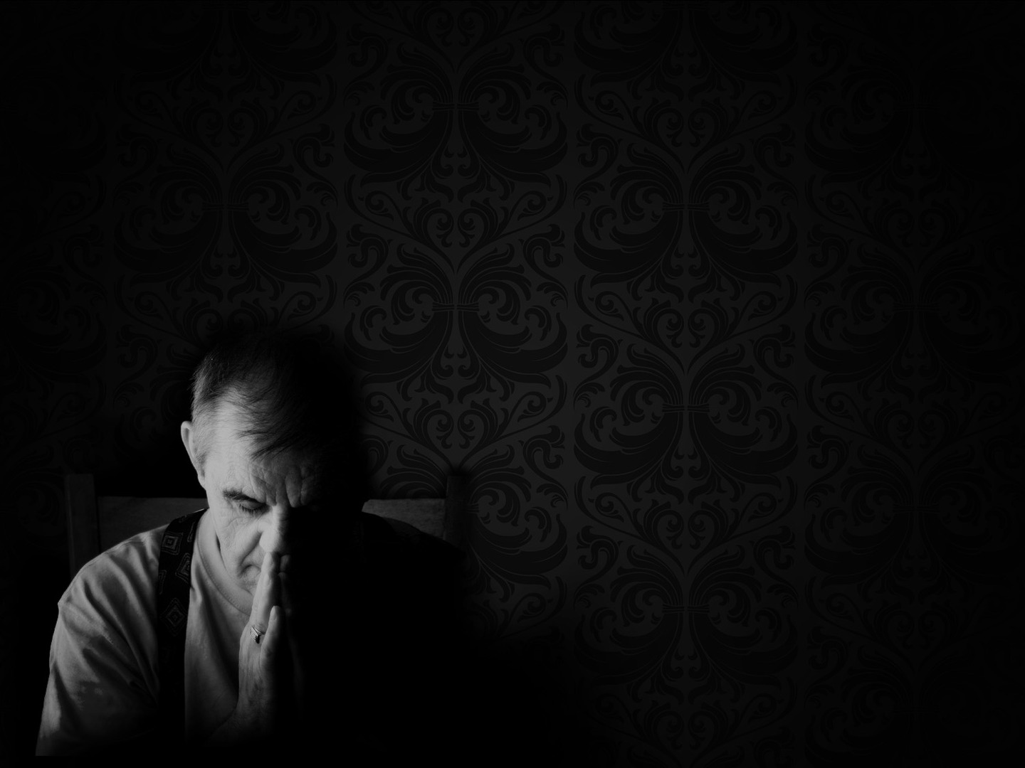
PHARISEES TAKE ISSUE (vs. 3:1-2)
“Again he entered the synagogue, and a man was there with a withered hand” (Mark 3:1)
“And they watched Jesus, to see whether he would heal him on the Sabbath” (Mark 3:2a)
“so that they might accuse him” (Mark 3:2b)
Notes:
“Again he entered the synagogue, and a man was there with a withered hand” (Mark 3:1)
- Now remember back in Mark 1:39 where it says, “And he went throughout all Galilee, preaching in their synagogues and casting out demons”
- So Jesus had come to preach on this particular Sabbath, and it is possible that Jesus’ and his disciples continued there from plucking heads of grain to this synagogue to preach
- ‘Again’, suggests that this is the synagogue at Capernaum. Meaning that this congregation has already witnessed Jesus remarkable displays of authority
- And once he gets there he notices a man with a withered hand. Withered meaning stiff and deformed, but it is important to note it is not life threatening
- Luke’s gospel tells us that it was his right hand, which if we assume that he is right-handed then it is debilitating, perhaps stopping him from work and therefore earning a living
“And they watched Jesus, to see whether he would heal him on the Sabbath” (Mark 3:2a)
- The subject of who is watching has not been defined, but based on the previous verses and verse 6 coming up, we know that it was the Pharisees who were watching him
- After the grainfield they were watching him very carefully, they were hanging in suspense waiting for him to mess up.
- This is no casual observance but a scrutinising of Jesus
- And when they saw this man with the withered hand in the synagogue, they would wait.
- Because part of their laws allowed healing to take place only if it was life threatening, if the person was going to die
- But in the case of this man, according to the Pharisee’s law of the Sabbath, this man would just have to wait until tomorrow. So they waited and watched
- Brothers and sisters. We must not expect different treatment. We too are always being watched, put under the microscope by the world, waiting for that gotcha moment
- The world and Satan love it when Christians fall into sin, that we might be made a mockery of.
- Our conduct is scanned with a jealous eye
- We are marked men and women. All that we do with our lives, the way we dress, the way we spend our money, the way we use our time, the world waits for us so that they can find fault
- And we are weak, we are fallible, sinful human beings, so we must be convicted of our desperate need of Christ at all times, our dire need of his strength
- This is sufficient to drive us to our knees in prayer.
- Hebrews 4:16 tells us, “Let us then with confidence draw near to the throne of grace, that we may receive mercy and find grace to help in time of need”
- Draw near to him and he will supply you with the grace and help in your time of need
“So that they might accuse him” (Mark 3:2b)
- They watched Jesus, oh so closely that they might accuse, for the Pharisees would not stop until Jesus was murdered
- Luke’s account tells us that Jesus knew their thoughts, John tells us Christ knows the wickedness of man’s heart
- They cared not for the man with the withered hand, only about accusing the Lord of the Sabbath
- Christ knows they are just waiting for him to slip up, to violate the law to accuse him

Slide 7

JESUS QUESTIONS THEM (vs. 3:3-4)
“And he said to the man with the withered hand, “Come here” (Mark 3:3)
“And he said to them, “Is it lawful on the Sabbath to do good or to do harm” (Mark 3:4a)
“to save life or to kill?” (Mark 3:4b)
“But they were silent” (Mark 3:4c)
Notes:
“And he said to the man with the withered hand, “Come here” (Mark 3:3)
- Other translations say, “Get up and come forward”.
- There is no privacy here. Jesus could have said to the man, I will heal you, but let’s do it some where quiet where we won’t be seen
- He calls the man to the centre of the synagogue.
- Jesus is determined to force the issue by a public display of both his healing power and his authority as Lord of the Sabbath
- Jesus will not back down and shy away from confronting the error and heresy of the Pharisees
- He will not cease in doing the will of his Father, in doing good on the Sabbath
- Note that Jesus calls the man, Jesus initiates. This is the only place in Mark’s gospel that Jesus initiates a healing without being asked or approached
- Imagine how the man with the withered hand feels, potentially risking his life
- Jesus once again, is going to completely abolish the Pharisees in exposing their hypocrisy with a question
“And he said to them, “Is it lawful on the Sabbath to do good or to do harm” (Mark 3:4a)
- Jesus attacks them once again where it hurts. Jesus asking is it lawful, in reference to the law of Moses, to the Old Testament which they were the experts in
- Jesus is digging the knife in and exposing them. Because they should have known better
- Isaiah 1:13 and verses following, God says, “Bring no more vain offerings; incense is an abomination to me. New moon and Sabbath and the calling of convocations – I cannot endure iniquity and solemn assembly. Your new moons and your appointed feasts my soul hates; they have become a burden to me; I am weary of bearing them. Wash yourselves; make yourselves clean; remove the evil of your deeds from before my eyes; cease to do evil, learn to do good; seek justice, correct oppression; bring justice to the fatherless, plead the widows cause.”
- Isaiah 58:13-14 also talks about this, about turning away from doing our own pleasures on the Sabbath and instead doing good and taking delight in the Lord, for this is the purpose of the Sabbath, this is the will of the Lord
- They should have known that the Sabbath was a day for doing good
- This first part of the question is a reference to the man with the withered hand. To heal him would be to do good, and to leave him as is would be to do harm
- But then Jesus delivers the final blow
“to save life or to kill?” (Mark 3:4b)
- This part of the question is a reference to Jesus. Jesus knew the thoughts of the Pharisees, he knew they wanted to accuse him and wanted him dead
- The answers were obvious, but it put the Pharisees in quite the dilemma
- Firstly, if they answer that it is okay and rightful to do good on the Sabbath then they can’t accuse Jesus for healing this man
- And even in accordance with their own laws it is right to save a life on the Sabbath
- But in their hypocrisy in their blindness and hardness of heart and their absolute hatred of Jesus they would in just 2 verses begin to plot to kill Jesus
- The audacity of these men to want to call out Jesus for healing this man, for showing mercy and having compassion and doing good on the Sabbath
- And yet they would grossly violate their own Sabbath law and begin to plot to kill the Lord of the Sabbath. Jesus is basically saying, “Who is really violating the Sabbath?”
- The answers were easy, obvious to everyone else standing in the room…
”But they were silent” (Mark 3:4c)
- They knew what was right, they knew how they should have responded.
- But they had no compassion or mercy for this man, their only concern was to catch Jesus, to accuse him and kill him
- What a disgrace to the human race, what an example of the total depravity of the human heart
- As the prophet Jeremiah says, ”the heart is deceitful above all things, and desperately sick”
- They see their fellow man suffering, but because of their pride they remained silent
- Jesus with one question, shuts their mouth

Slide 8
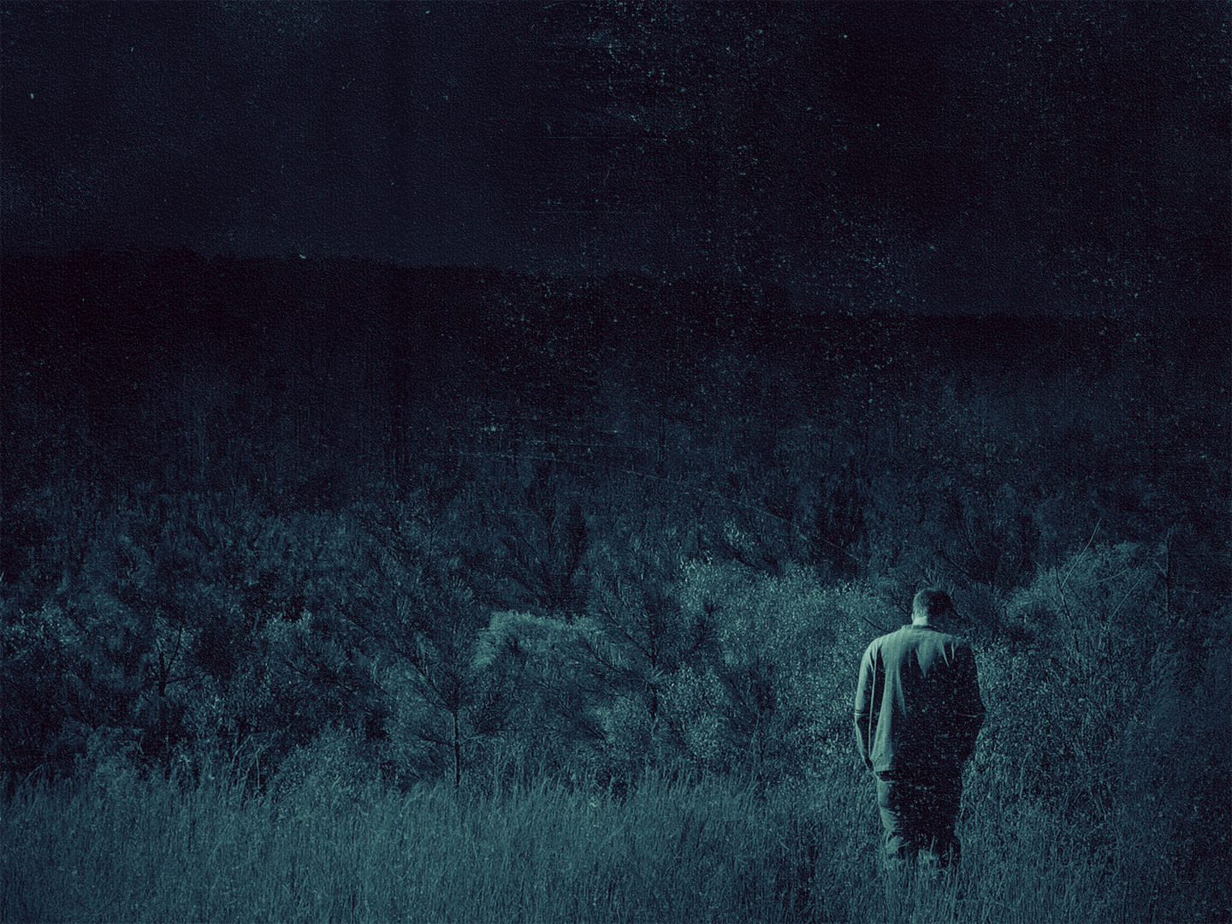
JESUS DEMONSTRATES AUTHORITY (vs. 3:5)
“And he looked around at them with anger” (Mark 3:5a)
“grieved at their hardness of heart” (Mark 3:5b)
“and said to the man, “Stretch out your hand” (Mark 3:5c)
Notes:
“And he looked at them with anger” (Mark 3:5a)
- To look around describes a summary and commanding survey.
- It’s as though Jesus looked at every single Pharisee right in the eye, a piercing gaze that penetrated the depths of their soul
- And he looked at them with anger. This word for anger is graphic, it is passionate.
- It is perhaps better described as fury, he is angry with their hypocrisy, with their sin
- Jesus is utterly outraged because they care more about their traditions and their man-made laws than this man’s life
- We know that Jesus was angry at other times throughout the New Testament, but this is the only explicit mention of Jesus being angry in the New Testament
- He was angry at their unbelief, at their rejection, at their heretical legalistic religion which cared so little for man. He is angry at their pride, their self-righteousness, their sin
- This is the wrath of God, demonstrated in Christ’s life towards sin
- Christian, let us hate and abhor sin in a similar manner. It is right for Christians to despise the sin of others, and our own sins
- For is it not sin which so deeply offends and separates us from God?
- Is it not sin which held our Lord and Saviour to that cursed tree? Pray earnestly that we would learn to hate sin more and more and love the things of God
- But he is not only angry, he is also…
“grieved at their hardness of heart” (Mark 3:5b)
- Anger and grief over sin and hard-heartedness must go together.
- Jesus’ was grieved because only hell awaited them if they will not repent and believe in the gospel, if they would not turn from their legalism, and trust in the finished work of Christ
- In Hebrew ‘heart’ comes closer to the word ‘mind’ in English. It not as concerned with emotions and more concerned with thoughts and will
- Their hearts were callous, there was stubborn resistance to the purpose of God.
- Hard-heartedness is the enemy to divine love, it keeps out repentance and faith.
- They were destroying their own souls out of their own hatred for him
- Let me ask you this, is Christ looking at you like this today? Do you have a hard heart?
- If he is, then hear this
- Only the regenerating work of the Holy Spirit can take a heart of stone and replace it with the heart of flesh
- The Word of God is like a hammer which chisels away and breaks the stone of our hearts until it is soft
- To the Christian. In just a few chapters, this word hard-hearted will be used to refer to the disciples. Are there callouses on your heart, have you become desensitised to sin?
- Run to the foot of the cross, repent and believe in the gospel. Come often to hear the Word of God preached.
- Shun and resist all hardening influences. Be pure, live constantly near the throne of God, and stay far away from the throne of iniquity
- Do not play with sin, flee from temptation
“And said to the man, “Stretch out your hand” (Mark 3:5c)
- Jesus cannot and will not back down. This is his final authoritative move
– He publicly declares his authority, reminding the Pharisees again that he is Lord of the Sabbath, he will save life rather than kill and he will do good rather than harm
- The man has two options. He can run, hide his face, deny the Son of Man and harden his heart
- Or he can obey

Slide 9

“He stretched it out, and his hand was restored” (Mark 3:5d)
Christ has gazed at each and everyone of us like that
Notes:
“He stretched it out, and his hand was restored” (Mark 3:5d)
- The man takes the risk, exposes himself to Jesus and is healed
- Jesus does not move a finger, for his word is powerful and authoritative
- Faith is not a private wager but a public glorious risk that Jesus is worthy of trust when no other hope can be trusted
- Jesus alone is worthy of that trust. Submit to the word of God Christian, obey the word of God, apply the word of God
- And Luke’s account says that this filled the Pharisees with fury. It drove them to madness, they were outraged
- But before you judge the Pharisees too hard, remember…
Christ has gazed at each and everyone of us like that
- All have sinned and fallen short of the glory of God, all we like sheep had gone astray. All of us were once hard-hearted and hostile to God, at enmity with God
- Your souls were sin-tainted, sin-withered deserving only the wrath of God and an eternity in hell
- But Christian, God imputed your sinfulness upon Christ, and gazed at Christ with anger and grief, and God’s one and only Son was crushed for your sin
- And your sin is put into Christ’s account, and his perfect righteousness is accredited to us, so that now God looks at us and instead of anger and grief, he smiles and says, “my child”
- Christ saves, and adopts us, and reserves a spot for us in eternity at the heavenly banquet.
- Rejoice Christian, rejoice! For you have been saved not by works, but by grace, so that none may boast

Slide 10
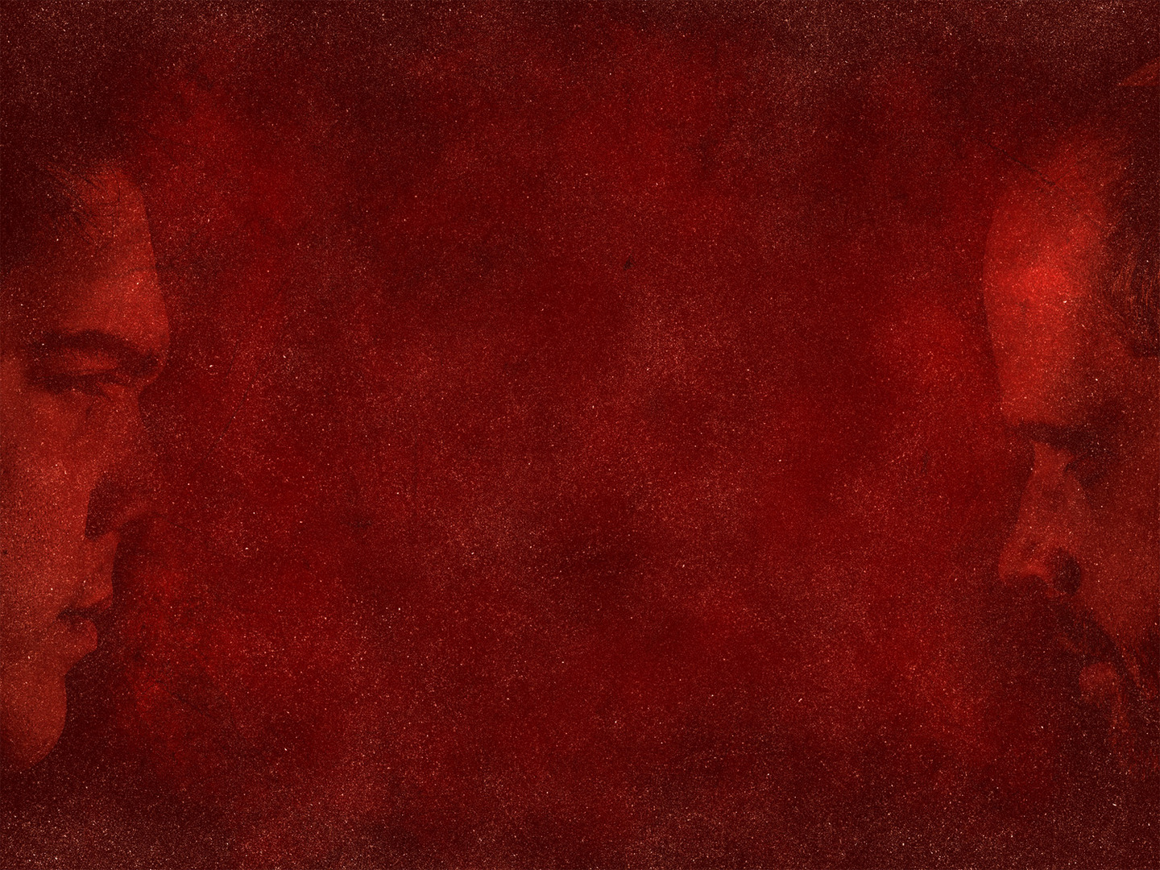
PHARISEES RESPOND (vs. 3:6)
“The Pharisees went out and immediately held counsel with the Herodians against him” (Mark 3:6a)
“how to destroy him” (Mark 6b)
This is the bitter fruit of that hardness of heart which provoked Jesus to anger and grief
Notes:
“The Pharisees went out and immediately held counsel with the Herodians against him” (Mark 3:6a)
- The Pharisees have just witnessed a miracle, an awesome demonstration of the authority and power of God
- This should have caused them to question everything they knew and thought about Jesus
- It should have brought them to their knees.
- But instead they held counsel, which means to plot together with. And they partnered with the most unlikely of groups, the Herodians
- These are men who loyally support the Herod dynasty and its cause, which in Galilee would be Herod Antipas, the one who would behead John the Baptist
- These 2 groups misaligned on many issues, but the blindness of their own agendas and false religion brought them together, and they would plot…
“how to destroy him” (Mark 6b)
- To destroy, to utterly destroy, to kill
- The Pharisees, Judaism’s official response to Jesus, kill him!
- They accuse Jesus of breaking the Sabbath and yet it was they who would violate the Sabbath, they would plot to kill
- It is here that the storm clouds of the cross begin to loom
- Here, 5 chapters before Jesus first prediction of his death, the cornerstone for the passion and death of God’s Son is laid.
This is the bitter fruit of that hardness of heart which provoked Jesus to anger and grief
- Though they would have him killed very shortly, it would all be in accordance with God’s will
- But their rejection of Jesus entails the rejection of the way, the truth, and the life and leaves them prey to distress and death
- This bitter fruit, this rejection and hatred of the Saviour, this hardness of heart, will only result in one outcome, their eternal damnation
- An eternity spent in hell
Let me close with some words from a hymn written by Charles Wesley called ‘A Tender Conscience’

Slide 11
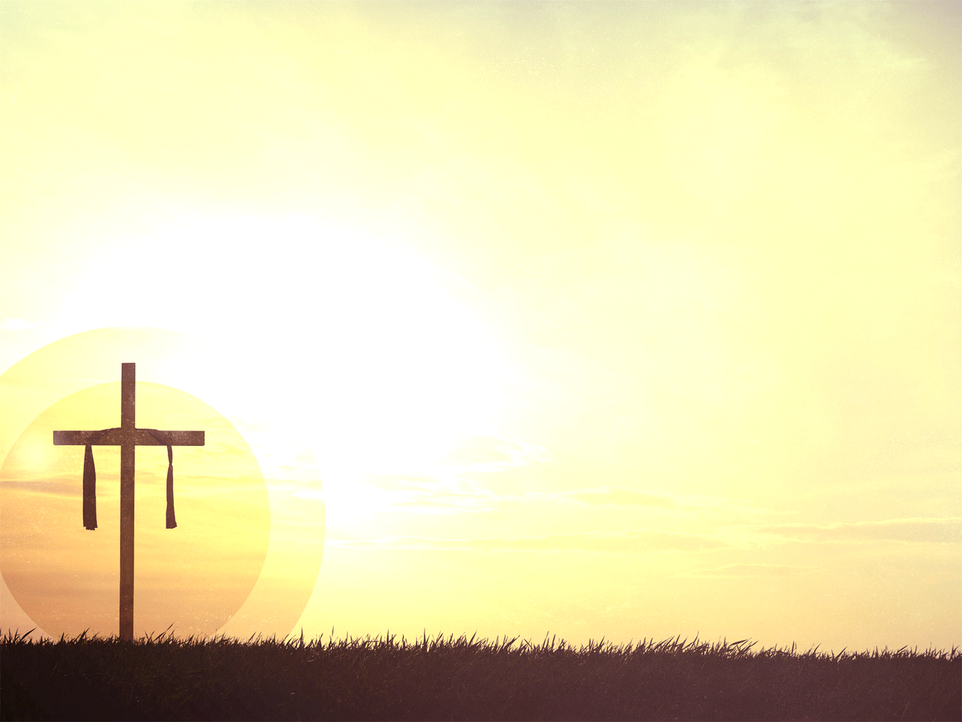
“I want a principle within
of watchful, godly fear,
a sensibility of sin,
a pain to feel it near.
I want the first approach to feel
of pride or wrong desire,
to catch the wand’ring of my will,
and quench the kindling fire.”

Slide 12
“Almighty God of truth and love,
to me Thy pow’r impart;
the mountain from my soul remove,
the hardness from my heart.
O may the least omission
pain my reawakened soul,
and drive me to that blood again,
which makes the wounded whole.”
Notes:
Christian, my dear brothers and sisters. Examine yourselves for any callouses. Draw near to the throne of grace and there you will find forgiveness
- There you will be washed clean by the blood of Jesus Christ
- Earnestly pray that you would be ever growing in your sensitivity to sin, and in your hatred of it
To the unbeliever, you who is hard-hearted, who fails to see just how corrupt you are, who rejects Christianity and the truth of the Bible, and fails to see their desperate need for a Saviour
- May the Holy Spirit cut you to the core, help you to see just how helpless and sinful you are that you might repent and believe in the gospel
- For only the gospel can take your heart of stone and grant a heart of flesh. Only Christ can do this
- Because only Christ has authority over it all
“Come to me, all who labour and are heavy laden, and I will give you rest”
- At the cross you will find rest, you will find grace, you will find mercy, you will find forgiveness, may the Lord open your eyes

