Slide 1
CHRIST’S AUTHORITATIVE MESSAGE AND CALL
Mark 1:14-20
Notes:
Good morning everyone. I hope you are all doing well
Well, if you are here for the first time today, we just started our journey through the gospel of Mark, and today is our second week
If you would all open up your Bibles to Mark 1:9
Last week Bill took us through the first 13 verses
And I want to quickly draw our attention back to last part from last week to help make sense of today’s verses
Verses 9-11 (read) is Jesus’ baptism, and God the Father publicly declaring that this is my Son, this is the Messiah, this is the king.
Making Jesus’ baptism essentially his coronation as king, and kings have authority
And so Mark wastes no time in showing Christ’s authority to his audience
Verse 12 – 13 (read) – These verses show us Jesus’ authority over Satan and his realm
And then what we are going to see in today’s verses is that Christ’s message demonstrates that he has authority over sin, and in his call we will see he has authority over sinners
So now moving into verse 14.
And as we go through these verses today, we must remember that Mark is not trying to give all of it to us in order, but rather trying to keep on point
To keep drawing our attention to the king and his authority as the announcer and inaugurator of the kingdom of God

Slide 2
CHRIST’S AUTHORITATIVE MESSAGE (vs 14-15)
“Now after John was arrested” (Mark 1:14a)
“Jesus came into Galilee” (Mark 1:14b)
“proclaiming the gospel of God” (Mark 1:14c)
Notes:
“Now after John was arrested” (Mark 1:14a) - John the Baptist has been preaching in the wilderness, he has been proclaiming a baptism of repentance and forgiveness of sins - In Mark 6:17 we read that the reason behind John’s arrest was because he stood on the truth - And called out the sin of Herod for his sinful and incestuous marriage - But here, right here in these verses Mark leaves all of that out, and he does so, because… - He wants us to keep our eyes fixed on the Messiah, the one who has authority over Satan, who is the serpent crusher - The word here for arrested is ‘handed over’ or ‘delivered up into custody’ - This word is important throughout Mark - In Mark 9:31, “The Son of Man is going to be delivered into the hands of men, and they will kill him” - Same word is used of Jesus in Mark 10:33 and then 8 more times in chapters 14-15 - And then Jesus warns his disciples in Mark 13 of the persecution that is coming, and 3 times that they would be ‘delivered’ over to persecution or death - And so it is being used most often by Mark to describe the fate of the faithful, of both Jesus and his followers - To the original readers of this, which was most likely Christians during the mid sixties AD - Who suffered severely, being tortured and burned for their faith under the reign of emperor Nero - This would be of great comfort for them to be reminded of those who have gone before them - That suffering is part and parcel of being Christian, that though we perish, God still reigns, and He will continue to build and sustain his church - And this is the same encouragement for us today - So Mark moves John off the scene. John has come preaching, “behold the Lamb of God, who takes away the sin of the world”. - He has prepared the way and made the path straight. - And now the Lamb of God, the Son of God, the Messiah, the Christ, the king enters onto the scene
“Jesus came into Galilee” (Mark 1:14b) - Now again quickly notice here that Mark leaves out the fact that for 6 months or so after Jesus’ baptism, Jesus ministry began in Judea and Jerusalem in the south - And he moved up through Samaria, which we read of in John 4, where Jesus talks to the woman at the well - And from there he moves to the northern parts which is where we end up now in Galilee – Jesus is baptised as his coronation as king, Mark then demonstrates Jesus authority over Satan in the wilderness - And is now going to reveal to us the authoritative message of the king Jesus Christ - And it all takes place in Galilee, as prophesied by Isaiah, and Jesus’ ministry will remain in Galilee until Mark 8
“proclaiming the gospel of God” (Mark 1:14c) - The word here for proclaiming, is also translated preaching - For preaching, proclaiming this gospel is the very reason which Jesus has come - Mark 1:38, Jesus says, “Let us go on to the next towns, that I may preach there also, for that is why I came out.” - It has been said before, “God had one Son, and He made him a preacher” and God’s method is preaching - For it is preaching that God has ordained as the means by which His gospel is communicated - If we are to see souls saved we are to preach, we are to proclaim to the world this good news, the best news the world has ever heard - This gospel is the gospel of God. - The word ‘of’ here is used to mean ‘from’ God - This gospel has its source in God, it comes from God – So it is from God, and it is about Jesus Christ, the Son of God, God wrapped in human flesh - This good news that we preach, is not a message we have to invent or change, it comes stamped with the authority of God - So we need not shy away, let us boldly declare the gospel of God - And then Jesus goes on to tell us what this gospel is

Slide 3
“and saying, “The time is fulfilled” (Mark 1:15a)
“and the kingdom of God is at hand” (Mark 1:15b)
“repent” (Mark 1:15c) – What repentance is not
What repentance is…
Notes:
“and saying, ”The time is fulfilled” (Mark 1:15a) - This is kairos time not chronos time, not clock time - Galatians 4:4 puts it like this, “But when the fullness of time had come , God sent forth his Son” - The dawning of a new age, a new era has arrived in accordance with God’s timing, as the fixed point in human history which God ordained for the Messiah to come - The time in which Genesis 3:15, the Passover, all the prophets pointed forward to has arrived - All that was foreshadowed in the sacrifices, all that which was a type, all that which was promised for a Saviour in the Old Testament has come - God with us, Immanuel is here - The coming of the Messiah in the flesh is now accomplished - This is big news, for if this is true, which it is, then Jesus the Messiah has come deal with sin, which is exactly what Jesus preaches here - He has demonstrated his authority over Satan by overcoming the temptations in the wilderness - And now the king is demonstrating his authority over sin, that’s what this authoritative message is all about
“and the kingdom of God is at hand” (Mark 1:15b) - And because the time is fulfilled the king is here, then so is his kingdom - The kingdom of God is a reference to the rule or kingship of God - God’s kingship is both eternal and eschatological, both fulfilled and awaited, present and imminent - It is God’s initiative and action. It is God who has come and entered history in order to secure His redemption - Prior to being a Christian each of us were slaves to sin, none of us did what was good, none of us sought after God - We belonged to the kingdom of darkness. - But in Christ, God has achieved all of His redemptive purposes which radically affects us in our alienation and rebellion against God - And this kingdom has been assigned unto Christ as king, by God - And he rules all who belong to him. - And so if you are a Christian today, if you are a child of God, he is your king, and you belong to his kingdom - And as his co-heir, his royal subject, his adopted child, united in Christ, we submit to his royal decrees as is written in His authoritative sufficient Word - And so the kingdom is present now in the hearts of all his elect, in the hearts of all those who belong to Christ - But it is not yet in that we await for the day when we are glorified and spend eternity in the glory of God in the new heavens and new earth - And it is at hand, it is close by, it’s graspable. - The kingdom of God has now had it’s inauguration, had it’s beginning in the person and work of Jesus Christ - And we look forward by faith to the day of its consummation when Christ returns to set everything right - And so with the beginning of Jesus’ ministry, a new era has begun, and it calls for an urgent response to the gospel - And as the king, Jesus puts forth his command of what our response must be
“repent” (Mark 1:15c) – What repentance is not… - It is a word we are so used to hearing, perhaps a word we don’t like hearing, a word, a command we need to hear and understand afresh - Repentance is not a onetime ‘I’m sorry’ or a superficial one-moment stance - Repentance is not only a hatred for the consequences of sin, of the fact that the wages for sin is death and an eternity in hell - Repentance must not start or stop there, for it is not death and hell that we have offended
What repentance is… - It means to turn and go the other way, to turn from self and sin and turn towards God which comes in the second command of Jesus here - Acts 20:21 says, “testifying both to Jews and to Greeks of repentance toward God and of faith in our Lord Jesus Christ” - It is not a once-off moment in our life. The words here for repent and believe are commands in the present tense - Meaning that repentance and faith is a continuous ongoing command for the Christian life - We never outgrow repentance and faith - 3 constants in the Christian life until we get to glory is sinning, repenting, and believing - Repentance is not a hatred of the consequences of sin, though that may be involved, - But, as Spurgeon put it, that “which makes me weep and abhor my past life because of the love of Christ which has pardoned it” - We repent of sin toward God, because having had the law of God preached, and God having torn the veil from our eyes, that we might see the hideousness of our sin - We get but a glimpse of the holiness of God, and we see ourselves clearly in light of an infinitely holy and just God - And we see that it is our sin that nailed Jesus Christ to that cursed tree - It was our sins that put the Lord of glory to death, and so we hate sin not because of the consequences but because we see we have offended God - You see God in His goodness and by His grace, has granted us the good gift of repentance, which is only wrought in us, not of our doing, but by His Holy Spirit - My dear friends, let that sink in, repentance is a gift, which reveals to us the goodness and grace of God - Because whilst it may be painful and difficult, in repentance we are able to turn to God and ask for forgiveness for all our wretchedness and sinfulness - And because of the finished work of Jesus Christ, He is faithful and just to forgive us all our sins, past, present, and future - Repentance is a good gift of God

Slide 4
"That dear friend," said he, "is repentance; repentance has been with me all my life, and I think I shall drop a tear as I go through the gates, to think that I can repent no more.” Rowland Hill
“and believe in the gospel” (Mark 1:15d)
The fullness of time has come, the king is here, he commands us to repent and believe, what is your response?
Notes:
Rowland Hill, who was an English preacher back in the 17 and 1800’s, when he was near death - Said he had one regret, and that was that a dear friend who had lived with him for 60 years would have to leave him at the gate of heaven…
“That dear friend,” said he, “is repentance; repentance has been with me all my life, and I think I shall drop a tear as I go through the gates, to think that I can repent no more.” - When temptation overcomes us, my dear friends, we find great need of repentance - Though we hate the sin that we need to repent of, and it is often through weeping and grief, by God’s grace he grants us repentance - But the Lord doesn’t just turn us away from self and sin, but turns us towards the cross that we might flee to the foot of it - Trembling with great sorrow for our offense as we gaze at the nail pierced hands of our Saviour - But equally with great thankfulness because God sent Jesus to save us from our sins and reconcile us to Himself - And then Jesus second command…
“and believe in the gospel” (Mark 1:15d) - Repentance and faith, repentance and believing in the gospel must and will always go together, for they are twins - All of us by nature stand guilty and condemned before a holy God. All we like sheep have gone astray, each of us to our own way - But the gospel, which Mark will lay out for us as we go along, as that this Messiah, this king, the Son of God, would come down in human flesh - And not only dwell amongst a sinful race, but die in my place, taking on the full wrath of God - So that all those who will believe, all those who will trust in Christ and only in Christ, might be saved from sin - You see this king, not only has authority over Satan, but also over sin - And his kingdom is full of people who submit to him, who bend the knee to him with great gladness and joy. Why? - Because he alone is both completely sovereign and good, and he alone can save
The fullness of time has come, the king is here, he commands us to repent and believe, what is your response? - Obey the commands of repentance and faith and you will inherit eternal life - But refuse it, and on your own hands shall be your blood forever and ever - Have you felt the full weight of your sins as you have got but a glimpse of the holiness of God, and then forsaken them? - Have you laid a hold of Christ and believed in him as your only hope for salvation? - This glorious gospel is the power of God unto salvation for all who will believe - Repent and believe in the gospel

Slide 5
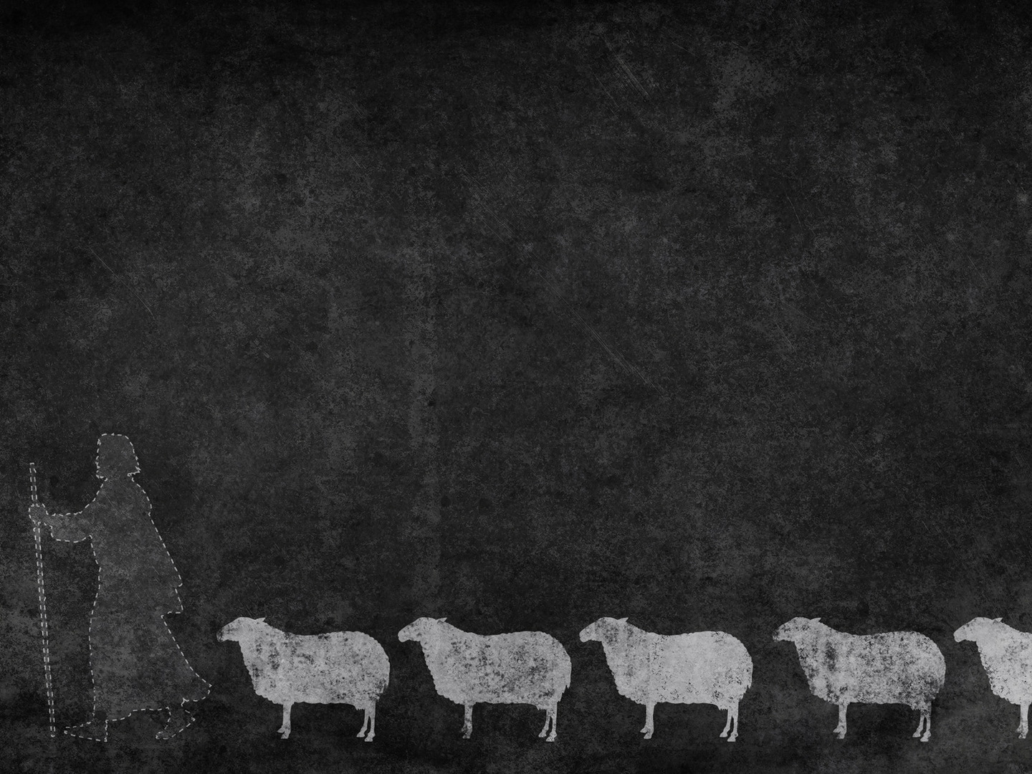
CHRIST’S AUTHORITATIVE CALL (vs 16-20)
“Passing alongside the Sea of Galilee, he saw Simon and Andrew the brother of Simon casting a net into the sea, for they were fishermen” (Mark 1:16)
“And Jesus said to them, “Follow me” (Mark 1:17a)
“and I will make you become” (Mark 1:17b)
Notes:
“Passing alongside the Sea of Galilee, he saw Simon and Andrew the brother of Simon casting a net into the sea, for they were fishermen” (Mark 1:16) - Jesus now heads down by the Sea of Galilee and it is here which will take up much of the story until midway through chapter 8 - And on this Sea, which we know is really just a big lake, it is said that there were no fewer than 16 bustling ports - You see fish was the main meat back then and the fish would have been exported and was prized in distant Alexandria and Antioch and Syria - Now again, Mark leaves out the fact that Simon and Andrew have already met Jesus. - They came down to the baptism of John in John 1 - But we remember that Mark only keeps in the crucial details for his narrative, he is keeping to the main theme of the authority of Jesus - We must realise that whilst being a fishermen was a plain, simple job - Given the amount of bustling ports and fish being so sought after, there is a good chance that these four men weren’t quite as poor as we often make them out to be - But certainly they were ordinary men. And Jesus sees them, going about their jobs, casting nets into the sea for they were fishermen
“And Jesus said to them, “Follow me” (Mark 1:17a) - These 2 brothers, known only a little to Jesus are called to follow him - The word here for follow is an adverb with the effect of a summons, like a summons from a king - Now normally to follow a rabbi, it was not that the rabbi would go searching for his students - But that the students would come and apply to join his school, they would essentially ask if they could follow the rabbi - But not so with Jesus the God-man. No, he goes and calls his followers - And in this call is the implication that they must be willing to abandon everything - In Mark 8:34-35, Jesus says, “if anyone would come after me, let him deny himself and take up his cross and follow me. For whoever would save his life will lose it, but whoever loses his life for my sake and the gospel’s will save it” - This is a call to total abandonment of self, it’s a call to carry our cross - It’s complete surrender to the will of God, and being willing to say, even when it may cost us everything, “Lord not my will but yours be done” - For we have been called into the service of Jesus Christ the king - But remember this, he does not call us to himself and then abandon us, no my dear Christian - He calls us, he saves us, he sustains us, and he sanctifies us - You see we press on to the prize of Jesus Christ, but we do so in His strength and His power
“and I will make you become” (Mark 1:17b) - Jesus calls his disciples, he calls his followers, and he equips them for his service - It is Christ who would teach and equip the apostles with the message of the gospel - He would teach them good doctrine, he would teach them to pray, he would teach them to preach - And not only did he tell them and show them, but he promised and fulfilled that promise, in sending the Spirit of God to enable them for this work, as he does us - Jesus called ordinary fishermen, to do extraordinary things - God does not need your strength, He asks for your submission - God chooses the weak and foolish things of the world, picked them up from the sea-side to shame the wise and strong - Brother and sisters in Christ, God saved us in Christ from the penalty of sin, and in doing so you have been adopted in the family of God - And it is by His Spirit that we are transformed, and conformed to the image of Christ - For He will make you become more like Christ. - Because it is the same gospel that saves, which sanctifies - It is all about Christ our king, and his life, death, and resurrection

Slide 6
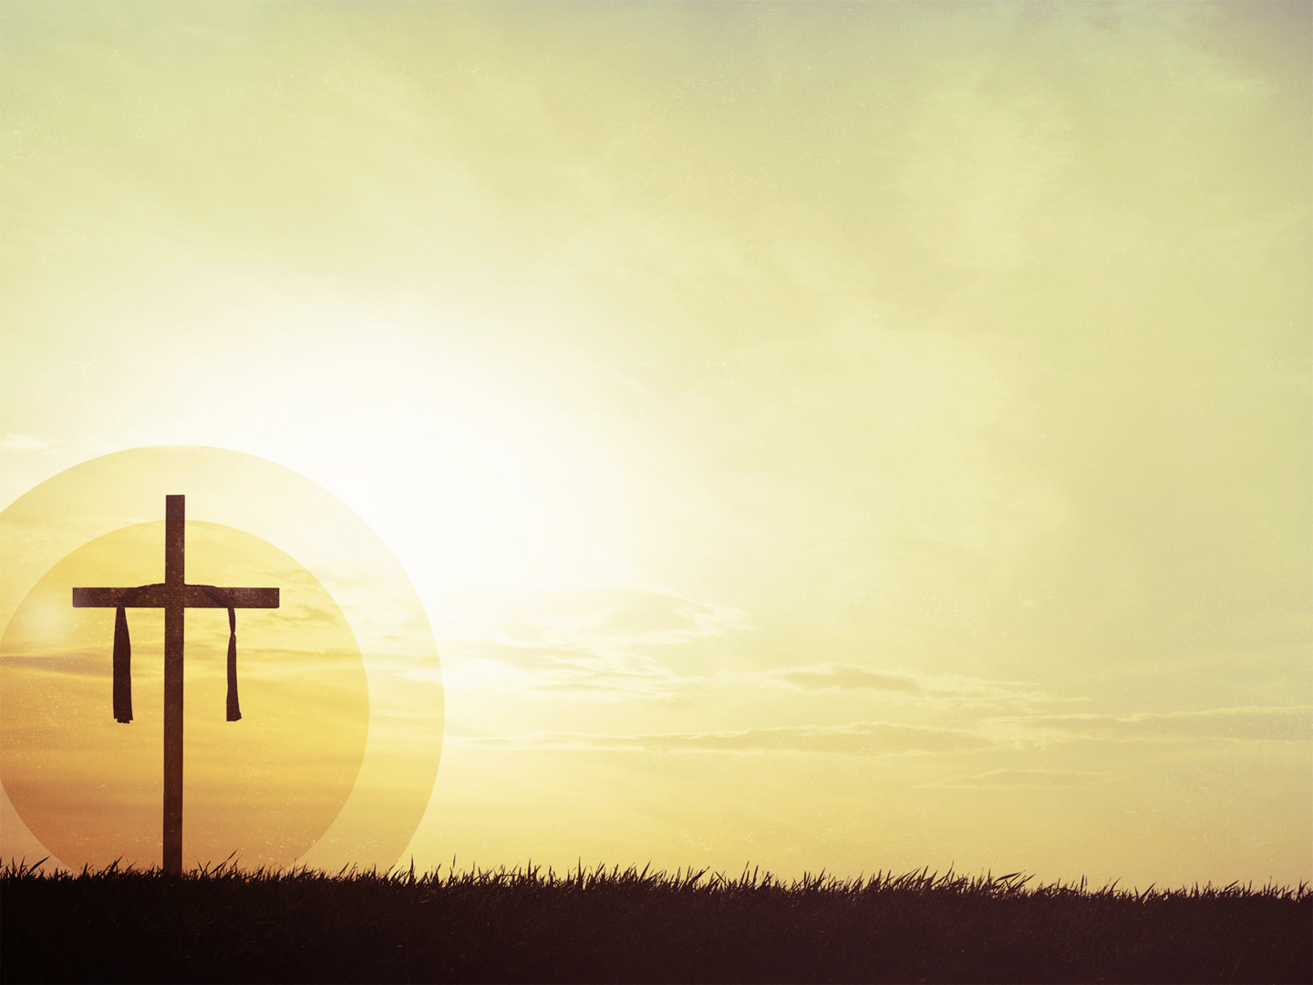
“fishers of men” (Mark 1:17c)
“And immediately they left their nets and followed him” (Mark 1:18)
“And going on a little farther, he saw James the son of Zebedee and John his brother, who were in their boat mending the nets” (Mark 1:19)
Notes:
“fishers of men” (Mark 1:17c) - Jesus’ now uses a metaphor that would have had very obvious implications to these four men that he calls, given that they are fishermen - Jesus found them casting a net into the sea, and he found them doing a hard day’s work - Jesus is now saying, I want you to stop doing that kind of fishing, follow me and come and be fishers of men that souls might be saved and brought into my kingdom - Jesus is saying, right now you have no idea how to do this, but I will make you become fishers of men - I will save you by the gospel, and then you will preach the gospel, for this is the means by which souls are saved - We see this metaphor of fishing also being used in the Old Testament in a couple of different places - But in Jeremiah 16:16 it says, “Behold, I am sending for many fishers, declares the Lord, and they shall catch them. And afterward I will send for many hunters, and they shall hunt them from every mountain and every hill, and out of the clefts of the rocks” - And in its context God was gathering a people to be judged for condemnation - But now, in light of God’s judgement, and as we look ahead to the consummation of the kingdom of God - Jesus is calling his people to himself to be heralds, preachers of the gospel, not for the condemnation, but for the salvation of souls - That’s what he calls these men to, and in a broad sense it is what he calls every follower of his to do as well
“And immediately they left their nets and followed him” (Mark 1:18) - Here it is again, one of Mark’s favourite words, ‘immediately’ - This time he uses it to place emphasis on Simon’s and Andrew’s obedience - He is underlining the immediacy of their response to the call of Jesus - It causes my mind to go to Luke 9:57-62, where Jesus calls 3 people and each of them give a reason as to why now just isn’t a good time to follow Jesus - That if they can just do one last thing, then they will follow Jesus - Not so here. Jesus calls, and ‘immediately’ they leave their nets, they leave their jobs and follow him - Folks, today is the day of salvation, repent and believe in the gospel - Could the same be written or said about us, are we quick to obey God’s Word? - Are you quick to heed the commands of the Lord? When troubles come your way, do you hasten to apply the promises of God’s Word? - May it be so. May we grow in our immediacy of heeding to the Word of the Lord - Though it may come at great cost to us to follow Christ, may we do so quickly and without compromise - These 4 brothers were fleet of foot to gather around Christ, to make him the centre of their lives - Will it cost you? Yes, it will cost you everything. He calls you to lay down your life, to die to self in order that we may gain Christ - But what greater privilege is there in this life then to spend it in the service of the king?
“And going on a little farther, he saw James the son of Zebedee and John his brother, who were in their boat mending the nets” (Mark 1:19) - These next two verses are parallel to the previous brothers. Jesus was passing alongside and saw Simon and Andrew - Now Jesus going on a little farther, and he sees James and John, sons of Zebedee - In Luke 5:10 we read also that James and John were business partners in their fishing trade with Simon and Andrew - So perhaps one fishing business that became really short of workers on this day

Slide 7
“And immediately he called them, and they left their father Zebedee in the boat with the hired servants and followed him” (Mark 1:20)
A sovereign king, with a sovereign call, a sovereign enabling, moved us to follow him by the sovereign power of God
As his followers, we are to carry on the mission of Christ, to be fishers of men
Notes:
”And immediately he called them, and they left their father Zebedee in the boat with the hired servants and followed him” (Mark 1:20) - Again, Mark uses the word immediately, this time to keep the story moving at a fast pace - We can assume that this call was the same as the previous verses, given that Mark is giving a parallel – That Jesus said to them, called them, “follow me, and I will make you become fishers of men” - But Mark deliberately inserts this next part as a point of emphasis, “they left their father” that we might see the cost of discipleship - That the call to follow Jesus, may mean we have to leave jobs, we may have to forsake friends, it may be something that drives a wedge between you and your family - But we must heed the call, for to choose the comforts of this life, for to put any relationship over Christ is idolatry and utter foolishness - Our vocation, our family, our identity belongs to him now. - We are children of God, holy, set apart and indwelled and sealed by the Spirit of God - And they left their father in the boat, which would have been borderline blasphemy in this time - They left him there with the hired servants, meaning that they weren’t necessarily poor - And then what did they do? - They followed him, they gathered around him, they bent the knee to him, for to follow Christ is to make him everything - And in doing so Christ is calling individuals into communion with him and with one another - Christ didn’t call them to individualism, he called them to be a part of the body of Christ, as he did all of us - Which is why we gather together, it’s the reason the local church is so important - That we gather to glorify the one who has saved us from our sins and reconciled us to God - And to use the gifts which God has so generously bestowed upon us to build up and edify one another that God might be glorified
A sovereign king, with a sovereign call, a sovereign enabling, moved us to follow him by the sovereign power of God - Mark’s point is simple. Christ has all authority, and he has come to establish his kingdom and reign in the hearts of all those who follow him - Until that day when the kingdom is consummated and he reigns physically - Brothers and sisters in Christ, Christ calls us, he saves us, he equips and sanctifies us, he sustains us until the end - He has authority over Satan, over sin and calls us to repent and believe in the gospel - And as he draws us to himself, he demonstrates that he also has authority over sinners. - Christ’s authority is over Satan, sin, and sinners - And this will be fully realised when Christ returns, for he hasn’t just saved us from the penalty of sin - In sanctifying us he demonstrates that he has saved us from the power of sin - Until one day when sin is no more and he saves us from the very presence of sin, and he glorifies us. Why? - Because such is the grace, and mercy of God, and such is the authority of Jesus Christ - It is all encompassing - Here’s what we are to do, here’s our task
As his followers, we are to carry on the mission of Christ, to be fishers of men - ”Go into all the world and proclaim the gospel to the whole creation. Whoever believes and is baptised will be saved, but whoever does not believe will be condemned” (Mark 16:16) - We are called to be fishers of souls. Does the fishermen strive to catch fish? Do they use all means they can, and grieve if unsuccessful? - Should that not be true for the Christian who understands the eternal realities of the gospel? - Does the fishermen have patience? Do they toil on day after day, and wait and work in hope? - May we toil day and night in the word, in prayer, in proclaiming the gospel to lost souls, and waiting and working, as we await the return of Jesus Christ - May the Lord stir in us zeal and earnestness for lost souls, for apart from the saving grace of the gospel, hell awaits them

Slide 8
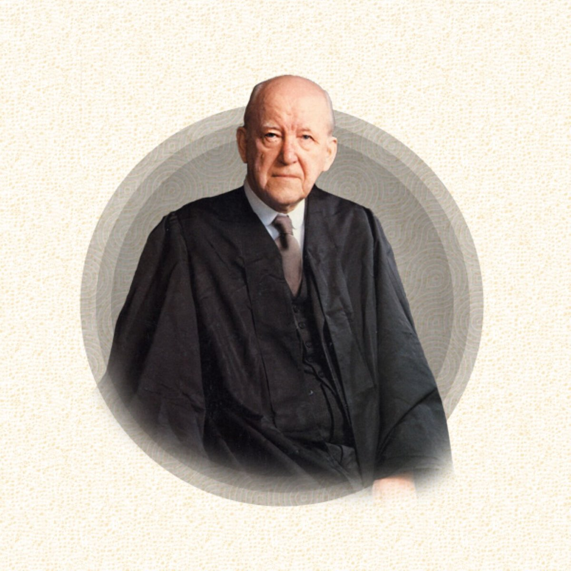
“The business of evangelism is not just to solve people’s problems; psychology does that, the cults do that, many things do that. The thing that separates the gospel from every other teaching is that it is primarily a proclamation of God and
our relationship to God. Not our particular problems, but the same problem that has come to all of us, that we are condemned sinners before a holy God and a holy law. That is evangelism. It must, therefore, always put repentance first.” Martyn Lloyd-Jones
Notes:
“The business of evangelism is not just to solve people’s problems; psychology does that, the cults do that, many things do that. The thing that separates the gospel from every other teaching is that it is primarily a proclamation of God and our relationship to God. Not our particular problems, but the same problem that has come to all of us, that we are condemned sinners before a holy God and a holy law. That is evangelism. It must, therefore, always put repentance first.” Martyn Lloyd-Jones
So my dear friends, preach that old sermon to one and all. Proclaim it just as Christ did
“The time is fulfilled, the kingdom of God is at hand; repent and believe in the gospel”
Let’s pray - Pray that any unbeliever here today, would be cut to the core by your Holy Spirit and heed the commands Jesus, to repent and believe in the gospel - May we, as your children, be ever grateful for the good gift of repentance, and hold Jesus’ twin commands of repentance and faith close our hearts, until that day when we get to celestial city - Where we are glorified and repentance is no longer needed, and our faith becomes sight - God we thank you for sending Jesus in your perfect timing, to be our Saviour from sin, and to be king, for you have given him all authority - We thank you for who you are, for your goodness and your mercy to us - In Jesus name we pray amen

