Slide 1
SCRIPTURE: THE FIRM FOUNDATION
2 Timothy 3:10-17
Notes:
Good morning everyone. Just wanted to quickly say a massive thank you to John for filling in last week at such short notice
And thank you to everyone for all the prayers, meals, and calls myself and Jess received over the last week
Well we are getting towards the end of our series in 2 Timothy, but these last few sermons contain some of the most famous passages - So if you would open up your Bibles to 2 Timothy 3, and we will work our way through verses 10-17
So today, I have the privilege of preaching on one of the key passages relating to our doctrine of Scripture
All throughout today’s passage Paul is constantly making a contrast between himself and the life of Timothy to the false teachers from Bill’s passage from 2 weeks ago
In verses 1-9 of chapter 3 Paul warns against people who love self, money and pleasure
And to fend off these people, and sin which so easily entangles Paul gives Timothy an example - He tells him to be expectant of persecution - He urges Timothy to endure and continue in the sacred writings - Which is all rooted in the firm foundation of Scripture
Many of us take the Bible that we have in our hands, or the 4 that we have sitting on our bookshelves at home for granted
But there was once a time when to have a Bible in English was so desired and yet so frowned upon by the Roman Catholic church that it was considered a crime

Slide 2
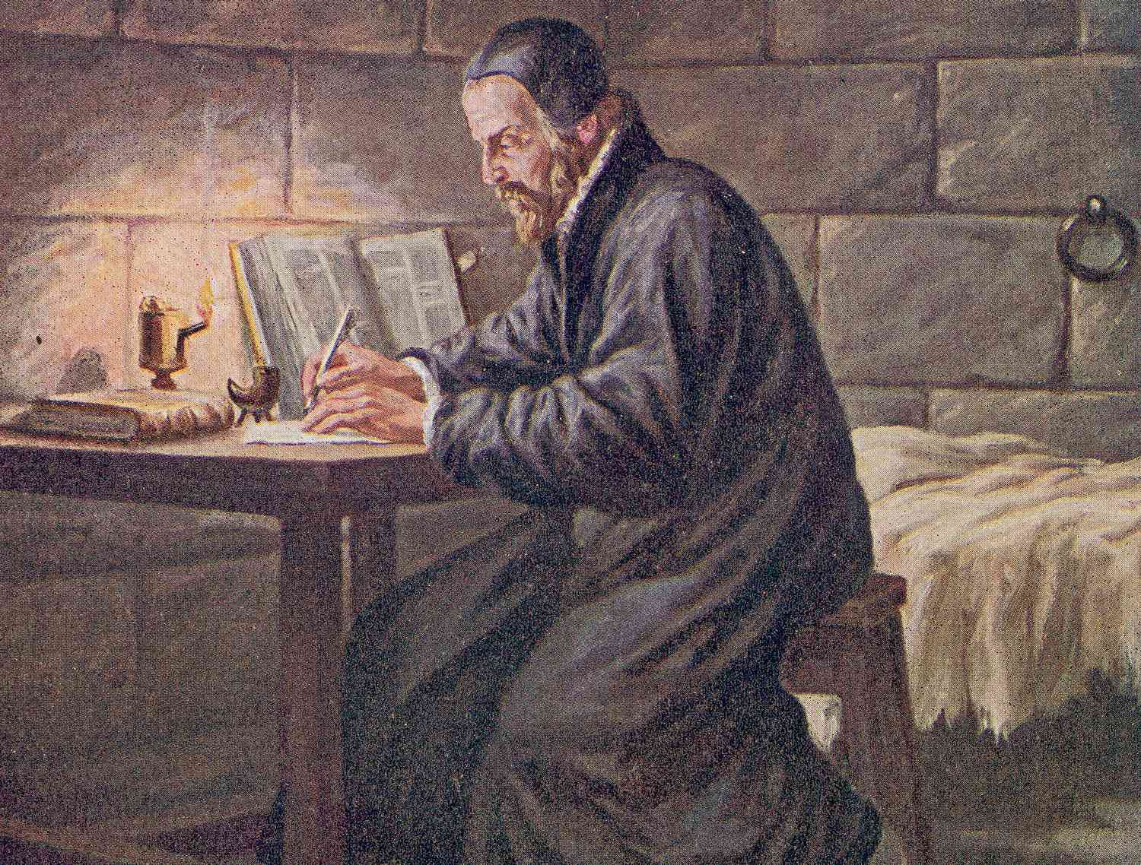
William Tyndale 1494 – 1536 (42 Years)
Notes:
Bishop Stephen Bradley once stated that: “We are in danger of forgetting truths for which previous generations gave their lives.”
The Illegal English Bible - It may surprise most English-speaking Christians that the first Bible printed in English was illegal and that the Bible translator was burned alive for the crime of translating God’s Word into English.
William Tyndale is known as the father of the English Bible, because he produced the first English translation from the original Hebrew and Greek Scriptures.
150 Years earlier Wycliffe had overseen a hand-written translation of the Bible, but this had been translated from the Latin Vulgate.
Because of the persecution and determined campaign to uncover and burn these Bibles, few copies remain. It would take an average of 8 months to produce a single copy of the Wycliffe Bible, as they had to be written out by hand.
William Tyndale’s translation was the first copy of the Scriptures to be printed in the English language.
The official Roman Catholic and Holy Roman Empire abhorrence for Bibles translated into the vernacular can be seen from this quote: The Archbishop of Canterbury Arundel declared: “That pestilent and most wretched John Wycliffe, of damnable memory, a child of the old devil, and himself a child and pupil of the anti-Christ…crowned his wickedness by translating the Scriptures into the mother tongue.” But then along comes William Tyndale
God’s Outlaw - William Tyndale was a gifted scholar, a graduate of both Oxford and Cambridge Universities.
Tyndale was shocked by the ignorance of the Bible prevalent amongst the clergy of the day
To one such cleric he declared: “I defy the Pope and all his laws. If God spares my life, before many years pass I will make it possible for the boy who drives the plough to know more of the Scriptures than you do.”
Supported by some London merchants, Tyndale sailed in 1524 for Germany, never to return to his homeland.
In Hamburg he worked on the New Testament, which was ready for printing by the following year.
As the pages began to roll off the press in Cologne, soldiers of the Holy Roman Empire raided the printing press. Tyndale fled with as many of the pages as had so far been printed.
Only one incomplete copy of this Cologne New Testament edition survives.
Tyndale moved to Worms where the complete New Testament was published the following year (1526). Of the 6000 copies printed, only 2 of this edition have survived.
In 1530 Tyndale’s translation of the first five books of the Bible, the Pentateuch were printed in Antwerp, Holland.
Betrayal and Burning - In 1535 Tyndale was betrayed by a fellow Englishman, Henry Phillips, who gained his confidence only to arrange treacherously for his arrest.
Tyndale was taken to the state prison in the castle of Vilvorde, near Brussels.
For 500 days, Tyndale suffered in a cold, dark and damp dungeon and then on 6 October, 1536, he was taken to a stake where he was garrotted and burned. His last reported words were: “Lord, open the king of England’s eyes.”
Tyndale’s Dying Prayer Answered - The Lord did indeed answer the dying prayer of Tyndale in the most remarkable way.
Just in the lifetime of William Shakespeare (1560-1616), 2 million Bibles were sold throughout the British Isles. About 90% of Tyndale’s wording passed on into the King James Version of the Bible.
​The Most Influential Englishman - William Tyndale can be described not only as the father of the English Bible, but in a real sense the foremost influence on the shaping of the English language itself.
Pioneers for Freedom - The Reformation in the 16th Century was one of the most important epochs in the history of the world. The Reformation gave us the Bible – now freely available in our own languages.
And they fought and were killed defending the principal that Scripture alone is our final authority
Tyndale’s life and work is a reminder of the cost that has been paid to have the Bible.
Even listening to a copy being read could be punished by death in the flames.
Today, our easy access to dozens of English translations can lead us to take the English Bible for granted.
My prayer and desire, is that God may so grant us the same desire and hunger for His Word as the men of old, even so far back as men like the apostle Paul
For he was Timothy’s example of a man of great faith, who cherished the sacred Scriptures, so let’s get into today’s passage

Slide 3
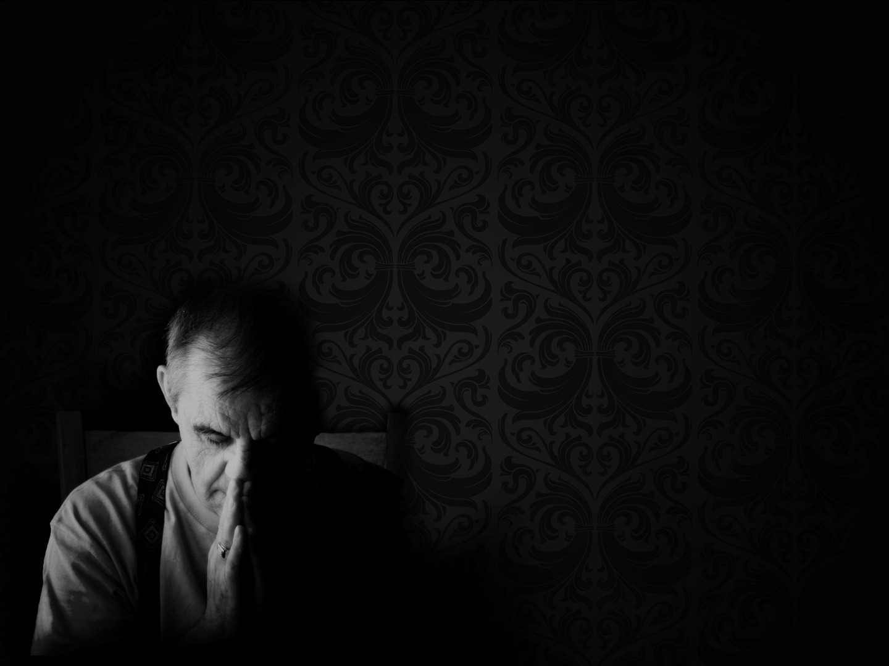
EXAMPLE (vs 10-11)
“You, however, have followed my teaching” (2 Tim 3:10a)
“my conduct, my aim in life” (2 Tim 3:10b)
“my faith, my patience, my love, my steadfastness” (2 Tim 3:10c)
Notes:
“You, however, have followed my teaching” (2 Tim 3:10a) - Paul beginning this section with ‘you however’, is him pointing back to the previous 9 verses - That yes there are evil wicked people out there - And there are false teachers running amuck in Ephesus and in the church - But you Timothy, you have a different call upon your life, you must be different - Paul switches from the signs of the end to now urge Timothy to conduct himself differently - Timothy, has and is to continue following in the footsteps of Paul - To imitate Paul as he imitates Christ - The word here for follow is like a disciple following his teacher, learning from him and following his example - It is to carefully investigate, to follow closely. - Luke uses this in Luke 1:3 when he said that he followed all things closely, as he wrote his orderly account of the gospel to Theophilus - The first thing that Paul exhorts Timothy to continue following is his teaching – It’s imperative that Paul put this first, because it is from teaching, or the word here is actually doctrine, that the rest of the list of virtues flows - Our doctrine, our theology, is not merely intellectual but formative in the way in which we live, it not only enlightens the mind, but shapes our hearts - 6 of Paul’s epistles list Timothy as co-author or co-sender, so Timothy knows a significant amount about Paul’s teaching. - And from his doctrine comes the practice of it
“my conduct, my aim in life” (2 Tim 3:10b) - Paul wasn’t ashamed that Timothy had witnessed his conduct, he had nothing to hide, for his conduct lined up with what he taught - Timothy knew Paul’s patterns, his habits, his intense labours and resolve to see the salvation of souls - Paul’s aim in life, his purpose was to preach the gospel where Christ was unknown. - He was to spread the gospel amongst the Gentiles, and this too was to be Timothy’s aim in life - Paul is directly contrasting his conduct and way of life with the false teachers in the previous verses. - He is not to be a lover of self, a lover of money and pleasure - He is not to be prideful, and seek to deceive people - He is to die to self and love Christ above all. He is to put to death, by the grace of God, the pleasures of this world - So too are we as Christians, we are to die to self and live for Christ. – Timothy is to be humble and rather than deceiving people, see those in darkness be brought into the light, through the proclamation of the gospel, through the preaching of the truth - And then step aside and watch as the power of God goes forth and breathes new life into dead hearts - Timothy’s life was to be agreeable to his doctrine - He is to be holy as God is holy, that his character and message would never be in doubt or in danger of being confused with those in the previous 9 verses - He is also to follow Paul’s…
“my faith, my patience, my love, my steadfastness” (2 Tim 3:10c) - Timothy is encouraged to pursue faith. Paul is not talking about saving faith, but daily trust in the Lord - Timothy knew that Paul daily relied on and trusted in the Lord for his strength - Patience in the English language is a very passive virtue - In the Greek the idea of waiting is not absent, but it also includes the will to endure through that which is in front of us - So as we patiently await the return of our Lord we are to be active in doing the will of God, in doing that which most glorifies Him - Paul’s love for people was great, because God first loved him - And it is upon thinking and meditating upon the love of God, as is particularly demonstrated through the sacrifice of Jesus Christ - That we are assured of His love, and it spurs us on to love others, our neighbours, our friends, and our enemies - And Timothy knew of Paul’s steadfastness, his perseverance. - Paul showed great fortitude in adverse conditions - And Paul is saying to Timothy, to the Christian, be steadfast, be immovable in the grace of God, knowing that He will hold you fast, and He will get you to glory

Slide 4
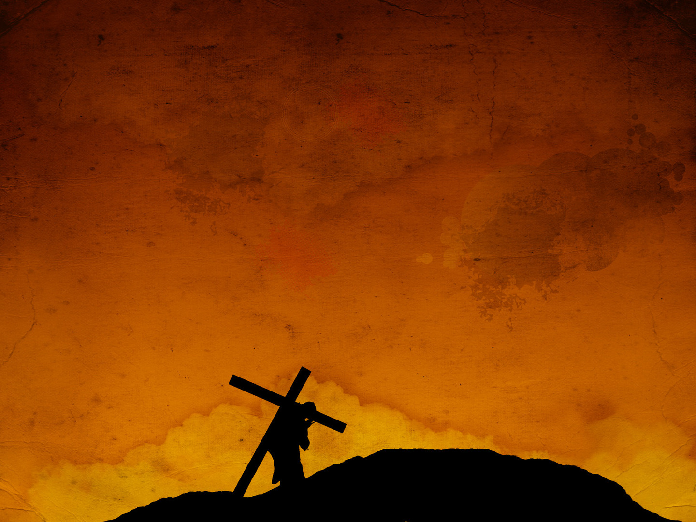
“my persecutions and sufferings that happened to me at Antioch, at Iconium, and at Lystra” (2 Tim 3:11a)
“which persecutions I endured; yet from them all the Lord the Lord rescued me” (2 Tim 3:11b)
Paul has lived a cross-carrying, self-denying life
Notes:
“my persecutions and sufferings that happened to me at Antioch, at Iconium, and at Lystra” (2 Tim 3:11a) - Notice we have switched from singular, my love, my faith, my patience, to the plural, persecutionS, and sufferingS - Meaning we are no longer talking about virtues but events in the life of Paul, which Timothy also must expect and endure - As a result of the virtues in which God has wrought in Paul by His grace, as a natural flow on effect, Paul has suffered greatly in his life - These three places that Paul mentions, he does so deliberately, this is part of Paul’s first missionary journey - Timothy didn’t jump on board with Paul until his second - In Antioch, Paul and Barnabas were initially received well, but then the jealous Jews incited persecution and they were kicked out of the city - At Iconium they spent a considerable amount of time, but they left when the Jew and Gentiles tried to stone them - And then at Lystra, Paul and Barnabas were initially received as gods, but eventually Paul was stoned, left for dead, and dragged out of the city - It is also here in Lystra that Timothy lived and would join Paul on his next missionary journey – So it is likely that Paul is mentioning these sufferings to cast Timothy’s mind back to the pain and suffering that Paul endured - Timothy probably heard testimonies and maybe even saw Paul laying outside, practically dead outside the city of Lystra - Timothy knew very well what Paul had gone through for the sake of the gospel, and again he is calling Timothy to the same mission, the same suffering - But we are also provided with hope…
“which persecution I endured; yet from them all the Lord rescued me” (2 Tim 3:11b) - Paul endured them all. - Notice something here, that God did not stop him from going through that suffering, or halt the hand of those who would try to stone him - God delivered Paul through suffering, not from suffering - And yet at the end of it Paul rejoices saying, the Lord was faithful, he rescued me - And even as Paul’s trial and execution loom, Paul is still able to think this exact same way - In 2 Timothy 4:18, “The Lord will rescue me from every evil deed and bring me safely into his heavenly kingdom. To him be the glory forever and ever amen” - Ah what wonderful faith, what amazing courage to look death square in the eyes and say, to God be the glory, for He will bring me safely home into His arms - Oh how we need this kind of tenacity, courage, and faith in this day and age
Paul has lived a cross-carrying, self-denying life - By God’s grace, Paul has done much for the kingdom of God, but he suffered much as well - Sincere devotion to the truth, self-denial, and a commitment to the gospel, so often brings tremendous suffering - This is what lies ahead for Timothy, and there is no way humanly speaking he will come out the other side unscathed by the world - And yet God in His sovereignty, through the finished work of Jesus Christ, will abolish suffering, and wipe away sin once for all, for all who will repent and believe in Jesus Christ - Few of us have ever and will ever endure anything like Paul did - But Paul goes on to say something that flies in the face of many of the false gospels that are preached in this day and age - What Paul goes through is not unique to him alone…

Slide 5
EXPECTATION (vs 12-13)
“Indeed, all who desire to live a godly life” (2 Tim 3:12a)
“in Christ Jesus will be persecuted” (2 Tim 3:12b)
“while evil people and impostors will go on” (2 Tim 3:13a)
Notes:
“Indeed, all who desire to live a godly life” (2 Tim 3:12a) - It is something we can all expect throughout our lives as Christians who desire to live a godly life. But what exactly is a godly life? - Well, there is a sense in which all who have the indwelling presence of the Holy Spirit, desire to live a godly life as a result of sanctifying work of the Holy Spirit - To desire to live a godly life is to make God’s divine will, and not our own the sole principle of all our thoughts, words and actions - So that whatever we do, whether we eat or drink, we do to the glory of God - It is to be led by the Spirit as a child is led by the hand of his father - And as we fixate all our affections and desires on Christ, and on doing His will. - We will inevitably encounter persecution.
“in Christ Jesus will be persecuted” (2 Tim 3:12b) - Those who belong to the kingdom of darkness will hate those who belong to the light. - If they hated Jesus, they will hate his disciples, for the servant is not greater than the master - Brothers and sisters in Christ, we must remember our calling, that Christ has chosen and called us out of the world, therefore the world will hate us - This verse puts the final nail in the coffin of the prosperity gospel or any false gospel that promotes an abundant life devoid of persecutions - There will be people who love self and hate God, and thus take great pleasure in casting stones, and putting whatever they can in the way of those who love God - And yet in spite of that, the command is to live godly, and fear not contempt for the sake of Jesus Christ - And as you do this, as you suffer, you will look around and see that while you may be persecuted for being obedient to the will of God…
“while evil people and impostors will go on” (2 Tim 3:13a) - Once again Paul is making reference back to those in the previous 9 verses - These are evil people, who have an insatiable hunger to satisfy the flesh, people who are dead in their sins - Just like we were prior to the grace of God working in us and making us alive to the things of God - These are people of corrupted mind, they are evil, and they are impostors - The word here for impostors is a direct reference back to Jannes and Jombres, Pharaoh’s magicians in Exodus - The word means sorcerer, enchanter, deceiver, a wizard, a seducer - These people are tricky, and have the appearance of godliness but deny its power - You see what makes all this persecution all the more terrifying is that it is often cloaked in Christianity - They are wolves dressed up in sheep’s clothing - Christian our worse persecution, so often comes from within - And these people, aren’t going from bad to better but rather…

Slide 6
“from bad to worse, deceiving and being deceived” (2 Tim 3:13b)
“but for those who are self-seeking and do not obey the truth, but obey unrighteousness there will be wrath and fury” (Rom 2:8)
“Dare, dare to live godly in Christ Jesus, though you may suffer all manner of persecution” – George Whitfield
Notes:
“from bad to worse, deceiving and being deceived” - The evil people are getting worse and worse, and they are prowling around deceiving others - But all the while, they think they are in control, pushing everyone into their trap, and yet they have been caught themselves, fallen prey to Satan’s deception - They themselves have become deceived – The elders of the local church are to watch for these people, for false teaching, and we are to call it out, that the sheep may not fall victim to it - John Calvin once said, ”the pastor ought to have two voices, one for gathering the sheep and one for driving away wolves and thieves” - The elders have been entrusted with the people of Coolum Beach Baptist Church, sitting under the authority of Christ and God’s Word. - We are build you up in the truth, wash you clean by the preaching of the Word of God - While also, as the wolves encroach on the sheep-fold we are to fend them off with the truth of God’s Word - As we see these evil people and impostors, they seem to go by unscathed - Remember it is because they are of the world, and the world loves them - But we must remember that God has already won, there will come a day when sin will be entirely vanquished, and God’s justice will be on full display
“but for those who are self-seeking and do not obey the truth, but obey unrighteousness there will be wrath and fury” (Rom 2:8) - We do serve a holy and just God - And he will one day pour it out upon those who have rejected him, they will be cast away for an eternity in hell - These people have spent their lives in fear of man, seeking after man’s approval, man’s attention, and a worldly reputation - But as Jesus says in Matthew, they should have “feared him who can destroy both soul and body in hell” - So do not stoop to their level. Do not fall for Satan’s trap, but rather…
“Dare, dare to live godly in Christ Jesus, though you may suffer all manner of persecution” – George Whitfield - You have been the given the privilege to believe, granted repentance and faith, eyes opened by the Holy Spirit - But it has also been given to you, the privilege of suffering for the sake of the gospel - Have your friends, family, or the whole world forsaken you? He will not - Are you rejected, downcast, in despair, have been cast aside? Jesus Christ will hold you fast, he will hold you close - So my dear friends, dare to live a godly life, in your short time here on earth. - May the gospel give you spines of steel, and hearts that are soft, and may God grant you courage to proclaim the gospel even when persecution comes - For indeed, all who desire to live a godly life, will be persecuted. So do not be surprised when it comes, and do not run from it - For it is often through the fiery furnace of life that we are conformed to the image of Christ

Slide 7
ENDURE (vs 14-15)
“But as for you, continue in what you have learned and have firmly believed” (2 Tim 3:14a)
“knowing from whom you learned it” (2 Tim 3:14b)
“and how from childhood you have been acquainted with the sacred writings” (2 Tim 3:15a)
Notes:
“But as for you, continue in what you have learned and firmly believed” (2 Tim 3:14a) - Again, contrasting with verse 7, Paul referring to the false teachers how they are “always learning and never able to arrive at a knowledge of the truth” - But not Timothy. Here Timothy is given his first imperative, his first command in this section, to continue, to endure, to remember what he learned and continue in it - Against the backdrop of evil people, wicked men, and impostors, Paul’s strategy for Timothy and for you Christian is to continue in the truth which you already know - The gospel truth and holiness are the surest, sweetest, strongest antidotes to error and unrighteousness - Here Paul is snapshotting what it is that separates us from the false teachers, the evil people and the impostors - It’s not that you are better than them, it’s the gospel, it’s the sweet aroma of the righteousness of Christ, it is the indwelling Spirit of the living God - My dear friends, it’s the grace of God having opened your eyes to the gospel - Now continue in the Word of God, and may God keep our feet firmly planted in our sure and steady foundation, Jesus Christ - Because it is by His grace that we walk in holiness, and it is by His grace that you no longer desire to live for self, for money, or for pleasure. - Only by His grace is your desire now that God might be glorified in all that you do - We must never become prideful, but always remembering that it is all of grace
“knowing from whom you learned it” (2 Tim 3:14b) - Once again, we continue with the theme of remembrance in this letter. - Remember who taught you, and remember the character of those who taught you - The ‘whom’ here refers most likely to 3 people. - First and foremost, Paul, and as we will discover in just a minute, his childhood teachers, his mother and grandmother, Eunice and Lois - Again, in stark contrast to previous 9 verses, the reliability of the gospel message can in part be seen in the character of Timothy’s teachers - Whereas the unreliable message of the false teachers, can also be seen in their evil and corrupt behaviour - Not because Timothy’s teachers are better people, but because the message they believe and teach Timothy with, is effective and powerful for both salvation, and transformation
“and how from childhood you have been acquainted with the sacred writings” (2 Tim 3:15a) - The word here for childhood means newborn child or unborn baby - But given the context and Jewish culture, Timothy would have started being taught the sacred writings, which is the Old Testament, from the age of 5 - So here Paul presents parents, and even grandparents with a challenge and an encouragement. - The challenge is this. Your child is never too young to start learning the Bible, or about God, or to hear the gospel. - But will you heed the command of the Lord to bring your child up in the way of the Lord? - Do not be so quick to dismiss your child’s ability or desire to learn about such holy matters. - There is no better time than now! - I know that we cannot save our child by teaching them all the theology in the world, - And yet shouldn’t we lay a firm foundation for our child that when God reveals their sin to them - And they cast themselves before the cross of Jesus Christ, they might praise the Lord for their upbringing - That like Timothy they might continue in Scriptures, knowing from whom they learned it - Voddie Baucham phrased the challenge like this, “If I teach my son to keep his eyes on the ball, but fail to teach him to keep his eyes on Christ, I have failed as a father.” - And yet I know there are many in this room, who have one or more children who do not know the Lord. - You are faithful parents, who did everything in their God-given strength, but as a parent I fail, we all fail over, and over and over - I do not say this lightheartedly, but take heart, for while they still draw breath there is still time. - Their salvation never rested in your strength, or your ability, it is only by grace alone through faith alone in Christ alone - The same gospel that saved you can save them, so keep praying - For the the gospel is the power of God unto salvation for all who will believe. - And parents, for your labour in the word with your child, God will commend you on that day when you enter glory, with well done good and faithful servant - Church, pray for our parents, pray for our kids, pray for our Sunday School teachers - For out there in Sunday School, and in the homes of all the parents of our church live future preachers, elders, deacons, wives, mothers, husbands, fathers, home group leaders, and Sunday School teachers. - Pray for them!

Slide 8
“which are able to make you wise for salvation” (2 Tim 3:15b)
“through faith in Christ Jesus” (2 Tim 3:15c)
Paul is essentially saying once again, ‘Remember’
Notes:
“which are able to make you wise for salvation” (2 Tim 3:15b) - Mankind is not wise of themselves, in fact we are foolish and ignorant of that which is good and pure and true - We are naturally without understanding of spiritual things. But the sacred Scriptures, are able to make us wise and knowing in this respect - But here’s what we must understand, the Holy Scriptures in and of themselves do not save us. - Many people have undertaken to reading the Scriptures cover to cover and do not close the book a born-again believer - It is only when He who breathed the Scriptures removes the veil from our eyes, opens our understandings, and gives light and knowledge in them that we become wise - We become wise because Scripture alone, points us to Jesus Christ, and we at this point see that there is salvation in none other than Jesus Christ
“through faith in Christ Jesus” (2 Tim 3:15c) - And now having repented and believed in Jesus Christ, we now read Scripture and gradually the Holy Spirit begins to reveal to us the truth - Constantly helping us to see Christ in all the Scriptures - And our great reason for faith, our assurance, rests in, “it is written” - For only by what is written in these sacred writings, in these Holy Scriptures, do we find confidence to stand against the world - The message of salvation begun in the sacred writings, the Old Testament, was fulfilled in the gospel which Paul preached to Timothy as a young adult - And it is this message, that which is written, that Timothy is to preach
Paul is essentially saying once again, ’Remember’ - The best way for Timothy, for the church, for pastors, for Christians today to stand firm, is to remember the Scriptures, remember what you have learned, - Remember what you have been taught over the countless years of having the Bible faithfully exposited to you week after week, and as you have read and studied the Bible year after year - The weapons of our warfare for the Christian life are few, but they are mighty - We have been given direct access to the throne room of God, we get to speak to God almighty - And He has given us His inspired, God-breathed, word - My dear friends, so often we ask ourselves, how can I be a man or woman of God? How can I walk closely with God? - And we are looking for 7 steps to be a better you, when in reality the answer is this, prayer and His Word - We persevere in that which He has given us. - Is it hard, does every ounce of the flesh want to stop us from doing so? Yes - But we fight, and we fight every day, because we know there is nothing more precious and nothing more sanctifying for the soul than that which He gave us, prayer and the Holy Scriptures - My prayer is that we would come to see the reading and study of God’s Word as a lifeline, as a necessity to our daily lives, as though it is the breath that fills our lungs. - ‘Remember’, remember what He has given to us - And then we move onto the why? Why have I harped on about the reading of God’s Word? - Why do we harp on and insist on preaching verse by verse, through whole books of the Bible? - Because…

Slide 9
THE FIRM FOUNDATION (vs 16-17)
“All Scripture” (2 Tim 3:16a)
“is breathed out by God” (2 Tim 3:16b)
“and profitable for teaching, for reproof” (2 Tim 3:16c)
Notes:
“All Scripture” (2 Tim 3:16a) - All Scripture is breathed out by God and profitable… - Here Paul would have been referring to the sacred writings of the Old Testament, which is no small statement for the church to remember today - We love the words of Jesus, and we love the theology of the epistles - But let us never forget that that the Old Testament is inspired, breathed out by the same God who inspired the New Testament - And Paul would also be referring to the oral, verbal accounts of the gospel - Now looking back through history, and how we now have all 66 books of the Bible established, we know that these 2 powerful verses apply to all 66 books - That ‘all Scripture’ refers to all of the Bible. And it is all…
“is breathed out by God” (2 Tim 3:16b) - Some translations have it as, “is given by inspiration of God” - This phrase here for breathed out by God, or God-breathed, occurs only here in the Greek Bible - What Paul is talking about is not the manner in which God created Scripture, but Scripture’s source. - That Scripture’s origin comes from God Himself - That the entirety of Scripture comes from the mouth of God - Paul is telling Timothy and to all the churches today, that Scripture is authoritative, because it’s authority rests in God - And because Scripture has been delivered to us by the authority of God, it is to be received as truth - And when the word of men, and the word of God are at odds, it stands to reason that man’s word must be realigned in accordance with Scriptures - This is God’s Word to us through the agency of the biblical authors. - As 2 Peter 1:20-21 says, “no prophecy of Scripture comes from someone's own interpretation. For no prophecy was ever produced by the will of man, but men spoke from God as they were carried along by the Holy Spirit” - So it was the Holy Spirit who was the principal author, who dictated to them, and in that sense, inspired the writers - And by this inspiration all of them were infallibly guided, so as to be beyond the possibility of erring - So Scripture is therefore God-breathed, it is authoritative, and thus it is…
“and profitable for teaching, for reproof” (2 Tim 3:16c) - Because Scripture is God’s word, it is true and therefore profitable for teaching, for reproof, for correction, and for training in righteousness - These four phrases can be divided into two groups. - Teaching and reproof, have to do with doctrine with theology, and correction and training in righteousness have to do with conduct - Meaning that what we believe matters, our theology shapes our conduct. - These four phrases also have what we call a chiastic structure, or what I like a call a double-layered compliment sandwich - You know when you go to give someone criticism, we are told to start with a compliment, end with a compliment, and in the middle is the criticism, or the negative - Well, here we have the two positives on the outside, and the two negatives on the inside - Teaching is the doctrinal formation of Scripture. - It is doctrine concerning what we ought to believe about God, the creation and fall of man, the person of Christ, his righteousness, his atonement, and eternal life - It is essential that we have a right understanding of doctrine, as found in Scripture, in order for reproof to occur - Reproof is the conviction of false doctrine, the calling out of heresies and errors - And the thing which cuts all false doctrine down, is the sword of the Spirit, is the Scriptures - So Scripture is authoritative and is profitable for doctrine which is good and right and pure, and calling out that which is evil, corrupt, and false - Which is essential in the context of Timothy in particular here who is dealing with false teachers and heresies

Slide 10
“for correction, and for training in righteousness” (2 Tim 3:16d)
“that the man of God may be complete, equipped for every good work” (2 Tim 3:17)
God’s divine word given to us, is THE firm foundation
Notes:
“for correction, and for training in righteousness” (2 Tim 3:16d) - Then Paul goes on to state how Scripture is profitable for the conduct, the behaviour of the person - First the negative, it’s profitable for correction. - After Scripture points out sin. - The sinful pattern then ought to be amended, through the submission of the Christian to God’s Word and the inward working of the Holy Spirit - In today’s self-esteem culture, people don’t want to be reminded of their need to repent, that they are fallen people - But as Christians we are called to repentance and faith, as an ongoing cycle in our lives - God accepts the Christian as they are, eternally secure as a result of their union with Christ, - But He does not leave us where we are, but gradually, day by day, conforms us to the image of His Son - So we must preach grace and sin, love and repentance, we must preach the whole counsel of God - We are not helping people if we tell them that they are fine living in sin, for we deny the good news of the gospel in doing that - The gospel is good news because it offers a way for totally depraved people to be made right with God - Upon seeing their sins, in light of a holy God, God offers forgiveness based on the finished work and resurrection of His one and only Son, Jesus Christ - Godly reproof always aims for correction. And so Christian, confess your sins, and you will find forgiveness in Christ - Unbeliever, repent and believe in Jesus Christ as Lord and Saviour, and you will be reconciled, made right with God, and adopted into the family of God - And now the positive, Scripture is profitable for training in righteousness, this is the positive descriptive that promotes God-like character - So it corrects us, shows us how we shouldn’t be living, and then shows us how we should be living - It instructs in how we are to lead a holy and righteous life before God
“that the man of God may be complete, equipped for every good work” (2 Tim 3:17) - This verse points and introduces us to the ultimate purpose of Scripture’s inspiration - That Scripture is profitable, in that it provides the content and direction necessary for Timothy, Christian leaders, and all Christians to be fully equipped and enabled for every good work - Elders, future elders, this is especially written for you, for we have one tool. It is this, it is the inspired, God-breathed Scriptures. - We are to guard it, to entrust it to faithful men, we are to be able to rightly divide it, we are to preach it - Paul gives Timothy one job, and God has instructed the elders of His church with one job. - Preach the Word! - The Word of God is authoritative, we have been given the decree of the king of Kings, and it is contained in these 66 books, and so we preach it, and dare not alter it - And we preach it because it is profitable that the man of God may be complete, equipped for every good work - This is the means by which God has been building His church for the last 2000 years - Christians, the Word of God is sufficient, it is enough, and we need nothing else that we may be complete, equipped for every good work - As the Spirit of God and Scriptures work together, the soul is converted from its beloved sins and lusts - And by the grace of God we are sanctified, being conformed to the likeness of Christ - And so we see that Paul is saying to Timothy cling tight to the Scriptures, because they are authoritative, and they are sufficient for doctrine and the Christian life
God’s divine word given to us, is THE firm foundation - The Catholic church, believes Scripture to be one of the primary foundations, one of the primary sources for doctrine and Christian living - But it is not one of, it is THE foundation, sola scriptura, Scripture alone - This is the firm foundation which will last forever – Christian the natural application is this - Will you spend the rest of your life committing yourself to know God’s Word, to read God’s Word that you might know Christ more and more intimately? - Elders, Home group leaders, Sunday School teachers, parents, grandparents, will you teach God’s Word faithfully - There needs to be a greater reverence and understanding of the Holy Scriptures in the church in the west - God does not ask for our gimmicks, God says, you want to be a man of God, a woman of God. - You want to walk more and more closely with me, you want to be a church that glorifies me - You want to love God more and hate sin. - Read the Word, know the Word, preach the Word, submit and obey the word - Let us contend for Scripture, hold fast to Scripture, let it guide our every step, for it is a lamp unto our feet - And praise God that He has made His will known by writing - And praise God that he has not only written His word, but sealed it upon our hearts and made it effectual - Let me close with a quote from John Wycliffe, who wrote the first English hand-written translation of the Bible from the Latin Vulgate during the 1300’s

Slide 11
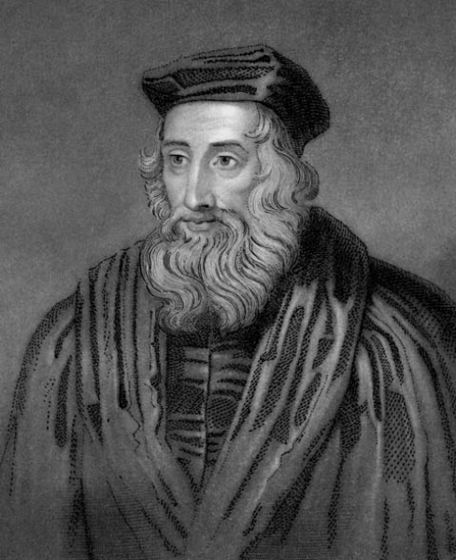
“The true Christian was intended by Christ to prove all things by the Word of God: all churches, all ministers, all teaching, all preaching, all doctrines, all sermons, all writings, all opinions, all practices. These are his marching orders. Prove all by the Word of God; measure all by the measure of the Bible; compare all with the standard of the Bible; weigh all in the balances of the Bible; examine all by the light of the Bible; test all in the crucible of the Bible. That which cannot abide the fire of the Bible, reject, refuse, repudiate, and cast away. This is the flag which he nailed to the mast. May it never be lowered!” – John Wycliffe
1330-1384 (54 years)
Notes:
So I urge you, let all things be measured against Scripture
Be acquainting yourselves with Scripture
May we never take the Scriptures for granted but rather take the Scriptures for the rule of your walking or else you may wander
For “All Scripture is breathed out by God and profitable for teaching, for reproof, for correction, and for training in righteousness, that the man of God may be complete, equipped for every good work”

