Slide 1
A GOOD SOLDIER’S CALL AND COMFORT
2 Timothy 2:1-13
Notes:
Good morning everyone, I hope you are all doing well
For those of you who are visiting us or joining us for the first time today, we are up to our 3rd sermon in our series on 2 Timothy
Today’s sermon has two main points, and it looks at Paul’s call to Timothy to suffer for the sake of the gospel in the first 7 verses
And then in verses 8-13 Paul provides Timothy with the comfort to endure the call to suffer
Today’s sermon is particularly relevant to elders and pastors in the church, but the application still generally applies to all of us
The Christian and pastor as a soldier is something we desperately need to recover today
The elders of a church (pastor’s included in that title) have been given a divine commission to raise up more faithful men in the church, and preach the gospel faithfully, no matter the cost
We need to be Christians of resolve and conviction as we execute the orders of our commanding officer Jesus Christ
Timothy so desperately needed to hear this.
He was being persecuted and attacked with heresy, false teaching, and misalignment with the gospel.
So much so that Paul notes Timothy’s spirit of fear, of timidity
He had become weary doing the work of the ministry, and had become overwhelmed with the fear of man
So this whole letter, but particularly this chapter is a wake-up call to Timothy, to die to self and live for Christ
And it’s a wake-up call for us to do the same
May God use this sermon, and use His Word to convict us, to encourage us, to point us onward to Jesus Christ and to be obedient to His Word, that He might be glorified

Slide 2
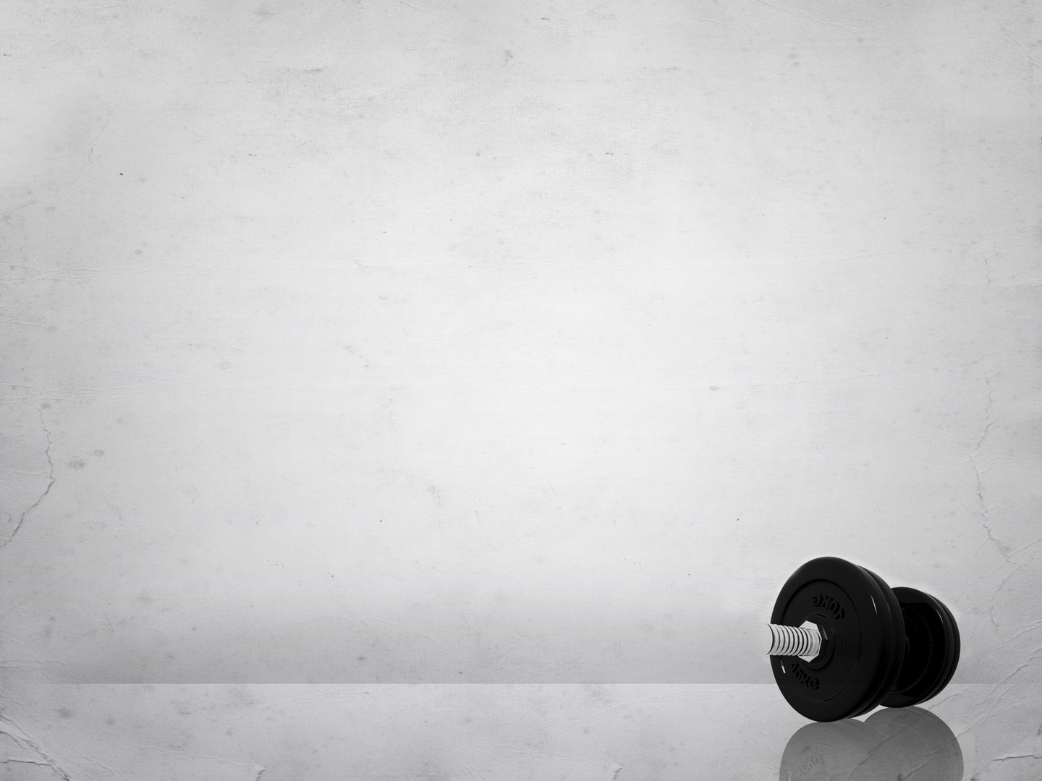
A CALL TO STRENGTH (vs 1)
“You then, my child, be strengthened” (2 Tim 2:1a)
“by the grace that is in Christ Jesus” (2 Tim 2:1b)
We need this empowering grace applied daily to our lives
Notes:
“You then, my child, be strengthened” (2 Tim 2:1a) - You then, or in other translations, it says, “You therefore”, and we know that whenever Scripture says therefore it points us back to the previous verses - Or sometimes the previous block of teaching, which Bill walked us through last week - Paul is writing an intimate final letter to Timothy, to his dear child in the faith, that he might be encouraged - He is saying, read again verse 9-10. It is God who saved you and called you. Not because of anything you did, but because of what Christ has done - Because of His own purpose and grace, which he gave us in Christ before the ages began, - And which now has been manifested through the appearing of our Saviour Christ Jesus, who abolished death and brought life and immortality to light through the gospel. - I mean how awesome is that - Timothy I know you’re scared, I know you’re fearful, but you need not fear for God has saved you, called you, by grace. - And none whom the Father has given to the Son will be snatched out of his hands - And then we have the examples of those who turned away from Paul, and then the example of Onesiphorus. - Paul is telling Timothy, it’s hard out there, people will abandon you, you will be mocked and ridiculed - Even in his church he has false teachers, heresies, woman trying to usurp the authority of men in the local church - But Timothy, remember the gospel and be strengthened - These words “be strengthened” are a present passive imperative - What I mean by that, is that present tense, indicates that this is ongoing, that this strength is something you need over and over and over. - You will need this strength every waking minute in order that you may be sustained - And passive means that the strength is not Timothy’s strength, but it needs to be enacted upon him from outside himself - He will not find the strength within, but without. - And the fact that it’s an imperative means it’s a command, Timothy, as a good soldier, I command you to be strengthened - This is not optional for the Christian life, and especially for elders, for we cannot hope to shepherd the flock apart from God enacting and working in us. - And where do we find this strength, yes from God, but more specifically…
“by the grace that is in Christ Jesus” (2 Tim 2:1b) - Now in Scripture the word grace is the same throughout as far as its source goes, but its context can change in that there are 3 senses in which it is used - The first is God’s unmerited favour, His grace in bestowing gifts upon the undeserving, which is all of us - This is God’s common grace, which we all enjoy, believer or unbeliever. - We are all given the privilege of being able to walk down the beach and swim, play and surf regardless of whether we have trusted in Christ - We are all given the privilege of friendship, comraderie, sunshine and the rain. - That’s the first sense, God’s common grace - The second is God’s saving grace – That God graciously forgives sinners such as Noah, Jacob, Moses, David and Paul, and you and me - These men were drunkards adulterers, murderers, they persecuted the church and schemed - God’s grace does not merely go to those who don’t deserve it, but it goes to sinners who deserved God’s wrath instead - We stand before an infinitely holy and just God deserving hell - And yet by grace, and grace alone, the Lord grants eternal life to those whom He has saved and called according to His own good will - It is not only that we don’t deserve grace, but we deserve condemnation - And then thirdly we have the grace that empowers us believers - Saved by grace, through faith, created in Christ Jesus for good works, prepared beforehand that we should walk in them
We need this empowering grace applied daily to our lives - But how? How is it applied if it isn’t something that we do - If it is strength which the Lord supplies, then we must humble ourselves, take a nice long look in the mirror - And allow the Holy Spirit to convict, to point out the pride and sin that is in our lives - For as James says, God resists the proud but gives grace to the humble - We must confess our weakness. Yes our weakness. - One of our greatest assets as a Christian is our weakness - Paul says in 2 Corinthians 12:9-10: and this is God saying this to Paul, “My grace is sufficient for you, for my power is made perfect in weakness”. Now Paul. “Therefore I will boast all the more gladly of my weaknesses, so that the power of Christ may rest upon me. For the sake of Christ, then, I am content with weaknesses, insults, hardships, persecutions, and calamities. For when I am weak, then I am strong” - So may God enable us to see just how weak we are, for it is through weak people that God works mightily - Christian maturity is realising more and more just how weak we are and how much we need God for strength, we become less dependent on self, and more dependent upon God - We bring nothing to the table but our weakness - So this is how the strength is applied, by humbling ourselves and seeing just how weak we are, for God will give grace to the humble

Slide 3
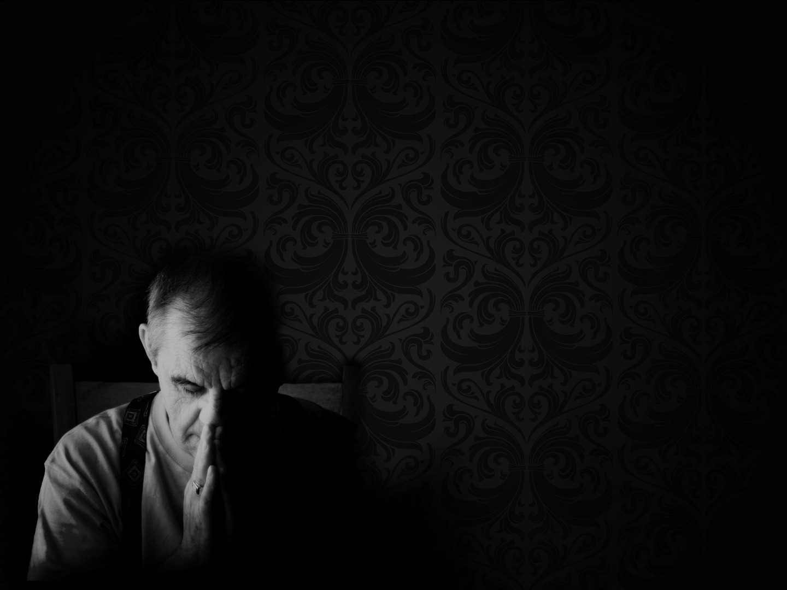
A CALL TO SUCCESSION (vs 2)
“and what you have heard from me in the presence of many witnesses” (2 Tim 2:2a)
“entrust to faithful men” (2 Tim 2:2b)
“who will be able to teach others also” (2 Tim 2:2c)
Notes:
“and what you have heard from me in the presence of many witnesses (2 Tim 2:2a) - Paul is about to give Timothy a second command, a command to entrust, a command to pass on, a command to carry on the gospel message through the generations. - This is not a succession of pope’s or apostles, but a succession of the gospel message, ensuring that it continues to be passed down, generation after generation - What Timothy has heard from Paul, is the totality of the gospel message. - This includes the doctrines of atonement, sin, resurrection, salvation by grace through faith - It was these doctrines that were preached before many witnesses. - Paul adds the ‘many witnesses’ to testify to the reliability of what he is saying - The church in Ephesus and its opponents were preaching myths and legends of which there were no witnesses to verify their reliability - But the gospel is reliable and trustworthy. It is widely and publicly attested to. - It is this firm, reliable, trustworthy gospel which Timothy is to…
“entrust to faithful men” (2 Tim 2:2b) - The word for faithful, means trustworthy and reliable - The gospel which Timothy was to guard, to protect, to preach without compromise, to defend at all costs - It is this gospel which Timothy is to pass on to faithful men - One of the main reasons Paul wrote this letter to Timothy was to urge Timothy to come and see him. - But before he does that, he must get the household of God in order, he must raise up trustworthy, reliable elders - And whilst this verse can be applied broadly to our great commission of discipleship to all people - Specifically I think Paul is talking to raising up elders, because he goes on to talk about the fact that they must be able to teach
“who will be able to teach others also” (2 Tim 2:2c) - They must be men as 2 Tim 2:15 says, who can rightly handle the word of truth - The word for able to is sufficient, competent, worthy, fit - So we must raise up men of character and men who understand the Scriptures, who can rightly divide the word of truth - Who will guard the gospel at all costs, who defend the bride of Christ, and build up the saints in Christ - There are 4 levels of succession here, Paul to Timothy, Timothy to faithful men, and faithful men to others - This is imperative for the health of the church, and the raising up of godly people, and particularly elders - Because this does not happen by accident, it must be done intentionally, but how? - Firstly, and primarily a strong pulpit ministry. - Preaching that holds true to the word of God, has always been the primary means by which the church is built, we see that in Ephesians 2 - It happens through mentoring and discipleship relationships like in Titus 2. - Where older men are able to get alongside younger men and teach them sound doctrine, teaching them theology, showing them how to faithfully exegete Scriptures, showing them how to do biblical theology - Showing them how to lead their families and bring up their kids in the way of the Lord - To love their wives like Christ loves the church - And ladies, in case you forgot, Titus 2 teaches the same thing for women - For older women to get along side younger women, to teach other women what is good, to show them how to love their husbands and children - To be self-controlled and pure, show them what it means to be godly women, who loves the church and longs to go deeper into the word of God - But it all centres around having a strong pulpit ministry. - Weak pulpit, weak church. Strong pulpit, strong church - Everything is brought under the word of God and the headship of Christ, for he is the authority, it is God’s Word and this is His church - Pastors, Elders, brothers and sisters in Christ, we all need to be governed and shaped by God’s Word

Slide 4
A CALL TO SUFFER (vs 3-7)
“Share in suffering as a good soldier of Christ Jesus” (2 Tim 2:3)
“No soldier gets entangled in civilian pursuits” (2 Tim 2:4a)
“since his aim is to please the one who enlisted him” (2 Tim 2:4b)
Notes:
“Share in suffering as a good soldier of Christ Jesus” (2 Tim 2:3) - Other translations have this as, “suffer hardship with me” - Paul is commanding, again its in the imperative, he is commanding Timothy to share in the same kind of suffering that Paul is - No one suffered more for the gospel than the apostle Paul. - Paul has been flogged, stoned, chased out of town, put in gaol multiple times, shipwrecked, mocked, and despised, all for the sake of the gospel - And Timothy knows this when Paul is commanding him to share in the same suffering - Every good soldier who is on the frontline, will suffer. And this call is again specifically true for preachers of the word - But Paul says in a chapter’s time, “indeed, all who desire to live a godly life in Christ Jesus will be persecuted” - It’s inevitable, the whole of the New testament, even Jesus himself, warns us to count the cost - Because to live a godly life is to enter into a life of suffering and persecution for the sake of the gospel. It’s to be expected - Soldiers risk death in combat, they have to sleep on the ground, they suffer the extremes of the weather, they go through days of hunger and thirst. - The life of a soldier, is one of suffering
“No soldier gets entangled in civilian pursuits” (2 Tim 2:4a) - A soldier suffers, and yet in the face of suffering they are single-minded, they are wholeheartedly devoted to one thing. - For to focus on anything else, is to jeopardise everything - Paul is telling Timothy that you cannot allow everyday life to keep you from faithful service and from prioritising Christ. - As Hebrews 12:1 says, “let us also lay aside every weight, and sin which clings so closely” - We must be wholeheartedly committed to the mission of the gospel, let us be committed to our vision, to know Christ and make him known - Civilian affairs can be anything. It can be a commitment to our own comforts, the fear of suffering, of man, or a love of possessions - Is the path that has been laid out for us hard? Yes - Is there going to be suffering and hardship? Yes - But you do not walk alone, for we press on and are being strengthened by the grace that is in Christ Jesus. - My dear brothers and sisters. You do not go alone. - For we have been given a royal mission, a royal decree, to go and preach the gospel to all nations. - And he has given us a royal promise, that surely he, the king of kings, will go with us until the end of the age - We must cast all idols aside, we must be killing sin, or sin will be killing us. - We must be willing to forgo the pleasures of this world, and we must fight against Satan’s fiery arrows - We have one goal, one mission, one aim in life
“since his aim is to please the one who enlisted him” (2 Tim 2:4b) - It’s Christ Jesus. Man’s chief end is to glorify God. It is Him who saved us, it is him who called us. - From a slave to sin, to a slave to righteousness - From a child of the devil, to a child of God - We suffer, and we lay down our life in the service of our Lord and Saviour, because he alone is worthy, he alone deserves the praise and the honour and the glory - So just as Paul urges Timothy, we persevere because our greatest pleasure in life is to please the one who enlisted us. - It is to please the one who saved us from our sins and eternity in hell - Paul is wanting Timothy to look at his life, and to look at his priorities. - Timothy’s situation is dire, it’s tough, but he cannot shy away now from the suffering - He cannot give in to the flesh, he needs to remember his first love, he needs to remember his call - As a preacher, as a pastor, as an elder, the call is to preach God’s word faithfully no matter the consequences - Christians we must be a people who are dedicated, committed, single-minded on living for the glory of God in everything we do

Slide 5
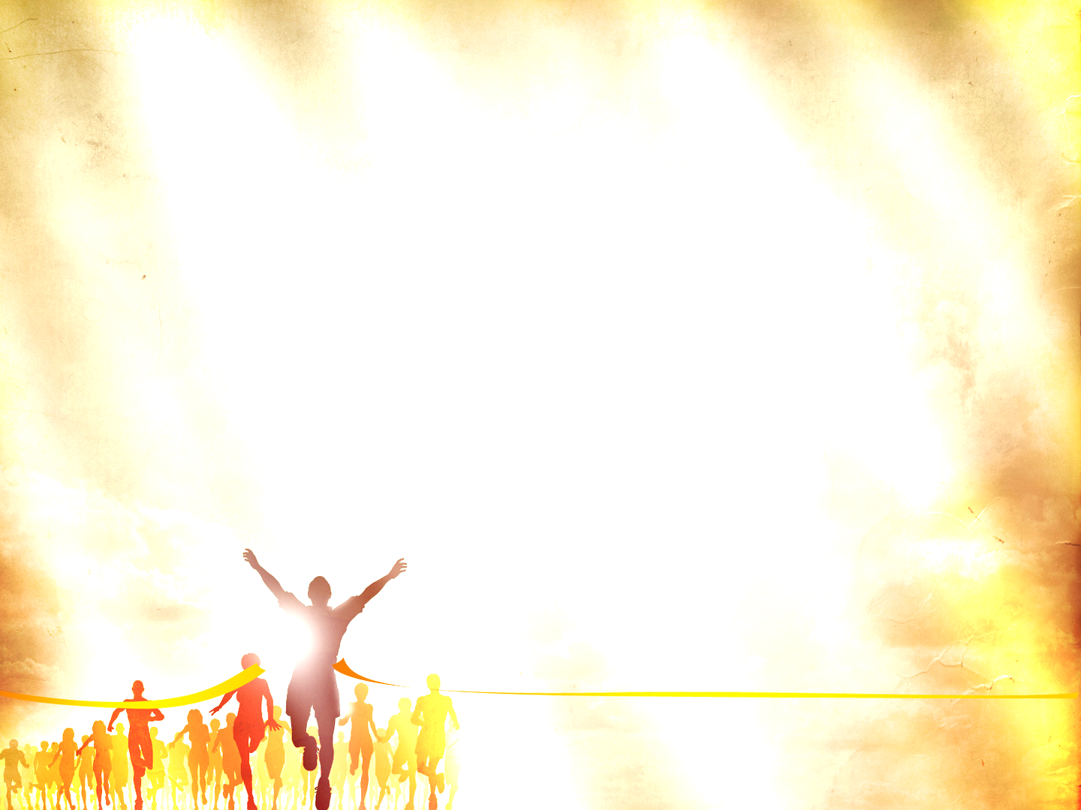
“An athlete is not crowned unless he competes according to the rules” (2 Tim 2:5)
“It is the hard-working farmer who ought to have the first share of the crops” (2 Tim 2:6)
“Think over what I say, for the Lord will give you understanding in everything ” (2 Tim 2:7)
Notes:
“An athlete is not crowned unless he competes according to the rules” (2 Tim 2:5) - An athlete must train. Timothy’s training is in godliness, he is to be strengthened by that grace that is in Christ Jesus, and persevere through hardships - That by God’s grace he may be conformed to the image of the Son - So that he may echo the words of Paul in chapter 4 of this letter. - ”I have fought the good fight of faith, I have finished the race, I have kept the faith. Henceforth there is laid up for me the crown of righteousness, which the Lord, the righteous judge, will award to me on that day” - We look to Jesus, as the founder and perfecter of our faith, who for the joy that was set before him endured the cross - We press on as soldiers, and we will suffer, but press on for the crown of life that is bestowed upon those who persevere by God’ grace - We are wholeheartedly devoted to Christ, and we labour, not for a perishable crown, but an imperishable crown - But we must do so according to the rules, or we must do so lawfully as the word translates - We must run the race in the right way, and in accordance with the rules. - For the minister in particular, I think Paul is saying, is that one of the rules, one of the things that you must get through is suffering - Secondly I think Paul is wanting to convey the idea of submissiveness. We must submit to God, the one who enlisted us, the one who gives us the rules - We play by his rules, not our own, and we submit to His commands, and we allow His Word, His precepts to guide us, by the power of the Holy Spirit, every step of the way - We do not get the liberty of being able to re-write the playbook. We are to remain faithful to the task at hand - Timothy could have accommodated the culture, and modify the biblical mandate given to him, but to do so would forfeit the prize - So Paul is making it clear, that as soldiers we are to be single-minded, and we are to be submissive, and now Paul goes on to tell Timothy to sweat, to work hard
“It is the hard-working farmer who ought to have the first share of crops” (2 Tim 2:6) - The emphasis in this verse lies on the effort. It is a call to exert, struggle and toil for the sake of Christ Jesus - The minister of the gospel must labour over the text, and remain faithful to the text, and apply the text to the saints that they might be edified - He is to labour in prayer on behalf of his people for their souls and pray with his people that God might be glorified through the local church - He is to be with his people during the highs and lows and bear their burdens - And in all that he does, he does it that God might be glorified - Christians, we are to lay it all on the line - Like farmers, as God’s servants, we must work hard doing the will of the Lord while the day lasts, and then we wait on the Lord to bring the fruit - This is a call to sweat, exhaust oneself for the sake of the gospel - Let me ask you, as I have often asked myself. Do you exert yourself, and pour yourself out for the sake of the gospel?
“Think over what I say, for the Lord will give you understanding in everything” (2 Tim 2:7) - I love this verse, because it sums up exactly how we should contemplate Scripture - “Think over what I say”. Paul is saying to Timothy, to think over, consider the things he has just said, to meditate upon Paul’s call to suffer - Thomas Watson defined this idea of considering of meditating as, “a holy exercise of the mind; whereby we bring the truths of God to remembrance and seriously ponder upon them and apply them to ourselves… It is not a few transient thoughts that are quickly gone; but a fixing and staying of the mind upon heavenly objects… As the bee sucks the honey from the flower – so by meditation we suck out the sweetness of a truth” - In Psalm 119 David constantly exhorts the reader to meditate, think deeply upon the Scriptures - And as such, that is what Paul is urging Timothy to do here, and as he does so, he trusts and knows that the Lord, through the Holy Spirit will apply it to his life - And he will guide him into all truth, as he is pointed back to Christ

Slide 6
COMFORT IN THE GOSPEL OF CHRIST (vs 8-10)
“Remember Jesus Christ” (2 Tim 2:8a)
“risen from the dead, the offspring of David” (2 Tim 2:8b)
“as preached in my gospel” (2 Tim 2:8c)
Notes:
“Remember Jesus Christ” (2 Tim 2:8a) - My mentor Colin, has on a few occasions said to me, that as Christians we are like leaking buckets - We need to keep being reminded of the gospel, because though we may get the gospel preached to us on Sunday - By Monday, we are already leaking, and so we need to keep being reminded of the good news of the gospel, over and over again, until the day when we are glorified - Paul knows this, and continuing with the theme of 2 Timothy which is remembrance, he says, “remember Jesus Christ” - Throughout this letter Paul refers to Jesus 12 other times as Christ Jesus - I mean in chapter 1 verses 1 and 2 alone Paul says it 3x. But here, the only time in 2 Timothy, Paul says Jesus Christ - You see by putting Christ before Jesus, Paul was highlighting Jesus being the anointed one, the Messiah, the king - But now, by flipping it around Paul switches the emphasis to the humanity of Jesus - Because yes we are called to suffer, and yes we must endure hardship, and yes we must persevere through it all – But remember Jesus, who yes is fully God, but is also fully man, and so he can sympathise with us - And even as the perfect, spotless lamb of God, died the death of a criminal, and endured the wrath of God in our place - Jesus suffered the wrath of God so that all those who are followers of Jesus Christ, will not suffer eternally - So remember Jesus Christ, for he paved the way of suffering - And look to him dear Christian, look to the forerunner, who endured it all, but now sits at the right hand of the throne of God, forever interceding for you
“risen from the dead, the offspring of David” (2 Tim 2:8b) - Remember how he suffered, and endured the wrath of God, but satisfied the wrath of God - The payment was accepted and he rose again on the third day that we might be justified - That we might now stand before God Almighty, not condemned, but as a righteous child of God, based exclusively on the grace of God, and the all sufficient merit of Jesus Christ - And because Jesus rose from the grave, death and sin has been defeated - So we suffer knowing that the victory has all been guaranteed because of the once for all sacrifice of Jesus Christ and his resurrection - And he’s the offspring of David. In 2 Samuel 7, God promised David that his greater Son, Jesus Christ would be on his throne forever. Jesus is the fulfilment of that promise - And God is faithful to his promises, all of which find their yes and amen in Christ - So Timothy’s first encouragement, example, and comfort in his suffering is to remember Jesus Christ, look to him
“as preached in my gospel” (2 Tim 2:8c) - Paul is not saying that this is his gospel, that it belongs to him, or because he is the author and subject of it - What he means that this is the gospel which was entrusted and committed to him by Jesus Christ. - And it was his God given mission to fully and faithfully preach it - He says it’s his gospel, as though he clung so tightly to it in his arms that no one could snatch it out - As though it was his soul’s single greatest treasure. - It was his gospel, because the gospel had so gripped his heart - And may the gospel do the same to each and every one of our hearts. - May it so grip our hearts, that we will guard the good deposit, and cling so tightly to it - Because we are so enamored with the person and work of Jesus Christ

Slide 7
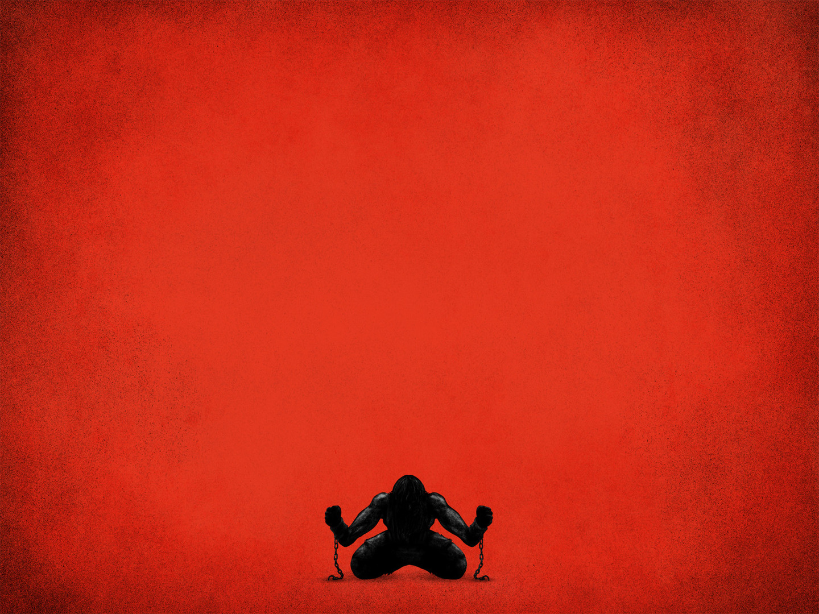
“for which I am suffering, bound with chains as a criminal” (2 Tim 2:9a)
“But the word of God is not bound” (2 Tim 2:9b)
“Therefore I endure everything for the sake of the elect” (2 Tim 2:10a)
“that they also may obtain the salvation that is in Christ Jesus with eternal glory” (2 Tim 2:10b)
Notes:
“for which I am suffering, bound with chains as a criminal” (2 Tim 2:9a) - Timothy’s second example and encouragement to endure the suffering which is laid out before him, is to remember how Paul has suffered for the sake of the gospel - It is because of the gospel, and the preaching of God’s Word, faithfully and without compromise, that Paul has endured so much hardship in his life - And now as a result of preaching the truth, he has been bound with chains as a criminal - The word here for criminal is the word usually used to those without conscience, it is used to refer to thieves, insurrectionists and murderers - Paul is being treated as an enemy of Rome, a serious criminal - Which usually entailed being arrested, tortured, sometimes hands and feet were cut off or they would have their eyes gouged out - And yet though Paul may be silenced and bound with chains…
“But the word of God is not bound” (2 Tim 2:9b) - The word of God is here referring to the gospel. - The gospel which is the power of God unto salvation is not and cannot be bound - Though they may bind the messenger, and though Timothy may end up in prison as well, the message can never be bound - In Paul’s earlier imprisonment, in Philippians 1:12-14 Paul says, “I want you to know brothers, that what has happened to me has really served to advance the gospel, so that it has become known throughout the whole imperial guard and to all the rest that my imprisonment is for Christ. And most of the brothers, having become confident in the Lord by my imprisonment, are much more bold to speak the word without fear” - And time and time again in the book of Acts, we see that though there was a tremendous amount of suffering, the word of God continued to multiply and grow the church rapidly - The gospel keeps spreading regardless of Paul’s chains - And so Timothy must trust the gospel is advancing, as we all must. - Our job is not to convert, but to tell others of the gospel - For when the gospel comes in power, it bears down on all before it, it cannot be bound - It is our responsibility to endure in proclaiming the gospel, and we let the Lord see the results
“Therefore I endure everything for the sake of the elect” (2 Tim 2:10a) - Paul is willing to suffer and endure everything that comes his way for the sake of the elect - Now we must wrestle with this subject of the elect. Who are the elect? - But there are a couple things we must consider when it comes to any topic of theology or doctrine - Our sole and final authority is Scripture, we must toss out experience and feelings, and let Scripture speak for itself - Secondly, Scripture interprets Scripture. Meaning that Scripture cannot contradict itself and we cannot come up with a doctrine based off of one verse - But we determine something based on the whole of Scripture - Thirdly, we must interpret Scripture through exegesis. Meaning we must, as best we can and by the guidance of the Holy Spirit, stay faithful to the text. - Interpret verses based on its context in Scripture, in history and in accordance with the author’s original intent - Regardless of what side you sit on with this, we must always come back to Scripture, and not listen to any person’s opinion, weigh up what I say against Scripture - And lastly, we must all humbly submit to whatever Scripture says - I believe based on Scripture that the doctrine of election states that God has chosen some from mankind, by His grace - And drawn them to Himself that they might be born again and granted salvation - Now there are many passages we could jump to - But I don’t have that kind of time, so let’s jump quickly to the letter of Ephesians - Let us go to Ephesians 1:3-11 - In verse 4, the word there for chose means to select out of, a highly deliberate choice with a definite outcome. - So God chose those whom he would save in Christ before even the world was created - Verse 5 – He predestined us. Meaning he predetermined or preordained those whom He would save. - Its root word means to establish boundaries. - God pre-established boundaries for our adoption in Christ. Why? Not because of anything foreseen, or anything we did, but according to the purpose of His will, it is all an act of grace - Continue reading until verse 11 - Then we skip down to Ephesians 2:1 onwards - Verse 5 – notice that. Notice that we are still dead in our trespasses, we still hate the things of God, we are still dead men walking away from God - And yet while we are in that state, based purely upon God’s grace we have been saved and made alive to the things of God. - Continue reading to the end of verse 10 - The London Baptist confession sums it up like this - In God’s appointed and acceptable time, he is pleased to call effectually, by his Word and Spirit, those he has predestined to life. - He calls them out of their natural state of sin and death to grace and salvation by Jesus Christ. - He enlightens their minds spiritually and savingly to understand the things of God. He takes away their heart of stone and gives them a heart of flesh. - He renews their wills and by his almighty power turns them to good and effectually draws them to Jesus Christ. - Yet he does all this in such a way that they come completely freely, since they are made willing by his grace. - If God did not choose us before the foundations of the world, and left us to our own devices to try and choose Him - With a nature that is totally depraved, and minds which were hostile to God, we would all be eternally lost and condemned to hell - Based on Romans 8, we are elected, called, regenerated, justified, adopted, sanctified, and glorified - All of it is a gift of God - And so Paul, was laying it all on the line, because of the sheer privilege of being able to be involved in preaching the gospel that the elect may enter into the sheepfold - And it was a comfort to Him to know that God is sovereign over it all - And all his present trials are but light and momentary afflictions in view of the priceless benefits - And he is encouraging Timothy, that we don’t know who the elect are, so we preach the gospel faithfully, that all of God’s elect may come to repentance and faith - And there is a comfort in this, in that the job of the Christian is simply to preach the gospel faithfully. - It is God who does all the saving. It does not rest on your eloquent speech or great apologetic skills - We are saved by grace alone, through faith alone, in Christ alone
“that they also may obtain the salvation that is in Christ Jesus with eternal glory” (2 Tim 2:10b) - We are predestined in Christ, and salvation is only in Christ, which is why we must remember Jesus Christ - The gospel is the person and work of Jesus Christ - And now all those who are saved look ahead at what awaits them, as an encouragement to endure the suffering - We look ahead and see the victory of the war, the imperishable crown, and a share of the first crops, we look ahead and see our Master - And He beckons us into eternal glory, with arms wide open, ready to embrace us, His children, and we are given a divine commendation, “well done, good and faithful servant”

Slide 8
COMFORT IN THE FAITHFULNESS OF CHRIST (vs 11-13)
“The saying is trustworthy, for: If we have died with him, we will also live with him” (2 Tim 2:11)
“if we endure, we will also reign with him” (2 Tim 2:12a)
“if we deny him, he will also deny us” (2 Tim 2:12b)
Notes:
“The saying is trustworthy, for: if we have died with him, we will also live with him” (2 Tim 2:11) - Throughout the 3 pastoral epistles, there are 5 trustworthy sayings, and the term never appears elsewhere in Scripture - Each of these sayings accompanies a foundational doctrinal statement - This hymn, or saying, is very Pauline in its language, and is placed here to inspire faithfulness to Christ - This first line is the conversion of the sinner and echoes Romans 6:8, “Now if we have died with Christ, we believe we will also live with him” - The old man has been crucified with Christ, and it is no longer I who lives but Christ who lives within me - The life we now live, we live in Christ and are kept by the Holy Spirit which now dwells in us - We have died to sin and are alive to the things of God, and because Christ lives, we live also, and we live to please the one who enlisted us - And because of the sufficiency of Christ’s life, death, and resurrection, we have assurance of an eternity with Christ
“If we endure, we will also reign with him” (2 Tim 2:12a) - If you persevere until the end, you will reign the Christ. - This is once again a summons, to Timothy and then to us as Christians, to press on and fight the good fight of faith - Be strengthened by the grace that is in Christ Jesus, you do not fight in your own strength, but by his grace, because in Christ we find grace upon grace. - There is enough grace and strength to be found in Christ for all, if we will but come and drink from Jesus, the fount of joy eternal - We are to press on in the face of danger and suffering and persecution and look to the glory that awaits
“if we deny him, he will also deny us” - The denial that Paul is referencing here is to deny Jesus in a settled and decided way. - This is not the same kind of denial that Peter did when he denied Jesus 3x, that was a moment of weakness - An instance of temporary faithlessness, which comes up in the next verse - Here we are talking about the kind of denial where Jesus Christ and the gospel is renounced and rejected in a settled way, in both word and deed - It references Jesus words in Matthew 10:33 – “but whoever denies me before men, I also will deny before my Father in heaven” - This is full blown apostasy, a complete denial of Jesus Christ and it serves as a warning to the church in Ephesus, especially, Hermogenes and Phygelus

Slide 9
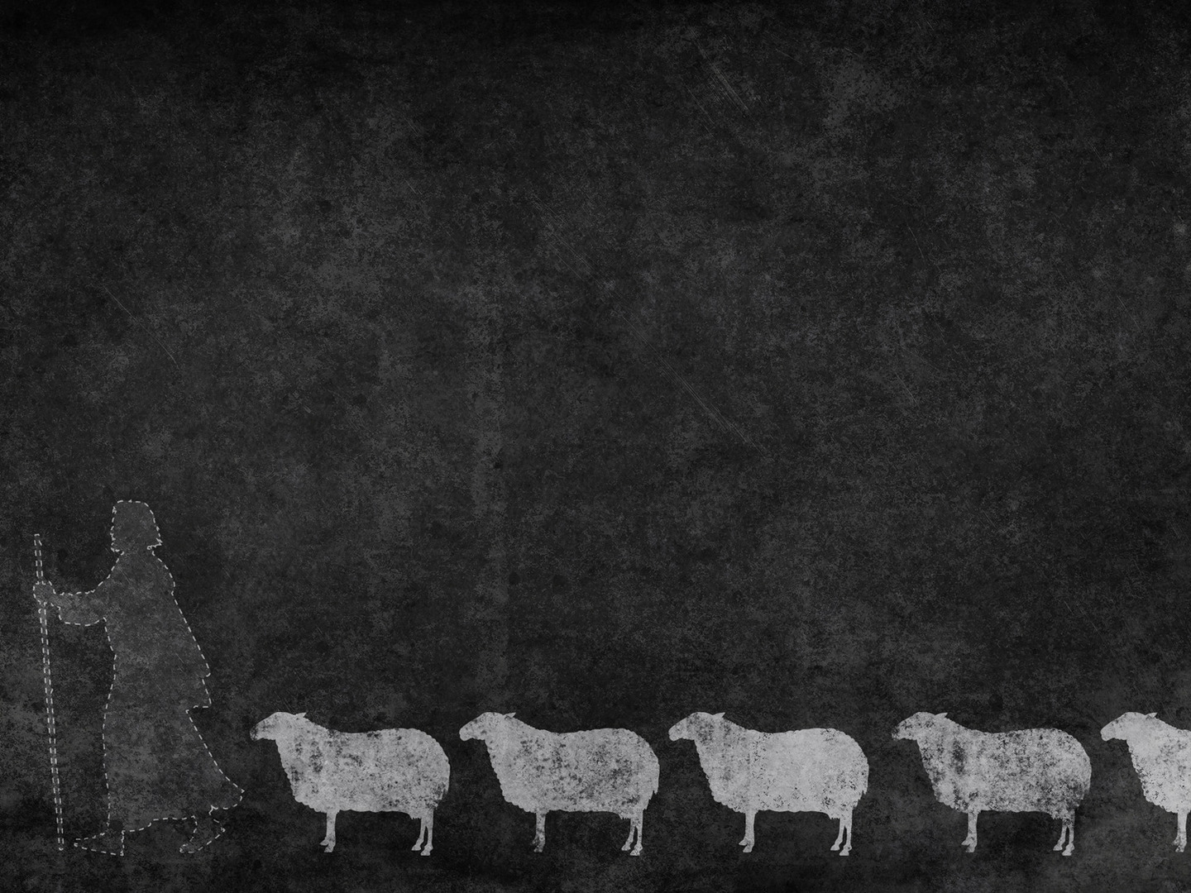
“if we are faithless, he remains faithful” (2 Tim 2:13a)
“for he cannot deny himself” (2 Tim 2:13b)
Christ is faithful to his sheep, for by his blood we are forgiven, reconciled to God, adopted into the family of God
Notes:
“if we are faithless, he remains faithful” (2 Tim 2:13a) - Now this can be interpreted one of 2 ways. It can be a warning or a promise - If it is a warning, God will be faithful to punish a person’s unbelief, which is true - But I don’t think Paul is referencing unbelief here, but temporary faithlessness such as Peter - Let me try and explain why I think that. - If this line is a warning to unbelievers, the language that is used is strange - Usually in Scripture when God’s faithfulness is referenced, it is usually to the benefits enjoyed by believers and not punishment - The tense of words shifts from future judgement, to present day life of a Christian. - This change indicates a change of topic from the previous line - But given that the focus is Christ’ faithfulness, it is dealing with Christ’s faithfulness as the great Shepherd to his flock - It is dealing with those moments of weakness as Christians when we fall into sin - Do you think Timothy could see some faithlessness in himself? - Paul encourages us that Christ is still faithful to his chosen people. - For to deny one of his sheep would be to deny himself
“for he cannot deny himself” (2 Tim 2:13b) - This is just good. Though we as humans are mutable, we are changeable. - We change all throughout our lives, our physical appearance changes, our food preferences change, our character and personality develop and change - But the Triune God is immutable, is incapable of change and will not deny or turn away even the weakest of sheep, he cannot and will not do that - For such is the grace and love of God. He is faithful to sustain his people to the end. - He preserves us in temptation, he convicts us in sin, he brings us to our knees in repentance - He empowers us to good works by his grace. And when we fail, God is faithful to His promise of redemption - And has sealed us with the Holy Spirit which now dwells inside of all his children as a guarantee of the eternal glory which awaits us
Christ is faithful to his sheep, for by his blood we are forgiven, reconciled to God and adopted into the family of God - It is our union with Christ, and his empowering grace that enables us to endure everything - Good soldiers in Christ Jesus we have a guarantee and a call to suffer for the sake of the gospel - Prepare to suffer, and even if we die, we live and reign with Christ - For to live is Christ and to die is gain - To endure in this life we need to be strong in the grace in Christ Jesus - We are going to need to raise up faithful men - We need men of conviction, men who understand just how weak they are, that they might be totally dependent upon God for the oversight of His flock - And razor sharp in their accurate preaching of God’s Word - We need to heed the call to suffer, and to look to Christ and his faithfulness for our comfort – And we give all honour and glory to Christ all the way to grave - Let me close with reminding us what Martin Luther said in his classic hymn, A Mighty Fortress Is Our God

Slide 10
“And though this world, with devils filled, should threaten to undo us, we will not fear, for God has willed his truth to triumph through us. The prince of darkness grim, we tremble not for him; his rage we can endure, for lo! his doom is sure; one little word shall fell him.”

Slide 11
“That Word above all earthly powers no thanks to them abideth; the Spirit and the gifts are ours through him who with us sideth. Let goods and kindred go, this mortal life also; the body they may kill: God's truth abideth still; his kingdom is forever!” Martin Luther – A Mighty Fortress Is Our God
Notes:
So, Christians, good soldiers in Christ Jesus, will you heed the call to endure hardship?
You will suffer, the body they may kill
God’s truth abideth still. His kingdom is forever
So lift your eyes, and look by faith and see your Lord and Saviour clothed in glory and splendour, see the glory that awaits
And while you are suffering for the sake of the gospel and the glory of God, remember Jesus Christ

