Slide 1
THE GOSPEL OF JESUS CHRIST
1 Corinthians 15:1-11
Notes:
Good morning all. I hope you are all doing well on this Easter Sunday
Well, today I have the privilege of preaching to you all on the resurrection of Jesus Christ
Perhaps there is no better place to go to then 1 Corinthians 15
But before we jump straight into the text today we need to understand a couple things about what is going on in Corinth
This letter was written around AD 51, which is before the earliest of the gospel records which tells us of Jesus’ resurrection
The church in Corinth was established while Paul was on one of his missionary journeys, and he stayed in Corinth approximately 18 months before departing
He then later receives a report about all these issues that had risen in the church, and it is to this report that Paul writes this letter
There have been divisions, people choosing who their favourite preacher was, did they follow Apollos, or was it Paul?
There was some major concerns over their morality and unhealthy sexual relationships
And then in chapter 15, arguably the most important text on the doctrine of the resurrection - Paul writes at length on what the biblical doctrine of the resurrection is
It’s important to note that Corinth is a Greek city. The Greeks had become dualistic - Meaning that they believed everything involving the spiritual was good, and all things matter was bad, such as the body
And so it seems that there had arisen amongst the church in Corinth a teaching that maintained that there would not be a resurrection of a physical body - Just that we would be disembodied spirits floating around for all eternity
But Paul will correct this in making it clear that we will live forever as a resurrected person with a physical body
And we find our assurance and theology for this in the very fact that Jesus Christ was resurrected from the dead with a physical body
So if you have your Bibles there, and open to 1 Corinthians 15:1-11
And let’s get into it.

Slide 2
THE SUFFICIENCY OF THE GOSPEL
“Now I would remind you, brothers, of the gospel I preached to you” (1 Cor 15:1a)
“which you received, in which you stand” (1 Cor 15:1b)
“and by which you are being saved” (1 Cor 15:2a)
Notes:
“Now I would remind you, brothers, of the gospel I preached to you” (1 Cor 15:1a) - In light of their denial of the resurrection of the body, Paul reminds them, and the tone in the Greek is one of a gentle rebuke - Saying if you deny your own resurrection than you deny the resurrection of Christ - So let me remind you once again of the gospel, the same gospel which founded the church in Corinth - It is the same one that testifies to the fact there will be a resurrection of the dead - Notice what he’s saying here. He doesn’t say let me tell you a different version of the gospel, - But let me preach the same gospel over and over again, for in the gospel lies the power of God - Not in the eloquent words of Paul, not in telling it in a way that makes it palatable, for that would strip the gospel of its power - Let me remind you once again brothers and sisters in Christ of the gospel of…
“Which you received, in which you stand” (1 Cor 15:1b) - This is the same gospel that Paul preached to them when he ministered among them in Acts 17 for around 18 months - Paul brought the gospel to bring them life, many were saved by this gospel, it established the church, and the Christian, both then and now, stands in this gospel - The word stand is in the perfect tense, meaning you took your stand there and you still stand there - But this gospel that you stand on includes the bodily resurrection of Jesus Christ - You take that away, and if you deny the resurrection of Jesus Christ, you no longer have anything to stand on – As Paul says in verse 14, “And if Christ has not been raised, then our preaching is in vain and your faith is in vain” - If the resurrection is taken away, if Jesus really didn’t rise from the grave, then we proclaim a dead Saviour, our preaching is in vain, our faith is worthless - Then as Paul says in verse 32, that if Christ is not risen, “Let us eat and drink, for tomorrow we die” - For if Jesus is dead, then let us live like the rest of the world, for there is no hope, and tomorrow we die - But Paul is here to set the record straight again, that there is only one gospel, and on this gospel we stand, because Jesus did rise and we serve a risen Saviour - So stand firm Christian
“and by which you are being saved” (1 Cor 15:2a) - I want you to notice something, the gospel which we received, past tense, and in which you stand, present tense, and by which you are being saved, future – The gospel, by the grace of God doesn’t just get you started, it doesn’t just save us and justify us, and then God leaves the rest to us and hopes that we will be perfectly obedient - If he does that, we are still heading for hell - The gospel saves us, and by the finished work of Jesus Christ, it is so complete, and so effective - That we stand before God our judge as guilty, but having repented and believed, and on the merit, and by the blood of the sacrifice of Jesus Christ, we are declared innocent - And we are then adopted into the family of God, and the Holy Spirit dwells inside and sanctifies us, conforms us, makes us more like Jesus Christ our elder brother - With full assurance, because Jesus rose from the grave on the third day, to show that the payment was accepted - Jesus was the propitiation the satisfaction of God’s wrath for our sins, and then God raised Christ from the dead to say - “Payment accepted, now all my children, all you who have been born again and repented and believed in Jesus Christ, will know that by my grace they will persevere until the end, because Jesus lives”

Slide 3
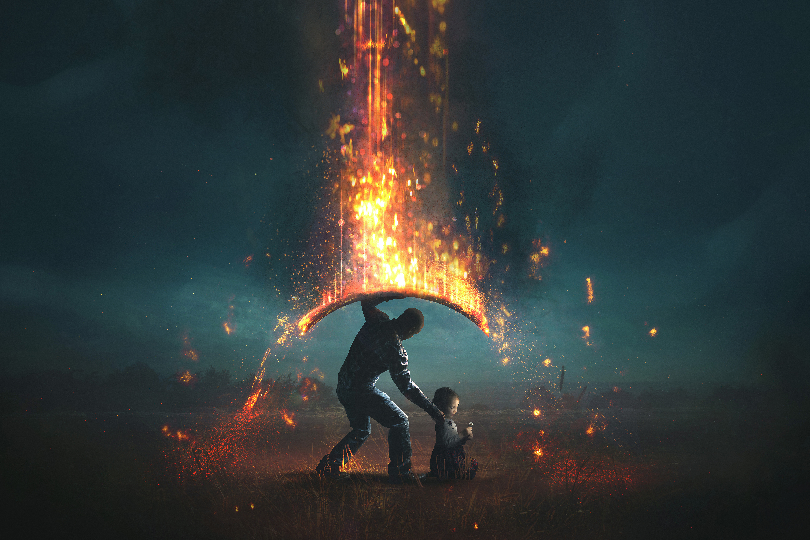
“if you hold fast to the word I preached to you” (1 Cor 15:2b)
“unless you believed in vain” (1 Cor 15:2c)
Christian, the gospel is sufficient to save you, it is sufficient to sanctify you, and is sufficient to glorify you
Notes:
“if you hold fast to the word I preached to you” (1 Cor 15:2b) - Now some people will say hang on, how can you guarantee perseverance until the end, if now Paul is saying we must hold fast - That it depends on us that we may or may not get to the end - Let us look at John 10:25-30. - We see here that all those whom the Father draws to Himself, and regenerates and grants repentance and faith to will never perish, and will never be snatched out of his hand - Philippians 1:6, “And I am sure of this, that he who began a good work in you will bring it to completion at the day of Jesus Christ” - Romans 8 tells us that those whom God predestined, He called us, He justifies us, and He glorifies us - Salvation in its entirety from God regenerating us and calling us, and then justifying and saving us from our sins, to then glorifying us, is all the work of God - And then he ends the chapter with those well known verses, “For I am sure that neither death nor life, nor angels nor rulers, nor things present nor things to come, nor powers, nor height nor depth, nor anything else in all creation, will be able to separate us from the love of God in Christ Jesus our Lord.” - And so what Paul is saying here, is that those who are of the sheep fold of Jesus will hold fast, because it is Jesus, the good shepherd, who preserves us - It is Jesus who holds me fast - In the words of that great old hymn: “When I fear my faith will fail, “Christ will hold me fast; When the tempter would prevail, He will hold me fast. I could never keep my hold Through life’s fearful path; For my love is often cold; He must hold me fast. He will hold me fast For my Saviour loves me so, He will hold me fast. - And we see that Paul makes this clear in the next verse, that you will hold fast to the gospel, because by the grace of God, He upholds you…
“unless you believed in vain” (1 Cor 15:2c) - Like in the parable that Jesus tells where he scattered the seed, the word, and some are thrown on the path, some on the rocky ground where there is no depth to their faith - Some falls among the thorns, these people hear the word, but the cares of the world chokes it out - This faith is in vain, is worthless, and meaningless - But that which falls on the good soil, will bear fruit because God’s grace works in them through the Holy Spirit - Paul is urging the Corinthian church, as he draws to a close with these last 2 chapters to examine themselves to whether they are in the faith - And I would urge us to do the same, to examine ourselves in light of His Word. - You will never be perfect, but when you sin, do you see how it has offended the holy and just God? Does the Holy Spirit convict you and lead you to repentance? - Do you take great delight in the things of God? In studying and chewing over God’s Word? - Do you love to talk to God in prayer? Do you love your brothers and sisters in Christ? - Do you love to gather together for church to sing the Word and hear the Word preached, and fellowship with the bride of Christ? - Or do you love your sin and the things of this world and care very little for the things of God?
Christian, the gospel is sufficient to save you, it is sufficient to sanctify you, and is sufficient to glorify you - And the gospel of Jesus Christ emphasises the resurrection of Christ, for if the gospel does not contain this essential element, then it is no gospel at all - The gospel you received, is the gospel in which you stand, and by which you are being saved - Charles Spurgeon put it best when he said, “If God has justified us it is well done, it is rightly done, it is everlastingly done. If He acquits me, who can condemn me” - God is faithful and our testimony is all of grace, right up until He calls us home to glory

Slide 4
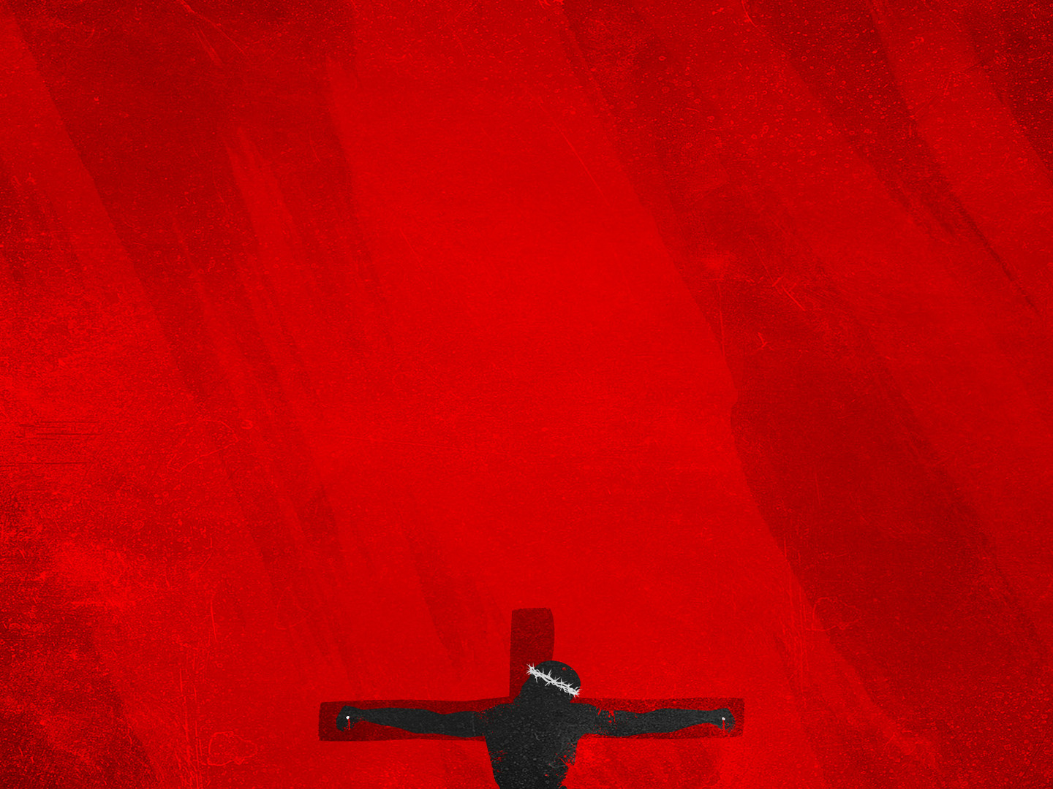
THE SUBSTANCE OF THE GOSPEL
“For I delivered to you as of first importance what I also received” (1 Cor 15:3a)
“that Christ died for our sins” (1 Cor 15:3b)
“in accordance with Scriptures” (1 Cor 15:3c)
Notes:
“For I delivered to you as of first importance what I also received” (1 Cor 15:3) - Now we move into the substance of the gospel. Paul tells us what the gospel is that he preached to the church at Corinth - And it is the gospel that Paul delivers as of first importance - There is nothing more important and more foundational than the gospel of Jesus Christ - And he delivered nothing more, and nothing less than that which he had received - How did Paul receive it though? Galatians 1:11-12 gives us the answer - “For I would have you know, brothers, that the gospel that was preached by me is not man’s gospel. For I did not receive it from any man, nor was I taught it, but I received it through a revelation of Jesus Christ” - Paul was given the mission of preaching the gospel to the Gentiles that they may come to know Jesus Christ as Lord and Saviour. - But Paul did not get the luxury of coming up with his own gospel, one that suited the times in which he lived, and he did not get to add to it or take away from it - His job was to administer to the church the pure, unadulterated gospel and the whole counsel of God’s Word. - To go outside of that is to go outside the authority in which Christ had given him or any other preacher today - Here’s the gospel…
“that Christ died for our sins” (1 Cor 15:3b) - I want you to notice that Paul doesn’t use Jesus’ name but his title, Christ - The word Christ means anointed one, the Greek equivalent of Messiah - The Christ was the one written about 700 years prior by the prophet Isaiah - He was the one born of the virgin Mary, so that he did not inherit our fallen nature - And Christ is the God-man meaning, that Christ could be our representative, like us but without sin - And being fully God he was able to completely, and perfectly obey the law of God on our behalf - And in doing this, Jesus Christ can now be our perfect substitutionary sacrifice. - And God made him who knew sin to be sin so that we might become the righteousness of God - Christ died for our sins, meaning it’s a substitutionary atonement, because we all sin and fall short of the glory of God - All we like sheep had gone astray and turned to our own ways - We deserved death and the full wrath of God, but Jesus takes the place of all who would turn from their sins and place their faith in him
“in accordance with Scriptures” (1 Cor 15:3c) - Now we know that Paul would be talking about the Old Testament, considering that Paul is one of the major authors of the New Testament - And we can certainly point to specific texts, but it’s important to note that the Old Testament in its entirety points us forward to the climax of God’s redemptive plan - Which culminates in the person and finished work of Jesus Christ - We see this point being made by Jesus to the strangers on the road to Emmaus, Luke 24:27, “And beginning with Moses and all the Prophets, he interpreted to them in all the Scriptures the things concerning himself” - There are a number of texts which point forward to Jesus death for our sins, Genesis 3:15, Psalm 22, but the foundational text to this is Isaiah 53: -“But he was pierced for our transgressions, he was crushed for our iniquities; upon him was brought the chastisement that brought us peace, and with his wounds we are healed”

Slide 5
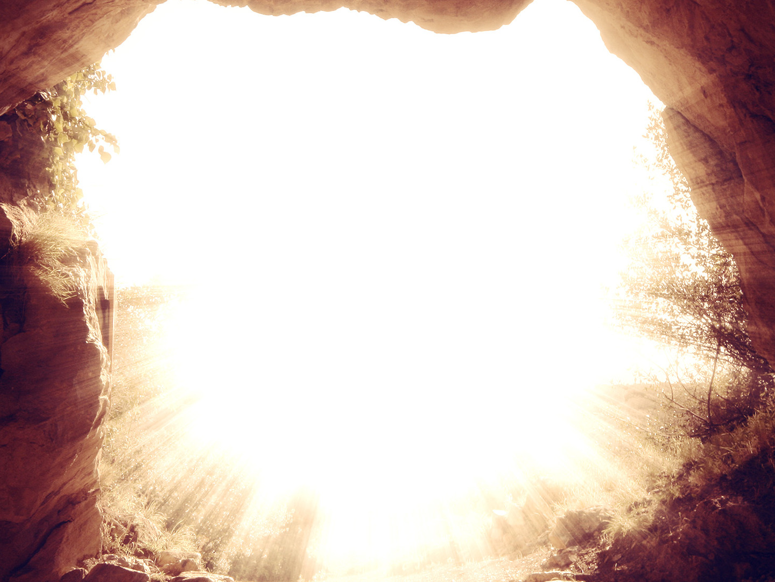
“that he was buried” (1 Cor 15:4a)
“that he was raised on the third day in accordance with Scriptures” (1 Cor 15:4b)
Jesus Christ’s death was for our sins, the fact that Jesus really died is attested to by his burial, and the effectiveness of Jesus’ Christ’s death is attested to by his resurrection
Notes:
“that he was buried” (1 Cor 15:4a) - Now you might be thinking, why on earth did Paul include this in the gospel message, what’s the significance of this - Many people were trying to find ways to refute the gospel message, to show that it was all a lie - One of those theories that people still try to claim to this day, is that Jesus didn’t really die - But what Paul was saying, is that Christ really DIED for our sins, and this is attested to, by the historical fact, that he was buried - You don’t normally bury a living person, but a dead man, and he was buried. But the gospel doesn’t end there. - Because if Christ stayed in the grave, then Jesus payment was not accepted, and we have no way of ever being reconciled to God – Our hopes would have died with him and been buried in his tomb - But when the two women, as we saw in today’s kid’s talk, went to the tomb where Jesus had been buried they saw…
“that he was raised on the third day in accordance with Scriptures” (1 Cor 15:4b) - The tomb is empty, because Jesus our Lord is alive, he is risen - Jesus, the Son of God, the second member of the Trinity, was raised by God the Father to prove that the judge is satisfied – Christian, my dear brothers and sisters in Christ. Jesus in his life, in being perfectly obedient to the will of God - Achieves perfect righteousness for the child of God and imputes that onto you, he gives that to you. - And in his death, your sin is imputed, placed upon him. And then Jesus is raised to life on the third day, for our justification. - Meaning that now when you stand before God as judge, with your papers in His hand, having now repented and believed in Jesus Christ - At the bottom of those papers, God signs it dipped in the blood of Jesus once for all sacrifice, saying, “This one is mine” - Christian, you belong to God, by grace alone, through faith alone, in Christ alone, in accordance with Scripture alone, to the glory of God alone - And Scripture does once again testify to the resurrection of Jeus - Peter in his great sermon at Pentecost, Acts 2:25-28 - Being the expository preacher that he was, preaches on Psalm 16, and says how David wrote concerning Jesus, verse 10 - “For you will not abandon my soul to Hades, or let your Holy One see corruption” - Peter goes onto say, David did die, was buried and his tomb is with us until this day. - So David not speaking about himself, foresaw and spoke about the resurrection of Christ , that he was not abandoned to Hades, nor did the flesh see corruption - We see it being prophesied once again in Isaiah 53:10, Isaiah 26:19 and Psalm 110 to name a few of them
Jesus Christ’s death was for our sins, the fact that Jesus really died is attested to by his burial, and the effectiveness of Jesus Christ’s death is attested to by his resurrection - We are now delivered from the wrath to come, that which awaits all those who reject Jesus Christ and the gospel message - And instead of wrath, we receive grace, and are brought near to God, with the full and complete assurance, a blessed assurance - That one day, having withstood the trials and temptations of this life - Having been preserved by the Good Shepherd Jesus Christ, you “will receive the crown of life, which God has promised to those who love him”

Slide 6
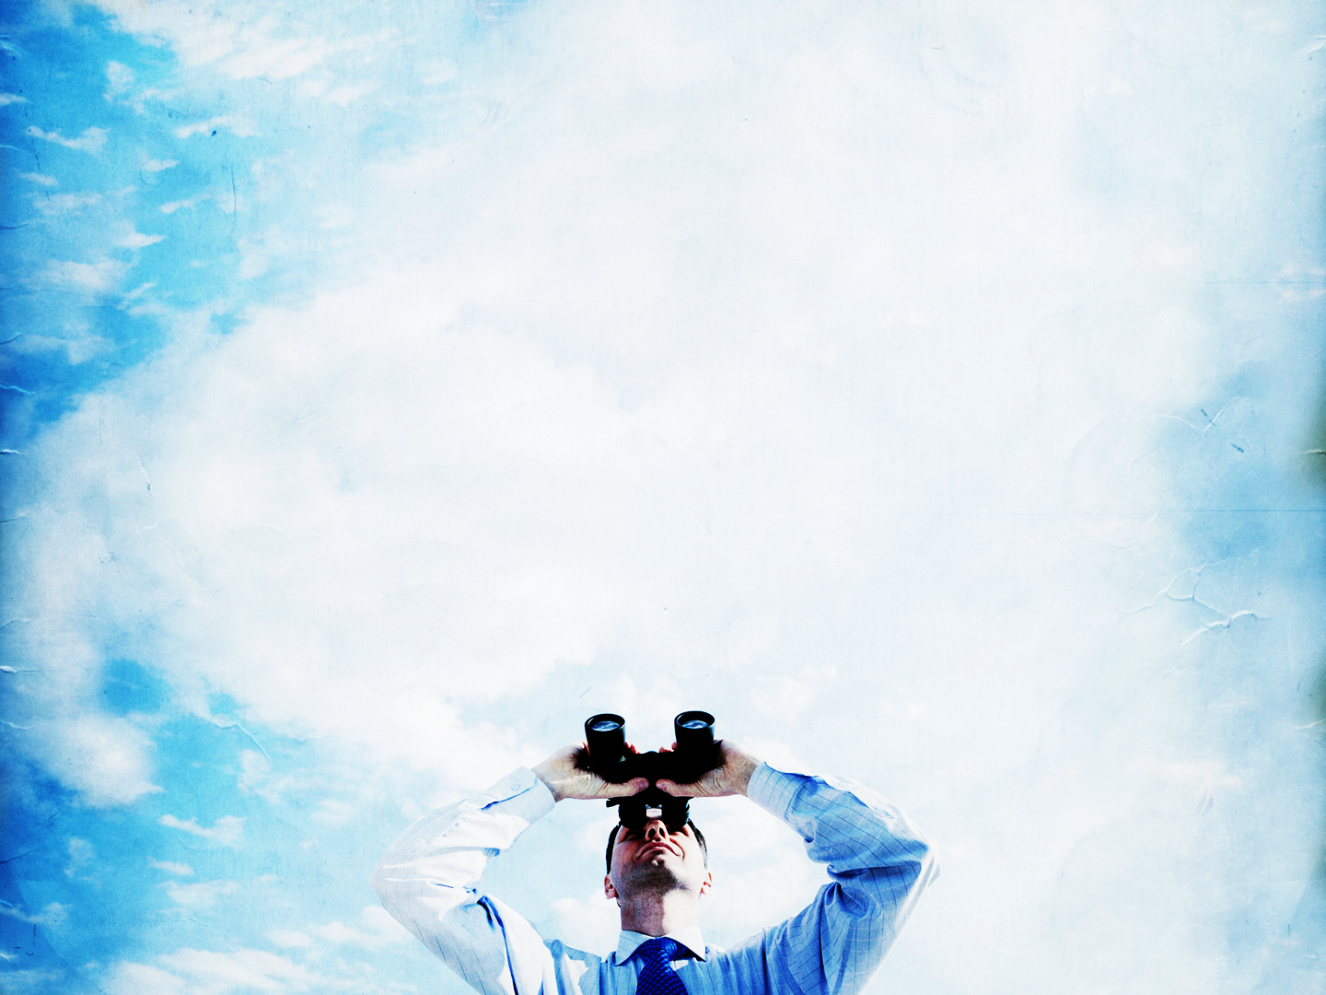
THE SPECTATORS OF THE GOSPEL
“and that he appeared to Cephas” (1 Cor 15:5a)
“then to the twelve” (1 Cor 15:5b)
“Then he appeared to more than five hundred brothers at one time, most of whom are still alive, though some have fallen asleep” (1 Cor 15:6)
Notes:
“and that he appeared to Cephas” (1 Cor 15:5a) - Paul now moves on to give a list of appearances in chronological order of the risen, resurrected Lord - I also want you to note that list isn’t exhaustive, in that it misses out some of the times that Jesus appeared before people - “and that he appeared”. If you want to prove to people that you’ve risen from the dead, what do you do? - You appear, you show up. Jesus first appears physically to Cephas, or perhaps better known as Peter - This is the man who denied Jesus 3 times before he died – Paul is saying, go talk to him, go ask him if Jesus is really alive - And you will find a man having now seen the risen Lord, and being filled with the Holy Spirit is preaching the gospel so unashamedly, - That he will no longer deny having seen Jesus, but would rather die preaching the gospel
“then to the twelve” (1 Cor 15:5b) - Now Paul is just giving them this title, so that we know exactly who he is talking about, even though we know that the time in which Paul is referring to is when there is only 11 - This most likely occurred in the upper room where they are all gathered in John 20:19-20 - And in that upper room, they saw the Lord, they saw his wounds, and now they would spend the remainder of their lives preaching the gospel and proclaiming that Jesus lives
“Then he appeared to more than five hundred brothers at one time, most of whom are still alive, though some have fallen asleep” (1 Cor 15:6) - This occurs most likely in Galilee, on one occasion, at one time, a real appearance - We must remember the other incredible thing about all that Paul is saying is that this letter is written before the 4 gospels - Thus Paul is not simply reciting what the gospels have already stated, but writing from his own perspective which the gospels will emphatically verify that Paul is telling the truth - He says this event in such a way, as if these people may know these 500 people. As if to say, go ask these people if they saw a risen Lord - The evidence is starting to stack up, and the funny thing is: - That if the Romans and Jews want to disprove that Jesus really is alive, and therefore gutting the gospel message of its power - All they have to do is produce a dead body, but they can’t, because Jesus is alive

Slide 7
”Then he appeared to James, then to all the apostles” (1 Cor 15:7)
Paul is appealing to the testimony of competent witness that the resurrection of Jesus is a historical fact
Christian, take heart, for our Lord lives and is risen
To the unbeliever, repent and believe in the gospel of Jesus Christ
Notes:
“Then he appeared to James, then to all the apostles” (1 Cor 15:7) - Now it is most likely that Paul is talking about Jesus’ brother James - And if you will remember back in John 7:5, “For not even his brothers believed in him” - They didn’t believe him while he was alive, they thought he was crazy - But James had a post-resurrection encounter with Jesus Christ, and went from not believing - To being one of the founders of the church and essential in the spreading of the gospel - And bearing witness to the fact that Jesus died for our sins, was buried and rose again, that sinners might be saved - Peter and James are unlikely witnesses, because they both denied Jesus - But Paul is saying, it is precisely because of this reason that their testimony is all the more reliable – And then to all the apostles, the unnamed apostles perhaps
Paul is appealing to the testimony of competent witness that the resurrection of Jesus is a historical fact – Let me read to you a section from Charles Hodge commentary on this section: - “If the witnesses be people of integrity, of sound mind and discretion, then human testimony establishes the truth of the fact beyond reasonable doubt - If in addition to these grounds of confidence, the witnesses give their testimony at the expense of great personal sacrifice, or confirm it with blood”, which church history and the Bible tell us that many of apostles were killed for their proclamation of the gospel, ridiculed, mocked, ran out of town and put in prison. So another tick for this one - If the occurrence of the resurrection of Jesus Christ had been predicted centuries before it came to pass - If it produces effects not otherwise to be accounted for, effects extending to all ages and nations - If God confirms the testimony of the original witness to the fact, and also the truth of the doctrines of which that faith is necessary, by the demonstration of His Spirit (Like through His Word which is sure and steady, is God-breathed) - Then it is insanity and wickedness to doubt the resurrection of Jesus Christ. All of these considerations concur in the proof of the resurrection of Christ, and render it the best authenticated event in the history of the world”
Christian, take heart, for our Lord lives and is risen - And he is seated at the right hand of God forever making intercession for you - As Ephesians 1 puts it, having been predestined for adoption before the foundations of the world, - And now being in Christ, He has blessed us in Christ with every spiritual blessing in the heavenly places - And we say a hardy ‘Amen’ with the apostle Paul, “Death is swallowed up in victory” - Therefore be steadfast, immovable, and always abounding in the work of the Lord - May His praises be ever on our lips
To the unbeliever, repent and believe in the gospel of Jesus Christ - You can reject the truth, and you will have an eternity, but it will not be in glory, but in hell - If you are sitting here today, lost, feeling nothing but undeserving, ill-deserving, hell-deserving, hear me on this, you’re right - But you are exactly the sort of person for whom the gospel is for. – God in His love, and His mercy, and His grace, sent Jesus Christ into the world to save sinners like you and me - That’s all of us, and so may God grant you the grace to see just how sinful you are - And just how lost, and helpless you are, and may he then turn your eyes to Jesus Christ - Showing you that Christ died for all of your sins, He would not even spare His own Son, that he might spare you - If you would but repent and believe in Jesus Christ as Lord and Saviour – Cast your sins before the cross, throw yourself on Jesus, and you will find life, you will find forgiveness - And by the precious blood of Jesus Christ, you will be reconciled to God, justified, and adopted - And by the grace of God your eternal destination will no longer be hell, but an eternity spent in heaven, forever in the glorious presence of God

Slide 8
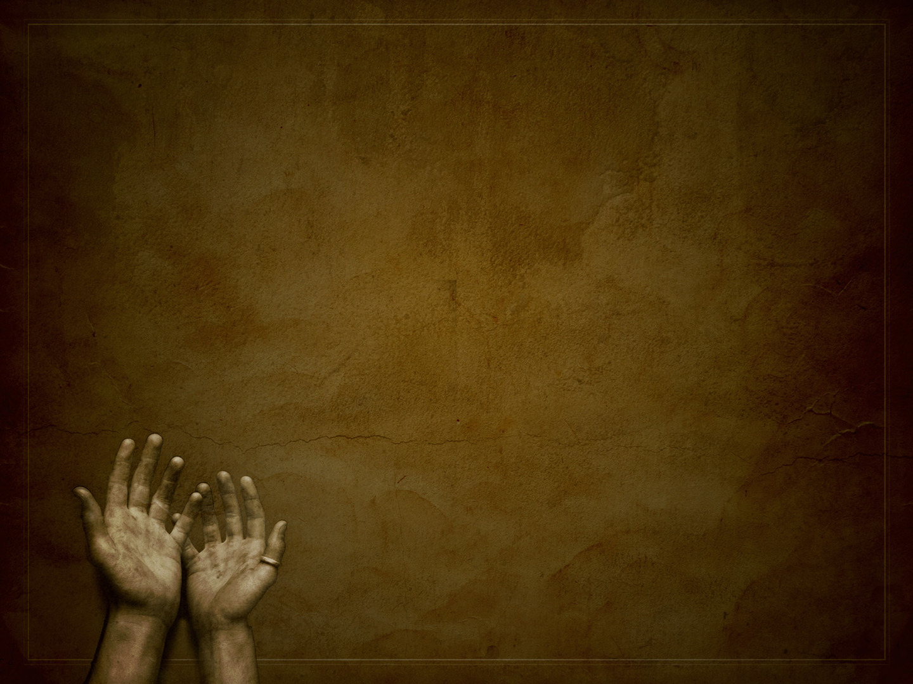
THE SPECIAL SPECTATOR OF THE GOSPEL
“Last of all, as to one untimely born, he appeared also to me” (1 Cor 15:8)
“For I am least of the apostles, unworthy to be called an apostle” (1 Cor 15:9a)
“because I persecuted the church of God” (1 Cor 15:9b)
Notes:
“Last of all, as to one untimely born, he appeared also to me” (1 Cor 15:8) - The phrase last of all, tells us that the last person Christ ever appeared to was Paul - After Jesus ascended to the right hand of the Father, Jesus appeared as the resurrected Christ, only to Paul - By implication, we can, based on the testimony of Scripture, say that there have been no subsequent appearances - Jesus appeared physically to all the founders of the church, with Paul being the last - And he was one untimely born. The word used here for untimely, is the same as the word for miscarriage, premature birth, and even abortion - Paul is saying Jesus appeared to him out of the ordinary, not like all the instances he has already mentioned - With the other apostles, we think of Peter, and John for example and the 12. - Jesus spent 3 years creating, nourishing, forming and teaching them - Paul on the other hand had been cast out from the womb so to speak, when he received his call and mission from Jesus Christ - Paul goes on to further describe what he means by his untimely birth
“For I am the least of the apostles, unworthy to be called an apostle” (1 Cor 15:9a) - There were some at Corinth who struggled with Paul’s apostleship and his authority - And Paul basically welcomes the criticism and says, I am unworthy to be called an apostle, I am the least of the apostles - But whether they like it or not, Paul was called to the office of apostle by Jesus Christ himself - The reason he is unworthy is…
”because I persecuted the church of God” (1 Cor 15:9b) - Paul prior to seeing Jesus, consented to the death of Stephen, the first martyr, brought havoc on the church, he was bringing men and women to prison - And even when he was on his way to Damascus he had letters of commission from the high priest in his pocket, to seize any Christians on his way to Damascus, and bring them bound to Jerusalem - He punished the Christians in every synagogue, compelled them to blaspheme, and persecuted them any chance he got - Paul brings this up on a number of occasions throughout his letters in the New testament, with deep contrition - You see forgiveness of sins, does not mean we will never remember that sin ever again - In fact I think God in His grace allows us to remember our sinfulness and depravity prior to coming to know Jesus Christ as Lord and Saviour - It reminds us of just how broken we were, how turned from God we were, how if left to our own devices, hell was the only destination - And we are immediately then reminded of God in His grace, and in His love, how he changed it all, because such is the power of God - It keeps us dependent upon God, it keeps us humble

Slide 9
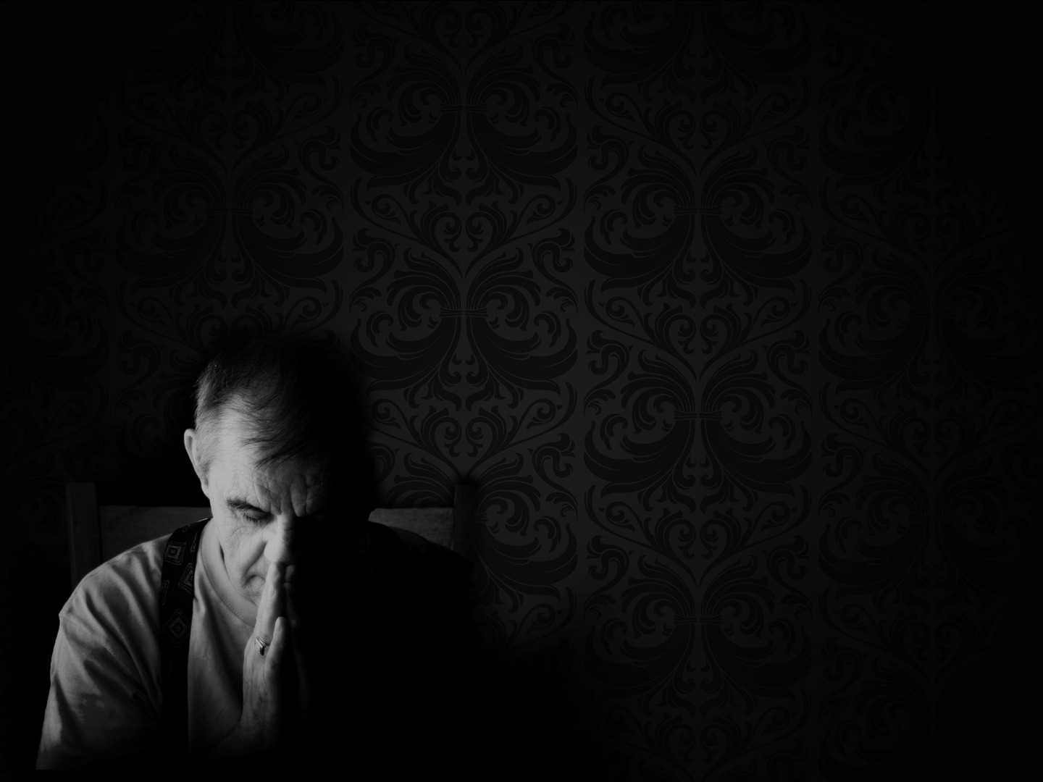
”But by the grace of God I am what I am, and his grace toward me was not in vain” (1 Cor 15:10a)
”On the contrary, I worked harder than any of them” (1 Cor 15:10b)
”though it was not I, but the grace of God that is with me” (1 Cor 15:10c)
Notes:
“But by the grace of God I am what I am, and his grace toward me was not in vain” (1 Cor 15:10a) - So here we have the final apostle, who was born out of time, he is unworthy, and he is the chief of sinners - And he is boldly declaring that the resurrected Jesus has been revealed to him - But what makes this so astounding, is that no one can look at the life of Paul without seeing the grace of God - Because how does someone who hated the church, persecuted and killed them, was locking them up any chance he got - Become one of the most prominent preachers and writers of the New Testament - The only answer, is the mighty Word of God and the resurrection. That Paul must have truly seen the risen Jesus - That the gospel message of Jesus life, death, burial and resurrection must have penetrated to the deepest, darkest depths of his heart - Cutting the old corrupt one out, has given him a new one, and caused him to be born again - There is no other explanation other than Paul must be telling the truth. That Jesus lives, and therefore the gospel is true and is the power of God unto salvation - He’s saying to the church in Corinth, I know you doubt me, I know you doubt my office as apostle, I know you doubt my authority - And you would be right to do so, look at my resume prior. I don’t deserve this - But my apostleship, is not about deserved, just like your adoption as a child of God is not about what you deserve. - If God gives us what we all deserve and we get justice, we all die - But by God’s grace I am what I am. - And God’s grace towards Paul was not in vain, it was not worthless, it was not without effect
“On the contrary, I worked harder than any of them” (1 Cor 15:10b) - Paul preached in season and out of season, he travelled over a greater part of the world than the other apostles - He preached more often, wrote more than any of them. He planted more churches, and was an instrument used of God for the converting of many souls - He endured more hardships and sufferings than any of them. He laboured to the point of weariness - And all of this was done to the glory of God - But he does not mention this to boast, no quite the opposite
“Though it was not I, but the grace of God that is with me” (1 Cor 15:10c) - He attributes all his success, all that he has done to the grace of God - Paul sees that he is nothing but what God has made him by His grace - He attributes it all to the grace of God and nothing to himself - Let us learn like Paul that we HAVE nothing that is good, but that which the Lord graciously gives us - And that we DO nothing good, but that which God works in us - Not that we do nothing, for we must submit to the will and word of God, and we co-operate with the grace of God - But even this co-operation is due to the grace of God. It is all of grace - Paul’s testimony here, ought to be ours, that everything that we have done, and everything that we are, is owed to the grace of God - By the grace of God I am what I am

Slide 10
THE SAME GOSPEL
”Whether then it was I or they, so we preach and so you believed” (1 Cor 15:11)
All the apostles 2000 years ago, preached the same gospel and it was sufficient then
And the same gospel 2000 years later, in 2025 is still “the power of God unto salvation”
Notes:
“Whether then it was I or they, so we preach and so you believed” (1 Cor 15:11) - One of the hardest things about maintaining a lie, is if there is a big group of people who have to make sure all their stories line up - If this many people are making it up, eventually something will slip out, the message will become inconsistent - The only way that the message can stay the same for 2000 years is if these people are telling the truth - And so Paul is saying, whether it is Peter, or James, or one of the other 11, or one of other 500 witnesses, the message stays the same - And though the church in Corinth may have wished it was Peter, or James, Paul is saying, they are going to give you the exact same gospel message - And by denying the resurrection, they are denying the gospel, and the facts and testimony of all the witnesses that Paul just brought up
All the apostles 2000 years ago, preached the same gospel and it was sufficient then - All the Christians in Corinth have their foundation of existence as born-again believers in the resurrected Christ - And everywhere these apostles went people were saved and churches were planted. Why? - It wasn’t because of their eloquence, or because they just discovered a brand new method of preaching - It was because they preached the gospel without compromise. - Everywhere they went, they were threatened with death or imprisonment if they continued - But they would not deny God, and they could not deny the truth, but by the grace of God they felt as if their only option was to preach the gospel of the resurrected Jesus Christ everywhere they went
And the same gospel 2000 years later, in 2025 is still “the power of God unto salvation” - There is only one gospel, the gospel of Jesus Christ in accordance with Scriptures. We must not try to tinker with it and get fancy with it or shape it so the culture likes it - There is only one gospel in which we stand and by which we are being saved. - Preachers today, need to echo those famous words of Martin Luther, when standing boldly against the heresy of the catholic church says, “Here I stand, I can do no other” - Preachers of the gospel, and Christians alike must say, that by the grace of God, “Here I stand in the gospel, I can do no other” - There can be no compromising of the gospel if people are to be saved - All true Christians cling to and believe in this gospel. That Jesus lived, that Christ died for our sins, was buried, and was raised on the third day - Charles Spurgeon put it like this, “So let us stand at the foot of the cross, and trust our souls once for all to Him who shed his blood for the guilty” - By this faith we live, and by this faith we die - As a summary of my message today, let me conclude with this

Slide 11
“It is the seal and memorial stone of the great work of redemption, which He came to do. It is the crowning proof that He has paid the debt He undertook to pay on our behalf, won the battle He fought to deliver us from hell, and is accepted as our guarantee and our substitute by our Father in heaven. Had He never come forth from the prison of the grave, how could we ever have been sure that our ransom had been fully paid? Had He never risen from His conflict with the last enemy, how could we have felt confident that He has overcome the power of death from the devil? But thanks be unto God, we are not left in doubt. The Lord Jesus really rose again for our justification.” – J.C. Ryle
Notes:
“We need not wonder that so much importance is attached to our Lord’s resurrection. It is the seal and memorial stone of the great work of redemption, which He came to do. It is the crowning proof that He has paid the debt He undertook to pay on our behalf, won the battle He fought to deliver us from hell, and is accepted as our guarantee and our substitute by our Father in heaven. Had He never come forth from the prison of the grave, how could we ever have been sure that our ransom had been fully paid? Had He never risen from His conflict with the last enemy, how could we have felt confident that He has overcome the power of death from the devil? But thanks be unto God, we are not left in doubt. The Lord Jesus really rose again for our justification.” – J.C. Ryle
If you are sitting here today and do not know Jesus Christ as Lord and Saviour. You have heard the gospel message, that you have sinned
And apart from repentance and faith you will have no hope
But Jesus Christ came and died for sinners
If you will but turn from your sins and believe in Jesus Christ, you will be accepted in Christ, as a child of God
And God will one day welcome you home, into heaven, and will say of you, “Well done good and faithful servant, enter into the joy of your master”
And to my fellow Christians. Did you read that?
Jesus lives, and the ransom has been fully paid. The penalty for sin dealt with. Jesus has overcome the power of sin.
And now we march onwards to glory, where one day, we will be set free from the very presence of sin.
Set free from the penalty of sin, power of sin, and one day the presence of sin
Oh what wondrous love, what amazing grace God has shown to us
This is the gospel we received, in which we stand, and by which we are being saved.
This is the gospel of Jesus Christ

