Slide 1
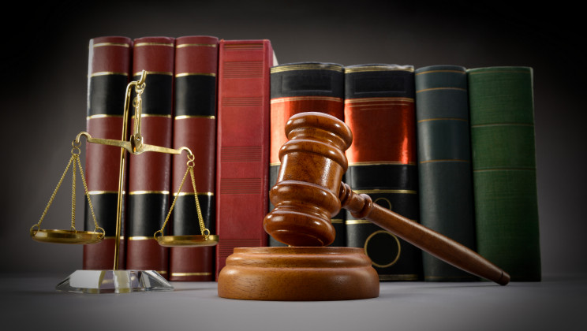
The Case of Christ
John 18:1-14

Slide 2
NCIS
Silent Witness
Lewis
Death in Paradise
Vera

Slide 3
The Facts Timeline
Sunday - 2 mile journey to Jerusalem from Bethany, where Jesus stays each night (Mark 11:9-10). Palm Sunday Monday - Jesus protests financial transactions within the temple; argues with chief priests (Mark 11:15-18) Tuesday - Jesus predicts/announces the date of his execution; debates with religious leaders; responds to question about greatest commandment (Matthew 21:23-24:2) Tuesday - Judas contracts to betray Jesus (Luke 22:1-6) Olivet Discourse Wednesday - Jesus warns against religious leaders, calling them hypocrites and snakes; From Mount of Olives, Jesus mourns Jerusalem's rejection and pending destruction (Matthew 22 & 23)

Slide 4
The Facts Timeline
Thursday (6pm-11:30pm) - Last supper with disciples - Passover meal (Luke 22: 7–38) Thursday (11:30 pm) – Friday (1:00 am) - Garden of Gethsemane - Jesus waits for his arrest (John 18: 1- 11)
Friday (1:00am-1:30am) - Confrontation in Garden and Jesus' Arrest (John 18: 1- 11)

Slide 5
Friday (1:30am-3:00am) – (Matthew 26:57-68) – Taken to High Priest & Whole Sanhedrin. Trial 1: Annas, former Jewish High Priest for 16 years - Jesus receives initial physical abuse.
Trial 2: Current Jewish High Priest, Caiaphas, and the Sanhedrin Court – Jesus bloodied by abuse. Friday (3:00am-5:00am) - Imprisonment at Caiaphas' palace (John 18:28) Friday (5:00am-6:00am) - Trial 3: All the Jewish elders, including the High Priest, Scribes and whole Sanhedrin. They decide to ask the Roman government to kill Jesus (Luke 23: 1-2)

Slide 6
Friday (6:00am-7:00am) - Trial 4: Hearing before Roman governor Pilate, who declares, "I find no guilt in this man." (Matthew 27: 11-14) Friday (7:00-7:30am) - Trial 5: Hearing before Herod Antipas, the son of Herod the Great, who had jurisdiction over Galilee. Jesus refused to answer any questions so Herod returned him quickly to Pilate (Luke 23: 6-12) Friday (7:30am-8:30am) - Trial 6: Pilate repeatedly tried to release Jesus but the Jewish leaders continued to object. Pilate physically tortured and beat Jesus beyond recognition seeking to satisfy the Jewish leaders. However the Jews demanded that Jesus be crucified. Pilate resisted but eventually gave the order to execute Jesus (John 19: 4-15)

Slide 7
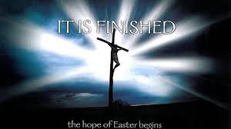
Friday (8:30am-9:00am) - Pilate's Roman soldiers take Jesus into the court ("Praetorium") and enjoy mockery and continued torture, including driving thorns into his skull (Mark 15: 16-20) Friday (9:00am-12:00 noon) - Jesus forced to carry his own
cross, then actual crucifixion (John 19: 16-24) Friday (12:00 noon - 3:00pm) - Momentous final 3 hours on the cross (Luke 23: 44-46) Friday (3:00pm) - Death (Matthew 27: 50-56) Friday (Before Sunset) - Burial (Matthew 27: 57-66)

Slide 8
Illegal Aspects of Trials & Crucifixion
Jesus was arrested secretly at night and was not formally charged of any offense. Judas simply pointed out Jesus, and a crowd arrested Him. There was no legal basis for this.
In his book Criminal Jurisprudence of the Ancient Hebrews, Samuel Mendelsohn states, “The testimony of an accomplice [in this case, Judas] is not permissible by Rabbinic law…and no man’s life, nor his liberty, nor his reputation can be endangered by the malice of the one who has confessed himself a criminal.”

Slide 9
Illegal Aspects of Trials & Crucifixion
2) Jesus was examined by Annas in a secret night proceeding (John 18:12-14, 19-23).
The Sanhedrin court illegally held its trial before sunrise. According to the Talmud, the Sanhedrin is forbidden from convening between the time of the evening and morning sacrifice. In the book Jesus Before the Sanhedrin, M.M. Lemann states that “no session [including a preliminary examination] of the court could take place before the offering of the morning sacrifice.”

Slide 10
Illegal Aspects of Trials & Crucifixion
Annas’s preliminary examination of Jesus resulted in no evidence. But instead of dismissing the case, the Sanhedrin proceeded to hold an illegal court.
Mendelsohn reveals why it was illegal: “Criminal cases can be acted upon by the various courts during the day time only, and by the Lesser Sanhedrin from the close of the morning sacrifice till noon, and by the Greater Sanhedrin till evening.”
The Jewish Mishna states, “Let a capital offense be tried during the day, but suspend at night.”

Slide 11
Illegal Aspects of Trials & Crucifixion
4) The Sanhedrin illegally convened to try a capital offense on a day before an annual Sabbath.
The Mishna reveals why: “They shall not judge on the eve of the Sabbath, nor on any festival.”
In Martyrdom of Jesus, Isaac Wise, a Jewish Rabbi, provides decisive evidence: “No court of justice in Israel was permitted to hold sessions on the Sabbath or on any of the seven biblical Holy Days. In cases of capital crime, no trial could be commenced on Friday or the day previous to any Holy Day, because it was not lawful either to adjourn such cases longer than overnight, or to continue them on the Sabbath or Holy Day.”
Jesus, however, was arrested on Passover evening, which is the day before the First Day of Unleavened Bread—an annual Holy Day!

Slide 12
Illegal Aspects of Trials & Crucifixion
5) The trial concluded in one day.
Again, reading from the Mishna, we learn, “A criminal case resulting in the acquittal of the accused may terminate the same day on which the trial began. But if a sentence of death is to be pronounced, it cannot be concluded before the following day.”
The trials before the Roman
Authorities started with Pilate
(John 18:23) after Jesus was beaten.
The charges brought against Him
were very different from the
charges in His religious trials.

Slide 13
Question
From the Evidence Presented;
Is Jesus Guilty or Not?

Slide 14
Evidence Withheld at Trials

Slide 15
