Slide 1
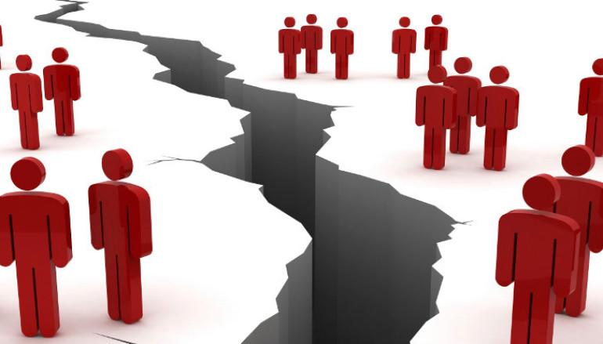
Jesus -
The Divider of People
John 7:1-15,25-27, 40-44

Slide 2
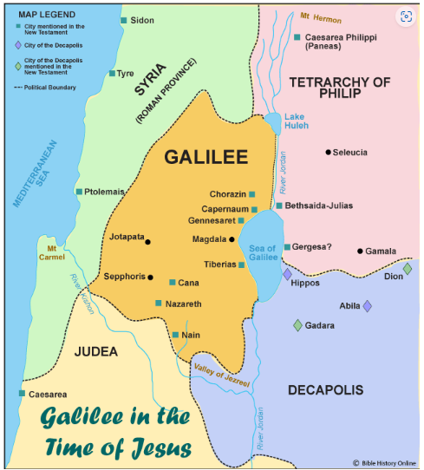
Jesus was born in Bethlehem (Judea)
Moved to Galilee as a child
Commenced his public ministry in
Galilee
Jerusalem is in Judea
Most people lived in Judea

Slide 3
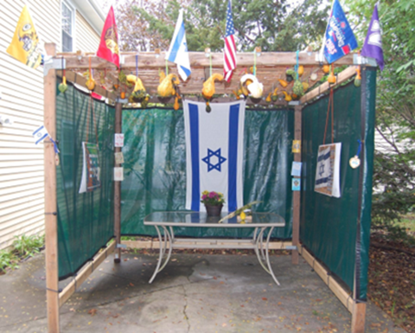
Feast of Tabernacles (Sukkot)
Sukkah

Slide 4
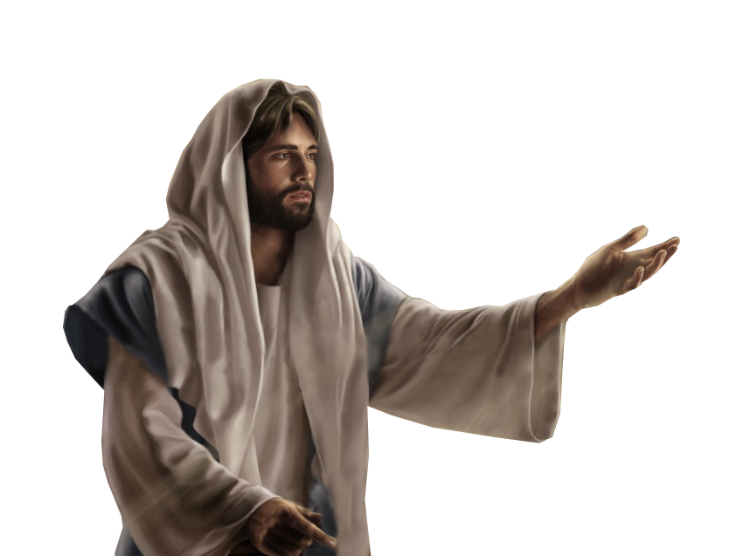
Why did the brothers want Jesus to go down to the festival?
Why was Jesus reluctant to go to the feast with his brothers?
Why didn’t his brothers believe in him?
Why did he change his mind? Did he lie?
What did the people think about Jesus?
What misconceptions did the people have about the Messiah?
Did anything change with the brothers?

Slide 5
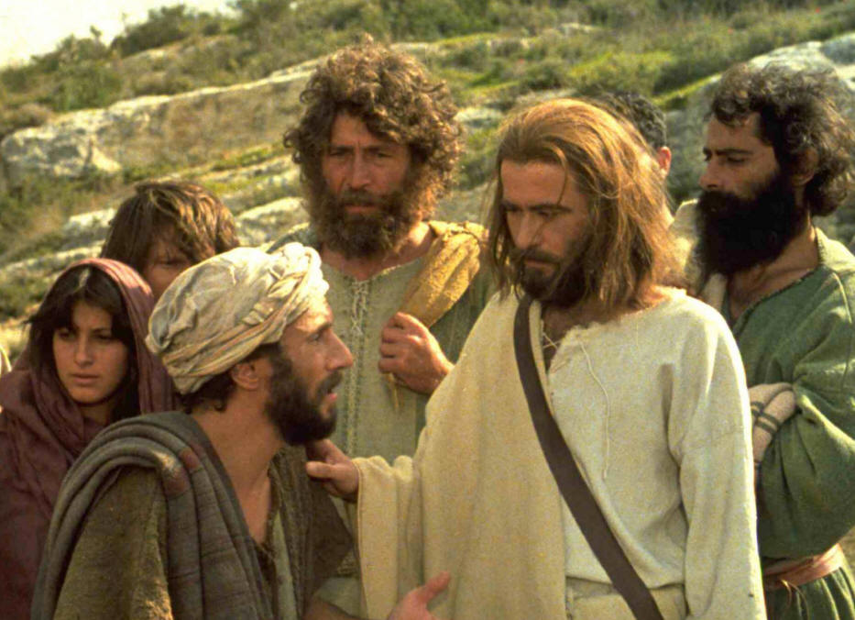
Why did the brothers want Jesus to go down to the festival?
To fulfill religious duties?
Perhaps to justify their brother’s claims?
Perhaps to gain notoriety for themselves?

Slide 6
Why was Jesus reluctant to go to the feast with his brothers?
Fear?
Privacy?
Notoriety?
Brothers at risk?

Slide 7
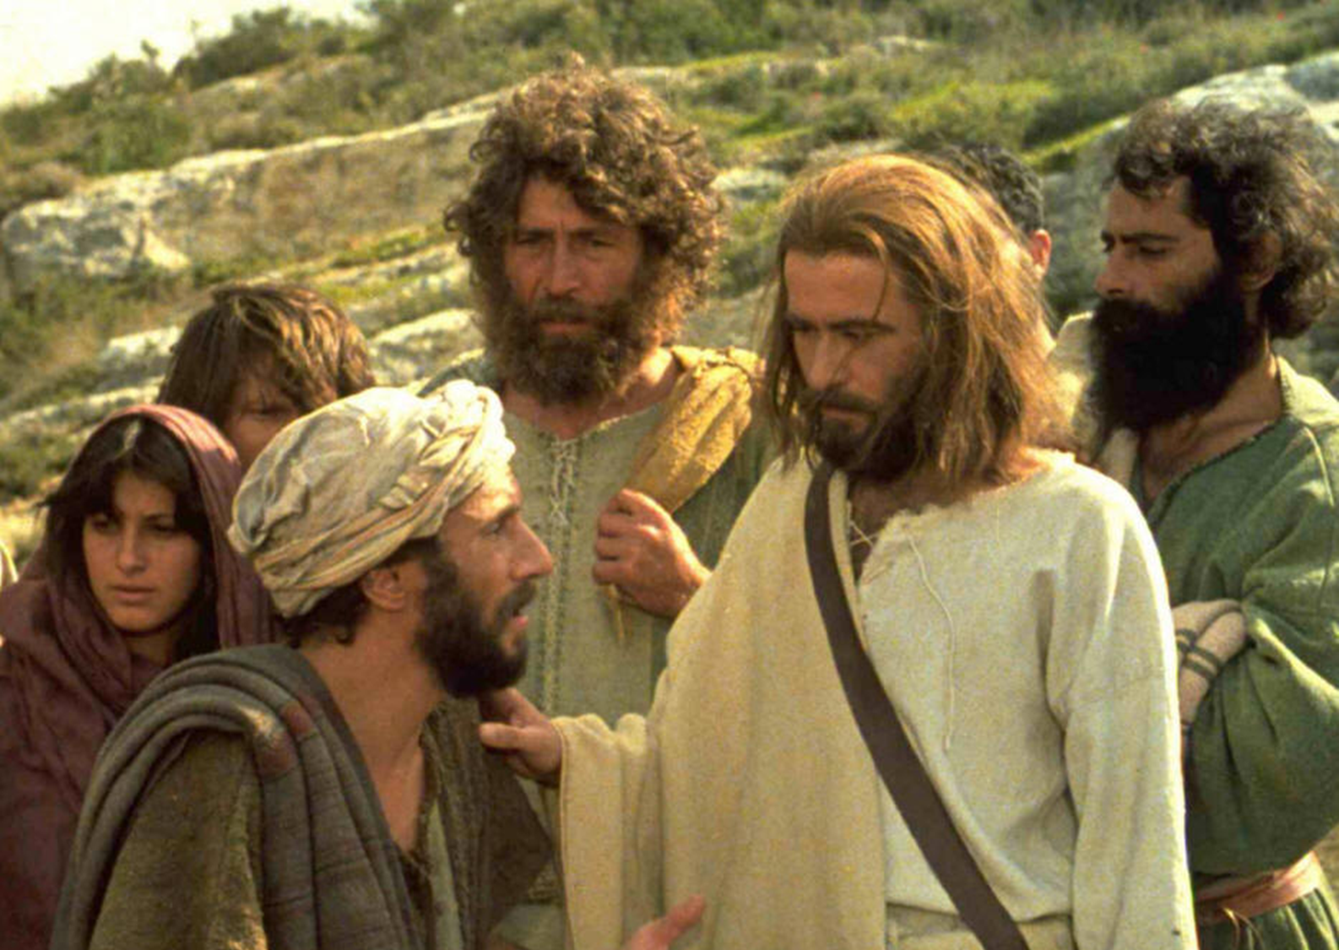
Why didn’t his brothers believe in him?
Peer pressure from their friends?
Earmarked as a radical to the village?
Going against cultural views and norms?
Didn’t believe IN him

Slide 8
Why did Jesus change his mind? Did he lie?
Dinner
Perhaps God spoke to Jesus
The verb anabainein
Brothers who were not yet convinced of his divinity

Slide 9
What did the people think about Jesus?
“He is a good man.” “No, he deceives the people.” “Surely this man is the Prophet.” “He is the Messiah.” “How can the Messiah come from Galilee?”
⁴³ Thus the people were divided because of Jesus. ⁴⁴ Some wanted to seize him, but no one laid a hand on him.
Division at Easter

Slide 10
What misconceptions did the people have about the Messiah?
The doubters were broken into two groups:
People who didn’t understand God’s Word.
People who understood God’s Word but were ignorant of how it applied to Jesus.

Slide 11
Did anything change with the brothers?
We know at least of two of Jesus’ half brothers, James and Jude became strong believers and leaders of the church after Jesus’ resurrection and ascension
Each of these brothers wrote a book bearing their own name in the New Testament
We know that James became the leader of the church in Jerusalem and was held in very high regard by Paul
Jude was known as the brother of James

Slide 12
Jesus is still the divider of people
Jesus has divided time – BC/AD - (BCE/CE)
Jesus can divide countries
Jesus can divide relationships
Matthew 10:35-38 ³⁵ ‘I have come to set a man against his father, a daughter against her mother, and a daughter-in-law against her mother-in-law. ³⁶ Your enemies will be right in your own household!’
³⁷ “If you love your father or mother more than you love me, you are not worthy of being mine; or if you love your son or daughter more than me, you are not worthy of being mine. ³⁸ If you refuse to take up your cross and follow me, you are not worthy of being mine.
Jesus can divide believers

Slide 13
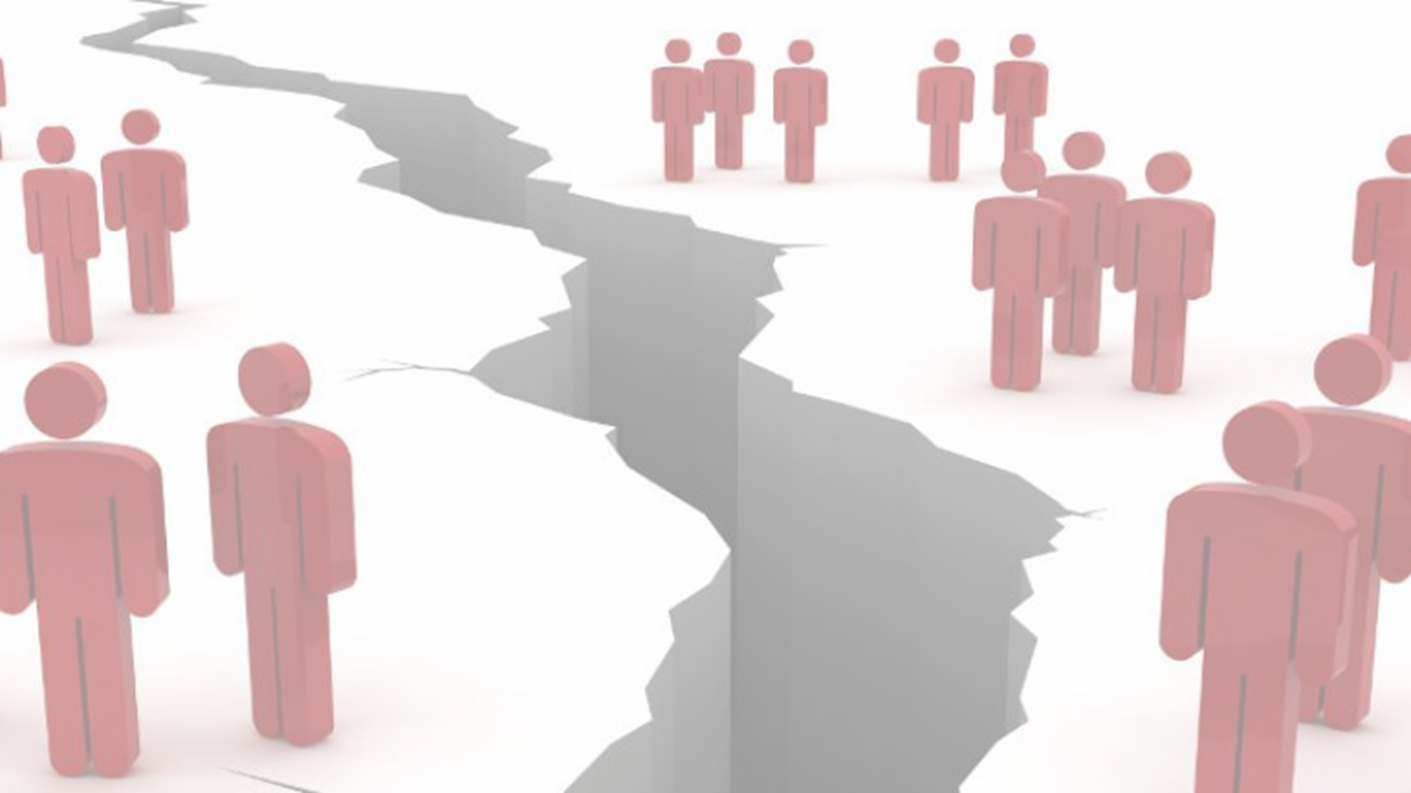
Summary
Unbelievers
Christians
Jesus is still dividing us today

Slide 14
John 3:16 “For God so loved the world, that he gave his only Son, that whoever believes in him should not perish but have eternal life.”
1 John 5:12 “Whoever has the Son has life; whoever does not have God’s Son does not have life.”
John 14:6 Jesus said to him, “I am the way, and the truth, and the life. No one comes to the Father except through me.”
Revelation 21:27 “Nothing evil will be allowed to enter, nor anyone who practices shameful idolatry and dishonesty—but only those whose names are written in the Lamb’s Book of Life.”

Slide 15
Jesus -
The Divider of People

