Slide 1
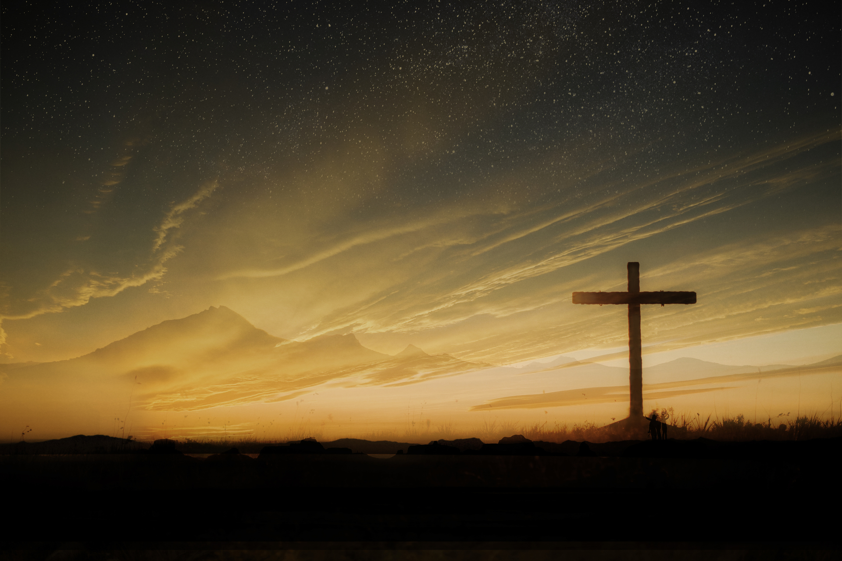
Good Friday
John 19

Slide 2
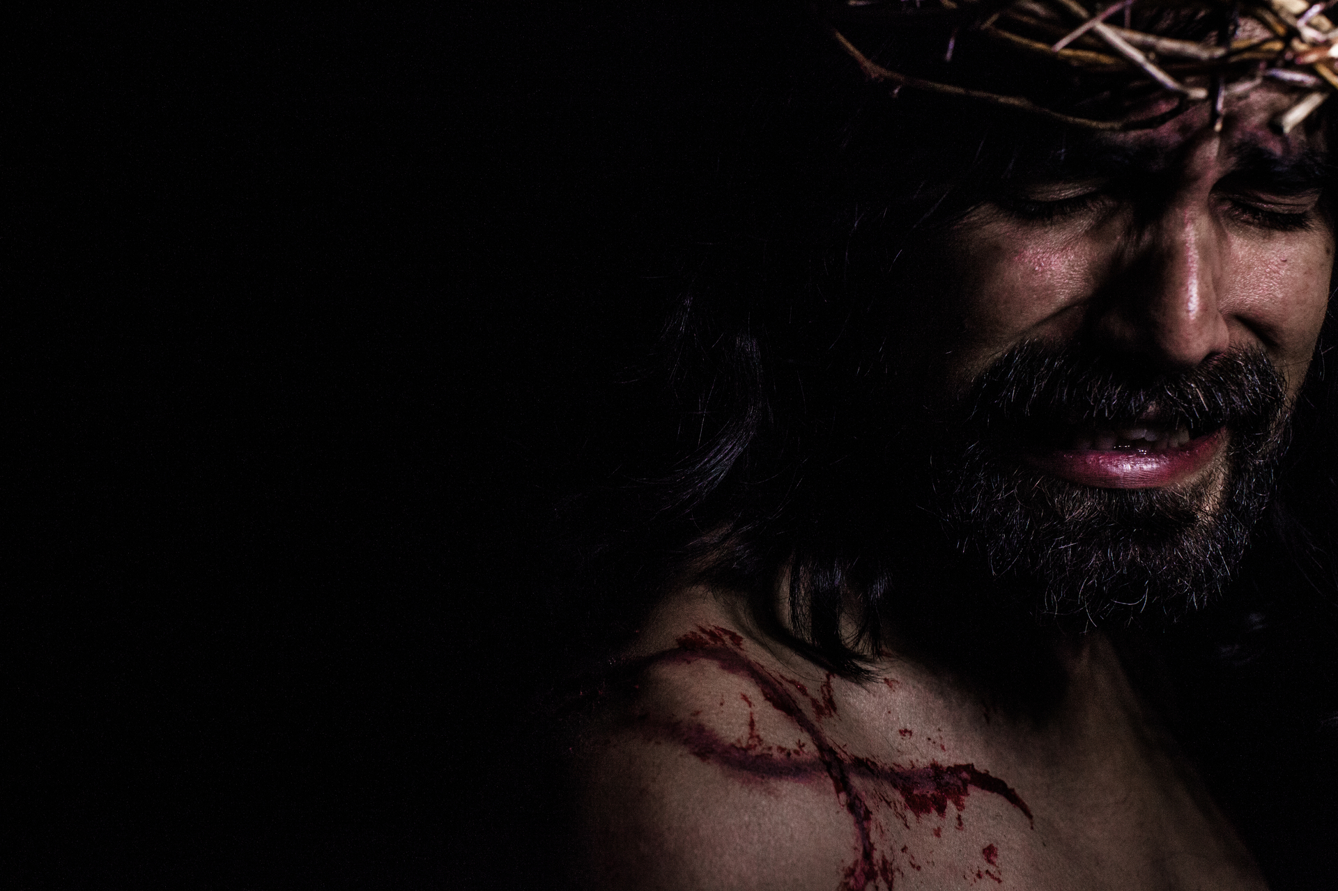
“crush your head, and you will bruise his heel.” Genesis 3:15
This was a prophecy that one would come and defeat Satan, but in the process, he would be bruised.
God had set a plan in place to destroy the power of sin through Jesus

Slide 3
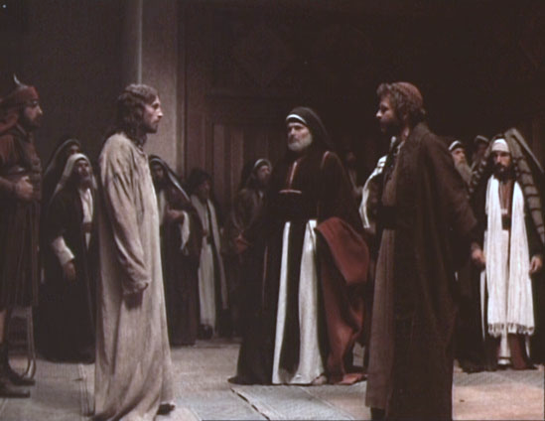
The Trial
False and conflicting witnesses
Held at night
He was then beaten, tortured, flogged, whipped, torn, and he came about as near to death as possible
He was mocked, ridiculed, and scorned by those who hated him
Roman law said a person could either be beaten or crucified but not both

Slide 4
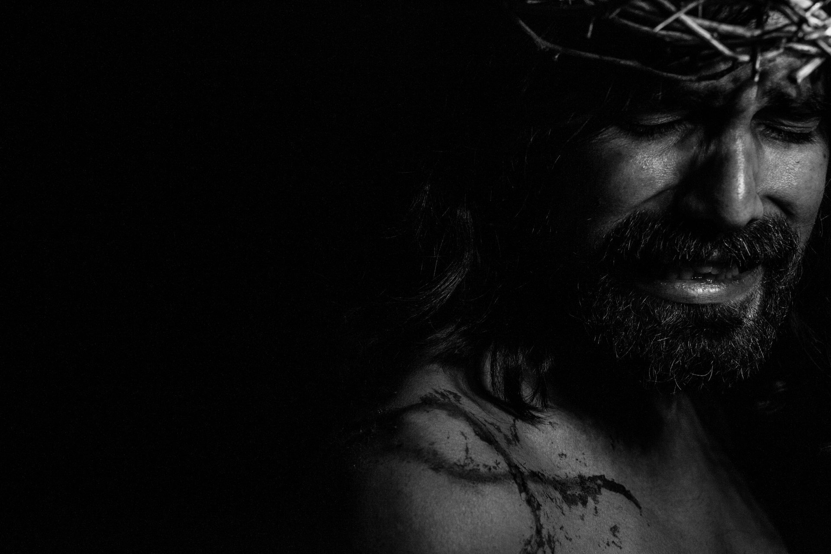
Isaiah 53 – The Suffering Servant
He was despised and rejected— a man of sorrows,
acquainted with deepest grief. We turned our backs on him and looked the other way. He was despised, and we did not care.
⁴ Yet it was our weaknesses he carried; it was our sorrows
that weighed him down. And we thought his troubles
were a punishment from God, a punishment for his own sins! ⁵ But he was pierced for our rebellion, crushed for our sins. He was beaten so we could be whole. He was whipped
so we could be healed.

Slide 5
⁶ All of us, like sheep, have strayed away. We have left
God’s paths to follow our own. Yet the Lord laid on him
the sins of us all. ⁷ He was oppressed and treated harshly,
yet he never said a word. He was led like a lamb to the slaughter. And as a sheep
is silent before the shearers, he did not open his mouth. ⁸ Unjustly condemned, he was led away. But he was struck down for the rebellion of my people. ⁹ He had done no wrong and had never deceived anyone. But he was buried like a criminal; he was put
in a rich man’s grave.

Slide 6
Psalm 22:16-18 – The Crucifixion Crowd
"Dogs surround me, a pack of villains encircles me; they pierce my hands and my feet. All my bones are on display; people stare and gloat over me. They divide my clothes among them and cast
lots for my garment."
King David penned these words nearly 1,000 years
before Jesus was crucified

Slide 7
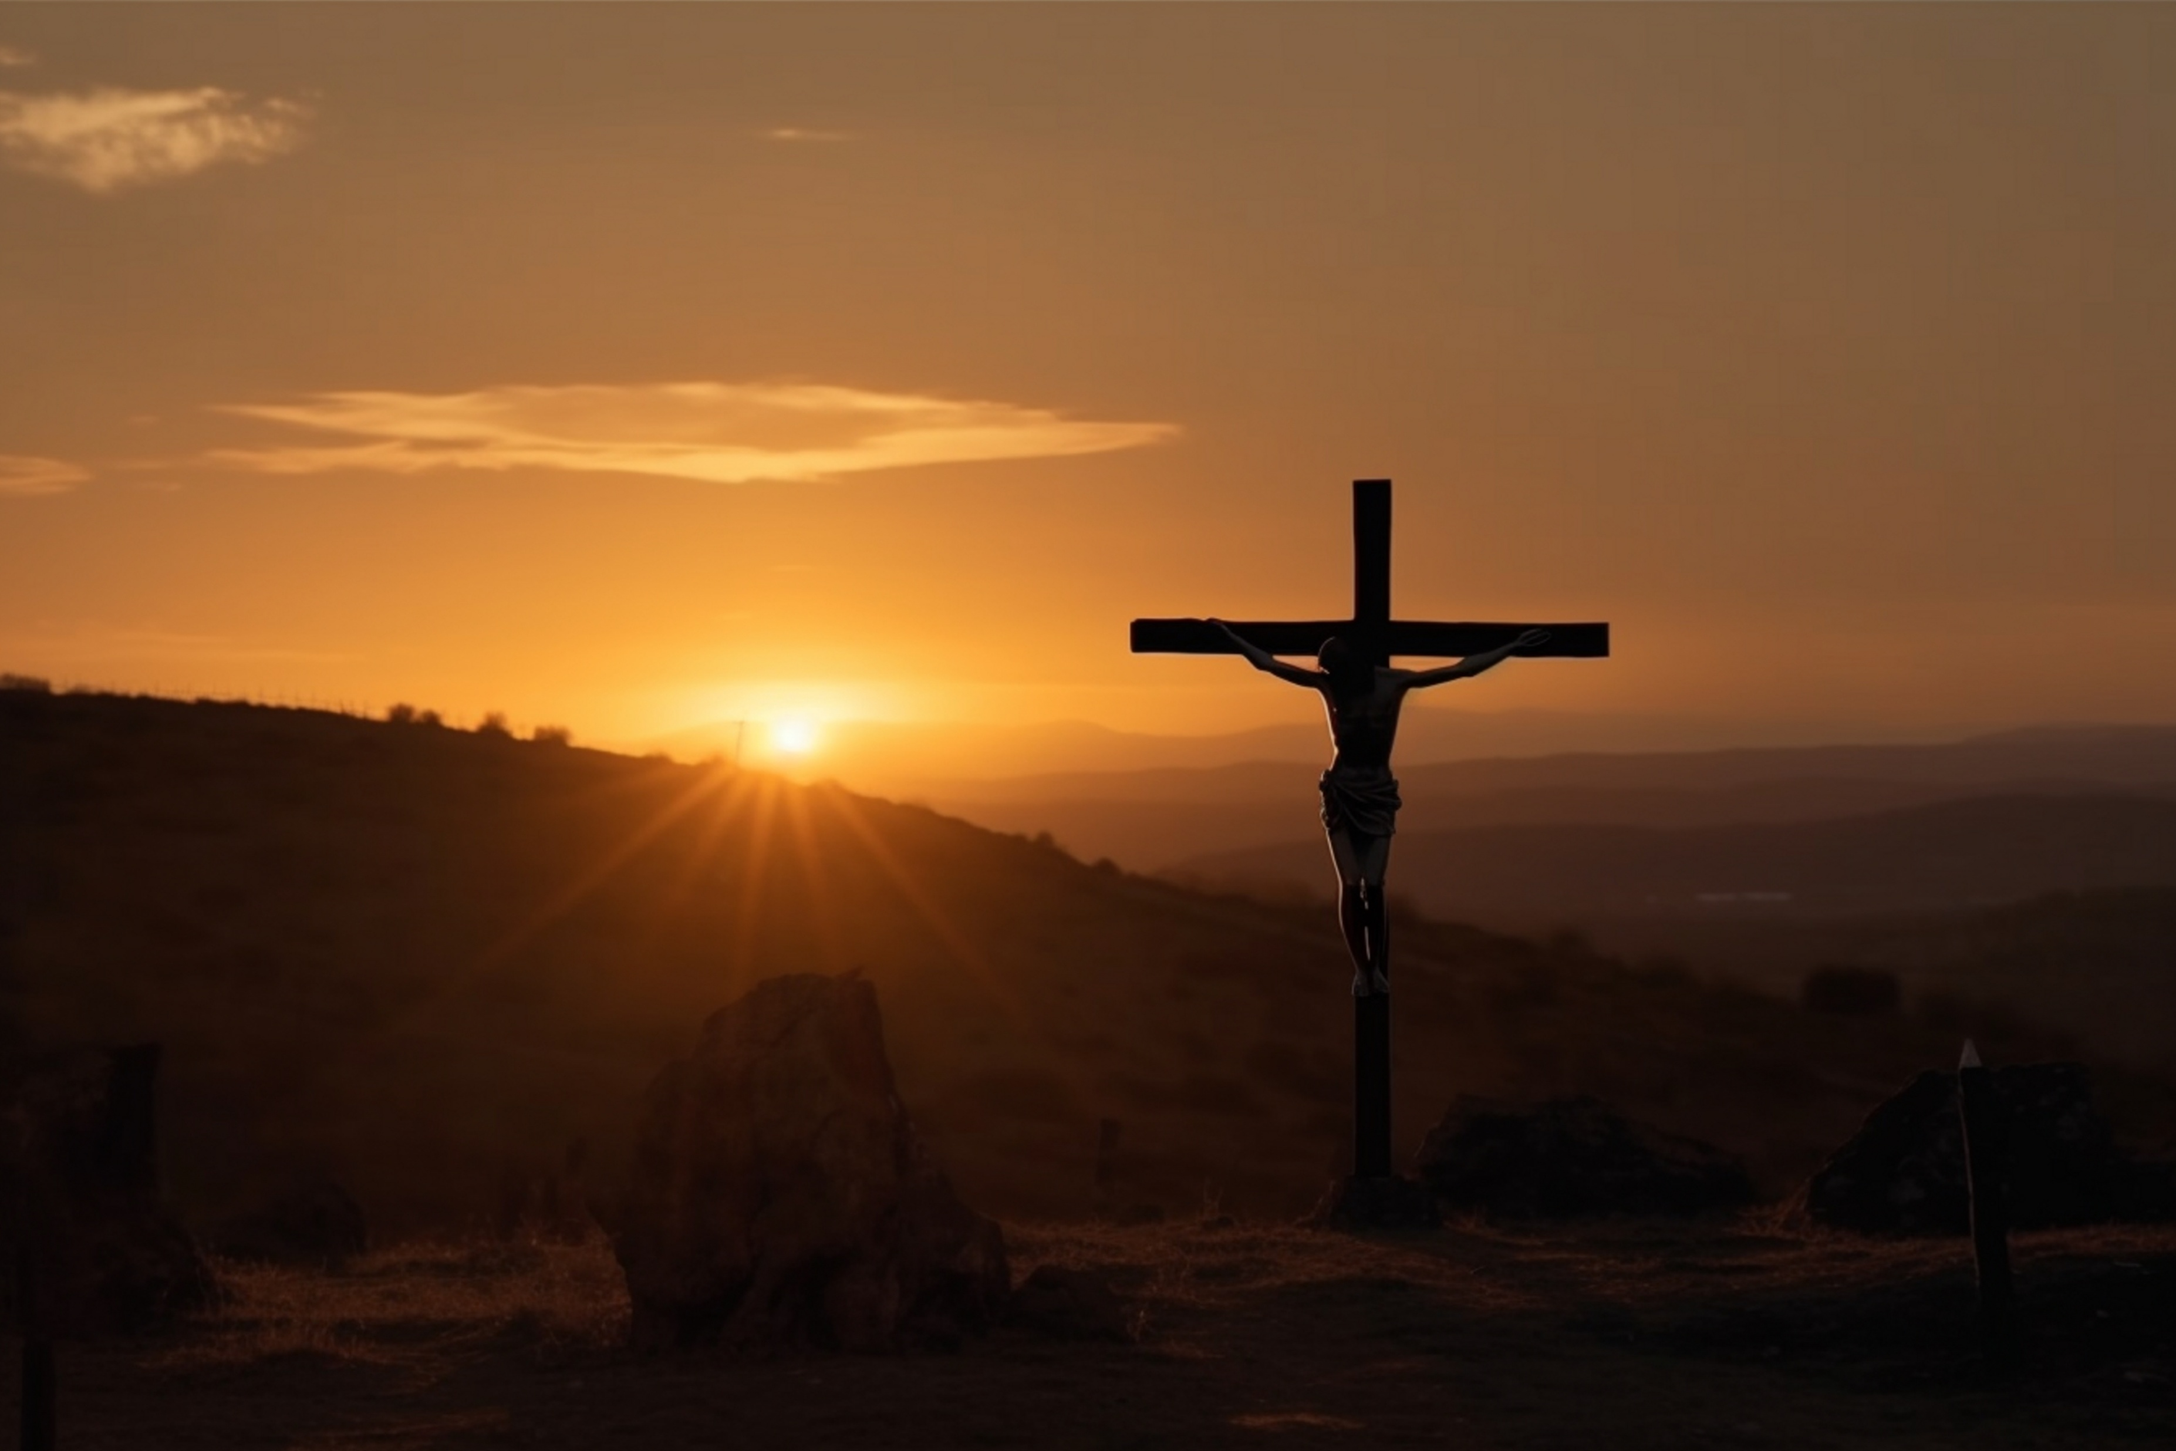
Seven Last Words – Bible Inspire
1. “Woman, here is your son.”– The Lesson of Love & Responsibility
2. “Truly I tell you, today you will be with me in paradise.”– The Lesson of Grace
3. “Father, forgive them, for they do not know what they are doing.” – The Lesson of Forgiveness
4. “My God, my God, why have you forsaken me?”– The Lesson of Suffering

Slide 8
5. “I thirst.” (John 19:28) – The Lesson of Humanity
6. “It is finished.” (John 19:30) – The Lesson of Victory
7. “Father, into your hands I commit my spirit.” – The Lesson of Surrender
It is only through the death and resurrection of Jesus that we can have the forgiveness of sins

Slide 9
Good Friday
His suffering was the price of our victory

