Slide 1
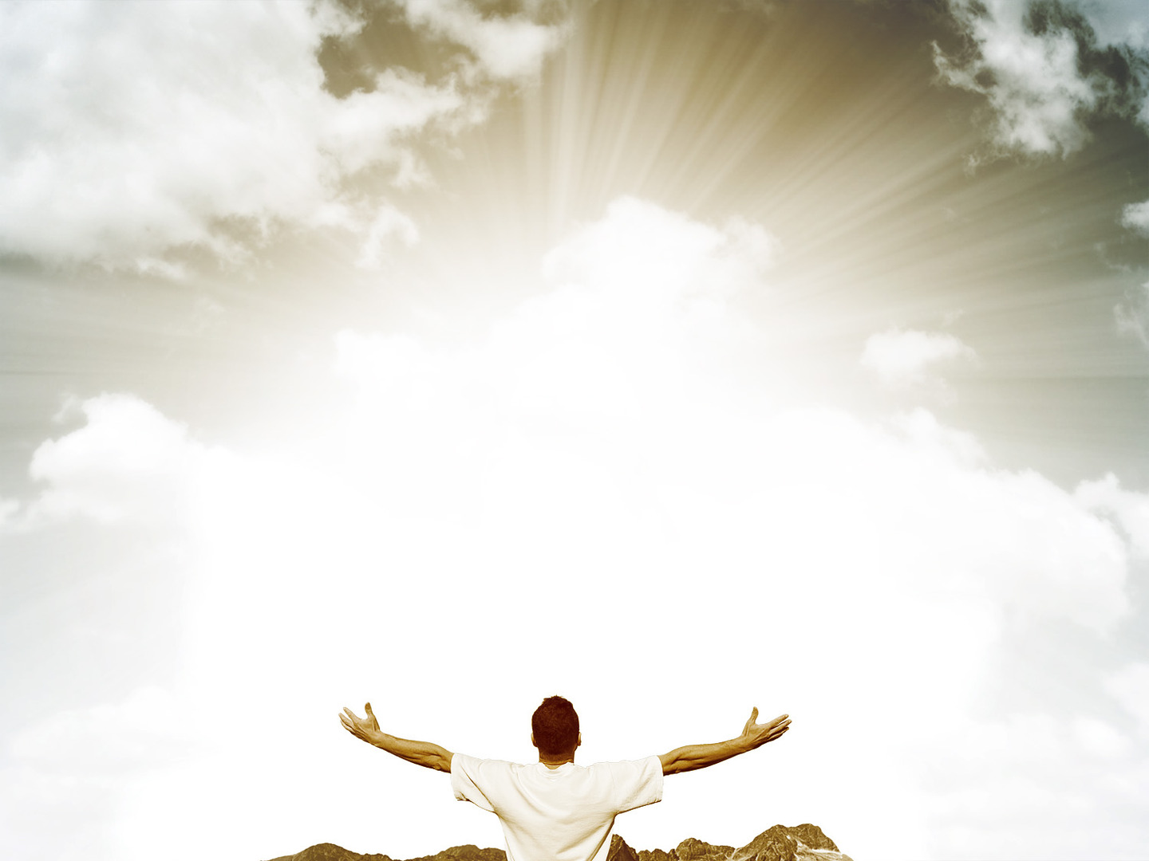
THE HOLINESS OF GOD
Isaiah 6:1-8
Notes:
Good morning everyone. I hope you are all doing well.
Today’s passage is perhaps the most climactic, overwhelming, and personal revelation in all of the Old Testament of God’s holiness
And perhaps one of our greatest needs as a church across the world is for an awareness of the holiness of God
And to have a personal encounter with the holiness of God through Scripture
But before we jump into today’s passage let me give some context
Isaiah was a prophet of Israel, some say the greatest prophet in the Old Testament
And Isaiah is speaking and ministering to the people of Israel during a time when the people wanted nothing to do with God
The nation had turned its back on God
And in chapters 2-5 Isaiah tells of some of the terrible sins that the people of God are committing
The kingdom of Israel is spiritually dead, and they are on the verge of being destroyed by the kingdom of Assyria, who are used as a vessel for God’s judgement upon them
But instead of turning their eyes back to God, they would live it up, for tomorrow they die
It is in this context that The Lord reveals Himself to Isaiah

Slide 2

THE SOVEREIGNTY OF GOD
“In the year that King Uzziah died” (Isaiah 6:1a)
“I saw the Lord” (Isaiah 6:1b)
“…sitting upon a throne, high and lifted up; and the train of his robe filled the temple” (Isaiah 6:1c)
Notes:
“In the year that King Uzziah died” (Isaiah 6:1a)
- This dates Isaiah’s vision somewhere around 740 BC
- Uzziah did a considerable amount for the nation of Israel
- During his reign of 50 years, Israel went through a time of economic prosperity, he was a great leader of their army and there was general progress for the land
- 2 Chronicles 26 tells us that “when he was strong, he grew proud, to his destruction”.
- And his pride caused him to be unfaithful to the Lord and he entered the temple of the Lord where only the priests can go
- Azariah and 80 other priests tried to warn him, but he became angry with them
- And at that moment God struck him with leprosy, and he remained a leper until the day he died
- His death signaled the end of a long period of time of relative peace and prosperity for Israel
- And it is during this time of uncertainty for Israel, that God reveals himself to Isaiah
“I saw the Lord” (Isaiah 6:1b)
- When Israel has rebelled against the Lord, and forgotten about Him, they are wondering who will lead the people, who could secure the future
- The word here for Lord is Adonai, which refers to God’s sovereignty, His sovereign rule
- It’s as though Isaiah is writing here, that in the year I saw Israel’s earthly king die, I saw the real King who will never die
- God alone is sovereign. He alone writes history in accordance with His own good will
- And it is at this point that God chooses to reveal Himself to remind Isaiah and all of Israel of this
- It’s as though he was reminding them that they were never meant to have earthly kings
- That they were only ever meant to bow the knee to God, and look at where earthly kings have put you
- In the hands of the Assyrian army, whom God has raised up for the judgement of His people Israel
- And we see here that Isaiah sees a picture of God, and the vision leaves us with more questions than answers, for his vision of God goes no higher than the robe of God
- And he’s…
“…sitting upon a throne, high and lifted up; and the train of his robe filled the temple” (Isaiah 6:1c)
- The throne high and lifted up is the ultimate symbol of sovereignty
- He sits above all earthly kingdoms, in the heavens, God answers to no one.
- He is not subject to any power, He reigns supreme over all, past, present and future
- His rule extends to each corner of history
- He is the one who raises kings up, and brings them down. He is the one who brings judgement or blessing upon nations
- And it is God who orders the steps of individuals. God does all things according to the purposes of His will
- A robe demonstrated how majestic a king was
- And so God is demonstrating and showing Isaiah His regal, His majesty, that He truly is the king of kings and Lord of Lords
- But then the vision slightly shifts from the Lord, to the ones surrounding Him

Slide 3
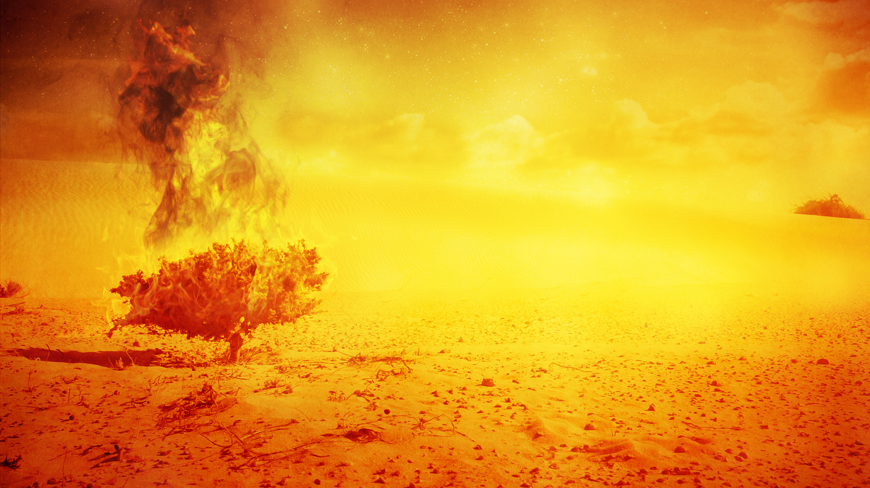
“Above him stood the seraphim” (Isaiah 6:2a)
“Each had six wings: with two he covered his face”
(Isaiah 6:2b)
“and with two he covered his feet, and with two he flew” (Isaiah 6:2c)
Notes:
“Above him stood the seraphim” (Isaiah 6:2a)
- The word here for seraphim means burning ones, or fiery ones
- They are the fiery guardians of the holiness of God
- They are burning with holy zeal to worship God in the splendour of His holiness
- We aren’t exactly sure how many seraphim surrounded God here, we get the impression that there is 2, but there also could have been thousands
- When we read Daniel 7:9-10, in Daniel’s vision of the Ancient of Days, it says,
- That “his throne was fiery flames, its wheels were burning fire. A stream of fire issued and came out from before him; a thousand thousands serve him, and ten thousand times ten thousand before him”
- So it is just as likely that Isaiah sees the Lord, high and lifted up, and His robe fills the temple and thousands of fiery, burning seraphim are surrounding this throne, about to burst out in song
- What an awesome, and terrifying sight this would have been to behold
“Each had six wings: with two he covered his face” (Isaiah 6:2b)
- For just as in Exodus 33 where God passes by Moses, and God hides Moses in the cleft of the rock, only allowing Moses to see God’s hind parts
- So it is with the seraphim, they cover their faces, not daring to gaze into the holiness and glory, of the sovereign, majestic, Lord of hosts
- They hide their faces to avoid being overwhelmed by the Supreme One.
- I mean these are sinless seraphim, even they dare not gaze directly at the King who reigns on high
“And with two he covered his feet, and with two he flew” (Isaiah 6:2c)
- Do you remember in Exodus 3, when God appears to Moses in the burning bush, and He calls out to Moses
- And he says to him, “Do not come near; take your sandals off your feet, for the place on which you are standing is holy ground”
- And Moses getting but a glimpse of the holiness of God in the burning bush, it says in verse 6, he hid his face, for he was afraid to look at God
- I think this is why the seraphim cover their feet, for they recognise they are unworthy to be in the presence of God, for the place in which they stand is holy ground
- They are making it clear to Isaiah that even they are unworthy to stand before the holiness of God
- And then with the other two they flew. Their remaining wings were used to fly at the beck and call of God, which we will see in verse 6
- And as if that wasn’t already overwhelming enough, Isaiah then hears the seraphim lift their voices in a terrifying call to one another

Slide 4

THE HOLINESS OF GOD
“And one called to another and said: “Holy, holy, holy is the Lord of hosts” (Isaiah 6:3a)
Everything about God is holy
“the whole earth is full of his glory!” (Isaiah 6:3b)
Notes:
“And one called to another and said: “Holy, holy, holy is the Lord of hosts” (Isaiah 6:3a)
- We know that in Scripture when it repeats a word, it is emphasising something,
- God wants the reader to pay attention to the repetition. It’s called a superlative
– But here the word is repeated 3 times. There is no other attribute of God in all of Scripture that is repeated 3 times like this
- God is not love, love, love, or truth, truth, truth. Nor His grace, or His mercy
- All of those things are important and essential to the character of God, but none of those are repeated 3 times
- To be holy is to be set apart. To be thrice holy is to be the holiest of all
- He is separate and alone in His holiness. He is so unfamiliar to us, and so beyond our comprehension.
- We cannot even begin to understand the holiness of God
- God is not like us, just better and more morally pure. God is in a category of His own.
- And dear friend, there is a very real sense in which that should strike fear into our hearts
- For this is the God who will call us all to account one day
- Here we have the sovereign Lord, the King of all kings.
- The Supreme One who raises kings up, and brings them down, the one who can bring a nation crashing down with but a mere breath
- And He is thrice holy. He is ethically pure, absolutely upright, and utterly true
- He is THE holy one
- This is the strongest form of the superlative in the Hebrew language, and even that doesn’t even begin to scratch the surface of just how holy God is
Everything about God is holy
- God’s holiness is not just one of His attributes, but as Joel Beeke, a pastor in America puts it:
- “There’s something about His holiness that radiates and pulsates through all the attributes of God”
- God’s love is holy, His wrath and His justice are holy, His goodness is holy
- And so what we need to understand is we cannot and must not ever try to reduce God to the way we define love, or wrath, or justice
- Because God is so transcendent, so other, His ways are higher than our ways
- We submit to Him and not the other way around
- For our decisions and emotions are tainted by sin, and yet His are flawless
- Every single act God has performed and will perform, every decree He issues flows from His perfect holy nature
- And so holiness is not just one of God’s attributes, but the very essence of His nature, and God alone is the supreme revelation of holiness
“The whole earth is full of his glory!” (Isaiah 6:3b)
- The glory of God is the visible manifestation of the character and conduct of God, which at its very core is God’s holiness
- God’s glory is the activity of God which shines forth for all to see which gives evidence of the holiness of God, which we read of elsewhere in Scripture
- In Romans 1:20 we read, “For his invisible attributes, namely, his eternal power and divine nature, have been clearly perceived, ever since the creation of the world, in the things that have been made."
- Or Psalm 19:1 puts it, “The heavens declare the glory of God, and the sky above proclaims his handiwork”
- God reveals who He is, His divine nature and attributes, His complete otherness and holiness through His creation
- Every attribute of God is adorned with His holiness, and it is a holiness that combines glory, and beauty, and honour, and majesty

Slide 5

“And the foundations of the thresholds shook at the voice of him who called, and the house was filled with smoke” (Isaiah 6:4)
“Shall walls and posts tremble before God, and shall we
not tremble?” Matthew Henry
It is the highest task of theology, and of our study of Scripture, to get a glimpse, to encounter the holiness
of God and His glory
Notes:
“And the foundations of the thresholds shook at the voice of him who called, and the house filled with smoke” (Isaiah 6:4)
- At the song of the seraphim the foundations of the temple begin to shake
- And smoke is filling the temple symbolising divine presence and the mystery of God
- For did this not also happen atop Mount Sinai when the Lord descended on it.
- There was thunder, and lightning, and fire, and trumpets blaring, and the mountain became wrapped in smoke as the mountain also trembled
- And when Jesus died, and curtain of the temple tore in two, what happened?
- The earth shook, and the rocks were split
- The shaking of the foundations and smoke is a manifestation of the majestic holiness of God
- There is no playing games with God. There is no toying around with Him, or you’ll be consumed
“Shall walls and posts tremble before God, and shall we not tremble?” Matthew Henry
- Too many people, too many Christians, too many churches, are content to never preach on a holy God.
- They will preach on a loving God, a graceful God, a merciful God
- But they will not preach on the holiness of God and the justice of God
- And yet all they have ended up doing is preaching a God that is not a God of the Bible
- Because instead of trembling and fearing this thrice holy God of the Bible, they fear man
- They fear the judgement of mankind, more than the judgement of an infinitely holy God
- They would rather hear the compliments and encouragements, and get pats on the back from humanity
- Rather than hearing, “well done good and faithful servant, you have preached the word faithfully, in season and out of season, now enter into the joy of your master”
- And yet the only reason a person can live their whole life in fear of only man is because they have never truly come to understand the holiness of God
It is the highest task of theology, and of our study of Scripture, to get a glimpse, to encounter the holiness of God and His glory
- To gaze upon God though His own self-revelation in the Scriptures
- To have our souls beautified by contemplating, and thinking deeply upon the majestic, beautiful, holy triune God
- To have a holy encounter, a holy awareness of the glory of God through the blood of Jesus Christ, is so overwhelming and yet is our highest task in theology
- We have all we need in Scripture, it is sufficient, for we no longer need a vision like Isaiah had because we “have the prophetic word more fully confirmed to us”
- “For men spoke from God as they were carried along by the Holy Spirit”
- And all that is contained within these 66 books is sufficient, it is enough
- For the Holy Spirit, the third member of the Trinity now guides us into all truth
- And applies it to our hearts, that we might even be able to get a glimpse of the holiness of God
- Oh to have more of His holiness shining into my heart, and consuming my thoughts through His word
- Flee to your Bibles, and stay there. And watch as the holiness of God humbles you, and beautifies your soul, making you more like Jesus, little by little, as God ushers you onwards to glory

Slide 6
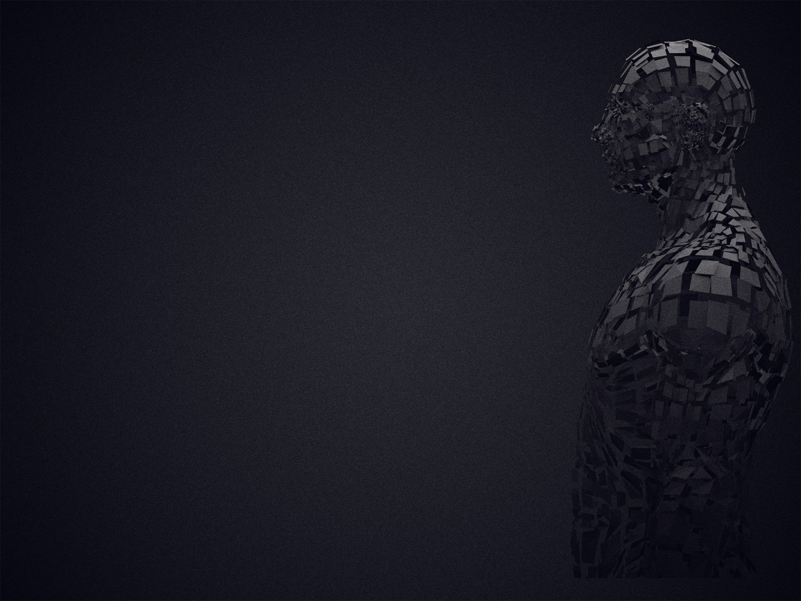
THE UNHOLINESS OF MAN
“And I said: ”Woe is me!” (Isaiah 6:5a)
“For I am lost” (Isaiah 6:5b)
“For I am a man of unclean lips” (Isaiah 6:5c)
Notes:
“And I said: “Woe is me!” (Isaiah 6:5a)
- These are the first words of Isaiah in this book out of his own mouth that aren’t from God
- This is far more than a sign of despair
- Just previously in Isaiah chapter 5 Isaiah pronounced a number of woes upon Israel;
- Verse 11, “Woe to those who rise early in the morning, that they may run after strong drink”
- Verse 18, “Woe to those who draw iniquity with cords of falsehood, who draw sin as with cart ropes”
- Verse 20, “Woe to those who call evil good and good evil”
- Verse 21, “Woe to those who are wise in their own eyes”
- Isaiah uses the word woe at least 10 times to refer to God’s judgement on others
- Jeremiah, Ezekiel, Nahum, Amos, Habakkuk, Hosea, Zephaniah, Zechariah, Micah, and even Jesus used it saying, “Woe unto you scribes and pharisees”
- It’s a word of cursing, particularly a prophetic curse, of God’s judgement towards people
- Isaiah having now got just a glimpse of the holiness and glory of God, sees himself clearly
- And sees that he is not worthy of anything but God’s judgement
- He is so overwhelmed by the majesty, sovereignty, and holiness of God, that it is as though the words fall out of his mouth, “Woe is me”
- He has become suddenly and brutally aware of himself in light of God’s holiness
- But his awareness does not stop with a prophetic curse upon himself…
“For I am lost” (Isaiah 6:5b)
- The LSB translates the word lost to ruined, or the NKJV translates it as undone
- This word means silenced, dumb struck, struck dead, on the brink of destruction
- It’s as though Isaiah is falling apart at the seams.
- He sees now that if God’s justice and wrath towards sin is unleashed upon him, he is all but a dead man
- In the face of such purity, such holiness, Isaiah is not struck by his own humanity or mortality, but by his own impurity.
- It’s as though in the light of God’s holiness, God illumined inside of him, just how black and wretched his own heart was
- And in that very moment, he felt as though he might die
- Christians, brothers and sisters in Christ, have you ever been so overwhelmed by your own sinfulness and the presence of God’s holiness?
- When was the last time we were in anguish over our sin because we got a glimpse of the holiness of God?
“For I am a man of unclean lips” (Isaiah 6:5c)
- It’s as though he sees the seraphim worshipping, but sees that his lips are oh so unworthy to declare the holiness of God with them
- He thinks back on the judgements and woes he has pronounced on Israel with his lips, and thinks, “Who am I to be a messenger of God?”
- He sees that he is but an imperfect preacher, with imperfect words, a dying man, preaching to dying men, “Who am I that God would choose me?”
- And yet I believe he is also pointing beyond the lips and to the heart, that yes, his lips are unclean, but it is because he has an unclean heart
- As the gospel of Matthew says, ”For out of the abundance of the heart the mouth speaks” and “what comes out of the mouth proceeds from the heart”
- My sinful words, portray my sinful nature, my sinful heart
- And we see this sense of being ruined elsewhere in Scripture.
- When Jesus in Luke 5, after a long night of no fish being caught, demonstrates his power
- By bringing in boat loads of fish, so much so that the boats are sinking
- And Peter comes to the shore, falls to his knees and says, “Depart from me, for I am a sinful man, O Lord”
- Peter has just witnessed, the holiness, the power, the glory of Jesus the God-man, his complete otherness
- And much like Isaiah, he sees how unclean and how unworthy he is to be in his presence, that he says to Jesus, “Depart from me”.
- He feels naked, he feels exposed
- It is only by the mercy of God, that you and I are not consumed at this moment as a result of God’s holiness and perfect purity

Slide 7
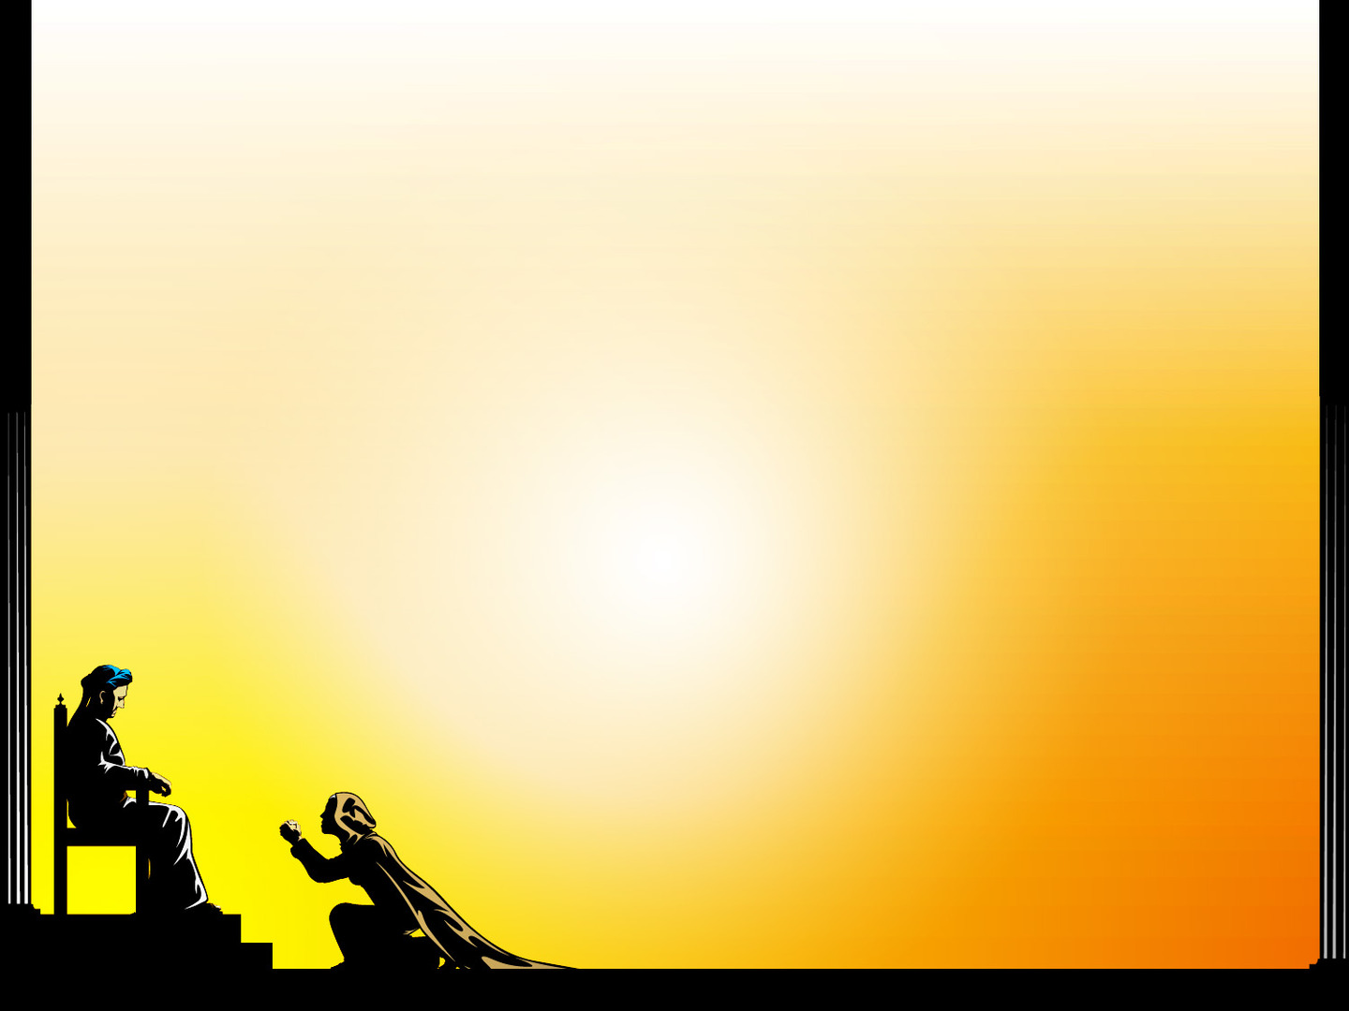
“And I dwell in the midst of a people of unclean lips”
(Isaiah 6:5d)
“For my eyes have seen the King, the Lord of hosts!”
(Isaiah 6:5e)
Christians, we must never forget the God whom we serve
Notes:
“And I dwell in the midst of a people of unclean lips” (Isaiah 6:5d)
- And now we see that he hasn’t just become painfully aware of his own sinfulness
- But he looks around, not accusatory, but with a heart of understanding why God’s judgement and wrath will fall upon Israel
- And I also believe that Isaiah now looks around with a pastoral heart, and sees just how in desperate need of repentance and salvation the people of Israel are
- So much so, that when in verse 8 the Triune God asks, “Who will go for us”, Isaiah says, “Here I am send me”
- Isaiah sees that he is a sinful preacher, among a sinful, unholy and imperfect people
- I mean this is the nation that God calls His own, and they were called to be holy, they were called to be set apart from the rest of the world
- And to go into world to help people see they need to repent and believe in the holy God
- But instead of being holy, they become just like the rest of the pagan nations, unholy, and conformed to the image of the world
- And Isaiah having now seen His sin, doesn’t turn to God and say, “they do it, look how sinful they are, I am better than them at least”
- No, he looks around and sees just how lost they are and how desperately they too need to have the holiness of God revealed to them.
- It’s as though he is overcome with grief over their lost souls
- But where does this sense of ruin, and anguish, and ‘undoneness’ come from?
“For my eyes have seen the King, the Lord of hosts!” (Isaiah 6:5e)
- Now that king Uzziah is dead, now that the lesser king is removed
- Isaiah is saying I have seen the greater one, the one who reigns above, and is sovereign over all
- One glimpse of Lord of the hosts, and he saw for the first time in his life, just how wretched he is
- No one can stand before the holiness of God, and not experience something similar, becoming painfully aware of the darkness and corruption that resides in their hearts
- Romans 3 tells us that “No one is righteous, no, not one… no one does good, not even one… their feet are swift to shed blood; in their paths are ruin and misery, and the way of peace they have not known.”
- And it’s as though Paul hears someone from the audience call out, but why Paul, why are we like this?
- Verse 18, “There is no fear of God before their eyes”
- Oh that God would reveal Himself to us, shine His holiness into the darkest depths of my soul, exposing all my sin
- What can do this but His Word.
- For His word is sharper than a two-edged sword, it penetrates to the darkest corners of my soul, exposing who I am
- That my sin might be ever before me, that I might confess it, and find forgiveness only in the blood of Jesus Christ, shed for all my sins
Christians, we must never forget the God whom we serve
- Many in the world ask, ”if God is real, then why do we suffer, why is there trouble in the world? If your God is a God of love, why does this happen?”
- John Macarthur responds to that, “If God weren’t a God of love, one sin, by one individual, would be the end of everything”
- We want a God who is non-threatening who bows to us. But that’s not the God of the Bible
- And so when we preach the gospel, when we share the good news, we preach every part of the gospel
- And we preach the holiness and justice of God, that it might bring them to their knees
- That they might see just how much it cost for the sinless saviour, to go to that cursed tree and pay the price for their sins and my sins, and have the holy justice of God poured out upon him, instead of me
- Because it is only then, that we begin to understand the fullness of God’s grace in saving us

Slide 8

THE GRACIOUS HOLINESS OF GOD
“Then one of the seraphim flew to me, having in his hand a burning coal that he had taken with tongs from the altar” (Isaiah 6:6)
“And he touched my mouth and said: “Behold, this has touched your lips” (Isaiah 6:7a)
“Your guilt is taken away…”
(Isaiah 6:7b)
Notes:
“Then one of the seraphim flew to me, having in his hand a burning coal that he had taken with tongs from the altar” (Isaiah 6:6)
- What we see in these next two verses is an infinitely holy God, in all His splendour and majesty, demonstrate His grace towards a finite, unworthy sinner like Isaiah, and like you and me
- God, seeing that Isaiah is broken, sends one of His messengers, the seraphim with a burning coal, which he holds in tongs
- Not because it is hot, but because it is holy
- This burning coal I believe refers back to the altar of the burnt offerings on the Day of Atonement in Leviticus 16
- When the high priest would offer a sacrifice for the sins of the people of Israel, as a sign which pointed to the once for all sacrifice for sins, the Messiah, Jesus Christ
- If you want to turn to Leviticus 16 starting from verse 11-14
- And so what we see here is that the coals would be offered up as an incense of prayer to God inside the veil of the holy of holies on this Day of Atonement
- And I believe it is this coal that the seraphim picks up with tongs
“And he touched my mouth and said: “Behold, this has touched your lips” (Isaiah 6:7a)
- Isaiah is broken over his sin, full of despair and without hope
- There is no promises to do better, or a promise to follow God if he will give Isaiah a fresh start
- Isaiah confesses and sees that the only thing he has to offer God is his sin
- And God in His holiness and in His mercy and His grace, sends the seraphim to touch his mouth, his lips
- The very thing which Isaiah confessed in the previous verses
- How does a holy God come to forgive those who have made themselves His enemies
- God reveals Himself to them, He shows us just how lost, how ruined, how undone we are and how broken we are in light of His holiness
– And He grants us repentance and faith
– Psalm 51 – David’s great prayer of repentance says, “The sacrifices of God are a broken spirit; a broken and contrite heart, O God, you will not despise”
- And upon a broken and contrite heart, and God granting us repentance and faith, something so miraculous happens
“Your guilt is taken away…” (Isaiah 6:7b)
- In true salvation, there is wrestling, there is pain, there is no cheap grace, no easy believism, but for the sinner who by the grace of God, places faith in Christ alone
- Their sin, their guilt is taken away.
- Isaiah’s sin is taken away, he was on the brink of destruction, of being ruined, and now his guilt is removed
- It is removed as far as the east is from the west.
- Isaiah has been pardoned, worthy of an eternity in hell, but by the grace of God, set free
- There is free forgiveness by the sheer mercy and grace of the holy God
- Isaiah did nothing to earn it
- Isaiah simply confessed His sin, and he received the grace of God
- But how is this possible? Isaiah has gone from being unholy, to holy, being set apart unto God
- How is this just, how is this fair?

Slide 9
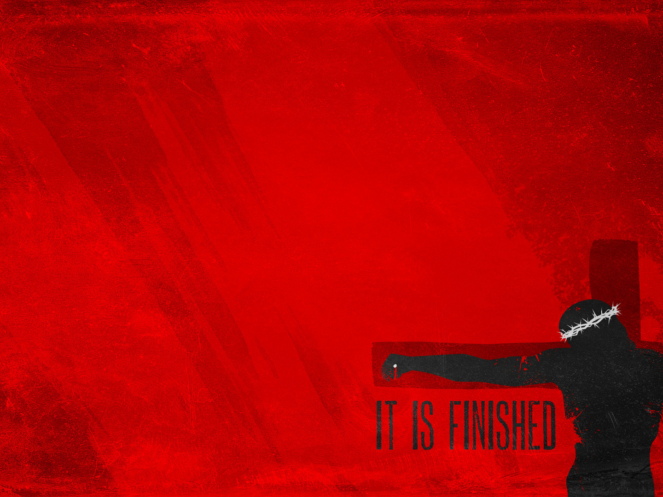
“And your sin atoned for” (Isaiah 6:7c)
This is the gospel, all of this points us to the cross
And now, having been saved by the grace of God, God now continues to work in Isaiah, and sets him apart
to be holy, to do His will (Isaiah 6:8)
Notes:
“And your sin atoned for” (Isaiah 6:7c)
- Isaiah sins were atoned for. His sins were paid for in full
- By nothing that he did, or nothing that he will do
- God’s justice and wrath have been satisfied, the payment for Isaiah’s sins have been paid in full
This is the gospel, all of this points us to the cross
- Jesus Christ lived the perfect life, sinless, and went to the cross to pay for the sins of all who would believe
- And he did so in full, because as he was dying, what were his last words?
- “It is finished”
- And on the third day he rose from the grave for our justification, demonstrating the payment for sin was paid in full and accepted
- And so now all who will repent and believe in Jesus Christ as Lord and Saviour, have their guilt taken away, and their sins atoned for
- Jesus Christ went to the cross for sinners like you, and me, and Isaiah, to save us from the all-consuming fire of God’s blazing holiness for all eternity
- Jesus was the propitiation, the satisfaction of God’s wrath and justice for all our sins, so that God is both just and justifier of the one who places faith in Christ
- And so now, dear saint, in the words of an old hymn
- “When Satan tempts me to despair
And tells me of the guilt within
Upward I look and see Him there
Who made an end to all my sin
Because the sinless Saviour died
My sinful soul is counted free
For God the Just is satisfied
To look on Him and pardon me
To look on Him and pardon me”
And now, having been saved by the grace of God, God now continues to work in Isaiah, and sets him apart to be holy, to do His will (Isaiah 6:8)
- “And I heard the voice of the Lord saying, “Whom shall I send, and who will go for us?” Then I said, “Here I am! Send me”
- Christian, what else is there for you to do, when you see just how unworthy and sinful you are
- And are then set free by the grace of God, through the sacrifice of His one and only Son
- When God beckons us into His army, and says, “Who will go”, “Who will go out as a sheep amongst wolves, to preach the gospel, to be set apart from the world, to live a life ever relying on the grace of God? Who will take up their cross? Who will go?”
- “Here I am, send me”
- When God’s forgiveness is so great, and His grace so amazing, what else can we do?
- There is no other response other than a life consecrated, committed, and surrendered unto the will of God
- God saves and sanctifies, for the only good we do, is Christ in us.
- And we press on in this life until one day when all is said and done
- He will glorify us, where we will spend an eternity gazing into the holiness of God, calling to one another with the seraphim, “holy, holy, holy is the Lord of hosts”
- Christian, this is where our hope lies

Slide 10

SUMMARY
Though earthly kings will come and go, God will always be on the throne, sovereign over all
God alone is holy, holy, holy
Today, through the Holy Spirit taking and applying the word of God to our hearts, we too can encounter
the holiness of God
Let the holiness of God drive us to high thoughts of God
and low thoughts of ourselves
Notes:
Though earthly kings will come and go, God will always be on the throne, sovereign over all
- Though you may look around and think all is lost
- Do not fear dear Christian, for God is sovereign, and He alone is sitting upon a throne in heaven, high and lifted up
God alone is holy, holy, holy
- There is none like Him, He is in a category all of His own
- He is so transcendent and so other, that we fail to comprehend just how distinct and Holy He is
Today, through the Holy Spirit taking and applying the word of God to our hearts, we too can encounter the holiness of God
- Not only can we, but I would say we must, for it is a glimpse of the holiness of God, shining forth into our hearts
- That is the very life-breath of God-centred obedience
- And I pray that we would respond to the holiness of God with awe, wonder, conviction of sin and surrender to His grace
Let the holiness of God drive us to high thoughts of God and low thoughts of ourselves
- As we gaze through Scripture and see the character of this thrice holy God, He becomes so big, and we become so small
- We need a renewed sight of God’s holiness in His word, and as we study the Scriptures
– The Holy Spirit will work in us, conforming us to the image of Christ, and making us holy that we might glorify God in all that we do.
- Let me close with this quote

Slide 11
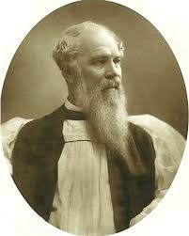
“Holiness is the habit of being of one mind with God, according as we find His mind described in Scripture. It is the habit of agreeing in God’s judgment —hating what He hates — loving what He loves — and measuring everything in this world by the standard of His Word.”
J.C. Ryle
Notes:
“Holiness is the habit of being of one mind with God, according as we find His mind described in Scripture. It is the habit of agreeing in God’s judgment — hating what He hates — loving what He loves — and measuring everything in this world by the standard of His Word.” - J.C. Ryle
My dear Christians, let us be a church who loves what God loves, and hate what God hates
Let us be a church built upon the firm foundation of the Word of God
And as we study the Scriptures, and preach through the Scriptures
Let us urge one another onward to holiness, keeping our eyes fixed on the day when we will spend forever and ever in His holiness, and in His glory

