Slide 1
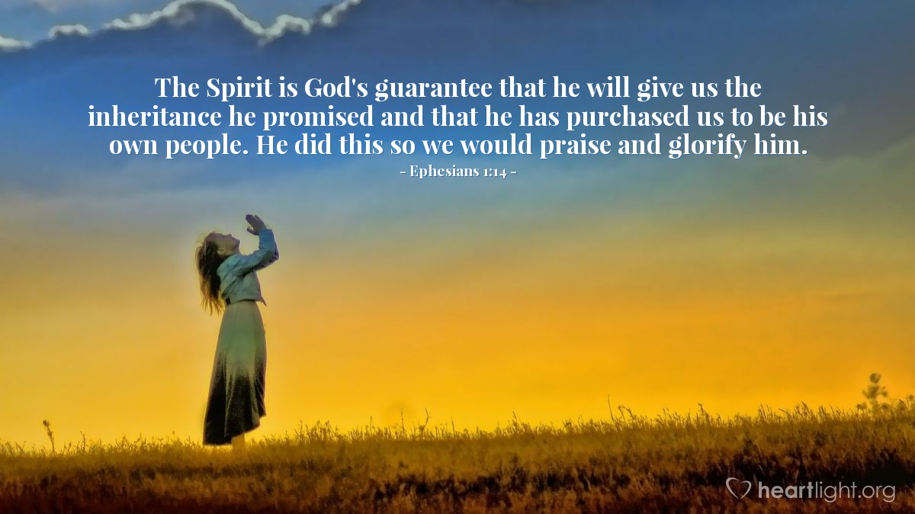
Predestination
Made Easy ?
Ephesians 1: 1 - 14
Notes:
Introduction Today, I want to take you on a journey to understand the profound and often complex doctrine of predestination. This theological concept has intrigued and puzzled many believers throughout history. It touches on the very nature of God’s sovereignty, grace, and our place in His divine plan. Let's explore this together with hearts open to the wisdom and mystery of our Lord.

Slide 2
DEFINITION of Predestination
The word predestination is composed of two parts: “Pre” meaning “before” and “destination” meaning “point of final arrival.”
To predestine something is to determine beforehand where it will end up.
Notes:
Answer these questions soon.

Slide 3
DEFINITION of Predestination
The word predestination is composed of two parts: “Pre” meaning “before” and “destination” meaning “point of final arrival.”
To predestine something is to determine beforehand where it will end up.
If you contemplate this doctrine for awhile, you’ll have to face some difficult questions:
If predestination is true, what happens to human responsibility?
Are we just robots, doing what God has ordained?
If some are predestined to heaven, then why bother with evangelism?
Notes:
Answer these questions soon.

Slide 4
DEFINITION of Predestination
The word predestination is composed of two parts: “Pre” meaning “before” and “destination” meaning “point of final arrival.”
To predestine something is to determine beforehand where it will end up.
If you contemplate this doctrine for awhile, you’ll have to face some difficult questions:
If predestination is true, what happens to human responsibility?
Are we just robots, doing what God has ordained?
If some are predestined to heaven, then why bother with evangelism?
If you believe that the triune God is sovereign, then predestination is not an issue.
Whereas, ultimate chance is problematic and frightening.
Notes:
Answer these questions soon.

Slide 5
God’s Plan
From the beginning of time, God’s predestined plan was for the redemption of His people.
Even when God made the world He foresaw its ruin and provided for the fulfillment of His basic plan in spite of sin.
Isaiah, Daniel, Jonah, etc., all point to God’s predestined plan for the world..
God the Father always had the predestined plan to send His only Son to save us from ourselves..
Christ’s crucifixion & resurrection were all preordained by God.
Acts 4: 28, “They did what your power & will had decided beforehand should happen.”

Slide 6
Grace and Free Will
God’s grace is the foundation of our salvation. Through His grace, we are empowered to make choices that align with His will. Our free will operates within the framework of God's sovereign plan.
Notes:
This topic has caused friendships to fracture, churches to split and divided Christians into different doctrinal groups.
One of the common concerns about predestination is its relationship with human free will.

Slide 7
Grace and Free Will
God’s grace is the foundation of our salvation. Through His grace, we are empowered to make choices that align with His will. Our free will operates within the framework of God's sovereign plan.
Predestination is not about God arbitrarily deciding our fate without regard to our choices. Rather, it emphasises that God's grace and purpose are at work in our lives, guiding us towards His divine will.
Notes:
This topic has caused friendships to fracture, churches to split and divided Christians into different doctrinal groups.
One of the common concerns about predestination is its relationship with human free will.

Slide 8
Grace and Free Will
God’s grace is the foundation of our salvation. Through His grace, we are empowered to make choices that align with His will. Our free will operates within the framework of God's sovereign plan.
Predestination is not about God arbitrarily deciding our fate without regard to our choices. Rather, it emphasises that God's grace and purpose are at work in our lives, guiding us towards His divine will.
Paul contends that man is responsible for his acts, therefore everything good or evil is done by US.
Man is responsible for his own sin and fall; God predestines the salvation.
Notes:
This topic has caused friendships to fracture, churches to split and divided Christians into different doctrinal groups.
One of the common concerns about predestination is its relationship with human free will.

Slide 9
Are We Just God’s Puppets?
Predestination forms the continuous thread that connects Everything in our fallen world.

Slide 10
Are We Just God’s Puppets?
Predestination forms the continuous thread that connects Everything in our fallen world.
Paul in Ephesians, Romans & 1 Corinthians is saying everything exists and acts only in obedience to the will of God.

Slide 11
Are We Just God’s Puppets?
Predestination forms the continuous thread that connects Everything in our fallen world.
Paul in Ephesians, Romans & 1 Corinthians is saying everything exists and acts only in obedience to the will of God.
Israel and ourselves are NOT God’s puppets.

Slide 12
Are We Just God’s Puppets?
Predestination forms the continuous thread that connects Everything in our fallen world.
Paul in Ephesians, Romans & 1 Corinthians is saying everything exists and acts only in obedience to the will of God.
Israel and ourselves are NOT God’s puppets.
Nations and individuals act in their own free will, i.e. to say Yes or No to Christ.

Slide 13
Are We Just God’s Puppets?
Predestination forms the continuous thread that connects Everything in our fallen world.
Paul in Ephesians, Romans & 1 Corinthians is saying everything exists and acts only in obedience to the will of God.
Israel and ourselves are NOT God’s puppets.
Nations and individuals act in their own free will, i.e. to say Yes or No to Christ.
We are free to choose election in Christ, or reject Him and go to hell.
(Therefore, the one who rejects Christ can only blame himself.)

Slide 14
Are We Just God’s Puppets?
Predestination forms the continuous thread that connects Everything in our fallen world.
Paul in Ephesians, Romans & 1 Corinthians is saying everything exists and acts only in obedience to the will of God.
Israel and ourselves are NOT God’s puppets.
Nations and individuals act in their own free will, i.e. to say Yes or No to Christ.
We are free to choose election in Christ, or reject Him and go to hell.
(Therefore, the one who rejects Christ can only blame himself.)
As Christians, We are predestined to conform to the image of Christ.

Slide 15
The Creator can do whatever He wants with that which He has created.
If people resist and reject God, they end up preparing their own destruction.
Not everyone is going to heaven. Left to ourselves, we’ll all go to hell. No one deserves heaven. If we go to heaven it’s because someone else paid the price for admission. JESUS
Genesis 2:7 says that we are formed from the dust of the ground, but we are designed with a purpose.
Are We Just God’s Puppets?

Slide 16

Robots or Not
Predestination is NOT fatalism or a mechanistic system, i.e. human choices & decisions really do not make a difference, because no matter what we do things are going to turn out as they were previously ordained.

Slide 17
Robots or Not
Predestination is NOT fatalism or a mechanistic system, i.e. human choices & decisions really do not make a difference, because no matter what we do things are going to turn out as they were previously ordained.
In a true fatalistic system, our humanity is destroyed and moral accountability is removed., i.e. free will is removed.

Slide 18
Robots or Not
Predestination is NOT fatalism or a mechanistic system, i.e. human choices & decisions really do not make a difference, because no matter what we do things are going to turn out as they were previously ordained.
In a true fatilistic system, our humanity is destroyed and moral accountability is removed., i.e. free will is removed.
Romans 8: 29, “For those he foreknew he also predestined to conform to the image of His Son.”
Called – Justified – Glorified, to conform to the image of Christ, which has been predestined when we Accept that call.

Slide 19
Robots or Not
Predestination is NOT fatalism or a mechanistic system, i.e. human choices & decisions really do not make a difference, because no matter what we do things are going to turn out as they were previously ordained.
In a true fatilistic system, our humanity is destroyed and moral accountability is removed., i.e. free will is removed.
Romans 8: 29, “For those he foreknew he also predestined to conform to the image of His Son.” Called – Justified – Glorified, to conform to the image of Christ, which has been predestined when we Accept that call.
God preordained that the Gospel message would be the means of bringing us to salvation, and NOT a means of using us as puppets. (Free Will)

Slide 20
Accept or Reject
First, from our human standpoint, we are completely free. When you wake up in the morning, you have a choice to get out of bed or to stay in bed. You can wear shorts or trousers. When you get in your car, you’re free to drive to work or you can head to Perth if you like. Every decision you make is a free choice.

Slide 21
Accept or Reject
First, from our human standpoint, we are completely free. When you wake up in the morning, you have a choice to get out of bed or to stay in bed. You can wear shorts or trousers. When you get in your car, you’re free to drive to work or you can head to Perth if you like. Every decision you make is a free choice.

Slide 22
Accept or Reject
First, from our human standpoint, we are completely free. When you wake up in the morning, you have a choice to get out of bed or to stay in bed. You can wear shorts or trousers. When you get in your car, you’re free to drive to work or you can head to Perth if you like. Every decision you make is a free choice.
Here's election. God voted for you; Satan voted against you; you cast the deciding vote, you know; you determine your destiny.
Jesus said to the disciples: “You haven't chosen Me; I chose you.” (JN 15:16) And in Thessalonians, Paul writes to the Thessalonians and emphasises the fact that they are saved by God's choice, God's choice. And then the other problem with that is that ultimately, ultimately, if it's my choice, which quite often I'm going to make the wrong choice.

Slide 23
"Predestined to be conformed to the image of His Son."
Salvation starts with God and ends with God. If predestination is true, it means that we can never claim any credit for our salvation. We don’t even get points for seeking the Lord because he sought us before we sought him.
Harry Ironside told of a prayer meeting where a man gave a stirring testimony of God’s grace in his life. Afterwards someone came up to him and said, “My brother, that was a fine testimony you gave. You talked a lot about God, but you didn’t mention your own part in salvation.” The man thought for a moment and then said, “You’re right. I did leave that out. My part was to run away from God as fast as I could, and God’s part was to run after me until he caught me.” So it is with all of us. We do the running away and God does the catching. We’re in charge of being lost. God is in charge of saving us.
Notes:
Henry Allan "Harry" Ironside was a Canadian–American Bible teacher, preacher, theologian, pastor and author who pastored Moody Church in Chicago from 1929 to 1948.

Slide 24
"Predestined to be conformed to the image of His Son."
Another example.
The father of a family has children and, in his mind, decides: “I want my children to study medicine”. At the right time he finds a teacher, gives them the appropriate study books so that they can grow up to be doctors. However, if they do not want to study medicine, then why would he bother to get books, find a teacher etc.
This thought, arrangement or disposition may have been in the father’s mind before the children were born.
To have such things carried out required “predestination”.

Slide 25
It is right for each Christian to ask themselves,
“Why am I a Christian?”
“What is the final reason why God decided to save me?”

Slide 26
It is right for each Christian to ask themselves,
“Why am I a Christian?”
“What is the final reason why God decided to save me?”
The doctrine of election & predestination tells us that I am a Christian simply because God decided to set his love on me.

Slide 27
It is right for each Christian to ask themselves,
“Why am I a Christian?”
“What is the final reason why God decided to save me?”
The doctrine of election & predestination tells us that I am a Christian simply because God decided to set his love on me.
“But why did He decide to set His love on me?”

Slide 28
It is right for each Christian to ask themselves,
“Why am I a Christian?”
“What is the final reason why God decided to save me?”
The doctrine of election & predestination tells us that I am a Christian simply because God decided to set his love on me.
“But why did He decide to set His love on me?”
Even with my sin, He simply decided to love me. He created me and then sent His Son to save me from myself and my life of sin.

Slide 29
It is right for each Christian to ask themselves,
“Why am I a Christian?”
“What is the final reason why God decided to save me?”
The doctrine of election & predestination tells us that I am a Christian simply because God decided to set his love on me.
“But why did He decide to set His love on me?”
Even with my sin, He simply decided to love me. He created me and then sent His Son to save me from myself and my life of sin.
Remember, He is Sovereign God and He can do whatever He desires or preordains.

Slide 30
It is right for each Christian to ask themselves,
“Why am I a Christian?”
“What is the final reason why God decided to save me?”
The doctrine of election & predestination tells us that I am a Christian simply because God decided to set his love on me.
“But why did He decide to set His love on me?”
Even with my sin, He simply decided to love me. He created me and then sent His Son to save me from myself and my life of sin.
Remember, He is Sovereign God and He can do whatever He desires or preordains.
It should humble us and make us to realise that we have no claim on God’s grace. Our salvation is totally due to God’s eternal grace alone.

