Slide 1
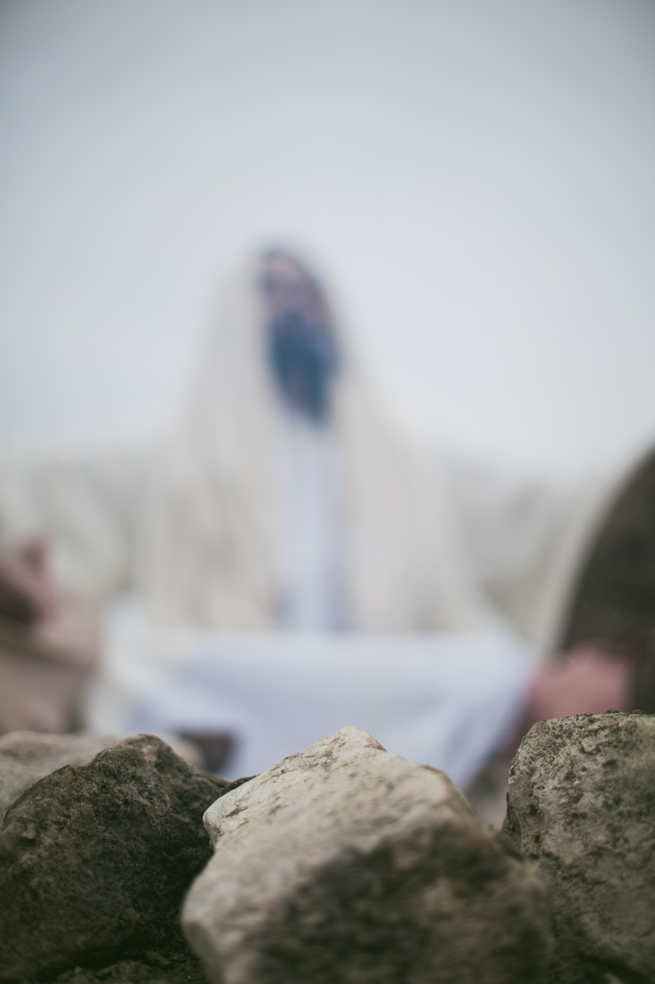
James
Study 8
Two Kinds of Wisdom
James 3:13-18
Faith in Action

Slide 2
James
FAITH AND ENDURANCE
TRIALS AND TEMPTATION
LISTENING AND DOING
THE FOlly of Favouritism
All or Nothing
Faith That Works
Who Can Tame the Tongue?
Faith in Action

Slide 3
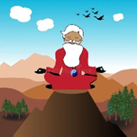
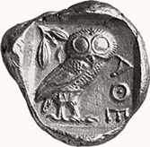
What is the difference between knowledge and wisdom?
Knowledge is the accumulation and understanding of information, facts and observations that you get by study or experience
Wisdom is the ability to use that knowledge to apply ethical and sensible judgements to a given situation

Slide 4
1 Corinthians 1: 19-23:
“As the Scriptures say, “I will destroy the wisdom of the wise and discard the intelligence of the intelligent.”
So where does this leave the philosophers, the scholars, and the world’s brilliant debaters? God has made the wisdom of this world look foolish. Since God in his wisdom saw to it that the world would never know him through human wisdom, he has used our foolish preaching to save those who believe. It is foolish to the Jews, who ask for signs from heaven. And it is foolish to the Greeks, who seek human wisdom. So, when we preach that Christ was crucified, the Jews are offended, and the Gentiles say it’s all nonsense.”

Slide 5
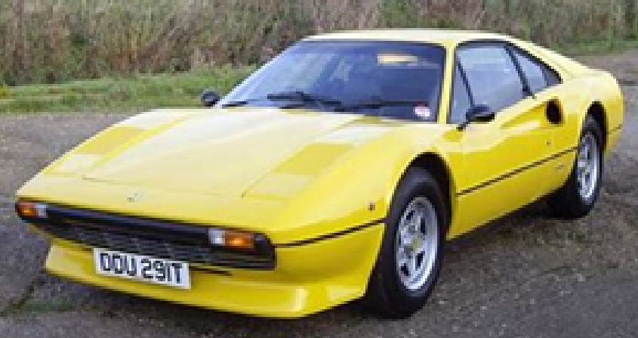
1985 Ferrari 308 GTB
The world offers us a wisdom based in human values, but it is a pale imitation of the real wisdom that God offers us
Jesus said: “Everyone then who hears these words of mine and does them will be like a wise man who built his house on the rock.” (Mt 7:24)

Slide 6
James 3:13
“If you are wise and understand God’s ways, prove it by living an honourable life, doing good works with the humility that comes from wisdom.”
What evidence is there that we are followers of Christ’s teachings?
Philippians 2:3-4 “Let nothing be done through selfish ambition or conceit, but in lowliness of mind let each esteem others better than himself. Let each of you look out not only for his own interests, but also for the interests of others.”

Slide 7
How does our reading in James define God’s wisdom (Gk - sophia)?
First of all Pure – (Gk – hagne)
Peace loving – (Gk – eirēnikē)
Gentle – (Gk – epieikēs)
Reasonable – (Gk – eupeithēs)
Merciful – (Gk – eleous)
Good deeds – (Gk – karpōn)
Impartial – (Gk – adiakritos)
Sincere – (Gk – anypokritos)
Righteous – (Gk – dikaiosynēs)

Slide 8
Summary
A worldly wisdom that is increasingly self-centred. It is evil and comes from the Devil
Then there is a wisdom that comes from God
Romans 12:2 ‘Do not conform to the pattern (or wisdom) of this world, but be transformed by the renewing of your mind’
Proverbs 14:12 ‘There is a way that seems right to a person, but its end is the way to death.’

Slide 9
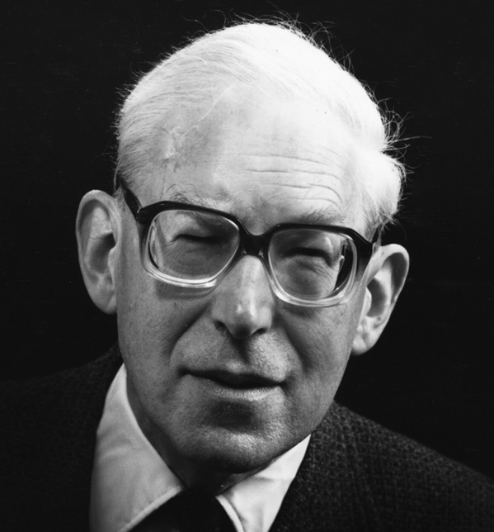
‘Not until we have become humble and teachable, standing in awe of God's holiness and sovereignty, acknowledging our own littleness, distrusting our own thoughts, and willing to have our minds turned upside down, can divine wisdom become ours.’
J.I. Packer

Slide 10
James
Study 8
Two Kinds of Wisdom
James 3:13-18
Faith in Action

