Slide 1
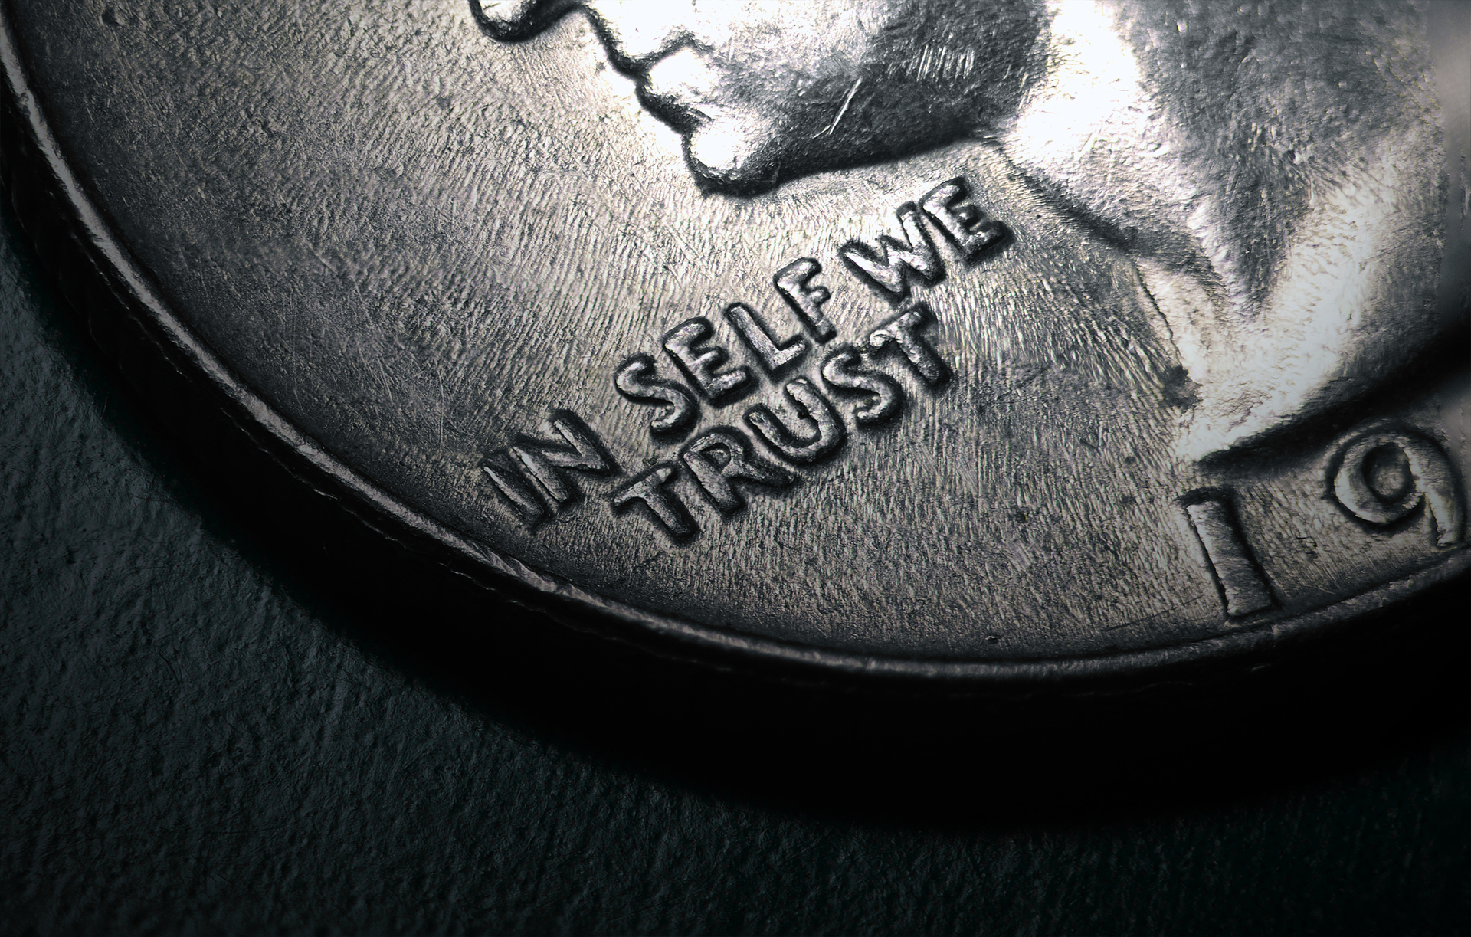
PRIDE AND HUMILITY
(Stop Playing God)
James 4:13-17
Notes:
Good morning everyone. I hope you are all doing well
Well, it’s my pleasure and privilege to be up here today to preach to you from the book of James
If you would open your Bibles with me, and we will open up to James 4
And the focus of today’s message will be on verses 13-17
James has a way with words, he pulls no punches, is straight to point, and just tells it how it is
And today’s passage is no different
We will see in today’s passage, the folly of human planning
The wisdom of godly planning, and the humility that is required in godly planning
This passage today, I think is convicting and extremely relevant and applicable to our world today
Because everyone makes plans. James is not rebuking the making of plans, in fact it is wise to make plans
What James rebukes is the making of plans without thinking about the will of God
In our culture today, I believe we have become desensitised to the sin of planning without taking into account the will of God
So much so, that perhaps we would struggle to even see it as a sin because of how ‘normal’ it is
But as we are going to see today, James makes it very clear, that to look ahead to the future in our life, without God’s will at the forefront, is arrogant and sinful
So let’s get into today’s passage

Slide 2

THE FOLLY OF HUMAN PLANNING (Vs 13-14)
“Come now, you who say” (James 4:13a)
“Today or tomorrow we will” (James 4:13b)
“go into such and such a town and spend a year there and trade and make a profit” (James 4:13c)
Notes:
Come now, you who say” (James 4:13a)
- The word ‘come’ is in the imperative, meaning this isn’t just an invitation, this is a command
- It is both a transitional phase from the last section to this one, but it is also used to get the readers attention
- James is wanting to give them a wake-up call. It is a rebuke.
- He is commanding them to examine themselves and to consider what he is about to say
- What James is about to discuss, is such a common thing in our society today, such a normal thing
- That even in the church we fail to see the sinful nature of it, which is what makes this sin of presumption so dangerous
- It’s dangerous because we have normalised it, and when we do that, we become numb to it
- My dear brothers and sisters, we must never become numb to sin, we must never fail to remember that it was sin that put Jesus on that cursed tree
- That it was for all your sins and mine, that Jesus suffered the wrath of God.
- So we must not become numb to sin
- And so we too must pay careful attention, we too must, “Come now”
“Today or tomorrow we will” (James 4:13b)
- It’s important to note, that James is not condemning planning, or being good stewards of our time
- That is a wise thing to do
- The sin lies in the way these merchants went about making their plans. Today or tomorrow WE WILL
- As though what they willed was guaranteed to happen. That what they promised to themselves was bound to happen
- James is exposing the sin of presumption and self-confidence
- The sin of presumption is thinking, or believing, or living our lives as though we can continue to live as a result of our own wills
- As though we are the masters of our own destiny
- That when these merchants left on their business trip, or what happens for anyone of us today or tomorrow simply needs to be decided by us and it will happen
- Now remember James is talking to Christians here, which is why he comes down so hard on them
- To behave like this, is to completely lay aside God’s providence, His sovereignty. It is practical atheism
- Meaning that although you may call yourself a Christian, say you believe in a God, you live your life as though He doesn’t exist. That’s practical atheism
- But the error of James’ audience doesn’t end there
“Go into such and such a town and spend a year there and trade and make a profit” (James 4:13c)
- Not only was the plan concocted entirely of their own wills, but how long they would live in these towns, as though the year was guaranteed to them
- And even the results of their business venture were certain.
- Why? Because they were arrogant enough to think that them waking up tomorrow and breathing was certain
- And spending a year in a town, and making profit rested entirely in their own hands. “It has been said, and so it will be” was their mentality
- And yet how many of us live our lives like this. How many of us, presume upon tomorrow as though it was owed to us
- Forgetting that the only reason I woke up this morning was because God is merciful
- And the only reason I will live to see another year is because God is merciful and is not finished with me.
- And the outcomes and results of my life, do not rest in my hands, but in the hands of my sovereign, merciful and good God
- And yet how many times do we make plans like those in the text?
- James then goes on to point out just how foolish these people are for making plans this way

Slide 3

“Yet you do not know what tomorrow will bring” (James 4:14a)
“What is your life? For you are a mist that appears for a little time and then vanishes” (James 4:14b)
A fact of life is that we are ignorant of the future
Notes:
“Yet you do not know what tomorrow will bring” (James 4:14a)
- What James is about to tell us in verse 14 has a twofold purpose.
- The first is rebuke, but the second is that he is telling us how we can guard against being sinful, presumptuous and foolish in our planning
- He rebukes the readers for playing God, for making all these plans, and yet they do not even know what tomorrow will bring.
- You can plan all you like, but that doesn’t mean it is guaranteed
- Not only do we not know what tomorrow will bring, we don’t even know what the rest of today holds for us
- We need to remember that we are only human. We can and should plan for tomorrow
- But our plans must always be in submission to God, for He alone knows what tomorrow will bring
- We have no assurance of our lives and comforts, and events of the next day.
- But Christian that’s okay, because our assurance, our comfort, our hopes, do not lie here on earth
- But all these things are found in Christ alone, who is seated at the right hand of God
- There is nothing that can touch our hope which rests in Christ.
- Our inheritance, our seat that is reserved in heaven is imperishable, unfading, and undefiled, and is secure
“What is your life? For you are a mist that appears for a little time and then vanishes” (James 4:14b)
- This is one of the great questions of the Bible. What is your life? Who are we that God should be mindful of us.
- For you are here one day and gone the next
- Psalm 39:5 puts it like this, “Behold, you have made my days a few handbreadths, and my lifetime is as nothing before you. Surely all mankind stands as a mere breath!”
- Perhaps Jesus himself best illustrates this point in the parable of the rich fool in Luke 12:13-21. So if you will open your Bibles to Luke 12:13-21
- Here is a man, who by God’s hand of blessing, produced a plentiful crop, and instead of being generous with his wealth, and making plans in submission to God
- He decided to plan to store up more
- But the last thing he expected was a visit from God. And God said to him that night.
- On the night that he decided to retire, to take life more slowly and enjoy the years to come
- God shows up and says, “Fool! This night your soul is required of you, and the things you have prepared whose will they be?”
- Basically God is saying, what good are your plans, when your life is now going to end
- We do not know what tomorrow will bring. So ask the tough question, ”WHAT IS YOUR LIFE? For you are a mist that appears for a little time and then vanishes” (James 4:14b)
A fact of life is that we are ignorant of the future
- There is no escaping this fact. But this is a blessing to us all.
- This knowledge should cause us to come low before the throne of God, every single day that He gives us breath
- James is wanting us, in the words of Psalm 90, “Teach us to number our days that we may get a heart of wisdom”
- Understanding that we are but mere mortals, that our knowledge is finite, that we do not know what tomorrow will bring. These are not bad things
- Because it brings us to a point of humility. It guards against foolish planning
- It teaches is to count every day as a blessing from God that we might live for His glory

Slide 4

THE WISDOM OF GODLY PLANNING (Vs 15)
“Instead you ought to say, “If the Lord wills” (James 4:15a)
“If the Lord wills, we will live”
(James 4:15b)
“If the Lord wills, we will live and do this or that” (James 4:15)
Notes:
“Instead you ought to say, “If the Lord wills” (James 4:15a)
- So now that James has reminded us of our mortality, and the foolishness of thinking we are the master’s of our own destiny, he corrects our speech from verse 13
- So in verse 13, James says, “Come now, you who who say, ‘Today or tomorrow we will”
- And so here in verse 15 we have James’ counterpoint to that way of thinking, speaking, and behaving
- James talks a lot about our words here, but don’t miss the point.
- He isn’t saying you must recite these words every time you sit down to make a point.
- James simply recognises that our words reflect our hearts
- We do not need to always say these words, but perhaps we should talk and think like this more
- That it may cause us to stop and think about the plans God has for our lives
- The heart must go along with tongue though. We know that Jesus does not want empty words, but he wants a broken and contrite heart.
- He wants full submission of your very souls
- James is saying that when people talk to you, or when they look at the way you live your life, and plan your life…
- It should be evident that you have been born again, and that you submit to the will of God
- And thus it is evident that God is over all in your life, and you are under His guiding and leading and direction and will, and not the other way round
- We have been saved, called a child of God and being sanctified, and in this process, we live by faith, which is us saying, “If the Lord wills”
- The person who lives like this trusts in God and submits all their plans to God’s will
“If the Lord wills, we will live” (James 4:15b)
- Whilst we do not know what tomorrow will bring. There is one who does.
- God does, our fully sovereign and completely good God, has allotted us a time in which we will die,
- We all have a date with death. But for the Christian, we take confidence.
- We know that though our time is short, our days are numbered, our date with death will come swiftly, but death is the gateway to eternal life with God
- To live is Christ and to die is gain. Oh that we would not only speak those words, but that they would spring forth from our hearts with great joy.
- That though I may die tonight, it would be then that I would meet my Saviour face to face
- Your life is in the hands of God Almighty
“If the Lord wills, we will live and do this or that” (James 4:15)
- The Lord doesn’t just determine whether we will live or die.
- He determines the events and circumstances of my life, whether that be through His permissive will.
- That is that God permits things to happen, by His choosing, It is not a passive will, but an active allowance
- One of the best example of God’s permissive will is found in Job 1:6-12. Let us quickly open to there
- God allows Satan to test Job, but God has the authority because He is the one who puts conditions on Satan, and Satan is bound by those conditions
- And then there is His decretive will. That is that God decrees and sovereignly directs things to happen
- Such as the very first verse of the Bible, that in the beginning God created the heavens and the earth
- The best example of God’s decretive will, is God sending Jesus Christ to die for our sins, so that all who will believe will be saved, adopted into the family of God
- This is God’s decretive will
- And then we also have the revealed will of God, which is the Scriptures,
- Which reveals what God is like, what we are like, the message of the gospel, all matters pertaining to life and godliness, and how we are to live as born-again believers.
- God’s will, always has as it’s goal, to bring glory to Himself, for He alone is worthy of the glory.
- James is making a confident assertion. That we will do this or that based on the will of God.
- It is confidence not in self but in God and that all is under His control, for there is no hands safer to have our life placed in than the triune God
The main point James is making in verses 13-15 is what we call the doctrine of divine providence

Slide 5

DOCTRINE OF DIVINE PROVIDENCE
”Providence is that continued exercise of the divine energy whereby the Creator upholds all his creatures, is operative in all that transpires in the world, and directs all things to their appointed end” – Martyn Lloyd Jones
“The providence of God in general way includes all creatures, but in a special way it takes care of his church and arranges all things to its good” – 2LBC 1689
So because God is sovereign, Christian, let the phrase,
“If the Lord wills”, be written across your life
Notes:
“Providence is that continued exercise of the divine energy whereby the Creator upholds all his creatures, is operative in all that transpires in the world, and directs all things to their appointed end” – Martyn Lloyd Jones
- God’s providence is seen in all aspects of life. Providence is not a Christian term for luck,
- Because whilst good things may come our way, and we say, “well that was providential”, it also applies to the bad times, the hard times, when we suffer
- When we get through those times of trial, we will be able to look back and say “that was the providence of God”.
- Jesus in Matthew 10:29-30 – “Are not two sparrows sold for a penny? And not one of them will fall to the ground apart from your Father. But even the hairs of your head are all numbered”
- Psalm 135:5-6 – For I know that the Lord is great, and that our Lord is above all gods. Whatever the Lord pleases, he does, in heaven and on earth, in the seas and all deeps”
- But for the Christian, brothers and sisters in Christ. Hear this…
“The providence of God in a general way includes all creatures, but in a special way it takes care of his church and arranges all things to its good” – 2LBC 1689
- The classic text Romans 8:38-39 - “And we know that for those who love God all things work together for good, for those who are called according to his purpose. For those whom he foreknew he also predestined to be conformed to the image of his Son, in order that he might be the firstborn among many brothers”
- This good that God is working together, is not prosperity, or health, or that you would be free from any disease in this world right now, if you would but pray hard enough.
- This good is answered in verse 39. That you might be conformed to the image of Jesus Christ
- And so when you go through trials, and hard times, and suffering, know this Christian.
- That God is using it for the greatest good, that you might bring glory to Him in being conformed to the image of Jesus Christ
- Even in your worst days, that which is meant for evil, God will use for good.
- So here’s the main point of verse 15…
So because God is sovereign, Christian, let the phrase, “If the Lord wills”, be written across your life
- As the lyrics of that old hymn goes, ”Have thine own way Lord, have thine own way”
- That’s the prayer of our hearts in the morning when we wake up

Slide 6
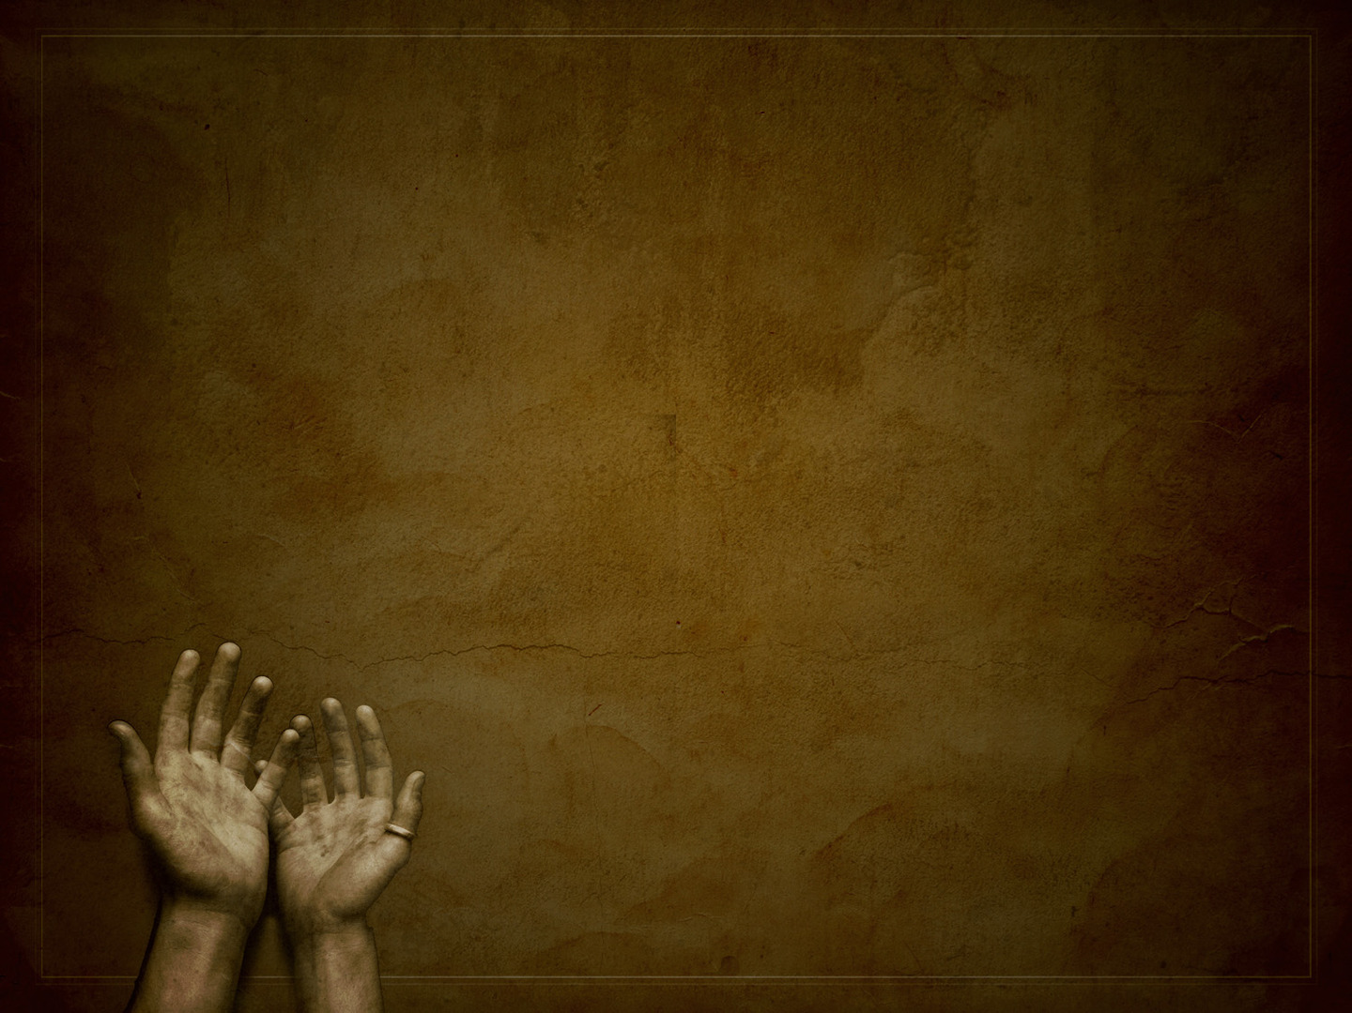
HUMILITY IN GODLY PLANNING (Vs 16-17)
“As it is, you boast in your arrogance” (James 4:16a)
“All such boasting is evil” (James 4:16b)
“Let the one who boasts, boast in the Lord” (1 Cor 1:26-31)
Notes:
“As it is, you boast in your arrogance” (James 4:16a)
- Boasting is a verb, it is something you do. It is an exultant abounding joy.
- The problem here does not lie in the boasting for we are taught in the New Testament to boast in the Lord
- It is what people are boasting in that is the issue. It is in their arrogance, which is actually in the plural, meaning arrogances
- Meaning they are boasting in all the things they are accomplishing
- They boast in their own misplaced pride and autonomy
- It is one thing to practice sin, it is another to defend it, and yet it is quite another to go around boasting about sin
- And yet when we go around telling and boasting of the wonderful things we have done, with no reference to God and His will, and His divine providence…
- Then we are guilty of making ourselves to appear as god of our own life, as though based solely on my ability and planning, all these things came to pass, it was all me.
- As Christians, there ought not be such arrogance in our hearts, for we understand that only by the grace of God, I am what I am.
- And if there is arrogance in your hearts, then repent, look to the cross, and you will find forgiveness
- And…
“All such boasting is evil” (James 14:6b)
- Evil is used in other Scriptures when referring to Satan as the evil one. Because it is from him and our fallen natures that such boasting comes
- And yet we must be careful. To glory in your sin is to show that your love is where your hatred should be, and your hatred where your love should be
- May God be swift in convicting and humbling us, and bringing us to our knees, that we might no longer glory in ourselves but in God,
“Let the one who boasts, boast in the Lord” (1 Cor 1:26-31)
- “For consider your calling, brothers: not many of you were wise according to worldly standards,^{[a]} not many were powerful, not many were of noble birth. ²⁷ But God chose what is foolish in the world to shame the wise; God chose what is weak in the world to shame the strong; ²⁸ God chose what is low and despised in the world, even things that are not, to bring to nothing things that are, ²⁹ so that no human being^{[b]} might boast in the presence of God. ³⁰ And because of him^{[c]} you are in Christ Jesus, who became to us wisdom from God, righteousness and sanctification and redemption, ³¹ so that, as it is written, “Let the one who boasts, boast in the Lord.”
- ”For what do you have that you did not receive ? If then you received it, why do you boast as if you did not receive it?” (1 Cor 4:7)
- If all that we have is the gift of the grace of God.
- If the very fact that I am alive and breathing this morning is as a result of God’s mercy, then why do we boast and live as if we were entitled to the day that has been given to us
- We must humble ourselves before the throne of God, recognising that every good gift comes from above, and so we must boast only in the Lord

Slide 7

“So whoever knows the right thing to do and fails to do it, for him it is sin” (James 4:17)
James is beckoning his audience to live holy lives
James is commanding urgency
Notes:
“So whoever knows the right things to do and fails to do it, for him it is sin” (James 4:17)
- What James is talking about here is the sin of omission
– There are sins of commission. Which is when we do what we should not do. Such as adultery, murder, lust, stealing. We do that which we shouldn’t
- And then sins of omission is when we fail to do that which we should do.
- Such as forgive others as we have been forgiven, loving our husbands or wives, loving our enemies.
- These are things which we know we should do but don’t
- Sins of omission are as real and serious as sins of commission
James is beckoning his audience to live holy lives
- In verse 13, James point out the wrong that they are doing
- And then in verse 15 he corrects them by telling them, “Instead you ought to say”
- Now that we know the right thing to do, go and do it. Go and be holy, and live in accordance with that which is written in God’s Word
- To fail to do so is a sin of omission. To know what is right and not to do it is sin
James is commanding urgency
- Now that you know how to live, don’t be slow about it
- Do not delay in being obedient to the commands of God
- Do not delay in always making our plans be in alignment with the will of God
- It is sinful to defer obedience to the gospel
- Are you here today saying, “I am going to repent and believe in Jesus Christ as Lord and Saviour”
- Then repent and believe today, for you do not know what tomorrow will bring
- God welcomes you with open arms
- Brothers and sisters in Christ. Do you read the great commission, to go and tell others of the good news of Jesus Christ, that we are all sinners, and Jesus Christ is our only hope of being saved from an eternity in hell
- Do not think, that one day I will do that. Are you saved? Do you know the gospel of Jesus Christ?
- Then go, go and share this good news, that others may enter the kingdom of God
- If we are saved, by the Holy Spirit that now lives inside us God will help us in getting about this holy business of serving the Lord Jesus Christ
- “What is your life” You are but a mist, here today, and gone tomorrow. Be up and doing, for soon we will be called home

Slide 8

A final implication - we ought to be reminded of our desperate need for the grace of God = Be humble
Though you will fail in your obedience, and cannot keep the moral law perfectly, remember Christ
Be humble, trust God. “For we are his workmanship, created in Christ Jesus for good works, which God prepared beforehand, that we should walk in them” (Eph 2:10)
Notes:
A final implication – we ought to be reminded of our desperate need for the grace of God = be humble
- Though James was written earlier than when Paul wrote Romans, all of Scripture is God-breathed as one cohesive book
- This verse, causes me to think of Romans 7
- Romans 7:18-19 – “For I know that nothing good dwells in me, that is, in my flesh. For I have the desire to do what is right, but not the ability to carry it out. ¹⁹ For I do not do the good I want, but the evil I do not want is what I keep on doing”
- While we are here on earth, in our fallen state, though we may know what is the right thing to do, because of the Holy Spirit which now dwells in us, we will still sin, and so we wage war against the flesh
- We will not be perfect this side of heaven, but by the grace of God we press on, and in His power we must be killing sin
- But we praise God that it was not by our works that we are saved, but by grace alone through faith alone in Christ alone, and that there is now no condemnation to those who are in Christ Jesus
Though you will fail in your obedience, and cannot keep the moral law perfectly, remember Christ
- Remember that he came and lived the perfect life, in perfect obedience to the law of God.
- Went to the cross as the perfect substitute in my place
- Taking on yours and my sin, and taking on the full wrath of God.
- Was buried and then raised to life on the third day, for our justification, that we might be made right with God
- With our sin having now been imputed to Christ on the cross, the believer receives Christ’s perfect righteousness
- So that we can now stand before an infinitely holy and just God, by the blood and finished work of Jesus Christ, not as a guilty condemned sinner, but as a child of God
- Though you will fail, and though you will sin as a Christian, remember Christ
- Remember all that he has done for you, and know that when you sin, you have an advocate in Jesus Christ who is faithful and just to forgive us of all our sins
Be humble, trust God. “For we are his workmanship, created in Christ Jesus for good works, which God prepared before hand, that we should walk in them” (Eph 2:10)
- You are not saved by good works, but for good works, so be holy as the Lord your God is holy
- Allow His Spirit to work in you and through you to do the good works which God prepared beforehand
- Do the good you know you ought to do, do it sincerely, do it wholeheartedly, and do it immediately

Slide 9

SUMMARY
May God continue to remind us of our mortality and humanity
God alone is sovereign. So let our hearts cry always be,
“If the Lord wills”
When all is said and done, I know that God will
one day make all things new
Notes:
May God continue to remind us of our mortality and our humanity
- May we never forget just how fragile our life is, and that our lives are so short. That we are not masters of our own destiny
- Nothing is certain but uncertainty. And it is a foolish thing to build your life upon that which has no certainty of ever coming about
- The foolish person plans only thinking of themselves
- But we forget that…
God alone is sovereign. So let our hearts cry always be, “If the Lord wills”
- We are not our own, we have been bought with a price. For God did not spare His one and only Son
- He will not leave the future of His children up to chance. He will not abandon His people
- Our God is a faithful God, who knows the beginning from the end, and is intimately involved in all that occurs, whether we live or die, right down to the circumstances and events of each of our lives
- All this occurs within the mystery that is the providence of God
When all is said and done, I know that God will one day make all things new
- And day by day, by His Holy Spirit He is sanctifying His children, that we might become more like Jesus, and that we might do that which glorifies Him
- And as His children, let us wait with confident assurance, with our lives in the hands of God Almighty our heavenly Father, who will one day raise us up to be with Him forever
- Where all sin will be cast away for eternity. My eyes will no longer behold the suffering and evil in this world that is a result of sin
- My eyes will be fixated on the beauty and the glory of God, and there I will be, forever praising His glorious name
- I am nothing, apart from the grace and mercy of God
- And so for this reason, I only have one boast, so let all my boast be in Jesus Christ alone

Slide 10
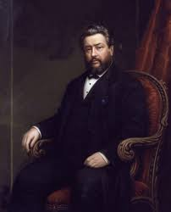
“There are two great certainties about things that shall come to pass – One is that God knows, and the other is that we do not know”
Charles Spurgeon
Notes:
If I could summarise what James is trying to say into one quote, it would be this
“There are two great certainties about things that shall come to pass – One is that God knows, and the other is that we do not know” - Charles Spurgeon
God knows, we don’t
Be wise, trust God, and let our hearts cry be, “If the Lord wills”
So that when all is said and done, our only boast will be in the Lord

