Slide 1
He Gives Us More Grace
James 4: 1 - 10
Notes:
It’s sad when you read this passage in the book of James and you realise he’s talking to Christians. He’s not talking about unbelievers.

Slide 2
V. 1 Where does fighting come from?
1– Fail to see our own sin.
-2- Blame-shifting.
-3- Assign hidden motives.
-4- Make assumptions.
-5- Read all of your past hurt into every situation.
-6- Stonewalling.
-7- Exaggerate an offense.
-8- Lack empathy for the other side.
Notes:
The problem is as old as Cain and Abel.
Doesn’t it come because we have sinful desires or lusts in our own hearts?
I am perfectly righteous in this situation. My sin and my spiritual blindness in no way contributed to this mess!
It’s not my fault. I only acted this way because of what you did!
I know the real reason you did what you did.
I don’t have all the facts, but I don’t need them. I know what was really going on!
Here we go again! This is exactly what happens every time!
I am not going to raise my voice, I will just kill you with my silence. I see you in the room but I will pretend you don’t even exist!
No, I don’t need perspective. This offense committed against me is the worst thing that has ever happened to anyone!
I don’t need to understand where you are coming from because I know I am right!

Slide 3
V. 2 - 3
Yet you do not have because you do not ask: James reminds us here of the great power of prayer, and why one may live unnecessarily as a spiritual pauper, simply because they do not pray, or do not ask when they pray. The purpose of prayer is to align our will with His, and in partnership with Him, to ask Him to accomplish His will on this earth (Matthew 6:10).
Notes:
The reason these destructive desires exist among Christians is because they do not seek God for their needs (you do not ask).
. Almost all who have such a critical and contentious attitude claim they are prompted and supported by the Spirit of God. James makes it clear that this contentious manner comes from your desires. “It is self-evident that the Spirit of God does not create desire which issues in envying.” (Morgan)

Slide 4
V. 2 - 3
Yet you do not have because you do not ask: James reminds us here of the great power of prayer, and why one may live unnecessarily as a spiritual pauper, simply because they do not pray, or do not ask when they pray. The purpose of prayer is to align our will with His, and in partnership with Him, to ask Him to accomplish His will on this earth (Matthew 6:10).
Again James looked back to the Sermon on the Mount when Jesus also used murder to express more than actual killing, but also as an inward condition of the heart, shown outwardly by anger (Matthew 5:21-22).
Notes:
The reason these destructive desires exist among Christians is because they do not seek God for their needs (you do not ask).
. Almost all who have such a critical and contentious attitude claim they are prompted and supported by the Spirit of God. James makes it clear that this contentious manner comes from your desires. “It is self-evident that the Spirit of God does not create desire which issues in envying.” (Morgan)

Slide 5
v. 2 - 3
Yet you do not have: This points to the futility of this life lived for the desires for pleasure. Not only is it a life of conflict, but it is also a fundamentally unsatisfied life.
Notes:
Again, one might ask, "What's wrong with wanting something that's just for me? Am I not allowed to have fun? Am I not allowed to get what I want once in awhile?" Let's look at the hard reality, saints. Pleasure is fun, but our lives have not been given to us just for pleasure. As the Scripture says,
1Cor. 6:19-20 ...you are not your own... you have been bought with a price...
You don't belong to yourself - Jesus Christ has bought you with His blood for His purposes. No, it is the unsaved person who may pursue pleasure. After all, like the apostle Paul wrote,
1Cor. 15:32 ...If the dead are not raised, let us eat and drink, for tomorrow we die.

Slide 6
v. 2 - 3
Yet you do not have: This points to the futility of this life lived for the desires for pleasure. Not only is it a life of conflict, but it is also a fundamentally unsatisfied life.
You ask amiss, that you may spend it on your pleasures: After dealing with the problem of no prayer, now James addressed the problem of selfish prayer.
The whole history of mankind shows the failure of evil lustings to obtain their object.” (Spurgeon)
Notes:
Again, one might ask, "What's wrong with wanting something that's just for me? Am I not allowed to have fun? Am I not allowed to get what I want once in awhile?" Let's look at the hard reality, saints. Pleasure is fun, but our lives have not been given to us just for pleasure. As the Scripture says,
1Cor. 6:19-20 ...you are not your own... you have been bought with a price...
You don't belong to yourself - Jesus Christ has bought you with His blood for His purposes. No, it is the unsaved person who may pursue pleasure. After all, like the apostle Paul wrote,
1Cor. 15:32 ...If the dead are not raised, let us eat and drink, for tomorrow we die.

Slide 7
V. 4
Adulteresses: This is a rebuke presented in Old Testament vocabulary. God spoke this way in the Old Testament when His people were attracted to some form of idolatry (Jeremiah 3:8-9, Ezekiel 6:9, Ezekiel 16:32, Ezekiel 23:37, and Hosea 3:1).
Notes:
4 For James, to choose the world over God is to commit spiritual adultery.
Christians will find it difficult to win the world for Christ if they withdraw from the world completely.

Slide 8
V. 4
Adulteresses: This is a rebuke presented in Old Testament vocabulary. God spoke this way in the Old Testament when His people were attracted to some form of idolatry (Jeremiah 3:8-9, Ezekiel 6:9, Ezekiel 16:32, Ezekiel 23:37, and Hosea 3:1).
But James used the phrase you adulteresses to give a specific spiritual picture. According to this picture, God is the “husband” and we are His “wife” (as in Old Testament passages such as Isaiah 54:5, Jeremiah 3:20, and Exodus 34:15-16).
Notes:
4 For James, to choose the world over God is to commit spiritual adultery.
Christians will find it difficult to win the world for Christ if they withdraw from the world completely.

Slide 9
V. 4
Adulteresses: This is a rebuke presented in Old Testament vocabulary. God spoke this way in the Old Testament when His people were attracted to some form of idolatry (Jeremiah 3:8-9, Ezekiel 6:9, Ezekiel 16:32, Ezekiel 23:37, and Hosea 3:1).
But James used the phrase you adulteresses to give a specific spiritual picture. According to this picture, God is the “husband” and we are His “wife” (as in Old Testament passages such as Isaiah 54:5, Jeremiah 3:20, and Exodus 34:15-16).
The prophets frequently compared the relationship between God and His people to a marriage relationship, i.e. (Isa 54: 5-6) For your Maker is your husband.
Notes:
our spirits are indeed characteristically prone to lust, jealousy, and idolatry, then we might ask: what hope is there for us? We have become enemies of God, we’re adulteresses, we’ll be destroyed,

Slide 10
V. 4
Adulteresses: This is a rebuke presented in Old Testament vocabulary. God spoke this way in the Old Testament when His people were attracted to some form of idolatry (Jeremiah 3:8-9, Ezekiel 6:9, Ezekiel 16:32, Ezekiel 23:37, and Hosea 3:1).
But James used the phrase you adulteresses to give a specific spiritual picture. According to this picture, God is the “husband” and we are His “wife” (as in Old Testament passages such as Isaiah 54:5, Jeremiah 3:20, and Exodus 34:15-16).
The prophets frequently compared the relationship between God and His people to a marriage relationship, i.e. (Isa 54: 5-6) For your Maker is your husband.
Adulterous is a blunt and shocking word, intended to JAR the readers and awaken them to their spiritual condition. The concept of spiritual adultery was taken from the OT – (Hos 2, 3, 9)
Notes:
. Think of the inner pain and torture inside the person who is betrayed by an unfaithful spouse; who must reckon with the truth, I am faithful to them, but they are not faithful to me. This is what the Spirit of God feels regarding our world-loving hearts.

Slide 11
V. 4
Do you not know that friendship with the world is enmity with God? James recognises that we cannot both be friends of this world, and friends of God at the same time (Matthew 6:24).
James agrees with the many passages in the Old Testament that tell us God is a jealous God (Deuteronomy 32:16 and 32:21; Exodus 20:5 and 34:14; Zechariah 8:2).
for you shall not worship any other god, for the LORD, whose name is Jealous, is a jealous God Exodus 34:14:
“The idea is that God loves men with such a passion that he cannot bear any other love within the hearts of men.” (Barclay)

Slide 12
V. 5
The Spirit who dwells in us yearns jealously: The indwelling presence of the Holy Spirit has a jealous yearning for our friendship with God. The Spirit will convict the Christian who lives in compromise.
‘You are grieving the Holy Spirit who has come to dwell within you, who yearns with a jealous envy to possess your entire nature for Himself.’ (Eph 4:30)
Notes:
.

Slide 13
V. 5
The Spirit who dwells in us yearns jealously: The indwelling presence of the Holy Spirit has a jealous yearning for our friendship with God. The Spirit will convict the Christian who lives in compromise.
‘You are grieving the Holy Spirit who has come to dwell within you, who yearns with a jealous envy to possess your entire nature for Himself.’ (Eph 4:30)
James agrees with the many passages in the Old Testament that tell us God is a jealous God (Deuteronomy 32:16 and 32:21; Exodus 20:5 and 34:14; Zechariah 8:2).
for you shall not worship any other god, for the LORD, whose name is Jealous, is a jealous God Exodus 34:14:

Slide 14
V. 6
God resists the proud: At the same time, James reminds us that this grace only comes to the humble. Grace and pride are eternal enemies.
James used a powerful word in the phrase, “resists the proud.”
Pride says we do not need anyone or anything. Grace is never received by the proud.
But gives grace to the humble: It isn’t as if our humility earns the grace of God. Humility merely puts us in a position to receive the gift He freely gives.
“but He gives more grace” – stands in strong contrast to the words, “God opposes the proud.”
Notes:
but, in James 4:6, God gives a greater grace.
God is able to overcome our own wicked hearts and rescue us from ourselves, so I favour this second translation. Either way, the overall sense of the passage is not greatly affected.

Slide 15
V. 6
God’s gift of sustaining grace is enjoyed only by those willing to admit their need and accept the gift. The proud, on the other hand, meet only resistance from God. Pride is often associated with jealousy and envy,
The essence of unbelief is failure to submit to God.
“The idea is that God loves men with such a passion that he cannot bear any other love within the hearts of men.” (Barclay)

Slide 16
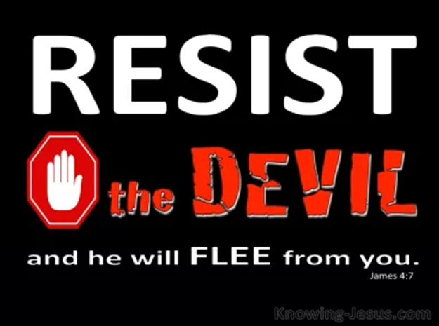
V. 7
Resist the devil and he will flee from you: This means to stand against the devil’s deceptions and his efforts to intimidate. As we resist the devil, we are promised that he will flee from you.
God is greater, and His grace is greater, so that we can resist the devil.
One of the devils primary purposes is to separate God from man.
James does not recommend that demons should be cast out of believers by a third party. Instead, James simply challenges individual Christians to deal with Satan as a conquered foe who can and must be personally resisted.
A famous ancient Christian writer named Hermas wrote, “The devil can wrestle against the Christian, but he cannot pin him.” (Cited in Barclay)
Notes:
Satan will test you and will probe your defences, he might even engage you for a prolonged period of time. The devil is truly powerful, and he has an ally in our flesh.

Slide 17
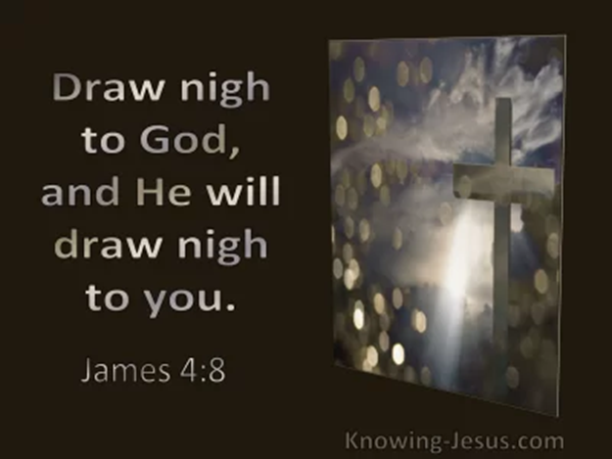
V. 8 - 9
Draw near to God and He will draw near to you: The call to draw near to God is both an invitation and a promise. It is no good to submit to God’s authority and to resist the devil’s attack and then fail to draw near to God. We have it as a promise: God will draw near to us as we draw near to Him.

Slide 18
V. 8 - 9
Draw near to God and He will draw near to you: The call to draw near to God is both an invitation and a promise. It is no good to submit to God’s authority and to resist the devil’s attack and then fail to draw near to God. We have it as a promise: God will draw near to us as we draw near to Him.
Therefore submit to God: In light of the grace offered to the humble, there is only one thing to do: submit to God. This means to order yourself under God, to surrender to Him as a conquering King, and start receiving the benefits of His reign.

Slide 19
V. 8 - 9
Cleanse your hands, you sinners; and purify your hearts, you double-minded. Lament and mourn and weep! As we draw near to God, we will be convicted of our sin. So we lament and mourn and weep as appropriate under the conviction of sin, and we are compelled to find cleansing at the cross.

Slide 20
V. 10
Humble yourselves in the sight of the Lord, and He will lift you up: As we come as sinners before the holy God (not as self-righteous religionists, as Jesus explained in Luke 18:10-14), we appropriately humble ourselves before Him. Then He will lift us up, because God resists the proud, but gives grace to the humble, and grace – the unmerited favour of God – always lifts us up.

Slide 21
draw near to God?
It means to draw near in worship, praise, and in prayer.
· It means to draw near by asking counsel of God.
· It means to draw near in enjoying communion with God.
· It means to draw near in the general course and tenor of your life.
Spurgeon
Notes:
What does it mean to draw near to God?

Slide 22
draw near to God?
It means to draw near
in worship, praise, and in prayer.
by asking counsel of God.
in enjoying communion with God.
in the general course and tenor of your life.
From the rest of the chapter, we see that the results of drawing near to God helps us to:
resist the devil.
become pure.
sorrow for our sin.
speak well of other people.
think of eternal things.
Spurgeon
Notes:
What does it mean to draw near to God?

Slide 23
10 Commands
Submit
Resist the devil
Come near to God
Wash your hands
Purify your hearts
Grieve
Mourn
Change laughter to mourning
Joy to gloom
Humble yourselves

