Slide 1
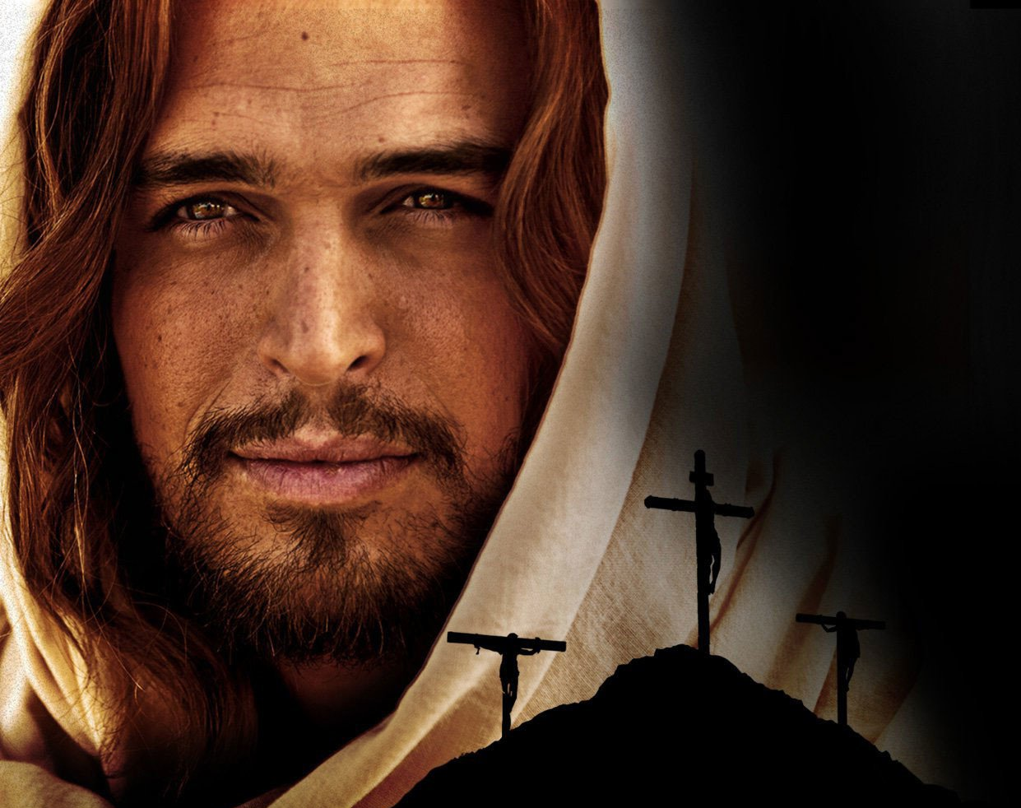
What Jesus do you follow?
Matthew 16:13-17

Slide 2
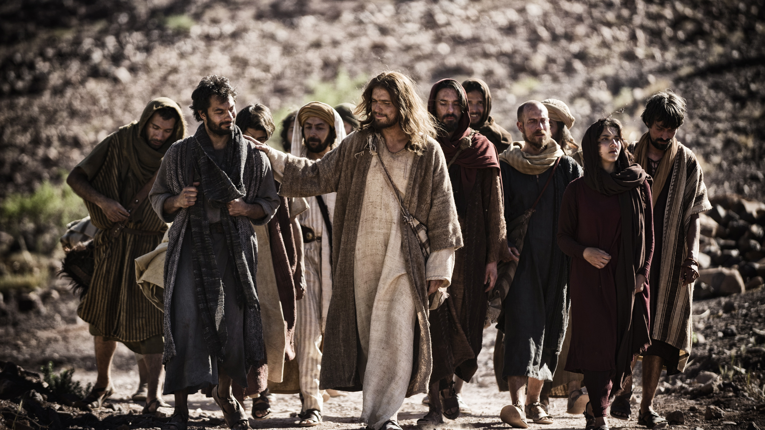
Who do people say that I am?
Who do YOU say that I am?
Why is this man Jesus so ………inescapable?

Slide 3
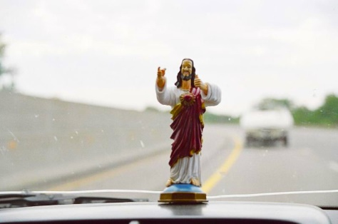
Through my trials and tribulations And my travels through the nations With my plastic Jesus I'll go far. Plastic Jesus, plastic Jesus, Riding on the dashboard of my car
Eddie Marrs
Cool Hand Luke

Slide 4
In an Ipsos survey done in America, the following was recorded regarding who people thought Jesus was:
76% of American citizens believed in a historical Jesus
Of people who identify as Christians, only 50% believe that He was the Son of God
20% of non-Christian religions and 27% non-religious Americans don’t believe Jesus was an important spiritual figure at all

Slide 5
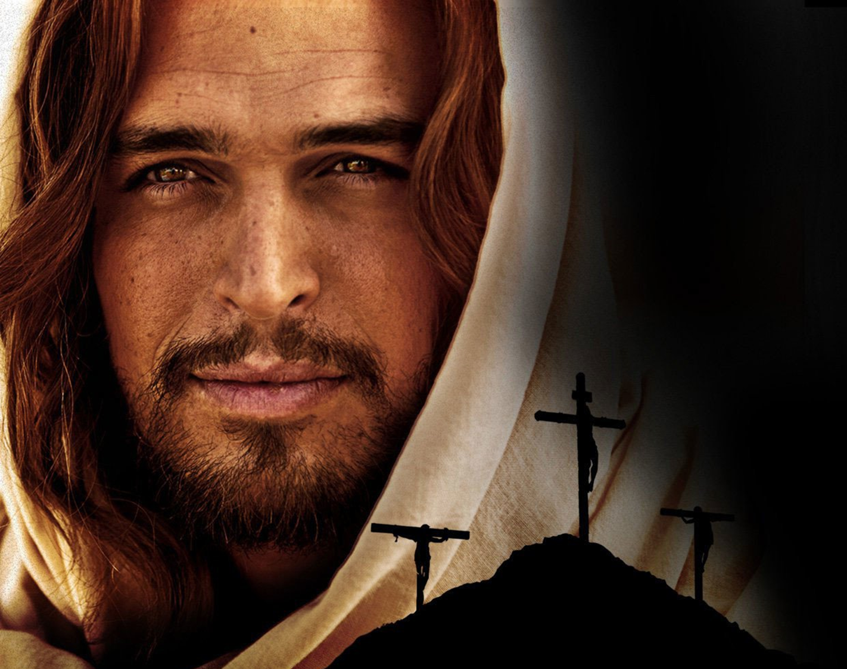
Wholly Human and wholly God
Craig A Evans PH.D - Chairman of Septuagint and Cognate Studies
“the divine nature of Jesus should never militate against his full humanity…. at three days of age, was Jesus fluent in Hebrew? Could he do quantum physics?...the book of Hebrews says that he had to learn”
Evans goes on to say that Jesus was “not just God in a human mask”.

Slide 6
He had to learn like we do. He had to interact in a family environment like we do. He laughed, he loved, he felt hunger, he felt joy, he felt pain, he felt rejection, he felt anger, he cried over people and the city of Jerusalem, and he anguished over going to the cross. These are all very human characteristics
Hebrews 4:15
“He understands our weaknesses, for he faced all of the same testings we do, yet he did not sin.”

Slide 7
When we appreciate his humanity, is when we can better relate to him, rather than some fake Jesus who is ‘God in a human mask’.
When we appreciate his humanity, we can better appreciate his sacrifice for us and how much that would have hurt, humiliated and cost him

Slide 8
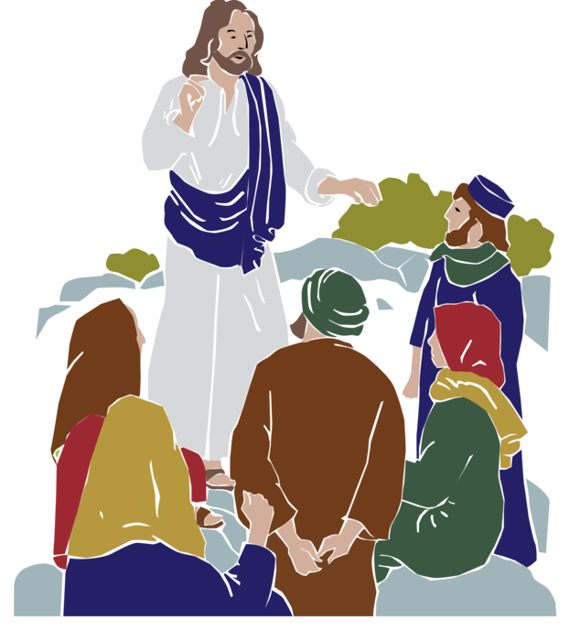
For three short years, Jesus walked with and taught his disciples.
They lived with him, learnt from him, laughed with him, ate with him and saw him do miraculous things
They understood his human side very well
But then it all changed!

Slide 9
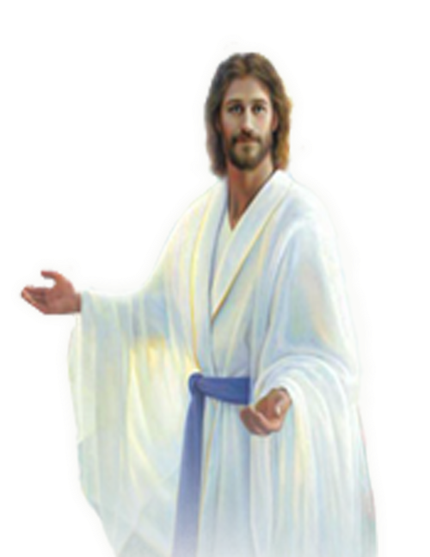
Mark 9:2-8
Jesus took Peter, James, and John, and led them up a high mountain to be alone. As the men watched, Jesus’ appearance was transformed, and his clothes became dazzling white, far whiter than any earthly bleach could ever make them. Then Elijah and Moses appeared and began talking with Jesus.
Peter exclaimed, “Rabbi, it’s wonderful for us to be here! Let’s make three shelters as memorials — one for you, one for Moses, and one for Elijah.” He said this because he didn’t really know what else to say, for they were all terrified.
Then a cloud overshadowed them, and a voice from the cloud said, “This is my dearly loved Son. Listen to him.” Suddenly, when they looked around, Moses and Elijah were gone, and they saw only Jesus with them.

Slide 10
If people who were so close to Jesus, were so profoundly affected by His appearance and His majesty, how much more should we take seriously the awesomeness of Jesus?
Do you want a plastic Jesus, one that is like a good luck charm to try and get you out of times of trouble, or do you want to follow the all-powerful, majestic Son of God?

Slide 11
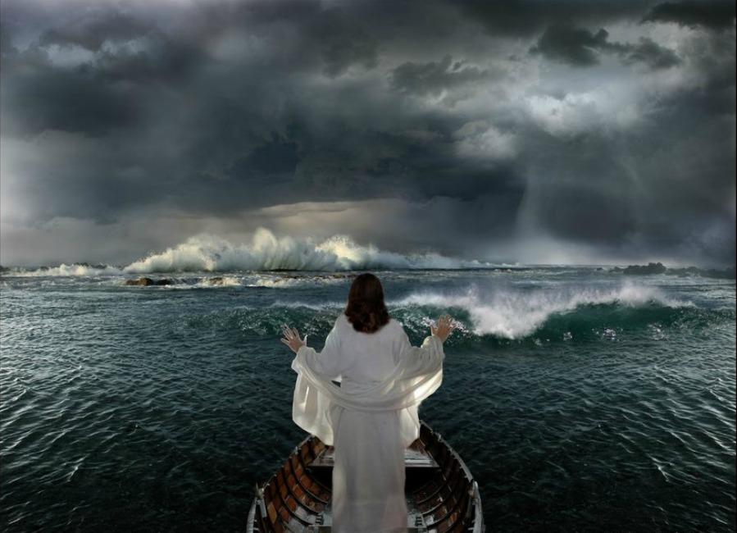
Luke 8:22-25
One day Jesus said to his disciples, “Let’s cross to the other side of the lake.” So, they got into a boat and started out. As they sailed across, Jesus settled down for a nap. But soon a fierce storm came down on the lake. The boat was filling with water, and they were in real danger.
The disciples went and woke him up, shouting, “Master, Master, we’re going to drown!”
When Jesus woke up, he rebuked the wind and the raging waves. Suddenly the storm stopped, and all was calm. Then he asked them, “Where is your faith?”
The disciples were terrified and amazed. “Who is this man?” they asked each other. “When he gives a command, even the wind and waves obey him!”

Slide 12
Walked on water – overcame physics
Water into Wine – overcame chemistry
Knew men’s hearts – overcame the gulf between the physical and spiritual
Forgave sin – overcame the power of sin
Healed the sick – overcame medical realities
Fulfilled OT prophecies – overcame the laws of probability
Cast out demons – overcame the power of the evil one
Jesus predicted His death and resurrection – He overcame the time continuum
Created the world (John 1:3) – overcame the laws of science

Slide 13
Takes and opens the scroll in Revelation 4– He alone has the
power to pronounce the judgements on the world
This same Jesus, this majestic Jesus is coming again
Acts 1:11 “The angels said, “Men of Galilee, why do you
stand looking into the sky? This Jesus, who has been
taken up from you into heaven, will come in just the same
way as you have watched Him go into heaven.”
Jesus is coming again, not as a babe but as King of Kings

Slide 14
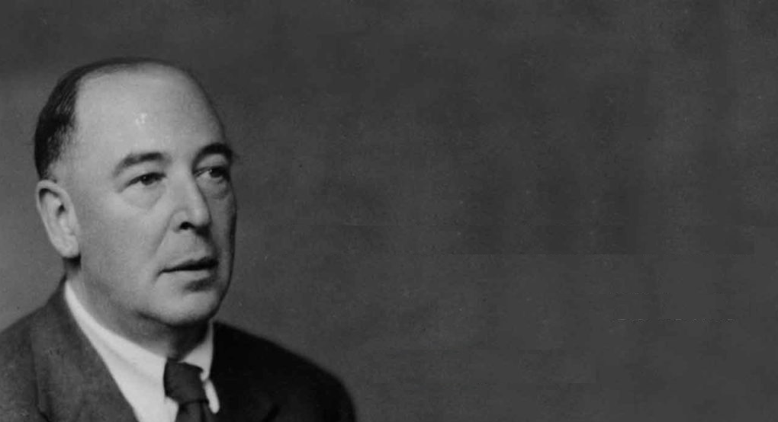
C S Lewis
1898 - 1963
C.S. Lewis trilemma:
Lunatic
Narcissistic personality disorder
Liar
Pathological Liar
Lord
Son of God

Slide 15
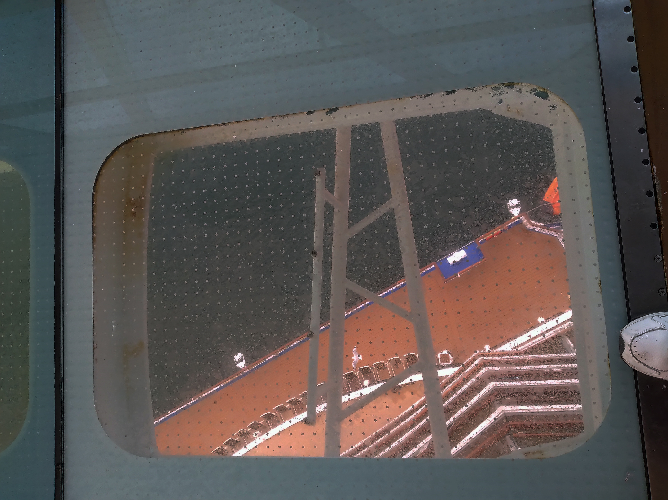
Royal Princess
Sea Walk
16 floors up
Hebrews 4:14-16
So then, since we have a great High Priest who has entered heaven, Jesus the Son of God, let us hold firmly to what we believe. This High Priest of ours understands our weaknesses, for he faced all of the same testings we do, yet he did not sin. So let us come boldly to the throne of our gracious God. There we will receive his mercy, and we will find grace to help us when we need it most.

Slide 16
What Jesus do you follow?
Matthew 16:13-17

