Slide 1
'TEACH US TO NUMBER OUR DAYS’
Psalm 90
Notes:
Good morning everyone. I hope you are all doing well, and happy new year!
If you would all like to open your Bibles and keep a finger on Psalm 90, this will be our text today
You will see before verse 1 even begins that it was Moses who wrote this Psalm
It is almost unanimous among biblical scholars that Moses writes this Psalm as a prayer, either during the times of Israel wandering in the wilderness, or just after in reflection on it
So before we jump into our verses today, I want us to get an understanding of where Moses is coming from, by jumping to Numbers 14
If you’ll remember just before this passage, they had gone to spy out the land of Canaan
And the spies returned and all but Joshua and Caleb said they should not go into the land
That it was full of giants and there was no way they could win the battle and enter the land
And the people of Israel begin to cry out against Moses and Aaron wishing they had stayed in Egypt where they were slaves
So let us read Numbers 14:26-35
This is the context of which Moses is writing Psalm 90

Slide 2
THE ETERNALITY OF GOD
“Lord, you have been our dwelling place in all generations” (Psalm 90:1)
Thomas Manton says a home has 3 uses: 1. For our defense and shelter from the storms
2. It is the place of our blessings and storehouse of our comforts
Notes:
“Lord, you have been our dwelling place in all generations” (Psalm 90:1) - Though Israel walked through the wilderness, there was one whom they could call upon as their dwelling place. - It was God Himself, the God of Abraham, Isaac, and Jacob, in whom they found refuge - When they wandered in circles for 40 years, God was their habitation - As He had always been since Adam, and continues to be, to do this day for Israel, as God’s chosen people - Though they had fallen under God’s displeasure, wherever they went, God was their home - And just as God was with Israel in the wilderness, so too is He with all believers, who are in Christ, and indwelled by the Holy Spirit. - In this life, the Christian always has a place to call home, a place to rest their head, found with and in the great I AM
Thomas Manton (a puritan minister) says a home has 3 uses: 1. For our defense and shelter from the storms - Though Satan will throw his fiery arrows at you, and temptation will come your way - God is our refuge, and in Him you find security and assurance of your salvation - John 10 reminds us of this, “My sheep hear my voice, and I know them, and they follow me. I give them eternal life, and they will never perish, and no one will snatch them out of my hand. My Father who has given them to me, is greater than all, and no one is able to snatch them out of the Father’s hand” - And by believing in Christ as Lord and Saviour the Holy Spirit comes and indwells all of God’s children - And we are sealed by the Holy Spirit which is the guarantee of our future inheritance, of spending forever in eternity with God - How firm a foundation, God saves us from sin, protects us from the work of the devil, and keeps us until the end. Praise be to God
It is the place of our blessings and storehouses of our comforts - It is in our homes that we keep all our comforts, all our treasured possessions, and so it is with God as our dwelling place. - In Him we are blessed with every spiritual blessing - We receive forgiveness, and grace, and mercy. We receive peace that surpasses all understanding - We receive the Holy Spirit, and are adopted into the family of God - We receive a new family, which is gathered here today, for the building up and the edification of one another - And we receive eternal life. All because of what Christ has done - Persevere Christian, continue to store up your treasures in heaven

Slide 3
3. It is the place of our rest
“Before the mountains were brought forth, or ever you had formed the earth and the world, from everlasting to everlasting you are God” (Psalm 90:2)
“The eternity of God is the foundation of the stability of the covenant, the great comfort of Christ” (Stephen Charnock)
Notes:
3. It is the place of our rest - Jesus says, “Come to me, all who labour and are heavy laden, and I will give you rest.” In Christ you will find rest for your souls - I don’t know what your year ahead looks like. But the pace of this life, this world, seems to be getting faster and faster - And at times, perhaps, it may feel like you just can’t keep up - That it feels impossible to slow down. Go to Jesus, and in him you will find rest. - Let him quieten your heart, as you look to the eternal rest in heaven, which awaits all of God’s children
“Before the mountains were brought forth, or ever you had formed the earth and the world, from everlasting to everlasting you are God” (Psalm 90:2) - The word eternity is a negative attribute. What I mean by that is it says what God is not. - And what God is not, is that He is not within time. He has no beginning and no end, and has no measures of time - God has been there before time itself existed, and He will continue to be there, from everlasting… to everlasting - But not only is He eternal, but throughout all eternity He is immutable, that is, He never changes - Like the mountains that stand so strong, and seem so immovable, so unchangeable, so too, and even more so is our God - You can always count on God to be the same yesterday, today, and tomorrow. His promises will remain for eternity. His Word endures forever
“The eternity of God is the foundation of the stability of the covenant, the great comfort of Christ” (Stephen Charnock) - What Charnock is saying, is that if God never changes, then Israel must still be God’s chosen people - For if he doesn’t change His mind, and if His Word is final, then all the promises made to Israel, must still stand - And in turn, because of God’s eternality, and His unchangeableness, Christ’s once for all sacrifice is enough - There never again needs to be another sacrifice. In Christ it was finished, in Christ it is done. God will not change is mind - And it is upon Christ and the shedding of His blood, that the new covenant stands, that our salvation rests and is secure - As we meditate upon the eternity of God, and as we look into 2025, may it create in us boldness in sharing the gospel - May it cultivate a deep love for the God whom we serve, and may it strip us of our love for this world and cause us to love God with all our hearts

Slide 4
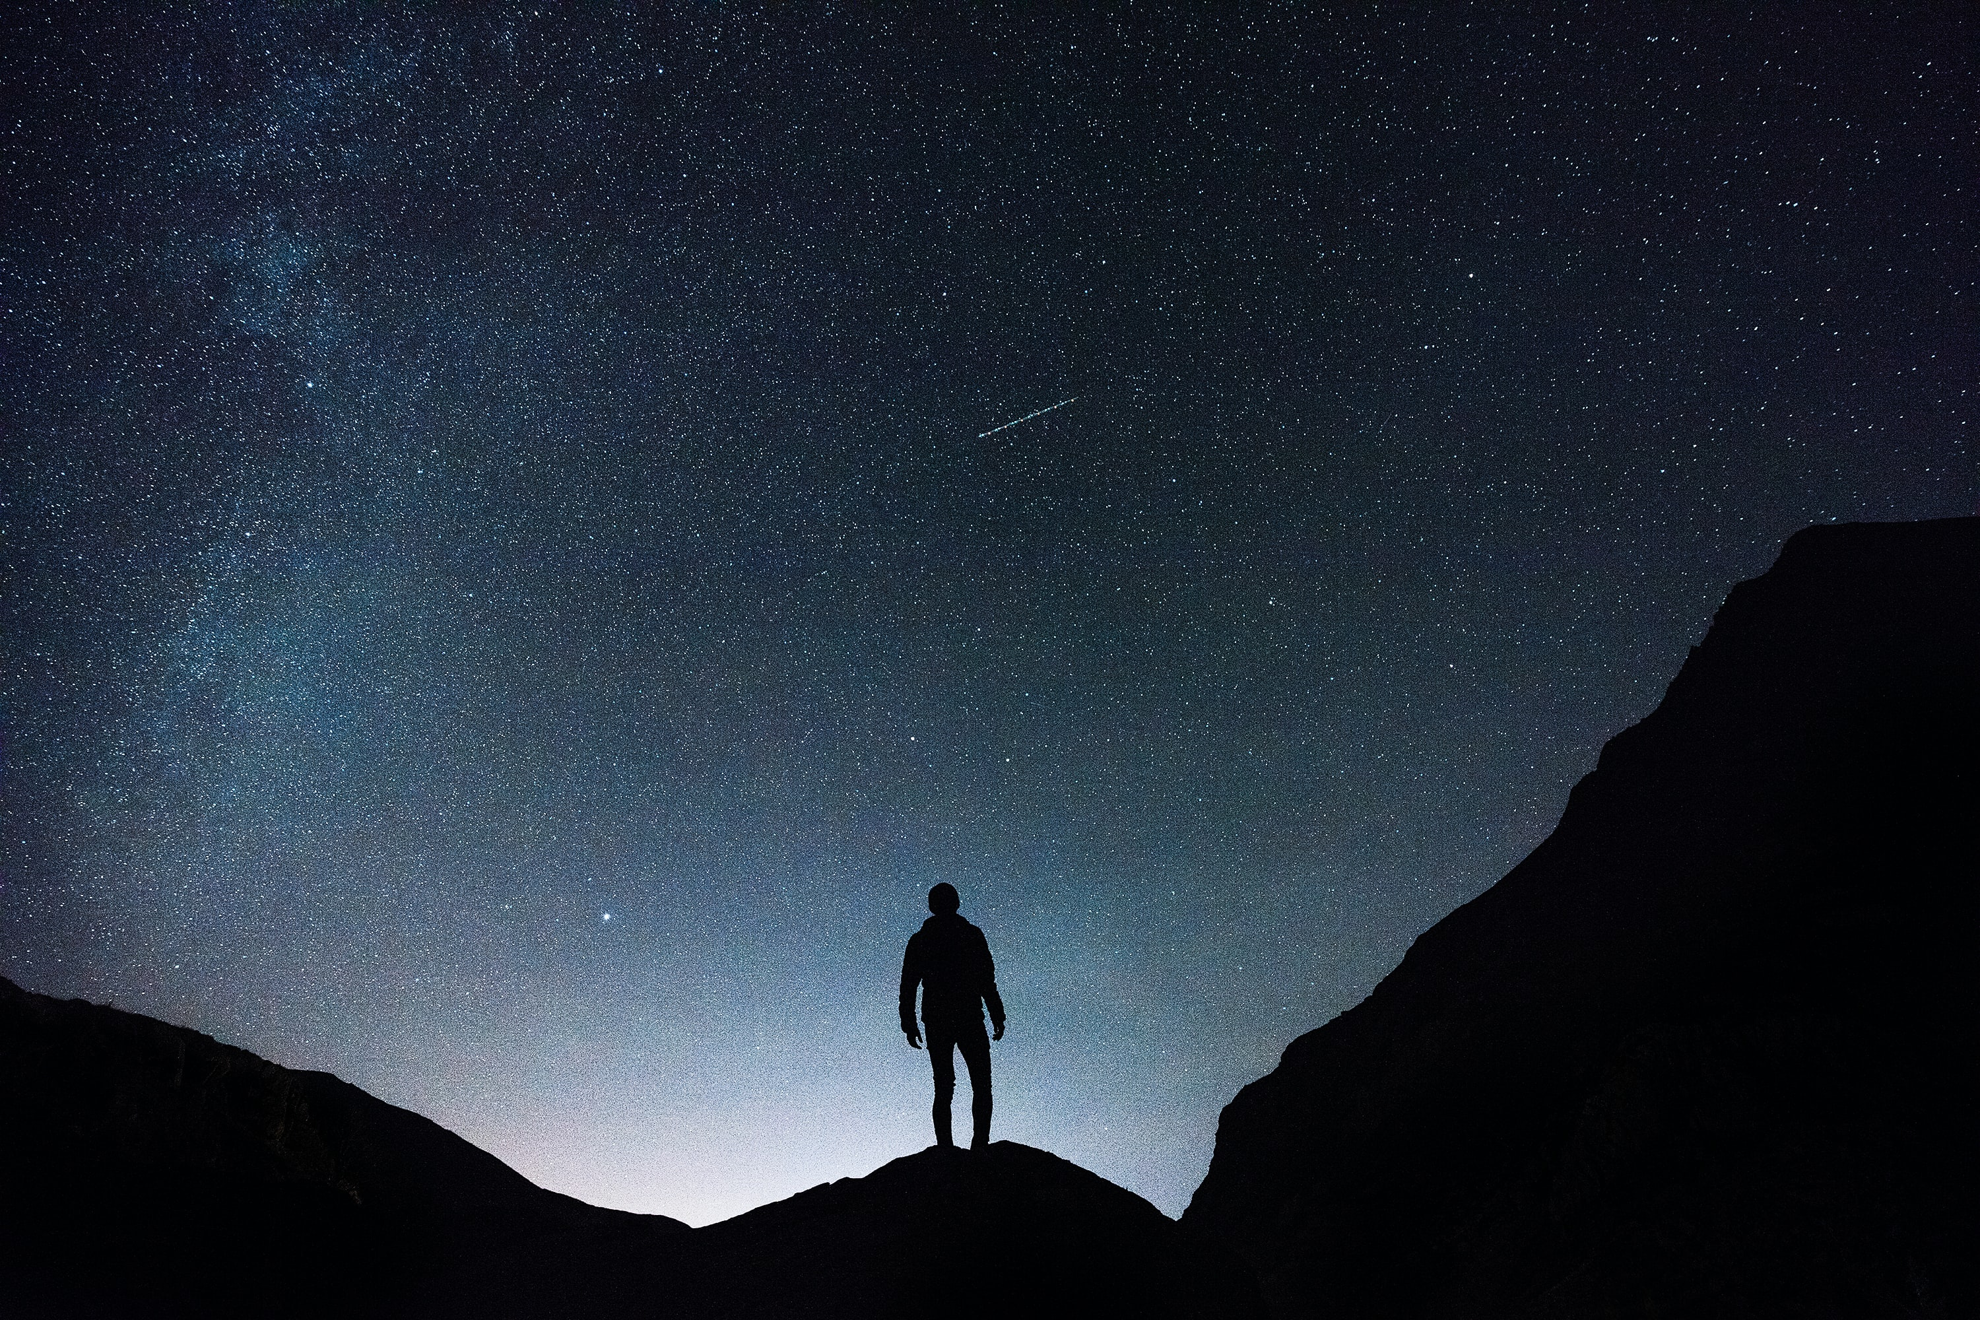
THE FRAILTY OF MAN
“You return man to dust and say, “Return, O children of man!” (Psalm 90:3)
“For a thousand years in your sight are but as yesterday when it is past, or as a watch in the night” (Psalm 90:4)
“You sweep them away as with a flood; they are like a dream…” (Psalm 90:5)
Notes:
“You return man to dust and say, “Return, O children of man!” (Psalm 90:3) - Moses starts out by presenting his readers, and fixating his prayer on the eternity of God - He does this to highlight just how big God is, and how small we are by comparison. For we are but dust - God creates man out of dust, and back to dust he goes at the word of His Creator - Many of us, like to avoid thinking about death, but death is the great equalizer, it is something we all must face - And there is perhaps nothing more sobering, and revolutionising to our lives, particularly for the Christian, than to ponder our own death - We all will one day die, and we will not exceed one moment longer than the day which has been pre-ordained by God
“For a thousand years in your sight are but as yesterday, when it is past, or as a watch in the night” (Psalm 90:4) - Think about that for minute, 1000 years are but as yesterday to God - Think of all the empires that have come and gone in that time. - The Roman Empire, the China dynasty, the Ottoman empire, the Mongul empire, the AZTEC, and the German empire - All of these are but as yesterday to God, and all the splendour of those kingdoms has all come to nothing, their glory all but forgotten - Mankind is mortal, but God is eternal, God is forever - Read Psalm 90:5-6
“You sweep them away as with a flood; they are like a dream…” (Psalm 90:5) - What is there on earth more frail than us - Spurgeon put it like this, “here is the history of the grass – sown, grown, blown, mown, gone. And the history of mankind is not much more than this” - It is as though we were born in the morning, and gone and withered in the evening – These are sobering and humbling thoughts for us all to consider as we seek out God’s will for our lives both individually and as church in 2025

Slide 5
THE JUSTICE OF GOD
“For we are brought to an end by your anger; by your wrath we are dismayed” (Psalm 90:7)
“You have set our iniquities before you, our secret sins in the light of your presence” (Psalm 90:8)
“Who considers the power of your anger, and your wrath according to the fear of you?” (Psalm 90:11)
Notes:
“For we are brought to an end by your anger; by your wrath we are dismayed” (Psalm 90:7) -Death and God’s wrath was at the forefront of Moses mind, because you see, a whole generation of Israelites were killed in the 40 years in the wilderness - All those over the age of 20 were to die. So probably around 600 000 Israelites were killed for their rebellion against God - Over 40 years, that averages out to be, that Moses was seeing dozens, upon dozens of people die every single day for 40 years - No pastor has done more funerals in their life than Moses - Moses here is reminding us of something that we all too often forget even as Christians - That yes, we die as a consequence of sin, for the wages of sin is death, which is a result of the fall, and the blame for sin rests on us - But actually, when we boil that down, it is that death in this life occurs as a result of our sin, and God’s divine wrath towards us as sinners - As people who have offended an eternally holy and just God - The holy justice of God demands that sin must be paid for. Which must in turn cause us to ask this question… - If sin is so serious, if God takes sin so seriously, why do we treat it so casually in our lives?
“You have set our iniquities before you, our secret sins in the light of your presence” (Psalm 90:8) - Moses has such a grasp upon eternal realities, and prays with such depth, and we see here he is just pouring forth his soul before God - There are no secret sins before God. God sees everything - As a Christian you may be asking, but doesn’t God remove our sins as far as the east is from the west? And the answer is yes legally, eternally - In terms of our justification, our standing before God, He looks at us in Jesus, having been washed clean by the blood of Jesus Christ, and now being forgiven - But He still sees our sin, there are still consequences for our sins. David suffered consequences for his sins, Moses wasn’t allowed to enter the promised land for his sins. - Were they forsaken and abandoned by God? By no means, for what could separate us from the love of God? - But God sees all
“Who considers the power of your anger, and your wrath according to the fear of you?” (Psalm 90:11) - None of us can fully grasp just how much God hates sin. None of us can fully grasp the divine wrath of God. None of us fear God too much - God is eternally loving, eternally graceful, eternally merciful, all of which we cannot fully grasp, but the same applies to His divine wrath - However, there is one person in all of human history, being fully God and fully man himself, who did come to face to face with the full wrath of God, and was able to fully grasp it - And we get a glimpse of this in the garden, just before he was crucified

Slide 6
“Father, if you are willing, remove this cup from me. Nevertheless, not my will but yours, be done… And being in agony he prayed more earnestly; and his sweat became like great drops of blood falling down to the ground” (Luke 22:42,44)
“Till on that cross as Jesus died, The wrath of God was satisfied; For ev’ry sin on him was laid — Here in the death of Christ I live.”
Notes:
“Father, if you are willing, remove this cup from me. Nevertheless, not my will but yours be done… And being in agony he prayed more earnestly; and his sweat became like great drops of blood falling down to the ground” (Luke 22:42,44) - What was in that cup that could make Jesus, who knew the will of God, from eternity past, who was both fully God and fully man, sweat drops of blood - What was in the cup? - In that cup was the suffering, the pain, the agony, the rejection that would come with the cross. - But ultimately it was the terrifying fact that Jesus was going to face the full wrath of God to pay the penalty for your sins, and for mine - He had to do it, it was the only way for the justice of God to be satisfied. - And because of that one sacrifice, all who will believe in him, will never have to face the wrath of God Almighty - Brothers and sisters in Christ, Jesus did that for you, he drank that cup for you. - As that great song puts it…
“Till on that cross as Jesus died, the wrath of God was satisfied; for every sin on him was laid – here in the death of Christ I live” - The wrath of God was satisfied, and so here in the death of Christ I live - I live, I am free, free from condemnation, free to be called a child of God, free to live a life to the glory of God - Oh what amazing love, how can it be? That Jesus my king, would die for me - Because of Christ, I live. - Turn from your sins, and believe in Jesus Christ, and you too can have life in Christ

Slide 7
TEACH US TO NUMBER OUR DAYS
“So teach us to number our days that we may get a heart of wisdom” (Psalm 90:12)
We do not know how long we will live, only God does
Having understood that our days are numbered, and now gone to God with hearts inclined to true wisdom, this is the practice of serious godliness
Notes:
“So teach us to number our days that we may get a heart of wisdom” (Psalm 90:12) - Moses having now laid out for us God’s eternal nature, His unchangeableness, our frailty and mortality in relation to God, and making it clear that we are all going to die - He then turns his heart towards God, and asks for wisdom. Asks for wisdom, not just for himself but for the nation of Israel - That is the prayer of a great leader. And I know that this is the prayer of the elders of this church - That we as the body of Christ would look to God, that we would live each day in light of eternity, that He would grant us wisdom to do so
We do not know how long we will live, only God does - John Calvin said this, “Even though we know we are going to die, we live each day like we are going to live” - We live our lives as though tomorrow is guaranteed, as though 2026 is guaranteed - It is by God’s mercy that we are alive and breathing today, because the days God has allotted to us have not run out - Fix your hearts on Jesus Christ, for we are but pilgrims, wandering this earth, until God calls us home - But we do not know the time or the hour that this will happen
Having understood that our days are numbered, and now gone to God with hearts inclined to true wisdom, this is the practice of serious godliness - May God enable us to be able to wake up each day, with one goal, one purpose, one resolution in mind - To see God glorified! We can only do that if, by the grace of God, He would teach us to number our days

Slide 8
THE GRACE OF GOD
“Satisfy us in the morning with your steadfast love, that we may rejoice and be glad all our days” (Psalm 90:14)
Steadfast love = checed
“Make us glad for as many days as you have afflicted us, and for as many years as we have seen evil” (Psalm 90:15)
Notes:
- Read Psalm 90:13-14
“Satisfy us in the morning with your steadfast love, that we may rejoice and be glad all our days” (Psalm 90:14) - Moses, instead of pleading with God to change the circumstances, to pull him out of this terrible situation – He is able to see, that as hard as it has been, it has been to the glory of God that it happen this way - So he prays for a change of heart. He asks that God would take his eyes off what’s happening around him, and look to be satisfied in God
Steadfast love = checed - This is God’s covenantal love, it can mean mercy, it can refer to God’s kindness, some translations perhaps best translate it as God’s loving kindness - This is God’s loyal love. It is God’s unfailing love, His faithful love, His one-sided love - God’s covenantal love is not determined by anything that we do, but by what He has done. - It is God choosing to bind Himself freely to all those who are chosen in Christ - Not because of anything we have done, but because of all that God has done in Christ, and nothing can separate is from His love - So Moses prayer begs the question of all of us today. Are you looking for a love that never fails, for a Father who will never give up on you or let you go, a place to call home? Are you looking for satisfaction? - You will find all of this only in one place… in the arms of our eternally merciful and gracious God. - Christian, be reminded of the gospel, of your first love, and be satisfied in God alone - To the unbeliever look to the cross, see what Jesus has done, repent and believe in him alone as your only hope of being saved from your sin and being called a child of God
“Make us glad for as many days as you have afflicted us, and for as many years as we have seen evil” (Psalm 90:15) - Having witnessed the tragedies that have happened in the wilderness as a result of the people’s sinfulness and God’s divine judgment - Moses now cries out, make us glad. Lord we see how we have grieved you, restore unto us the joy of our salvation - When tough times come our way, when trials come to bear upon us, may they drive us to Jesus, to the foot of the cross, and may we be glad in Christ

Slide 9
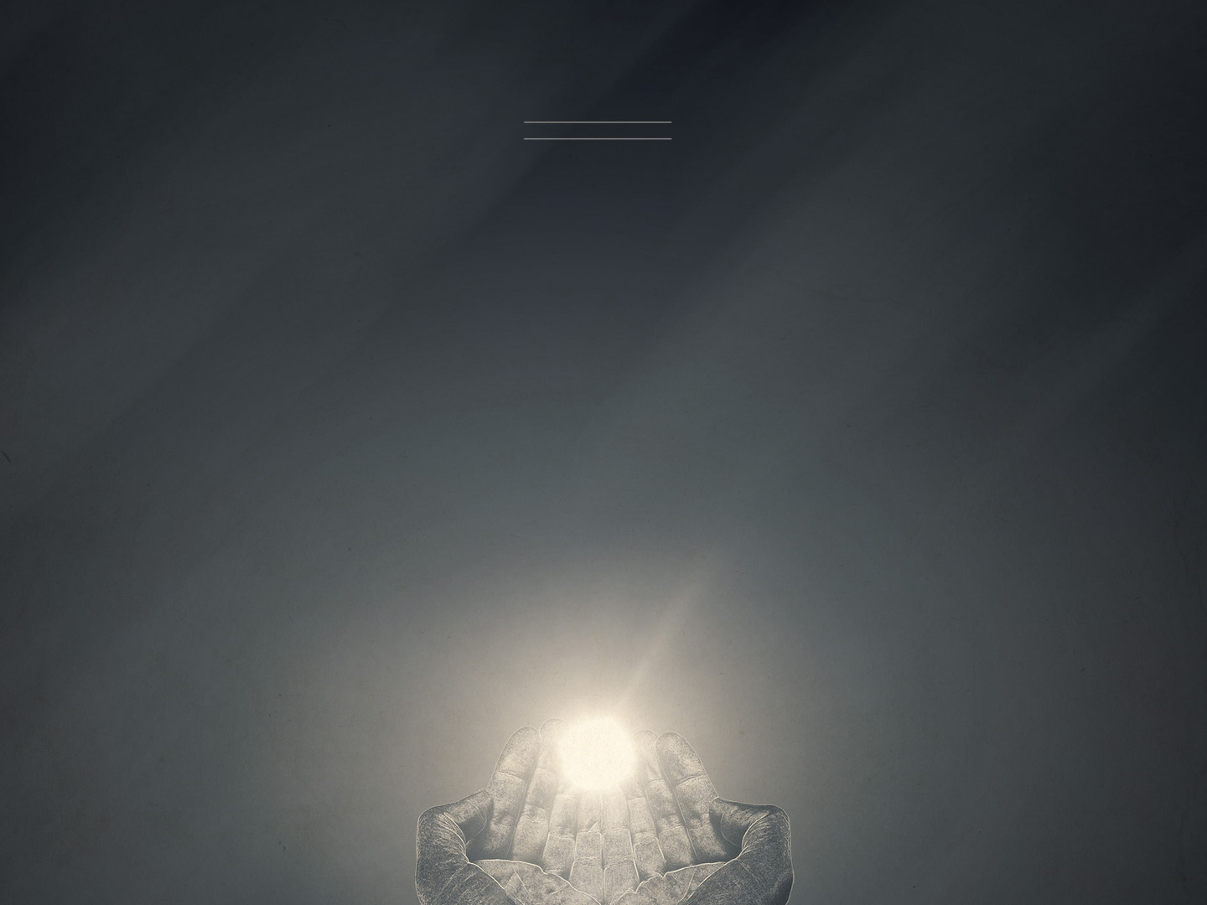
“Let your work be shown to your servants, and your glorious power to their children” (Psalm 90:16)
“Let the favour of the Lord our God be upon us, and establish the work of our hands upon us, yes, establish the work of our hands” (Psalm 90:17)
Notes:
“Let your work be shown to your servant, and your glorious power to their children” (Psalm 90:16) - Lord, show us your work, show us your mighty hand - Let it be heard, let the good news of the gospel be preached, let us behold your glory in Jesus Christ through faith - Let us see the glory and grace of our Lord Jesus Christ be displayed in this church, and in this community like never before - If God is missing this year in 2025, in all our activities, in all our ministries, and in each of our lives, then all will be in vain - We may be busy ‘doing ministry’ but if God is missing, it is all for nothing – Let your work be shown to your servants. And your glorious power to their children - God’s people long to see the glory of God, and we long to see our children behold the glory of God - We have been seeing some new families over this past year walk in through the doors of this church - Let us pray that all the kids would come to know Jesus at a young age - May all our children walk in the truth as it is revealed to them in Jesus Christ
“Let the favour of the Lord our God be upon us, and establish the work of our hands upon us, yes, establish the work of our hands” (Psalm 90:17) - Moses has seen the displeasure of God, the anger of God, but he is calling upon God’s mercy, and asking for God’s favour to now be upon them - The word here for favour can also be beauty, or pleasantness, literally reading as let the beauty of the Lord our God be upon us - As a church for 2025, is this not also our prayer, that the beauty and the favour of the Lord our God be upon us - For He is altogether lovely. His divine favour, beauty, is better than life itself - This beauty covers all our guilt, all our filth, all our shame, and He begins to make us holy, conforming us to the image of Christ - And in doing so He establishes the work of our hands. And in Hebrew when they write something twice, the author is emphasising it - Moses is crying out to God, establish the work of our hands. Lord let us do nothing unless you are doing it through us - For only that which Christ does in and through us, by the power of the Holy Spirit will matter - Only what’s done for Christ will last. - Lord show us your work, let us behold your glory, and establish the work of our hands, that we might be examples of your grace, and that your name might be glorified - That’s our prayer for 2025

Slide 10
SUMMARY
In God alone, through Christ, we find a refuge, a home, an eternal dwelling place
Our lives are short, we all have a date with death. Lord, teach us to number our days
Let the beauty, the mercy, and the grace of God enthrall us in 2025
Notes:
In God alone, through Christ, we find a refuge, a home, an eternal dwelling place - Christian, this is not just something to agree with, to mentally approve of and know - Have you felt this in your life? God says come to me, I will protect you, I will give you rest, in me you will find all that you need - This year you may encounter many tough times. - May you know it as a living reality, that in God you have a dwelling place, who has been a dwelling place in all generations. He will not fail you - Perhaps there are those of you sitting here today, who have home for your body, but your soul is homeless - God says to you, “Come to me. This house has already been paid for by the precious blood of my Son, Jesus Christ.” No repayments, nothing owed, debt paid - Trust in Christ alone, turn from your sins and believe in Jesus that you might be saved and receive an eternal home with God
Our lives are short, we all have a date with death. Lord teach us to number our days - Let us keep our hearts and minds in the Word of God. For it is there, through the truth of God’s Word, that the Holy Spirit sanctifies the children of God - The truth of God’s Word affects the way we live, it is powerful - And as we take hold of the truth, and we grasp it in our hearts, God will sanctify us and cause us to live a life of urgency to the glory of God - He will stir in us a heart for the lost, and an urgency to preach the gospel to the lost that they might know the power of God unto salvation - Do not waste the opportunities God brings your way this year.
Let the beauty, the mercy, and the grace of God enthrall us in 2025 - Are you personally thrilled by Jesus Christ? - God saved you, that you might go and tell others about the mercy and grace of God, about the only gospel that can save - And He saved you that you might be satisfied and enthralled by Him and Him alone - May our eternal, unchanging, just, holy, merciful, and gracious God enthrall us this year - Let it be evident in our lives that the only thing that satisfies us God himself - And may the gospel go forth mightily, that we might, by the grace of God, see the lost be found, see sinners be saved, and called home to their heavenly Father

Slide 11
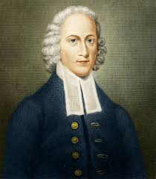
“Lord, stamp eternity on my eyeballs” Jonathan Edwards
Notes:
Let me close with this today. Jonathan Edwards was one the greatest American revivalist preachers who was around in the 1700s
While Jonathan Edwards was yet a teenager, he wrote 70 resolutions for the rest of his life
Numbers 1-4 were all to do with living his life to the glory of God, because all he wanted was to see God glorified
Numbers 5-7 all had to do with the use of his time, that he might live his life to the glory of God
So Jonathan Edwards would pray this prayer:
“Lord, stamp eternity on my eyeballs”
Lord, teach us to number our days, stamp eternity on our eyeballs, fix our hearts and minds on Jesus Christ, that we might live our lives to the glory of God
Let me close today in prayer by reading a portion of this Psalm

