Slide 1
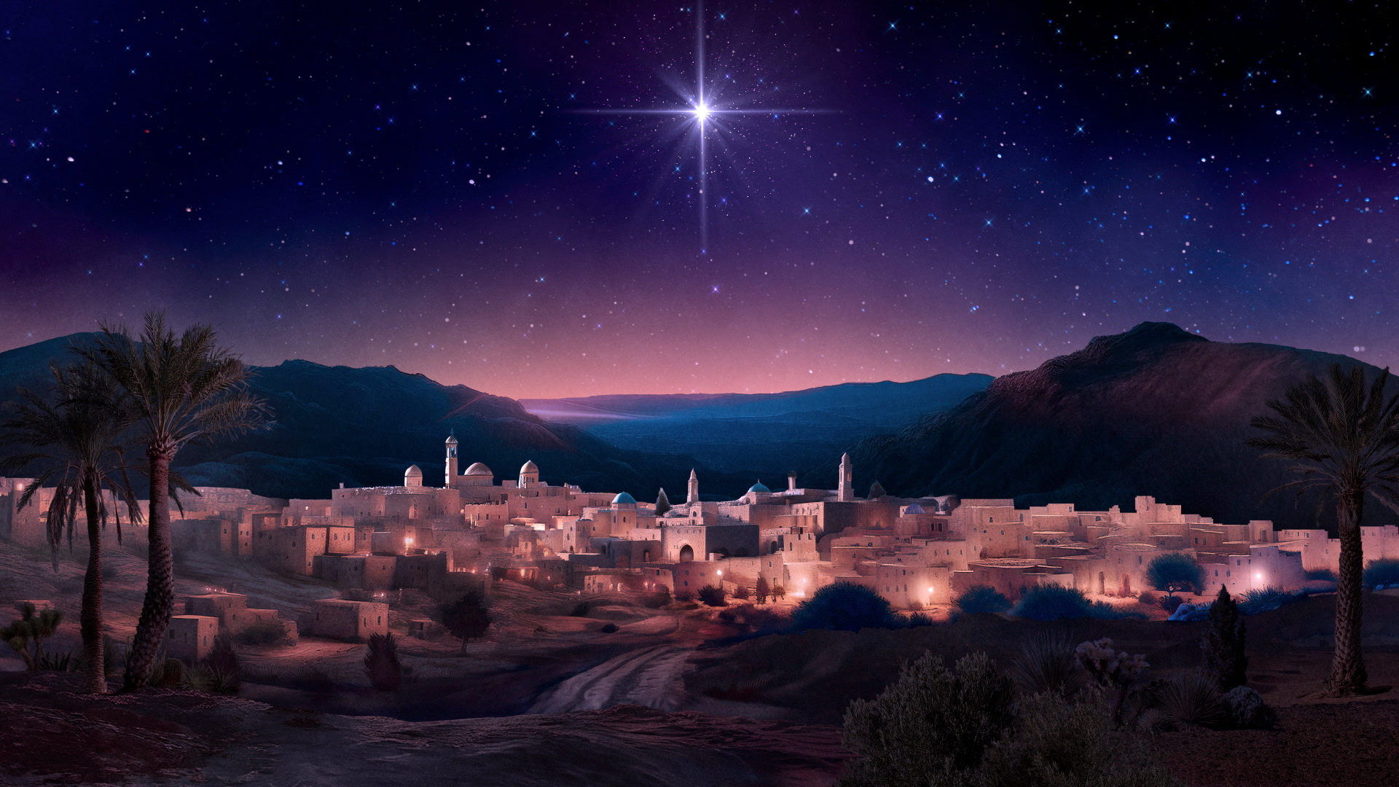
The Glory of CHRISTmas
Notes:
These first 18 verses of John’s Gospel are powerful, and rich with theology
Matthew Henry, a puritan from the 1600’s said that, “The first verses of St. John’s gospel were worthy to be written in letters of gold”
Now, I can probably imagine what you are all thinking. - “That’s all good and well Harrison, but this doesn’t read like a very Christmasy passage”
But, Christmas is all about Jesus and who he is, and the importance of Jesus being born into the world
And in this passage we certainly deal with who Jesus is and the necessity of his birth, or as the Gospel of John puts it, “The Word became flesh”
The other thing I hope for us all to see tonight is the glory of Christ, and thus the glory of Christmas
But before we jump into the focus verse for tonight, which is verse 14, I want us to take a quick look at verse 1, just to help us understand what ‘the Word’ is

Slide 2
THE WORD
“In the beginning was the Word” (John 1:1a)
“and the Word was with God” (John 1:1b)
“and the Word was God” (John 1:1c)
Notes:
“In the beginning was the Word” (John 1:1a) - For those of us who have been in churches and been a Christian long enough, know that the Word is Jesus, in these verses - In this verse, we can clearly see that John is pointing us back to the very beginning of the Bible, in Genesis 1:1, which tells us that in the beginning God - Before anything existed God was, for He is eternal with no beginning and no end - And so Jesus, the Word, is also eternal without a beginning and without an end
“and the Word was with God” (John 1:1b) - John masterfully communicates to his readers, that Jesus is distinct from God - As verse 18 of this same chapter puts it, that the Word is at the Father’s side - They enjoyed a close relationship, with one another, perfect fellowship with one another - God did not create mankind because He was lonely, for the three persons of the Godhead enjoyed perfect relationship
“and the Word was God” (John 1:1c) - So the Word is eternal, and was with God, and is God - We serve a triune God, 1 God in 3 persons. We do not worship 3 gods - Jesus is the eternal begotten Son of God, as vs 14 says - That doesn’t mean that Jesus was created by God, it means that he is the unique Son of God. - For all who are believers are considered sons of God, but we are sons of God by adoption - Jesus is the only Son of his kind, not created by God, but begotten, unique, one of a kind - Jesus and the Father are co-equal and co-eternal - For all things were made through and by him, and without him nothing exists - He is the source of all life and light - But perhaps you may understand all this, and yet you are still left wondering…

Slide 3
But why did John use ‘the Word’?
We must look back to the Old Testament, because we believe that Scripture interprets Scripture
“he has made him known” (John 1:18)
Notes:
But why did John use ‘the Word’? - Why did John not just say Jesus, or Son of God? - What does this ‘the Word’ even mean? - It’s important that we understand this because it assists us in seeing and understanding the cohesiveness of Scripture - That it really is one big story, with common threads called doctrines, running all the way through - The Greek word for ‘the Word’ is Logos, and there are various philosophies and interpretations of this word, and they can be helpful - But I believe that more importantly than looking at the contextual philosophies of the time that this Gospel was written, we must go back to Scripture
We must look back to the Old Testament, because we believe that Scripture interprets Scripture - If you don’t study the Bible, if you don’t dig deep, and join a local church that teaches you the Bible - You’re going to miss a lot of the meaning that is embedded beneath the surface level in Scripture - AW Tozer once said, “Nothing less than a whole Bible can make a whole Christian” - So, with all that being said, what does the Old Testament have to teach us about ‘the Word’? - The word of God is connected with God’s powerful activity in creation, God revealing Himself, and deliverance - It was by His word, that God spoke creation into existence. It was by His word that God revealed Himself to Samuel - It was by His word that God directed Israel through the prophets and called them to repentance and salvation
“he has made him known” (John 1:18) - Right at the end of the chapter, there is this phrase ‘made him known’, which is actually the Greek word we use for exegesis - Meaning that the Word, the Logos, explains, interprets and reveals God - For only Jesus is the Word, for by him all things were created, by him God revealed who He was, and by him deliverance comes, salvations comes - And there is thus hope for all who will believe in the Word

Slide 4
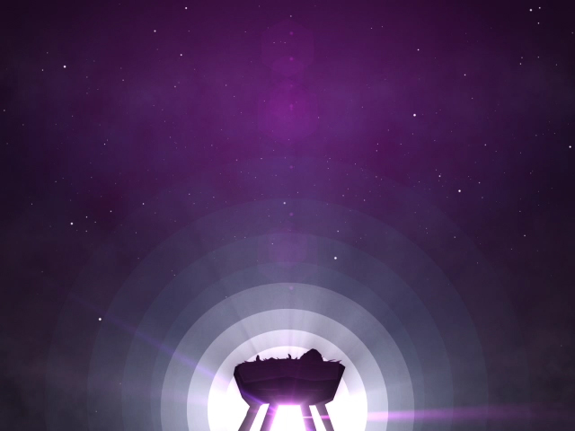
THE WORD BECAME FLESH
“And the Word became flesh” (John 1:14a)
In becoming, Jesus did not cease to be all he was in being fully God
Jesus became like us in every way, except that of sin
Notes:
“And the Word became flesh” (John 1:14a) - John uses the term Logos 3 times in verse 1, and then only once more here in verse 14 - By using it he recalls all that we have just learned. That the Word eternal, who is with God and is God eternally now becomes flesh - And this is the Christmas story according to John. - Jesus, the one who created us, and whom we have rejected and despised - Humbles himself in becoming a man
In becoming, Jesus did not cease to be all he was in being fully God - Many take this word, ‘became’, to mean that in becoming flesh, in becoming a man, Jesus ceased being God - Or that he remained fully God and only appeared to be human, or at different points in the story he was God, and other points he was human - But that’s just not true, and it’s not only not true, but it’s heresy - The Word, fully God, did become fully man, while remaining fully God
Jesus became like us in every way, except that of sin - Jesus did become fully man, in order that he might be born, live and die as a sacrifice, as our perfect substitute, for only a perfect man could pay for the debt of sin for mankind - And yet he was born without sin, and was able to keep his record clean because he was fully God – But this is the good news of Christmas. Jesus became just like us so he can sympathise with us - He understands the struggles that you might be going through at school, or at home, or in the workplace - And yet because he is fully God, and he is our great high priest, meaning he represents all believers before God, he can deal with the Father on equal terms, because he is very God - The natures were in one person, but one did not diminish other. - Him being God was not diminished by him becoming human, nor was his humanity overpowered by his deity - He became like us in every which way, except without sin

Slide 5
“and dwelt among us” (John 1:14b)
The Word is Immanuel, this is God with us
Jesus is the answer to the question as old as time itself, “What is God like?”
Notes:
“and dwelt among us” (John 1:14b) - The word here for dwelt is skenos, which means tabernacle - And once again, John is pointing back to the Old Testament, where the tabernacle was the place where God’s glory was, demonstrating His presence with His chosen people Israel - Jesus is God’s glory manifested to us, and we will talk about glory very shortly, but what John is saying here is his version of the Christmas story…
The Word is Immanuel, this is God with us - This is him the one whom all of Scripture points to - This is him, the one who who has no beginning and no end - This is him, who is very God very God, who has become fully man, that we might be saved – For unto us a child is born, unto us the Word has become flesh, to save his people from their sins - Colossians tells us that, “In him the whole fullness of deity dwells bodily” - In Jesus Christ, in this baby boy in a manger, the fullness of the Godhead is pleased to dwell - This is amazing news, because what we find in this manger is that…
Jesus is the answer to the question as old as time itself, “What is God like?” - Many people say well if God is real why won’t he just reveal Himself - But at Christmas we celebrate the answer to this question, that in Jesus we find out exactly what God is like - On top of that God has given 66 authoritative books, combined into one collection, which is sufficient for knowing exactly what He is like - Oh that we would cherish Christ as we ought, and hold the Scriptures so dearly to our hearts - Because it is there that we see ourselves for the sinners we are, and is there that we find a holy, and just, and merciful, and gracious God

Slide 6
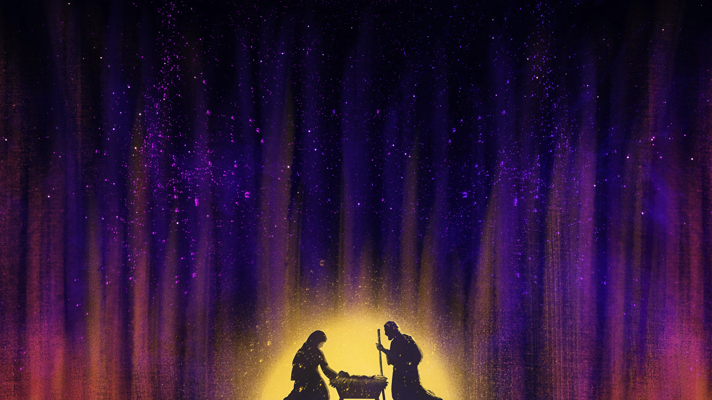
THE GLORY OF THE WORD
“and we have seen his glory” (John 1:14c)
God’s glory was often on display in the Old Testament (Exodus 19:16-20; 33:18-23; Isaiah 6:1-5)
Jesus did many mighty miracles, to demonstrate the glory of God (John 2:11; John 11)
Notes:
“and we have seen his glory” (John 1:14c) - Other translations say, “and we have beheld his glory” - Now there is a sense in that while Jesus walked the earth, all those who saw him saw the glory of God, but certainly not in it’s fullest sense - In John 11, just after raising Lazarus from the dead, Jesus turned to Martha, the sister and said, “Did I not tell you, that if you believed you would see the glory of God?” - And by the Holy Spirit regenerating us, and giving us a new heart, and only then as we look to Christ with eyes of faith do we truly behold his glory - So I think John here is more specifically talking about Jesus’ disciples - But this where the glory of Christmas comes into play - When we come to understand how awesome it is that in Christ, God’s glory was made manifest, we should be filled with gratitude to God - And fall on our knees in sheer awe of Him and of the privilege of being in Christ as followers of Jesus
God’s glory was often on display in the Old Testament - Let’s read a couple passages from the Old Testament, firstly, open to Exodus 19:16-20 - So this is just before Moses received the 10 commandments from God - But I mean this is quite a scene. Moses has already informed the people that no man or animal dare even touch the mountain, for to do so would bring death - Because this is the holiness and glory of God - It’s a terrifying scene in many ways, there is smoke, and thunder, and lightning , and the whole mountain is shaking, and trumpets are being blasted - But this is the glory of God Almighty - And then jump over just a few chapters to Exodus 33:18-23 - I love how Moses begins these verses, with a plea to God to show His glory. - What a prayer for the church, that we come expectantly on Sunday’s, gathering as the people of God praying, show us your glory - But then, God hearing Moses’ plea says that He cannot do that - For God to completely unveil His glory before the eyes of Moses would kill him. God’s glory is too awesome, it’s too holy, it’s too bright, that no man can see him and live - And then, I will just do a quick over of this next one, but in Isaiah 6, Isaiah has this vision of God - Sitting upon a throne, and God’s robe fills the temple, and there are seraphim, angels, covering his face and his feet, meaning that all that is left for Isaiah to see of God is God’s robe - And the angels are singing holy, holy, holy, is the Lord of hosts, the whole earth is full of his glory - And once again the foundations are shaking, and it’s filled with smoke - And upon seeing this, and seeing only God’s robe, Isaiah cries out, “Woe is me, For I am lost; for I am a man of unclean lips” - God’s glory in the Old Testament was awesome and terrifying, and we dare not gaze into His glory, for the only outcome is certain death. - And yet in the Word made flesh, God’s glory is made manifest to us, and the disciples stared into the face of God. - And yet while here on earth, the complete fullness of the glory of God was still veiled in Jesus by his flesh, but was seen in other ways
Jesus did many might miracles to demonstrate the glory of God - Each of Jesus’s signs in the Gospel of John were done to demonstrate His glory - And when Jesus calmed the storm, the disciples in the boat became afraid, because they had just witnessed the glory of God on display - The sovereignty and power of God had just been demonstrated before their very eyes - And then Peter, James and John on the mount of transfiguration, they beheld Christ’s glory - His face shone like the sun, and his clothes became as white as light, and then God spoke and three of them fell on their faces and were terrified - Truly in Jesus Christ, God’s glory was made manifest, but this isn’t even the quintessential point of God’s glory in the gospels

Slide 7
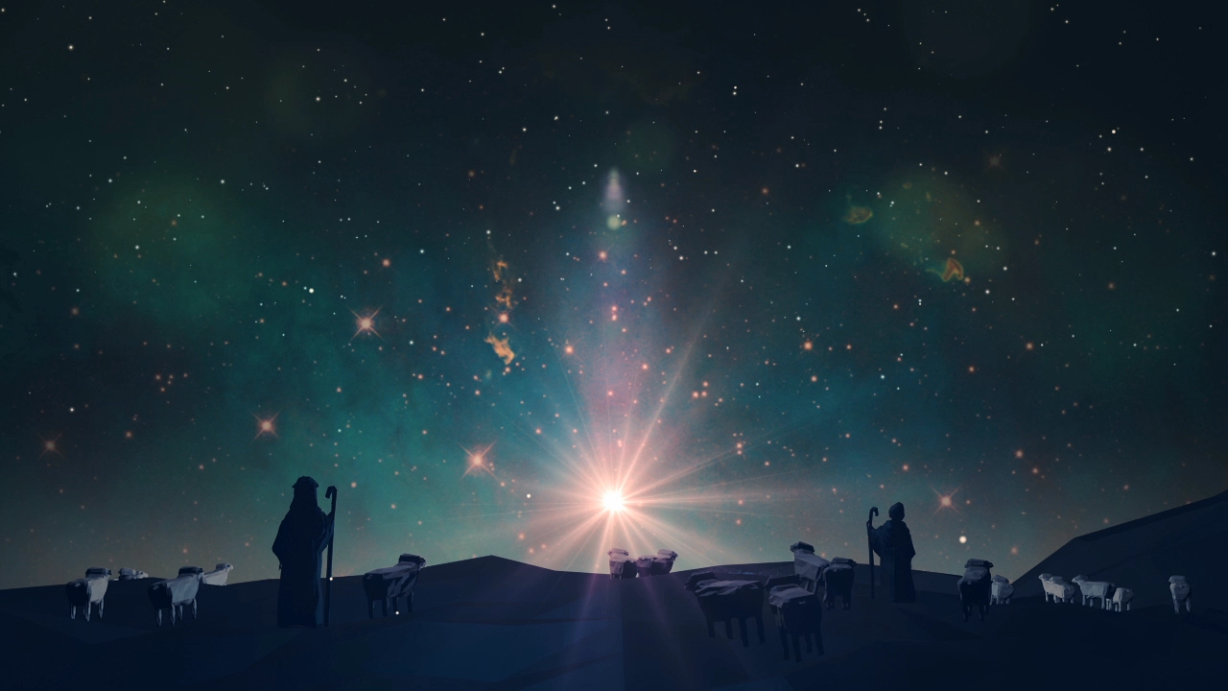
“The hour has come for the Son of Man to be glorified” (John 12:23)
We too must glory in the cross of Jesus Christ
Have you beheld the glory of God by faith?
Notes:
“The hour has come for the Son of Man to be glorified” (John 12:23) - God’s glory culminates at the end of Jesus’ life, as the hour comes when he was to be crucified for sin - It is so backwards in comparison to the world. The world considers glory to go hand in hand with fame and wealth, and with being well-liked, with reputation and popularity - And yet here in the most shameful act known to any man, Jesus Christ, the God-man was sent to the cross, to die for a crime that you and I committed - And he did that willingly, voluntarily, so that God could be glorified and that we might have eternal life - It in this one scandalous act, the glory of God is on full display. All of redemptive history, and all of Scripture points to this one event - Because it is here, by the once for all sacrifice, that salvation was secured for all who will believe - And we know that it has been secured, that the work is finished, because 3 days later, Jesus rose from the grave… payment accepted, debt paid! - And so it is for this reason that…
We too must glory in the cross of Jesus Christ - The job of the pastor, of the preacher is to lift him up. That week after week you might behold his glory. - That you might think so little of me, and so much of Him - For who am I but a sinner saved by grace. I am but a dying man, preaching to dying men and women - There is no greater privilege, it is a sweet and blessed work to be able to magnify Christ. - Brothers and sisters, do not think you have got off so lightly, for your lives - Your ministries to which God has allotted to you, ought to be saturated in Christ that those who are around may behold his glory - This is soul saving work Christians, for we were created for God’s glory, and now by the grace of God and by the power of God at work in us, we live our lives to the glory of God. - And we preach the gospel to the glory of God - Oh that we would be like John the Baptist, living a life that declares to the world, I must decrease so that he might increase
Have you beheld the glory of God by faith? - It is only by faith in the Lord Jesus Christ. This faith looks at Jesus Christ, the God-man who lived and died for us - It looks at him and sees my debt being paid, that I could be forgiven and brought near to God - And when you behold His glory by faith, you will find yourself asking. Whom do I have on earth but Jesus? - Who is there in heaven that I desire besides him? For it is Christ who has done for you what none could do but God - To the unbeliever, I urge you to believe in Christ, repent of your sins, turn from your sins, and believe in Christ. Behold His glory by faith - There is no greater joy in life, there is no greater privilege, to have your debt paid, and be given the perfect righteousness of Jesus Christ - That you might be adopted into the family of God, to be called a child of God - I have no greater gift to offer you this Christmas than Christ himself

Slide 8
THE WORD IS FULL OF GRACE AND TRUTH
“Full of grace and truth” (John 1:14d)
Jesus as expressed in the Scriptures, is full of truth, there is no other foundation by which we ought to build our lives
Jesus Christ is the full expression of God’s saving grace, and all the necessary truth to save can only be found in him – John MacArthur
Notes:
Full of grace and truth” (John 1:14d) - Christ is full of grace, and from his fullness, brothers and sisters in Christ, we have all received grace upon grace is what verse 16 tells us - Romans 5 tells us that is in grace we stand. Christ reveals God to us, and the God whom we serve is a God full of grace - For it was only by God’s mercy and grace that God sent Jesus Christ into the world to save His people from their sins - God’s mercy says to His child, the believer, though you deserved hell, eternal death, I will not give it to you because of Jesus - Grace says, though you do not deserve eternal life, or to be called a child of God - Though you do not deserve to enjoy all the days of your life here on earth, or for eternity to come in an intimate relationship with Jesus Christ - We don’t deserve that, we are not entitled to it, but because of the finished work of Jesus Christ, it is yours - This is all granted for the believer - It is just grace upon grace. Won’t you come to the river that never runs dry. Come to Jesus and there you will find grace, upon grace, upon grace - Amazing grace how sweet the sound that saved a wretch like me. - God’s grace will never truly be amazing, until we understand just that, that we are a wretch, deserving nothing, but in Christ we are given everything
Jesus as expressed in the Scriptures, is full of truth, there is no other foundation by which we ought to build our lives - Jesus is the rock upon which we build our lives. Only when we are founded in him, can we have assurance that though storms may come our way - Though Satan may tempt us to despair, in him and because of him we will get there, He will get you there. - We have assurance that in him, and by the grace and power of God we will one day see that which we only saw with eyes of faith, and spend forever in the glory of God - All God’s promises find their yes and amen in Jesus, because God will never lie, He is always faithful, He is always true - Though all else may fail, Christ never will, for he is full of truth
Jesus Christ is the full expression of God’s saving grace, and all the necessary truth to save can only be found in him – John MacArthur - Scripture teaches us that salvation from sin is only found in believing the truth of the gospel, by which one receives His saving grace - The full grace of God, and the full truth of God are never more clearly seen and revealed than in the Word made flesh, in that baby boy in the manger - It is in Christ alone that the soul can be satisfied, if you would but die to self, and live for Christ, then in him you will find life, and life to the fullest

Slide 9
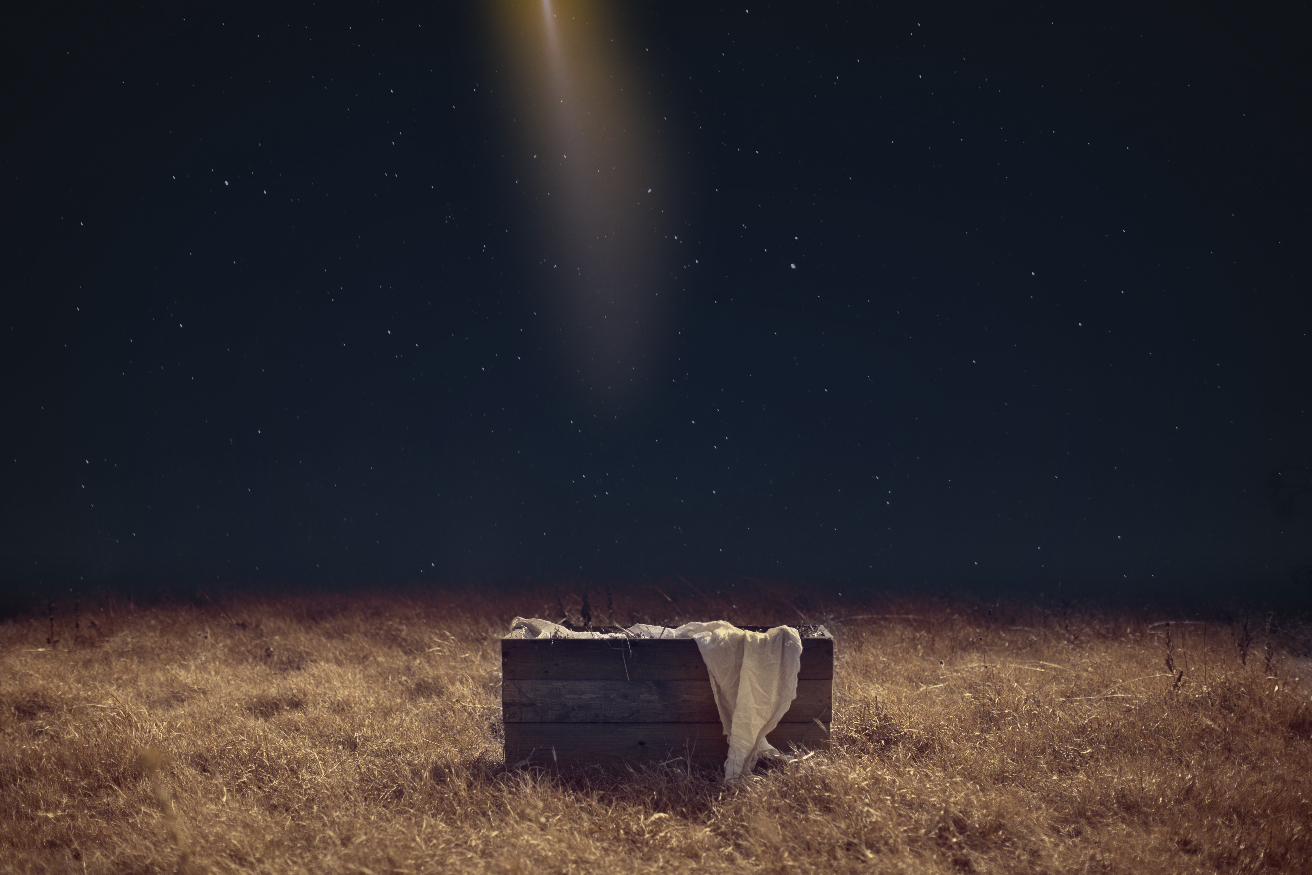
SUMMARY
Jesus, the Word, being both fully God and fully man, came to dwell among us
The glory of God, which was once far off, was brought near in Jesus Christ, that we may behold his glory by faith
This Christmas let us remember that grace, truth, salvation are available only in the Word incarnate. Come to him!
Notes:
Jesus, the Word, being both fully God and fully man, came to dwell among us - When we wake up tomorrow morning, before we do anything may we remember that we celebrate because the Saviour of the world was born - That Jesus Christ became one of us, without sin, that he might save us from an eternity in hell and reconcile us to God, bring us back to God
The glory of God, which was once far off, was brought near in Jesus Christ, that we may behold his glory by faith - The fullness of the Godhead was pleased to dwell in Christ, and so in him God saw fit to demonstrate, to manifest His glory - And then the Lord of glory was crucified. How astonishing is the love of Christ, that would stoop so low, so as to exalt us
This Christmas let us remember that grace, truth, salvation are available only in the Word incarnate. Come to him! - Jesus said I am the way, the truth and the life, no one comes to the Father except through me. It’s Jesus, it’s him, he is the only way - Christians, let us never tire of hearing about our Lord and Saviour who supplies all our needs, in whom we find grace upon grace. For He alone is worthy of all the glory
Let me close with a poem

Slide 10
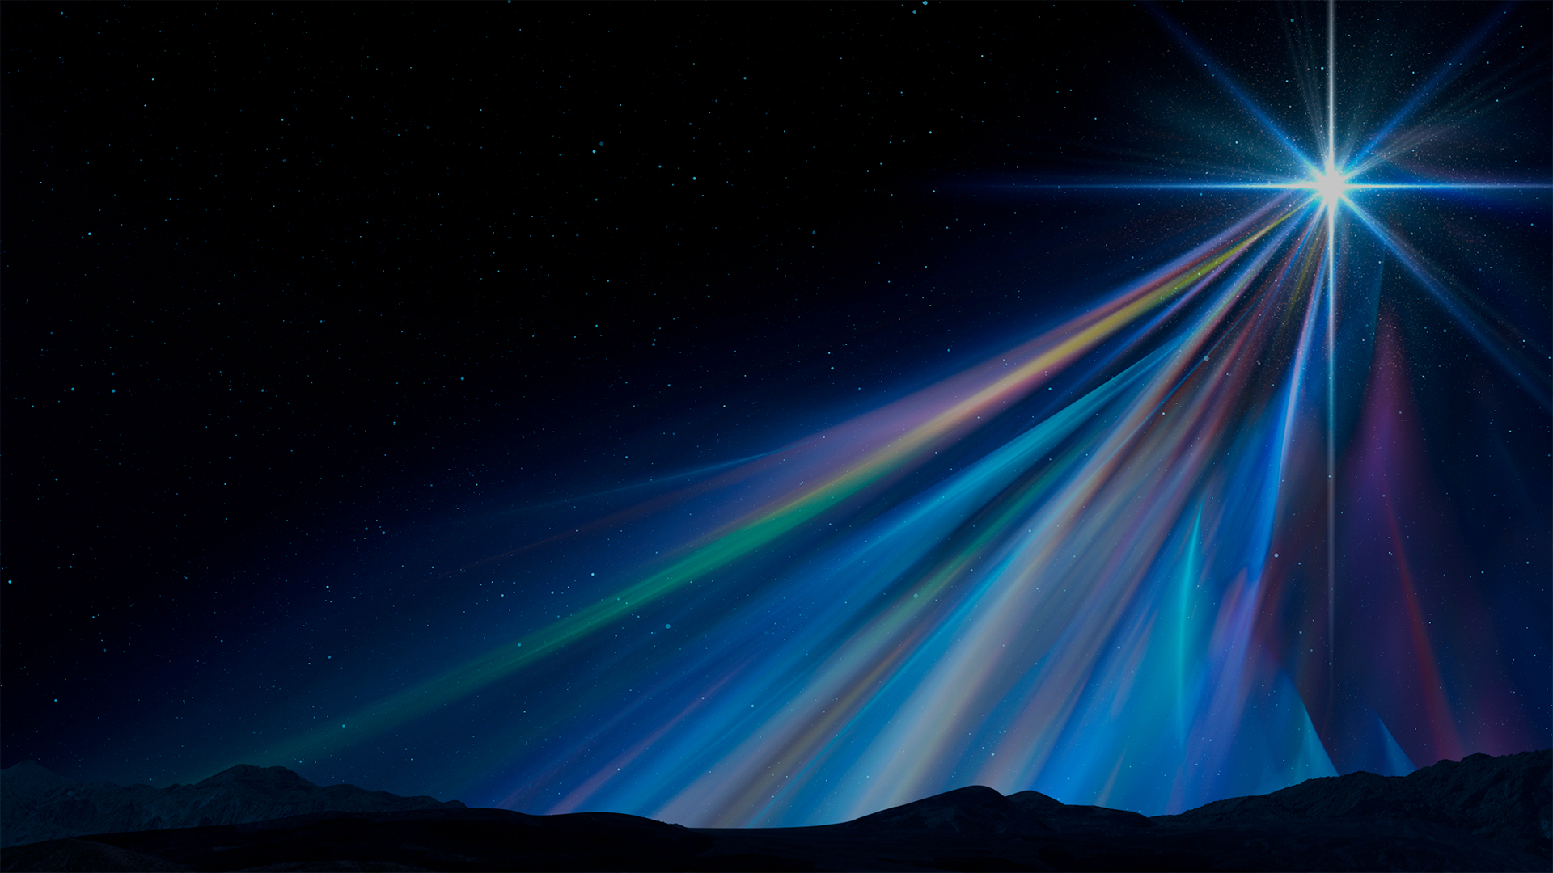
Forsaken, hated, and despised
A child of wrath, no hope, forlorn,
Cast down by sin, by anger torn
Our hopelessness was not disguised.
Who can reverse this solemn state?
Who can turn sour into sweet?
Who can our mortal trespass meet?
Who can our crooked souls set straight?

Slide 11
A Scandal! God breathed human air;
Unjust that good would die for sin;
Absurd that we must die to win!
Resist? Embrace sin’s deep despair.
The Form of God who took our form
An endless debt by blood to pay.
Both man and God appeared that day,
When Christ, the saving Lord was born.

Slide 12
No more forsaken, no more wrath
No longer hated or cast down
A tender babe, a cross, a crown
He came to set redemption’s path – Author Unknown
Notes:
Christian’s, rejoice, no more forsaken, no more wrath.
O come let us adore him, for by his blood, by his sacrifice, and by his resurrection, you are no longer enemies of God, but a child of God
To the unbeliever, Jesus Christ came into the world to save sinners
Repent and believe in him, and you will be saved

