Slide 1
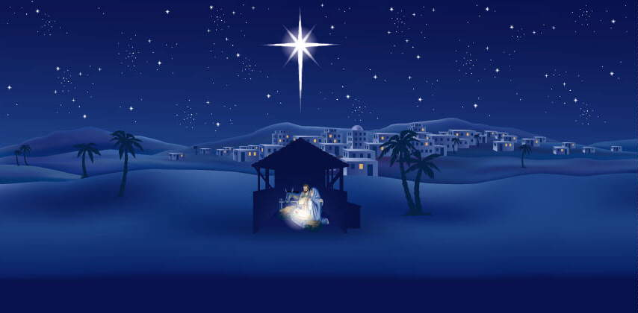
“So, where is the peace?”

Slide 2
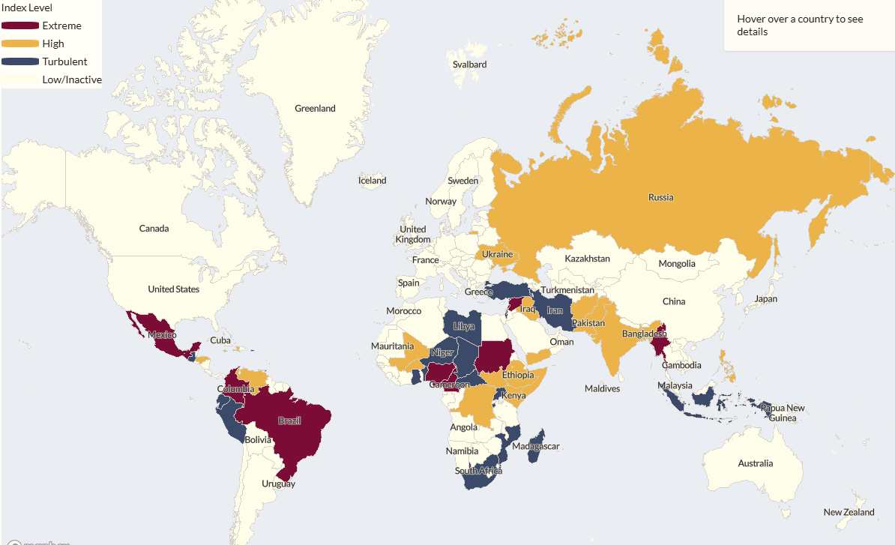

Slide 4
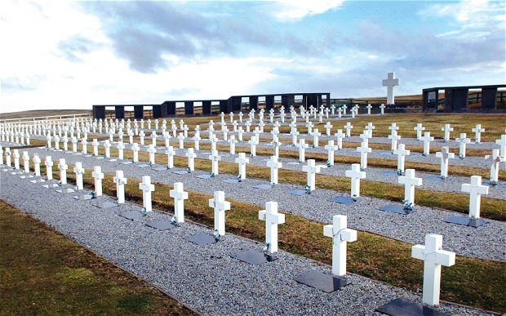
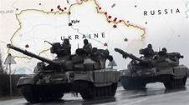
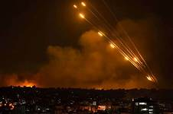
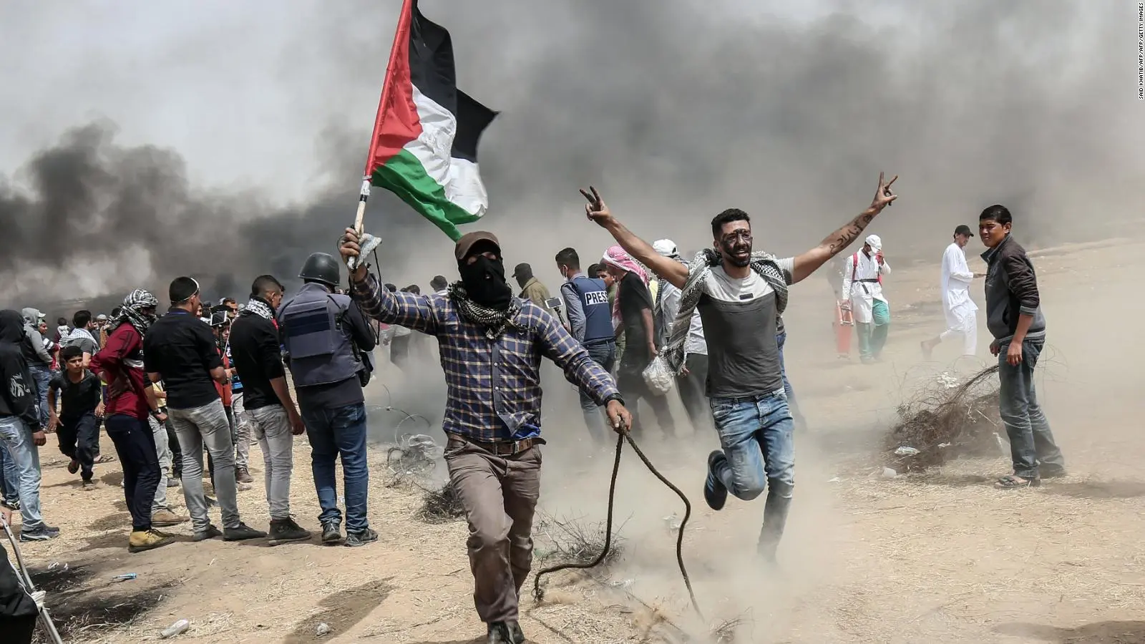
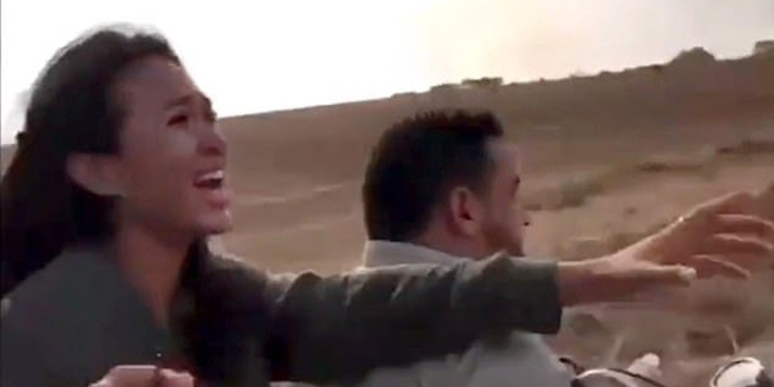
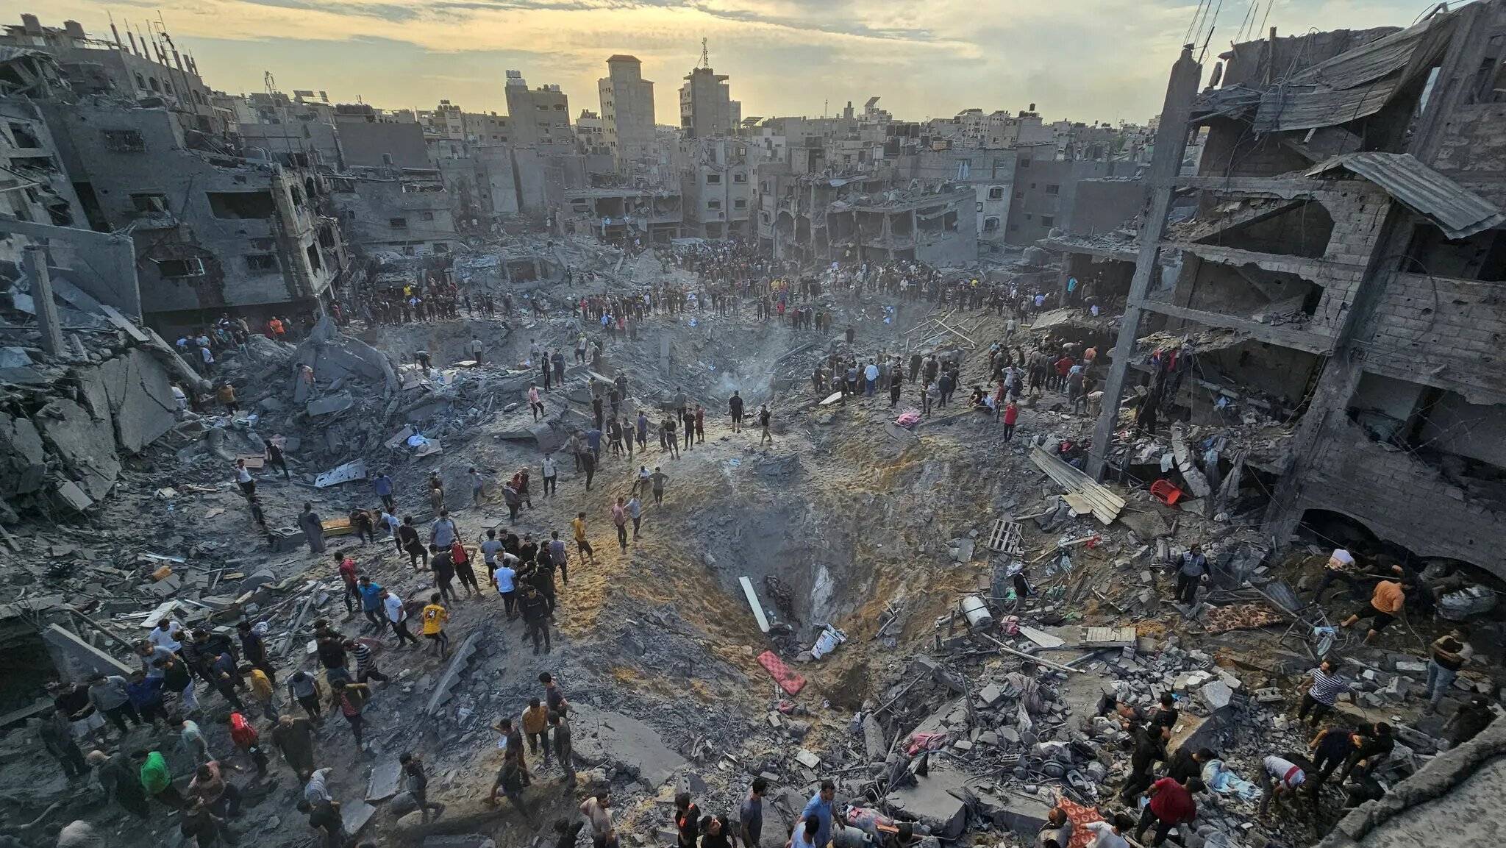
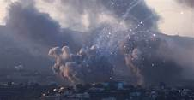
The World at War

Slide 5
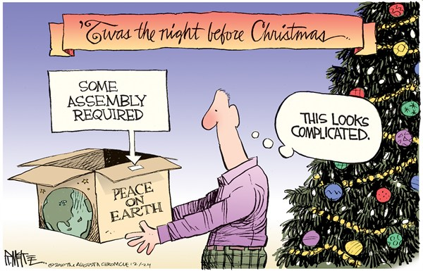
Understanding “PEACE” is an enigma to many!

Slide 6
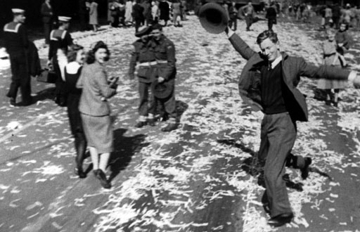
Peace is a fantastic blessing!

Slide 7
[Isa 9:6-7] "For to us a child is born, to us a son is given, and the government will be on His shoulders. And He will be called Wonderful Counsellor, Mighty God, Everlasting Father, Prince of PEACE. Of the increase of His government and PEACE there will be no end. He will reign on David's throne and over his kingdom, establishing and upholding it with justice and righteousness from that time on and forever. The zeal of the LORD almighty will accomplish this.

Slide 8
[Isa 11:6-10] "The wolf will live with the lamb, the leopard will lie down with the goat, the calf and the lion and the yearling together; and a little child will lead them... They will neither harm nor destroy on all my holy mountain, for the earth will be full of the knowledge of the LORD as the waters cover the sea.

Slide 9
[Micah 4:3] "He will judge between many peoples and will settle disputes for strong nations far and wide. They will beat their swords into ploughshares and their spears into pruning hooks. Nation will not take up sword against nation, nor will they train for war anymore."

Slide 10
[Isa 60:1-4] "Arise, shine, for your light has come, and the glory of the LORD rises upon you. See, darkness covers the earth, and thick darkness is over the peoples, but the LORD rises upon you and His glory appears over you. Nations will come to your light, and kings to the brightness of your dawn. Lift up your eyes and look about you: All assemble and come to you; your sons come from afar, and your daughters are carried on the arm."

Slide 11
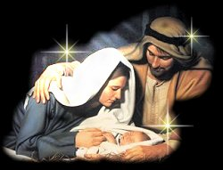
The angels were not proclaiming universal peace among all people but
PEACE with GOD!
From the time of Jesus’ Birth, GOD’S PEACE was available to all people!

Slide 12
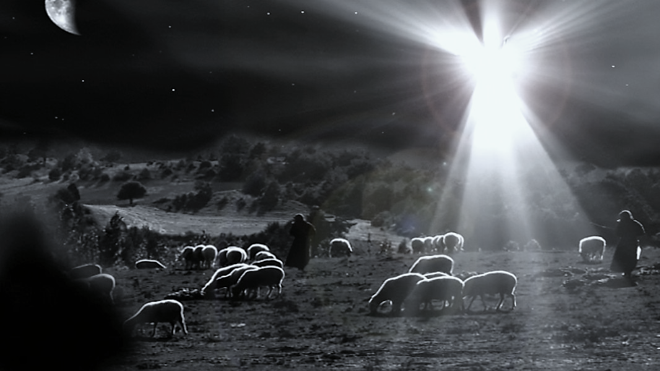
“Glory to GOD in the highest and on earth PEACE to men on whom His favour rests”

Slide 13
Paul wrote...
[Eph 2:14] “… He Himself is our peace…”
God was reconciling us to Himself…
[Col 1:20] “… by making peace through
His blood, shed on the cross.”

Slide 14
May you know...
GOD’S PEACE through CHRIST
PEACE with those around you
LOVE of family and friends
FORGIVENESS and COMPASSION towards others

Slide 15
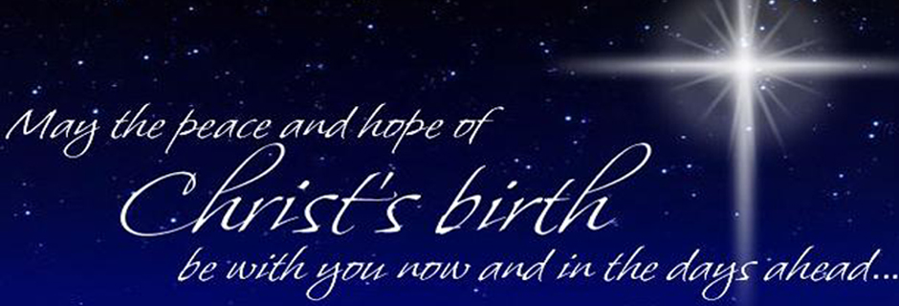
Happy Christmas Everyone!

