Slide 1
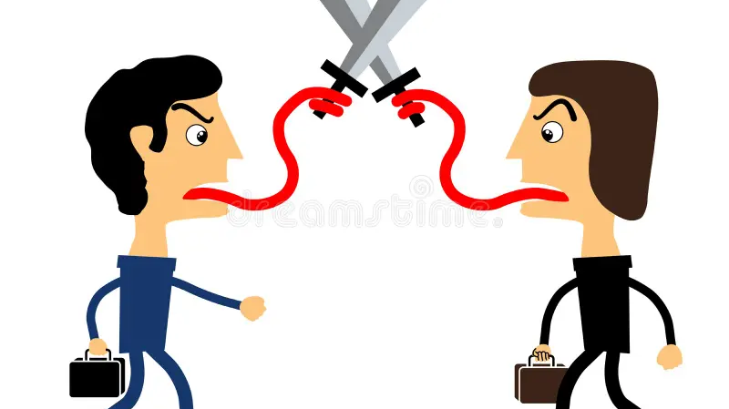
Taming the tongue
James 3: 1 - 12

Slide 2
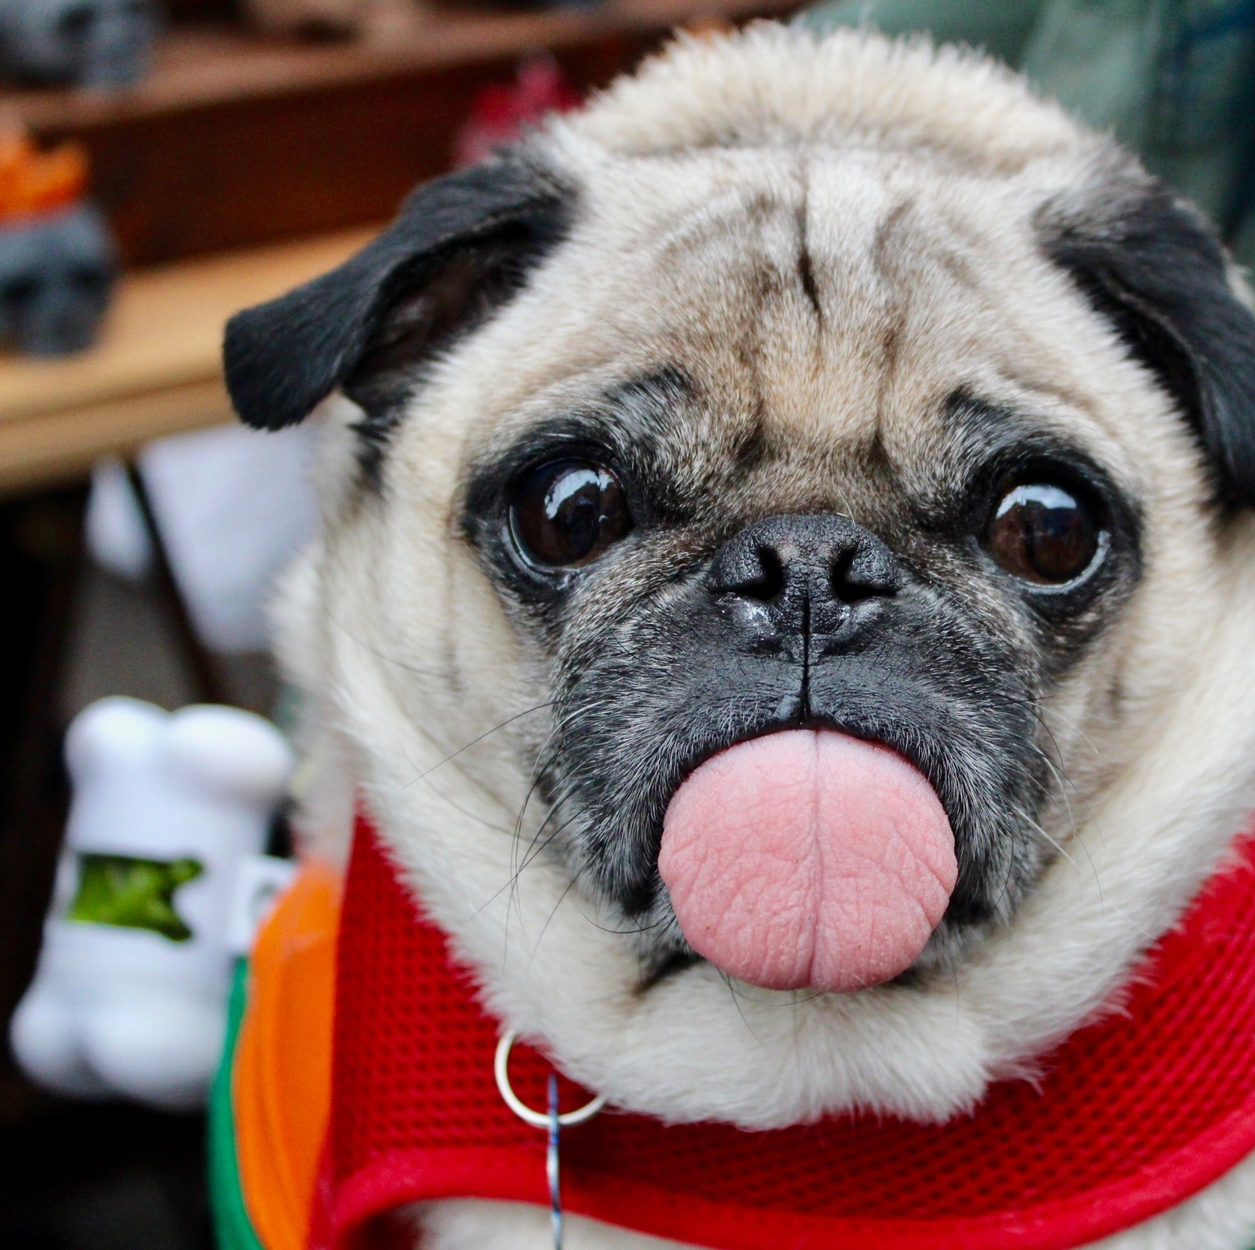
Research reports that on average we speak 700 times a day.
Studies have shown that both men & women speak an average of 16,000 words a day.
Other research says we spend about 1/5 of our life talking.
The human tongue accounts for under 1% of our body mass, but can punch well above its weight in the worst areas.
Notes:
700! Even if we think that’s way too high, let’s just say it’s 100.
What else do you do 100 times a day?

Slide 3
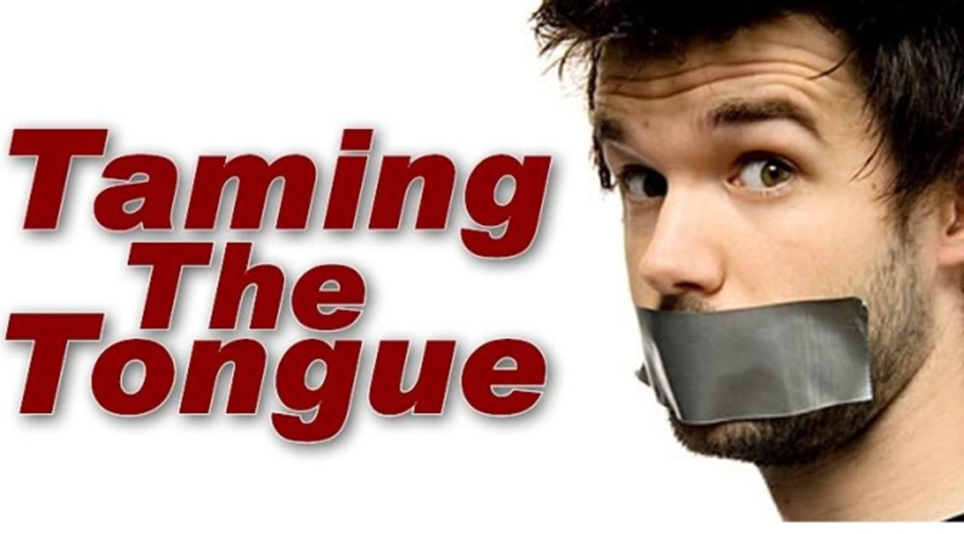
Proverbs 12:18, The words of the reckless pierce like swords, but the tongue of the wise brings healing.
Proverbs 15:4, The soothing tongue is a tree of life, but a perverse tongue crushes the spirit.
Proverbs 17:27, “The one who has knowledge uses words with restraint,…”
Proverbs 18:21, The tongue has the power of life and death, and those who love it will eat its fruit.
Notes:
The Scriptures, outside of James, talks extensively about the use of the power of our tongues and speech.

Slide 4
The Bible tells us God is a speaking God. (Genesis)
God spoke the world into existence. (Genesis)
One of the names for Jesus is literally, “The Word of God.” (John)
God upholds the universe by his “powerful word.” (Hebrews)
Words have immense power. (Churchill’s orations in 1940’s that mobilised his battle-weary countrymen to defend England.)
Massive ships can be controlled by one man in the helm controlling a rudder 1/1000th the size of the ship.
Notes:
So it makes sense that God would care deeply about how we use our words in his world.

Slide 5
Abuse By Tongue
Adam blamed Eve (Genesis 3: 12)
Psalms refer to those whose throat is an “Open Grave,” whose “Tongues Deceive,” & whose “Mouths are Full of Curses & Bitterness.” (Psalms 5: 9, 10:7, 140:3)
Isaiah sensed the weight of words when he saw a vision of God’s throne room & responded with, “Woe to me! .. I am ruined! For I am a man of unclean lips, …
I Live among a people of unclean lips.” (Isaiah 6: 5)

Slide 6
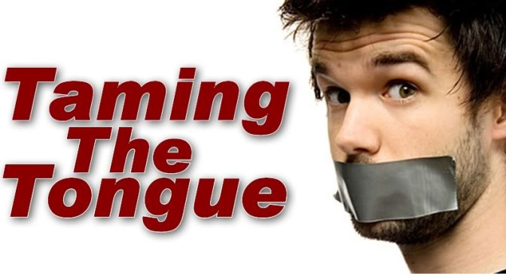
James 3: 1 – 12, discusses talking.
In James 1: 19, he exhorted us to be
“Slow to Speak.”
In James 1: 26, he said, Our use of the tongue is one indicator of true religion.
Luke 6: 45, “A good man brings good things out of the good stored up in his heart, and an evil man brings evil things out of the evil stored up in his heart.
For the mouth speaks what the heart is full of.”
Jesus says that, “we will have to give account on judgement day for every careless word we have spoken.” (Matthew 12: 36)
Notes:
This passage continues James's big idea that faith and works go together. Specifically, that what one does (or says) proves what they really believe. Those who trust God, who really believe Him, begin to be changed in their speech, as well. And yet, everyone still stumbles.

Slide 7
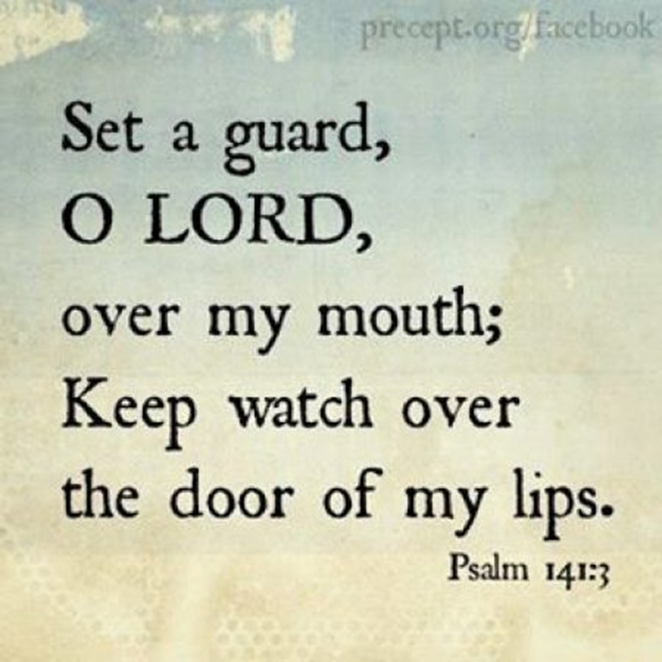
What God wants us to understand about our tongues:
The Tongue is Powerful
The Tongue is Dangerous
The Tongue is Untamable

Slide 8
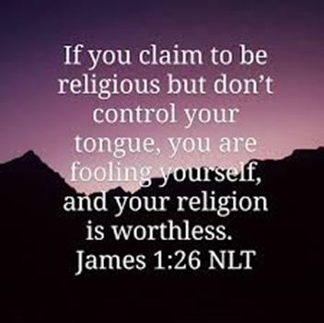
The Tongue is Powerful (1-5a)
Teachers must be careful with their words.
Teachers hold a lot of power
Verse 2, saying we all stumble with our tongue.
When we talk about the tongue, we’re really talking about the heart.
One commentator refers to the tongue as the master key of our bodies. It determines everything else, moving us either positively or negatively.
Notes:
1. In verse 1, James directs attention to those who teach. So here I am, standing in front of you to teach, and by reading this passage I’m inviting judgment on myself.
By nature of the position, to do a lot of good or a lot of bad. And while James is primarily talking about those who teach in the church, we can expand that even to our parenting. We parents teach all the time, don’t we? We must be careful when doing so. Our words hold immense weight.
But you don’t have to be a teacher to fall into sins of speech. James opens is up in No one is exempt

Slide 9
Jesus said that out of the heart, the mouth speaks
(Luke 6:45).
We can never truly say, “I didn’t mean it.”
We might not say all we really think but, what we say,
we really think.
We always mean it, and usually, we mean much more than we actually say.

Slide 10
Jesus said that out of the heart, the mouth speaks
(Luke 6:45).
We can never truly say, “I didn’t mean it.”
We might not say all we really think but, what we say, we really think.
We always mean it, and usually, we mean much more than we actually say.
“If you cannot go for twenty-four hours without saying unkind words about others, then you have lost control over your tongue.”

Slide 11
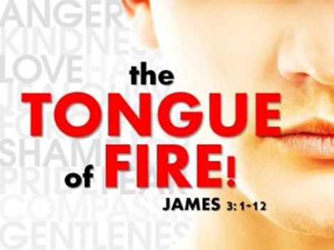
THE TONGUE IS DANGEROUS (5b-6)
“How great a forest is set ablaze by such a small fire.” (v. 5)
The tongue can kill. All it takes is a spark:
one bit of gossip,
one explosion of anger,
one biting remark,
one lie,
one word.
“Death and life are in the power of the tongue.” (Proverbs 18:21)
Our words don’t even have to be intentionally murderous to do great harm. All it takes is a little carelessness.
Notes:
Not too long ago, there was a wildfire raging through Southern California that burned 22,000 acres, eating up homes and businesses. How did it start? From a smoke bomb used in a gender reveal party. The party was held on September 5th. The flames were finally extinguished on November 16th.

Slide 12
“Staining the whole body, setting on fire the entire course of life.” (v. 6)
The tongue pollutes the rest of our body, affecting our whole life.
Satan himself works with the evil of our tongues.
Satan enjoys watching the results of our wicked tongues.
In our sinfulness, we comply all too easily.
We break the Ten Commandments with our tongues. (Exodus 20: 3-17)
We take the Lord’s name in vain.
We neglect the sabbath.
We idolise people and things.
We dishonour mother & father.
We murder through angry speech.
Commit adultery through lustful words & speech.
We steal truth through our lies.
We complain about things we don’t have , but others do.

Slide 13
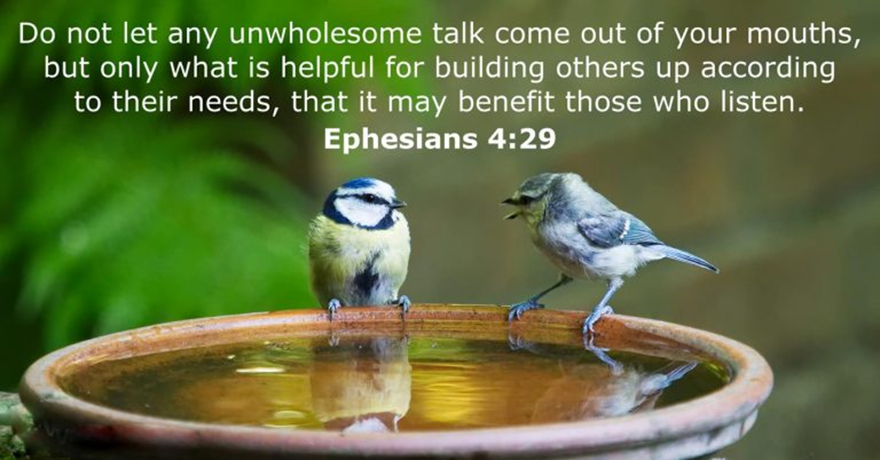
THE TONGUE IS UNTAMABLE (7-12)
UNTAMABLE. We can tame both the smallest animals and the largest, But not our tongue (less than 1% of our body)
One piece of gossip
One outburst in weary frustration
A thoughtless “slip of the tongue.”
RESTLESS. (v.8) Bible translator J.B. Phillips translates to, “always liable to break out.”
HYPOCRISY. (v.10) Blessing & Cursing God, all with the same tongue.
Praise God on Sunday, & then gossip at lunch the same day.
Do their devotions before work, then go to work destroying others.
Have Social Media for helping others, but then show hatred to friends.
Notes:
Mankind can tame any kind of animal. But in verse 8 James says there is one thing no human being can tame: our tongue. Isn’t that an amazing statement?

Slide 14
The tongue is NOT untamable.
James says it’s Impossible for US to tame our tongue.
We Must tame it, but We are unable. It is our duty to tame it.
Jesus said, “It is the Spirit that gives life; the flesh is No help at all.”
(John 6:63)
He did NOT say, The flesh is some help.
NO, He said the flesh is No help at All.

Slide 15
The tongue is NOT untamable.
James says it’s Impossible for US to tame our tongue.
We Must tame it, but We are unable. It is our duty to tame it.
Jesus said, “It is the Spirit that gives life;
the flesh is No help at all.” (John 6:63)
He did NOT say, The flesh is some help.
NO, He said the flesh is No help at All.
DO NOT TRY TO TAME THE TONGUE YOURSELVES.

Slide 16
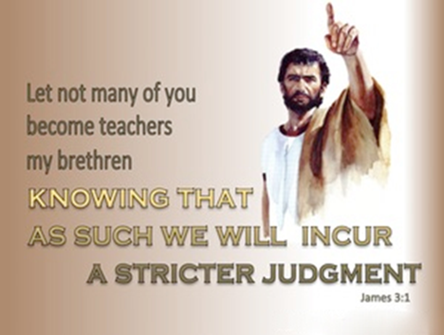
To tame the tongue
“..be ready always to give an answer to every man that asks a reason of the hope that is in us, with meekness and fear.” (1 Peter 3:15)
“At the name of Jesus… every tongue should confess that Jesus Christ is Lord, to the glory of God the Father.” (Philippians 2: 10,11)
“But I tell you that men will have to give account on the day of judgement for every careless word they have spoken. For by your words you will be acquitted, and by your words you will be condemned.”
(Matthew 12: 36, 37)
Notes:
God has made our tongues for His glory, and that is what it should be used for,

Slide 17
Steps to Transform Your Speech
Ask God for help. (Psalm 19:14; 141:3)
2. Confess your sins to God and others. (1 John 1:9; James 5:16)
3. Use your tongue to praise and encourage.
(Psalms 34:1; Eph 4:29; Heb 3:13)

Slide 18
Steps to Transform Your Speech
THINK – Before a word is uttered from your mouth & ask yourself the following
5 questions.
T – is it true
H – is it helpful
I – is it inspiring
N – is it necessary
K – is it kind?

