Slide 1
FAITH THAT WORKS (Effects of the gospel)
James 2:14-26
Notes:
Good morning everyone. I hope you are all doing well.
Today I have the privilege of preaching on arguably the most famous text from James, and yet one that at times has caused much debate
The sermon is subtitled the effects of the gospel, because I want us to understand from the start that James is not talking about what the gospel requires for us to be saved, but what the effects of the gospel are having been saved
Let us remember as we go through today’s passage that this letter was written to Jewish Christians.
Some of them were genuine, some of them not, hence why James gives lots of tests
Jews had gone from one extreme to another on the matter of works.
Judaism by this time had become a complete works righteousness system, that you are made right with God by the works you perform and meeting the requirements of the law
And along comes the gracious gospel of salvation, which is all about grace, freedom, liberty and joy
And so it could have been that some of them misunderstood that freedom and went too far the other way, from legalism to an abusive liberty, where nothing was required of them
And so James addresses that in today’s passage
So that we understand what the Bible says on the matter of faith and works, let me begin with an illustration
ILLUSTRATION: Let us suppose an apple tree has been planted, now the source of life to that tree is at the root, whether it has apples on it or not.
The apples do not give it life, but the whole of the life of the tree will come from its root.
But if that tree stands in the orchard, and when the springtime comes there are no buds, and when the summer comes there are no leaves and no fruit.
And the next year, it stands there without bud or blossom, or leaf or fruit, you would say it is dead—and you are correct—it is dead.
It is not that the leaves could have made it live, but that the absence of the leaves is proof that it is dead!
So, too, is it with the person who claims to have faith. If he has life, that life must give fruits, evidence that the faith is a true saving faith.
If the person claims to have faith and thus to have a root, but there are no works, then the inference that this person is spiritually dead is certainly a correct one!

Slide 2
AN EMPTY CONFESSION
“What good is it, my brothers, if someone says he has faith…” (Jas 2:14a)
“but does not have works? Can that faith save him? (Jas 2:14b)
“If a brother or sister is poorly clothed… and one of you says to them, “Go in peace, be warmed and filled,” without giving them the things needed for the body” (Jas 2:15-16)
Notes:
“What good is it, my brothers, if someone says he has faith…” (Jas 2:14a) - James is calling to question everyone who says they believe in Jesus Christ - Anyone who claims to be a follower of Jesus, which there many of us here in the room today. - James is very quickly going to make a distinction between someone who says they have faith, and someone who has faith - And James, being the clever communicator that he is, says some very provocative things to get our attention - What good is it if you only claim to be a follower of Jesus? What good is your outward profession? What good is your lip service? - Doesn’t the gospel go much deeper than that? Doesn’t the person and work of Jesus Christ go much deeper than simply what we say to people? - For if a person says they have faith…
“but does not have works? Can that faith save him?” (Jas 2:14b) - I want you to notice something here. James is not calling into question the whole idea of being justified by faith alone, of being saved by faith alone - What he is doing is helping us to understand what “faith alone” really means - James is calling into question all the nominal Christians - All those who want the rewards of the gospel, who want to spend forever with Jesus Christ in heaven - And yet refuse to give up walking hand in hand with the world. They refuse to deny themselves and take up their cross - Those who refuse to repent of the very sins that Jesus Christ came and died for - Can that faith save you? Can that faith save anyone? - And then he says…
“If a brother or sister is poorly clothed… and one of you says to them, “Go in peace, be warmed and filled,” without giving them the things needed for the body?” (Jas 2:15-16) - Now clearly in the context of James, there is this struggle between the rich and the poor, because James has addressed this a couple of different times - James is saying that true faith will meet the clear and present needs of brothers and sisters - False faith only offers empty words and meaningless advice - False faith is marked by false compassion - True faith will have genuine compassion which is stirred up in us by the Holy Spirit and he will work in us a desire to act upon our compassion

Slide 3
“What good is that?” (Jas 2:16b)
For a person to have faith and to SAY they have faith are two entirely different things
Notes:
“What good is that?” (Jas 2:16b) - James closes by saying, “what good is that?”, meaning that he believes he has answered his original question of, “Can that faith save him?” - In Greek, that question literally translates to, “Faith can’t save him (that is the person with no works) can it?” - A faith that has no care, no desire, no love towards the things of God, towards loving God and loving others is a dead faith that is useless - A profession of faith that has no conviction of sin, no desire of repentance when we have sinned, and only a desire for the things of this world, is nothing but an empty confession - And an empty confession has never saved anyone
For a person to have faith and to SAY they have faith are two entirely different things - If we tend to talk about our faith in Christ and truth of God’s Word, but do nothing, we may be in spiritual trouble - For the root, is by grace, through faith alone, in Christ alone. And we are born again by the Holy Spirit who regenerates us and gives us a new heart - But it doesn’t stop at a new heart, because the Holy Spirit is now indwelling the believer, and we are adopted into the family of God - And as children of God, children begin to behave and look like their other brothers and sisters, and in our case, as a result of our adoption - We begin to be transformed and conformed to the image of our eldest brother, our Lord and Saviour, Jesus Christ - James is saying your confession of faith, if it has no works, is nothing but an empty confession

Slide 4
AN EMPTY CONFESSION WITH NO EVIDENCE
“So also faith by itself…” (Jas 2:17a)
“If it does not have works, is dead” (Jas 2:17b)
“But someone will say, “You have faith and I have works” (Jas 2:18a)
Notes:
“So also faith by itself…” (Jas 2:17a) - Again, now that James has defined what he means by faith, which is an empty confession - We must not take him here as saying we aren’t justified, made right with God by faith alone - He is saying, that kind of faith I just spoke about, the empty confession by itself
“If it does not have works, is dead” (Jas 2:17b) - Now Paul and James are not at odds on this, because Paul when talking about works, is referring to works of the law such as circumcision - Paul is talking about pre-conversion works, he is saying that works as means for standing innocent before God is impossible - Because nothing but the blood of Jesus Christ can cleanse us from all our sins - James here, as he has already qualified in the previous verses is talking about works of love. - James is talking about post-conversion works, or what the Bible would call our sanctification - Which is only possible if we have the indwelling presence of the Holy Spirit as a result of being born-again - So they are not at odds with one another, but rather complementing one another. - Paul is talking about the requirements of the gospel, that which is necessary to be saved, which is repentance and faith - James is talking about the effects of the gospel, as a result of the gospel which is the power of God unto salvation, He will produce in us holiness and good works - And the person that merely claims to have faith, but has no evidence for it - Well that is a dead, useless faith. And if that person is you today, then repent and believe in the gospel, for the gospel is your only hope of being saved from hell
“But someone will say, “You have faith and I have works” (Jas 2:18a) - James is about to make the comparison between dead faith and living faith - He wants us to see how illogical it is to proclaim a real genuine faith, that is only an empty confession - Faith and works are not special spiritual gifts that a Christian may or may not have - Both are not optional in the Christian life, that is James whole argument in the passage

Slide 5
“Show me your faith apart from your works” (Jas 2:18b)
“and I will show you my faith by my works” (Jas 2:18c)
If salvation is becoming a new creation, then it can do nothing but demonstrate itself in a way that is consistent with the Word of God
Notes:
“Show me your faith apart from your works” (Jas 2:18b) - If someone says, “I believe in God,” James replies, “I will believe you have true faith when it shows itself in works” - There is no in-between here. There is no confession of faith in God that doesn’t demonstrate itself that can still be true genuine faith, that can save you - In the Sermon on the Mount, there is a good tree that bears good fruit, a bad tree that bears bad fruit, that’s it - A tree that proclaims to be a good tree but produces no fruit is by definition dead, it is a bad tree.
“And I will show you my faith by my works” (Jas 2:18c) - James is presenting a scenario of the true believer confronting the hypocrite saying, “You make a profession, you say you have faith; I make no such boasts, but leave my works to speak for me” - Now some of you may be asking, what kind of works are we talking about here. - James says the Christian will patiently and triumphantly endure through trials - They will make a habit of purity in their life, of putting away filthiness, of repenting of their sins which they commit - Obedience to Scripture, because Jesus is our Lord and Saviour - Love and compassion for the needy - He will soon go on to say that the Christian will be able to control their tongue - They they will be humble - They will have growing desire for spending time in the Word of God, and spending time in prayer - For is it possible for the saved person to say, “I believe Jesus died for me, and I hope to be saved” and yet live in constant neglect of prayer, and never reading His Word? - Yes, we are still sinners, and while we are still here on earth in our flesh we will fall, we will sin as Christians. - So a person may go for short periods of time as a result of gratifying the desires of their flesh, where they may neglect the things of God, but it will not be a life of persistent and willful neglect - It is a living faith, an obedient faith
If salvation is becoming a new creation, then it can do nothing but demonstrate itself in a way that is consistent with the Word of God - If salvation is new birth, transformation, a new heart, adoption into the family of God, total change - Then it cannot help but demonstrate itself in the behaviour that is consistent with that new nature - However, here’s what I don’t want you leaving here today and doing. - If you leave here today and force yourself to read your Bible, force yourself to pray, force yourself to go to church, force yourself to say nice things and then thinking you are saved - You are becoming just like the Pharisees who try to save themselves apart from Christ - James is not saying we work our way to heaven, but that Christ works in us our way to heaven - The good works that we do are a result of God’s grace and Him causing us to be born-again - The good works we do are a result of us seeing just how weak we are and trusting in the grace of God to sustain us and strengthen us, and work in us these good works - This is not about working harder to get to heaven, but about trusting in Jesus Christ more and more and allowing him to work in us - And dedicating our lives to living in accordance with His will as is revealed in His Word - Martin Luther puts it like this

Slide 6
“O it is a living, busy, active, mighty thing, this faith. It is impossible for it not to be doing good works incessantly. It does not ask whether good works are to be done, but before the question is asked, it has already done them, and is constantly doing them. Whoever does not do such works, however, is an unbeliever. He gropes and looks around for faith and good works, but knows neither what faith is nor what good works are. Yet he talks and talks, with many words, about faith and good works.” – Martin Luther
Notes:
Faith, however, is a divine work in us which changes us and makes us to be born anew of God, John 1:12-13. It kills the old Adam and makes us altogether different men, in heart and spirit and mind and powers; and it brings with it the Holy Spirit.
O it is a living, busy, active, mighty thing, this faith. It is impossible for it not to be doing good works incessantly. It does not ask whether good works are to be done, but before the question is asked, it has already done them, and is constantly doing them. Whoever does not do such works, however, is an unbeliever. He gropes and looks around for faith and good works, but knows neither what faith is nor what good works are. Yet he talks and talks, with many words, about faith and good works.

Slide 7
AN ORTHODOX DEAD FAITH
“You believe that God is one” (Jas 2:19a)
“You do well. Even the demons believe” (Jas 2:19b)
“… and shudder” (Jas 2:19c)
Notes:
“You believe that God is one” (Jas 2:19a) - Considering that James is talking to Jewish Christians here, it is most likely that he is referring here to the Shema in Deuteronomy 6:4 - Which says, “Hear, O Israel: The Lord our God, the Lord is one” - You can believe all of the right things about God, you could believe that God is a Triune God, who is all-knowing, all-powerful, and ever-present - You could believe intellectually that Jesus is both fully God and fully man, who died for the sins of the world and rose again from the dead - And yet unless there is a personal relationship with Jesus Christ, which has reconciled you to God, it is all for nothing
“You do well. Even the demons believe” (Jas 2:19b) - You can almost here the sarcasm in this statement. You believe God is one, good for you - But even the demons believe that - Don’t hear what James isn’t saying here. - Many people will take this verse, and be like, it doesn’t matter what you believe, doctrine doesn’t matter, just as long as you believe - That’s not what is being said here, in fact I would say in our day and age we have leaned too much this way. - We are in an age where people are biblically illiterate and care very little for theology - Which is dangerous, because unless we believe in the fact that because of Adam we are totally depraved, or that our God is a Triune God - Or that Jesus is both fully God and fully man, that he died on the cross, taking the penalty which I deserved - And taking on the full wrath of God and then rose again from the dead 3 days later - These things are imperative to the gospel and if you throw theology and doctrine out the window - Then you can proclaim to have a personal relationship, having placed your faith in Jesus Christ all that you like - But if your faith is not in the Jesus of the Bible, and you worship a different God then the one that is in the Bible, then your faith is in vain - I believe that churches ought to get back to teaching theology and doctrine, that they may know the Word of God - And that Christians may be equipped to discern truth from error, and they they may walk more closely with God - James is simply suggesting that correct doctrine in and of itself is insufficient to save you because even the demons believe that God is one
“… and shudder” (Jas 2:19c) - Now this word shudder, or tremble refers to uncontainable, uncontrollable, violent shaking from extreme fear - Knowledge of God terrifies them because they do not add the love of God to their knowledge of Him, they will not place their faith in Christ - And yet there are perhaps millions who have a dead orthodox faith, go to church regularly, know the gospel intellectually - And think themselves saved yet ought to shudder in fear of what awaits - We must deal with this soul damning impression that a simple intellectual knowledge of the gospel is equal acceptance of saving faith - Acts 6:30-31 says this, “Then he brought them out and said, “Sirs, what must I do to be saved?” And they said, “Believe in the Lord Jesus, and you will be saved” - The phrase believe in here means to move toward the object and resting upon it’s object, “The Lord Jesus” - To rest everything on him. A real saving faith is committed. It wholeheartedly follows its Master

Slide 8
ABRAHAM… JUSTIFIED BY WORKS
“Do you want to be shown, you foolish person, that faith apart from works is useless?” (Jas 2:20)
“Was not Abraham our father justified by works” (Jas 2:21a)
Justified meaning number 1 = Which Paul used in Rom 4 = to acquit or treat as righteous
Justified meaning number 2 = Which James uses = To vindicate, to show, to demonstrate as righteous
Notes:
“Do you want to be shown, you foolish person, that faith apart from works is useless?” (Jas 2:20) - It’s like James is saying, “Do you still not understand what I am, saying, do you still not get it, let me try and put it another way, let me talk about what living faith looks like” - James is calling out the foolish person, the person who is still clinging to their bare profession of faith and yet is empty of good works - He wants them to see that their empty confession is useless, barren of fruit, and will only leave them guilty before a just God on judgement day - And like Paul, James understands his audience and brings up Abraham, the patriarch of the nation of Israel
“Was not Abraham our father justified by works” (Jas 2:21a) - It’s at this point that hairs begin to raise on the back of our necks - And at first glance it may seem that James contradicts Paul, but there is no conflict between James and Paul, they do not preach a different gospel - The confusion comes because James uses the word justified, similarly to Paul. - Let’s read Romans 4:1-5 - So we see here Paul says Abraham was justified, by faith, and yet James says Abraham was justified by works - But there are actually 2 general meanings for this word ‘justified’
Justified meaning number 1 = Which Paul used in Rom 4 = To acquit or treat as righteous - This is referring to God’s judicial verdict of innocence pronounced over the sinner who trusts Jesus Christ in faith - Paul in his letters will usually use it to refer to God’s forensic declaration of right standing before Him which takes place the moment a person believes - Romans 3:26 – “It was to show his righteousness at the present time, so that he might be just and the justifier of the one who has faith in Jesus” - It is at this moment of repentance and faith that our sin is imputed, is given, to Christ and he takes the penalty of sin on our behalf - And then Christ imputes his righteousness to us that God looks at us declares us clean, spotless, innocent, a child of God - Not because of works, but by grace alone, through faith alone, in Christ alone
Justified meaning number 2 = which James uses = To vindicate, to show, to demonstrate as righteous - This justified means that Abraham’s works demonstrated him as righteous - His works proved his faith to be true saving faith - His works were a demonstration of something that had already occurred previously - Because where you have a person who has received the righteousness of Christ, you have a person who WILL show that righteousness - And he showed it when…

Slide 9
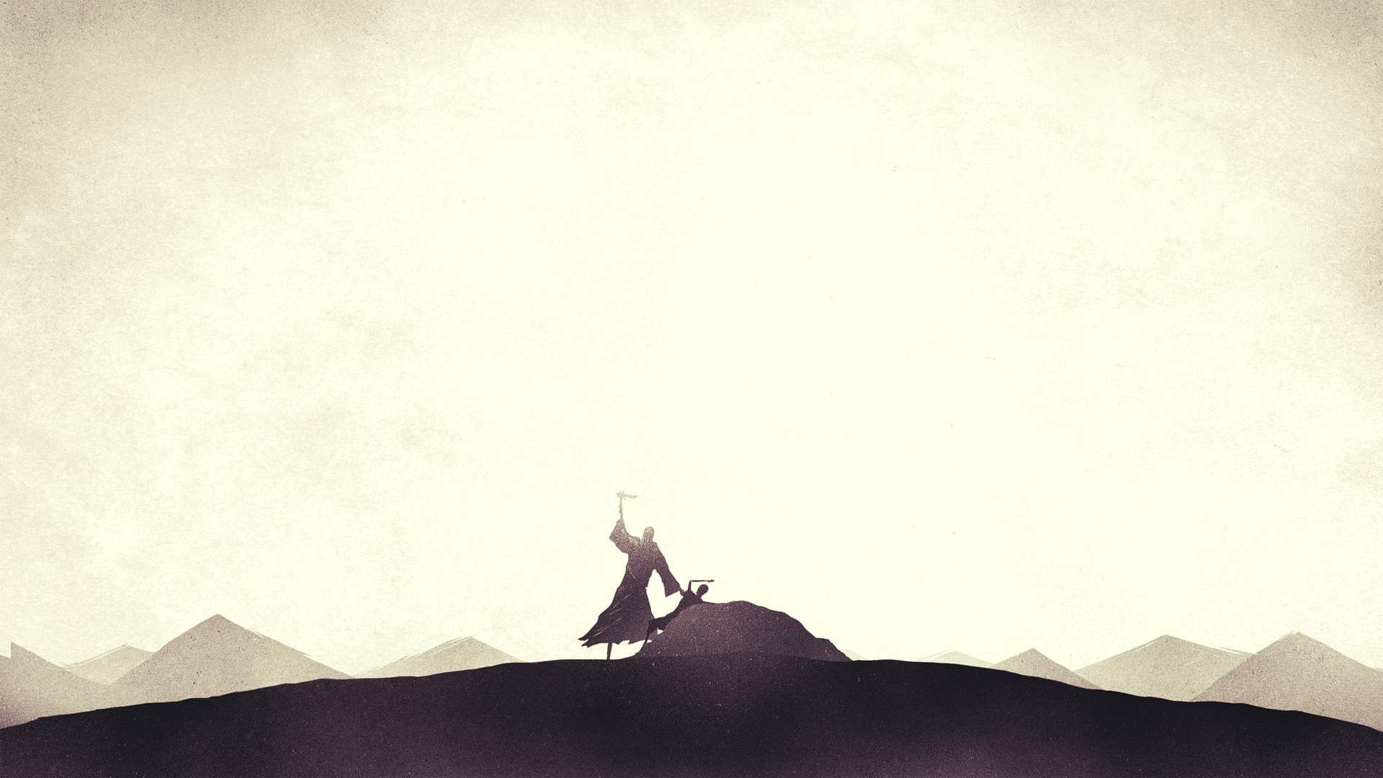
“When he offered up his son Isaac on the altar” (Jas 2:21b)
“You see that faith was active along with his works and faith was completed by his works” (Jas 2:22)
“It is therefore faith alone which justifies, and yet the faith which justifies is never alone” – John Calvin
Notes:
“When he offered up his son Isaac on the altar” (Jas 2:21b) - Abraham offered up his son in Genesis 22, whereas Abraham’s faith in God occurred in Genesis 15:6, “And he believed the Lord, and he counted it to him as righteousness” - No works, just faith in God, and then James brings up Abraham’s quintessential ‘work’, which occurs approximately 30 years later, demonstrating the truth of the prior claim of Abraham’s faith - Abraham’s claim to faith was justified by his fruit, his outward obedience, and Hebrews 11 tells us that it was by faith that these works were done - His works were not the cause of his salvation nor did they add to Christ’s perfect and sufficient merit, it was simply the evidence that his faith was genuine
“You see that faith was active along with his works and faith was completed by his works” (Jas :22a) - Living faith is active faith and will always produce works - Faith and works may be distinguished but they must never be separated or divorced from each other - This word here for completed, is James basically saying that our faith is perfected, brought to fulfillment, brought to maturity when it is evidenced in our lives - As we go on in this life, in the process of sanctification we will see our faith maturing, seeing a more consistent pattern of holiness and godliness in our lives as a result of God’s grace - Never will we perfect, but day by day, the Holy Spirit will be conforming us to the image of Jesus Christ
“It is therefore faith alone which justifies, and yet the faith which justifies is never alone” – John Calvin - The person who loves Christ feels that the love of Christ compels him and they endeavor to spread abroad the gospel of Jesus Christ - For it is the fact that God first loved us that spurs us on to good works, and not our own love for him - When you understand the depth of God’s grace, and His love demonstrated in Christ’s finished work on the cross, the true Christian cannot help but serve him

Slide 10
SUMMARY
No one will be saved by merely knowing the facts of who Jesus is or what the gospel is
True saving faith will always result in good works
It is God who works in us and through us, and continues to sanctify us, until that day when we join with Him in eternal glory
Notes:
No one will be saved by merely knowing the facts of who Jesus is or what the gospel is - Believing that there is a God, or believing that God really did send Jesus to die for us is of no great significance in terms of salvation - Christ says whoever believes IN me has eternal life, so the question is not whether you know about Jesus, but whether you know him personally as Lord and Saviour
True saving faith will always result in good works - That is essentially all that James is saying here in this letter - Jesus says, “every healthy tree bears good fruit, but the diseased tree bears bad fruit” - Those who do not produce good fruit will be cut down and thrown into the fire. Those who do not have true saving faith will perish for eternity in hell
It is God who works in us and through us, and continues to sanctify us, until that day when we join with Him in eternal glory - Our salvation is the work of God from beginning to end. It is Christ plus nothing - As we trust in Christ and commit ourselves to him, and allow the Word of God to conform us to the likeness of Jesus Christ - And to cause us to walk in a manner worthy of gospel by which we were called - We will see that it is God’s grace that saves, sustains and gets us through until the end. - When we understand this we will see, like Paul did, that God doesn’t need our strength, but our weakness - Because it is in our weakness that we will come to completely rely on God, and in our weakness we will find that His grace is more than enough
Let me close with this…

Slide 11
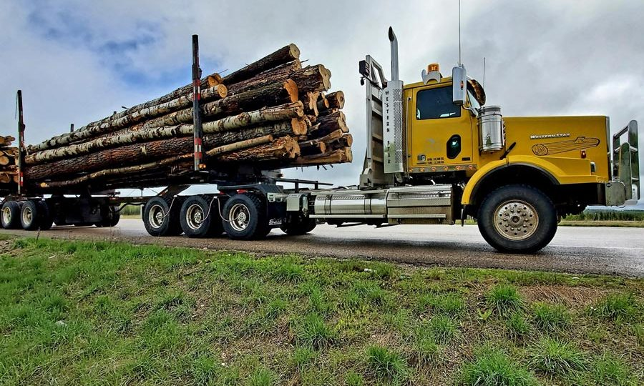
“How is it that so many people today profess to have had an encounter with Jesus Christ, and, yet, they are not permanently changed?” Paul Washer
Notes:
This was shared by a preacher named Paul Washer and he says this:
Let’s imagine that I show up late and I run up here on the platform, and all the leaders are angry with me and say, “Brother Paul, don’t you appreciate the fact you’re given an opportunity to speak here and you come late?”
And I’d say, “Brothers, you have to forgive me.” - “Well, why?”
“Well, I was out here on the highway, and I was driving and I had a flat tire and I got out to change the tire, and when I was changing the tire, the lug nut fell off
And I wasn’t paying attention that I was on the highway and I ran out and I grabbed the lug nut
And as soon as I picked it up in the middle of the highway, I stood up and there was a 30-ton logging truck going 120 miles an hour about ten yards in front of me, and it ran me over and that’s why I’m late.”
Now, there would only be two logical conclusions. One, I’m a liar or, two, I’m a madman. You would say, “Brother Paul, it’s absolutely absurd. It is impossible to have an encounter with something as large as a logging truck and not be changed.”
How is it then, that so many people today profess to have had an encounter with Jesus Christ, and, yet, they are not permanently changed?
What James is begging of us today, is to examine ourselves whether we are in the faith.
If you are, if you have repented and placed your faith in Jesus Christ as Lord and Saviour, then rejoice, and praise God for His grace towards you - And keep the eyes of your heart turned towards Jesus
But if you don’t, if there is no relationship between you and Jesus Christ
Or perhaps you proclaim faith but there is no evidence, and never has been, and therefore never will be
Then all I can do is urge you to repent and believe in gospel. Cast yourself before the cross, there is no work you can do that will save your souls
A simple confidence in the person and finished work of Jesus Christ, whom God raised from the dead, will save your soul, and it is in keeping ourselves in humble surrender to Him, that He will work in us
It is by grace alone, through faith alone, in Christ alone, that’s it, that’s the only hope I have to offer to you today
Let’s pray

