Slide 1
TRIALS & TEMPTATION
James 1:12-18
Notes:
Good morning everyone. I trust you are all doing well
Well today we carry on with our sermon series in James, with today being sermon number 2
Last week Greg introduced our sermon series and finished on verse 12 of chapter 1
But I think it is helpful for the context of today’s sermon to begin my sermon from verse 12 because it is the connecting verse between these 2 sections
But my prayer and my hope for you all, as it has been for me, is that we would see from these passages, firstly that God is good, that He walks with us through our trials, that we may persevere until the end
And also, that in this text we will see, that unlike what Martin Luther believed, James does not advocate for a works-based righteousness but one that is entirely the work and will of God
So let’s get into it

Slide 2
THE BEAUTITUDE OF JAMES
“Blessed is the man who remains steadfast under trial” (James 1:12a)
“for when he has stood the test he will receive the crown of life” (James 1:12b)
“which God has promised to those who love him” (James 1:12c)
Notes:
“Blessed is the man who remains steadfast under trial” (James 1:12a) - This verse right here is a beautitude - For we as believers as followers of Christ, are considered blessed, should be happy, will be fulfilled as we persist through trials - The world will often frown upon trials, it considers suffering to be a bad thing. - But notice it doesn’t say, ‘Blessed are those who never endure trials, or are never tempted’, for then you must be really loved by God - Those who endure the trials of this life for the sake of Christ should count it all pure joy - Should consider themselves blessed, but why should we consider ourselves blessed…
”for when he has stood the test he will receive the crown of life” (James 1:12b) - James is pointing to a future day when we stand before God after having endured all the trials of life as result of God working in and through us - James isn’t saying every time we endure any individual trial, but he is pointing to when Jesus comes back and we have endured all of life’s trials - We endure for what the crown represents, for this crown of life, is eternal life spent with our Lord and Saviour - The one who has journeyed with us, and picked us up, the one who has spurred us on in order that we may endure all of life’s trials - But perhaps you are wondering, what assurance do we have of receiving this crown of life, - Because we know that we cannot hope to get through this life unstained and untainted by sin, enduring every single trial perfectly, it’s an impossibility because of our fallen nature - James goes on to say that this is the crown of life…
“which God has promised to those who love him” (James 1:12c) - We have assurance of this crown because God has promised it to those who love Him, of whom we only love because He first loved us - And because this is a promise from God, and we know that God is faithful, if you are a true, born-again Christian here today - You will persevere because He who began a good work in you will finish it - You will persevere because the primary source of your endurance is the gospel by which you were saved - George Whitfield, who was an evangelist and played an essential role in the The Great Awakening - Which was the revival of the 1700’s, once said this, “All trials are for 2 purposes, that we may be better acquainted with our own wicked hearts, and that we may be better acquainted with our own beloved Saviour” - For it is in the furnace that God’s love will never seem more dear to us, and create a greater desire in our own hearts to walk a life of obedience to Him

Slide 3
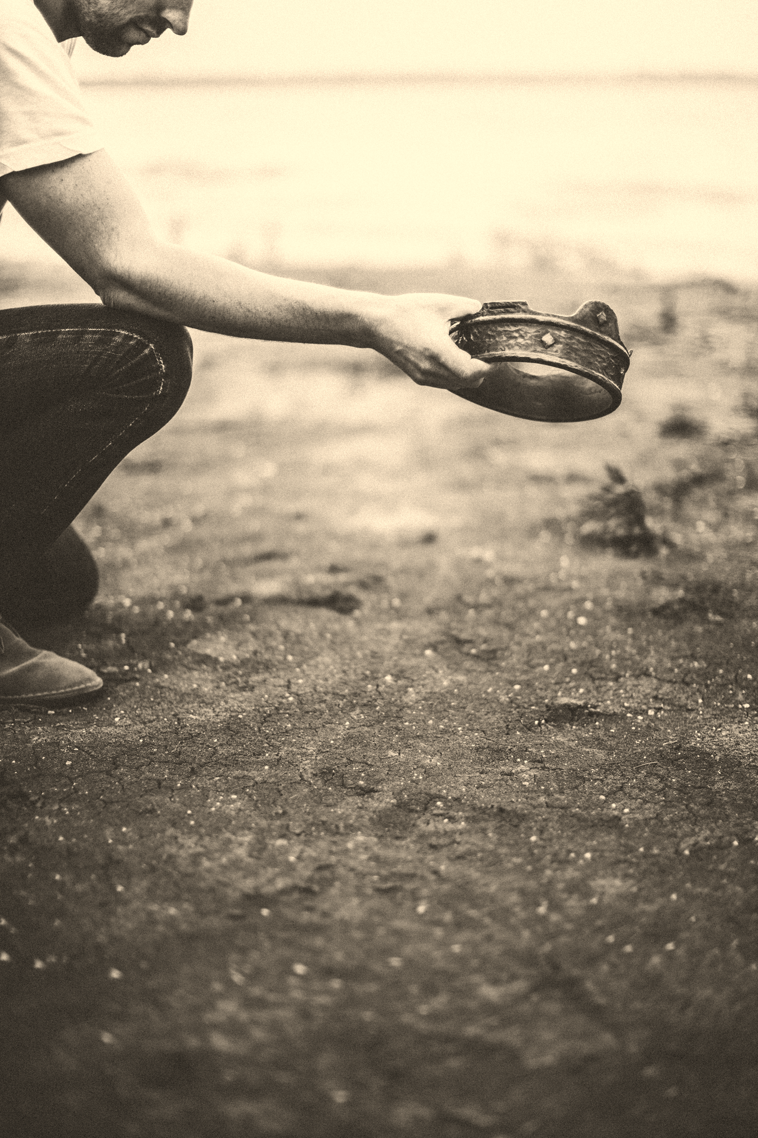
Many in the world look at the Christian life and the idea of enduring trials as ’missing out on life’
It is as we go through these trials, and press deeper than we ever have into Christ, that we become more like Christ
”They cast their crowns before the throne, saying, “Worthy are you, our Lord and God, to receive glory and honour and power” (Rev 4:10c-11)
Notes:
Many in the world look at the Christian life and the idea of enduring trials as ‘missing out on life’ - Many look at Christians and wonder why we bother, why not opt out for a little while, loosen up, enjoy ourselves for a little bit - I’m sure many looked at Paul, Peter, Silas, Barnabas, and Stephen, who were being mocked, ridiculed, imprisoned, whipped, stoned, cast out of towns, shipwrecked, and killed, all for the sake of the gospel and wondered why they did it, why they kept going - And the authorities would often give them a way out if they would but stop preaching the gospel - But what the authorities and people at the time failed to see is that…
It is as we go through these trials, and press deeper than we ever have into Christ, that we become more like Christ - We suffer and endure all that comes our way because God sent Christ to earth to become the God-man, our Saviour - We suffer and endure because of all that Jesus did, because we lived lives of rebellion, choosing to go against God’s intended purpose for us - And it was me who should have died on that cross becoming a curse, and yet Christ willingly went to the cross in my place, enduring the wrath of God almighty - So that I could experience God’s mercy, and grace, and forgiveness, in order that I could be reconciled to God - We suffer and endure because we have the guarantee of eternal life, because Christ rose from the grave and now sits at the right hand of the Father
“They cast their crowns before the throne, saying, “Worthy are you, our Lord and God, to receive glory and honour and power” (Rev 4:10-11c) - On a couple occasions Colin has discussed this particular verse in our mentor meetings, and it is always a humbling and touching reminder to me - The context is talking about the twenty-four elders casting their crowns before God, but I believe there is a sense that this will be us with the crown of life which God places on our head - We will cast it before the feet of God saying, I am not worthy of this, everything that I did in this life worthy of glory and honour, doesn’t belong to me - But it belongs to God, all the glory belongs to Him

Slide 4
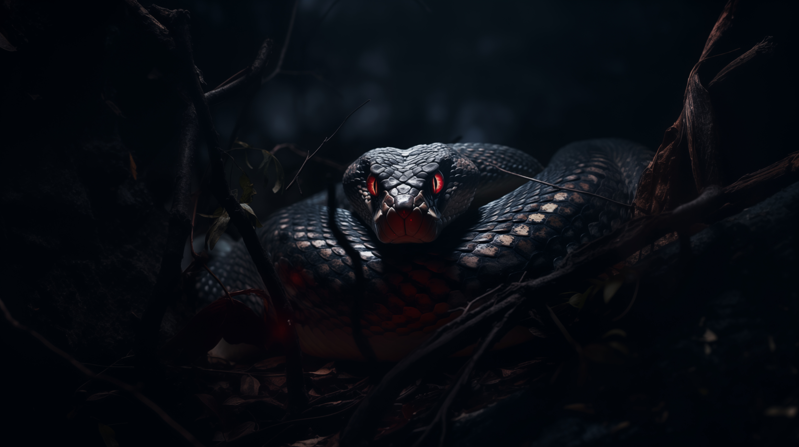
BORN OF MAN
“Let no one say when he is being tempted, “I am being tempted by God,” (James 1:13a)
“for God cannot be tempted with evil” (James 1:13b)
“and he himself tempts no one.” (James 1:13c)
Notes:
”Let no one say when he is being tempted, “I am being tempted by God” (James 1:13a) - Where it says, ‘when he is being tempted’, in the Greek that is in the present tense - Which means that we dare not blame God even while we are right in the middle of giving into the lusts of our flesh, while we are in the process of fighting our battles - While we are in the process of being tempted let no one blame God, is what this is saying - And yet we know that humans love to play the blame game. - Think back to Genesis 3 when Adam and Eve sinned, and through their disobedience, sin and death entered the world - Adam in verse 12, having been approached by God, has the audacity to say to God, “The woman whom you gave to be with me, she gave me the fruit of the tree and I ate.” - And when God questioned Eve, she said, “The serpent deceived me, and I ate”. Basically saying to God it was the creature you created - Rather than taking responsibility and being held accountable for their actions, they shifted the blame to God, saying it was His fault - But we do the exact same thing don’t we. We blame the circumstances around us, the environment God has placed us in - We will blame God for making us a certain way. For making us with certain inner passions - We will say or think things like, “God created me with anger issues, it’s His fault. God created me with a desire for more than one woman, it’s His fault. - God created me stubborn, that’s why I struggle with forgiveness - God created me with an attraction to the same gender. It’s his fault” - Or what’s even worse now, is rather than blaming God. People say well God doesn’t make mistakes, and He made me this way, so I guess this sinful act must now be a good thing - And yet how dare we accuse God of creating us with a sinful intent, which was wrong to begin with, and then say that God celebrates the sin that we commit. - Which was the sins which Jesus Christ was sent to pay the price for and die for - And yet it is because of the hardness of our hearts, and natural depravity of our hearts, that we look at that which is evil and call it good.
“For God cannot be tempted with evil” (James 1:13b) - This word cannot, is the only time this word is used in the Greek and it means, that God is inexperienced with evil, He has no capacity for evil - All evil repulses God, He cannot tolerate it, because He who hates evil cannot delight in evil
“and he himself tempts no one.” (James 1:13c) - God doesn’t want people to fall into sin, He is not pleased in watching people roll around in the mud, in their own sin - And so we can take comfort in the fact that when we fall into sin, when we see the evil that is in the world, that it did not come from God - God can be turned to in times of temptation, because He does not cause it, He may allow it, but He will not cause evil - Rather as 1 Cor 10:13 says, “God is faithful, and he will not let you be tempted beyond your ability, but with the temptation he will also provide the way of escape, that you might be able to endure it”

Slide 5
“But each person is tempted when he is lured and enticed” (James 1:14a)
“by his own desire” (James 1:14b)
“Then desire when it has conceived gives birth to sin” (James 1:15a)
“and sin when it is fully grown brings forth death” (James 1:15b)
Notes:
“But each person is tempted when he is lured and enticed” (James 1:14a) - If you want to know where to look, who to blame when being tempted, when you have fallen prey to sin - Then we ought to go to a mirror, and staring right back at us will be the person at fault - Do not blame others, or Satan, or the world, and certainly not God, for it is the result our own wretched hearts - Then James goes on to use 2 words, lured, which is hunting term, and enticed, which is fishing term - Luring, like luring an animal into a trap. The trap is baited and the animal sees the bait and walks straight into the trap - And enticed, the literal meaning to catch a fish with bait. To dangle the worm on the end of the hook, in order to entice a fish to bite and be caught - Satan may bait the hook, the world may bait the hook, but what is it that causes us to look at the bait, and be attracted to it, to be lured and enticed by it?
“by his own desire” (James 1:14b) - It is our own desire, its our own lusts, our own passions of our souls - The meaning of desire here is any intense longing for an improper object, that gets in the way of our proper pursuit of God - The problem lies within. For when we look at anything and desire it at the cost of being obedient to God, and demonstrating our love to Him, it becomes an idol and thus sinful
”Then desire when it has conceived gives birth to sin” (James 1:15a) - In verse 15, we have what some theologians have called, ‘the fool’s biography’. Here we have 3 generations - The desire is the parent, sin is the child, and death is the grandchild - The words used for give birth and brings forth in verses 15 and 18 are 2 slightly different words in Greek that have pretty much the same meaning, referring to child-birth - Sin always begins with a desire, that’s exactly what happened in the garden, -And I think if you are being completely honest with yourself, every time you have sinned it has begun with a desire towards something other than seeking God and His glory - That desire gives birth to sin
“and sin when it is fully grown brings forth death” (James 1:15b) - We all experience this, even the believer will one day die, but by the grace of God we will be raised back to life to spend forever in eternal life - The unbeliever, who never had their sins cleansed by the blood of Jesus, was never born again and given a new heart - Will not only experience an earthly death, but will be cast out into the lake of fire, where they will spend forever in the flames of eternal death - To deal with sin, it must be atoned for it must be paid for. - But we must go back to the beginning and deal with our desires, - And only by the power of God at work in us, giving us a new heart and nature, are we then given new desires, a desire that fixates on Jesus Christ - And our heart’s greatest desire is now to see God glorified. - While we are still here on earth, waiting for Jesus to return, we will still sin, but because of all that Christ has done, we can be forgiven and we will also experience victory over sin - Until that day when we are called home, and sin will be no more

Slide 6
BLESSINGS OF GOD
“Do not be deceived, my beloved brothers” (James 1:16)
“Every good and perfect gift is from above” (James 1:17a)
“coming down from the Father of lights” (James 1:17b)
“with whom there is no variation or shadow due to change” (James 1:17c)
Notes:
“Do not be deceived, my beloved brothers” (James 1:16) - This verse functions as a joining verse, as a powerful command to heed what James has just said, and pay close attention to what James is about to say - This word deceive suggests a sense of wandering, going astray, being mistaken - So do not wander, do not go astray, do not be mistaken in blaming God for your temptations, for your own sins, and instead start blaming yourself - And here’s why…
“Every good and perfect gift is from above” (James 1:17a) - How awesome is God. God does not supply temptation, He does not long to see humanity fall into sin - Rather He showers us in every good and perfect gift. Many people will pause to consider the problem of pain. - They ask why a loving God would allow suffering, why He would allow trials, why He would allow death - But many will not spend the same time to pause and ponder the problem of happiness. - Why should a holy and righteous God grant me, the sinner, restful days, a happy home, a loving wife, and healthy and dear children to a sinner like me? - Because God is a good and gracious God. - When we truly grasp this in our hearts we will ask ourselves the question, “Why in the world am I going after baited hooks to be satisfied when God is pouring out more than I could ever use or need to be satisfied in?”
“coming down from the Father of lights” (James 1:17b) - James is referring to God here as the Creator, the one who created the sun, the moon and the stars. - It is God who placed the 200 billion trillion stars in the universe - And that same God only created us in His own image, as the crown jewel of His creation - But unlike the lights He created, His glory never fades, it never dims because in Him…
“with whom there is no variation or shadow due to change” (James 1:17c) - God is immutable, which means He never changes - There is no shadow because in Him there is no darkness at all - God is the same yesterday, today, and tomorrow, and He will always be fully sovereign, and completely and utterly good - So don’t give in to your own desires, don’t be lured by the devil’s bait. For every good and perfect gift is from above - Look to God to be satisfied

Slide 7
BORN AGAIN OF GOD
In order to obtain the crown of life, we must love Him, we must be holy
”Of his own will he brought us forth” (James 1:18a)
“by the word of truth” (James 1:18b)
Notes:
In order to obtain the crown of life, we must love Him, we must be holy - And yet James has just finished telling us sin, which brings forth death, comes from within - In and of ourselves we are not capable of loving God, and without hope of ever entering into a relationship with a holy and righteous God - In order to do that, we must be set apart from sin and unrighteousness which would require a sacrifice, someone to pay our unpayable debt and a new heart - We are asking for the impossible, and yet we have a God who makes the impossible possible
“Of his own will he brought us forth” (James 1:18a) - This is what we call the doctrine of regeneration, or what Jesus calls in John 3, being born again - God in His grace and mercy, in accordance with His own good will, was pleased to regenerate us, to cause us to be born again - And we must be born again to enter the kingdom of God as Jesus tells Nicodemus - Jesus says, “Truly, truly, I say to you, unless one is born again, he cannot see the kingdom of God” (John 3:3) - God doesn’t lead people into sin, He makes new creations - But how it is that we are born again…
“by the word of truth” (James 1:18b) - Eph 1:13 helps us to understand what this word of truth is. - It says, “In him you also, when you heard the word of truth, the gospel of your salvation” - 1 Pet 1:23-25 says this, “since you have been born again, not of perishable seed but of imperishable, through the living and abiding word of God…And this word is the good news that was preached to you” - This word of the truth is the gospel by which every Christian is saved - Us being regenerated by God and the gospel which is the power of God unto salvation, always go hand in hand and is the only means by which any of us can be saved - God always works through the preaching of the gospel - And because our salvation is entirely God’s doing who is completely good, we find great hope in this - Because unless God changes, unless His will changes, which is impossible, then we can have assurance of our relationship with our heavenly Father - That we will persevere in Christ, by the grace of God until the end

Slide 8
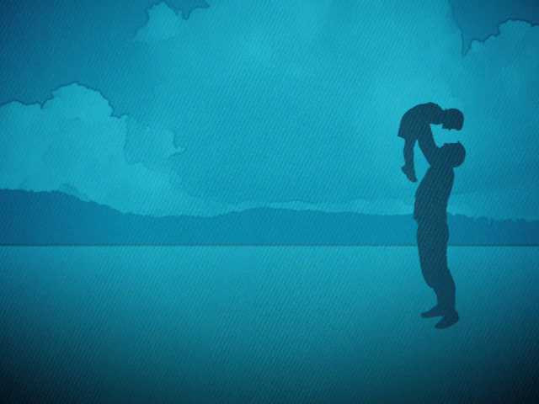
Though you were dead, by the grace of God, you live. Though you were far off, God has brought you into an intimate relationship with Himself
“that we should be a kind of firstfruits of his creatures.” (James 1:18c)
As God’s firstfruit, His beloved child, He will care for you, year after year
Notes:
Though you were dead, by the grace of God, you live… - Let us read quickly through Ephesians 2:1-10 and it is such a rich passage, but we will quickly skim through it - Eph 2:1-3 = Summary… We are dead, slaves to sin and to be subjects of God’s wrath, we only have hell awaiting us - Eph 2:4-10 – But by the grace of God, while we were dead, we were made alive, that is we were born again, and so it is by grace through faith in Christ so that none may boast - Notice it says nothing about about what I did, apart from being dead, apart from the sin which put Jesus on the cross - But it said everything about God and what He did in Christ that I might be saved. - CHRIST PLUS NOTHING - And God did this…
”that we should be a kind of firstfruits of his creatures.” (James 1:18c) - In the Old Testament, out of all that belonged to the Lord the firstfruits was specially His - The first fruits had to be the best, they had to be set apart as holy to the Lord - It was also an annual offering that was a reminder to the people of Israel that the Lord keeps His promises - That the Lord has supplied all that they needed for the past year for all their crops and cattle
As God’s firstfruit, His beloved child, He will care for you, year after year - He has caused you to be born again to a living hope in Christ Jesus - He has justified you by the finished work of Jesus, cleansing you from sin of which you have repented and now believed in Jesus Christ as Lord and Saviour - He has adopted you as a child of God, and will continue to conform you to the image of His Son, our elder brother Jesus, until that day when we are glorified. - He does all this because you are specially His, and He has set you apart as holy - That’s what it means to be “a kind of firstfruits of His creatures”

Slide 9
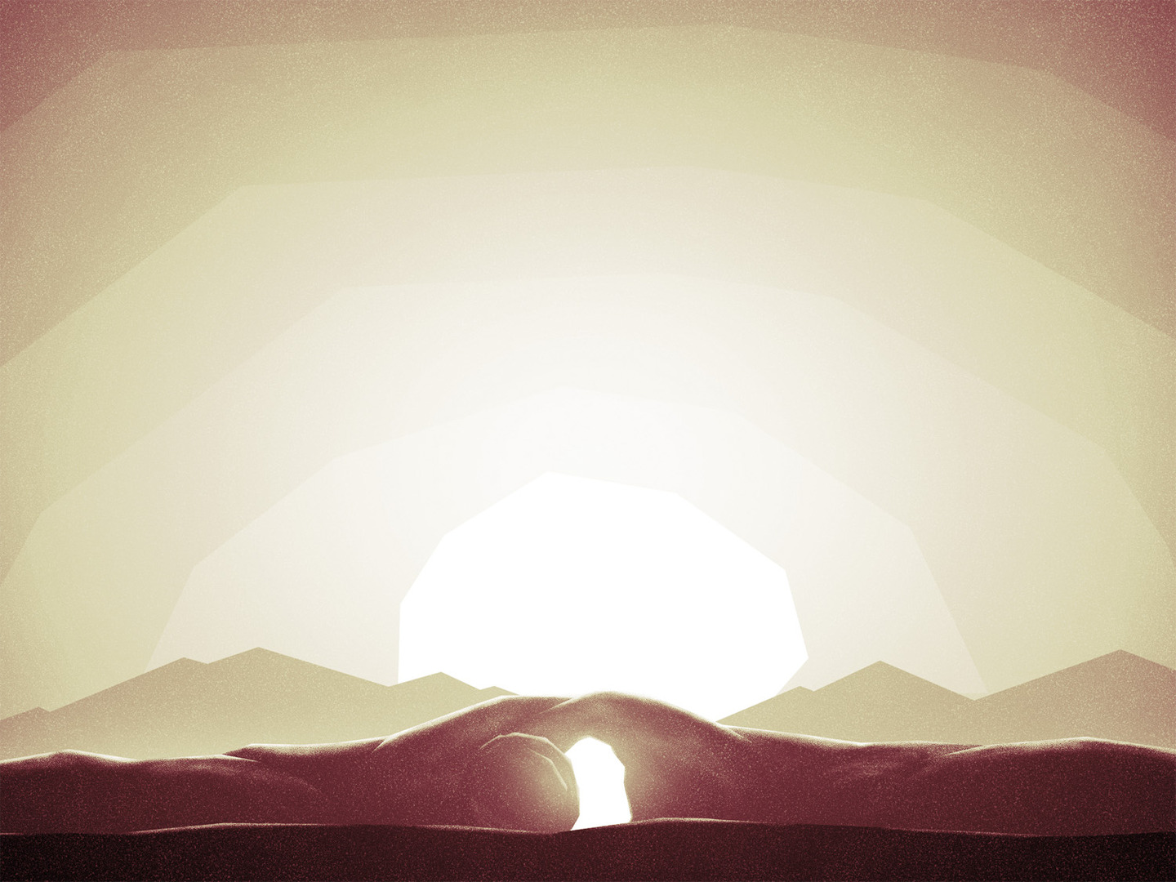
SUMMARY
May we never be a people who blame God for temptation, falling into sin
REMEMBER that our heavenly Father is completely good, so when trials and temptations come, run into His arms
God in His goodness and mercy has caused us to be born again through the gospel, that we will one day receive the crown of life
Notes:
May we never be a people who blame God for temptation, falling into sin - We ought to be slow to blame God for our desires, our temptations, our sins - Because James tells us that God cannot be tempted by evil, He is incapable of evil
REMEMBER that our heavenly Father is completely good, so when trials and temptations come, run into His arms - Walk in the Spirit, be happy in the Lord, for only in God do we find the way of escape, the way of enduring through life’s great trials - This is one of the key truths that I want you all to walk away with today. - God is sovereign over all, and He is good, He is all that is good, and anything that is good comes from Him
God in His goodness and mercy has caused us to be born again through the gospel, that we will one day receive the crown of life - If you are a born again believer with a new heart, new desires to glorify God and do that which pleases Him, you will get to heaven and will be welcomed with open arms - God will place that crown on your head, because it is given to those who love Him - And our love for Him is only possible because He first loved us, ”God shows his love for us in that while we were still sinners, Christ died for us” (Rom 5:9) - And so because of that we will cast that crown before His feet, saying “all the glory and honour belongs to you and you alone God” - Let me close with this

Slide 10
“A man who is born again, or regenerated, believes that Jesus Christ is the only Saviour who can pardon his soul. In himself he sees nothing but unworthiness. But he has full confidence in Christ, and trusting in Him, he believes that his sins are all forgiven. He believes that, for the sake of Christ's finished work and death on the Cross, he is reckoned righteous in God's sight…He may have fears and doubts. He may sometimes tell you that he feels as if he had no faith at all. But ask him if he is willing to trust in anything instead of Christ and see what he will say. Ask him if he will rest his hope of eternal life on his own goodness, his own works, his prayers, his minister, or his church, and listen to his reply. Are you born again?” – J.C. Ryle
Notes:
A man who is born again, or regenerated, believes that Jesus Christ is the only Saviour who can pardon his soul. In himself he sees nothing but unworthiness. But he has full confidence in Christ, and trusting in Him, he believes that his sins are all forgiven. He believes that, for the sake of Christ's finished work and death on the Cross, he is reckoned righteous in God's sight…He may have fears and doubts. He may sometimes tell you that he feels as if he had no faith at all. But ask him if he is willing to trust in anything instead of Christ, and see what he will say. Ask him if he will rest his hope of eternal life on his own goodness, his own works, his prayers, his minister, or his church, and listen to his reply. Are you born again? – J.C. Ryle
If today, you don’t know Jesus Christ as Lord and Saviour, turn from your sins and believe in Jesus Christ, acknowledging that apart from him you have no hope of finding forgiveness for your sins.
Trust only in Christ and your answer to that question can be yes, I am born again, I am loved by God, and the crown of life awaits you, eternal life awaits you
If you are a Christian, if you have been born again, then let all that is within you praise His holy name for eternal life is assured, all the blessings of being in Christ Jesus belong to you
Continue for all the days of your life to trust only in Christ, forsaking the world and clinging only to Jesus
Let’s pray

