Slide 1
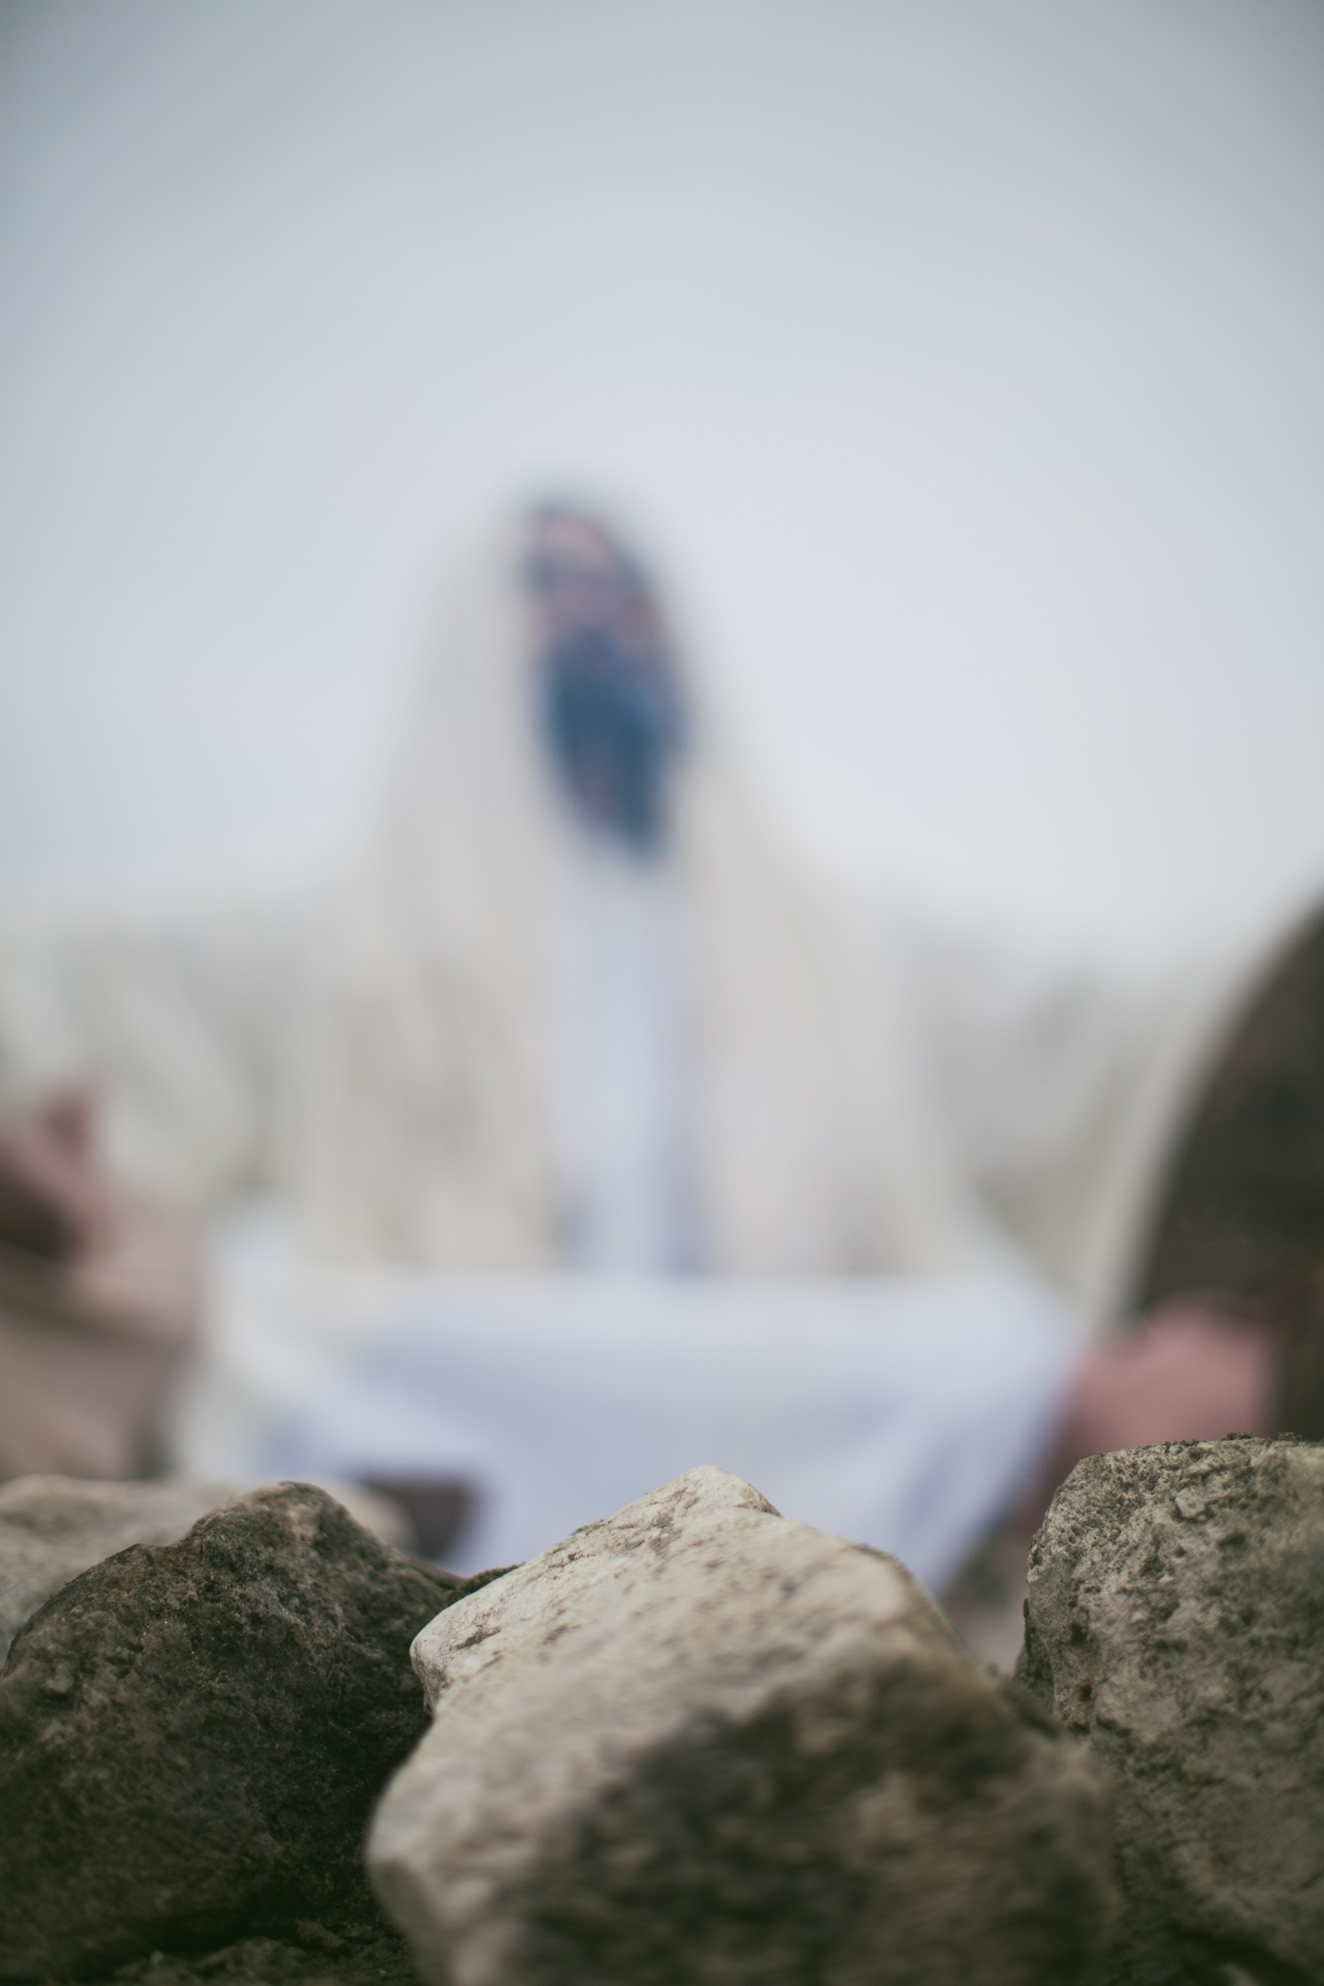
James
Folly of Favouritism
James 2:1-7

Slide 2
James 2:1
My dear brothers and sisters, how can you claim to have faith in our glorious Lord Jesus Christ if you favour some people over others?
Belief, repentance and commitment to following Jesus
How can your faith be real if your actions don’t match your convictions?

Slide 3
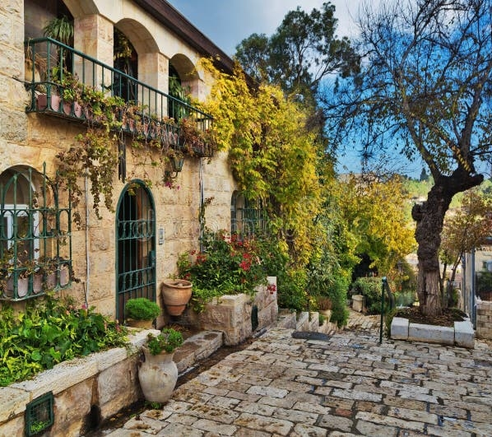
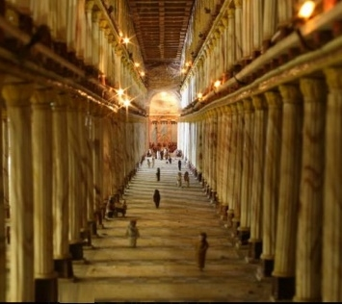
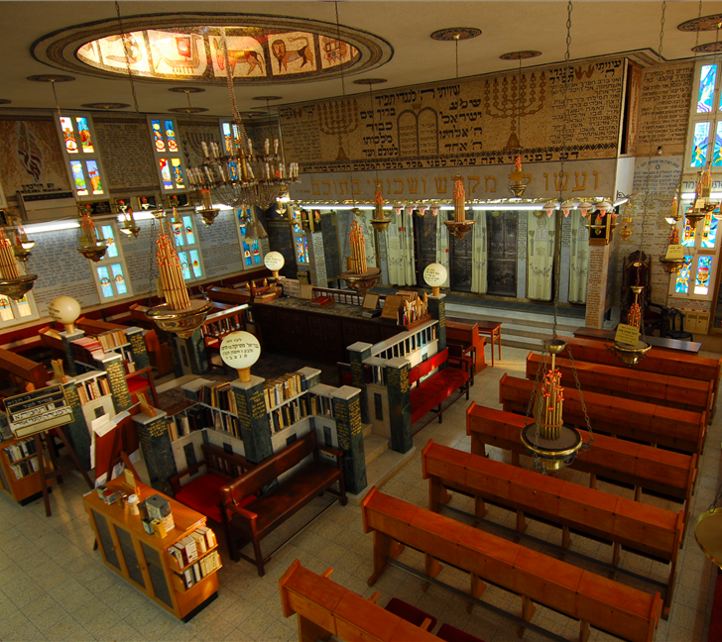
James 2:2
“For example, suppose someone comes into your meeting dressed in fancy clothes and expensive jewelry, and another comes in who is poor and dressed in dirty clothes.”

Slide 4
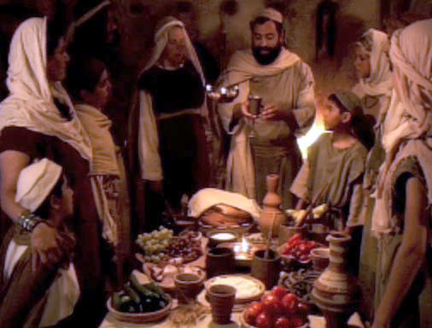
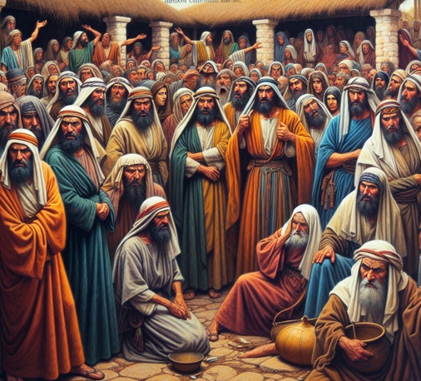
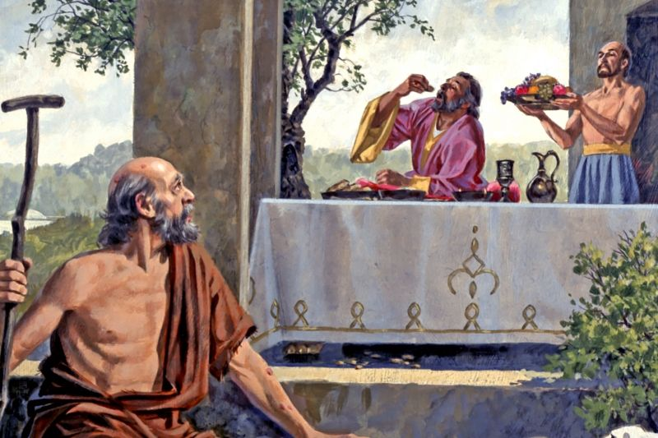
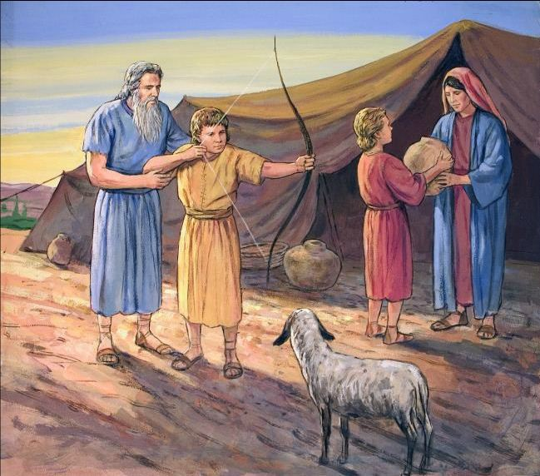
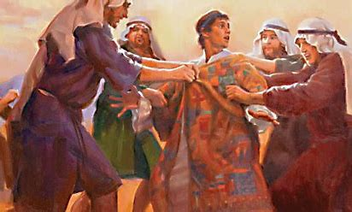
^{James 2:3,4 ”}If you give special attention and a good seat to the rich person, but you say to the poor one, “You can stand over there, or else sit on the floor”—well, doesn’t this discrimination show that your judgments are guided by evil motives?”
Peter preferred to eat with the Jews
Jacob and Joseph
Jacob and Esau
Greek Widows
James

Slide 5
^{James 2:5-7}
“Listen to me, dear brothers and sisters. Hasn’t God chosen the poor in this world to be rich in faith? Aren’t they the ones
who will inherit the Kingdom he promised to those who love him? But you dishonour the poor! Isn’t it the rich who oppress
you and drag you into court? Aren’t they the ones who slander Jesus Christ, whose noble name you bear?”
Does James mean that the poor will automatically go to Heaven and the rich to hell?

Slide 6
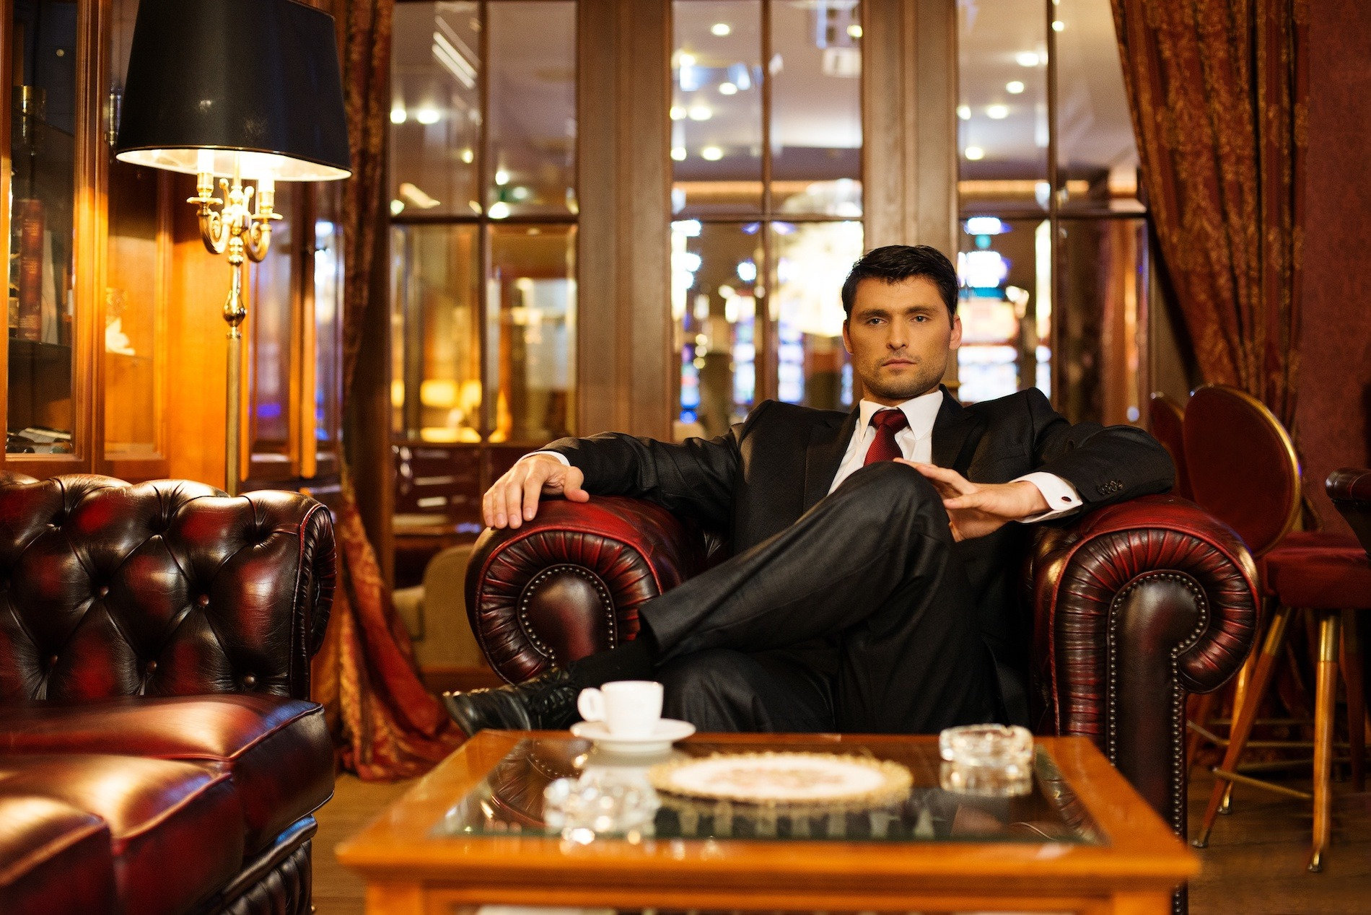
Can’t wealth indicate intelligence, wise choices in life and hard work?
But wealth can also indicate that a person obtained wealth by:
Having the good fortune to be born into a wealthy family
Often a sign of ruthlessness, greed or selfishness
It may have been obtained through fraud or other criminal activity
By honouring someone just because he or she dresses well, we are making appearances more important than character.

Slide 7
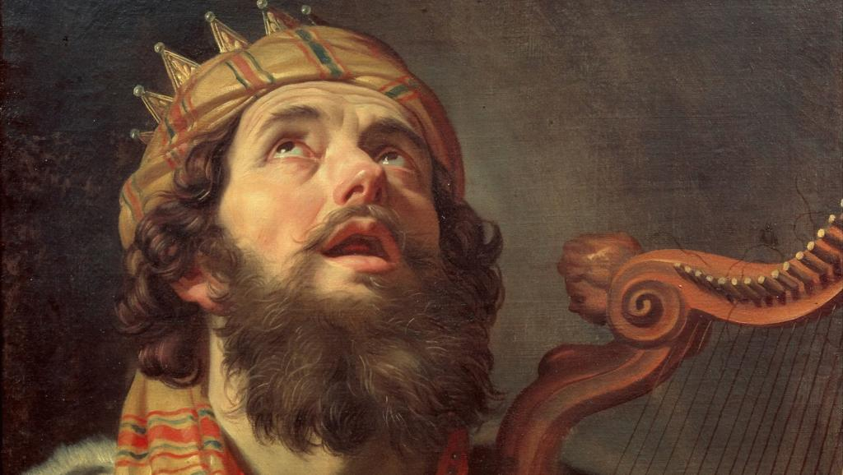
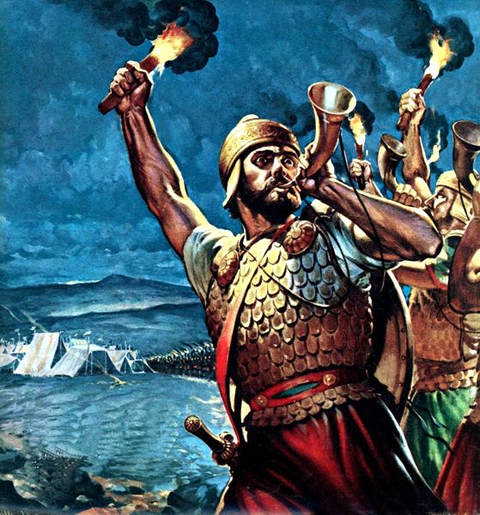
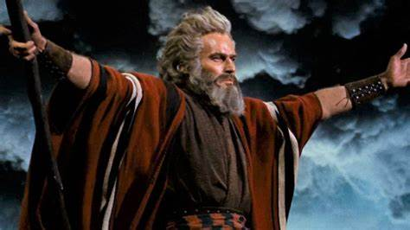
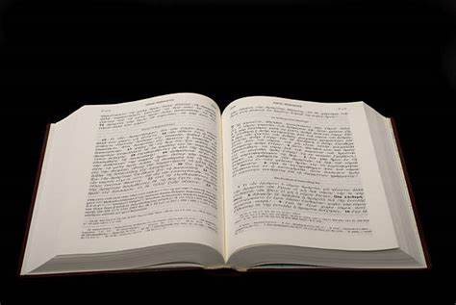
King David
Moses
Gideon
1 Samuel 16:7 “People judge by outward appearance. But God looks at the heart”

Slide 8
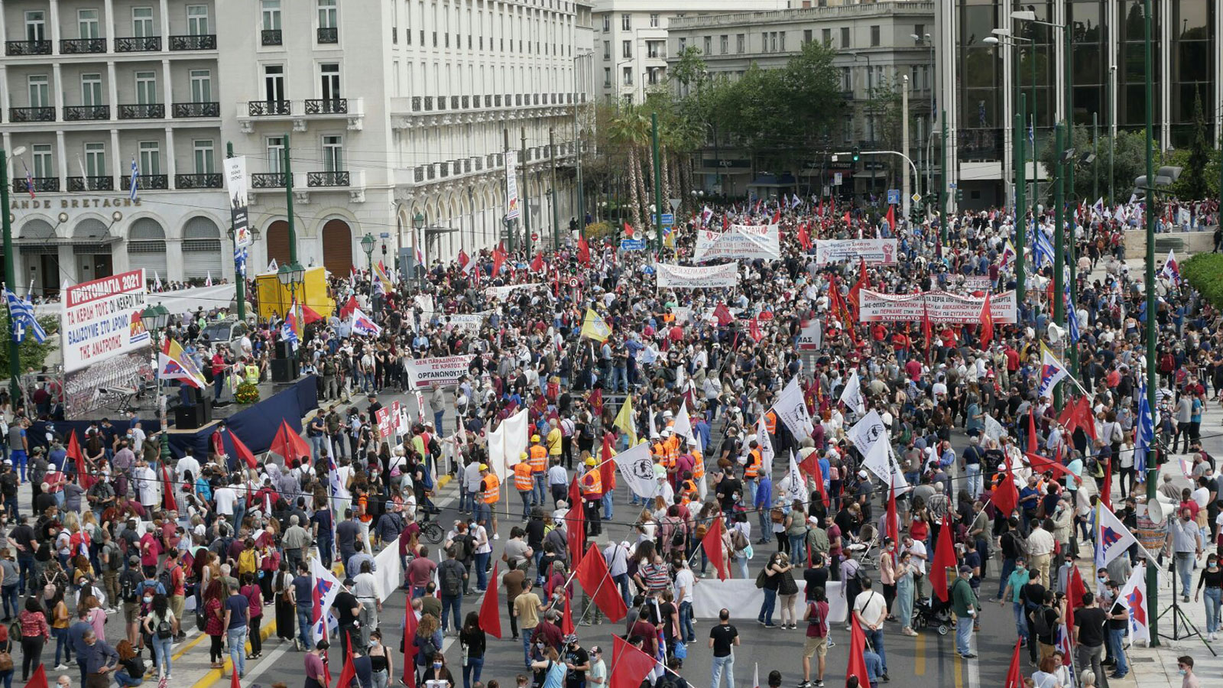
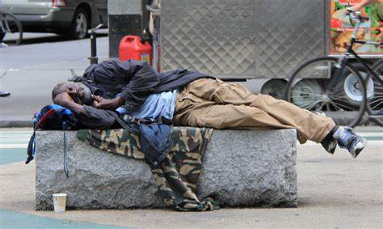
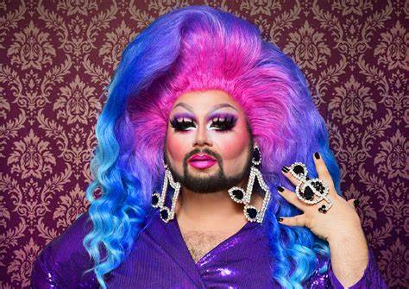
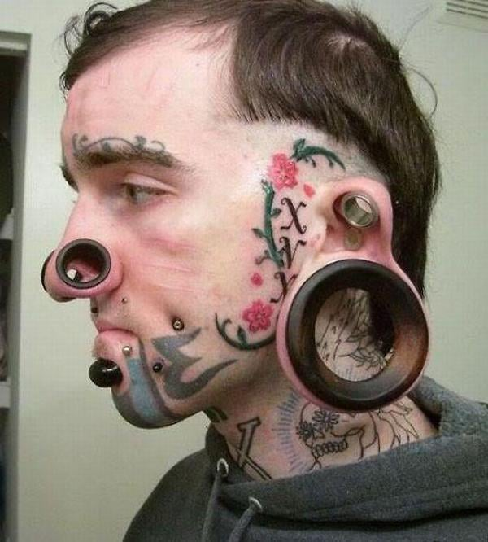
What does this mean to us here today?

Slide 9
Casting Crowns – Does Anybody Hear Her?
She is running, A hundred miles an hour in the wrong direction
She is trying, But the canyon's ever widening In the depths of her cold heart So she sets out on another misadventure just to find she's another two years older and she's three more steps behind
Does anybody hear her? Can anybody see, or does anybody even know she's going down today?
Under the shadow of our steeple with all the lost and lonely people, searching for the hope that's tucked away in you and me Does anybody hear her? Can anybody see?
She is yearning, for shelter and affection that she never found at home She is searching for a hero to ride in to ride in and save the day

Slide 10
And in walks her prince charming and he knows just what to say Momentary lapse of reason and she gives herself away
Does anybody hear her? Can anybody see, or does anybody even know, she's going down today?
Under the shadow of our steeple, with all the lost and lonely people, Searching for the hope That's tucked away in you and me Does anybody hear her? Can anybody see?
If judgement looms under every steeple If lofty glances from lofty people They can't see past her scarlet letter, and we never even met her, never even met her
He is running - a hundred miles an hour in the wrong direction

Slide 11
James
Folly of Favouritism
James 2:1-7

