Slide 1
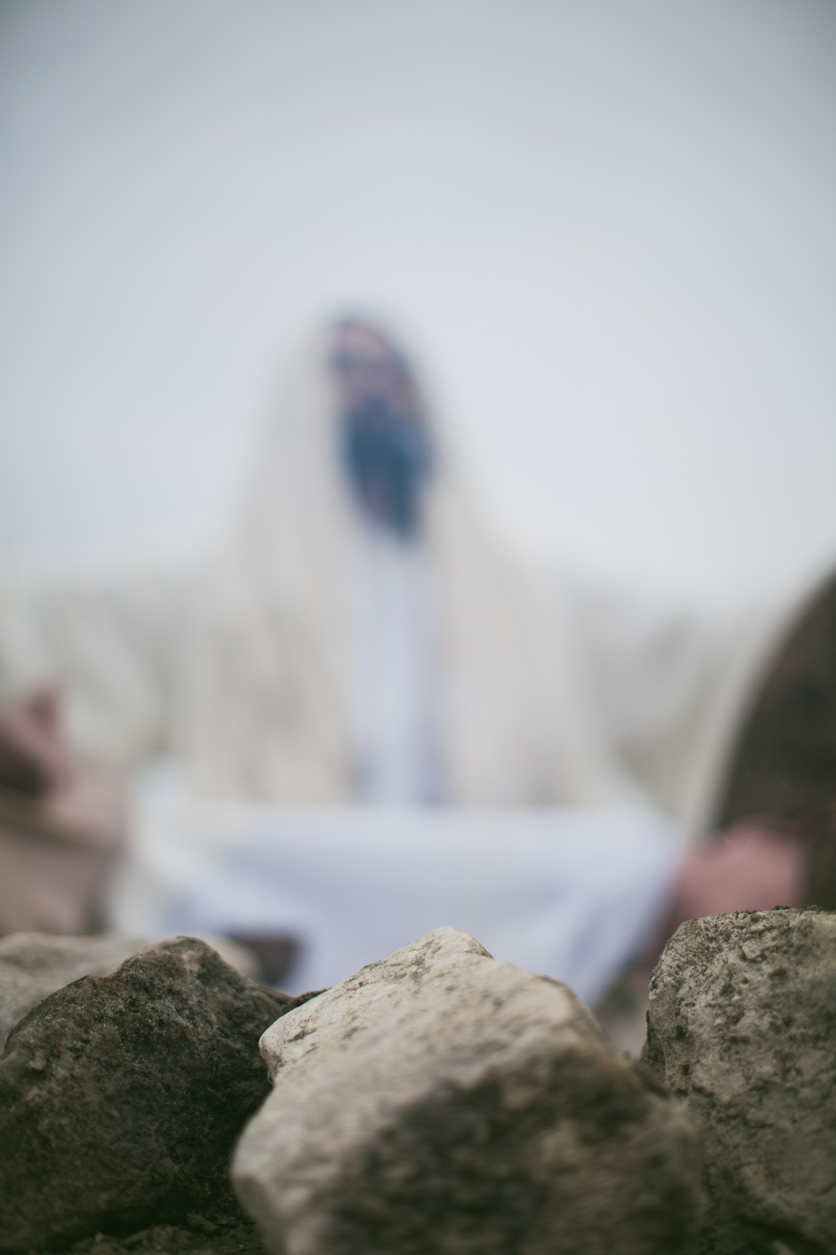
James
Faith and Endurance
James 1: 1-12

Slide 2
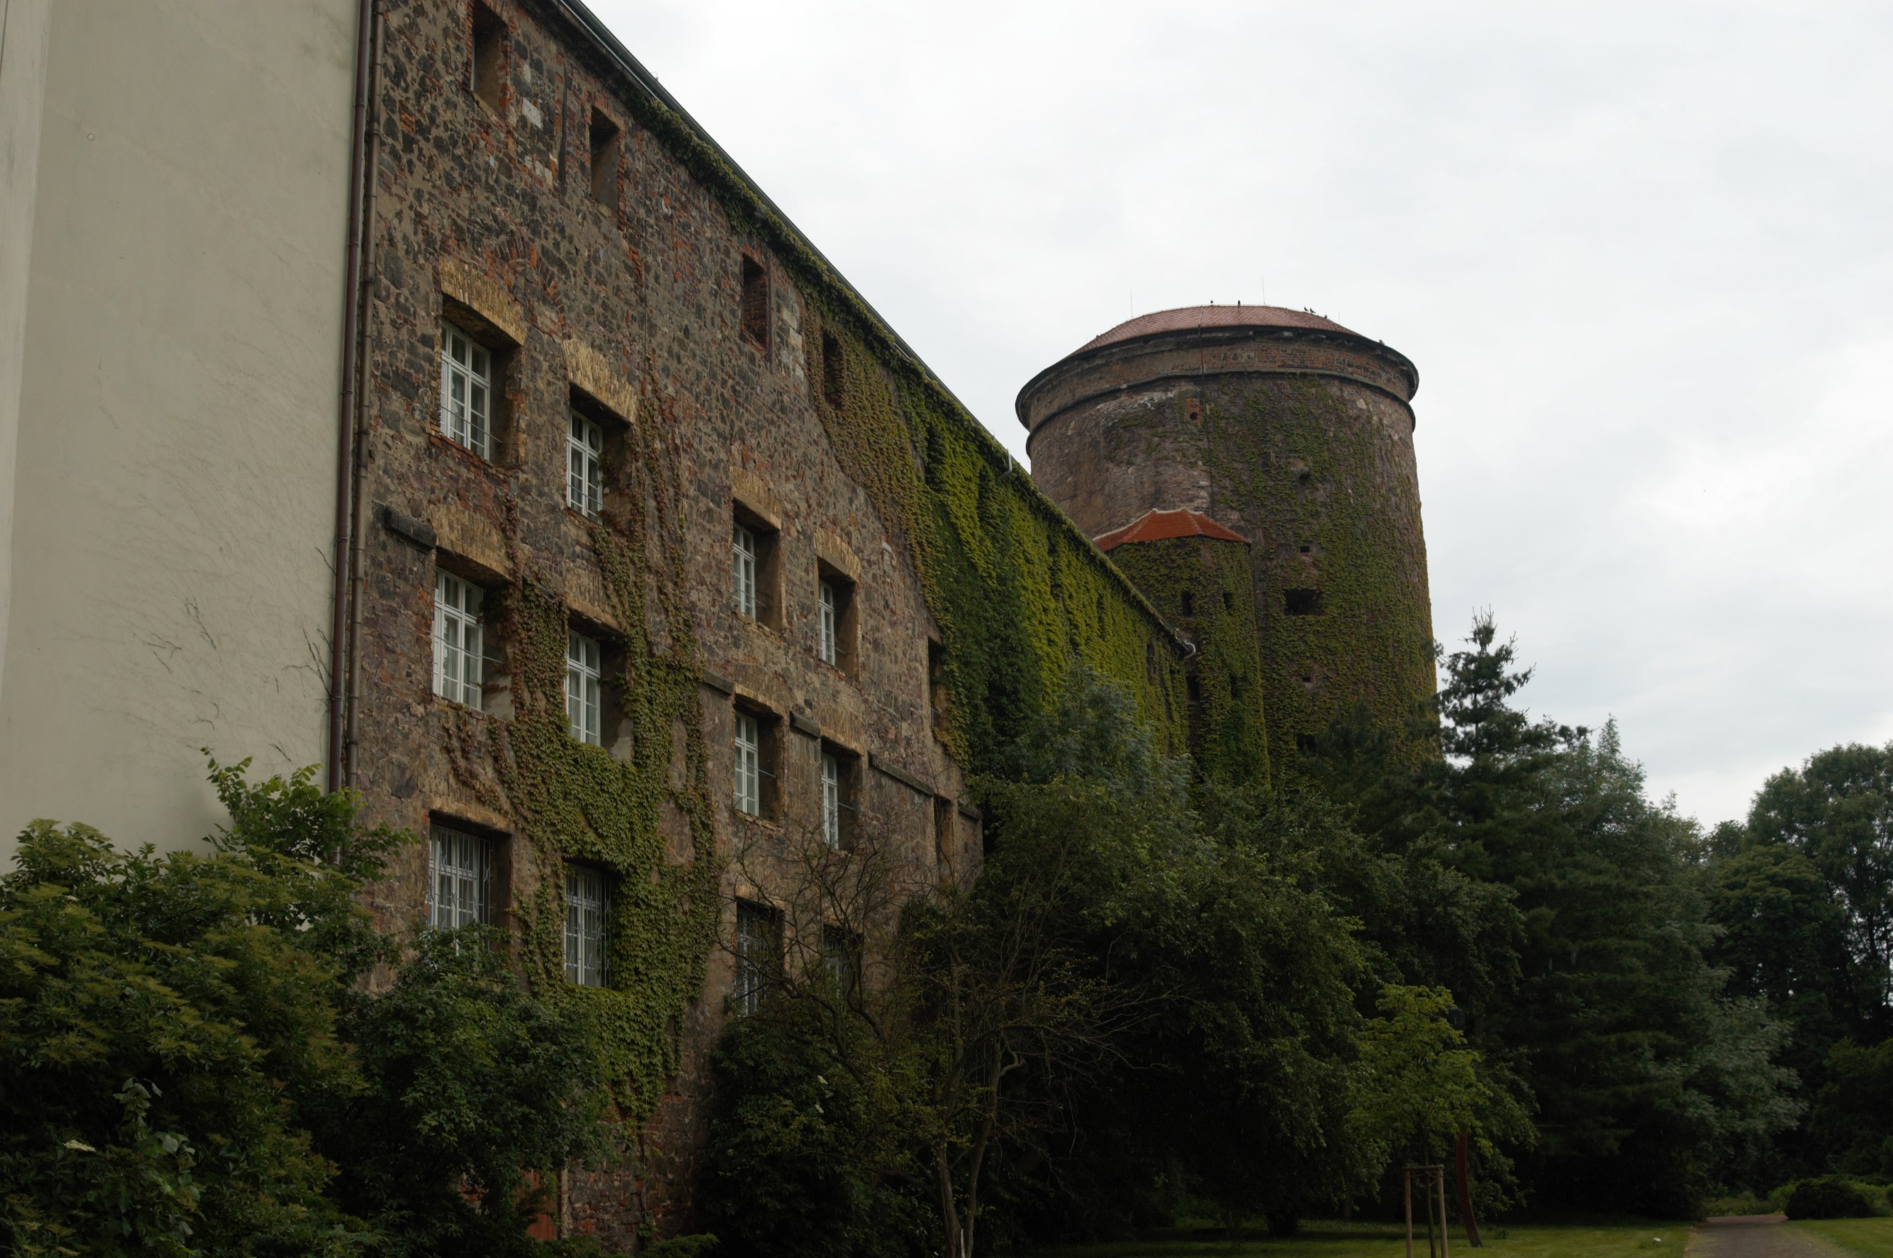
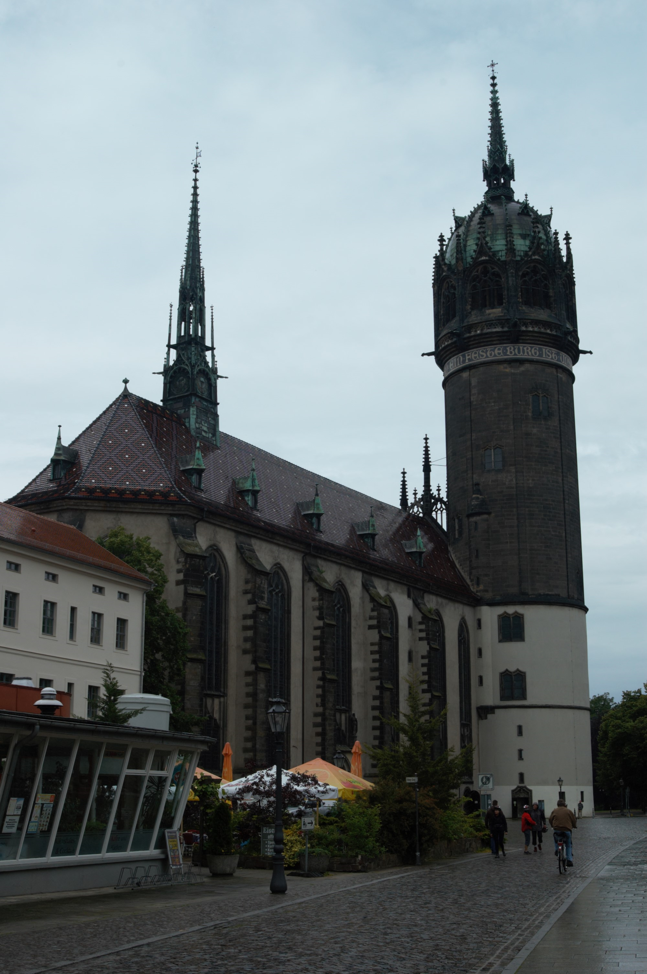
Wittenberg
(Lutherstadt)

Slide 3
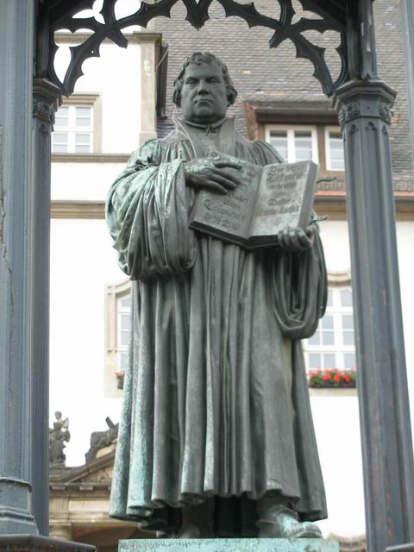
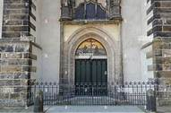
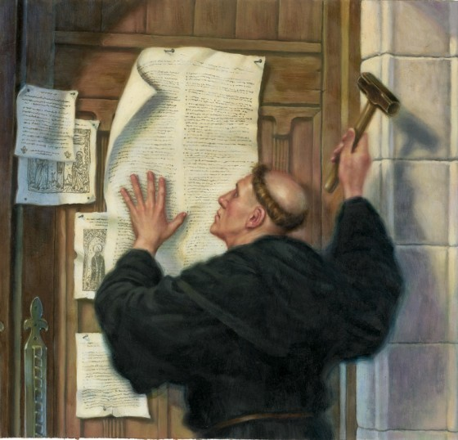
Roman Catholic Priest and Theologian
Taught theology at Wittenberg University
Indulgences for St Peter’s Basilica
Ninety-Five Theses (31 October 1517)
Martin Luther (1483 –1546)

Slide 4
James
Introduction
Half-brother of Jesus (Jude also)
Galatians 2:9 “In fact, James, Peter, and John, who were known as pillars of the church, recognised the gift God had given me, and they accepted Barnabas and me as their co-workers.”
Sceptic
Paul called him a "pillar" of the church
Faith in Action

Slide 5
James
Introduction
Half-brother of Jesus (Jude also)
Galatians 2:9 “In fact, James, Peter, and John, who were known as pillars of the church, recognized the gift God had given me, and they accepted Barnabas and me as their co-workers.”
Sceptic
“The only other apostle I met at that time was James, the Lord’s brother” Galatians 1:9
“When they had finished, James stood and said, “Brothers, listen to me”
Acts 15:13
Paul called him a "pillar" of the church
“The next day Paul went with us to meet with James, and all the elders of the Jerusalem church were present” Acts 21:18
Paul, on his first and last visit to Jerusalem, saw James
James has authority and position in the Jerusalem council of Elders
Faith in Action
He was martyred 62AD

Slide 6
Study 1: Faith and Endurance
Acts 8:1 Saul was one of the witnesses, and he agreed completely with the killing of Stephen. A great wave of persecution began that day, sweeping over the church in Jerusalem; and all the believers except the apostles were scattered through the regions of Judea and Samaria.
1 Peter 1:1 This letter is from Peter, an apostle of Jesus Christ. I am writing to God’s chosen people who are living as foreigners in the provinces of Pontus, Galatia, Cappadocia, Asia, and Bithynia.
James 1:1-12

Slide 7
Study 1: Faith and Endurance
Jesus warned about the false teachers to come.
Matthew 24:24 “For false messiahs and false prophets will appear and perform great signs and wonders to deceive, if possible, even the church”
Acts 20:29,30 “I know that after I leave, savage wolves will come in among you and will not spare the flock. Even from your own number men will arise and distort the truth in order to draw away disciples after them.”
Into this context of persecution and false teaching, James writes his book
James 1:1-12

Slide 8
Trials
James 1:2 “Dear brothers and sisters, when troubles of any kind come your way, consider it an opportunity for great joy.”
James does not say IF you have troubles but WHEN you have troubles
James does not say that our natural reaction should be joy, but for us to consider it an opportunity for great joy
^{Romans 8:7 “}The mind governed by the flesh is hostile to God; it does not submit to God’s law, nor can it do so.”

Slide 9
So why, when troubles of any kind come our way, should we consider it an opportunity for great joy?
1. It is an opportunity to strengthen our endurance and faith
Romans 5:3-5a “We can rejoice in our sufferings, knowing that suffering produces endurance, and endurance produces character, and character produces hope, and hope does not put us to shame, because God's love has been poured into our hearts through the Holy Spirit who has been given to us”
2. It grows our trust in God and His provision for us
3. It is an opportunity to witness about the joy that only God can give
4. It is evidence that the enemy is not happy with our stance for God

Slide 10
Verse 5 “ If you need wisdom, ask our generous God and He will give it to you”
We must trust and believe God will show the best path to take
God’s wisdom is :
Practical – God wants to help us identify the most practical solution
Divine – Goes beyond common sense – joy in times of distress – helps us chose right from wrong
Christlike – asking to be like Christ – 1 Corinthians 1:24 “Christ is the power of God and the wisdom of God”
Are you driven by circumstances or are you trusting God for an outcome?
A wavering person is not totally convinced that God’s way is best

Slide 11
Verses 9-11 Rich and Poor
1 Timothy 6:10 “For the love of money is the root of all kinds of evil. And some people, craving money, have wandered from the true faith and pierced themselves with many sorrows.”
What do we do with what God has given us?
James warns us that life is brief, but eternity is forever

Slide 12
Verse 12 – Crown of Life
What crowns are given to Christians in the Bible?
A crown of:
Life, Victory, Rejoicing, Righteousness, Glory
Revelation 4:10-11
“The twenty-four elders fall down and worship the One sitting on the throne (the One who lives forever and ever). And they lay their crowns before the throne and say,
“You are worthy, O Lord our God, to receive glory and honour and power. For You created all things, and they exist because You created what You pleased”.

Slide 13
James
Summary
James encourages us to seek joy, even in times of trials
We are urged to seek the wisdom that comes from God
James 1:1-12
We are encouraged to hold on to our possessions loosely and not be greedy
James tells us that our life is fleeting and that we should seek eternal rather than temporal values
We are reminded that we have been given eternal life and we will worship God in Heaven

Slide 14
James
Faith and Endurance
James 1: 1-12

