Slide 1
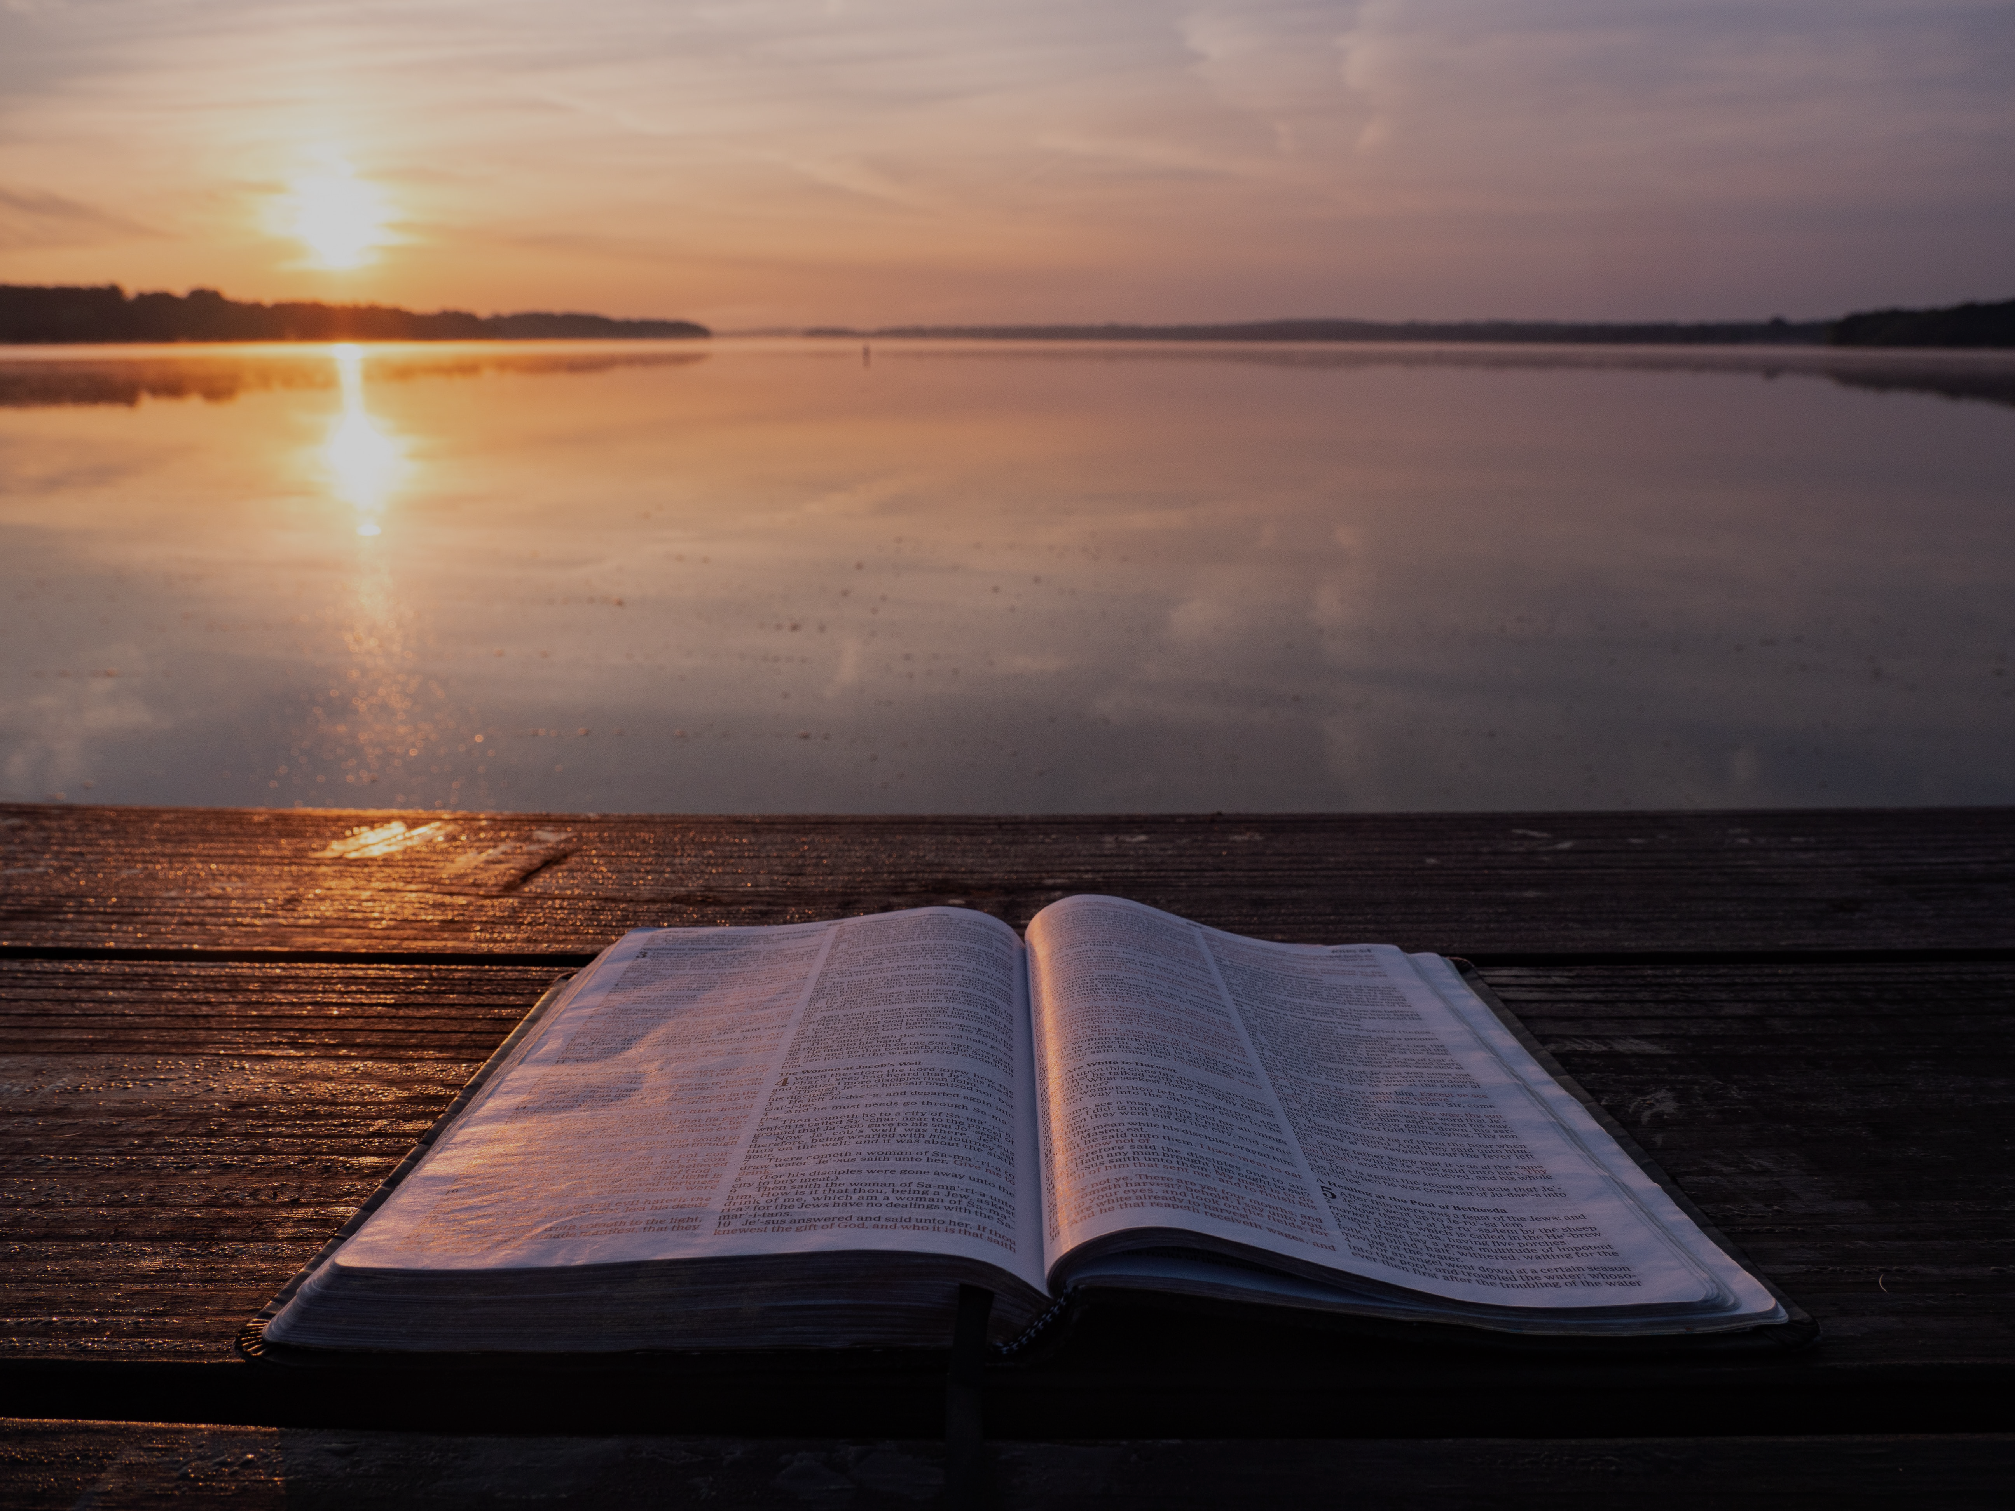
THE SKIES AND THE SCRIPTURES
PSALM 19
“I take this to be the greatest poem in Psalter and one of the greatest lyrics in the world” – C.S. Lewis
Notes:
Good morning everyone. I hope you are all doing well
Today’s passage is a very rich passage in that it deals with the way God communicates with us, that He has revealed Himself in two ways
There is God’s revelation to us through that which He has created, which is what theologians call God’s general revelation
And then we have the Word of God, the Bible, His God-breathed Word to us, which is what is called God’s special revelation
We will be looking at both today, but the majority of our time will be spent in verses 7-9, on God’s special revelation
But folks if you get nothing else out of today, we see in this passage that our God is not silent, our God still speaks through His Word today, because our God is still saving the lost
The message of Psalm 19 is that the glory of God displayed in the heavens points us to the grace of God displayed in the Bible
This psalm is basically a miniature version of the largest chapter in the Bible, Psalm 119, there are many similarities between the two
But it is such an amazing psalm, C.S. Lewis had this to say about it, “I take this to be the greatest poem in the Psalter and one of the greatest lyrics in the world”
I pray that today you would leave, being encouraged and urged to commit to the study of the Word of God, to keep pressing on in this life with two feet firmly embedded in the Word of God
Let’s get into it

Slide 2
THE SKIES
“The heavens declare the glory of God, and the sky above proclaims his handiwork” (Psalm 19:1)
“Its rising is from the end of the heavens, and its circuit to the end of them, and there is nothing hidden from its heat” (Psalm 19:6)
God has demonstrated His power, and exhibited His glory in creation, that all who reject Him will be without excuse
Notes:
“The heavens declare the glory of God, and the sky above proclaims his handiwork” (Psalm 19:1) - The heavens don’t simply bring glory to themselves, but they bring glory to God - God created the world in such a way that it was to point people to Him. - It’s purpose was not that we would gaze in wonder only at creation itself, but cause people to think, “Wow, how awesome is the God who created all of this” - David, the author of this psalm, knows none of what we know of modern science, and yet you can imagine when he was a shepherd boy, tending to his father’s sheep, gazing up at the night sky, he was overwhelmed by the glory of God - And that is how it ought to be for us as Christians, that as we gaze at God’s wondrous creation, we too should be overwhelmed by the glory of God - And then as we read on…
“Its rising from the end of the heavens, and its circuit to the end of them, and there is nothing hidden from its heat” (Psalm 19:6) - Every moment God’s existence, power, wisdom, and goodness, are being sounded abroad by the heavens which shine upon us from above - None can escape its heat, every single day, every single one of us witness God’s glory in creation - In creation God has given sufficient evidence for Himself, that God has revealed to the whole world, that there is a Creator
God has demonstrated His power, and exhibited His glory in creation, that all who reject Him will be without excuse - Romans 1:18-20 – “For the wrath of God is revealed from heaven against all ungodliness and unrighteousness of men, who by their unrighteousness suppress the truth. For what can be known about God is plain to them, because God has shown it to them. For his invisible attributes, namely his eternal power and divine nature, have been clearly perceived, ever since the creation of the world, in the things that have been made. So they are without excuse” - When Jesus returns to judge the world, we cannot claim ignorance. The heavens declare the glory of God. - God is practically shouting at mankind saying look at creation and then look past creation to the one true God, the Creator of it all - If you do not know there is a God, God is saying, you do not know me because you are deaf and blind, you suppress the truth, you ignore my handiwork, and for that you will be cast into an eternity away from me, to an eternity in hell - Creation is so clear and unmistakable in its evidence that it is enough to condemn, all are without excuse - But this should not cause the Christian to be lazy, because God’s general revelation is not enough to save, it is enough to condemn, but it is not enough to save - God’s great commission still stands. Our task is to go and make disciples, teaching them to obey all that God commands - Our task is to go out and preach God’s special revelation, His written Word

Slide 3
GOD’S WORD IS PERFECT AND SURE
“The law of the Lord is perfect” (Psalm 19:7a)
Perfect = Complete, sound, without blemish
“Reviving the soul” (Psalm 19:7b)
Notes:
“The law of the Lord is perfect” (Psalm 19:7a) - In verses 7-9 David is going to use 6 titles for the Word of God, followed by 6 characteristics of the Word of God, followed by 6 benefits or effects of the Word of God - The law of the Lord. This is David’s favourite reference to the Word of God. - In the original Hebrew the word for law is torah, which is usually a name for the first 5 books of Moses, but here it is also a reference to all of God’s Word - This word also means instruction, direction, teaching. It is talking about God’s Word as divine instruction, as divine teaching - And because its source is divine, because its source is a perfect God, we can without a doubt claim that this God inspired, these God-breathed words, are also perfect in their original manuscripts
Perfect = Complete, sound, without blemish - It is without blemish, there is no error, it is inerrant - There is nothing missing from it, it is complete, and so we dare not add anything to it, or take anything away from it - It lacks nothing and possesses everything - Nothing in this book is to be done away with, or to be altered, and to do so is to commit treason of the highest order - As preachers, teachers, pastors, ministers of God’s Word our only authority rests solely in the authority of God, rests solely in God’s Word and being faithful to the text - And we seek to stay faithful to the text, by completely leaning on the Holy Spirit as He guides us into all truth, because it is only in God’s Words that there is true saving power
“Reviving the soul” (Psalm 19:7b) - Now this phrase here has two aspects. The first is the nourishing of the soul, like food to the body - The Word of God revives our souls, it nourishes our souls. - We have some people in our congregation who are sick, who are weary, who are tired from the trials of life - But the Word of God says, “Come to me, all who labour and are heavy laden, and I will give you rest”, run to Jesus, lay your burdens before him, come to him with your struggles, and he will give you rest - The more literal effect here is actually that of saving souls. The word here for revive actually means to turn back, to return, and in some translations is actually translated to say ‘converting the soul’ - And so to me this is both awesome and terrifying. - To our elders, our preachers, to anyone in a teaching role in our church, all of you who are ministering to a lost soul, our RI instructors, all you evangelists, hear this, - It is in God’s Word, it is by the reading, preaching and teaching of God’s Word, that new life is given, that a person is born again by the power of the Holy Spirit - God’s Spirit goes forth and regenerates, and brings new life, where the truth of the Word of God is preached and applied - Think of Acts 2, Peter’s sermon at Pentecost, God’s Spirit was poured out in a mighty way upon the faithful preaching of God’s Word - And because herein lies the power of salvation, thousands of souls were saved and adopted into the family of God - Or we have Philip. Upon explaining Isaiah 53 and the message of Christ crucified to the Ethiopian Eunuch - The eunuch repented and believed in the Lord Jesus Christ and was saved and baptised - Many souls have been saved by preachers who have stuttered, who had no idea of public speaking - But they had every idea that the power of the gospel did not rest in their eloquence, but in their faithfulness to the Scriptures. - My job as a pastor, as a preacher is not to be the most entertaining preacher, or the most well spoken preacher, but in my weakness, to completely and humbly depend on God and His Word. - The charge that Paul gives is the same charge given to every preacher of God’s Word across the world. Here’s what Paul charges Timothy with, “I charge you in the presence of God and of Christ Jesus, who is to judge the living and the dead, and by his appearing and his kingdom: PREACH THE WORD” - My job is to read the text, to study the text, to be faithful to the text, to be God’s vessel, His mouthpiece and preach His Word to you - And then step aside and watch as God’s Word goes forth in power, saving souls and edifying the saints - It is God’s Word not my word that saves - God’s Word revives the soul, because salvation has nothing to do with me, and everything to do with God

Slide 4
“The testimony of the Lord is sure” (Psalm 19:7c)
“How firm a foundation, O saints of the Lord, Is laid for your faith in his excellent Word! What more can he say than to you he has said Who unto the Saviour for refuge have fled?”
“Making wise the simple” (Psalm 19:7d)
Notes:
“The testimony of the Lord is sure” (Psalm 19:7c) - To give a testimony is to bear witness to something - So the Word of God, is God bearing witness to who He is, what He wills, what He requires, and what He will do - As we study the Scriptures we come to understand who God is, that He is sovereign over everything, that He is Creator, that He is one God in three persons - That Jesus Christ, is both fully God and fully man - God bears testimony against sin, and on behalf of righteousness - As Charles Spurgeon put it, “His testimony is plain, decided, infallible, and is to be accepted as sure” - What David means here when he says sure, is probably described quite well in the old hymn, ‘How firm a foundation’
“How firm a foundation, O saints of the Lord…” - God’s Word is a firm foundation, of which we are to build our lives upon, like the story of the wise and foolish builder - So that when the troubles of life come, only those standing on the firm, sure foundation of the Word of God will remain standing - It is an unwavering foundation, and it is upon this foundation that God has always built His Church - Ephesians 2:19, “So then you are no longer strangers and aliens, but you are fellow citizens with the saints and members of the household of God, built on the foundation of the apostles and prophets, Christ Jesus himself being the cornerstone, in whom the whole structure, being joined together, grows into a holy temple in the Lord” - The Word of God is perfect, it is complete, it is without error. it is also a sure, firm, infallible foundation which the household of God is being built upon - So we must not deviate from that which is written in Scripture
”Making wise the simple” (Psalm 19:7d) - The word here for simple is similar to foolish. - It basically means being open-minded, but this is a negative thing in this context, because this person doesn’t know what to keep in their mind - It means that they are easily led astray, easily enticed - But the Word of God will revive you, will save you and over time, by the Word of God, and through the working of the Holy Spirit… - You will be made wise, you will become discerning, you will be able to differentiate between the things of the world and the things of God, and walk in them - David says in Psalm 119:99, “I have more understanding than all my teachers, for your testimonies are my meditation” - David is saying that as we dwell on His Word, as we meditate upon them and allow it fill our minds and go way down deep into our hearts, we become wise, we become more understanding - Because the God of the Bible is all-knowing and is the giver of wisdom - There will be many in this life who will be richer than you, who will be more talented than you, who will be more popular than you - But what David is saying is that the one who wins in life is the person who is a man or woman of God’s Word - And so the Word of God not only saves, but it sanctifies us, it makes us wise, it makes us more and more like our elder brother, Jesus Christ

Slide 5
GOD’S WORD IS RIGHT AND PURE
“The precepts of the Lord are right” (Psalm 19:8a)
“Rejoicing the heart” (Psalm 19:8b)
“The commandment of the Lord is pure” (Psalm 19:8c)
“Enlightening the eyes” (Psalm 19:8d)
Notes:
“The precepts of the Lord are right” (Psalm 19:8a) - The word used for precept is often translated as statutes, we are talking about Yahweh’s charges, His mandates. These are doctrines, not ideas or suggestions - This looks at Scripture as absolute truth - The precepts of the Lord are right. This is not right as opposed to wrong, but right as in a right path - It is the doctrine of God, His absolute truth that lays out a straight path for us to walk in obedience to
“Rejoicing the heart” (Psalm 19:8b) - Walking in obedience to God’s commands is a good thing - We walk through this dark, deceptive world, knowing that the Holy Spirit now lives inside us, and helps us see Christ in Scripture - And we have His precepts to guide us home - And we now walk in the light, we walk by the Spirit - This causes great rejoicing in the heart. There is no greater joy in this life, than to live our lives for the glory of God, for this is mankind's chief purpose - In Luke 11 we are told that true joy, true happiness comes through the Word of God being known and obeyed
“The commandment of the Lord is pure” (Psalm 19:8c) - God’s Word is right and it is pure. It does not need to be tweaked, we do not need to flick through its pages working out what is right and wrong, because there is no stain of sin that pollutes it - It is pure, it is clear, in that it gives clear direction for life
“Enlightening the eyes” (Psalm 19:8d) - Whether your eye be dim with sorrow or sin, the Scripture is skillful, like a surgeon with a scalpel, and makes the eye clear and bright - The purity of God’s truth cures the blindness of the soul, and we become illumined by the Holy Spirit, and we now see things as they were intended to be seen, because we see them through the lens of Scripture - Psalm 119:105 says, “Your word is a lamp to my feet, and a light to my path” - The Word of God is like the lights that light up the runway at an airport at night, it guides us, it keeps us on the right track, it keeps pointing ahead, onwards to eternal glory. - Urging us, convicting us, encouraging us not to look to the left or the right, but keeping our eyes fixed on Jesus Christ - God’s commands and the Holy Spirit is working in us. Our obedience to them, keeps us on the way of life

Slide 6
GOD’S WORD IS CLEAN AND TRUE
“The fear of the Lord is clean” (Psalm 19:9a)
“Enduring forever” (Psalm 19:9b)
“The rules of the Lord are true” (Psalm 19:9c)
“And righteous altogether” (Psalm 19:9d)
Notes:
“The fear of the Lord is clean” (Psalm 19:9a) - Now this one seems like a strange reference to the Word of God - However, the fear of the Lord is synonymous with the effects of Scripture - For the Word of God declares God’s glory in its fullest sense, and it brings us to our knees in reverence, in fear of our Lord - And this fear is clean, it is free from defilement, it is free from corruption - Anything that is tainted with sin, with corruption, is temporary and will fade away, but not the Word of God - The Word of our God…
“Enduring forever” (Psalm 19:9b) - The prophet Isaiah tells us that the “the grass withers, the flower fades, but the word of our God will stand forever” - The evidence that God’s Word is pure, is clean, is free from defilement is in the fact that it endures forever - The Word of God is eternal
“The rules of the Lord are true” (Psalm 19:9c) - Other translations have this word for rules as judgements - Meaning that the judgements, the verdicts that the Lord has given are true - His decrees are true. All of them combined, the whole counsel of God is true, the church of God will not yield on this - We will not compromise on the fact that God’s Word is true. Because if it is not true, then our faith is in vain, we have no solid ground to stand on - But we know that the Word of God, and the gospel therein, from Genesis to Revelation, is perfect, sure, right, pure, clean and is therefore true - And so we can fight the lies of the world, and the fiery arrows of Satan knowing that God’s Word is true and can fend off even the most brutal attacks - We can walk out that door knowing that in Christ, we will suffer in this life, and we will one day face death - But that in Christ we have been set free, and because Christ rose from the grave, because Christ lives, in him, we too will live and walk in God’s presence forever - Because God’s Word is true we can be certain that in Christ we have a hope that transcends this life, this world
“And righteous altogether” (Psalm 19:9d) - This is saying that all that God has said is just, is right, and so God is always right - And then a person who has repented and believed in Jesus Christ and his finished work is made righteous altogether - Christ has taken our sin, our sin has been laid upon him on the cross, and in its place he gives us his righteousness - Now let us go out and live a life that is worthy of the gospel to which we have been called. Let us live a life that demonstrates that we believe the Word of God to be true
We do this by making Scripture…

Slide 7
OUR TREASURE, PLEASURE, AND PROTECTOR
“More to be desired are they than gold, even much fine gold” (Psalm 19:10a) = Scripture is our great treasure
“Sweeter also than honey, and drippings of the honeycomb” (Psalm 19:10b) = Scripture is our great pleasure
“Moreover, by them is your servant warned; in keeping them there is great reward” (Psalm 19:11) = Scripture is our great protector
Notes:
“More to be desired are they than gold, even much fine gold” (Psalm 19:10a) = Scripture is our great treasure - Men will speak of solid gold, and men will work in gold mines for days, weeks, and months, only to dig out the smallest amount of gold and deem it a worthy cause - How much more worthy then is it to spend days, weeks, months, years, a lifetime digging into the Scriptures discovering not solid gold, but solid truth, and meeting with God Himself - Flee to your studies, and sprint to Scriptures. And may your hearts leap for joy at the idea of gathering together with your brothers and sisters in Christ in church and at home groups to hear the Word of God preached and to study the Word of God together as the family of God - We should be eager to meet with God Almighty in His Word and to know God more intimately through His Word
“Sweeter also than honey, and drippings of the honeycomb” (Psalm 19:10b) = Scripture is our great pleasure - David is trying to find the words to help us to see the beauty of Scripture - The things that taste sweet in this world, that seem beautiful in this world, that may even take our breath away, are nothing in comparison to the God of the Bible - It should be our greatest pleasure, and we should read the Scriptures with rejoicing in our hearts, knowing that these are the words of God, that God speaks to us through this book - There is no greater joy, and no greater pleasure than to know God
“Moreover, by them is your servant warned; in keeping them there is great reward” (Psalm 19:11) - The puritan William Gurnall put it like this, “The Word of God stands between the saints and danger” - As the Holy Spirit works through our study of Scripture, He will keep us from falling into sin - By keeping them there is great reward. - A reward is something that you get when the work is done, and there is only one who has kept the Word of God perfectly, and his name is Jesus Christ - And when he died he declared that it is finished, and so when I have run this race, when I pass from this life into the next, I will receive the reward that rightfully belonged to Jesus Christ, and yet in God’s grace, he rewards me and all that repent and believe in His one and only Son

Slide 8
SUMMARY
God has generally revealed Himself in His creation, that we all may see His glory and understand that there is a Creator
God has specifically revealed Himself through the written Word of God, which all points to Jesus Christ, that all who would repent and believe in Jesus might be saved, sanctified and glorified
SCRIPTURE IS SUFFICIENT!
Notes:
God has generally revealed Himself in His creation, that we all may see His glory and understand that there is a Creator - God in His goodness and grace created the world and in doing so put His glory on display for all to see - So that all could understand our God is an awesome God, and so that all would be without excuse when Jesus returns - But He didn’t stop there, because…
God has specifically revealed Himself through the written Word of God, which all points to Jesus Christ, that all who would repent and believe in Jesus might be saved, sanctified and glorified - The Word of God is God’s special revelation that we may enter into a loving, covenantal relationship on the sole basis of the person and work of Jesus Christ - And the nature and person, and the work of Jesus Christ is all found in the Bible. We could not know the gospel if God had not so graciously revealed it to us through His Word - So believe in His Word, believe in the gospel, and you will be saved from the penalty, power, and one day the presence of sin - Saved from an eternity in hell, and instead you will spend eternity in heaven with God
SCRIPTURE IS SUFFICIENT - Which basically means that the Scripture alone is sufficient for life and godliness and for every area of the Christian life - What God is saying in this Psalm, to every single person in this room, is that yes Scripture is perfect, yes it is inerrant, yes it is reliable, but even more than that, it is sufficient - IT IS ENOUGH, so let us a live a life that demonstrates this foundational truth - Let us be a people that treasure the Scripture and take pleasure in obeying God’s words, so that like was said of John Bunyan, if they were to cut us, we would bleed the Bible - Let me close with this quote from Spurgeon

Slide 9
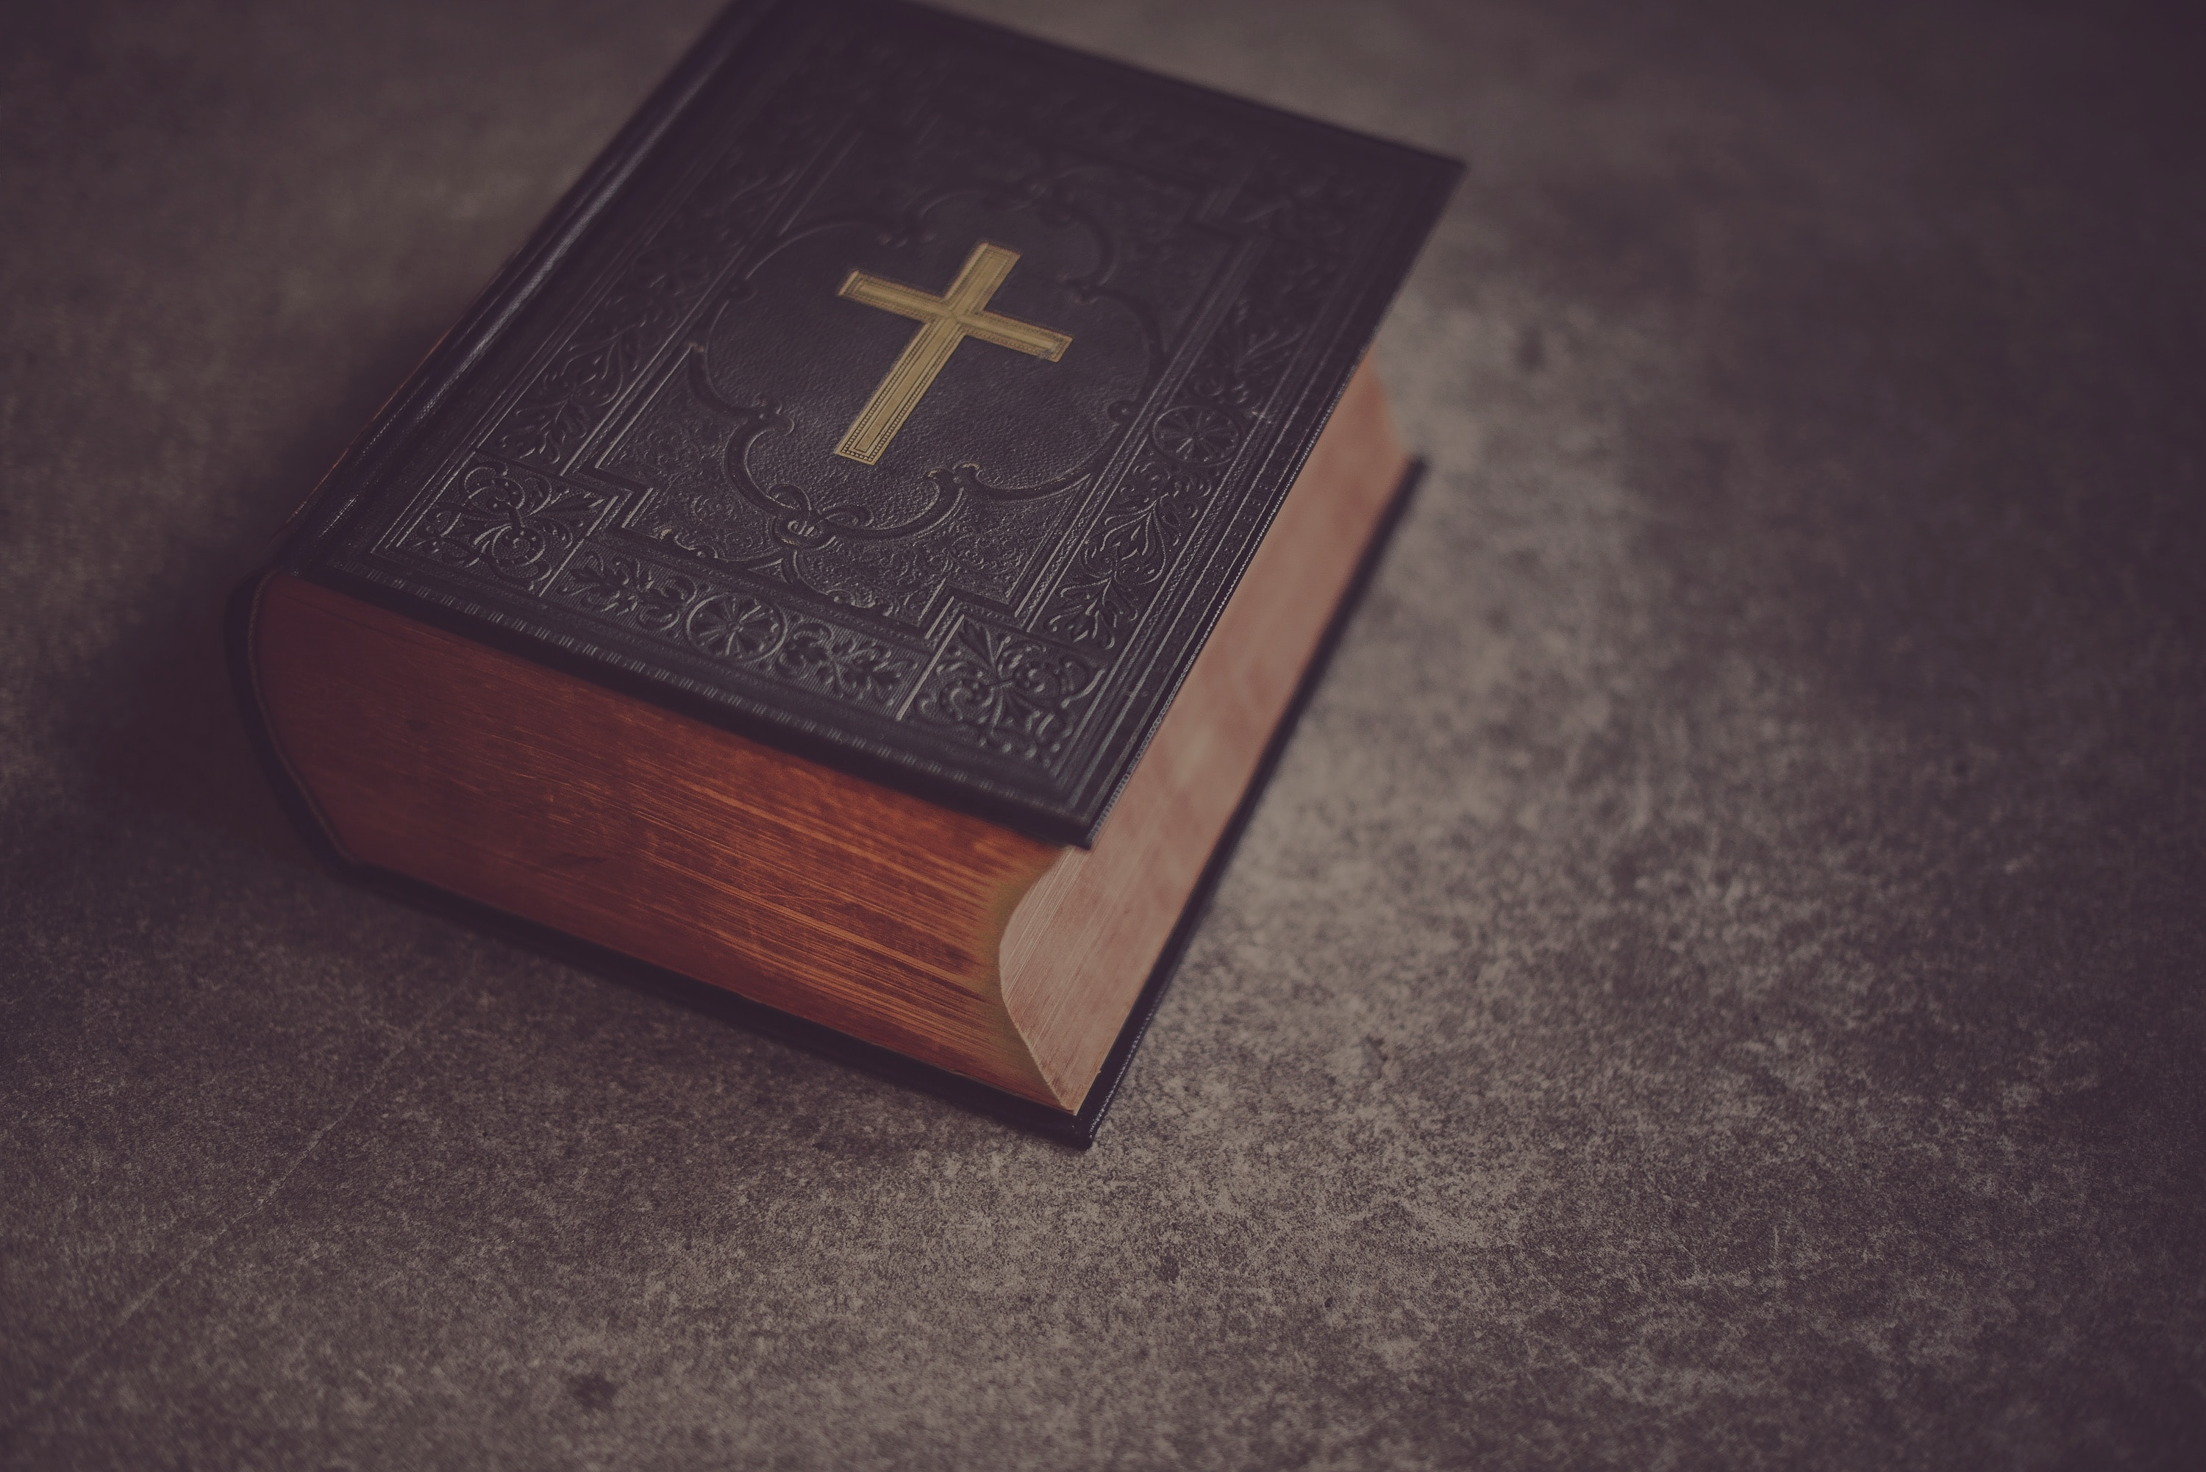
“This weapon is good at all points, good for defense and for attack, to guard our whole person or to strike through the joints and marrow of the foe. Like the seraph’s sword at Eden’s gate, it turns every way. You cannot be in a condition that the Word of God has not provided. The Word has as many faces and eyes as providence itself. You will find it unfailing in all periods of your life, in all circumstances, in all companies, in all trials, and under all difficulties. Were it fallible, it would be useless in emergencies, but its unerring truth renders it precious beyond all price to the soldiers of the cross.” C.H. Spurgeon
Notes:
This weapon is good at all points, good for defense and for attack, to guard our whole person or to strike through the joints and marrow of the foe. Like the seraph’s sword at Eden’s gate, it turns every way. You cannot be in a condition that the Word of God has not provided. The Word has as many faces and eyes as providence itself. You will find it unfailing in all periods of your life, in all circumstances, in all companies, in all trials, and under all difficulties. Were it fallible, it would be useless in emergencies, but its unerring truth renders it precious beyond all price to the soldiers of the cross.
Soldiers of the cross, brothers and sisters in Christ, as we read Scripture, and as we are reminded that God is sovereign, that God is good, full of grace, that God is faithful, let us take great comfort in who God is
When Satan tempts us to despair, when he tries to entangle us in sin, and tries to take our eyes off Jesus, stay in the Word, and know that the gates of hell will not prevail
Know that God will finish the work which He began in you, because of who Jesus is and what he has done
And when we read in Scripture or hear the preaching of the Word and are reminded of the gospel, when we remember that day when God saved us, and clothed us with the righteousness of Christ
Let His grace set our hearts aflame, let us go out into the world knowing that God goes with us
And let us proclaim the gospel to the lost, and bring light into this dark world, with the full confidence and assurance knowing that it is not my word that saves, but His Word that saves

