Slide 1
Called to Serve
Philippians 2:1-9

Slide 2
Is there any encouragement from belonging to Christ?
Any comfort from His love?
Any fellowship together in the Spirit?
Are your hearts tender and compassionate?
² Then make me truly happy by agreeing wholeheartedly with each other, loving one another, and working together with one mind and purpose.

Slide 3
Don’t be selfish; don’t try to impress others.
Be humble, thinking of others as better than yourselves. Don’t look out only for your own interests, but take an interest in others, too.
You must have the same attitude that Christ Jesus had
What attitude did Jesus have?

Slide 4
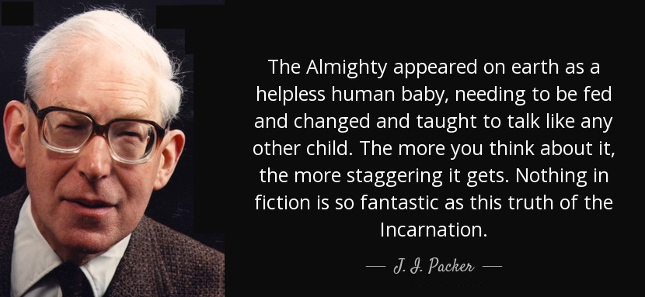
Though he was God, he did not think of equality with God as something to cling to. Instead, he gave up his divine privileges;

Slide 5
He took the humble position of a slave (servant) and was born as a human being.
When He appeared in human form, He humbled Himself in obedience to God and died a criminal’s death on a cross.
We can choose our attitude – we can approach life expecting to be served or we can look for opportunities to serve others.

Slide 6
What does the Bible say about being called to serve?
Galatians 6:10 “So then, as we have opportunity, let us do good to everyone, and especially to those who are of the household of faith”
Ephesians 2:10 “For we are his workmanship, created in Christ Jesus for good works, which God prepared beforehand, that we should walk in them.”

Slide 7
Hebrews 13:1-3 “Let brotherly love continue. Do not neglect to show hospitality to strangers, for thereby some have entertained angels unawares. Remember those who are in prison, as though in prison with them, and those who are mistreated, since you also are in the body.”
1 Peter 4:10 “As each has received a gift, use it to serve one another, as good stewards of God's varied grace”
To not use the skills God has given us in serving others is to act as a poor steward for God

Slide 8
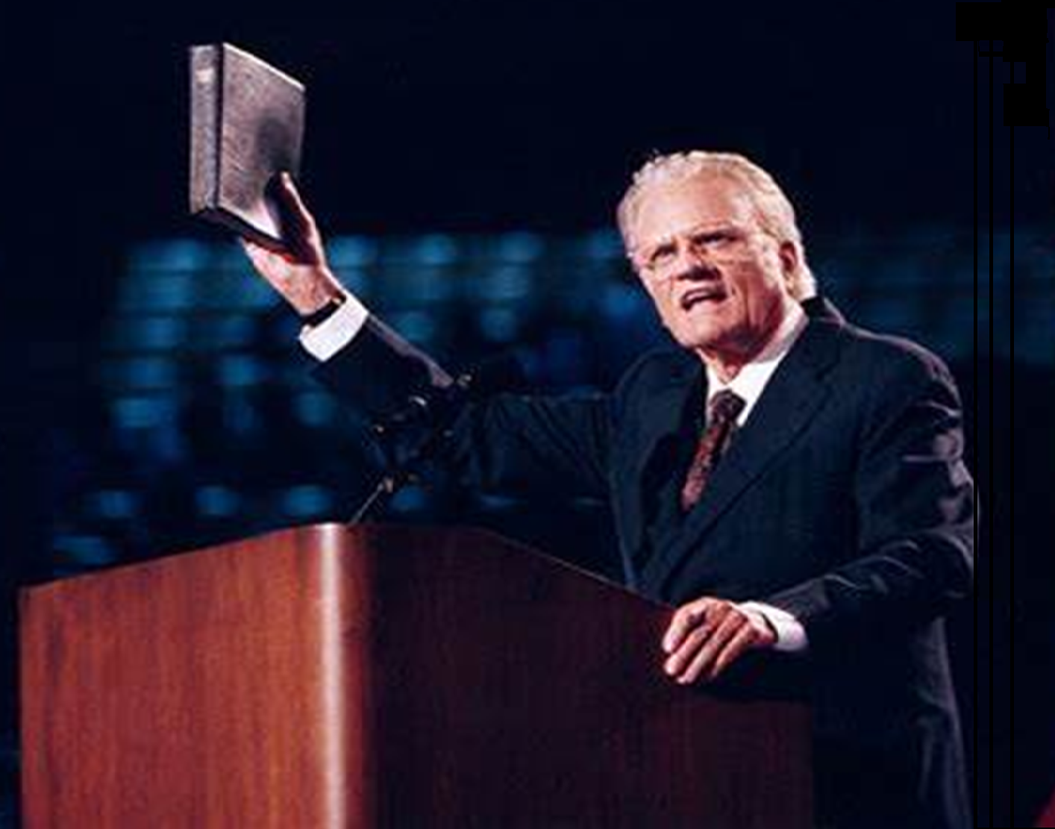
Matthew 25:37-40 “Then the righteous will answer Him, Lord, when did we see You hungry, and feed You, or thirsty, and give You something to drink? ‘And when did we see You a stranger, and invite You in, or naked, and clothe You? When did we see You sick, or in prison, and come to You?’
And the King will answer them, ‘Truly, I say to you, as you did it to one of the least of these my brothers, you did it to me.”
The highest form of worship is the worship of unselfish Christian service.
Billy Graham

Slide 9
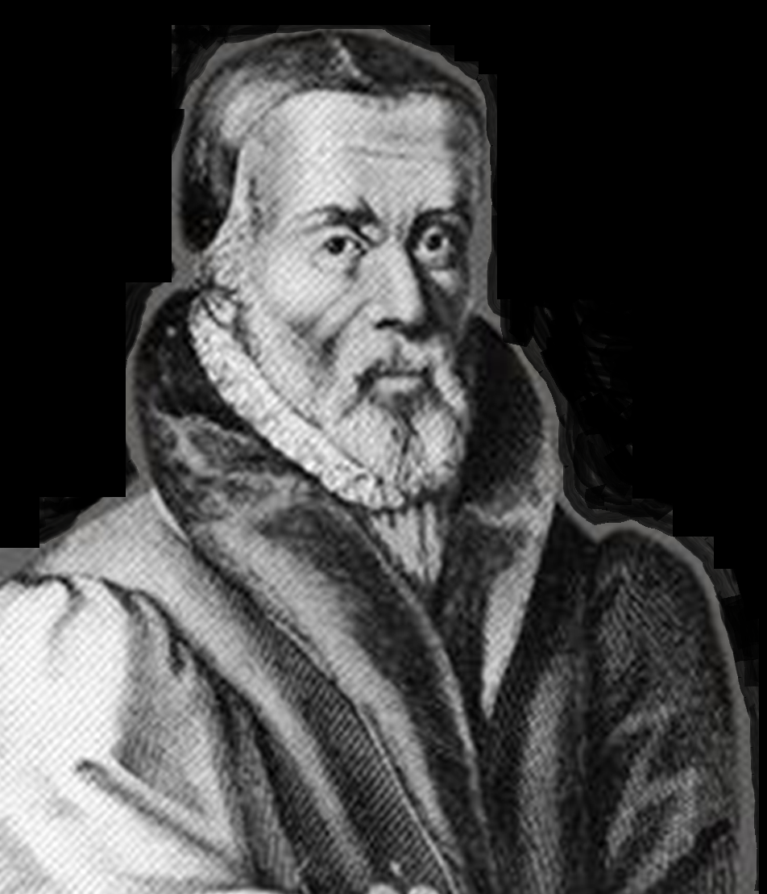
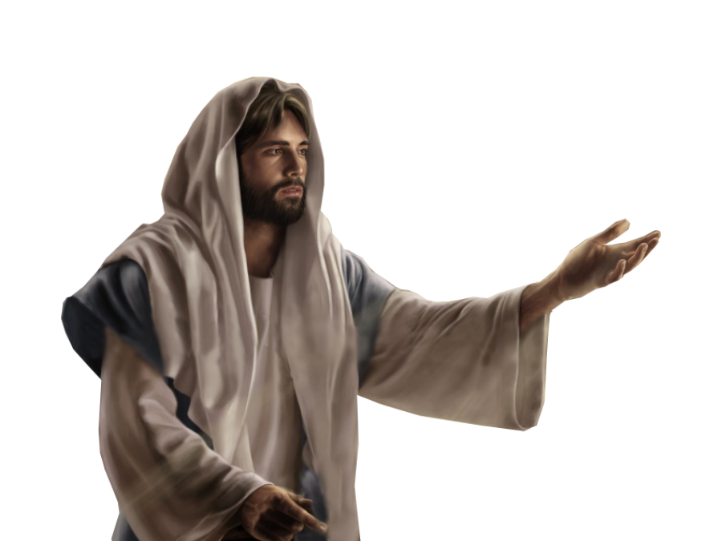
There is no work better than to please God; to pour water, to wash dishes, to be a cobbler, or an apostle, all are one; to wash dishes and to preach are all one, all deeds done to please God
William Tyndale (1494-1536)
Mark 10:45
“For even the Son of Man came not to be served but to serve others and to give his life as a ransom for many.”
Serving others is not an option but a command

Slide 10
Hinderances to Service
Some people are physically too infirm - PRAY
Some people make excuses as to why we don’t get involved:
Too busy doing stuff I enjoy
I didn’t notice that it needed to be done
I need to have a nanna nap
That kind of menial work is for someone else not me
It impacts my lifestyle
I can’t do it because I like to sleep in

Slide 11
How can we apply this to our life today?
What can I do at the church to serve Him?
“let us do good to everyone, and especially to those who are of the household of faith”
Transportation, visitation, meals, baking, helping in the kitchen, sound desk, multimedia desk, hospitality, welcoming visitors, social events, RI, helping out the youth group, playgroup, breakfast, music team, counting, painting, repairs, mowing, gardening, writing cards/emails, etc.

Slide 12
What things can we do in the community?
Melbourne University study – 1 in 4 people and nearly 50% of young people surveyed said they feel lonely

Slide 13
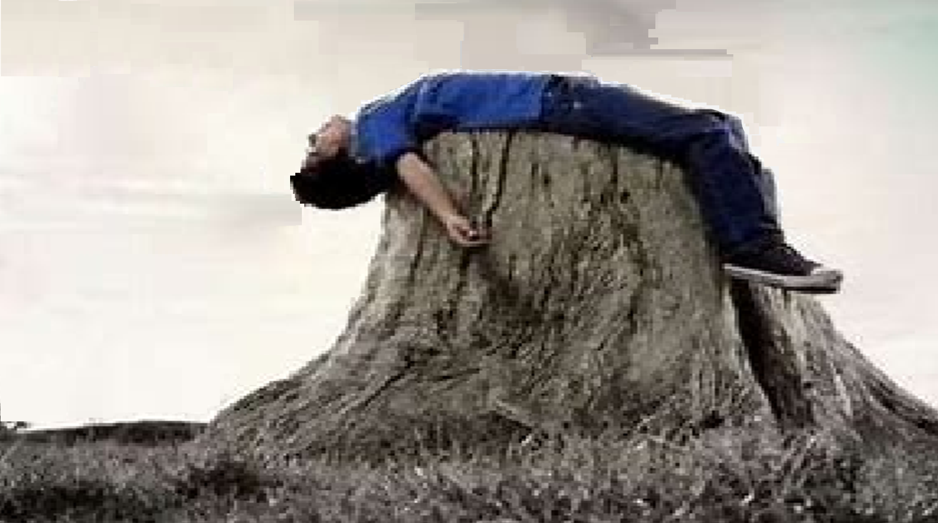
Romans 12:1
Therefore, I urge you, brothers and sisters, in view of God’s mercy, to offer your bodies as a living sacrifice, holy and pleasing to God—this is your true and proper worship

Slide 14
Summary
Saved to Serve
Jesus is our perfect example
Jesus did not offer us an easy life
Jesus did not have lifestyle breaks
A living sacrifice is our true and proper worship

Slide 15
Called to Serve
Philippians 2:1-9

