Slide 1
Proverbs 23: 19 – 26 (NIV)
¹⁹ Listen, my son, and be wise, and set your heart on the right path: ²⁰ Do not join those who drink too much wine or gorge themselves on meat, ²¹ for drunkards and gluttons become poor, and drowsiness clothes them in rags.
²² Listen to your father, who gave you life, and do not despise your mother when she is old. ²³ Buy the truth and do not sell it— wisdom, instruction and insight as well. ²⁴ The father of a righteous child has great joy; a man who fathers a wise son rejoices in him. ²⁵ May your father and mother rejoice; may she who gave you birth be joyful!
²⁶ My son, give me your heart and let your eyes delight in my ways,

Slide 2
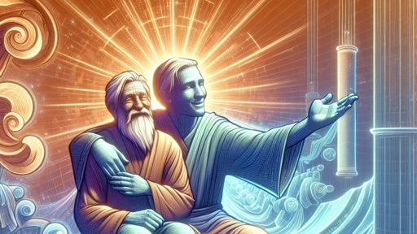
A Father’s Joy
Proverbs 23: 19 – 26

Slide 3
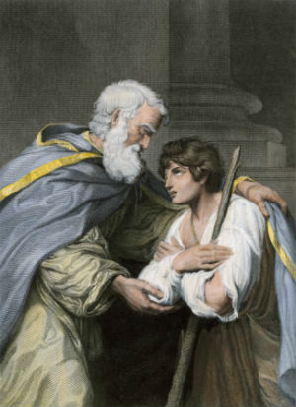
Old Testament Father
In the OT, the father was the main figure who wielded authority and commanded respect.
He was to be honoured & obeyed (Ex. 20, Deut 21)
He possessed almost unlimited power over the lives of the members of his family. (would even sell his daughter into slavery) (Ex. 21:7)
Have his son stoned if the son attempted to stray from the father’s religion, (Deut. 13:6-10), or if the son was a glutton or drunkard
(Deut. 21:18-21)
Serious offences could result in a death sentence (Gen. 38), or a birthright being removed (Gen. 35)
The father had certain responsibilities: love, care for & protect, train, educate, discipline his children (Deut. 1,4,6)

Slide 4
Old Testament Father
God made Abram the father of a multitude of nations.
(Gen. 17) & gave him the new name of Abraham
God is the Father of Israel (Jer. 31, Isa. 63) & Israel is God’s son
God declares Himself to be the God of Abraham, Isaac & Jacob
(Ex. 3:15)
The ultimate expression of a father is in God sending His only Son into the world of sin, death, hell & the cross.
God is father, not by independent decision, but in His very nature and being.
God is not love because He loves; He loves because He is Love.
God is not father because He has a son; He has a son because He is a father. Father and son are so related that if the son loses the Father, he loses himself.
Where the son is Not connected to the Father,
or rejects the Father, sin is present.

Slide 5
Old Testament Father
Esau anguished over losing his father's blessing (Gen. 27:38)
One whole chapter of Genesis describes the blessing Jacob gave to his twelve sons (Gen. 49).
Father had to convey all the written law to his children (Deut. 6:7-9)
When a boy became old enough to work with his father, the father became his principal teacher. (e.g. Jesus becoming a carpenter like his father (Mark 6:3)
New Testament pictures Abraham as our father (Rom. 4:11-12), and the blessing that came through him is the gift of Jesus (Matt. 1:1), through whom all the nations will be blessed (Gen. 12:3).
Notes:
The blessing of the father is a well-known motif in the patriarchal narratives of Genesis.

Slide 6
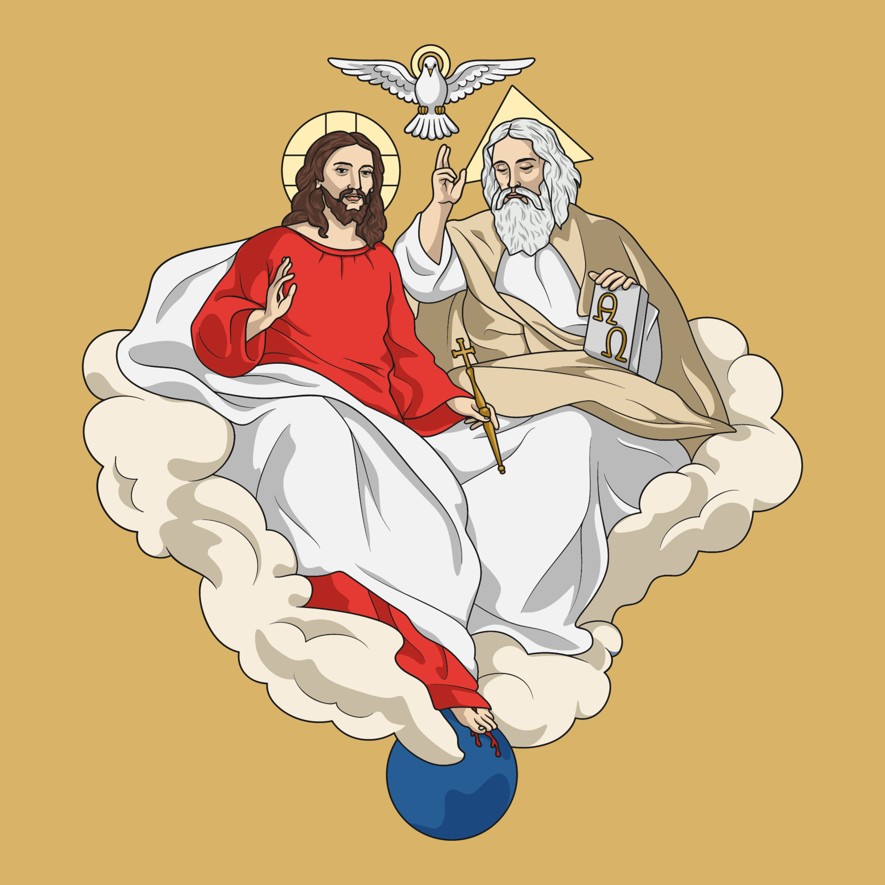
New Testament Father
Jesus own words
“I tell you, the Son can do nothing by himself; he can do only what he sees his Father doing, because whatever the Father does the Son also does. For the heavenly Father loves the Son and shows him all he does. Yes, and he will show him even greater works than these, so that he will be amazed. For just as the Father raises the dead and gives them life, even so the Son gives life to whom he is pleased to give it. Moreover, the Father judges no one, but has entrusted all judgement to the Son, that all may honour the Son just as they honour the Father. Whoever does not honour the Son does not honour the father who sent him.” (John 5:19-23)
Notes:
God the Father did not abandon his Son, Jesus. The Bible tells us that when Jesus came out of the water the Holy Spirit descended and rested on him.

Slide 7
New Testament Father
The baptism of Jesus found in the Gospel of Matthew speaks powerfully to the issue of fatherhood. Though the passage marks the inauguration of Jesus' earthly ministry, these verses allow us the privilege of beholding one of the most intimate interactions between Jesus and his Father. In the beauty of this moment we see Jesus acting in loving obedience to his Father, and the Father disclosing to the world unashamedly how deeply he loves his Son. The divine warmth of this Father and Son embrace radiates life-changing truths that powerfully address the subject of fatherhood. (Matthew 3:11-17)

Slide 8
New Testament Father
In the Lord's Prayer
(Our Father who is in heaven) He's present and attentive
He desires the best for his children.
(Give us our daily bread) He provides for his children’s daily needs.
(Forgive us our debts) He forgives his children.
(Deliver us from evil) He protects his children from evil.
(His kingdom come and will be done) He gives his children hope for the future.
(Matt. 6:9-13)

Slide 9
Fatherlessness
Fatherlessness adversely affects,
Individuals,
Families,
Neighbourhoods,
Churches,
Cities
Nation.
Fatherlessness and family breakdown cost Australia 13 billion dollars per year.
Notes:
One critical aspect of fatherhood that is plaguing our society in epidemic proportions is fatherlessness. Throughout the world father absenteeism is pervasive and the ramifications are devastating.

Slide 10
Fatherlessness
Fatherlessness Impacts,
Education,
Poverty Levels,
Social Behaviours, (Low Self Esteem)
Health Care,
Increase in Sexual Issues,
Emotion Development (Psychological)
Substance Abuse
Suicidal Behaviour
Bryan Rodgers of the Australian National University
Notes:
And there is a list of other factors that are essential to our children's wellbeing
. Coupled with the fatherless crisis is the innate struggle men encounter in not only trying to be a present father, but being a good father as well. Being present is one thing, but being a good father is a whole other ball game. Many dads are present in the home, but being present is no guarantee that they are the loving and nurturing fathers God intends for them to be in their homes. A present "bad dad" can, and have done equal, and in some cases more damage to their children and family than an absent dad. Men who love their families constantly grapple with the question,

Slide 11
Fatherlessness
According to the Australian Bureau of Statistics, 870,000 children, around 1 in 6, live without their biological father at home.
71% of high school dropouts are fatherless; fatherless children have more trouble academically, scoring poorly on tests of reading, mathematics, and thinking skills; children from father-absent homes are more likely to be truant from school, more likely to be excluded from school, more likely to leave school at an early age.
Most research focuses on two major causes for the growth in fatherlessness since the early 1960's: divorce and out-of-wedlock births. – The number of divorced adults in 2008 was 844,400 compared to 393,000 in 1960.

Slide 12
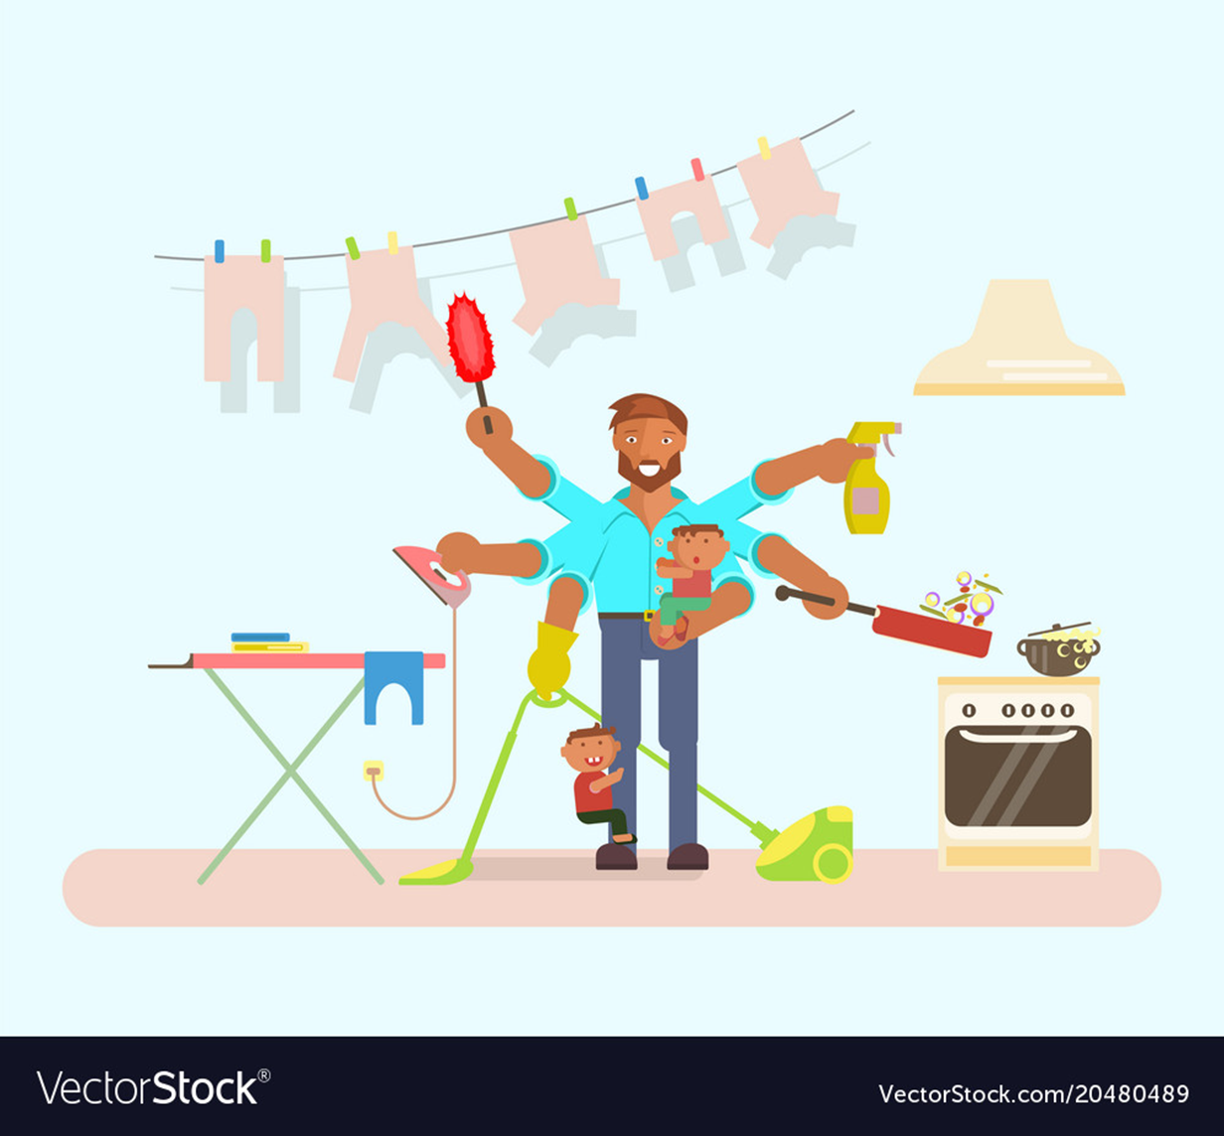
Today’s Fatherhood
Men and boys do not know how to be good Husbands, Fathers or even being a Male.
Finances
Time Management
Common mental health challenges.
Addiction and problem gambling.
Workplace challenges.
Relationship conflict.
Racism and discrimination.
Housing and financial insecurity.
Anger Management
Lack of Confidence
Notes:
The ideal man is often what makes a man suffer the most. As a man, you’re expected to be tough, you’re expected to not cry, and you’re expected to be the bread winner. This leads to other issues, such as you’re expected to be a father, you’re expected to love sports and not want to share your emotions, because doing so would be too “weak” If you show even a hint of weakness, society could eat you alive.

Slide 13
Today’s Fatherhood
Without a father figure in the home, boys are going from female-dominated home environments to female-dominated school environments where less than one in nine schoolteachers is a man, back to female-dominated home environments — where boys are being told to behave. These same environments demean boys and young men just for being male but at the same time only reward them when they "man up." With such mixed messages, it's no wonder many boys and young men are struggling, either
in school or afterwards, with emotional disturbances, in interactions
with the opposite sex, or with drug use and gang activities.
Institute for Family Studies

Slide 14
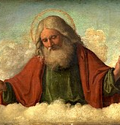
Heavenly Father’s Example
Follow the example of your Heavenly Father.
Be present with your children physically and emotionally.
Find creative ways to let your children know that they are yours and that you wouldn't trade them for the world.
Understand that you are not perfect, but which human parent is?
Stop beating yourself up over your shortcomings.
Notes:
Today, you may be a person who is living with a father wound. Your earthly father may have failed you, but God will not.

Slide 15
Heavenly Father’s Example
Rely on your loving Heavenly Father to give you the grace you need to be the father he wants you to be. He will help you to be present, acknowledging, loving, and affirming to your children.
He promises to be the Father you always wanted and needed.
Just as the Heavenly Father opened the heavens to proclaim his love for his Son Jesus, He will touch the pain in your heart and pour out love and mercy to heal your deepest wounds.

