Slide 1
TRUE THANKFULNESS
Luke 17:11-19
Notes:
Well, good morning everyone. I hope you are doing well
For those of you who don’t know me, my name is Harrison, I am the associate pastor here at this church, and I am also the president of the soccer club
Well, given that today is a celebration and thanksgiving service, I thought what better Bible passage to address than one that deals with what true thankfulness looks like
Let me begin with a story about a man named H.A. Ironside, who was a well-known and well respected pastor in America
ILLUSTRATION: In his book FOLK PSALMS OF FAITH, Ray Stedman tells of an experience H.A. Ironside had in a crowded restaurant. - Just as Ironside was about to begin his meal, a man approached and asked if he could join him. Ironside invited him to have a seat. Then, as was his custom, Ironside bowed his head in prayer. - When he opened his eyes, the other man asked, "Do you have a headache?" Ironside replied, "No, I don't." The other man asked, "Well, is there something wrong with your food?" - Ironside replied, "No, I was simply thanking God as I always do before I eat." - The man said, "Oh, you're one of those, are you? Well, I want you to know I never give thanks. I earn my money by the sweat of my brow and I don't have to give thanks to anybody when I eat. I just start right in!" - Ironside said, "Yes, you're just like my dog. That's what he does too!”
Whilst Ironside was definitely just trying to be funny, I think this story makes a good point
More and more in this world we are seeing people turn away from even accepting the existence of God, thinking that we are all self-made people
And so thankfulness is becoming a lost art in the world, because they think that the only thanks they owe is to themselves
But as a result they are missing out on one of the greatest blessings we can have in this life. Living a life of gratitude to the one who created us.
My prayer is that hopefully by the end of this message we will have a greater understanding and greater desire to be more thankful in our lives to the God who created us all

Slide 2
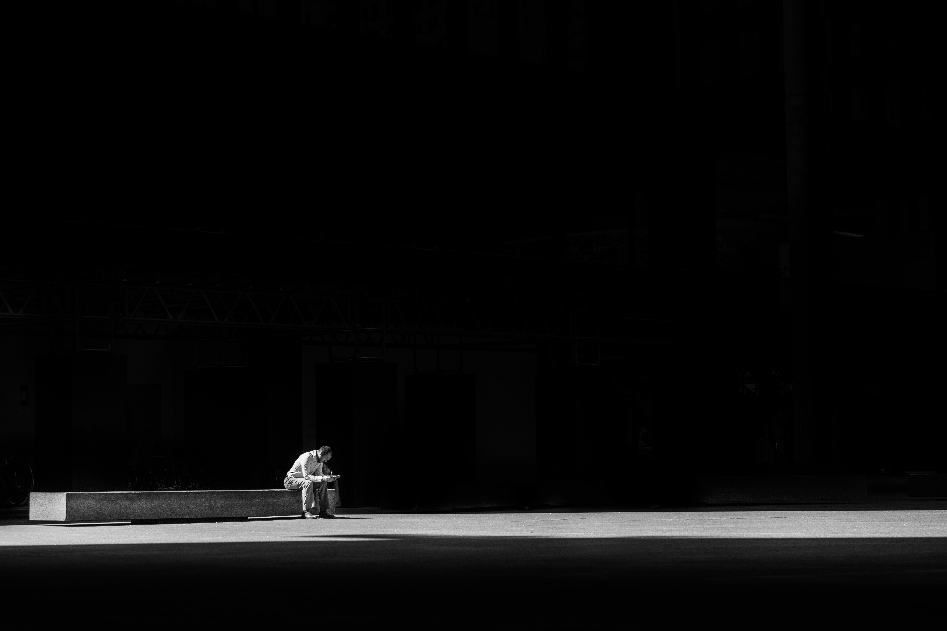
SETTING THE SCENE
“On the way to Jerusalem he was passing along between Samaria and Galilee” (Luke 17:11)
“He was met by ten lepers who stood at a distance” (Luke 17:12b)
We are all spiritual lepers who are in desperate need of healing
“and lifted up their voices, saying, “Jesus, Master, have mercy upon us” (Luke 17:13)
Notes:
“On the way to Jerusalem he was passing along between Samaria and Galilee - Now this story occurs in Luke’s gospel towards the end in chapter 17 of 24. In fact we are only 2 chapters away from Jesus triumphal entry, on palm Sunday - So what Luke is saying is that Jesus is getting closer and closer to the time in which he would die on the cross - The second thing I want us to note here is this road between Samaria and Galilee is a road less-travelled - The Jews who lived in Galilee would never walk this road because they despised, they hated the Samaritans so much - That even though this road would have been a short cut to get to some places, they would have taken the long way round, so they didn’t pass Samaria
“He was met by ten lepers who stood at a distance” (Luke 17:12b) - Leprosy was a terrible disease. Whilst the word here for leprosy can be used to talk about a variety of different diseases, the worst kind would show up in sores on the skin - It would damage the skin and the flesh underneath the skin, and as a result it could eat away fingers and toes. It was an awful disease - And in this day, they believed the disease to be contagious, and almost incurable. - So the priest would see them, and if it really was leprosy, they were basically sentenced to a lifetime of quarantine - Like what happened during COVID but not just for a week but for all the days of their life, unless by some miracle they were healed. - And they didn’t quarantine in their house, they would have to leave their homes, their families, and even their town - They were outcasts, rejects, and no one would dare go close to them. - So lepers would often band together outside of a town which is what we see here, a group of lepers standing at a distance
We are all spiritual lepers who are in desperate need of healing - As a result of the first sin, which occurred in the garden with Adam and Eve, sin entered the world, and death through sin - But it wasn’t just them. We all do the wrong thing. We all break God’s law. We have all lied, or stolen, or hated someone with a burning passion, we have all disobeyed our parents - And when we do this we separate ourselves from God and His love, and His family - None of us are perfect, and because of that, we cannot be a part of God’s Kingdom, we are outcasts, with no hope of ever reaching God and His kingdom in our strength - This is what we see with the lepers, they are desperate, they know they cannot ever hope to return to their homes or their families apart from a mighty working of God’s power
“and lifted up their voices, saying, “Jesus, Master, have mercy upon us” - Now we can tell in the way they address Jesus, they clearly have some idea of who Jesus is - Even though they are social outcasts, this man Jesus is changing the world as we know it, he has come and flipped the world upside down - They must have heard of his miracles. - I mean Jesus was calming storms with his words, those who were deaf were hearing again, the blind could now see, and he was raising the dead back to life - Jesus was turning heads everywhere he went - And so in desperation they call out, have mercy upon us - With the obvious being implied. Lord heal us!

Slide 3
ABUNDANT BLESSING
“When he saw them he said to them, “Go and show yourselves to the priests” (Luke 17:14a)
“And as they went they were cleansed” (Luke 17:14b)
Every single one of us experience God’s goodness and mercy daily in our lives
Notes:
“When he saw them he said to them, “Go and show yourselves to the priests” (Luke 17:14a) - Now some of you are probably thinking, what on earth do the priests have to do with anything? Well, I’m glad you asked. - This was the normal procedure when the leper was cured. - The priests acted as a kind of health inspector, and they basically just made sure that the cure had taken place, to then free them to go back into society - The other thing we need to notice is that prior to this Jesus had healed 2 other lepers in 2 other circumstances. - One of them was healed when Jesus touched the leper, an immediate healing. I mean that was unheard of, people didn’t even get close to lepers, let alone touch them - But such is the love and compassion of Jesus - The other time Jesus said to the leper, “Be clean”, and it was so. This time it is totally different - All that Jesus says is ”go and show yourself to the priests”. And the healing didn’t happen instantly, it was delayed a little
“And as they went they were cleansed” (Luke 17:14b) - I mean this is amazing, Jesus calls out from a distance, “Go and show yourself to the priests”, and every single on them was cleansed - To heal one leper would have been enough to crown a person with lifelong fame, but Jesus here heals ten - I mean it’s practically a mini hospital, and Jesus Christ, the Son of God, heals every single one of them - So you can imagine the commotion as they are walking to go and see the priests. - They are probably talking, and one of them looks at his friend and notices the sores start to clear up on his face - And perhaps another all of a sudden has all his fingers again. And another has his ear grow back - I mean it’s just amazing, the power of God has truly come upon these people, in such an awesome and miraculous way
Every single one of us experience God’s goodness and mercy daily in our lives - Okay, so maybe none of us have never had something like this happen in our lives, but all we have to do is look outside at where we live and see God’s blessing upon our lives - Christian or not, God still showers us with blessing - I mean blessing number one, we have coffee, we have friends, we are able to come along on Saturday’s and kick around a soccer ball and enjoy ourselves - We have food we can put on the table, we have a roof over our heads. God blesses us with family and kids - Personally, I am so thankful to God for my wife, the privilege of being a husband and father, for my 3 kids, even when they come in and wake me up much too early. - For the blessing of this church family - For the blessing of being president of this club, and being a pastor in this church. - God is so good to us, if we will but take the time to count our blessings, and see that it is God who gives abundantly in His goodness - And at the same time recognise that we did nothing to deserve any of this, praise and thanks belong to God alone and it should never cease to be on our lips - But there is a blessing, a mercy, a kindness that far exceeds any of these, which can only be found in the person of Jesus Christ

Slide 4
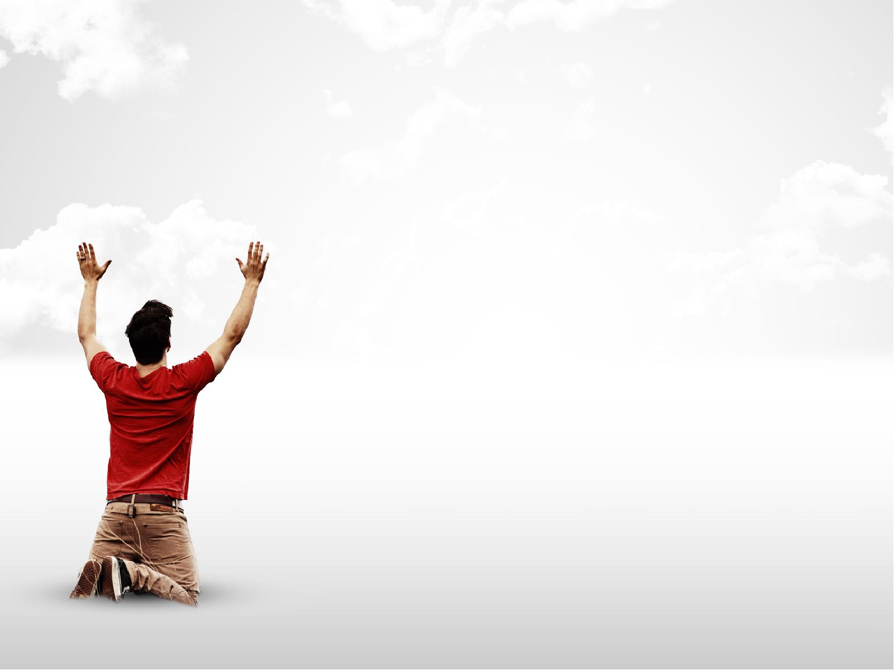
ONE THANKFUL LEPER
“Then one of them, when he saw that he was healed, turned back” (Luke 17:15)
The one was not content with the gift of healing, he wanted to know the gift-giver
“praising God with a loud voice; and he fell on his face at Jesus feet” (Luke 17:15-16)
Notes:
“Then one of them, when he saw that he was healed, turned back” (Luke 17:15) - I mean you can imagine the excitement, they would all have a sense of excitement and gratitude. - But it is one thing to feel grateful, it is another to show it, and only one turned back to show it - The other 9 couldn’t wait to go and see the priests, and who can blame them in a sense - Because upon the priests declaring them clean they could return to embrace their wives, their families, they could return to society - Not as lepers, but just as normal members of society - But one leper thought, “we’ve got all day to see the priests, first we have to go back and see Jesus - He’s the one that healed us, he’s the one we called upon, and apart from him we are still outcasts, still nobodies, doesn’t he deserve us turning back”
The one was not content with the gift of healing, he wanted to know the gift-giver - Being free of leprosy was not enough. This leper had seen something of God in Jesus. - He recognises that only God Almighty could do a work like this. He recognises that Jesus must really be the Son of God - For who else could say, “Go and show yourselves to the priests” and heal a whole group of lepers - This leper wants to say to Jesus, you are everything to me, you are more than this healing, and so he returns…
“praising God with a loud voice; and he fell on his face at Jesus feet” (Luke 17:15-16) - 10 lepers began calling out for Jesus to have mercy. 10 lepers began with a loud prayer to Jesus - Only 1 leper praises God with a loud voice. What’s the difference between the one leper and the other 9? - This one leper saw himself for what he was. He was an outcast, he had been rejected from his own town, no one even dared come close to him - He knew he wasn’t deserving of anything, and yet having come to the end of himself he called out to Jesus - And Jesus in his mercy, and in his love completely healed this man of his physical disease - What he is effectively saying, “I was nothing, but because of the grace of Jesus, I have been given new life” - When we see that in our own lives, that we are sinners, that we are nothing and yet God still showers us with blessing after blessing - How can we do anything but be like this leper, not being satisfied with the blessings, the gifts, but being in desperate need to know the gift-giver Himself and praise God with a loud voice, falling on our faces at Jesus’ feet?

Slide 5
“giving him thanks” (Luke 17:16b)
“Now he was a Samaritan” (Luke 17:16c)
This Samaritan leper was exposed to the goodness and grace of God, and it changed his life forever
Notes:
“Giving him thanks” (Luke 17:16b) - He gives all the praise, all the honour, all the thanks to Jesus because he understands that in his own strength, he could never have healed himself - But Jesus being so rich in love and mercy, saw fit to heal these unworthy lepers - As a Christian this is where we ought to want to spend all the days of our lives, at the feet of Jesus, giving him thanks
“Now he was a Samaritan” (Luke 17:16c) - Samaritan’s were despised by the Jews. And we must remember that Jesus was a Jew, he was supposed to hate this man - But Jesus doesn’t play favourites. Jesus invites all - This one man was a leper, strike 1, a Samaritan, strike 2, a social outcast, strike 3 - And yet God’s grace and goodness were far greater than all of these
This Samaritan leper was exposed to the goodness and grace of God, and it changed his life forever - The standard of God is perfection, we were created for relationship with God, but we have all sinned and fall short of that standard, and so we could no longer be in relationship with God - None of us have anything to offer God that He doesn’t already have - But here’s the good news, here’s the gospel. The perfection that God asks of us, he gives us in Jesus Christ - Jesus Christ came and lived the perfect life on our behalf, and died taking on all the sins, all the wrong things we have ever done, and they are placed on him upon the cross - That should have been us because the consequences for our wrong doings was death - But Jesus died for us, and yet doesn’t stay dead, because on the third day he rises again, so that all who would believe in him may now enter into a relationship with him, both now and forever - God didn’t lower His standard, you see Jesus was the perfect sacrifice and he takes the sin of all who will believe, and gives us his perfection - Not that we are now perfect, but God looks at us through Jesus, and sees us as though we were perfect, because Jesus is perfect, and we are now called children of God - And so the Christian is no longer an outcast, no longer a reject, but welcomed into God’s Kingdom, and warmly embraced by our heavenly Father. - Not because of what we have done, for the only thing we contribute to the gospel is our sin, but because of what Jesus has done - That kind of love, and goodness, and grace ought to change our lives forever - This why the gospel is called good news, and this is the blessing that far outweighs them all.

Slide 6
THE GREATEST BLESSING
“Then Jesus answered, “Were not ten cleansed? Where are the nine?” (Luke 17:17)
“And he said to him, “Rise and go your way, your faith has made you well.” (Luke 17:19)
Jesus Christ himself is the greatest blessing
Notes:
“Then Jesus answered, “Were not ten cleansed? Where are the nine?” (Luke 17:17) - These 9 have miraculous faith. They believed that Jesus had the power to heal them of their leprosy - They believed he was a miracle worker, but they did not believe he truly was the Son of God, - That Jesus was the Saviour, that he was their only hope for not only being physically healed but being cured of their sin, they did not believe these things - The 9 were happy, they were thankful that they were healed, but not enough to turn back. - They wanted to get back to their families, and turning back to Jesus would take time - Committing their lives to Jesus would require sacrifice in their life - And many of us today are thankful for many of the blessings that God gives us, but not enough to turn back to Jesus, not enough be followers of Jesus - But the one leper who returned, Jesus looked at him…
“And he said to him, “Rise and go your way, your faith has made you well.” (Luke 17:19) - In the original language, the word here for ‘well’ means to be made whole - And so not only has he been made well in body but also in soul - In Christ he has been healed and he has been made right with God and adopted into the family of God - Once broken, an outcast, with no family, but now made whole and declared a child of God
Jesus Christ himself is the greatest blessing - In Christ we find all that we need. Yes turning back to Jesus will require sacrifice, following Jesus will completely change your life as you know it - But there is no greater blessing, because not only are we saved from our sins, healed, made well by trusting completely in Jesus Christ - But every child of God, who has been saved by believing in Jesus Christ, is given the Holy Spirit - And so God goes with us all the days of our lives, making us more and more like Jesus - Jesus Christ is the greatest blessing

Slide 7
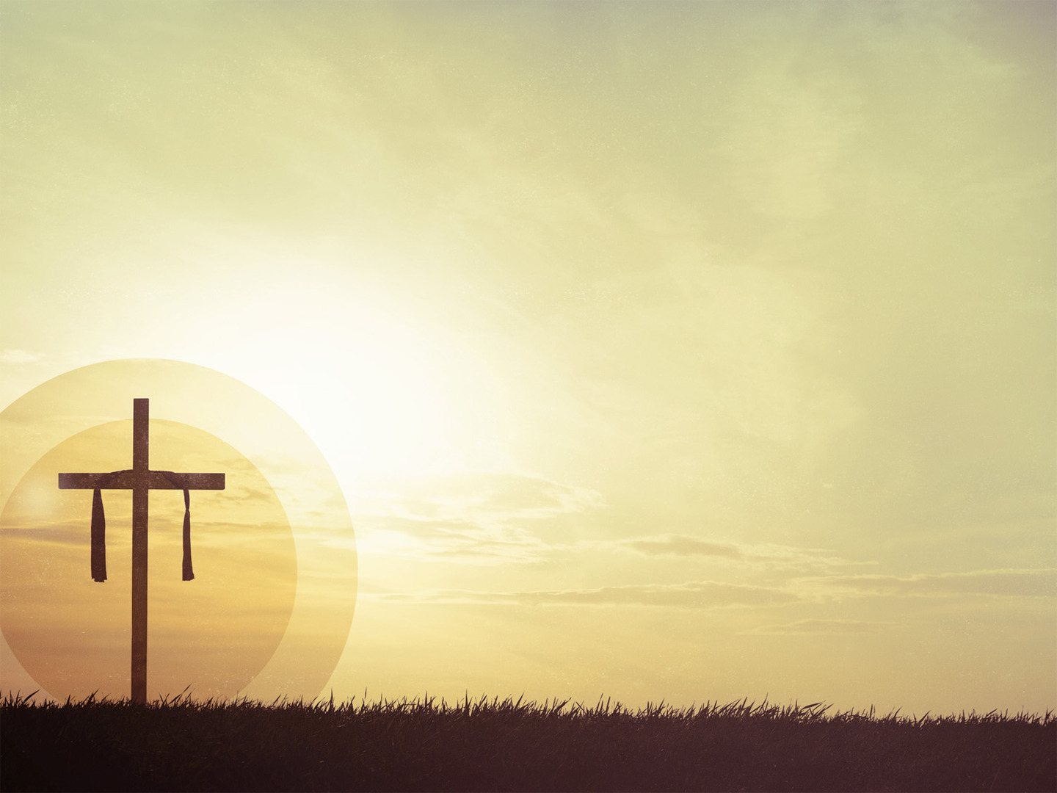
TRUE THANKFULNESS…
Happens when we understand who we are
Happens when we understand what has been freely offered to us
Happens when we understand what happens as a result of believing in Jesus Christ
Notes:
Happens when we understand who we are - If you think you deserve things, you’re not thankful when you get them - Imagine your husband or wife buys you that one gift you have been wanting your whole life, and they go to give it to you - And you respond with, “It’s about time, I thought I would get that years ago”, I mean that’s entitlement at it’s finest - We are only truly thankful for anything in life when we are humble enough to see what we deserve. - True thankfulness to God begins and will only occur when we see that because of our sin we deserve nothing
Happens when we understand what has been freely offered to us - Romans 6 tells us that the free gift of God is eternal life - God’s love goes so deep, and his goodness is so wide, and his grace is so high, that He would not even spare His own Son - While we were still enemies, and still shaking our fists at God, God sent Jesus to come and die for you - Jesus is what has been freely offered to us
Happens when we understand what happens as a result of believing in Jesus Christ - And so when we see that we deserve nothing because of our sin, and yet see how great God’s love and grace is to us, and we see that in Jesus our sins are paid for - And we place our faith in Jesus, and we surrender our whole lives to him - We are made right with God, we enter into a relationship with God, and we are adopted into the family of God - And as a result of God’s power at work in our lives, we begin to bear the family resemblance, God makes us more and more like our elder brother Jesus Christ - Until one day, when sin is no more, there will be no more sickness, no more tears, no more death, because of what Jesus did on the cross - But what’s even more, we will spend forever in the very presence of God, wandering the streets of heaven, praising and thanking Him for all that he has done

Slide 8
Edward Spencer waded again and again into the frigid waters to rescue 17 passengers. In the process, his health was permanently damaged, in fact he was a semi-invalid for the rest of his life. Some years later at his funeral, it was noted that not one of the people he rescued ever thanked him.
Notes:
In a daily devotional called ‘Our Daily Bread’, a man by the name of Warren Wiersbe tells a story about a ministerial student in Evanston, Illinois, who was part of a life-saving squad. - In 1860, a ship went aground on the shore of Lake Michigan near Evanston - And Edward Spencer waded again and again into the frigid waters to rescue 17 passengers. - In the process, his health was permanently damaged, in fact he was a semi-invalid for the rest of his life. - Some years later at his funeral, it was noted that NOT ONE of the people he rescued ever thanked him.
Jesus Christ came and lived so that all who might believe in him would be saved and given eternal life
If you are a Christian here today, then let us be like the one Samaritan leper, and let us spend all the days of our lives praising and thanking God with a loud voice, and on our faces at the feet of Jesus
If you are not, then can I urge you, believe in Jesus Christ today, and you will be saved.
If you will, like the one leper, turn back, turn away from all your sins and run to Jesus Christ, thanking him for all that he has done and seeing that he is your only hope for being saved from sin
Then God will not turn you away, but He will welcome you with open arms, and all of heaven will rejoice
And you will hear the words, “Rise, for your faith has made you well.”

