Slide 1
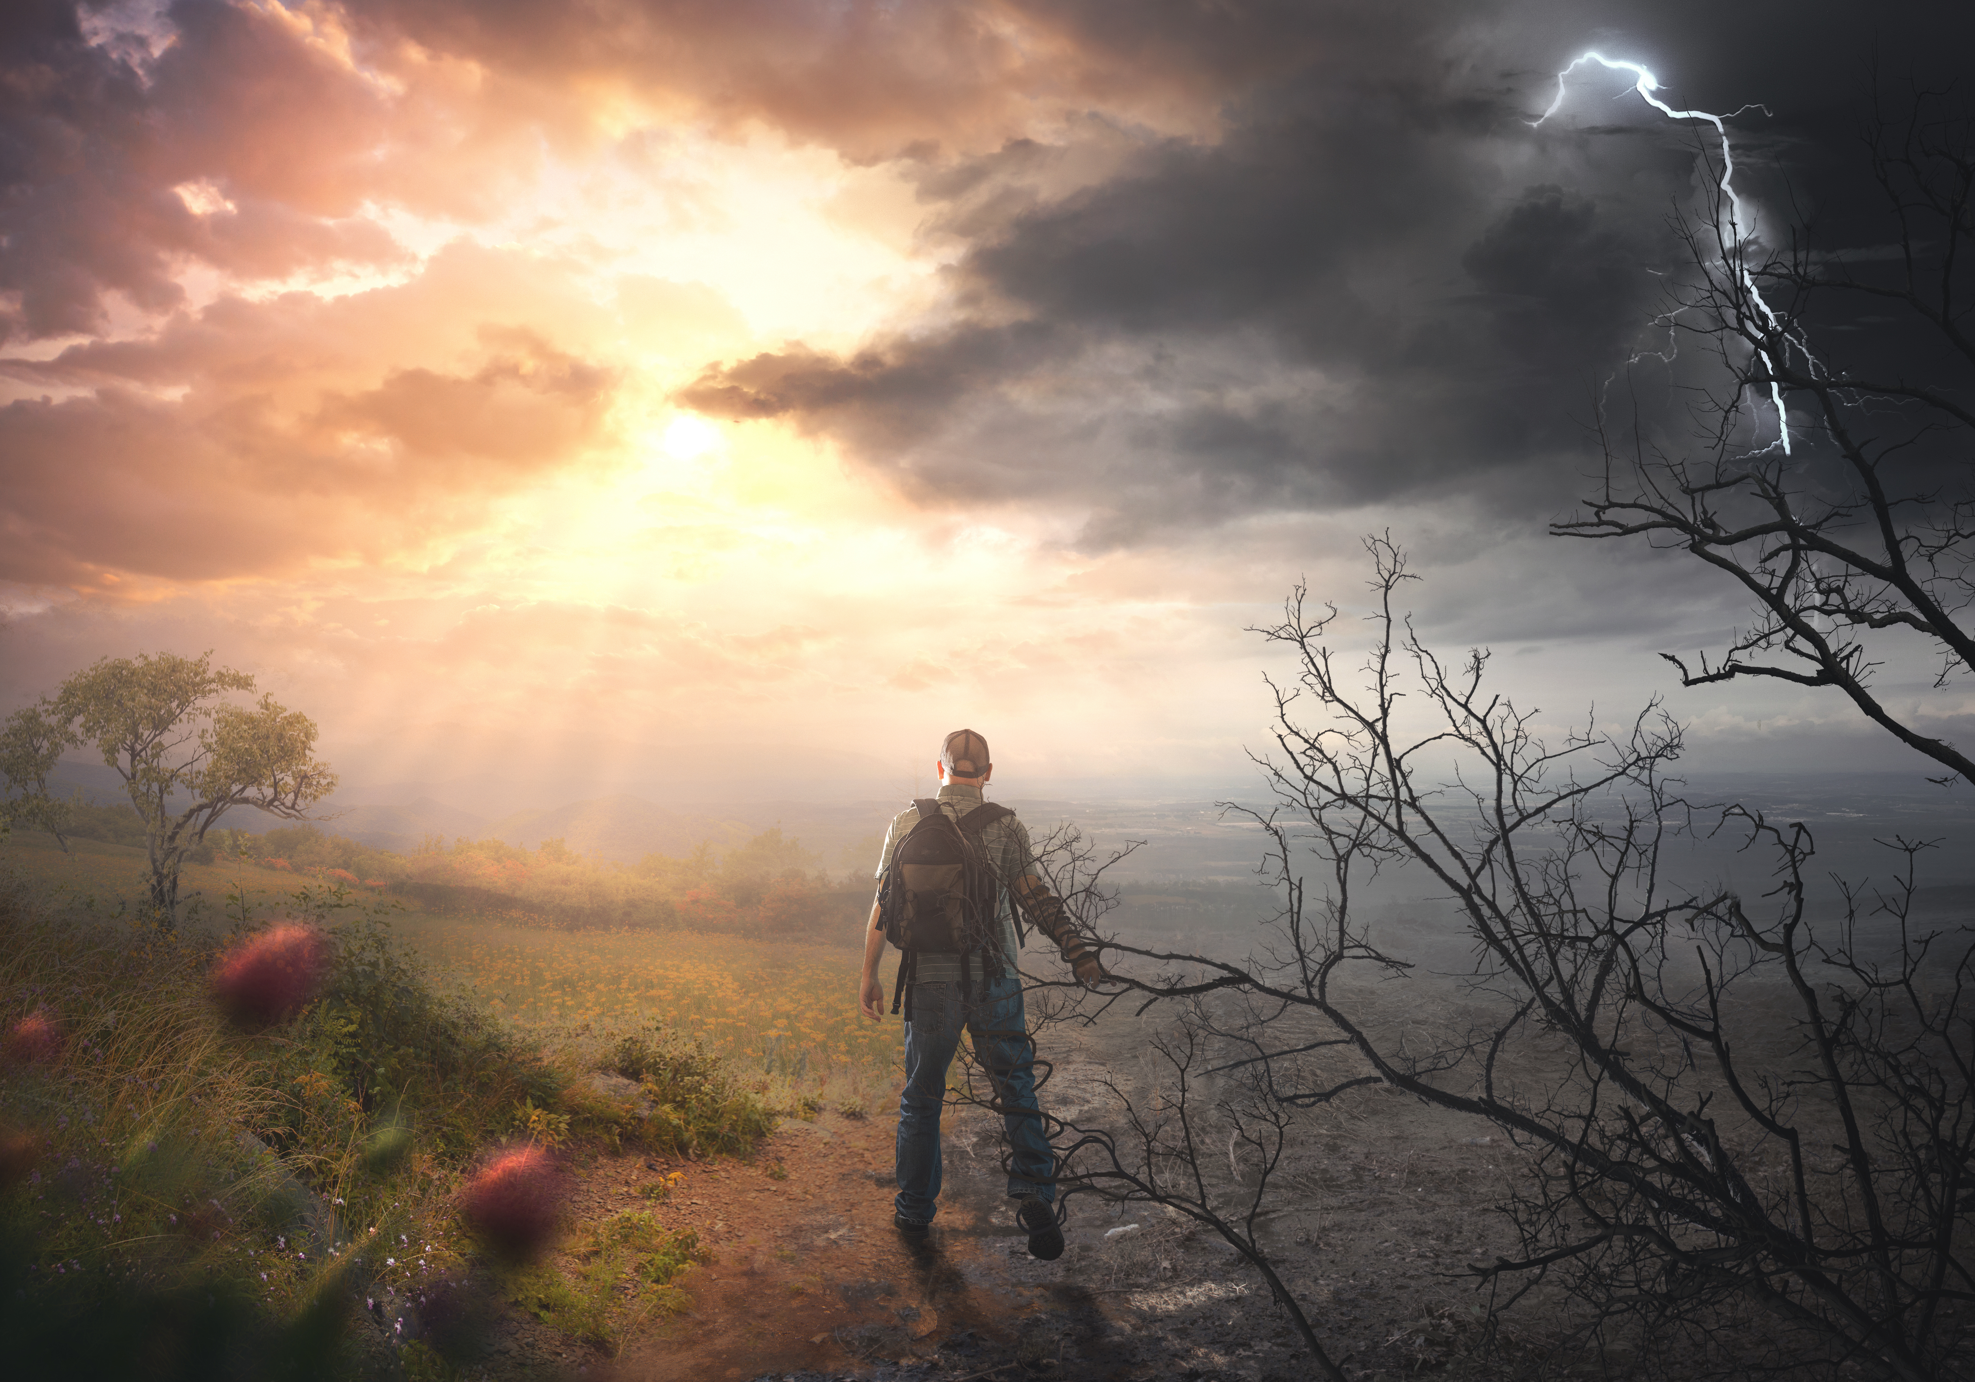
‘Narrow Gate, Narrow Way’
Matthew 7:13-14
Notes:
Good morning everyone.
Well we are in our second last week in the Sermon on the Mount, and Jesus being the master preacher, wants to leave no stone unturned
He beckons the crowd for a response
Jesus uses four powerful images
And in each of the four there is 2 opposites presented
The verses read out to us today have 2 ways, followed by 2 trees, 2 confessions, and 2 builders
And in each of the four there is a call to decision, a call to respond.
And in each there is also an appeal to follow him, to make the right choice
In today’s verses Jesus makes sure his listeners know what they are getting themselves into, he does not sugar coat his message, he says, “count the cost”
So the question for us all today is will you take up your cross and follow Jesus, or will you enter the wide gate?

Slide 2
THE SERMON ON THE MOUNT SO FAR…
Matt 5:1 - 16 – General portrait of the Christian and how they are to remain in society
Matt 5:17 - 48 – The righteousness of the Christian is to exceed that of Pharisees
Matt 6:1 - 24 – Jesus then shows us in practical terms how we are to pray, fast, and give, compared with Pharisees
Matt 6:25-7:12 – Deals with the Christian attitude towards this life, and attitudes towards others in our judgement
Notes:
Matt 5:1-16 – General portrait of the Christian and how they are to remain in society - All throughout the sermon Jesus has been giving kingdom principles which begins with the beatitudes, explaining how those in his kingdom will look - Blessed are the poor in the spirit, blessed are the merciful, blessed are the meek, and so forth, for theirs is the kingdom of heaven - Then he carries on by saying that kingdom citizens are to be salt and light, and are to remain in this dark world as ambassadors of his kingdom
Matt 5:17-48 – The righteousness of the Christian is to exceed that of the Pharisees - If you will remember when Jesus addresses the crowds, he brings their attention to the Pharisees, who were the most religious, and the most outwardly righteous people any of them would have known - And he warns them and urges them, that those who belong to his kingdom must exceed their righteousness - Jesus then proceeds by giving them 6 antithesis, talking about some of the 10 commandments - Jesus expounds the law, and makes it clear that believers aren’t to be just concerned about the act, they are to be concerned about the heart, about the motive behind their acts. - It was not enough to just never kill, because to hate another person is to murder them in your heart.
Matt 6:1-24 – Jesus then shows us in practical terms how we are to pray, fast, and give, compared with Pharisees - Once again Jesus uses the Pharisees as an example and states that kingdom citizens will not do things for the glory of mankind - They will not be worried about getting the praise of those around them. - They will go to their secret place to pray, they will give without their left hand knowing what their right hand is doing, but why? - Because they seek only the commendation of the Father, because their treasure lies in heaven and doing what brings glory to God
Matt 6:25 – 7:12 – Deals with the Christian attitude towards this life, and attitudes towards others in our judgement - Jesus tells the crowd that those in his kingdom ought not to be anxious for anything for their heavenly Father will take care of their needs, because He is a faithful and caring God - Instead, seek first the kingdom of God and His righteousness - And then he ensures that kingdom citizens know how to judge others appropriately, and that we are to do to others as we would have them do to us - And we now get to the “So what?” point of the sermon. Jesus has finished the main content of his sermon and is wrapping up with his application - Jesus is asking the people in no uncertain terms, “This is the kingdom I have come to establish, this is the character of kingdom citizens, now what are you going to do about it?”

Slide 3
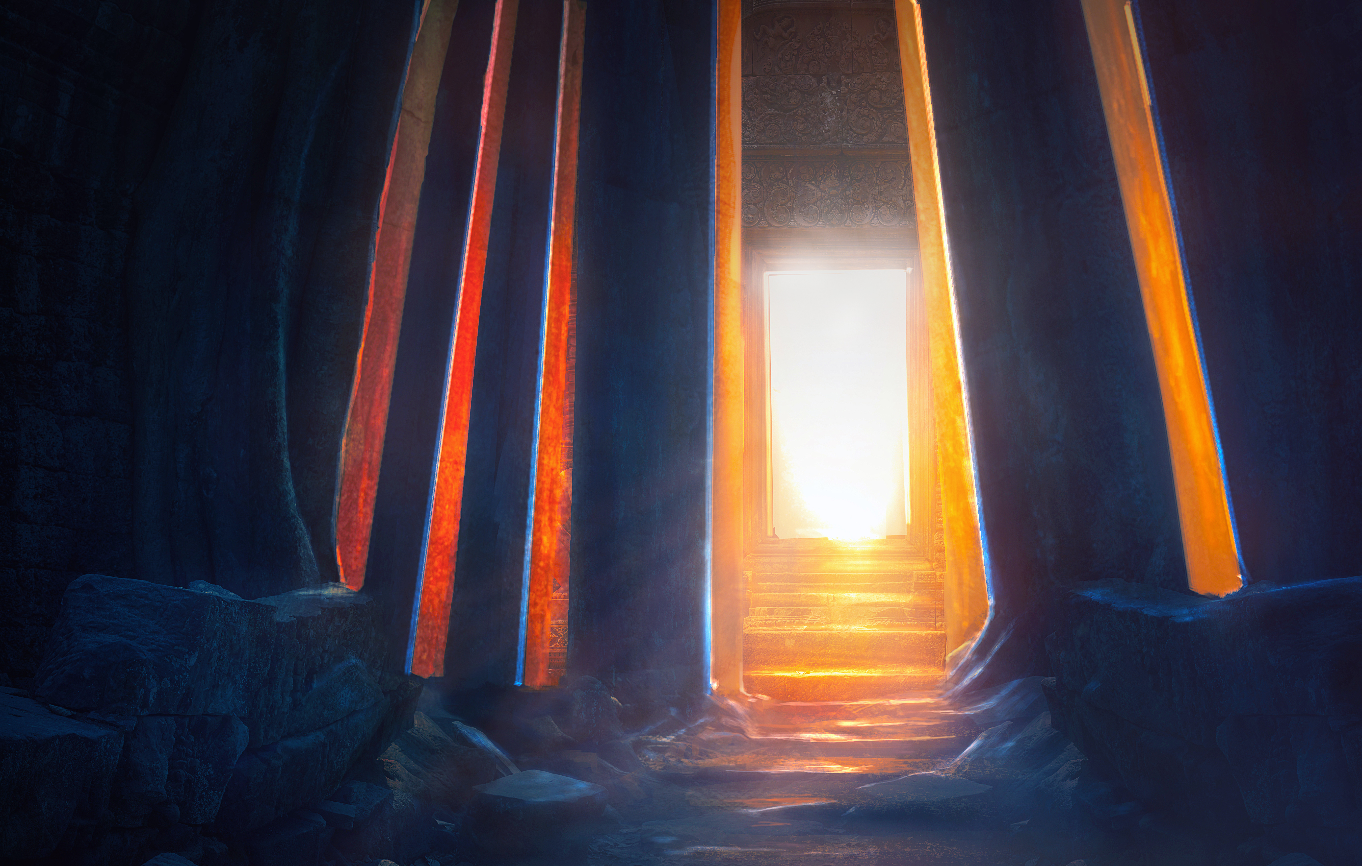
THE NARROW GATE
“Enter by…” (Matt 7:13) = To go in, it’s a verb
To enter something, is to do so intentionally, this does not happen accidentally
“… the narrow gate” (Matt 7:13)
Notes:
“Enter by…” (Matt 7:13) = To go in, it’s a verb - But it’s also a command. This is how Jesus begins the first of his four warnings - He doesn’t begin by giving the two gates, the two ways, and then say ‘pick this one.’ - Straight up, he wants to make it clear which one is the right one - Jesus isn’t saying make a good choice, Jesus is saying make the right choice - He doesn’t try and hide which gate we should enter through, rather he simply declares, “Enter by the narrow gate”
To enter something, is to do so intentionally, this does not happen accidentally - When you talk to people and you ask them, ‘Are you a Christian?’ they will give you a few responses - The first one ‘Yes, I am a Christian, I make sure I go to church every Sunday’, but going to church doesn’t make you a Christian - You might say, ‘I am a Christian, therefore I go to church’, not ‘because I go to church every Sunday, therefore I am a Christian’, for we are not saved by anything we do - Others may respond with ‘I grew up a Christian, I was raised in a Christian home, so yes I am a Christian’ - Or others will say, ‘Yes, I have been a Christian all my life’, but if we believe that the doctrine of original sin is true and biblical - That we were born into sin as a direct result of being born from the line of Adam, then it is a theological impossibility for us to have been a Christian all our lives - We can only enter the narrow gate intentionally, and the answer is simple - It is only by repentance and faith in Christ alone is one deemed a Christian, are we called a child of God - Now I don’t know about your kids, I have 3 kids, and not one of them was born repenting and believing, thus making it impossible for them to have been a Christian their whole life - I love my kids deeply, and my heart’s single greatest desire is to see them commit their lives to Jesus Christ, but they were not born repenting and believing “… the narrow gate” (Matt 7:13) - This gate is narrow, but I want discuss the gate first, before we look at this idea of narrowness - The gate is more of who than a what, the gate is Jesus Christ himself - In John 10:9, one of Jesus great I am statements, he declares that he is the door - In John 14:6 Jesus says, “I am the way, the truth, and the life, NO ONE comes to the Father except through me” - The gospel message culminates in the person and work of Jesus Christ - And so to enter by the narrow gate is to enter through Jesus - Jesus is saying, you can only enter this path through me, and by me, for there is no other way

Slide 4
The outstanding characteristic to which he calls us to is ‘narrowness’
There is no room for worldliness, no room for the baggage of your sin, it must be laid before Jesus
It is a narrow gate, but it is not a complex gate
Notes:
The outstanding characteristic to which he calls us is to ‘narrowness’ - Jesus is the gate, so it is narrow in that it is only through one person - The gospel of Jesus Christ openly and uncompromisingly announces itself as being something which starts with a narrow entrance - Jesus doesn’t apologise for this - Rather, he boldly proclaims it because he is not ashamed of the gospel - So too should our proclamation of the gospel be to the world. Unapologetic and unashamed
There is no room for worldliness, no room for the baggage of your sin, it must be laid before Jesus - The narrow gate calls for a denial of self, you cannot have the world and Jesus Christ, for there is no room for both through this narrow gate, it is one or the other - Jesus calls us to take up our cross, to be crucified with him, so that it is no longer I who lives but Christ who lives within me - We must be born again, for only those who are born again will enter the kingdom of God - Glory not in your riches or the things of this world, all of your wealth, all of your promotions, all of your reputations will not buy you a single paving stone in the streets of heaven - And only by casting our sins before the foot of the cross and by God’s forgiveness and grace are we given entrance through the narrow gate
It is a narrow gate, but it is not a complex gate - We are called to repentance and faith - We are urged to believe in Jesus Christ as Lord and Saviour, in childlike faith - Is it difficult, is it hard to enter through this gate? ABSOLUTELY, it is impossible apart from the grace of God - For it is only by grace, through faith, in Christ alone, that we are saved - It is only by a mighty working of the grace of God upon our hearts that we will die to self, that Christ might live in us, but that begins with repentance and faith - I was dead in my sin, I had no hope, and it was only as I gazed upon the cross of Jesus Christ and saw the greatest demonstration of mercy the world has ever known - It was on the cross of Jesus Christ that I saw my sins, I saw myself for what I was, a sinner, deserving, worthy of the wrath of God - But because of Christ and his sacrifice, and by the same power that raised Jesus from the dead, I have been born again, and by His grace, I LIVE , I live! - Believe in Jesus Christ, and you will be saved

Slide 5
THE WIDE GATE
“For the gate is wide…” (Matt 7:13b)
“And the way is easy…” (Matt 7:13c)
“That leads to destruction…” (Matt 7:13d)
Notes:
“For the gate is wide…” (Matt 7:13b) - This gate is wide, is does not ask anything of us, it does not demand anything of us - It is wide, it is inviting, it is tempting for all of us - But it is not just for the atheist or for the agnostic, or for the new age guru - Entering this gate is the Pharisees, the Sadducees, those who were religious - Those who thought they were honouring God, and thought they were living in accordance with His law, and yet were still dead in their sins - If you will recall, all the way through the sermon on the Mount Jesus is addressing those who would have considered themselves disciples - So he is asking us to test ourselves, for the wide gate will accept any doctrine, it will allow you to be the dictator of truth, for you decide for what is right and wrong - He is asking us, have we repented and believed in Jesus Christ as is written in Scripture, or are we believing in a Jesus that suits us, that suits our life. - And the evidence for this, as is mentioned in the following verses after this, is in our fruit, in our works - Because real, genuine, repentant faith will always produce good works, for it is Christ who will now live and work in us - But unless we place our faith in Jesus Christ, the Jesus Christ of the Bible, we will find ourselves entering the wide gate, and on the broad path - Romans 5:12 tells us, “Therefore, just as sin came into the world through one man, and death through sin, and so death spread to all men because all sinned” - We have all sinned, and we all fall short of God’s glorious standard and so apart from the grace of God and placing our faith in Christ alone, we have all entered the wide gate and are on the broad path
“And the way is easy…” (Matt 7:13c) - The word here for easy, means broad or spacious - ‘You do you’ is a phrase that the young people today like to use, meaning you do whatever makes you happy - And this statement is so true for whoever walks this road, it’s all about you - There is no one to tell you that what you are doing is wrong, and if they do, they are just a bigot, they are narrow-minded - And on this road, they believe that all roads lead to God, there cannot be only one way to God they say - We all just need to find the one that works for us, and let everyone just do their own thing - But Jesus is making it very clear that in this life, there are only 2 roads – Christ and his kingdom, and everybody else
“That leads to destruction…” (Matt 7:13d) - If you enter through the wide gate, tread the path that is easy, therefore dying without faith in Christ, there is a gulf fixed between you and heaven - Between heaven and hell there is no traffic, for none have ever passed from hell to heaven - And when you enter into eternal destruction, you will be like the rich man in the story of the rich man and Lazarus, begging for but a drop of water to cool your tongue - What’s even more terrifying than this, is there are preachers out there, who will not warn people of hell, who refuse to make people aware of the fact that they are sinners - They will preach an easy gospel, an easy salvation, offering only cheap grace - They will say God loves you so much, He sent Jesus to die for you, believe and receive, and you will be saved - But they won’t teach on the wrath of God, that the very reason Jesus came and died was for my sins, that God is a holy God, and He cannot tolerate sin - And so in this gospel, there is no talk of what we deserve, and so in the end, I’m left wondering, what is it that Jesus is saving me from exactly? - “Oh but isn’t the gospel good news, isn’t it a gospel of grace”, And to that I say, it is, IT IS ALL OF GRACE - But it is only when we understand the doctrine of sin do we begin to truly understand the magnitude of God’s grace - It is only when we understand that we deserved destruction that we begin to comprehend the grace of God - That there is nothing sweeter in this universe than the grace of God - If we will not preach the whole gospel then we are offering people a false sense of security, thinking they are on the way to life, when we are preaching them right into hell

Slide 6
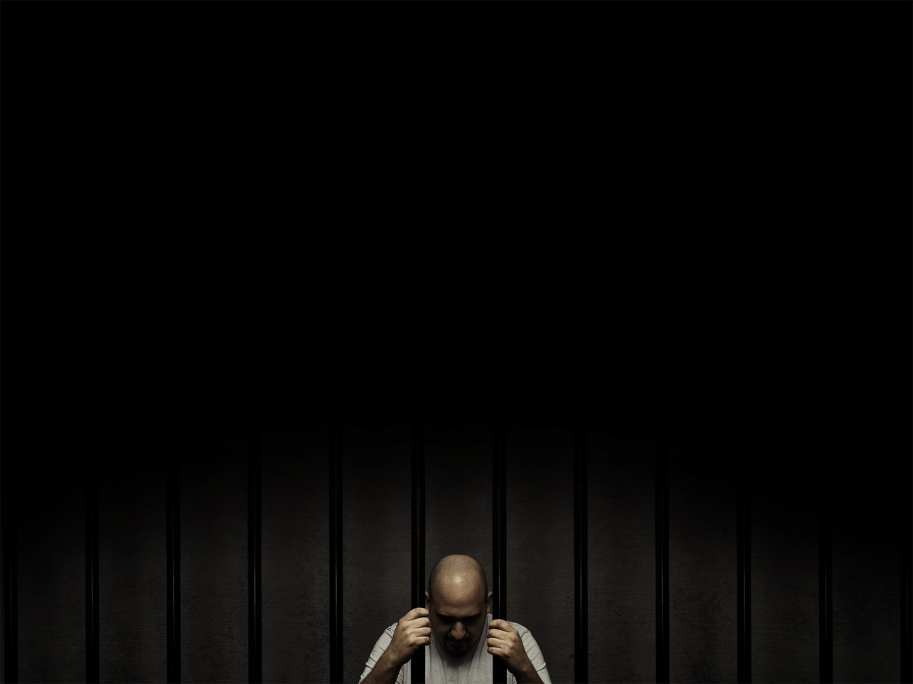
People cry out for justice, “If God is a good God, then He wouldn’t send me to hell”
“And those who enter by it are many” (Matt 7:13e)
“If sinners be damned, at least let them leap to Hell over our dead bodies. And if they perish, let them perish with our arms wrapped about their knees, imploring them to stay. If Hell must be filled, let it be filled in the teeth of our exertions, and let not one go unwarned and unprayed for.” Charles Spurgeon
Notes:
People cry out for justice saying things like, “If God is a good God, then He wouldn’t send me to hell” - The world would change this verse to read, ”For the gate is wide, and the way is easy that leads to life, and those who enter by it are many - They are correct in assuming God’s goodness, but the problem is that we are not good, and God will not tolerate that which isn’t completely an utterly good - But the world seems to think that most people are good and therefore deserve heaven and that hell is only reserved for the Adolf Hitler’s of the world - The world believes most people are good because there is no fear of God in their eyes - And so because they believe they are good they cry out for justice! But if we get justice, we all die - But God in His mercy sent Jesus Christ, who is the only truly good person to ever live, he lived the perfect life, paid the price for my sins, satisfied the wrath of God - So that God could be both just and the justifier of the one who places faith in Jesus Christ
“And those who enter by it are many” (Matt 7:13e) - All of us by default, having been born in sin find the broad and wide gate - Those who venture forth on this road are all around us - So many people cling tight to their sin, they will not let it go, and while they cling to their sins, they cannot have Christ - For many of us here we have friends, neighbours, family members, all who are venturing towards destruction - So we need to keep praying, keep preaching the gospel, keep pointing to the narrow gate that they may find it, because…
“If sinners be damned, at least let them leap to Hell over our dead bodies. And if they perish, let them perish with our arms wrapped about their knees, imploring them to stay. If Hell must be filled, let it be filled in the teeth of our exertions, and let not one go unwarned and unprayed for.” Charles Spurgeon - Brothers and sisters, those who have entered through the narrow gate, our king has given us a royal decree - He has given us a great commission to go and make disciples of all nations. - We do not get to decide who is saved, we do not get to force people through the narrow gate - But God has given us a gospel that can break even the hardest hearts, so preach it to them, pray for them - For a time is coming when our king will return to judge all of mankind

Slide 7
THE NARROW WAY
”For the gate is narrow and the way is hard” (Matt 7:14a)
Self cannot exist on this path, for we must deny ourselves daily
Christ has gone before us, and as you look up it is Christ who goes with us
Notes:
For the gate is narrow and the way is hard” (Matt 7:14a) - We have already looked at the fact that the gate is narrow - But not only is the gate narrow, but the way is hard - The word here for hard in the Greek means compressed. Elsewhere in Scripture it is also used as distress, affliction, and persecution - Jesus doesn’t sugar coat, he simply presents the truth. - Jesus is saying, this is the gate I want you to enter, and if by the grace of God you do, this life is going to be hard, there is going to be pain, there will be suffering, and you will be persecuted - Acts 14:22 says “that through many tribulations we must enter the kingdom of God” - In 2 Timothy 3:12 says, “Indeed, all who desire to live a godly life in Christ Jesus will be persecuted” - Suffering and persecution are part and parcel with belonging to Jesus Christ and his kingdom. - Because the darkness will always hate the light, it cannot stand it, but it will not win, because in Christ we are already guaranteed victory - And because it is hard, because there will be pain and suffering…
Self cannot exist on this path, for we must deny ourselves daily - Because if we are truly seeking what we want in our sinful flesh, we would never seek pain, suffering and persecution -It is as though there is a notice at the front of the narrow gate saying – ‘Leave self outside’ - Jesus tells us that if anyone would come after him, they must first deny themselves - How can we bless them that curse us, how can we love our enemies - We cannot do that, only Christ can do that in us and through us - So we must leave self outside, we must die to ourselves, the old man must be crucified with Christ - It will be difficult, it is narrow all the way, but it is the most glorifying, and soul satisfying thing a person can do, to go on following Christ all the days of their life
Christ has gone before us, and as you look up it is Christ who goes with us - Christ has lived the perfect life, he knows what you’re going through - He suffered more than any one of us ever could even imagine - We have a great high priest who can sympathise with us, who knows the struggles, the only difference is he did it without sinning - So not only did he go before us, but Christ promised to be with us until the end of the age. He ascended to the right hand of the Father, where he is forever interceding for us - And sent the third member of the Godhead, the Holy Spirit, to come and dwell inside of all God’s children - So that when you fail, when you feel weak, he will be right there urging us onward to glory - He will pick us up, he will be our comforter. - And when we sin in this life, while on the narrow way, the Holy Spirit will convict us and will not leave us in sin, he will always bring us back to the foot of the cross, and lead us back into the arms of our heavenly Father through repentance - And when we ask for forgiveness of our sins, we have an advocate in Jesus Christ, who is faithful and just to forgive us our sins - So look up dear Christian, look up and remember Jesus Christ goes with you - Is there a greater privilege than to know that you get to spend the rest of your days walking with your Lord and Saviour - If there were no other reward for entering this gate, and walking this road, that would be more than enough

Slide 8
“That leads to life” (Matt 7:14b)
“And those who find it are few” (Matt 7:14c)
There is only one gate that leads to life, and it is in the shape of a cross
Notes:
“That leads to life” (Matt 7:14b) - So not only has Christ gone before the Christian, and goes with the Christian - But look ahead, look by faith, and there you will see Jesus Christ, waiting to welcome you into presence of God, waiting for the day that you receive your commendation, “Well done good and faithful servant” - Happy is the person who has Christ, for not only do we receive salvation, and are we pardoned from our sins, but we find rest in Christ, we discover true joy and gladness, peace, contentment, and abiding satisfaction - And because we know that eternal glory awaits us, for it is promised to the child of God, we can echo Paul’s words to the Philippians, “to live is Christ and to die is gain” - Yes the gate is narrow, yes the way is hard, but hang on, because at the end of this road there is life
“And those who find it are few” (Matt 7:14c) - You will not find many on this path, you will feel lonely at times, but take heart, there are others - That’s why the church was established by God, that we might meet together and spur each other on, encourage one another, pray for one another - That we might be reminded that we are not alone. - That is why we are commanded not to forsake the gathering, because it is good for us to meet with the family of God, and it is good for us to be edified through the preaching of God’s Word - Following Christ has always been unpopular, Christians have always been in the minority - But if God is on our side, then who can stand against us, what can separate us from His love? - Nothing, for we are more than overcomers in Christ
There is only one gate that leads to life, and it is in the shape of a cross - Christian, you will suffer, just as Christ suffered, you will be persecuted, there will be pain, - But Jesus Christ suffered and died, dealing with the penalty of sin, and rose from the grave on the third day, defeating death and in doing so defeating the power of sin - Until one day Jesus will return and he will call us home, and on that day the very presence of sin will be no more and we will be glorified, and enter into the joy of our Master

Slide 9
SUMMARY
In closing his sermon, Jesus simply lays out the truth, he puts the choices before us, life or death?
A wide gate, an easy road, many companions, destruction
A narrow gate, a hard road, marked with pain, suffering and persecution, few companions, life
Notes:
In closing his sermon, Jesus simply lays out the truth, he puts the choices before us, life or death? - He gives us the two choices, but Jesus does not leave us guessing which one is the right one, he says enter by the narrow gate - Jesus has been building up to this point of the sermon - And Jesus turns to his congregation, he turns to the crowd that has been listening all this time and says, “Well there is my purpose, this is what my kingdom looks like and those who belong to it. So what are you going to do about it? - Here’s the 2 choices…
A wide gate, an easy road, many companions, destruction - To all those who are on this path, who are still dead in their sins and venturing forth on this road - I pray that God would give you no rest until you have gone beyond the dangers of hell and been born again into the family of God - And if you will repent and believe then you will have made the right choice entering by…
A narrow gate, a hard road, marked with pain, suffering and persecution, few companions, life - Repent and believe in the gospel, and in doing so take heart my brothers and sisters - For you do not walk alone, though we are few in number, God almighty walks with us, and dwells inside of us - For all those who have entered by the narrow gate are saved at once, and one day when we pass through death, we will enter the gates of heaven unchallenged, walk the streets of gold unashamed, and bow before our heavenly Father without fear of condemnation, for the Christian is free in heaven, they are at home in Jesus Christ

Slide 10
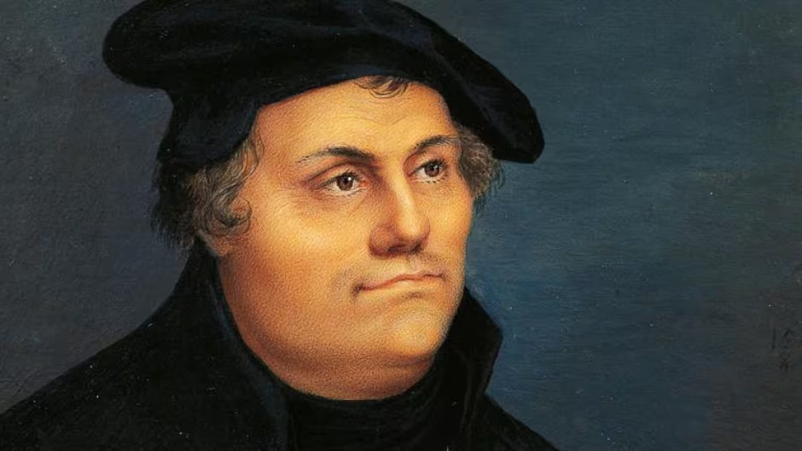
"The life of Christianity consists of possessive pronouns" says Martin Luther. It is one thing to say, "Christ is a Saviour"; it is quite another thing to say, "He is my Saviour and my Lord." The devil can say the first; the true Christian alone can say the second.”
Notes:
"The life of Christianity consists of possessive pronouns" says Martin Luther. It is one thing to say, "Christ is a Saviour"; it is quite another thing to say, "He is my Saviour and my Lord." The devil can say the first; the true Christian alone can say the second.”
Can you declare today that Jesus Christ is your Lord and Saviour?
If not, then I urge you, do not let another minute pass by without repenting and believing in Jesus Christ
If you will look to Jesus Christ as your only hope of being saved from your sins, God will not turn you away
If you can say that Jesus is your Lord and Saviour, if you are a child of God, then know this.
Christ goes has gone before you, he goes with you, and he awaits you at the end of this road, where we will enter into his presence forever
Let us leave this place with joy in our hearts and the message of the gospel on our lips, for it is only the message of Jesus Christ and him crucified that has the power to save

