Slide 2
The Friends of Israel Gospel Ministry is a worldwide evangelical ministry proclaiming biblical truth about Israel and the Messiah, while bringing physical and spiritual comfort to the Jewish people
We are committed to teaching how scripture reveals…
God’s love for Jewish people
The Biblical significance of the Land of Israel

Slide 3
We do this through:
Speaking / teaching in local churches
Books and other resources
Our bi-monthly magazine, Israel My Glory
Prophecy conferences
Study tours to the Holy Land
Reaching out in love to Jewish people
“Backpacker ministry”
MORE INFORMATION: foiaustralia.org

Slide 4
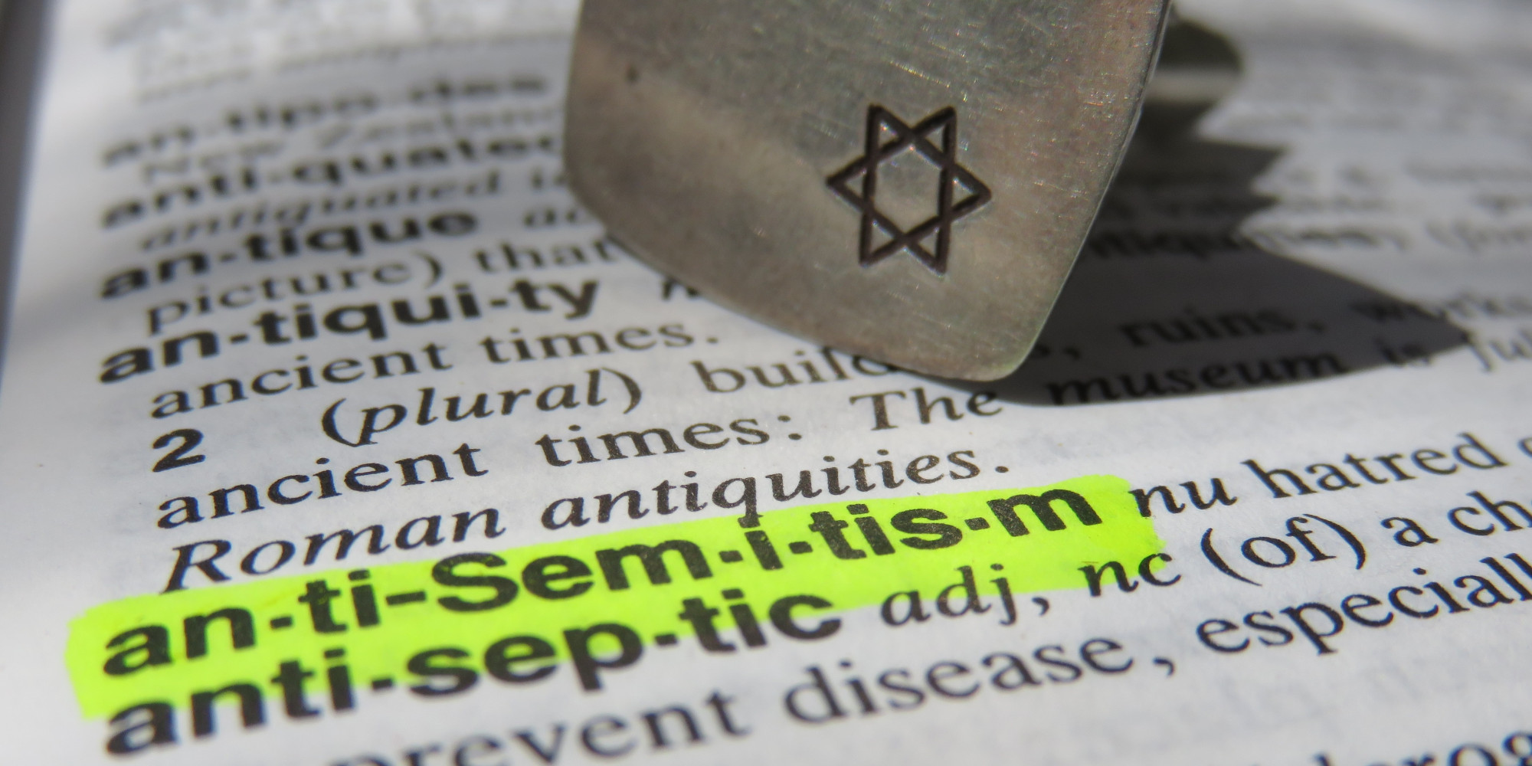
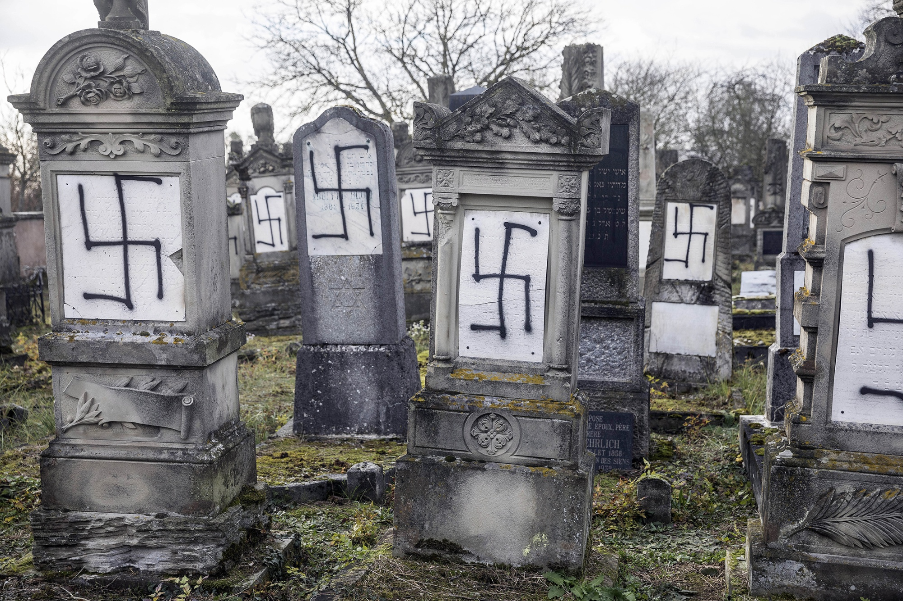
ANTISEMITISM
“The World’s Oldest Hatred”

Slide 5
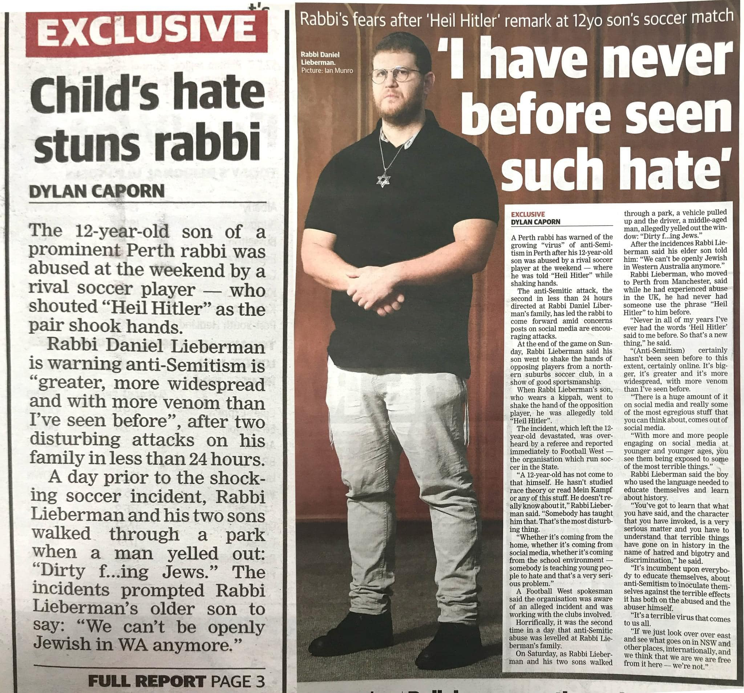
Perth WA
May 2024

Slide 6
ANTISEMITISM
… any bias, discrimination, persecution, hostility, or act of violence against Jewish people just because they are Jews

Slide 7
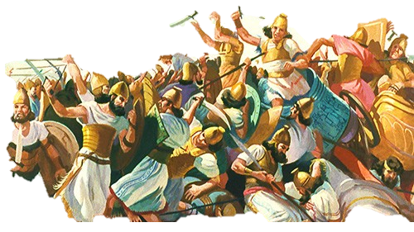
Psalm 83:1-4 – Asaph
“Do not keep silent, O God! Do not hold Your peace, do not be still, O God! For behold, Your enemies make a tumult; and those who hate You have lifted up their head. They have taken crafty counsel against Your people and consulted together against Your sheltered ones. They have said, ‘Come, and let us cut them off from being a nation, that the name of Israel may be remembered no more.’”

Slide 8
ALL THE LAND from the Jordan River on the East through to the Mediterranean Sea in the West, belongs ONLY to Palestinian Arabs.

Slide 9
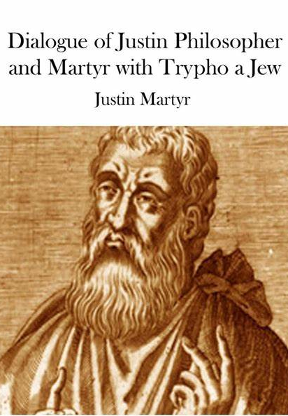
… any gifts of God's favour that formerly may have been directed towards the Jews, have now been transferred to the Church
100-165 AD
… Jews were murderers of Jesus for which they were doomed forever to exile and subordination

Slide 10
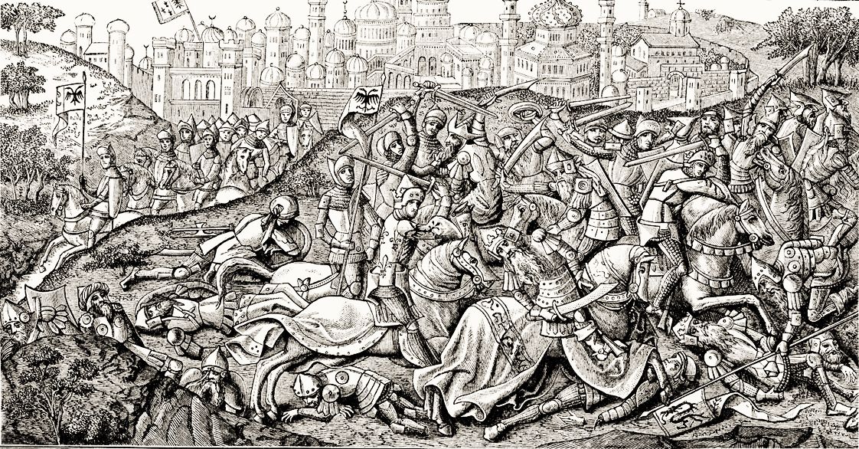
“Jewish Infidels” living in Christian territories, especially in the Rhine and Danube valleys, were slaughtered and pillaged

Slide 11
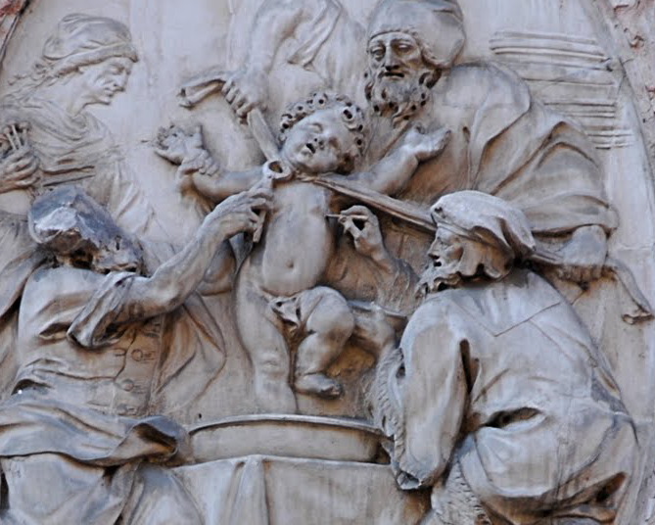
Palazzo Salvadori in Trento, Italy “Martyrdom of Simon of Trent”
… a false accusation “BLOOD LIBEL”

Slide 12
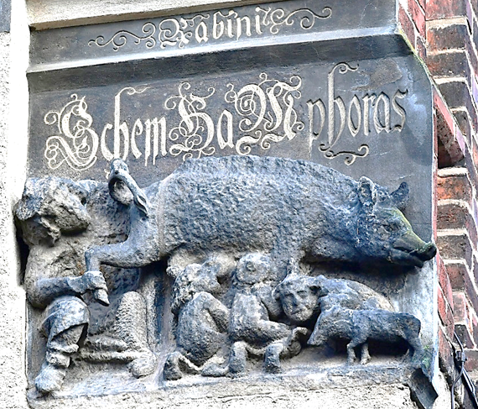
4m high carving from late 13th Century Wittenburg Church in Germany

Slide 13
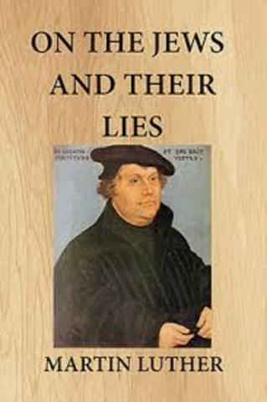
“… set fire to their synagogues or schools…
“… their houses… be razed and destroyed.
“… prayer books and Talmudic writings… taken
“… rabbis be forbidden to teach…on pain of loss of life and limb.
“… safe-conduct on the highways be abolished completely for the Jews.

Slide 14
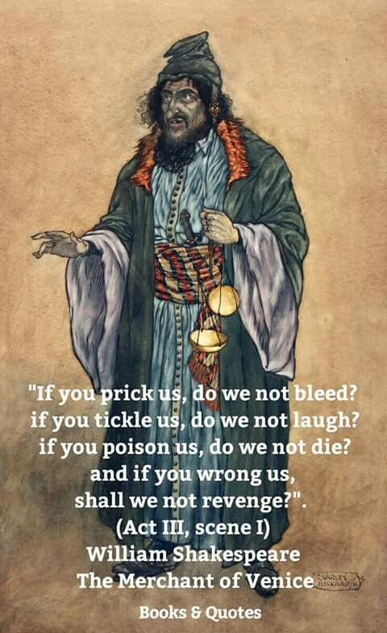
Shylock was characterised as sly, greedy and a cheat.

Slide 15
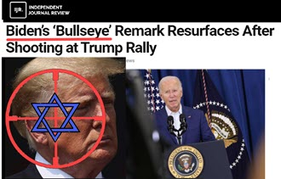
Antisemitism by extreme right-wing agitator!
Dr. David Duke: The Zionist Deep State Desperately Tries to Assassinate Trump!
Don’t be fooled, the Zionist Jewish Supremacist Elite has always hated Donald Trump. They hate his immigration stance, they hate his proposed friendship with Christian Russia. They hate him and led his impeachment.

Slide 16
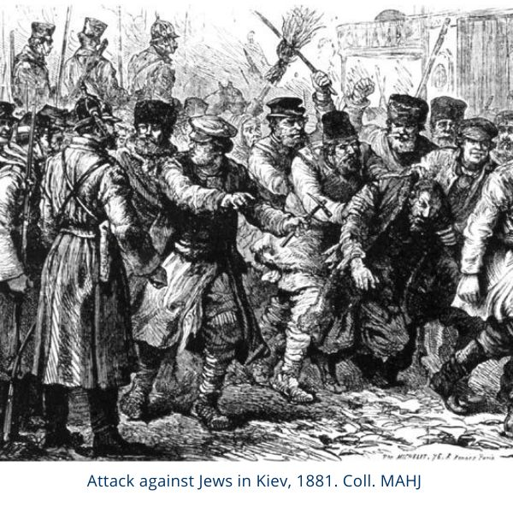
From the 1880’s – 1920’s
Russian POGROMS
“POGRAM” means “to wreak havoc”

Slide 17
Alfred Dreyfus was falsely accused as a traitor selling military secrets to the Germans.
As a Jew, prejudice against him provided the distrust necessary to ensure a conviction.

Slide 18
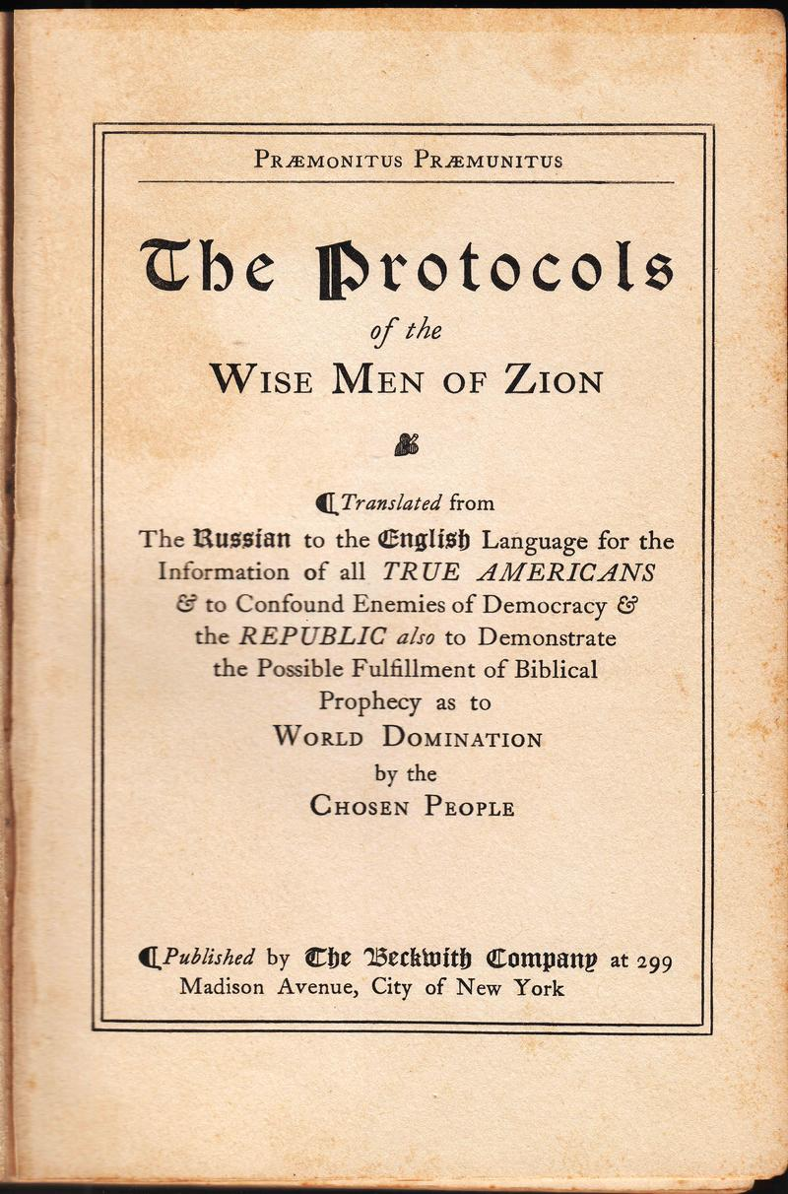
… purports to be the minutes of meetings held secretly by Jewish wise men plotting to control the world.
Conspiracy theorists over the last century have fed on its lies
FORGERY plagiarised from French satire
This edition: 1920

Slide 19
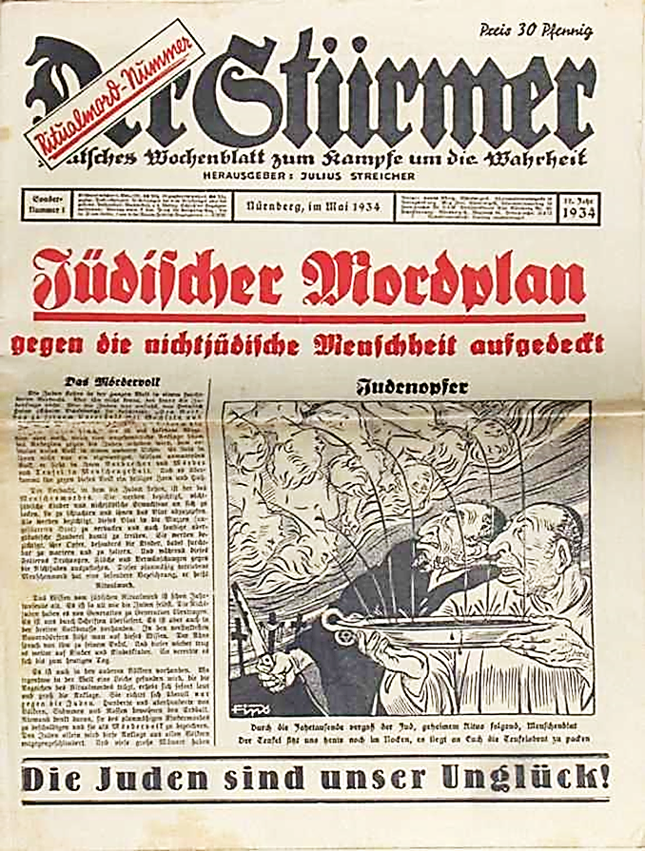
1934
Jewish Murder Plan
against non-Jewish mankind
The Jews are our misfortune
Image depicting BLOOD LIBEL

Slide 20
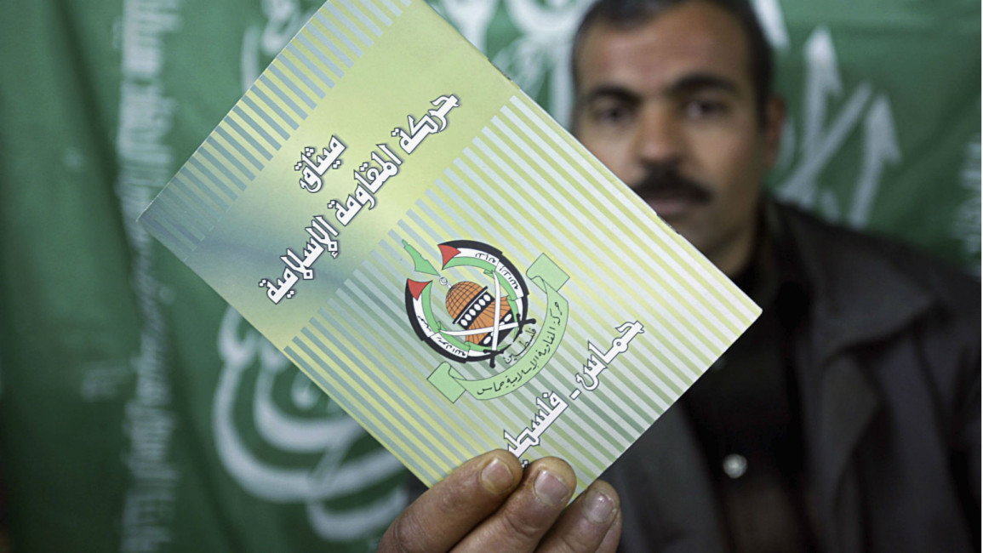
HAMAS charter
The original, 1988 version of the HAMAS charter emphasises four main themes:
# Destroying Israel and establishing an Islamic theocracy in Palestine is essential;
# Unrestrained jihad is necessary to achieve this;
# Negotiated resolutions of Jewish and Palestinian claims to the land are unacceptable;
# Historical antisemitic tropes that reinforce the goals.
The Covenant proclaims that Israel will exist until Islam obliterates it, and jihad against Jews is required until Judgement Day. Compromise over the land is forbidden…

Slide 21
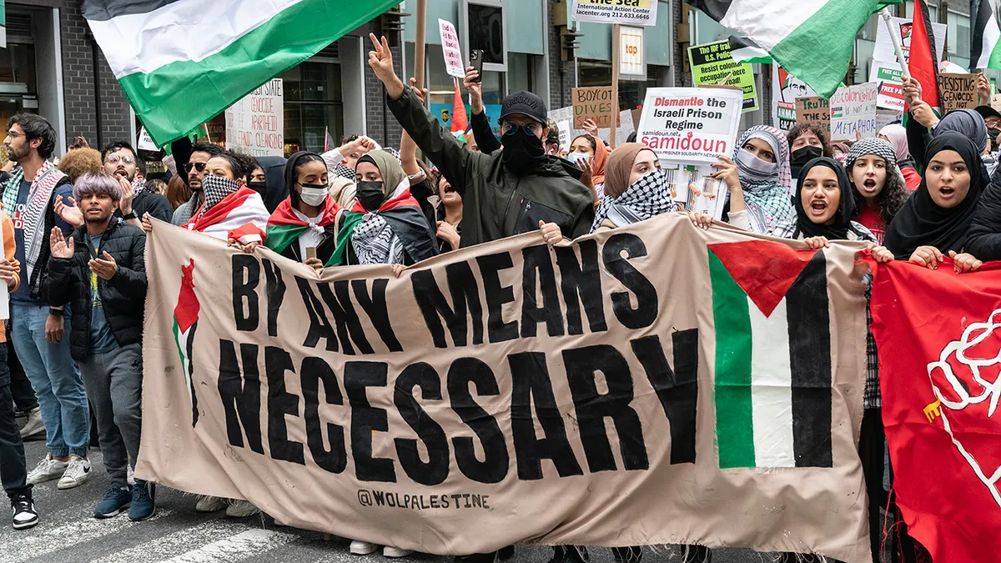
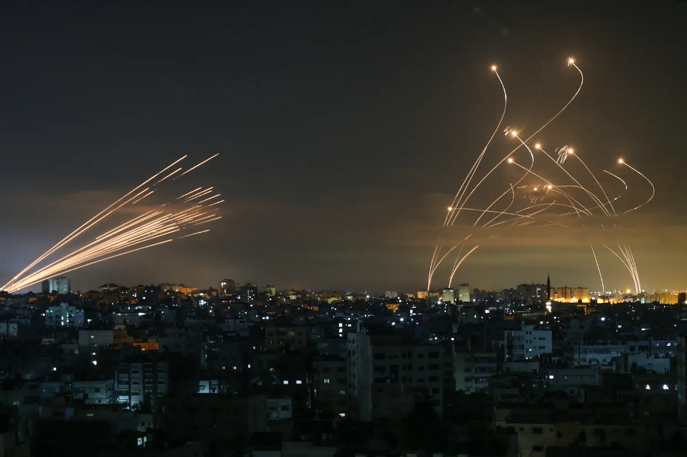
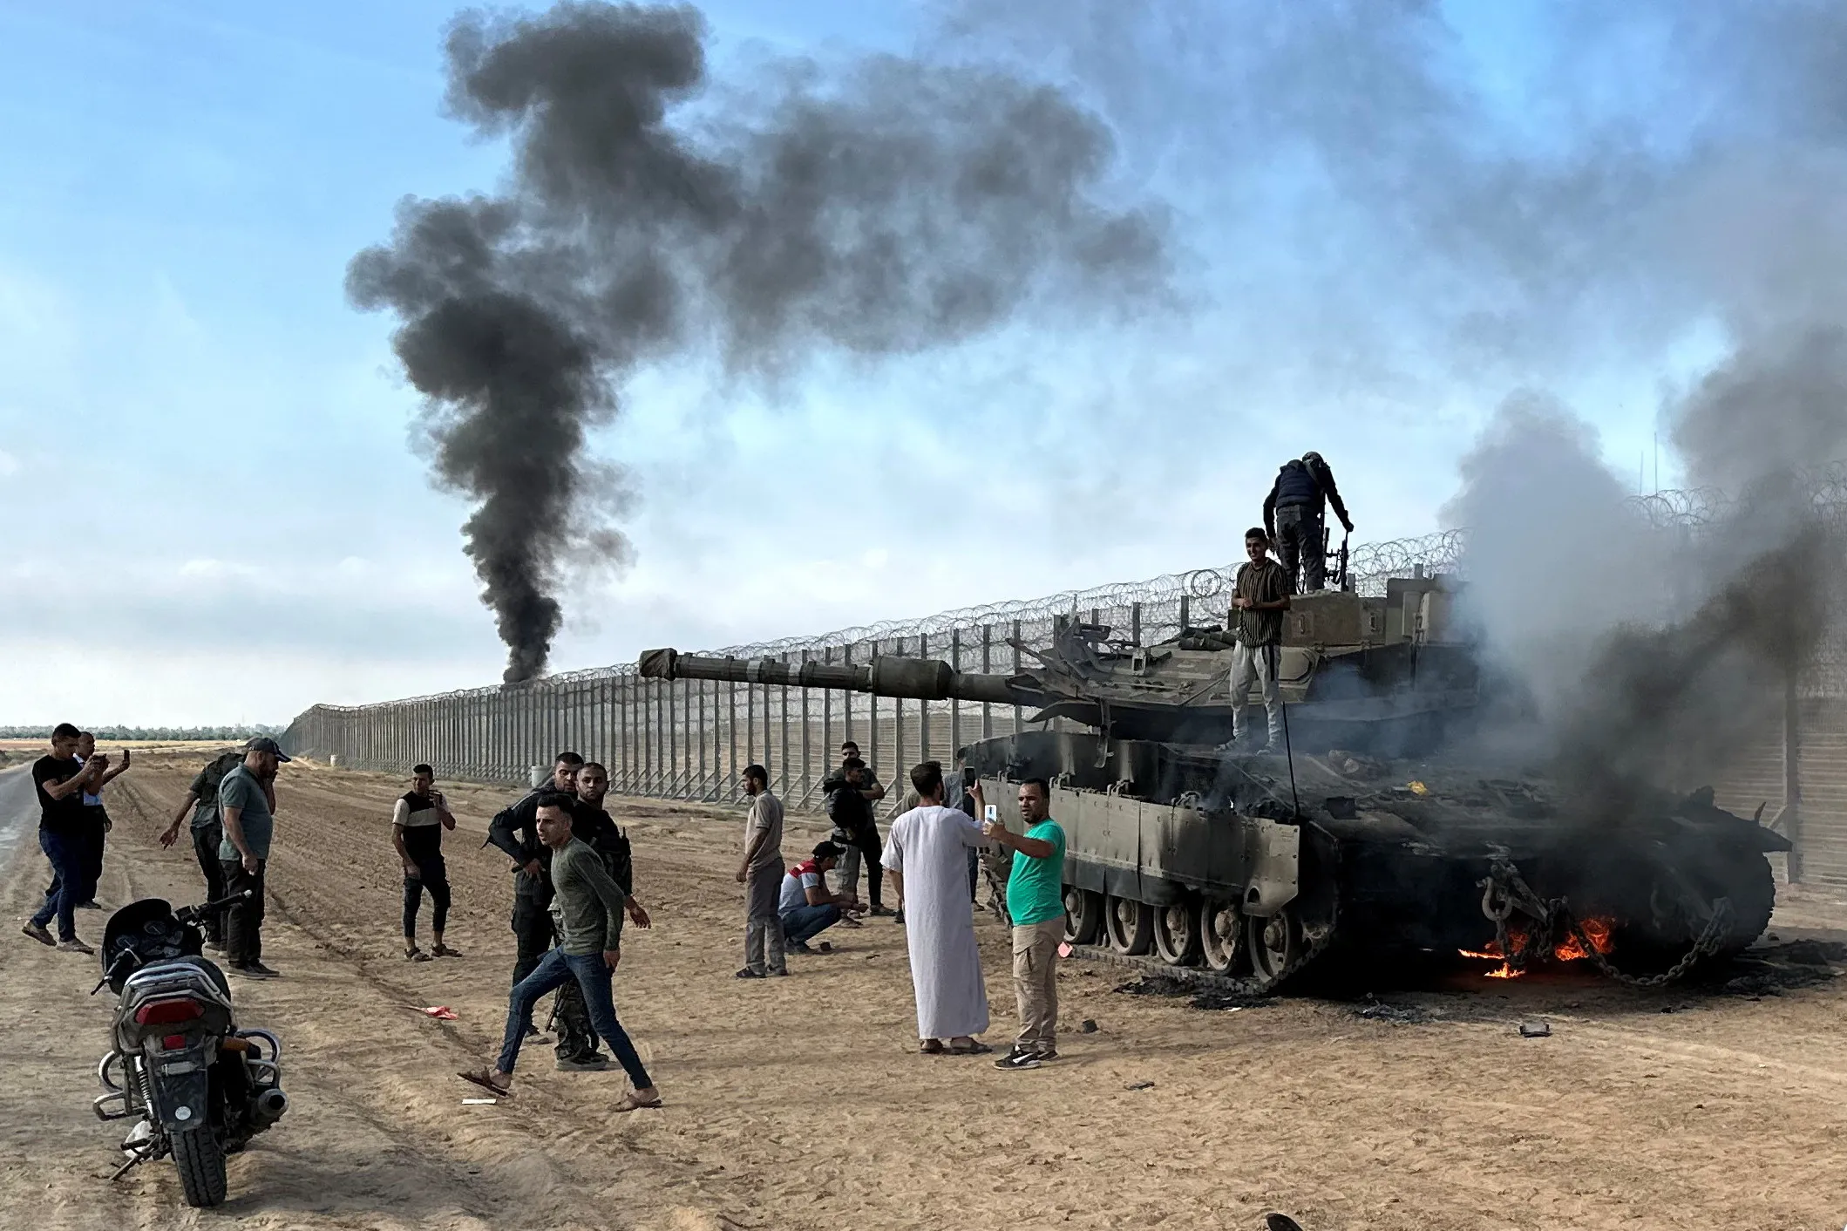
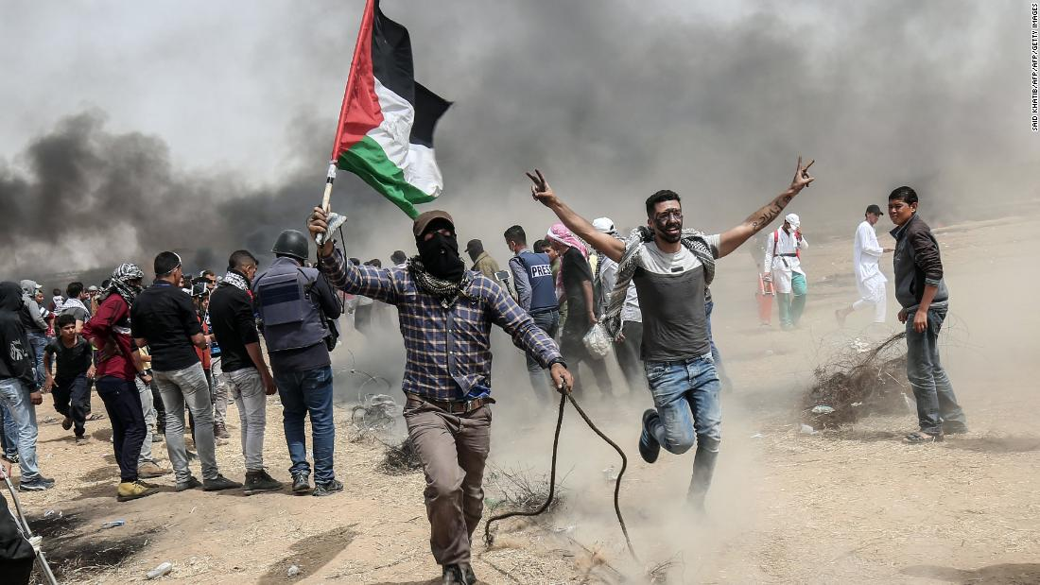
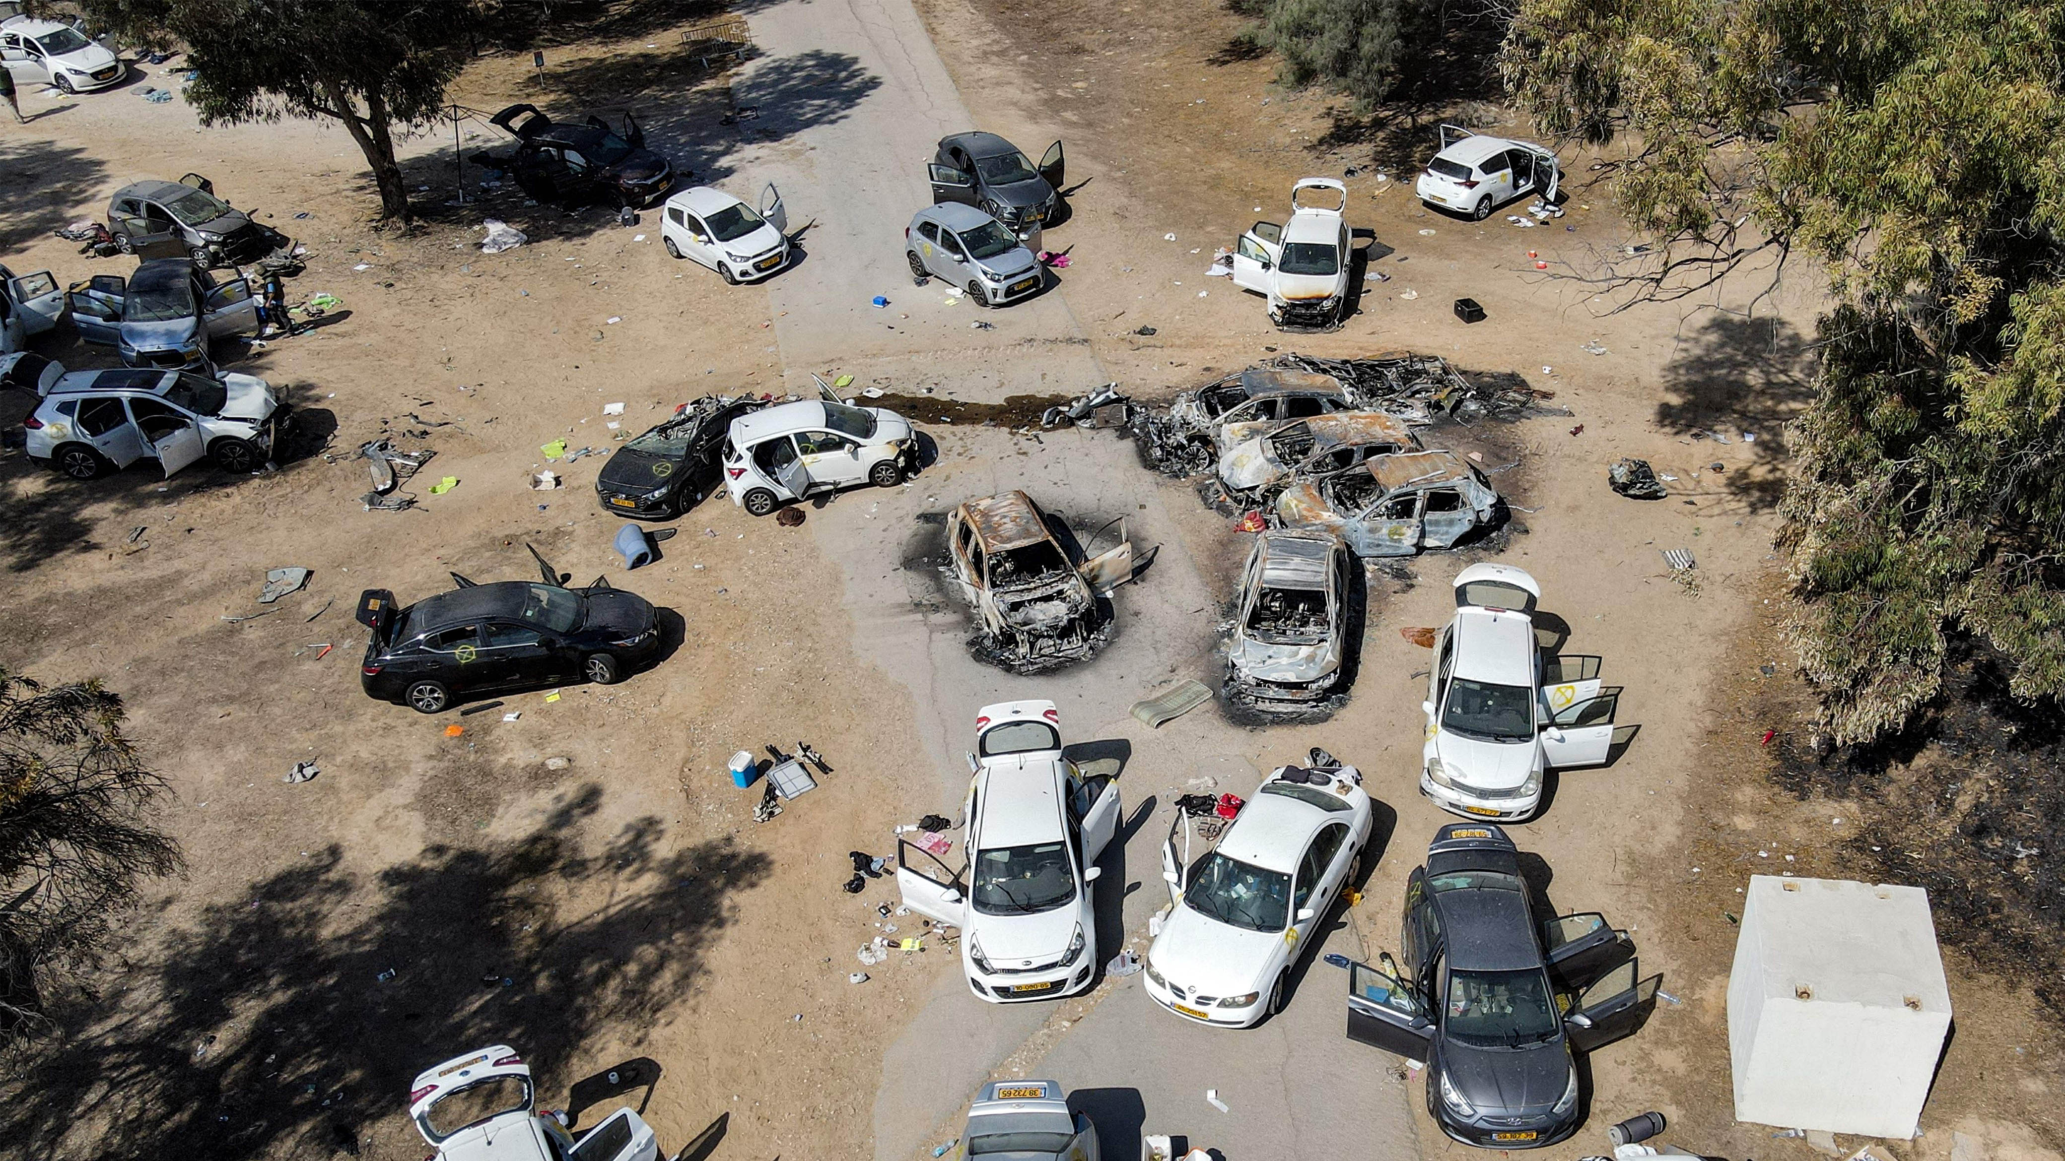

Slide 22
At its core, ANTISEMITISM is a Satanic attack on God’s eternal plan of salvation through the Jews.
Pharoah’s plan TO KILL Hebrew boys in Egypt
Balak tried to get Balaam TO CURSE Israel
Haman sought TO ANNIHILATE the Jews
Herod tried TO MURDER baby Jesus
Religious leaders call for JESUS’ CRUCIFIXION
Jews were PERSECUTED, HUNTED, EXPELLED and KILLED - the HOLOCAUST

Slide 23
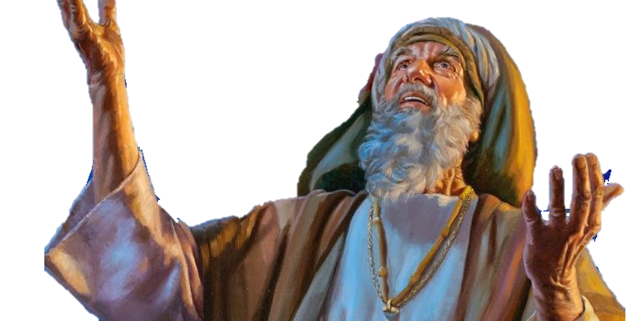
God’s view of the Jews is very different from that of the world or of Satan!
Gen 12:1-3
“GET OUT OF YOUR COUNTRY, from your family and from your father’s house, to a land that I will show you.
I WILL MAKE YOU A GREAT NATION;
I WILL BLESS YOU AND MAKE YOUR NAME GREAT; and you shall be a blessing. ³ I will bless those who bless you, and I will curse him who curses you; and IN YOU ALL THE FAMILIES OF THE EARTH SHALL BE BLESSED.”

Slide 24
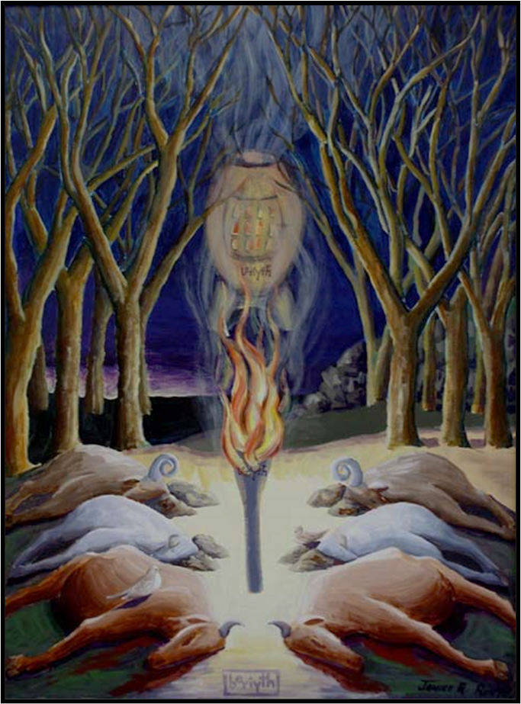
God’s view of the Jews is very different from that of the world or of Satan!
Gen 15
God UNILATERALLY confirmed His promises to Abram WITH AN UNCONDITIONAL COVENANT which clearly defined the land He had given them FOREVER
Deut 7:6 & 14:2
“…you are A HOLY PEOPLE to the Lord your God; the Lord your God has CHOSEN YOU to be a people for Himself, A SPECIAL TREASURE (segullah) above all the peoples on the face of the earth.”

Slide 25
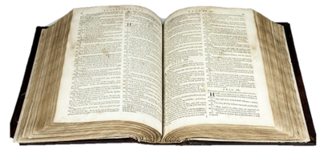
God’s view of the Jews is very different from that of the world or of Satan!
Jer 31:35-37
Thus says the Lord, who gives the sun for a light by day, the ordinances of the moon and the stars for a light by night, Who disturbs the sea, and its waves roar (The Lord of hosts is His name) ³⁶ “IF those ordinances depart from before Me, says the Lord, THEN the seed of Israel shall also cease from being a nation before Me forever.” ³⁷ Thus says the Lord: “IF heaven above can be measured, and the foundations of the earth searched out beneath, I WILL also cast off all the seed of Israel for all that they have done, says the Lord.”

Slide 26
God’s view of the Jews is very different from that of the world or of Satan!
Zech 2:8
David Levy:
God’s love for Israel is UNCONDITIONAL (Deut 7:6-8), UNFAILING (Isa 63:9), and UNENDING (Jer 31:3). Israel will be PRESERVED as long as the world exists (Jer 31:35-37)

Slide 27
WHEN WILL ANTISEMITISM END?
With the establishment of the Millennial Kingdom, and the binding of Satan, Israel will finally find the peace it has long sought with the “Prince of Peace” reigning from Jerusalem.
In the coming Kingdom, Jews will even be sought after:
Zechariah 8:23 “Thus says the Lord of hosts: ‘In those days ten men from every language of the nations shall grasp the sleeve of a Jewish man, saying, “Let us go with you, for we have heard that God is with you.” ’ ”

Slide 28
So, what can we do?
PRAY FOR the PEACE OF JERUSALEM and the PEOPLE of ISRAEL
PRAY AGAINST both the work of SATAN and the evil of TERRORISM against God’s People
STAND AGAINST ANTISEMITISM in all its forms
ENCOURAGE individual JEWISH PEOPLE and demonstrate your support for them
TEACH your children to LOVE WHAT GOD LOVES!

