Slide 1
Judging Others
7 “Do not judge, or you too will be judged. ² For in the same way you judge others, you will be judged, and with the measure you use, it will be measured to you.

Slide 2
³ “Why do you look at the speck of sawdust in your brother’s eye and pay no attention to the plank in your own eye? ⁴ How can you say to your brother, ‘Let me take the speck out of your eye,’ when all the time there is a plank in your own eye? ⁵ You hypocrite, first take the plank out of your own eye, and then you will see clearly to remove the speck from your brother’s eye.

Slide 3
⁶ “Do not give dogs what is sacred; do not throw your pearls to pigs. If you do, they may trample them under their feet, and turn and tear you to pieces.

Slide 4
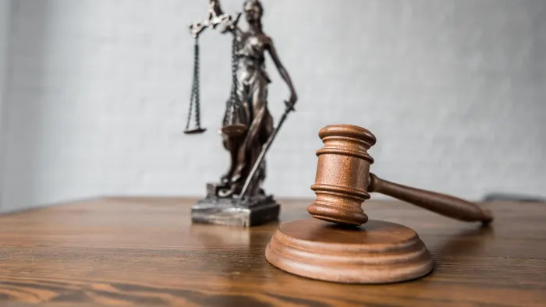
To Judge or Not To Judge
Matthew 7: 1 - 6

Slide 5
Are Christians Judgemental?
A gay couple moves into a new apartment, and discovers they are neighbours with three Christian individuals.
The first Christian neighbour, after talking with the new couple, regularly avoids eye contact and rushes out of the complex.
The second Christian neighbour, while talking with the couple, angrily denounces their lifestyle and 'draws' a relational 'line in the sand’.
The third Christian neighbour, while talking with the couple, is pressed about his beliefs, and states clearly that he believes homosexual acts are contrary to God's desires and design.
Notes:
Think about this scenario, and tell me which of these three self-described Christians is being judgemental:

Slide 6
Are Christians Judgemental?
A gay couple moves into a new apartment, and discovers they are neighbours with three Christian individuals. The first Christian neighbour, after talking with the new couple, regularly avoids eye contact and rushes out of the complex. The second Christian neighbour, while talking with the couple, angrily denounces their lifestyle and 'draws' a relational 'line in the sand'. The third Christian neighbour, while talking with the couple, is pressed about his beliefs, and states clearly that he believes homosexual acts are contrary to God's desires and design.
So who is being judgemental here?
Notes:
AND I WILL LEAVE TO YOU TO BE THE JUDGE AND MAKE UP YOUR OWN MIND AT THE END OF THE MESSAGE

Slide 7
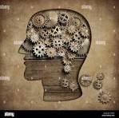
Psychologists describe the phenomenon of "projection," defined as "the attribution of one's own ideas, feelings, or attitudes to other people or to objects; especially, the externalisation of blame, guilt, or responsibility as a defence against anxiety.
Notes:
We saw a sad example of this a number of years ago when televangelist Jim Baker's sexual sins were exposed. Who was one of the loudest critics? Televangelist Jimmy Swaggart, whose own sexual sins were exposed a few months later. Those who are most critical tend to be those who condemn themselves for the very same sins. In condemning others, they are affirming their self-condemnation and self-loathing.

Slide 8
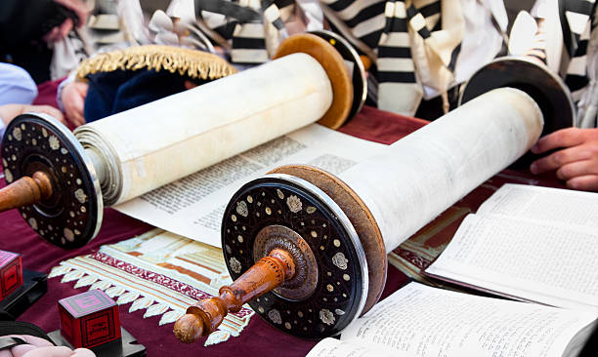
In Judaism, the pain of shaming is considered more bitter than death. This is reflected in the teaching that one should rather fling himself into a fiery furnace than humiliate someone in public Living with shame and humiliation is viewed as worse than death, for the dead no longer endure the burden of shame.
(Talmud, Bava Metzia 59a).
Notes:
The Hebrew term Talmud (“study” or “learning”) commonly refers to a compilation of ancient teachings regarded as sacred and normative by Jews from the time it was compiled until modern times and still so regarded by traditional religious Jews.

Slide 9
Is there such a thing as not judging
“We may be taught not to judge a book by its cover, but when we see a new face, our brains decide whether a person is attractive and trustworthy within a tenth of a second.” This “first impression” mechanism is not inherently bad; it’s part of our innate survival instinct and ability to identify dangers quickly.
Princeton University Research
Notes:
In reality, there’s no such thing as not judging. We all judge everything, all the time, instantly. It’s how we are created, and it’s scientifically proven.
As the university study suggests, it is a survival instinct, inherently built into us. Without it all manner of calamities have the potential to harm us.

Slide 10
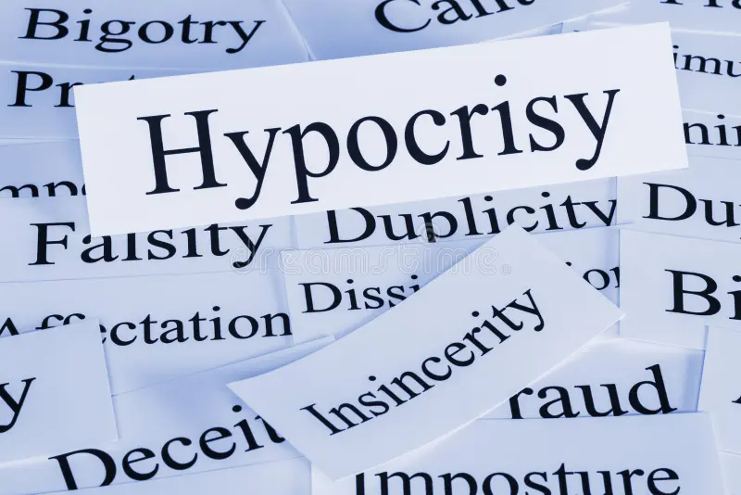
Church hypocrisy
The Church harbours within itself so much;
Hatred,
Strife,
Judgement,
Enmity,
Corruption,
Sexual Sin,
Mental and Emotional Abuse,
Pride,
Injustice,
False Teachings, and
Many Other Evils.
Notes:
I’m reminded of the tendency within the Church to judge the world outside despite the Church’s own flaws.
There is a reason there are about 40,000 sub-denominations in Christianity. It’s because the Church can’t even get along with itself.

Slide 11
Church Hypocrisy
The Church harbours within itself so much;
Hatred,
Strife,
Judgement,
Enmity,
Corruption,
Sexual Sin,
Mental and Emotional Abuse,
Pride,
Injustice,
False Teachings, and
Many Other Evils.
You, therefore, have no excuse, you who pass judgement on someone else, for at whatever point you judge another, you are condemning yourself, because you who pass judgement do the same things. (Romans 2: 1)
Notes:
Yet, its focus often lies outside, on how “evil and messed up” the world is.
Secular people don’t try to act as if they embody righteousness and holiness; religion does.

Slide 12
V. 1 - 2
Don’t judge does Not mean don’t think
Do not be the judge.
Do not use your own opinions and thoughts and standards to judge others.
God is the judge.
God is the one who decides what is right and wrong, not you.
This means you should not use your own ideas to judge other people.
Notes:
Some would make the ludicrous claim that Jesus himself never judged people's actions as evil while he was on earth.
Jesus does not require us to suspend our critical faculties. But he is warning us not to be quick to criticise, since our judgemental attitude may reflect our own sins more than our brothers' sins.

Slide 13
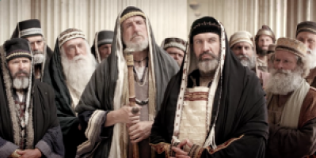
one word that describes Christians
^{“Judgemental”}
²⁷ “Woe to you, teachers of the law and Pharisees, you hypocrites! You are like whitewashed tombs, which look beautiful on the outside but on the inside are full of the bones of the dead and everything unclean. ²⁸ In the same way, on the outside you appear to people as righteous but on the inside you are full of hypocrisy and wickedness. (Matthew 23: 27-28)

Slide 14
Beyond the Bounds
¹¹ The Pharisee stood by himself and prayed: ‘God, I thank you that I am not like other people — robbers, evildoers, adulterers — or even like this tax collector. ¹² I fast twice a week and give a tenth of all I get.’
¹³ “But the tax collector stood at a distance. He would not even look up to heaven, but beat his breast and said, ‘God, have mercy on me, a sinner.’
¹⁴ “I tell you that this man, rather than the other, went home justified before God. For all those who exalt themselves will be humbled, and those who humble themselves will be exalted.” (Luke 18: 11-14)
The religious leaders criticised and condemned others as a way of building themselves up.
Notes:
Often when critiquing others, we go beyond the bounds of human judgement.
Sadly, that often happens in the church
Are we pointing out their failures because we genuinely love them and want the best for them? Or is it out of anger, pride, or jealousy? When we point to people’s failures out of pride, anger, or jealousy, there will often be joy in their failure or demise. Sometimes, there is even a spirit of retaliation, which desires to spread and broadcast others’ failures. This spirit is often seen in gossips.

Slide 15
one word that should describe Christians
Loving
Kind
Peaceful
Patient
Good
Understanding
Faithful
Gentle
Wise
(Galatians 5: 22-23)
Notes:
I believe many people today, if asked to give one word that describes Christians, would pick the word “judgemental”. For many, Christians are judgemental.
Now, I think all of us would rather these people suggest words like
BUT WHY

Slide 16
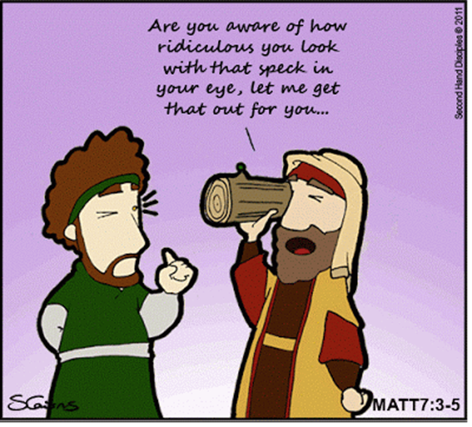
v. 3 - 5
careful self-examination
We should not focus on other people’s sins while neglecting our own.
We should always look to ourselves first.
We should always examine ourselves and our own hearts and motivations first.
You should not adopt a “better than thou” attitude.
(This does not mean you have to be perfect in order to correct others).
Notes:
The comparison is intended to be funny. Picture a man with a large plank of timber in his eye stooping down to perform minute eye surgery on a man with only a sawdust speck in his eye.
Yet that is what we do when we try to correct others without careful self-examination and surrender so that God can cleanse our own lives. Jesus calls those who are quick to correct others without correcting themselves "hypocrites," and enjoins them to take the plank out of their own eye first.

Slide 17
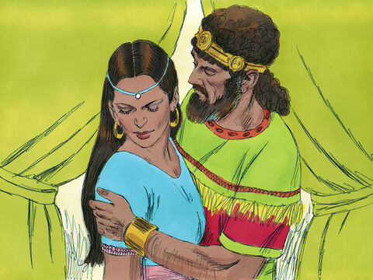
Failure to notice own faults
A great picture of this is the story of David and Nathan. David committed adultery with Bathsheba, killed her husband, and then married her. In response, Nathan shares with David a story about a servant with one lamb that he loved, and a ruler who had many sheep. When guests came to visit, instead of killing one of his many sheep, the ruler killed his servant’s lamb — the one he loved. When David heard this story, he was outraged. He declared, “That man shall surely die!” Then Nathan replied, “You are that man!” (2 Sam 12: 1-7)
Notes:
If we criticise without applying the same standard to yourself that you apply to others, then we are like the Parable in 2 Samuel about King David.
This is Not a deliberate deception, but a failure to notice your own failings.
It is other people, and especially God, who can see the Hypocrisy of your self-righteousness.

Slide 18
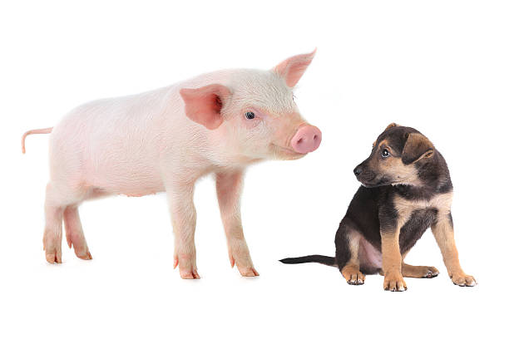
v. 6
Pigs & dogs
One of the keys is to understand the view of dogs and pigs in Hebrew culture. Pigs, of course, were considered unclean animals; Jews were forbidden to eat pork of any kind. Only Gentiles raised pigs (Matthew 8:30-34).
Dogs were scavengers around the towns and cities. They might eat the decaying flesh of carcasses in the wild, which would have deeply offended the Jews' understanding of holiness and ritual cleanness. Dogs are looked down on in verses like Proverbs 26:11 and Matthew 15:26-27. The Jews also used the word "dogs" to refer to Gentile outsiders (Philippians 3:2 and Revelation 22:15).
Notes:
This little section is peculiar to Matthew.
We are called to identify who are dogs and pigs. This is not a characterisation about the person but understanding how they treat the gospel message. This is describing their spiritual condition. They will not appreciate the message. They are antagonist to the gospel and are not going to respond to it.

Slide 19
v. 6
"If anyone will not welcome you or listen to your words, shake the dust off your feet when you leave that home or town." (Matthew 10:14)
Jesus is saying this: Don’t take your children to an expensive Steakhouse Restaurant, because they will not appreciate it. Your children are happier at McDonald’s, therefore, do not take them to a fine dining restaurant. They will not appreciate what they are receiving. (Acts 18; 1 Cor 2; Titus 3)
Notes:
Jesus is instructing his disciples to discern those who reject the gospel outright, and not to continue to declare it to them so that it is continually slandered and discredited. Rather, go to those who are receptive and hungry for hope.
In essence, you should not force God’s Word onto anyone if they have no inclination to accept it.
God’s Word is Holy, therefore why keep throwing God’s Word at someone if they keep misusing it.

Slide 20
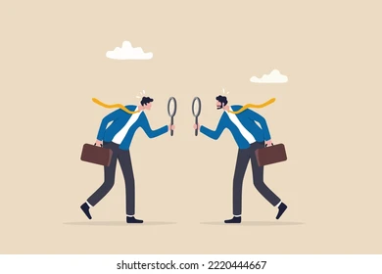
How the Christian is to Judge
STOP PLAYING GOD
When we judge others in a way that we would not judge ourselves, we are hypocrites.
When we hold other people to a different standard than we hold ourselves to, we are hypocrites.
Look at yourself before you look at others.
Think about your own sin and your own failing before you confront another with their shortcomings.
First judge your life by the same judgement you are judging others.
Unlike the Pharisees, we must not act 'holier than thou' in the way we deal with people.
Notes:
We must not go into the situation to help them with a feeling of superiority, thinking that we are any better than they are in any way just because we may not have given in to the temptation to fall into that particular indiscretion.

Slide 21
How the Christian is to Judge
Be the first to admit you are wrong and apologise.
Do not be hasty to point out other people’s faults.
When you have disagreements with others, humbly pray and ask God to show you your own faults and deal with them.
From time to time ask others to evaluate your character in certain areas. They may be more likely to spot problems you didn’t notice yourself.

Slide 22
How the Christian is to Judge
There is always three sides to the story.
Be careful of judging people without all the information
Scripture forbids hasty judgments. says, “The one who gives an answer before he listens—that is his folly and his shame.” (Proverbs 18:10)
With Adam, God asked if he had eaten from the forbidden tree—though God, obviously, knew the answer. (Gen 3).
With Sodom and Gomorrah, God sent angels down to see if the outcry against it was true (Gen 18).
“Stop judging by mere appearances, but instead judge correctly.” (John 7:24)

Slide 23
Are Christians Judgemental?
A gay couple moves into a new apartment, and discovers they are neighbours with three Christian individuals.
The first Christian neighbour, after talking with the new couple, regularly avoids eye contact and rushes out of the complex.
The second Christian neighbour, while talking with the couple, angrily denounces their lifestyle and 'draws' a relational 'line in the sand’.
The third Christian neighbour, while talking with the couple, is pressed about his beliefs, and states clearly that he believes homosexual acts are contrary to God's desires and design.
Notes:
Think about this scenario, and tell me which of these three self-described Christians is being judgemental:

Slide 24
So Who is Being
Judgemental ?
Notes:
BACK TO THE QUESTION OF THE 3 CHRISTIANS AND THE GAY NEIGHBOURS

