Slide 1
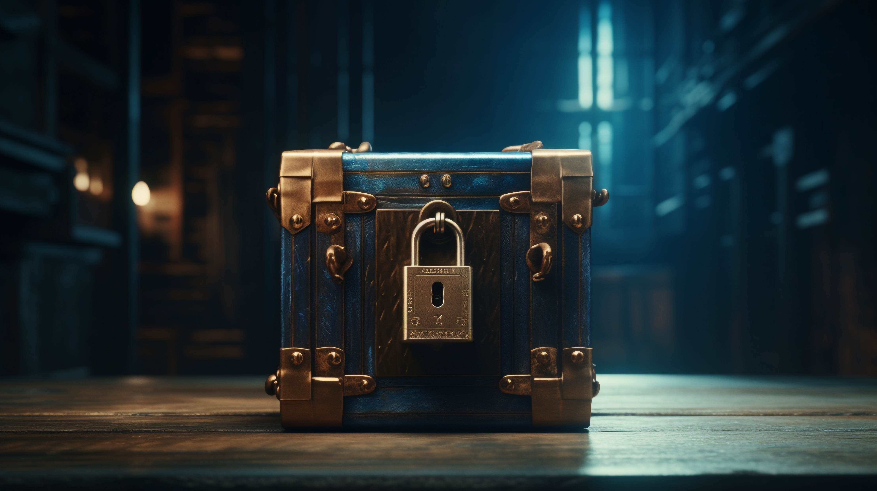
CHRIST OUR TREASURE
Matthew 6:19-21
Notes:
Good morning everyone
I hope you are all doing well
Well this morning we are carrying on with our series in the Sermon on the Mount
However, as good a job as Levi did, I will not be focusing on all those verses
My main focus will be on verses 19-21, looking at our treasure
Sitting in front of these verses and studying these verses, and meditating upon these verses for a lot of hours is very challenging and convicting, and certainly the Holy Spirit has been stirring in my heart this week, and it is my prayer today that the Holy Spirit would do the same in your hearts

Slide 2
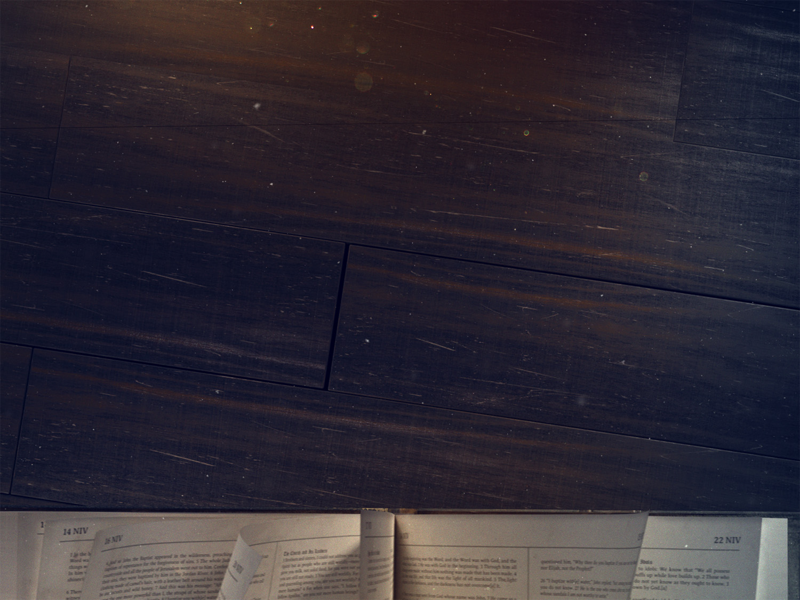
RECAP
Matt 5:21-48 demonstrates how a disciple exceeded the righteousness of the scribes and Pharisees
Matt 6:1-18 describes the way followers of Jesus have a motivation that surpasses the Pharisees
Today’s verses join together both the righteousness and our motivation, to point us to our treasure
Notes:
Matt 5:21-48 demonstrates how a disciple exceeded the righteousness of the scribes and Pharisees - If you will remember, Jesus is calling out the Pharisees, and saying that they have missed the point of the law - No one could ever be made righteous by obedience to the law, because of our sin nature, we could not meet God’s glorious standard - And so he urges people to stop looking to the Pharisees, to their standard of righteousness, because they would need a righteousness that far exceeded theirs - For it is only by believing in Jesus Christ do we receive a righteousness that allows us to enter through the gates of heaven
Matt 6:1-18 describes the way followers of Jesus have a motivation that surpasses the Pharisees - Matt 6:1 – “Beware of practicing your righteousness before other people in order to be seen by them” – that’s the Pharisees motivation, to be seen - Then Jesus continues saying that when you give to the needy do so in secret, why? Because our Father who sees in secret will reward you - We practice our righteousness, we do the works that God is working in us, not for the praise and honour of man, but simply because we have been saved, we have been set free, and so we do all things to please our heavenly Father
Today’s verses join together both the righteousness and our motivation, to point us to our treasure - Christians, because we have received the righteousness of Jesus Christ and now having been made right with God, our motivation ought to lie solely in doing what pleases God - And thus, our loyalty, our priorities, our treasure must go beyond this world - The secret in the previous 18 verses carries on over into this section, that to cast aside the things of this world we must see and conceive of ourselves as children of our heavenly Father, -Because storing up our treasures in heaven is something that can only be accomplished in God’s strength

Slide 3
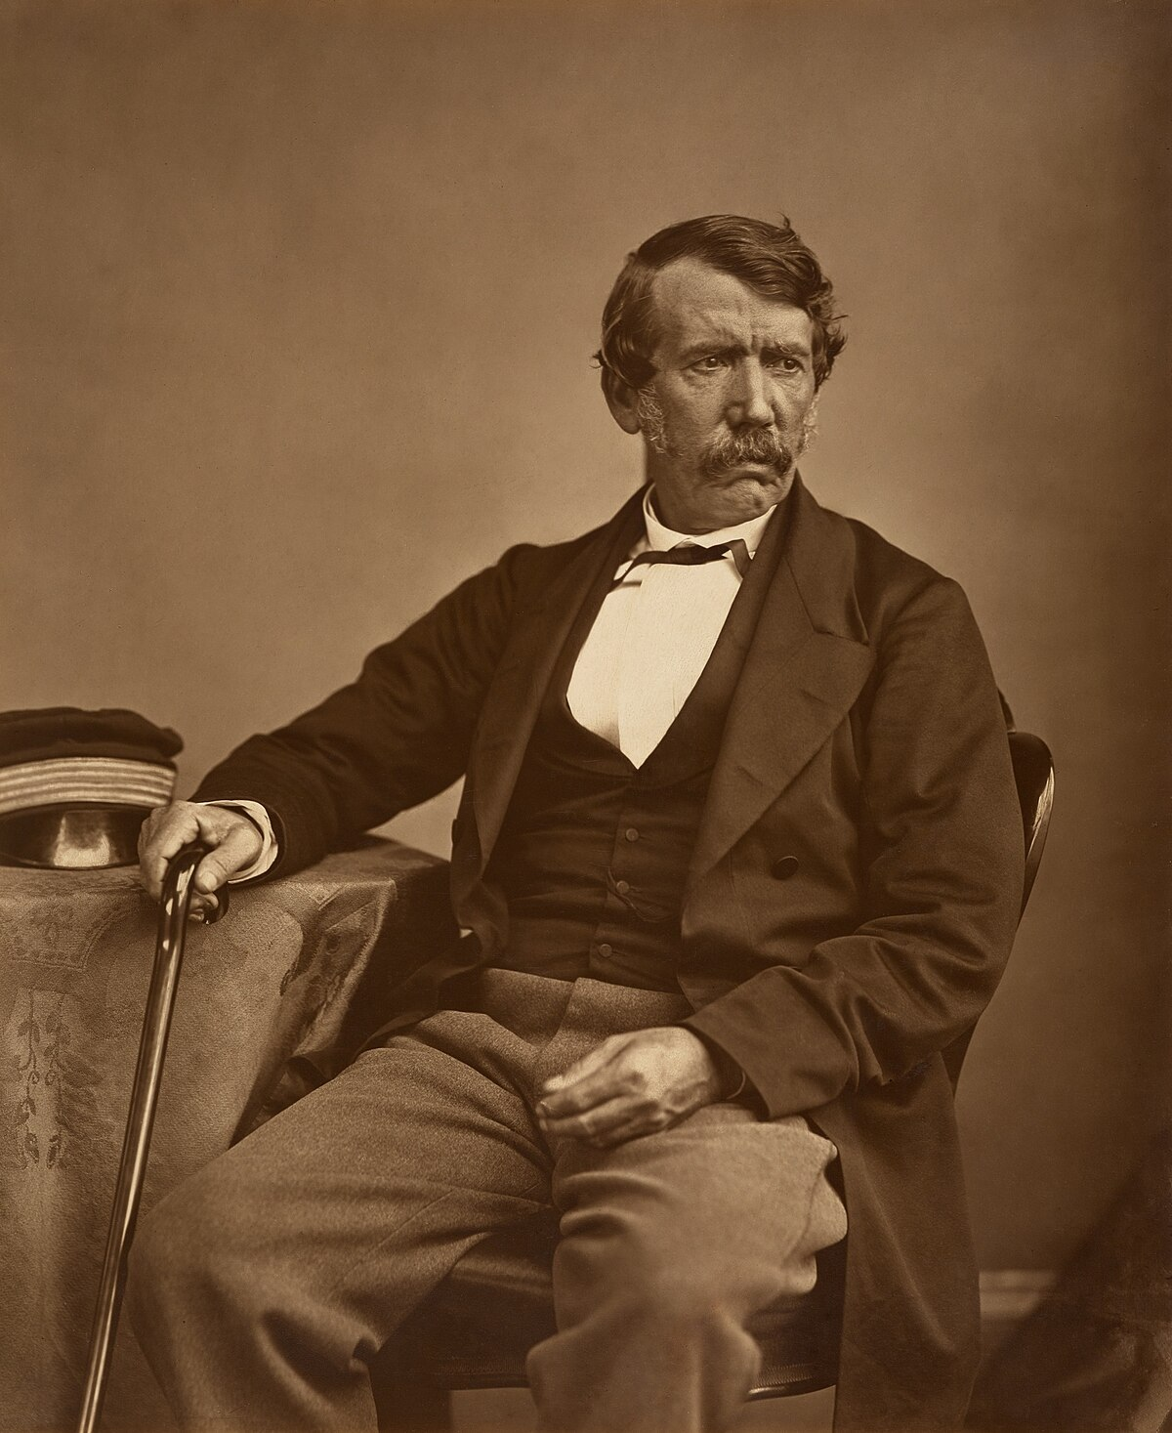
“If your heart were to be buried in the place you loved most during life, where would it be? In your pocketbook? In an appropriate space down at the office? Where is your heart?” - Unknown
Notes:
This is a picture of a man by the name of David Livingstone
David Livingstone lived from 1813– 1873
He did many things with his life, one of which was being a missionary in Africa
But when he died, the body of David Livingstone was buried in England where he was born, but his heart was buried in the Africa he loved. At the foot of a tall tree in a small African village the natives dug a hole and placed in it the heart of this man who they loved and respected.
If your heart were to be buried in the place you loved most during life, where would it be? In your pocketbook? In an appropriate space down at the office? Where is your heart?
That is essentially what today’s message is all about, that is the question Jesus is asking of each and everyone of us in this passage

Slide 4
TREASURES ON EARTH
“Do not lay up for yourselves…” (Matt 6:19a)
“Treasures on earth” (Matt 6:19b)
Jesus is warning us against anything that stops with this world only
Notes:
“Do not lay up for yourselves…” (Matt 6:19a) - The first two words, “Do not”, Jesus is warning us, he is wanting us to reflect - He is saying “Stop” whatever it is that I’m about to tell you - It’s a call to examine yourself, a call to reorientate and repent – Because this thing that Jesus wants us to stop is one of the greatest dangers we face in Christianity in general, but particularly in western Christianity - And the word here for lay-up or store up, means to heap up, to gather – So Jesus is saying stop heaping up for yourselves - Because it is an exercise in futility
“Treasures on earth” (Matt 6:19b) - Here Jesus is referring to material things, money, to wealth - Jesus is forbidding the hoarding of treasure for selfish reasons, to indulge in, whether it be for today or for the future - It is the godless, selfish, accumulation of goods, which are used only with a mind to further our kingdom, and with no second thought being given to God and His Kingdom - In those days it would have been things like valuable clothes and precious metals - If he were to address today’s culture, it would be things like houses, land, cars and furnishings - But it would be remiss of us to think that treasures on earth stopped purely at money and wealth
Jesus is warning us against anything that stops with this world only - You see those who are poor need this exhortation just as much as the rich - We all have treasures in some shape or form. It may not be money, but it could be your husband, your wife, your kids - No matter how big or small it is, if it is everything to you, if it is always on your mind, that is your treasure - It could be the love of honour, money, position, status, popularity, it could be your work, or maybe it is the next promotion - Anything that consumes your thoughts and actions, and desires, that stops with this world, is an earthly treasure

Slide 5
“Where moth and rust destroy and where thieves break in and steal” (Matt 6:19c)
Do these earthly things keep you up at night?
Our hearts were not meant to be satisfied with the things of this world
Notes:
“Where moth and rust destroy, and where thieves break in and steal” (Matt 6:19c) - Jesus quickly points out that all these earthly treasures are meaningless, are futile in the end, because they are here one day and gone the next - The moth represents nature’s corrosion, the rust is time’s corrosion, and the thief is man’s corrosion - Whatever earthly treasure you have it will not last. Either nature, time, or someone else will take it away from you - So do not let these treasures consume you - Now you may be thinking, but isn’t it biblical to work to provide for my family, to put food on the table, that we might have a roof over our heads. - And the answer is of course yes, we were created to work, and to look after our families, that was part of our original design - But for how many of us, does it actually ever stop there? How quickly do we become discontent with that? - There is a question that will help give greater clarity as to what your treasure is
Do these earthly things keep you up at night? - Or whenever you get a quiet moment is it these earthly treasures that consume your thoughts? - We will fret and are anxious about so many things in life - We desire things passionately: we yearn for bigger homes, better land, better paying jobs - That our kids would be set-up financially and become upstanding citizens in society, that they get good grades, that our reputation remains untouched - The desire for wealth, and the fleeting treasures of this world is God’s greatest competitor in the hearts of humanity - But is it not foolish to trade things of eternal value for the temporary, these things which we are never satisfied with and quickly grow tired of? - And the reason we grow tired of them, or are always reaching for more, and never being satisfied is because…
Our hearts were not meant to be satisfied with the things of this world - If you will remember in our series on Genesis, where we looked at how God created mankind to have dominion over the earth - And yet it seems as though the earth has dominion over mankind - Mankind may have all the wealth the world has to offer, all the fame, power, friends, and pleasure, and yet we will still feel empty - And so we echo the author of Ecclesiastes in saying, ”Behold all was vanity and striving after wind, and there was nothing to be gained under the sun”. - Our hearts will not be satisfied by the things of this world

Slide 6
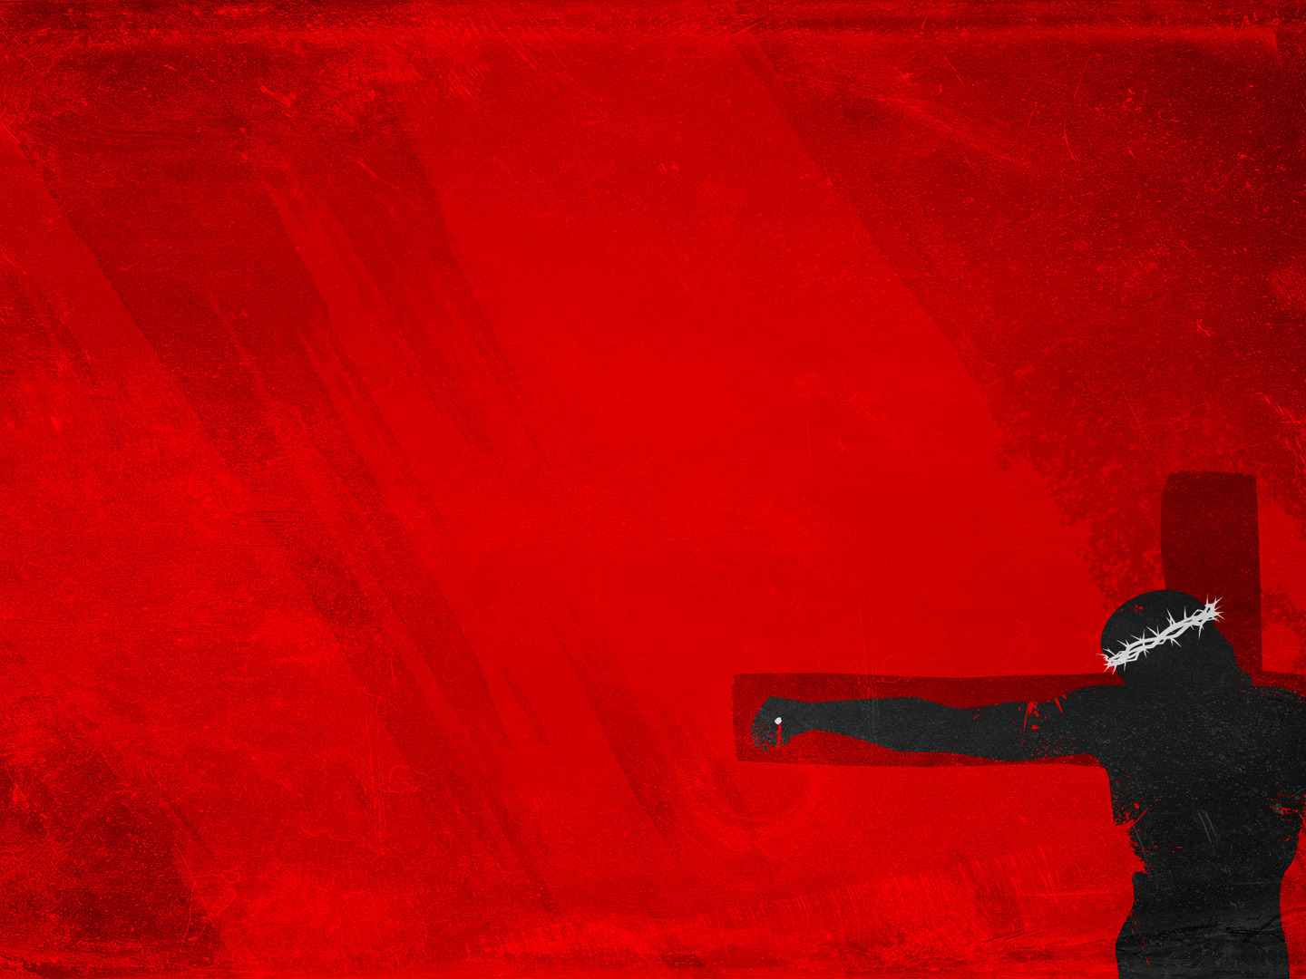
TREASURES IN HEAVEN
“BUT lay up for yourselves…” (Matt 6:20a)
“Treasures in heaven” (Matt 6:20b)
“For I decided to know nothing among you except Jesus Christ and him crucified” (1 Cor 2:2)
Notes:
“BUT lay up for yourselves…” (Matt 6:20a) - As with a lot of things in Scripture there are two opposing choices before us - We are either part of the kingdom of darkness or the kingdom of light. We are dead in our sin or alive to God. - We are either children of the devil, or of our heavenly Father - And here, the two choices are now laid before us - One choice offers immediate gratification, immediate rewards that are temporary and deceptive - The second choice is a narrow road which may cost us everything, and is beyond the ability of even Scripture to describe - The other thing I want us to notice in this verse, is that this phrase, lay up for yourselves, may cause some to think that we earn this treasure in heaven, - But it is not so much a reward given for performing meritorious acts, but by belonging to and living by the priorities of the kingdom to which we belong to - This is not a statement of justification, that you will be made right with God based upon you laying up for yourselves treasures in heaven - But it is saying that if you are true child of God, then this is where your treasure ought to be and will be - And if it is not, then you either do not belong to the family of God, or you are backslidden and in dire need of God’s forgiveness, and in desperate need of God’s loving discipline to turn your eyes back to Him - But lay up for yourselves…
“Treasures in heaven” (Matt 6:20b) - Treasures in heaven are whatever is of good and eternal significance such as doing righteous deeds, suffering for Christ’s sake, forgiving one another, willingness to share what has been bestowed upon us by our heavenly Father - It is using our wealth to further God’s Kingdom, to contribute to your local church, to contribute to the mission field - It is being obedient to the Word of God - It is giving generously to the poor because we understand that it all belongs to God, and we are but borrowing it from Him - And so we are able to look at this world, understanding that we are but pilgrims in this world. - We are pitching our moving tents a day's march nearer to home - But this idea of ‘treasures in heaven’ does not stop there, it cannot stop there, for our desires to do these things rests in one treasure that far outweighs them all
“For I decided to know nothing among you except Jesus Christ and him crucified” (1 Cor 2:2) - Paul tells us that the central message we are to preach is Christ crucified and all its implications, because it is here that we find the greatest treasure, the sweetest truth one could ever utter - To the sinner, that’s you and me, there is no greater message because it says to us that we have all sinned and fallen short of God’s glory, each of us were like sheep and had gone astray - But in His goodness, God sent Jesus, who is the only answer to the problem of sin, to come and live the perfect life, to go to the cross where he would bear the full weight of God’s wrath in our place, and Jesus would become a curse - And he would die upon that cross, taking the penalty of sin upon himself, instead of you, and being raised to life on the third day, that we might be justified, that we might be made right with God - And now all who believe in Jesus Christ are made right with God, but not only that, we are adopted into the family as children of God - And now by the power of God at work in us we begin to bear the family resemblance, we are gradually conformed to the image of Jesus, which is what we call sanctification - And after being raised from the dead, Christ ascended to the right hand of the Father, where he is forever making intercession for us until the day when he comes back and calls us home to enter into the joy of our master - Where we are then set free from the very presence of sin, and spend forever gazing at the glory of God - Part of being a Christian is believing with every fibre of our being, “God, you can have it all, you can have all the treasures of this world, just give me Jesus, just give me Jesus” - It is deciding to know nothing but Jesus Christ and him crucified, for he is my only treasure

Slide 7
“Where neither moth nor rust destroy and where thieves do not break in and steal” (Matt 6:20b)
All is God’s, and all is to be used for His glory
The only thing that can satisfy the longing in our hearts is the great treasure of knowing Jesus Christ
Notes:
“Where neither moth nor rust destroy and where thieves do not break in and steal” (Matt 6:20b) - You see, not only is the treasures in heaven worth more, but they are far more secure and last for eternity - Because it does not rest in the hands of mere mortals, but in the hands of almighty God - So, it would be foolish to store up treasures on earth, in comparison with the wisdom of knowing Christ Jesus our Lord, and thus storing up our treasures in heaven - And so we hold the things of this world loosely in our hands, we hold them in a state of blessed detachment, meanwhile clutching the gospel close to our hearts - And clinging tightly to the cross of Jesus Christ, with every last shred of strength that is granted by our heavenly Father
All is God’s, and all is to be used for His glory - Corinthians tells us that whether we eat or drink, whatever you do, do it to the glory of God - We have been placed on this earth to live in close relationship with God, to glorify His name in all that we do - Let me read 1 Peter 1:3-5 and then 8-9 - It once again reminds us that our treasure lies with God, and it is undefiled, imperishable, and unfading - And we press on this life by the power of God, being kept and carried through this life by the sovereign hand of God, doing all for His glory - With our eyes fixed on our inheritance which lies in heaven, where there is a seat being kept there, with your name on it - And on that day, what we will have known by faith, will now become sight, where we will dwell forever in eternal glory with the Triune God, who throughout this life was always faithful, who never once let us down
The only thing that can satisfy the longing in our hearts is the great treasure of knowing Jesus Christ - You were not made to fill the longing in your hearts with the things of this earth - Our souls were not given that they might be filled with the temporary - Our hearts were made for the full measure of God’s glory - Nothing but the person and the will of God will ever satisfy the longing of your hearts - The person who does the will of God will abide forever, and I can promise you, that you will never regret ‘living too much’ for the kingdom - You will not get to heaven and wished you hadn’t sacrificed so much for the sake of God’s kingdom - I think the true Christian will get to the end of their life, and only wish they could have done more, that they would have given up more, that God might be glorified

Slide 8
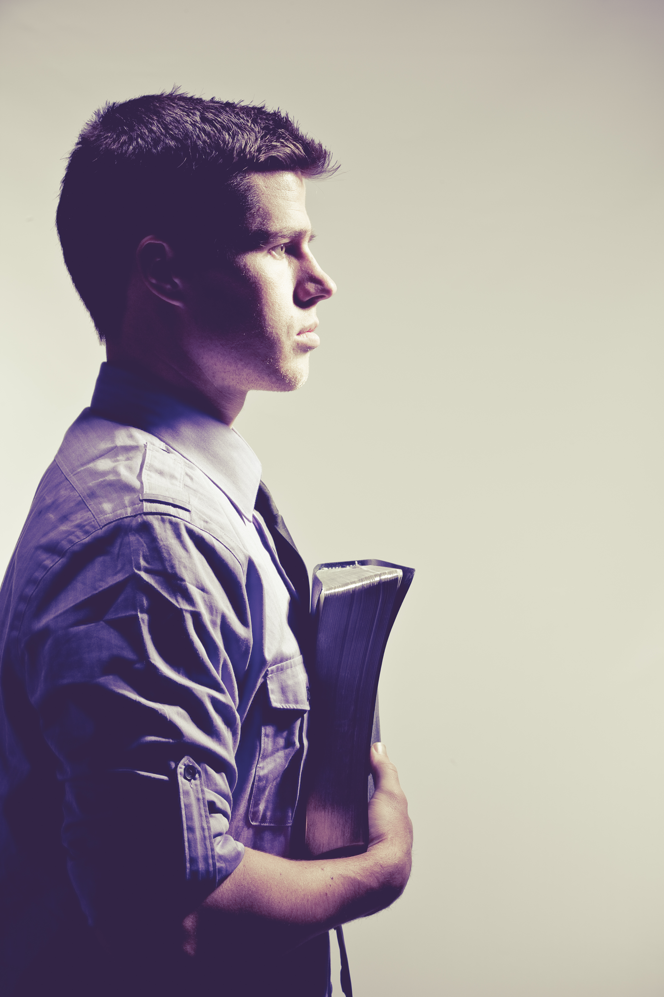
WHERE IS YOUR TREASURE?
“For where your treasure is” (Matt 6:21a)
“There your heart will be also” (Matt 6:21b)
“You cannot serve God and money” (Matt 6:24c)
Notes:
“For where your treasure is” (Matt 6:21a) - I want you to notice something here, that the treasure is placed first, and it is the treasure that the heart goes after - It’s as though Jesus were sitting down with us right now, and locking eyes with us, and through the written Word of God he is asking us, “Where is your treasure?” - If a stranger were to follow you around not knowing what you did on a Sunday, would they hear you discussing the things of God, spending time in prayer. - Would they see us doing the will of our heavenly Father, reading Scripture and meditating upon it? - Would they see us being generous with our money, with our time, and gracious with our words. Would they see a person occupied with serving the kingdom of God and their local church, the body of Christ - Or would they see a person completely occupied with the things of this world, and themselves - Only giving God 5 minutes before they go to bed each night, and an hour and half each Sunday - If the latter be true then I urge you to repent and believe in the gospel! For in the blood of Jesus Christ, you will find forgiveness and you will be washed white as snow
“There your heart will be also” (Matt 6:21b) - I pray that the Lord Jesus would be your single greatest treasure, that he would have your hearts, that he would have his way in you - That you would love him with all your heart, with all your soul, with all your mind, and with all your strength - God’s “Well done good and faithful servant” shall stand forever, and if we have laid up our treasure with Him, with Him our hearts will be.
”You cannot serve God and money” (Matt 6:24c) - And in case we have missed it, Jesus just wants to make sure that we got the message - He doesn’t say that we shouldn’t, or that we must not, or that it isn’t ideal - He says CANNOT, you cannot serve both. It is an impossibility – Fallen man is a slave to someone, we all can only have one master - It is either God or money, there is no in between - There can be no competitors in the heart of the believer - Examine your hearts, search yourselves and be rid of the things of this world, of the treasures of the earth - Jesus is calling for a single-minded devotion, and so we must cast off anything that takes our eyes off Jesus - For if God is not served with complete devotion, then He is not served at all

Slide 9
SUMMARY
The things of this world are only temporary, so do not indulge in them, but turn your eyes from them
Turn your eyes to Jesus, remember Jesus Christ, for if our treasure is in him, then our treasure is eternal
We all must examine ourselves and one day give an answer to God as to where our treasure lies
Notes:
The things of this world are only temporary, so do not indulge in them, but turn your eyes from them - Satan will use whatever means necessary to get our eyes off Jesus -Remember that nothing here lasts, our treasures here are not safe, they are not secure. Instead…
Turn your eyes to Jesus, remember Jesus Christ, for if our treasure is in him, then our treasure is eternal - Like the old hymn, “Turn your eyes upon Jesus, look full in his wonderful face, and the things of this world will go strangely dim” - As you behold his glory, the beauty of the things of this world will fade - Jesus Christ is our single greatest treasure and only in him will we be satisfied, only in him do we find a treasure that lasts forever
We all must examine ourselves and one day give an answer to God as to where our treasure lies - Our King forbids division of aim and purpose in this life - We cannot have 2 masters, God and the world will never agree - You can live for this world, or you can live for the next, but to live equally for both is impossible - Choose this day whom you will serve, let your treasure be found in Christ and Christ alone, and may God finish the good work he began in you

Slide 10
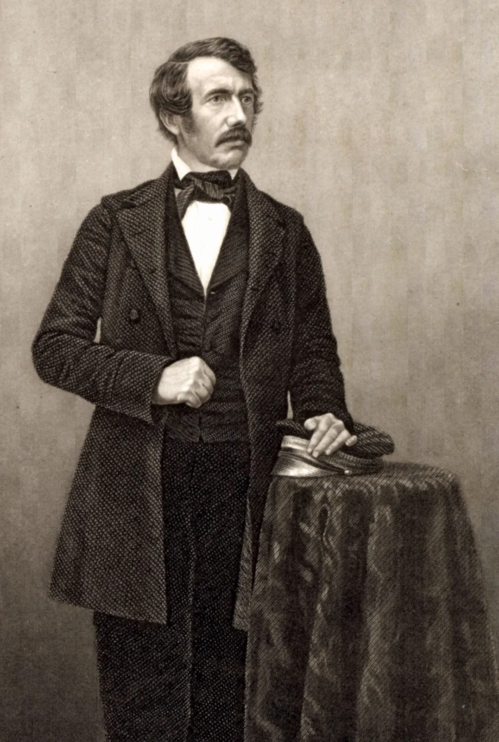
“Away with the word sacrifice. Say rather it is a privilege. Anxiety, sickness, suffering, or danger, now and then, with a foregoing of the common conveniences and charities of this life, may make us pause, and cause the spirit to waver, and the soul to sink; but let this only be for a moment. All these are nothing when compared with the glory which shall be revealed in and for us. I never made a sacrifice.” David Livingstone
Notes:
I began this sermon with a story about David Livingstone, and so I thought it would be appropriate to end with him
During his time as a missionary, David survived malaria, was separated from his family for long periods of time, was mauled by a lion, witnessed 400 people be killed, had friends die on the mission field, and then he himself died in the African jungles at the age of 60.
Prior to his death David had this to say about being wholeheartedly devoted to God and His Kingdom.
“For my own part, I have never ceased to rejoice that God has appointed me to such an office. People talk of the sacrifice I have made in spending so much of my life in Africa. Is that a sacrifice which brings its own blest reward in healthful activity, the consciousness of doing good, peace of mind, and a bright hope of a glorious destiny hereafter?
Away with the word sacrifice. Say rather it is a privilege. Anxiety, sickness, suffering, or danger, now and then, with a foregoing of the common conveniences and charities of this life, may make us pause, and cause the spirit to waver, and the soul to sink; but let this only be for a moment. All these are nothing when compared with the glory which shall be revealed in and for us. I never made a sacrifice.”
It is no sacrifice to leave behind the things of this world, to suffer for belonging to Christ
There is no greater privilege than to leave behind the things of this world, that the name of God might be glorified, until the day when you are called home to your heavenly Father
Brothers and sisters in Christ, remember the gospel by which you have been saved, press on in the power of God, lean on God and His Word, and may Christ alone be your single greatest treasure

