Slide 1
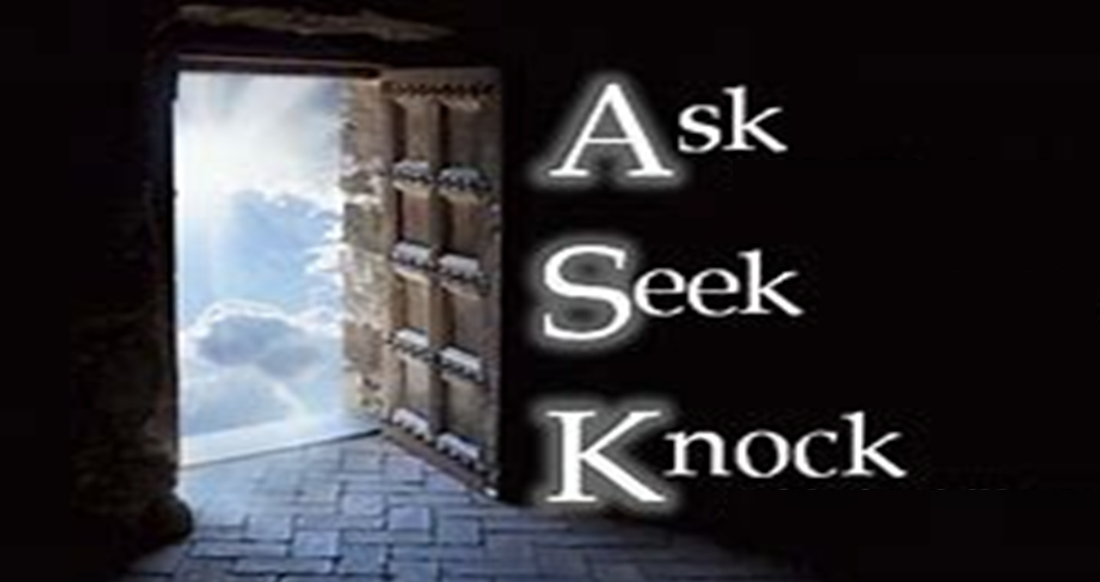
Matthew 7:7-12

Slide 2
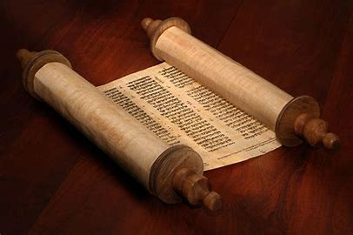
Torah - Moses received the Torah as a written text
Talmud - hakhnasat orekhim (hospitality to guests)
The Talmud even says that welcoming guests is “greater than welcoming the Divine Presence”
Talmud - Talmud is considered the explanation of the written text

Slide 3
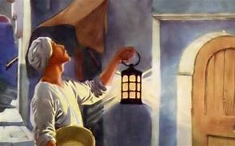
“Then, teaching them more about prayer, he used this story: “Suppose you went to a friend’s house at midnight, wanting to borrow three loaves of bread. You say to him, ‘A friend of mine has just arrived for a visit, and I have nothing for him to eat.’ And suppose he calls out from his bedroom, ‘Don’t bother me. The door is locked for the night, and my family and I are all in bed. I can’t help you.’ But I tell you this — though he won’t do it for friendship’s sake, if you keep knocking long enough, he will get up and give you whatever you need because of your shameless persistence.” Luke 11:5-8

Slide 4
“And so I tell you, keep on asking…….. (Luke 11:9)

Slide 5
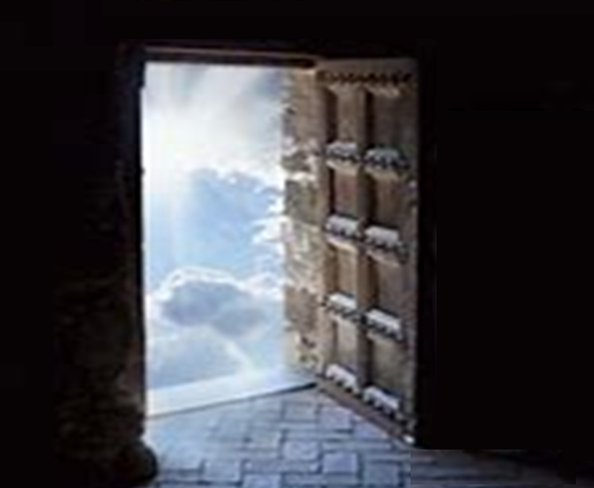
⁷ “Keep on asking, and you will receive what you ask for.
Keep on seeking, and you will find.
Keep on knocking, and the door will be opened to you.
⁸ For everyone who asks, receives. Everyone who seeks, finds. And to everyone who knocks, the door will be opened. Matthew 7:7,8

Slide 6
John 14:14 “If you ask me anything in my name, I will do it”
Mark 11:24 “Therefore I tell you, whatever you ask in prayer, believe that you have received it, and it will be yours”
Matthew 17:20
“I tell you the truth, if you had faith even as small as a mustard seed, you could say to this mountain, ‘Move from here to there,’ and it would move. Nothing would be impossible.”

Slide 7
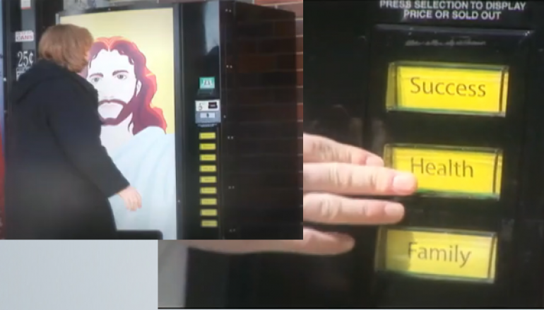

Slide 8
1 John 5:14
“And we are confident that he hears us whenever we ask for anything according to His will.”
James 4:3 “And even when you ask, you don’t get it because your motives are all wrong — you want only what will give you pleasure.”
Matthew 6:33 “And when you pray, you must not be like the hypocrites…”
Psalm 66:18 “If I had not confessed the sin in my heart, the Lord would not have listened.”

Slide 9
Psalm 143:6
“I stretch out my hands to you; my soul thirsts for you like a parched land”
Jeremiah 29:12-13 “Then you will call upon me and come and pray to me, and I will hear you. You will seek me and find me, when you seek me with all your heart”
Matthew 5:6
“Blessed are those who hunger and thirst for righteousness, for they shall be satisfied”

Slide 10
Revelation 3:20 ”Behold, I stand at the door and knock. If anyone hears my voice and opens the door, I will come in to him and eat with him, and he with me”.
Matthew 24:33 “So you, too, when you see all these things taking place, know for certain that He is near, right at the door.”
John 10:9 ”I am the door: by me if any man enter in, he shall be saved, and shall go in and out, and find pasture”

Slide 11
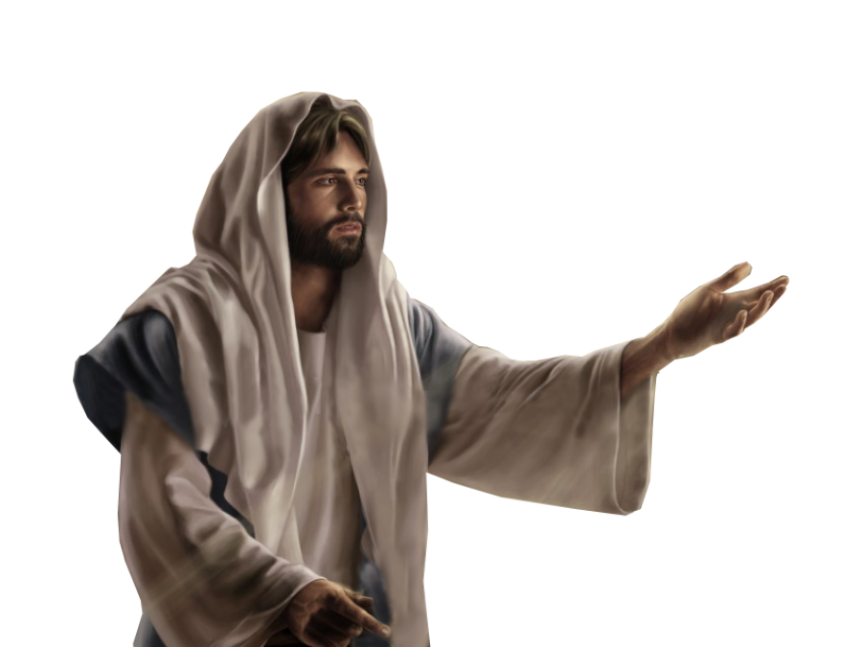
The Golden Rule
Matthew 7:12 “Therefore do to others whatever you would like them to do to you. This is the essence of all that is taught in the law and the prophets.”
Matthew 22:37-40 Jesus replied, “You must love the Lord your God with all your heart, all your soul, and all your mind.’ This is the first and greatest commandment. A second is equally important: ‘Love your neighbour as yourself.’ The entire law and all the demands of the prophets are based on these two commandments.”

Slide 12
The Golden Rule
Is the Golden Rule related to the teaching on prayer?
The conjunction Therefore links it to the teaching on prayer
James 2:15,16 “If a brother or sister is poorly clothed and lacking in daily food, and one of you says to them, “Go in peace, be warmed and filled,” without giving them the things needed for the body, what good is that?”
Cook meals
Provide transport
Help clean
Serve others in the church or community
Visit and pray for people
Etc
We can:
We can be the answer to prayer by serving others

Slide 13
Summary
Are we Asking for the right reason?
Not selfishly
Not hypocritically
Always surrendering to God’s will
In our prayer life:
Are we Seeking correctly?
Hungering and thirsting after God’s presence
Are we seeking God with all of our heart
Are we Knocking enough?
Do we give up too soon because we haven’t seen an answer
Do we believe that God is listening to us?
Are we prepared to do something for others and be the
Answer to prayer?

Slide 14
Matthew 7:7-12

