Slide 1
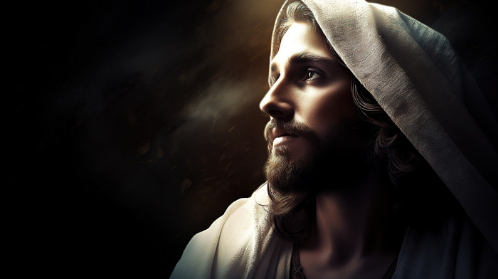
A Pattern for
Dynamic Prayer
Matthew 6:7-13

Slide 2
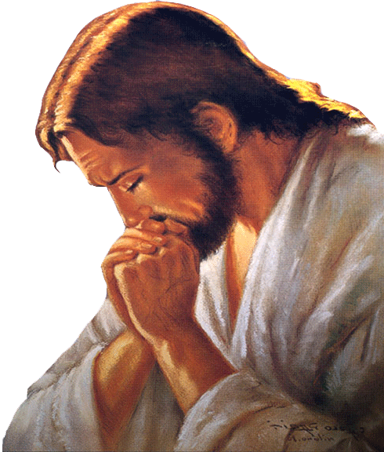
What is the Lord’s Prayer?
Is it something we only need to pray as a congregation?
Is it a model of prayer?
Is it the Lord’s prayer or a prayer for disciples?
Was it only for the disciples at the time?
Is it a prayer that we need to pray every day?

Slide 3
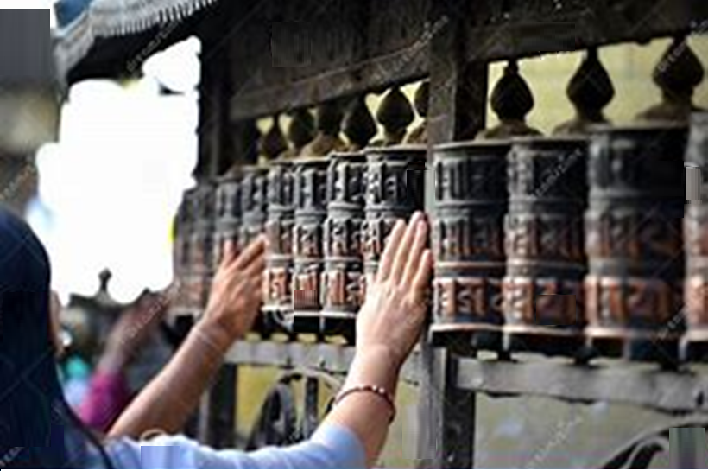
What is prayer?
No, prayer is a dialogue between God and us

Slide 4
In verse 7, Jesus gives a warning on prayer….
⁷ “When you pray, don’t babble on and on as the Gentiles do. They think their prayers are answered merely by repeating their words again and again.
What does Jesus mean when He says don’t babble on like the Gentiles do?
Does He mean that we shouldn’t repeat prayers like the Lord’s Prayer?

Slide 5
⁸ Don’t be like them, for your Father knows exactly what you need even before you ask him!
If God knows what we need, why does He need us to ask Him?
And if He knows what we need, do our prayers actually change anything?

Slide 6
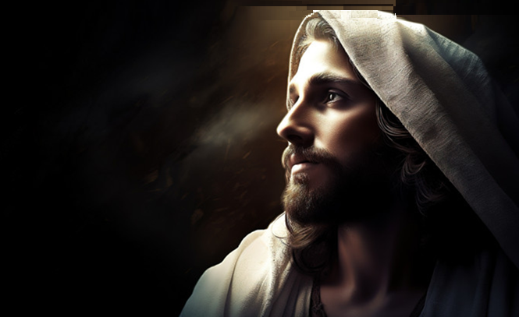
1) The Lord’s Prayer
Firstly, it is a prayer of relationship
Jesus commences nearly all of His prayers, with an intimate acknowledgement of God as His father
Real prayer is only accomplished through being in a relationship with God the Father.
Living, loving paternal relationship between a father and child

Slide 7
Secondly, it is a prayer of praise and humility
The first half of the Lord’s Prayer acknowledges:
God rules His kingdom and that He is a holy God
His desires will be done in Heaven and also on Earth

Slide 8
The second half of the Lord’s Prayer acknowledges:
Praise and Humility
“Give us this day”
Praise: He is in control of our lives
Humility: We are reliant on our Heavenly Father
“Forgive us our sins”
Praise: God alone has the power to forgive sins
Humility: We are reliant on God’s forgiveness
What right do we have to not forgive others?

Slide 9
“Don’t let us yield to temptation, but rescue us from the evil one”
Praise: We are acknowledging God’s sovereignty and victory over sin
Humility: We are weak and subject still to our sinful nature
Jesus is teaching us that we should be in intimate conversation with our Heavenly Father every day

Slide 10
John chapter 17
The first 8 verses of this prayer are praise to the Father
¹⁵ I’m not asking you to take them out of the world, but to keep them safe from the evil one. ¹⁶ They do not belong to this world any more than I do. ¹⁷ Make them holy by your truth; teach them your word, which is truth. ¹⁸ Just as you sent me into the world, I am sending them into the world.
²⁰ “I am praying not only for these disciples but also for all who will ever believe in me through their message. ²¹ I pray that they will all be one, just as you and I are one”

Slide 11
Matthew 26:39
³⁹ He went on a little farther and bowed with his face to the ground, praying, “My Father! If it is possible, let this cup of suffering be taken away from me. Yet I want your will to be done, not mine.”
It is not wrong for us to ask God to try and get us out of a difficult situation
It is not wrong to passionately beg God to intervene
Why did God not answer Jesus’ prayer of another solution?
Notes:
Why did God not answer Jesus’ prayer of another solution? Why did God not answer Jesus’ prayer of another solution?

Slide 12
Anderson Hultgren wrote “Sometimes, we must relax our grip, take God’s hand, and follow Him through the pain. When you are suffering, petition God first and listen for His answer. Bring your mind to Him ⁠— dialogue with Him, read His words, and meditate upon Him. Like Jesus, our petition becomes submission”
Never doubt that God knows what is ultimately best for you, even if you can’t see it at the time

Slide 13
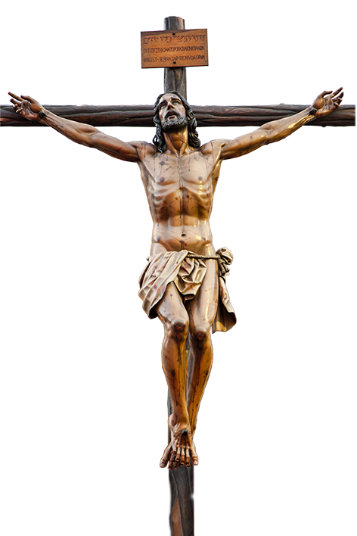
Matthew 27:46
⁴⁶ At about three o’clock, Jesus called out with a loud voice, “Eli, Eli, lema sabachthani?” which means “My God, my God, why have you abandoned me?”
Why the change?
Habakkuk 1:13 says “Your eyes are too pure to look on evil”
Galatians 3:13 “Christ redeemed us from the curse of the law by becoming a curse for us — for it is written, “Cursed is everyone who is hanged on a tree”

Slide 14
John 1:12 “But to all who believed him and accepted him, he gave the right to become children of God.”
Romans 8:15 “So you have not received a spirit that makes you fearful slaves. Instead, you received God’s Spirit when he adopted you as his own children. Now we call him, “Abba, Father.”
God wants to adopt us as Sons and Daughters

Slide 15
Is it a prayer that we need to pray every day?
Is it something we only need to pray as a congregation?
Is it the Lord’s prayer or a prayer for disciples?
Was it only for the disciples at the time?

Slide 16
Why do we need to pray if God knows our needs before we
even ask?
Is it a model of prayer?
Have the praise of God utmost in our minds
Intimate, heartfelt and relevant communication with God
Our requests to our Father should reflect praise and humility
We need to bow to His sovereign will in our life.

Slide 17
A Pattern for
Dynamic Prayer
Matthew 6:7-13

