Slide 1
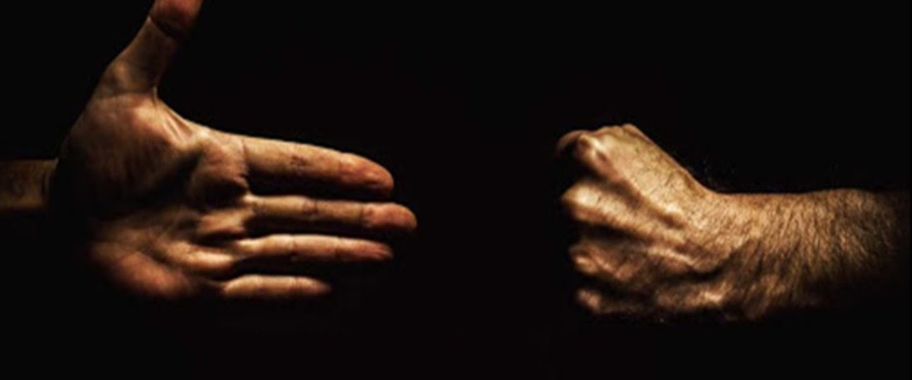
Love Your Enemies
Matthew 5:38-48

Slide 2
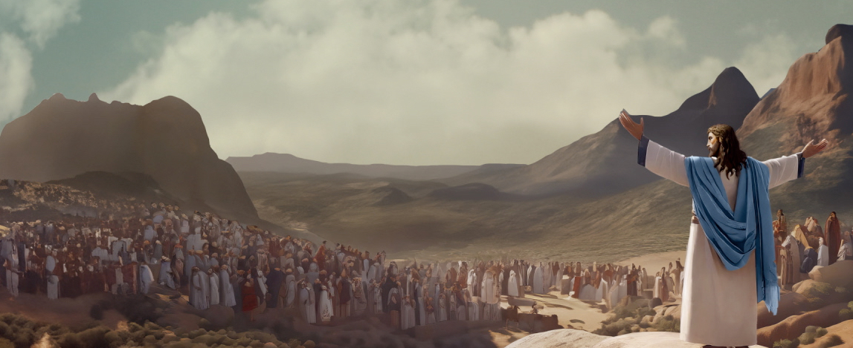
Beatitudes – God blesses those who are humble, who hunger for righteousness, who are merciful, who work for peace and whose hearts are pure.
Need a righteousness which is greater than the then religious leaders
We can sin in our heart, not just our actions
If we lust after someone in our heart then we commit adultery
Our heart is what we need to change and to protect

Slide 3
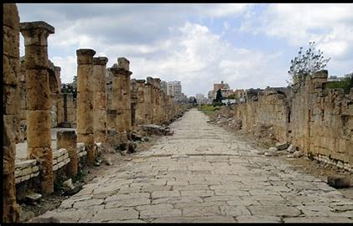
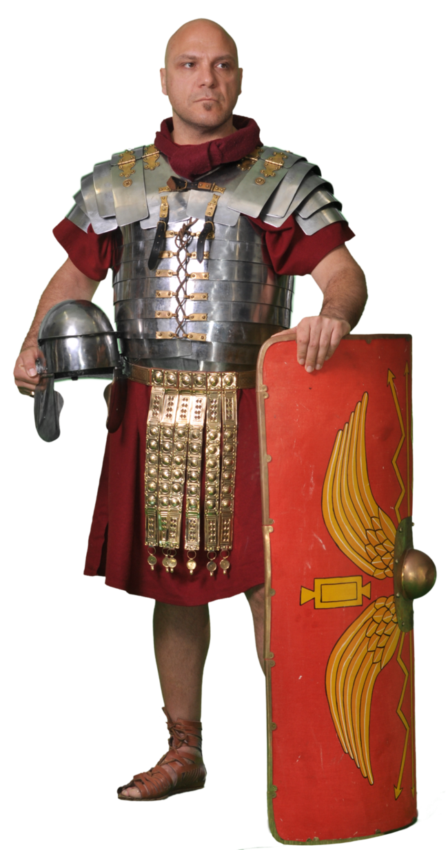
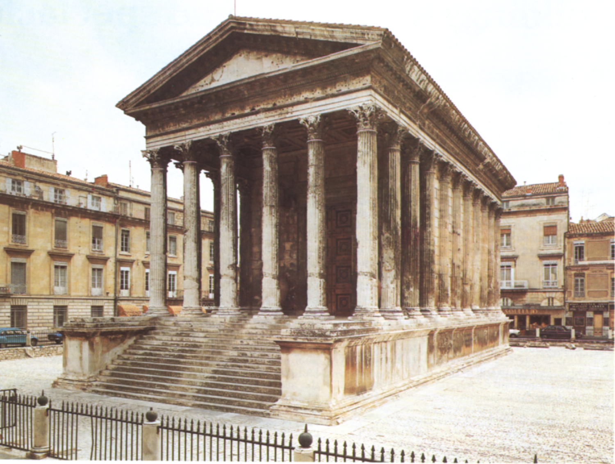
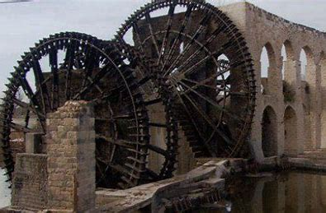
International Road System
Conquered by the Romans
230BC – 400AD
Roman rule could be brutal if crossed
All non-Roman citizens were treated like second class citizens.
Roman laws always took precedence over local laws
Architecture
Technology

Slide 4
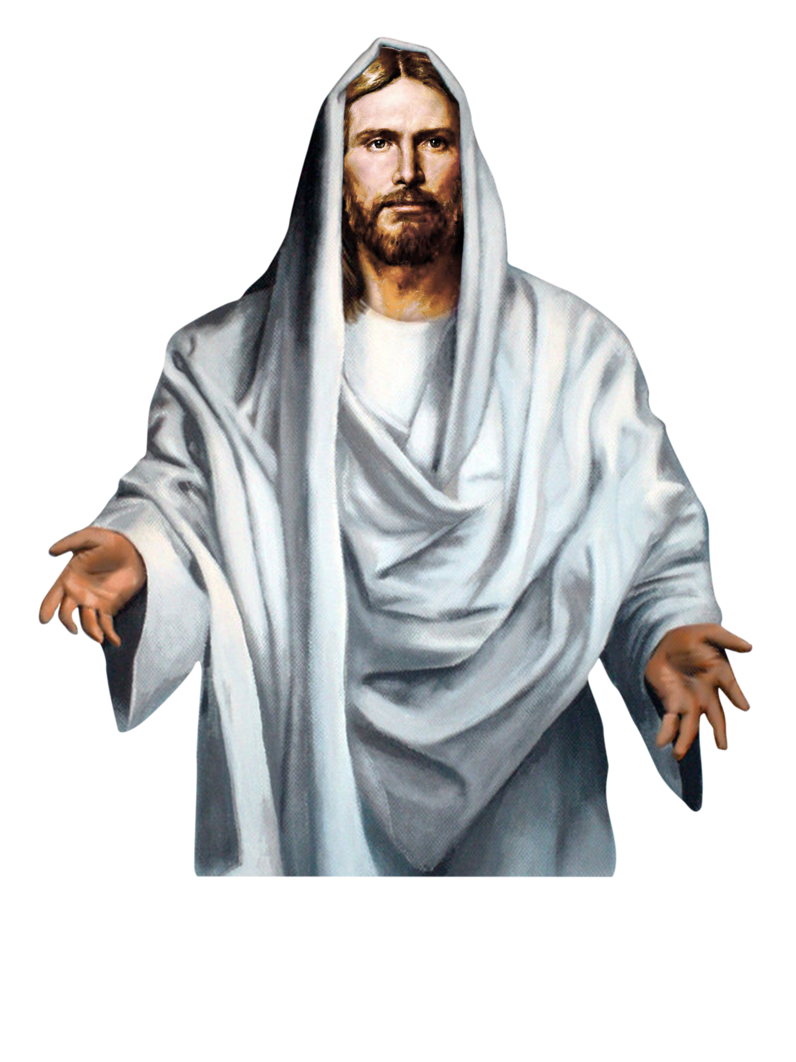
³⁸ “You have heard that it was said, ‘Eye for eye, and tooth for tooth.”
The law was given to judges and said in effect “Make punishment fit the crime”. It was not a guide for personal revenge
““Do not seek revenge or bear a grudge against a fellow brother, but love your neighbour as yourself. I am the Lord.” Leviticus 19:18

Slide 5
Jesus then gives 4 examples of how we should not look for revenge:
1) “If anyone slaps you on the right cheek, turn to them the other cheek also”
2) “And if anyone wants to sue you and take your shirt, hand over your coat as well”

Slide 6
3) “If anyone forces you to go one mile, go with them two miles”
Maximum distance of a thousand paces (Latin: “mille passus”) - mile
4) “Give to the one who asks you, and do not turn away from the one who wants to borrow from you”

Slide 7
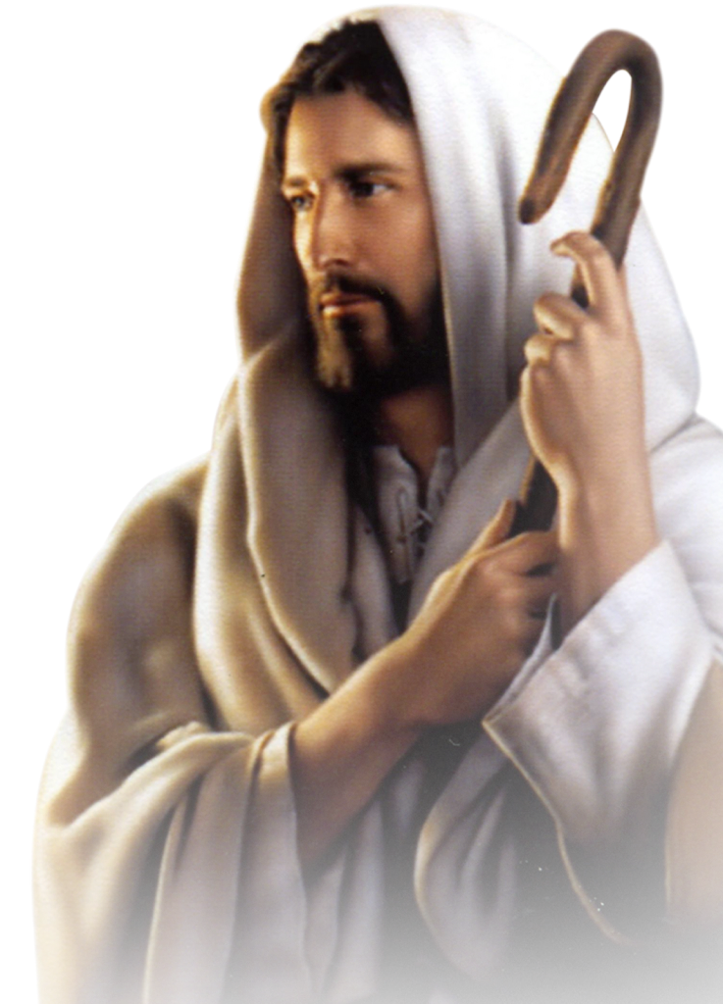
⁴³ “You have heard that it was said, ‘Love your neighbour and hate your enemy.’ ⁴⁴ But I tell you, love your enemies and pray for those who persecute you”
Psalm139:21-22 “I hate those who hate you, LORD, and abhor those who are in rebellion against you? I have nothing but hatred for them; I count them my enemies.”

Slide 8
“If you love those who love you, what reward will you get? Are not even the tax collectors doing that? ⁴⁷ And if you greet only your own people, what are you doing more than others? Do not even pagans do that?”
Romans 5: 7,8 “For rarely will anyone die for a righteous person, though for a good person perhaps someone might possibly dare to die. But God demonstrates His own love for us, in that while we were still sinners, Christ died for us.”

Slide 9
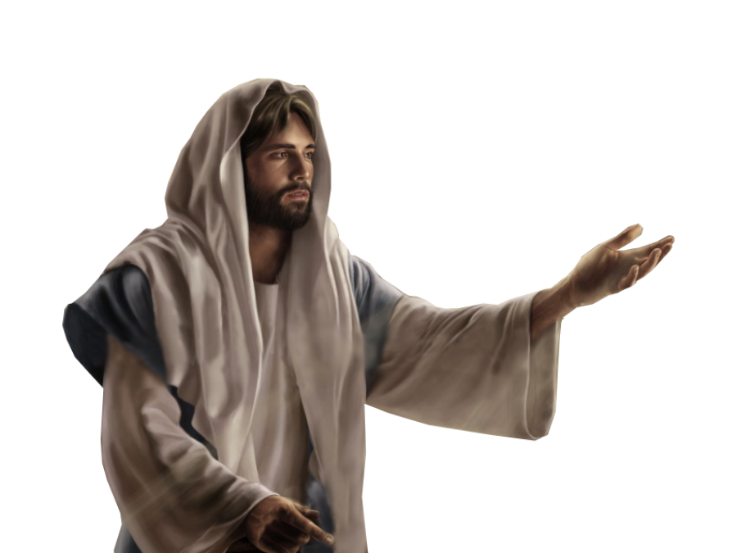
How does all of that apply to us?
Jesus suggested a new, radical response to injustice:
Instead of demanding rights, give them up freely!
1 Corinthians 7:22 “If you were free when the Lord called you, you are now a slave of Christ”

Slide 10
2) Whatever kindness we do for others, do it without expecting a return
It is easy for us to say, ‘why should I keep helping as they never seem to appreciate what I do?’
Acts 20:25 You should remember the words of the Lord Jesus: ‘It is more blessed to give than to receive.’

Slide 11
Examples
* Pope John Paul 2nd
* Yasir Arafat
* Uday and Qusay Hussein
* Grand Ayatollah of Baghdad
* Israel’s Chief Rabbis
‘You listen to their stories, you get to know each person
and love them’

Slide 12
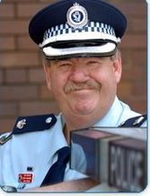
Chief Inspector Gary Raymond (Ret)
Police Commissioner’s Citation
Australian Police Medal (APM)
Order of Australia Medal (OAM)
Granville Train Disaster Medallion
Detective on Anita Cobby murder
Chaplain to the Police
Salvation Army

Slide 13
How can we learn to love our enemies?
What steps can we take to really love our enemies?
1. Show genuine respect
Show your enemies the genuine respect that every human being deserves. Learn to think of them with compassion and not contempt
Responding to evil with more evil does not solve the problem. And Jesus knew this when he said, “Forgive them, Father, they don’t know what they are doing.”

Slide 14
2. Put yourself in their shoes
There may be an underlying reason for their attitude and actions. We may not know their history and how they ended up the way they did.
3. Find common ground
Acknowledging your differences. When you acknowledge that there are differences between you, you can open the door to common goals and actions.

Slide 15
4. Forgive them
Jesus makes it clear many times in the Bible that we must model our forgiveness of others on God's forgiveness of our sins. Either you can hate what happened in the past and not change a thing, or you can accept it and move forward
5. Reach out to them first
Take the first step – leaving things simmer ends up in guilt and/or anger
Matthew 5:25b “settle things quickly with your adversary”

Slide 16
6. Pray for your enemies
Praying honestly for them is loving in the same way our Heavenly Father loves
1 Corinthians 13:4–5, “Love is patient, love is kind. It does not envy, it does not boast, it isn't proud. It does not dishonour others, it isn't self-seeking, it isn't easily angered, it keeps no record of wrongs."

Slide 17
Love Your Enemies
Matthew 5:38-48

