Slide 1
giving
2 Corinthians 9: 1 - 15
Notes:
More than 2,300 Bible verses talk about wealth and possessions and 11 out of 39 of the parables of Jesus discuss money.
We give money to the things that we most value, and oftentimes those things are temporary and fleeting. A typical budget reveals that we value our homes, transportation, and entertainment. What we give to the church is indicative of the longing we have for the glory of God.
The problem is that most of us have also developed habits that don’t align with our goals.
• We need to recognize as a society we are gripped by greed. Need to look after yourself, no one else will.

Slide 2
Philosophies
Greece said, "Be wise, know yourself.“
Rome said, "Be strong, discipline yourself.“
Epicureanism says, "Be sensuous, enjoy yourself.“
Psychology says, "Be confident, assert yourself.“
Materialism says, "Be satisfied, please yourself.“
Pride says, "Be superior, promote yourself.“
Humanism says, "Be capable, believe in yourself.“
But Christianity says, "Be a steward, give of yourself."
Notes:
Epicureanism says that the absence of pain is the greatest pleasure; it also advocates a simple life.

Slide 3
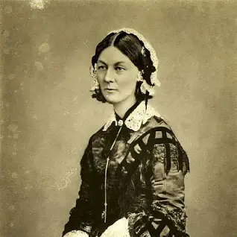
At 30, Florence Nightingale
wrote in her diary,; "I am thirty years of age, the age at which Christ began his mission. Now no more childish things, no more vain things. Now, Lord, let me think only of Thy will."
Years later, near the end of her illustrious, heroic life, she was asked for her life's secret, and she replied,
"Well, I can only give one explanation. That is, I have kept nothing back from God."

Slide 4
Why does God want your money?
US Psychiatrist Karl Menninger said, "Our capacity to give is one of the best indications of mental health. I have known very few generous people who were mentally ill." The fact remains, abundant living begins with abundant giving.
Notes:
It can’t be because He needs the financial help—He owns everything and has no need for anything,
Our consumer-oriented society pressures us to place too much value on material things, to the point that our joy is based on how much we have. This approach to life results in chronic dissatisfaction. We never seem to have enough.

Slide 5
At the heart of Christianity is giving.
"For God so loved the world, he gave . . ." (John 3:16).
We are never more like God
than when we give.
Jesus said, "I did not come to be served, but to serve, and to give my life" (Matt. 20:28).

Slide 6
⁸ “Will a mere mortal rob God? Yet you rob me.
“But you ask, ‘How are we robbing you?’
“In tithes and offerings. ⁹ You are under a curse — your whole nation — because you are robbing me. ¹⁰ Bring the whole tithe into the storehouse, that there may be food in my house. Test me in this,” says the Lord Almighty, “and see if I will not throw open the floodgates of heaven and pour out so much blessing that there will not be room enough to store it. (Malachi 3: 8-10)

Slide 7
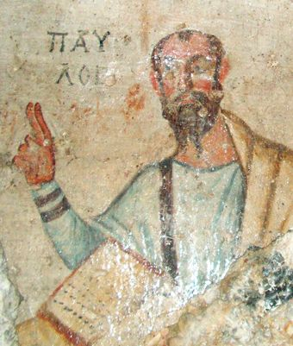
THE OFFERING FOR THE JERUSALEM CHURCH
In the late-40s A.D., a famine swept across Judea, and Christians in Jerusalem were in need. The leaders of the Jerusalem church, James, Cephas, and John requested Paul “to remember the poor — which very thing
I (Paul) was also zealous to do” (Galatians 2:9-10; Acts 11:19-30).
Paul responded by encouraging Christians to contribute to an offering to provide relief for Jerusalem Christians.
Notes:
Theirs was an Agricultural environment , therefore Jesus’ & Paul’s references to Sowing, Reaping, etc are the images people of the day were familial with.

Slide 8
Let Us Give Worshipfully
“Cain brought some fruits of the soil as an offering to the Lord. But Abel brought fat portions from some of the first born of his flock.” (Gen 4:3-4a)
Abraham also give tithes and offerings to the Lord. (Gen 22)
Noah sacrificed to the Lord. (Lev 22:19)
Under Moses the worship of God certainly involved the offering up of sacrifices to God. (Ex 36-40)
Paul viewed the financial support sent from the Philippians to him as “fragrant offering, a sacrifice acceptable and pleasing to God.” (Phil 4:18)
Notes:
If you were to read through the Old Testament you would certainly see just how central giving was to the worship of God from the beginning. When Cain and Able came to worship, they came with something to offer.
The sacrificial system implemented under the Mosaic Covenant was complex. There were many different kinds of offerings – burnt offerings, drink offerings, grain offerings, and incense offerings. There were guilt offerings, and freewill offerings. This complex form of worship was instituted by God for a time in order to serve as a means of grace for the people of God under the Old Covenant and to paint a picture of the Christ who would one day come.
When you give in support of the advancement of Christ’s kingdom – when you give for the building up of the temple, which is the church – when you give for the support of gospel ministry – it is an act of worship. We should give worshipfully to the Lord.

Slide 9
Let Us Give Sacrificially
“Each one must give as he has decided in his heart, not reluctantly or under compulsion, for God loves a cheerful giver.” (2 Corinthians 9:7)
“Now concerning the collection for the saints: as I directed the churches of Galatia, so you also are to do. On the first day of every week, each of you is to put something aside and store it up, as he may prosper, so that there will be no collecting when I come.” (1 Corinthians 16:2)
“Jesus looked up and saw the rich putting their gifts into the offering box, and he saw a poor widow put in two small copper coins. And he said, ‘Truly, I tell you, this poor widow has put in more than all of them. For they all contributed out of their abundance, but she out of her poverty put in all she had to live on.”’ (Luke 21:1–4)
Notes:
1) One of the questions that people ask is, “if I am to give worshipfully, how much should I give?” I think the best way to answer that question is to say that you should give sacrificially.
I am certainly not in favor of requiring a tenth in a legalistic way.
Notice the way that Paul talks about giving. Each one is to give “as he has decided in his heart” and “as he may prosper”, which means according to his prosperity, or ability.
Jesus is saying the same in Like, i.e. according to Prosperity and ability.

Slide 10
Let Us Give Faithfully
Our giving should be faithful as in consistent.
Our giving should be faithful as in regularly.
Our giving should be faithful as in with hearts full of faith.
“Remember this: whoever sows sparingly will also reap sparingly, and whoever sows bountifully will also reap bountifully.” (2 Corinthians 9:6)
Notes:
“And God is able to make all grace abound to you, so that having all sufficiency in all things at all times, you may abound in every good work. As it is written, ‘He has distributed freely, he has given to the poor; his righteousness endures forever.’ He who supplies seed to the sower and bread for food will supply and multiply your seed for sowing and increase the harvest of your righteousness. You will be enriched in every way to be generous in every way, which through us will produce thanksgiving to God.” (2 Corinthians 9:8–11, ESV)

Slide 11
Let Us Give For The Promotion Of Christ’s Kingdom
All things are from God and are for God
God is greater than either your needs or fears
GIVING IS NOT AN END IN ITSELF
Notes:
Here I simply wish to emphasize that when you give, the money does not vanish into thin air, but has an impact upon the kingdom of God.
The elders and deacons of the church have a responsibility to use the tithes and offerings wisely and appropriately. Budgets should be established and maintained that reflect the God given mission of the church. Just as the priests under the Old Covenant were to use the offerings of the people for the establishment, promotion, and maintenance of the worship of God in the temple of God. So too elders and deacons are to manage the monies of the church so that Christ’s temple is indeed build up through the proclamation of the word of God, by the power of the Holy Spirit. Our mission is the great commission. The monies of the church are to be used for the accomplishment of that mission.
The point I am making is that kingdom work does cost money. And it is your giving that makes it possible. Stuff gets done, that is the point. Giving is practical.

Slide 12
Let Us Give Willingly
“Each one must give as he has decided in his heart, not reluctantly
or under compulsion…” (2 Corinthians 9:7)
You should not and are not to be forced to give by the Church.
(The church does not send a bill to it’s members.)
Your giving is between you and the Lord!
Jesus said, "It is more blessed to give than to receive" (Acts 20:35)
Notes:
I’ve actually heard of churches that insist on seeing the bank account information of their members so they can compare it to the giving. That’s very troubling to me.

Slide 13
Let Us Give Cheerfully
“God loves a cheerful giver.” (2 Corinthians 9:7)
I hope that you are blessed when you give.
I hope that you do it with a smile on your face.
I hope that it brings a sense of satisfaction to you to know that God, by his grace, has enabled you to work hard, to earn a living, and to bring a portion of what you have earned to him as an offering – “a sweet smelling aroma.”
It is more blessed to give than to receive.
Giving should result from inward resolve, not from impulsive or casual decision.
Once the amount to be given has been determined, as Paul says, the gift should be given, “Cheerfully.”

Slide 14
Let Us Give To The Glory Of God
We ought to give to the glory of God.
“This service that you perform is not only supplying the needs of God’s people but is also overflowing in many expressions of thanks to God.”
(2 Corinthians 9:12)
“Thanks be to God for His indescribable gift!”
(2 Corinthians 9:15)
Notes:
Some give, but seeking glory for themselves.
Once again. All things are from God and are For God.

Slide 15
Am I thinking about money the right way? (Do we put God first or money? )
Prayerfully consider your giving.
Am I giving Worshipfully, Sacrificially, Faithfully, and with the furtherance of Christ’s kingdom in mind.
Give Willingly, Cheerfully, and to the Glory of God
Do I see all things as coming from God and myself as a steward.
Make sure that whatever you give, be it small or great, be it 1% or 50%, that your heart is right before God.
“He who did not spare his own Son but gave Him up for us all, how will he not also with him graciously give us all things?” Romans 8:32

Slide 16
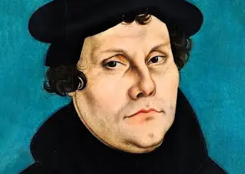
"A religion that gives nothing, costs nothing,
and suffers nothing,
is worth nothing."
(Martin Luther)

