Slide 1
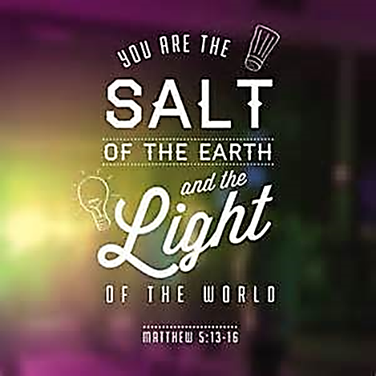

Slide 2
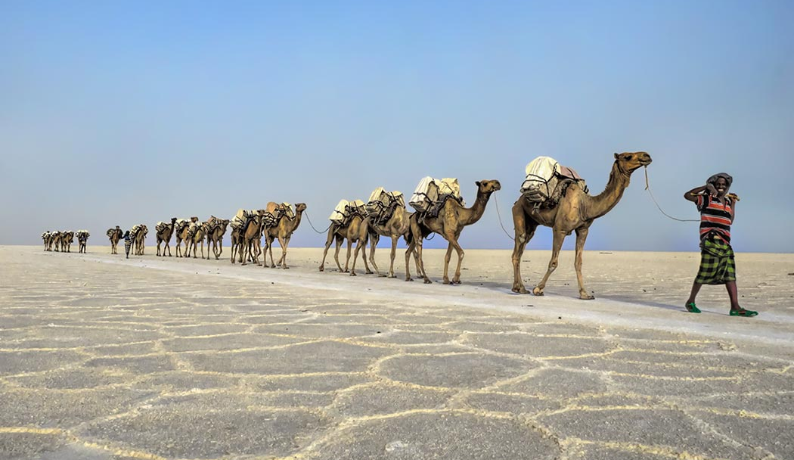
“from the beginning of civilisation until about 100 years ago, salt was one of the most sought-after commodities in human history.”
Notes:
“Salt: A World History.” Mark Kurlansky reminds us, is the only rock that we eat, and its importance has shaped civilisation in all sorts of important ways. We think of salt as something that we put on foods to give them a little more flavour, but the author of this book reminds us that “from the beginning of civilisation until about 100 years ago, salt was one of the most sought-after commodities in human history.”

Slide 3
“from the beginning of civilisation until about 100 years ago, salt was one of the most sought-after commodities in human history.”
Roman soldiers were sometimes paid with special salt rations. That is where our word, “salary,” actually comes from.
Salt in Jesus time came from the Dead Sea – Very salty, but, Impure (therefore, salt could be washed out easily)
Notes:
In fact, salt was so valuable in Jesus’s time that Roman soldiers were sometimes paid with special salt rations. That is where our word, “salary,” actually comes from. It’s also why, when someone is not doing their job, we sometimes say “they are not worth their salt.”
Dead Sea salt contained a lot of minerals & so the TRUE salt content could be Washed out

Slide 4
“from the beginning of civilisation until about 100 years ago, salt was one of the most sought-after commodities in human history.”
Roman soldiers were sometimes paid with special salt rations. That is where our word, “salary,” actually comes from.
Salt in Jesus time came from the Dead Sea – Very salty, but, Impure (therefore, salt could be washed out easily)
To become tasteless, = Foolishness
Notes:
Dead Sea salt contained a lot of minerals & so the TRUE salt content could be Washed out
The Greek translates Jesus word Tasteless, as more literally, FOOLISHNESS

Slide 5
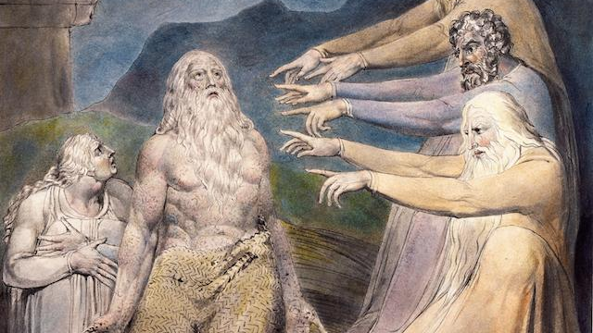
Job 6:6
"Is tasteless food eaten without salt, or is there flavour in the white of an egg?
I refuse to touch it; such food makes me ill."

Slide 6
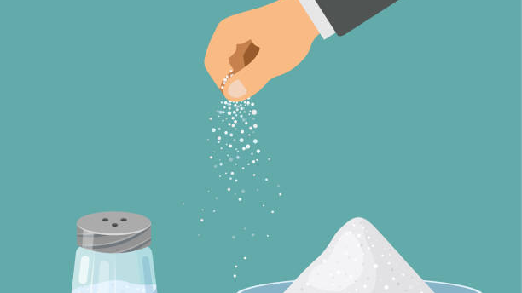
V. 13 uses of salt
Seasons Food
Preserves
Fights & Kills some Bacteria
Gives Strength
Creates a Thirst
Notes:
Almost everything we eat has Salt in it. Even just a pinch of salt can make a difference
Salt retards spoilage. It doesn’t prevent the process of decay, but it slows it down and prevents its spread. Meat left to itself will spoil. Cure the meat with salt and it will last a long time
salt is an antiseptic that first stings and then heals. It kills some types of bacteria.
Without it, your body quickly weakens. That’s one reason the Romans gave their soldiers salt. Soldiers in the World Wars and in hot tropical areas were given salt tablets. Aust ration packs are quite salty.
It creates thirst and causes you to crave something to drink.

Slide 7
uses of salt
Seasons Food
Preserves
Fights & Kills some Bacteria
Gives Strength
Creates a Thirst
Salt is no good on its own.
It doesn’t exist for itself.
Salt, to be effective, must be in contact with the meat
Notes:
Note that salt, to be effective, must be in contact with the meat or fish it is to preserve. To be effective, we must be involved where we work and where we live. This puts us in a tension because the dominant culture doesn’t necessarily like us.
Salt is no good on its own. It doesn’t exist for itself. It’s kind of obvious when you think about it, but salt is always used for something else. The salt shaker on the table is not the meal. It is simply there to help flavour the meal. Salt doesn’t exist for itself. And that’s true for us as Christians. Yes, we are valuable. We are important. But not for ourselves.

Slide 8
uses of salt
Seasons Food
Preserves
Fights & Kills some Bacteria
Gives Strength
Creates a Thirst
Salt is no good on its own.
It doesn’t exist for itself.
Salt, to be effective, must be in contact with the meat
We exist for Jesus
Notes:
Jesus came to tell people about His Father and about Heaven. That is, He Glorified God, His Father.
We exist to do exactly the same. We exist to Glorify God the Father through Glorifying His one and only Son Jesus.
We exist for Jesus, NOT ourselves. By ourselves we are nothing but water and a collection of various chemicals.

Slide 9
Light & darkness
V. 14 Light vs Darkness
John 8:12, He says, "I am (Jesus) the light of the world. Whoever follows Me will never walk in darkness, but will have the light of life."
Ephesians 5:8, "You were once darkness, but now you are light in the Lord."
Colossians 1:13 , "He has rescued us from the dominion of darkness and brought us into the kingdom of light, into the kingdom of the Son He loves."
Psalm 119:105, "Your word is a lamp to my feet, and a light to my path."
I Peter 2:9, "You are a chosen people, a royal priesthood, a holy nation, a people belonging to God, that you may declare the praises of Him who called you out of darkness, into His wonderful light."

Slide 10
John 1:5, “The light shines in darkness, but the darkness has not understood it.”
Darkness is a non-entity.
Darkness is simply the absence of light.
Darkness has no ability to overcome the light.
Jesus said we are the light of the world, not the light of the church.
Notes:
Houses in Jesus day were generally 1 room and few if any windows. They were dark. A single light would illuminate the entire house.
That’s what the apostle John was trying to say. If the only time we let our light shine is at church on Sunday, we essentially hide our lights under a basket.

Slide 11
“The Bible is not the light of the world, it is the light of the Church. But the world does not read the Bible, the world reads Christians! ‘You are the light of the world.” (Charles Spurgeon)
Notes:
You are the Light.

Slide 12
“The Bible is not the light of the world, it is the light of the Church. But the world does not read the Bible, the world reads Christians! ‘You are the light of the world.” (Charles Spurgeon)
We don’t have to change the world to give glory to God.
We don’t have to fix all the problems of our world.
We just need to let our light shine.
And that will bring glory to God.
Notes:
The smallest act of kindness, the simplest gesture of hospitality and welcome, the humblest sharing of our time or talent – these all give glory to God.
No matter how small your light is, it is exactly what this world needs.

Slide 13
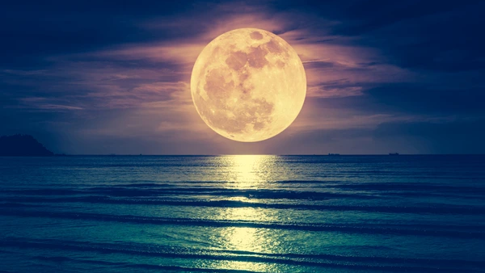
When the moon is at its brightest, it is not providing any light of its own.
Reflects the light of the sun.

Slide 14
When the moon is at its brightest, it is not providing any light of its own.
Reflects the light of the sun.
When we are being the light of the world, we’re not actually providing any light of our own.
We’re simply reflecting the light of the Son.
When we are doing that well, we are then being fully ourselves.
As disciples of Jesus that is what He has called us to be.
The darker the world around us, the more important the light we shine.

Slide 15
World vs church
The church is being walked on by the world today.
There is no respect for the church in this world anymore.
Because we are too much like the world.
We use the same foul language, see the same movies, ignore the Bible, and the fact is the average person on the outside of the church looks at the average person on the inside of the church and says, "He's no different than I am, so why should I go to church or practice Christianity?"
Notes:
Now what is the difference between salt and light? Salt relates to our character; light relates to our conduct. Salt deals with what we are; light deals with what we do.

Slide 16
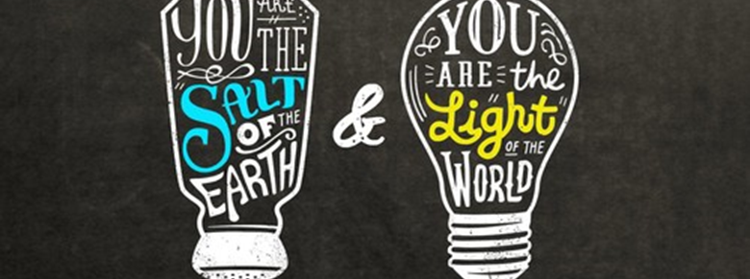
Dietrich Bonhoeffer, the German-born Lutheran pastor who died for his faith at 39 said, “A community of Jesus which seeks to hide itself has ceased to follow Him.”

Slide 17
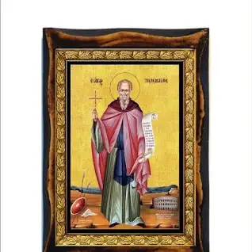
telemachus
Born 3rd century
Asia Minor, Eastern Roman Empire
Died 1 January AD 391
Rome, Western Roman Empire (Italy)
Notes:
Read Telemachus

