Slide 1
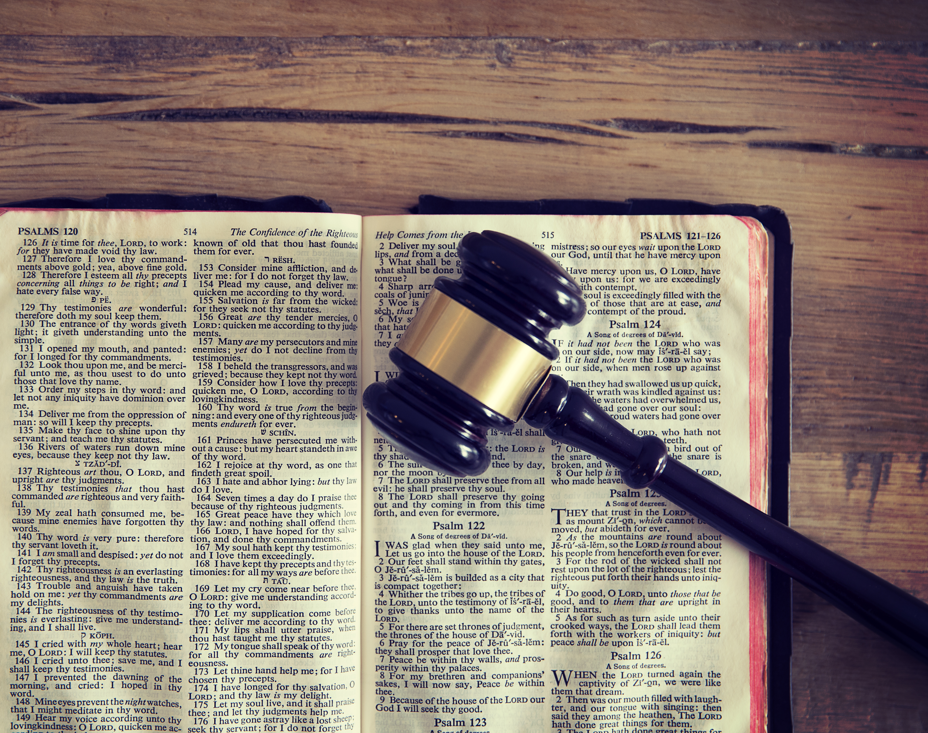
CHRIST FULFILLS THE LAW
MATTHEW 5:17-20
Notes:
Good morning everyone. Happy Mother’s day to all the mothers out there
Well, what a great Mother’s day sermon, getting to talk to you all about how Jesus Christ has fulfilled the law
For those of who are new or have missed the last couple weeks, we are doing a series on the Sermon on the Mount, and we are up to our third one in the series
I know that perhaps during the Bible reading many of you may have been thinking that this passage seems rather boring, and so what hope is there for this sermon.
But, many scholars and pastors believe this passage to be the most important or one of the most important verses in the Sermon on the Mount, and some even extend it as far as saying that it is one of the most important verses in the entire Bible

Slide 2
“I do not believe that any man can preach the gospel who does not preach the Law. Lower the Law and you dim the light by which man perceives his guilt… it lessens the likelihood of his conviction and conversion. I say you have deprived the gospel of its most powerful weapon when you have set aside the Law. You have taken away from it the schoolmaster that is to bring men to Christ . . . They will never accept grace till they tremble before a just and holy Law. Therefore, the Law serves a most necessary purpose, and it must not be removed from its place.” Charles Spurgeon
Notes:
In our culture and even in our churches we don’t like talking about the Law of God, or we feel like we need to apologise for it.
Or sometimes we try to cover it up, pretending like it doesn’t exist
Here’s what my good friend Charles Spurgeon has to say on preaching the law:
“I do not believe that any man can preach the gospel who does not preach the Law. Lower the Law and you dim the light by which man perceives his guilt… it lessens the likelihood of his conviction and conversion. I say you have deprived the gospel of its most powerful weapon when you have set aside the Law. You have taken away from it the schoolmaster that is to bring men to Christ . . . They will never accept grace till they tremble before a just and holy Law. Therefore, the Law serves a most necessary purpose, and it must not be removed from its place.”
If we fail to understand just what these 4 verses are saying here in the Sermon on the Mount, then we fail to grasp exactly what the gospel is and what it is that Jesus accomplished for us on the cross

Slide 3
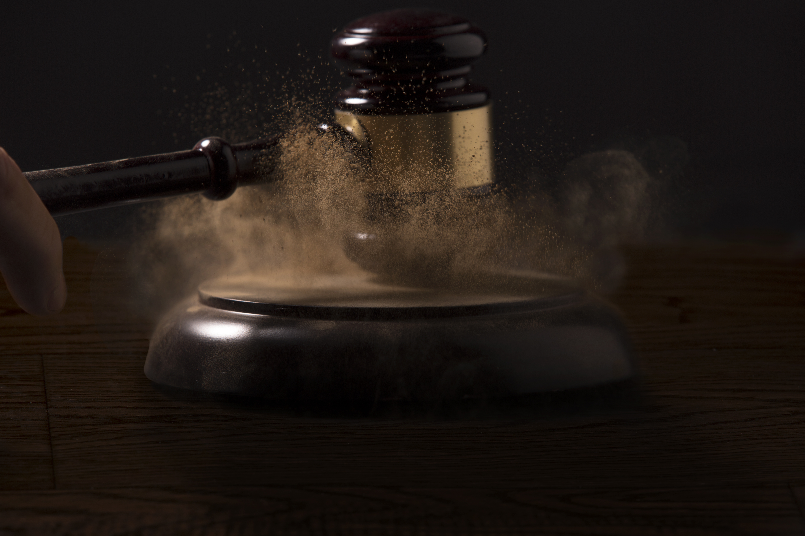
CHRIST FULFILLS THE LAW
“Do not think…” (Matt 5:17a)
“That I have come to abolish the Law or the Prophets” (Matt 5:17b)
“I have not come to abolish them but to fulfill them” (Matt 5:17c)
Notes:
“Do not think…” (Matt 5:17a) - Firstly, this makes me think of Matthew 9, the story of Jesus and the paralytic, where the paralysed man’s friends lower him into the building - And Jesus says something amazing, he says that the man’s sins are forgiven before even healing him. - And this triggers the scribes, and they say to themselves, Jesus is blaspheming, because they don’t believe Jesus to be the Son of God - And then verse 4 of that chapter, “But Jesus, knowing their thoughts” - Or John 2:24-25 – “Jesus on his part did not entrust himself to them, because he knew all people, and needed no one to bear witness about man, for he himself knew what was in man” - Jesus knows that many of the scribes and Pharisees are going to see him do things that will make them think that Jesus is a lawbreaker - But Jesus is saying, do not think that, do not be so quick to declare me a lawbreaker because I break the law in accordance with your understanding - “Do not think…”
“That I have come to abolish the Law or the Prophets” (Matt 5:17B) - Now the Law often referred to the Torah, the first 5 books of the Bible written by Moses - And there are 12 books written by prophets in the Old Testament - But I think Jesus is referring not just to those 17 books of the Old Testament, but the whole of the Old Testament Scriptures - So Jesus is saying, I know that many of you know the Old Testament, but your interpretation is incorrect - They are going to see Jesus share meals with sinners, heal people on the Sabbath, show compassion and love and even touch the unclean such as the lepers - And the Pharisees will be very quick to call him out on it, to declare him unclean, a sinner, a blasphemer, a false teacher
“I have not come to abolish them but to fulfill them” (Matt 5:17c) - If we think that Jesus is breaking the law, then our interpretation is wrong, as was the Pharisees and the scribes - Why would Jesus come and abolish that which God established - There has never been anything wrong with the Law of God. The Law of God is perfect because God, the law giver is perfect - The law has never been the issue, the issue has always been with us - Jesus has come to fulfill the law. And this word fulfill has a lot of weight to it - So what does it really mean?

Slide 4
The Law and the Prophets have always pointed forward to Jesus (1 Pet 1:10-12)
“All of Scripture is breathed out by God…” (2 Tim 3:16-17) which applies to BOTH the New and Old Testament
Jesus fulfilled the Law of God in perfect obedience to the Father
Notes:
The law and the Prophets have always pointed forward to Jesus (1 Pet 1:10-12) - Let us read 1 Peter 1:10-12 - Jesus himself is the fulfillment and substance of all the types, and prophecies, and commands of the law - He establishes in its deepest sense all that is written in Holy Scripture, and puts a new fullness into it - You see the law is perfect. But it was not plan A, and then as if to say there was something wrong with plan A, Jesus needed to come and fix it and be plan B - Jesus is also not the fulfillment of plan A as if they are separate from one another. As if Jesus comes second to the law - There is only one plan, God’s redemptive plan, which is found and ultimately culminates in the person and work of Jesus Christ. - The Law of God is perfect, and Jesus fulfills the law in that it points to him, the perfect Son of God, the second member of the Trinity
“All of Scripture is breathed out by God…” (2 Tim 3:16-17) - The 2 testaments must always go together. Jesus is telling us here that all of this is the Word of God, it is all authoritative. - Jesus in his ministry quotes the Old Testament everywhere - Remember when Jesus was baptised and he went into the desert for 40 days and 40 nights, and Satan comes to tempt him. - How does Jesus defeat Satan here and overcome the temptation? - He takes hold of the sword of the Spirit, he wields the Word of God, and quotes the Old Testament, and by the written word of God in the Old Testament, Satan’s plans are thwarted and he flees
Jesus fulfilled the Law of God in perfect obedience to the Father - If Jesus doesn’t fulfill the law of God, then we have no perfect sacrifice, no substitute and no Saviour and therefore, NO GOSPEL. - And you might be thinking in what way did Jesus actually keep and obey the Law of God? - Well, the law in the Old Testament is often broken down into 3 categories, judicial or civil law, moral law, and ceremonial law - The judicial law is those laws given specifically for the culture and place of the Israelites that encompass all of the moral law, except the 10 commandments, but often tied in with the 10 commandments - The moral law is basically summed up in the 10 commandments. And Jesus perfectly fulfills the moral law in living the perfect life, coming and living a life of perfect obedience on our behalf to the Father - The ceremonial law is basically found all throughout the Old Testament, but probably best summarised in the book of Leviticus, which deals a whole lot with sacrifices - And so through Jesus Christ’s death, his sacrifice, resurrection and ascension to the right hand of the Father, all of the ceremonial law is fulfilled - Jesus is the once for all sacrifice, the just for the unjust, the perfect for the imperfect. - Never again is another sacrifice to be made for our sins, because in Jesus it was accomplished, it is finished - And Jesus is raised to life for our justification, that we may be made right with God and he ascends to the right hand of the Father - And unlike the priests of Israel who were constantly standing because there were always sacrifices that needed to be made for sins - Christ our great high priest goes to the right hand of the Father and SITS, because Jesus death was sufficient - And so because Christ fulfilled the law of God, we have the gospel which is the power of God unto salvation FOR ALL WHO WILL BELIEVE

Slide 5
THE LAW IS TIMELESS
“For truly, I say to you, until heaven and earth pass away” (Matt 5:18a)
“Not an iota, not a dot, will pass from the Law” (Matt 5:18b)
“Until all is accomplished” (Matt 5:18c)
Notes:
“For truly, I say to you, until heaven and earth pass away” (Matt 5:18a) - When Jesus says, “For truly, I say to you”, this is a form of speech that basically means Jesus is making a solemn declaration about a weighty truth - Jesus is saying, listen up because what comes next is important, and I need you to try and grasp whatever it is I’m about to say - Until heaven and earth pass away. That is to say, NEVER. - Jesus is about to make a statement that will stand the test of time
“Not an iota, not a dot, will pass from the Law” (Matt 5:18b) - An iota or a dot are among the smallest strokes in Hebrew writing - Therefore, the Law of God is unchangeable, it is permanent, it is timeless, even right down to the smallest stroke of the pen - Jesus has the highest possible view of the Old Testament. He is saying that none of it shall ever pass away
“Until all is accomplished” (Matt 15:18c) - This is not simply a reiteration of the Law of God never passing away - It is that, but it is even more than that. - The accomplishment is not just referring to Jesus’ life, death, resurrection and ascension - For all of the prophesies in the Old Testament must take place. Not one jot or tittle will fail in its fulfillment - Jesus is saying one day all will be accomplished in my kingdom at the end of time, which was prophesied by the prophets of old, and would be prophesied by people like John in the book of Revelation - The only way the for the Law of God to change is if God changes, and we know that God cannot change - So because the Word of God in it’s whole is timeless, and unchangeable let us find comfort and hope in this - Though the word of mankind may fail you, not an iota, not a dot of God’s Word shall pass unfulfilled. - His promises, His truth, His Word, will never fail you, for it is a firm foundation

Slide 6
THE LAW IS RELEVANT
“Therefore, whoever relaxes one of the least of these commandments and teaches others to do the same will be called least in the kingdom of heaven” (Matt 5:19a)
“But whoever does them and teaches them will be called great in the kingdom of heaven” (Matt 5:19b)
God’s Law as fulfilled in Jesus and interpreted by Jesus is our standard of holiness
Notes:
“Therefore whoever relaxes one of the least of these commandments and teaches others to do the same will be called least in the kingdom of heaven” (Matt 5:19a) - So now that we understand that not even the smallest component of God’s Law will pass away - We must understand that even the least of these commandments is expected to be obeyed - Now some of you are probably squirming in your seats wondering where I am going with this, perhaps thinking I’m about to make some very legalistic claim - Those who are a part of God’s kingdom, ought to live their lives in accordance with a kingdom ethic, and it is still relevant and applicable in our lives today - The issue here though is NOT just obedience, whilst that is certainly an aspect, but whether we undermine the law’s authority by teaching that it can be ignored or lowered in severity - But those who do this will be called the least in the kingdom of heaven
“But whoever does them and teaches them will be called great in the kingdom of heaven” (Matt 5:19b) - In the gospel of John, Jesus tells us that those who love him, will keep his commandments - In 1 John, we are told that to the children of God, His commands are not burdensome - But rather as a RESULT of the saving power of the gospel, we now enjoy doing what pleases God - And as a result of the sanctifying power of the gospel, HE PRODUCES FRUIT in our lives - It is the work of God from beginning to end - Our King, Jesus Christ, fulfills the law, and His Spirit works in all who have believed in Jesus Christ, to do that of God’s good pleasure as set forth in the written Word of God - And so, teachers, pastors, elders in the church, the universal church, must not only talk about God’s grace, and God’s love, and God’s goodness and His kindness - But Jesus tells us we must teach the children of God about the holiness of God and the justice and righteousness of God as demonstrated in the commands of God
God’s Law as fulfilled in Jesus and interpreted by Jesus is our standard of holiness - Too many teachers and preachers neglect to remind people of the holiness to which the Spirit of God works in us - We are telling people that they are saved by grace, and forgetting to remind them about the sheer awesomeness and holiness of the God of whom we serve - And as a result, we are seeing Christians who think that because they are saved by grace, they can sin, they can sleep around, live with their boyfriend or girlfriend before marriage - And God won’t mind because we are saved by grace - We are seeing people who proclaim to be Christian in name and yet proudly and boldly live lives that go directly against the Word of God, but it’s okay because we are saved by grace - And yet Paul in Romans 6 directly speaks to this. He says, “Shall we go on sinning so that grace may abound? MAY IT NEVER BE” - Listen to me. Don’t get the wrong idea here. It is by grace, through faith, in Christ alone that you are saved. But as a direct result of your salvation, and if you are truly a born again believer - By the power of God at work in you, one day at a time, one sin at a time, He will convict you of sin and kill that sin in you and transform you, that you might be conformed to the image of Jesus Christ - Never in this life will you be perfect, be completely rid of sin, until one day, when Jesus returns, and all the saints are raised to life, and then you will be glorified and sin will be no more

Slide 7
THE LAW IS INSUFFICIENT
“For I tell you, unless your righteousness exceeds that of the scribes and Pharisees” (Matt 5:20a)
During the 1st Century if you asked someone “who are the most ethical, righteous, godly people you know of?”
“You will never enter the kingdom of heaven” (Matt 5:20b)
Notes:
“For I tell you, unless your righteousness exceeds that of the scribes and Pharisees” (Matt 20a) - Scribes were professional students and teachers of the law of Moses, but also many of them added laws and traditions into the Law of God - They were essentially bureaucrats and experts on the Jewish life - Pharisees was the title of the reformist movement or school within Judaism, which people volunteered to, and were devoted to the meticulous practice of the law – ritual purity, tithing, sabbath observance etc. - Both these groups were most holy outwardly, and of chief importance among the Jews
During the 1st Century if you asked someone “who are the most ethical, righteous, godly people you know of?” - Without hesitation the answer would have been the Scribes and the Pharisees, without hesitation - This is so important for us to understand because as is often rightly preached and taught, Jesus and the disciples are like the good guys, and the Pharisees and Scribes are like the bad guys, the villains of the story - But we must not fail to see that the Pharisees and the scribes were looked up to, and were considered the most holy of men during the times of Jesus - But the verse doesn’t finish there. Jesus says unless your righteousness exceeds that of the scribes and Pharisees
“You will never enter the kingdom of heaven” (Matt 5:20b) - Jesus just drops a bomb and is saying, “If you want to be a part of my kingdom, then you have to be more righteous than the most righteous people any of you know of” - And so you can imagine, the sighs in the crowd, the dropping of many heads thinking, “I have to do more, be more, pray more, fast more, preach more, give more and be greater than the most holy and devout men we know?” What hope do I have? - But here’s what we need to understand. For the Pharisees and the scribes, their religion, their hope rested in their works, their legalism - They thought, like all other world religions today, that by being obedient to the law in deed only, they could attempt to attain or retain salvation by works, that they could earn God’s favour - They thought that they had the highest view of the law possible, that they have obeyed so well, and held the law in such high esteem that God would have to be pleased with them - As if somehow they were now good enough for God based on their own merit

Slide 8
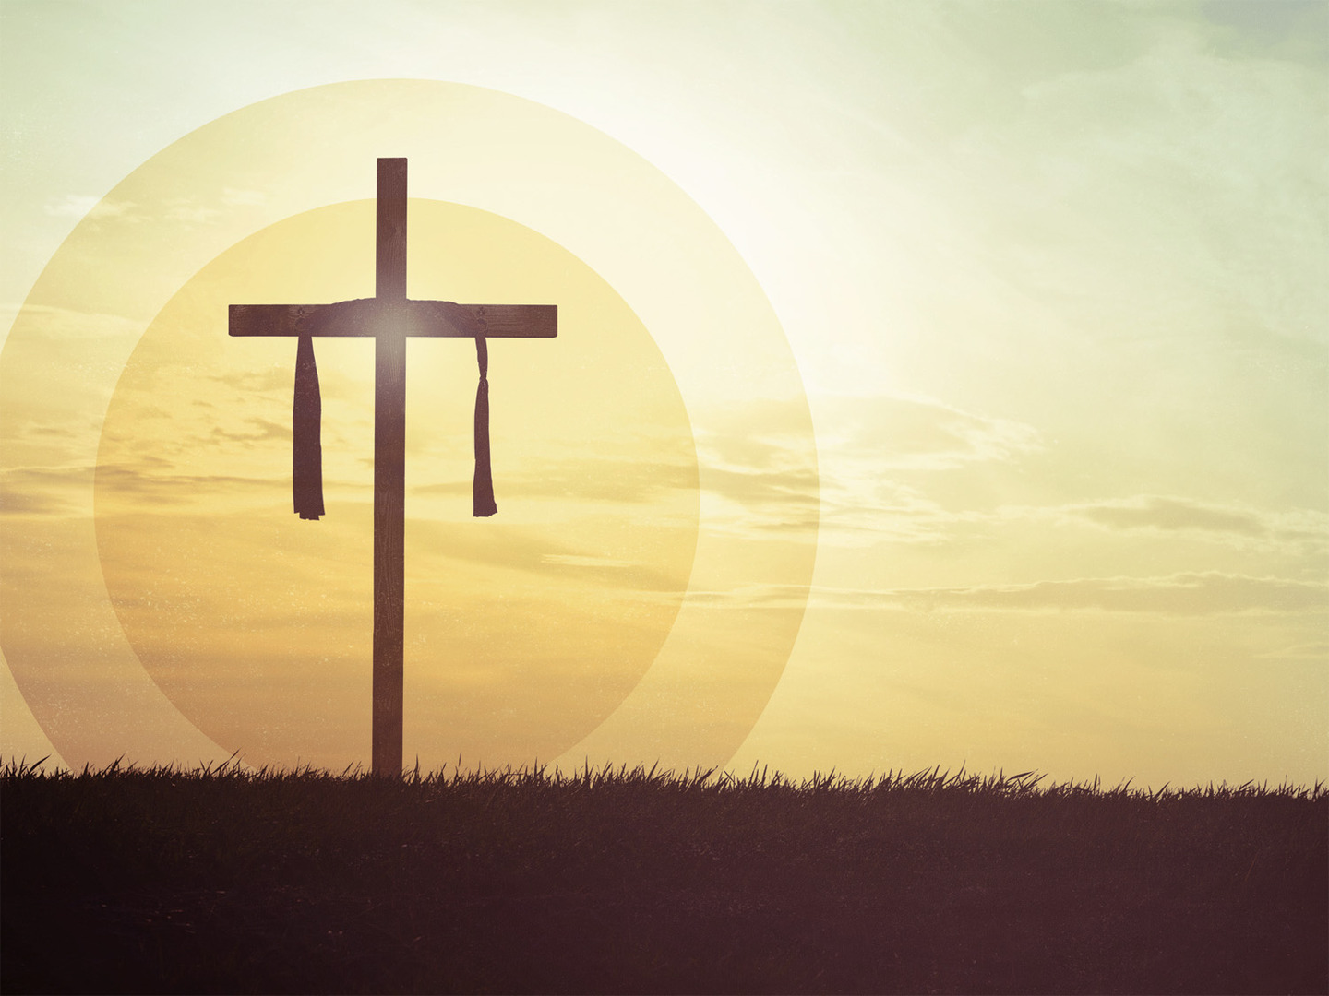
The Kingdom of God is concerned about the heart
Following on from these verses (vs 21-48) Jesus deals with 6 laws/attitudes of the heart
The perfect righteousness that grants us entrance into the kingdom of heaven is only accomplished by believing in the finished work of Jesus Christ
Notes:
The Kingdom of God is concerned about the heart - You see the actual problem was they didn’t have a high enough view of the Law of God - As they studied the Law of God they should have seen this beautiful, unattainable law, that drives them to their knees in repentance, and see that their works are but filthy rags, and only by the grace of God, could they ever be saved - Only by an encounter with God Almighty, taking their heart of stone and replacing it with a heart of flesh and thus causing them to be born again - Could they ever receive the favour of God, based on the all-sufficient merit of Jesus Christ - God doesn’t want YOUR works, he wants you to believe in the finished work of Jesus Christ. - And once you believe in Jesus Christ, the Spirit of God works in you that you might be conformed and begin to bear the family resemblance. - You are not saved by good works but for good works
Following on from these verses (vs 21-48) Jesus deals with 6 laws/attitudes of the heart - And we will be dealing with these in the next few sermons, but let me give you an overview of what Jesus basically says - Jesus basically says this, “You’ve heard this from the Pharisees and the Scribes, here’s the standard you have been judging yourself by” - “Here’s what I want to say to you, THAT’S NOT GOOD ENOUGH!” It doesn’t get to heart of the matter - And in this very last verse of this section, verse 48, in summing it all up Jesus says, “You therefore must be perfect, as your heavenly Father is perfect” - The standard is perfection. And we could never hope to do that in our own strength, but that’s the beauty of the gospel, you don’t have to, it actually has nothing to do with you, and everything to do with Jesus Christ - Jesus is saying, lift that drooping head, and look to the cross of Jesus Christ - And understand that it is impossible for you, but what is impossible for man is possible with God. - The very reason Christ came was to fulfill the law, to obey the law of God, to die as the perfect substitutionary sacrifice on your behalf - So that you might receive the perfect righteousness of Jesus Christ
The perfect righteousness that grants us entrance into the kingdom of heaven is only accomplished by believing in the finished work of Jesus Christ - Jesus perfect righteousness goes beyond anything you have ever seen. - If the law was enough we could have stopped there, but the law was always pointing to something, someone greater - We moved beyond Mount Sinai, to the hill of calvary - And just as God gave His law to Moses for the people of Israel on top of Sinai. - On calvary, God gave His one and only Son so that whoever believes in him shall not perish but have eternal life - He made him who knew no sin, to be sin, so that in him we might become the righteousness of God - And so if we have believed in Jesus Christ for our only hope of salvation, we are no longer under law but grace - And so I rejoice in the grace of God, because I’m not under the law, I’ve been saved by Jesus Christ and I’m now free for the first time to live in right relationship with God when it comes to the law - And we are free to render joyful obedience to the law of God. - And when we are walking with Christ and keeping our eyes on him, and we look to the law and see the sin in ourselves, we can always turn it back to praise and worship because Christ kept the law - And we repent of our sins, knowing that we will be forgiven, and we praise God because Christ has fulfilled and kept the law, and that he is the one who will also keep it in me - It is only by the righteousness of Jesus Christ and by believing in him that we enter the kingdom of heaven

Slide 9
SUMMARY
The perfect Law of God was perfectly fulfilled by Jesus Christ
“Whoever has my commandments and keeps them, he it is who loves me” (John 15:21)
The Law of God in and of itself cannot save you and was never meant to save you, only the one to whom it points to can save you
Notes:
The perfect Law of God was perfectly fulfilled by Jesus Christ - The law and the prophets were always signs pointing to the person in whom they would find their culmination and completion - Jesus did not come to turn the Old Testament upside down, - He was pointing out to the Pharisees and the Scribes that in all their rigorous study, they had entirely missed the point of the law, that it was already the right way up because it pointed to Jesus Christ
“Whoever has my commandments and keeps them, he it is who loves me” (John 15:21) - Obedience to the commands of God is not the means of my justification, of being made right with God - But rather it is the fruit, the evidence of God’s grace at work in me - For the law is no longer written on stone but on the hearts of all those who have been born again, and we meditate upon the law of God, and we consider it a great privilege and joy to live a life of obedience, a life that is pleasing and glorifying to God
The Law of God in and of itself cannot save you and was never meant to save, only the one to whom it points can save you - Can you keep the law perfectly? Absolutely not - Jesus Christ is the only who has ever kept it or ever will - We do not ask, are we trying hard enough, but am I firmly rooted and grounded in him? - And so we abide in him, the one who has done it all, that’s the way to righteousness, abiding in Jesus Christ who is our perfect righteousness

Slide 10
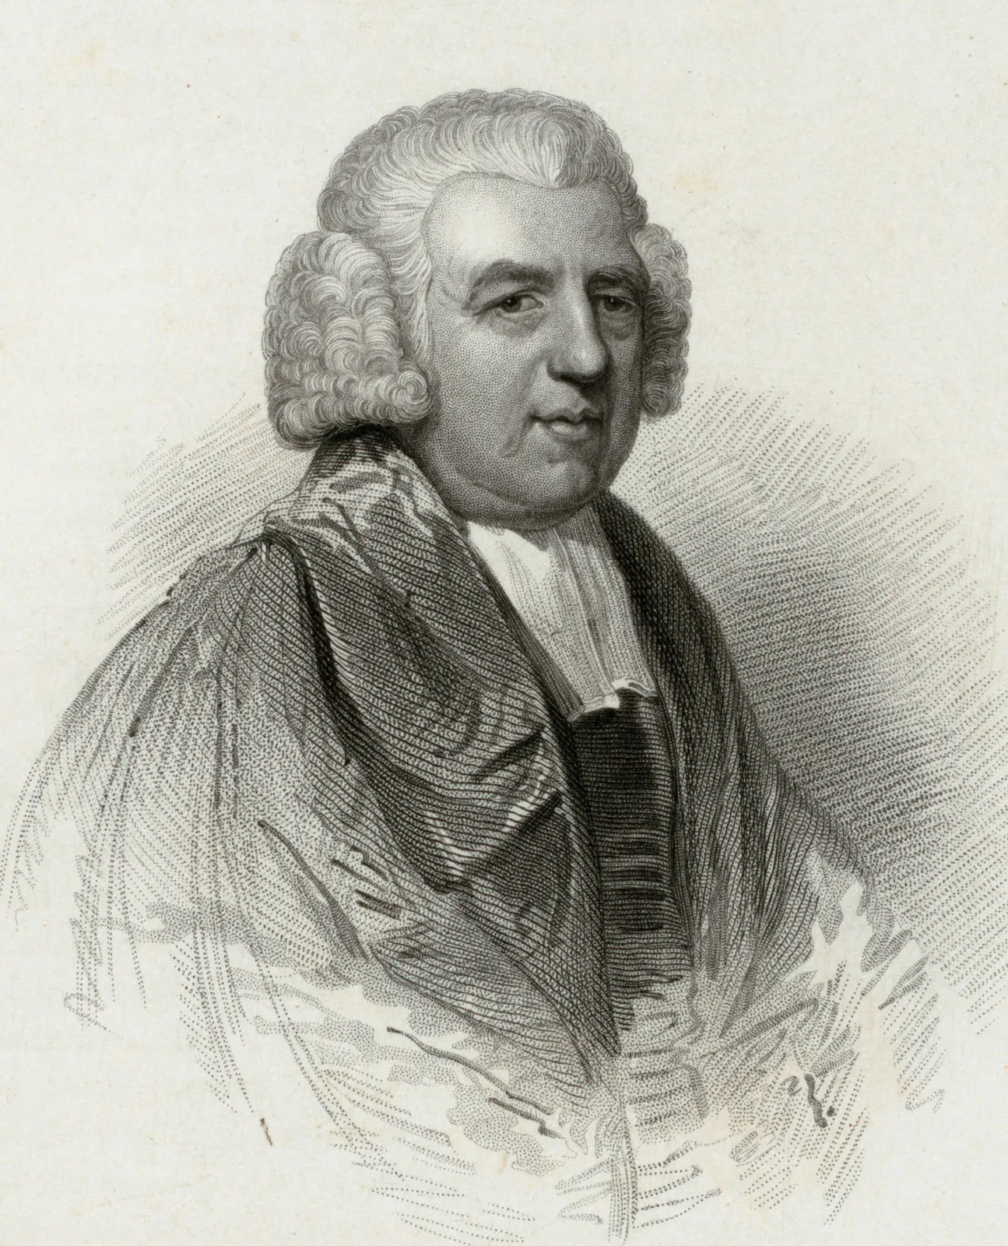
“I am not what I ought to be, I am not what I want to be, I am not what I hope to be in another world; but still, I am not what I once used to be, and by the grace of God I am what I am” John Newton
Notes:
So here’s what I want you to understand brothers and sisters in Christ.
The moral law of God is our standard of holiness and how we know whether we are sinning, and so we must not neglect it or cover it up
Nor is it there so that you might beat yourself to death. It is how we measure our holiness, so that you might look back and see how the power of God has been at work in your life and that you have grown
And we echo the words of John Newton, the writer of Amazing Grace, and we can say:
“I am not what I ought to be, I am not what I want to be, I am not what I hope to be in another world; but still, I am not what I once used to be, and by the grace of God I am what I am” John Newton
We look at the law of God and see that only by the grace of God I’ve grown, only by the grace of God I am what I am

