Slide 1
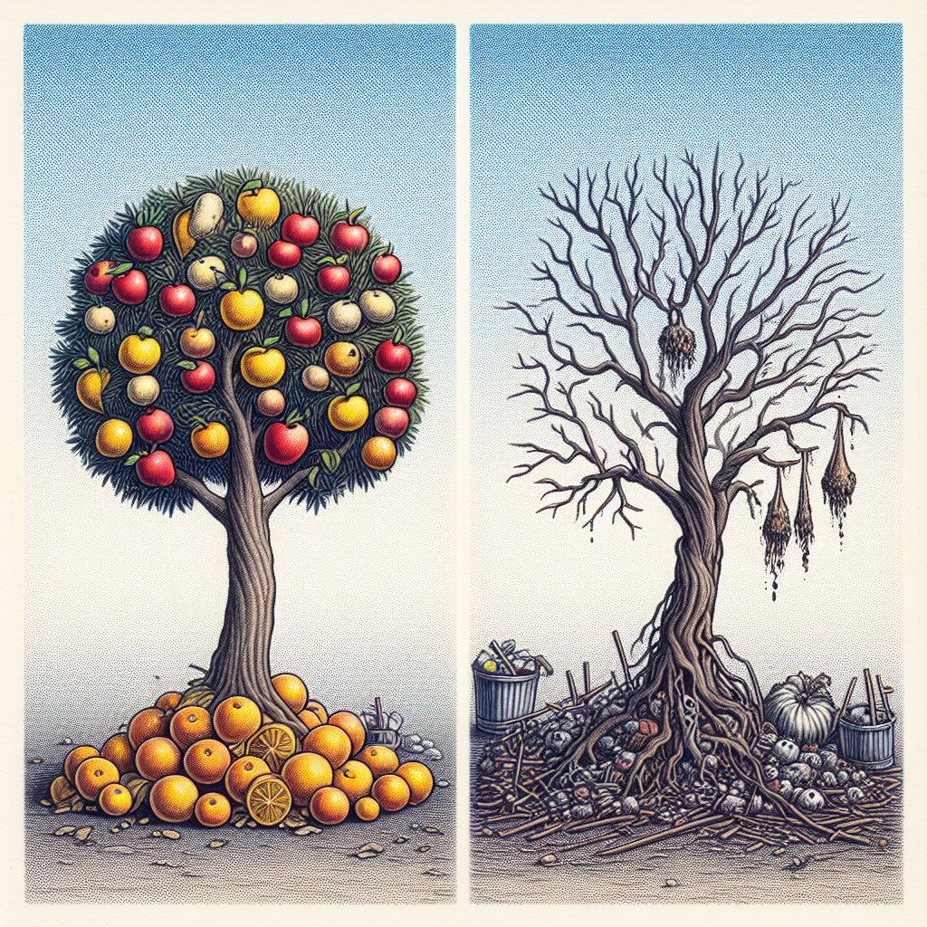
The Beatitudes
Matthew 5:1-12

Slide 2
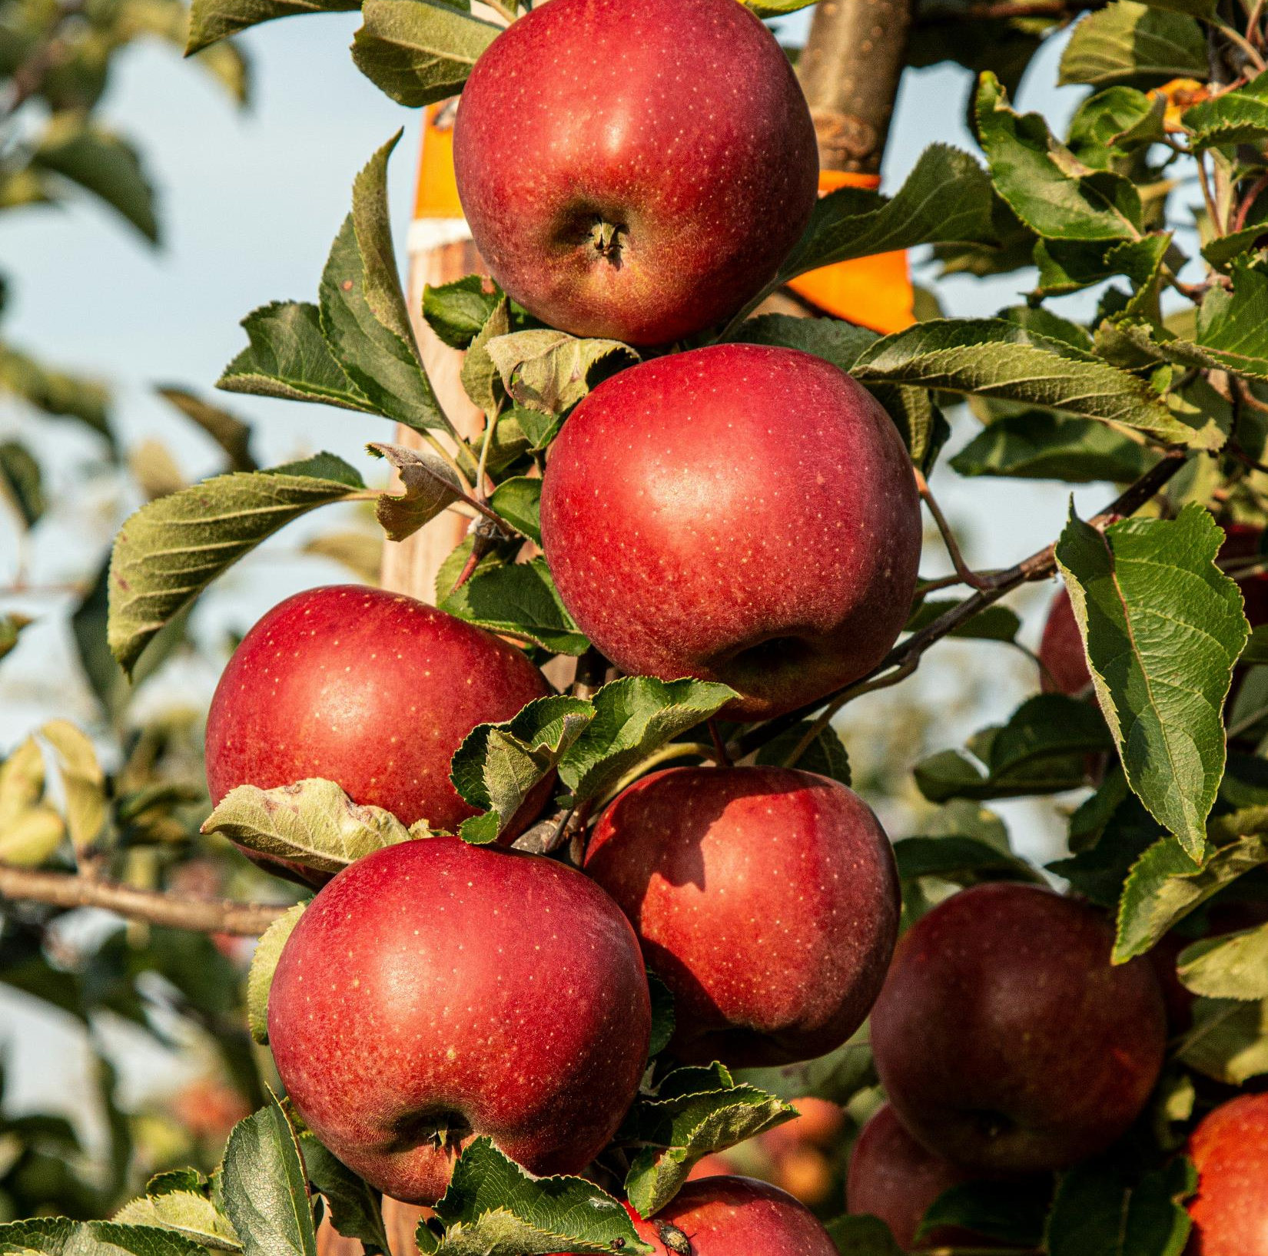
WHAT ARE THE BEATITUDES?
Characteristics (fruit of repentance) identifying those who are receiving salvation
A portrait of the righteous who live by faith
A diagnostic tool to test whether my belief in Jesus is real, saving faith

Slide 3
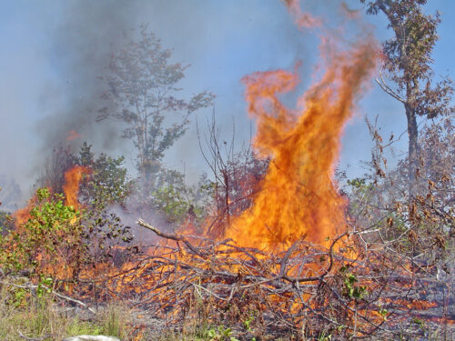
What’s at stake?
Possessing God’s kingdom
Inheriting the earth
Being filled with righteousness
Receiving mercy (Matt 6:14-15)
Seeing God
Being called children of God (John 1:12)
Any/all these are only true of those who are receiving salvation from sin, death and destruction in hell.

Slide 4
Sermon on the Mount (The Context)
Matt 3:1 John preached “Repent, for the kingdom of heaven is at hand.”
Opportunity or Warning or Both?
Matt 3:7-10 “who warned you to flee from the coming wrath? Bear fruit in keeping with repentance, and do not presume (you’ll escape God’s wrath)… Every tree therefore that does not bear good fruit is cut down and thrown into the fire.”
What does this have to do with the Sermon on the Mount and the Beatitudes?
Matt 4:17 “From that time (on) Jesus began to preach, saying, “Repent, for the kingdom of heaven is at hand.”
Jesus shares the same message, same concerns as John. Namely, many are presuming that they are saved, but are not bearing the fruit of repentance. The way they are living shows they are not children of God.
Matthew 7:13-28 is filled with Jesus warnings about the deadly consequences of not bearing the fruit of repentance. He contrasts heaven and destruction.

Slide 5
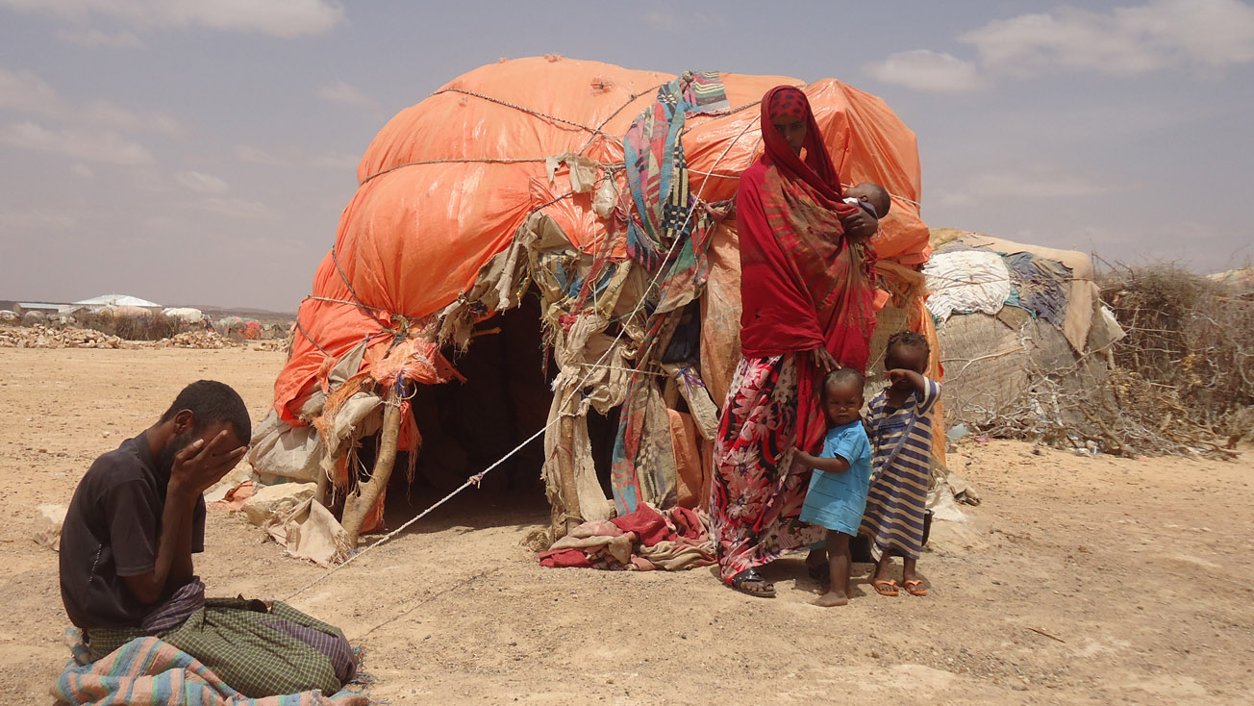
Blessed are the poor (in spirit)

Slide 6
Christianity 101 – Knowing my Spiritual Poverty
Ps 51:17 “the sacrifices of God are a broken spirit; a broken & contrite heart, O God you will not despise”
If you are spiritually poor (impoverished):
You know you have nothing to offer, to buy or trade with God (John 15:5; 1 Cor 4:7);
You know you are utterly dependent on God;
You ask God for his help in big and little things (Matt 6:11);
You take a place of humility, seeking God’s glory – not your own (Matt 5-7 fasting, praying, giving in secret – not to be seen).
Matt 5:16 “that they may see your good deeds and give glory to your Father in Heaven”
Phil 2:13 “it is God who works in you both to will and to work for His good pleasure”
The Bible undermines all self-sufficiency and self-fulfilment, even probably self-approval and self-esteem. (Ex 4)
Christianity is not for the strong and capable. It is for weak wretches.

Slide 7
Blessed are the
Blessed are
the Mourning Ones
Ps 51:17 “the sacrifices of God are a broken spirit; a broken & contrite heart, O God you will not despise”
All believers feel sorrow for their sin, not just for sin’s consequences. We don’t merely know that we have sinned, but that we are sinners. (Mark 10:18; Luke 11:13)
A Christian’s mourning continues throughout this mortal life (Matt 6:12)
As we grow in Christ, we mourn our losses in the fight of faith, looking to God for forgiveness and grace to defeat sin.
God’s Amazing Grace saved “a wretch like me”.

Slide 8
Blessed are the Meek
^{Psalm 37}
¹ Fret not yourself because of evildoers; be not envious of wrongdoers! ² For they will soon fade like the grass and wither like the green herb.
³ Trust in the Lord, and do good; dwell in the land and befriend faithfulness. ⁴ Delight yourself in the Lord, and he will give you the desires of your heart.
⁵ Commit your way to the Lord; trust in him, and he will act. ⁶ He will bring forth your righteousness as the light, and your justice as the noonday.
⁷ Be still before the Lord and wait patiently for him; fret not yourself over the one who prospers in his way, over the man who carries out evil devices!
⁸ Refrain from anger, and forsake wrath! Fret not yourself; it tends only to evil. ⁹ For the evildoers shall be cut off, but those who wait for the Lord shall inherit the land.
¹⁰ In just a little while, the wicked will be no more; though you look carefully at his place, he will not be there. ¹¹ But the meek shall inherit the land and delight themselves in abundant peace.
Psalm 37 meek people:
Trust & delight in the Lord
Commit their way to God
Wait patiently for God
Don’t worry or fret about evildoers’ success
Are slow to anger

Slide 9
Blessed are the
Blessed are the Hungry & Thirsty for Righteousness
Matt 6:33 “Seek first the kingdom of God and His righteousness”
Hungry, thirsty Jesus-followers have different life-consuming priorities to the world.
We hunger & thirst for Jesus and his righteousness.
John 6:35 “ I am the bread of life. Whoever comes to me will never be hungry and whoever believes in me will never be thirsty.”
1 Cor 1:30 “Christ Jesus has become for us … our righteousness”
1 John 3:7 “Little children, let no one deceive you. Whoever practices righteousness is righteous, as he is righteous.”

Slide 10
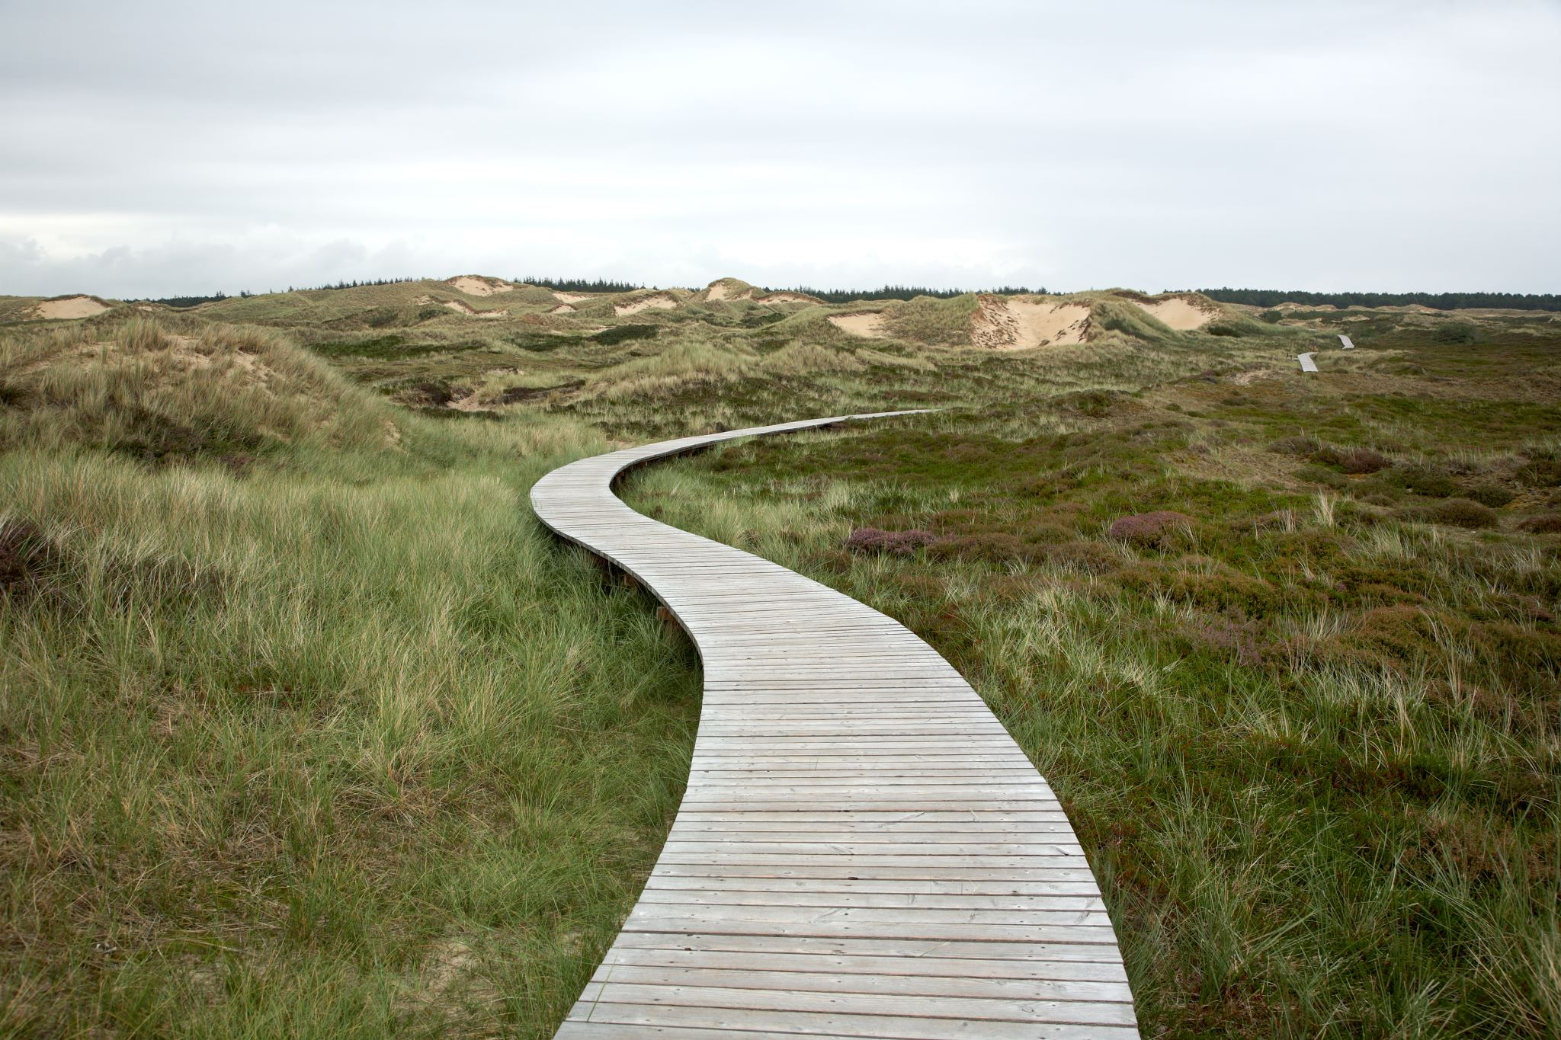
First Four Beatitudes of Emptiness
Poor in spirit (spiritually impoverished)
Those who mourn (their sin)
The meek (leaving it up to God)
Those hungry & thirsty for righteousness
Second Four Beatitudes of Righteousness
The merciful
The pure in heart
The peacemakers
Those persecuted because of righteousness
James 1:27 Religion that is pure and undefiled before God the Father is this: to visit orphans and widows in their affliction, and to keep oneself unstained from the world.

Slide 11
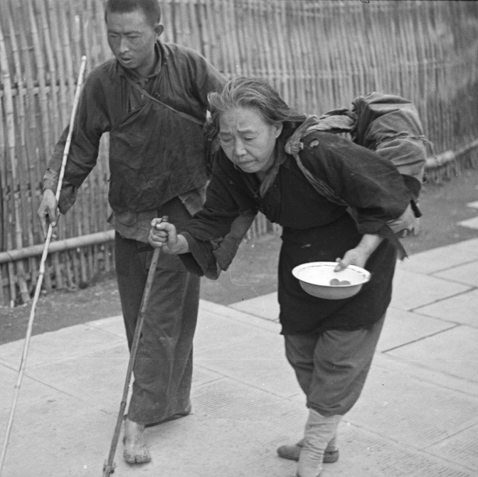
Blessed are the Merciful Matt 9:13 “I have desired mercy – not sacrifice”
Merciful believers see and respond compassionately and sacrificially to practically help those they encounter who are distressed and/or needy.
Matt 25:31-46 (The sheep & goats prophecy has so much language resembling the Beatitudes & Sermon on the Mount.)

Slide 12
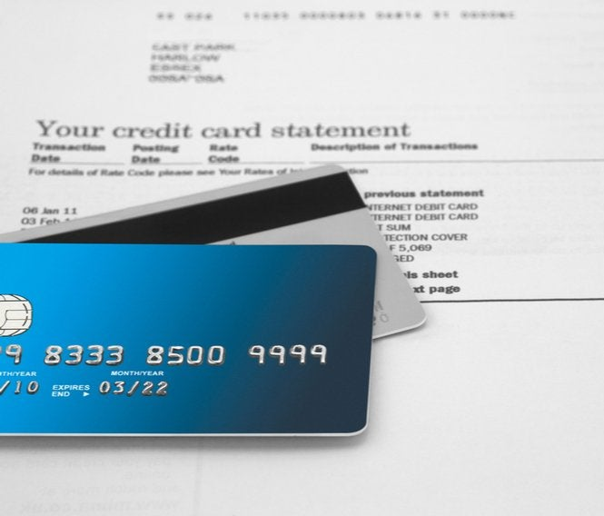
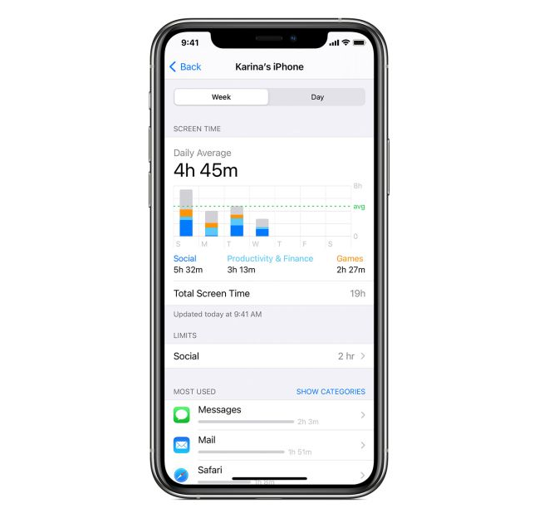
Blessed are the Pure in Heart
Matt 6:24 “No one can serve two masters; for either he will hate the one and love the other, or he will be devoted to the one and despise the other.”
Ps 27:4 “One thing have I asked of the Lord, that will I seek after: that I may dwell in the house of the Lord all the days of my life, to gaze upon the beauty of the Lord”
The pure in heart seek one thing above all: to enjoy the glory of God. So we wage war (by the Spirit) against all impurity including:
lust (Matt 5:29)
deeds of the sinful nature (Rom 8:13)
sexual immorality, impurity, sensuality, idolatry, sorcery, enmity, strife, jealousy, fits of anger, rivalries, dissensions, divisions, envy, drunkenness, orgies, and things like these (Gal 5:19-21)

Slide 13
Blessed are the
Blessed are the Peacemakers
Rom 12:18 “If possible, so far as it depends on you, live peaceably with all.”
Peacemakers are those who do their best to have loving relations with everyone they encounter. Peacemaking is seen when we:
refrain from anger & insults (Matt 5:22)
prioritise reconciliation (Matt 5:24)
don’t retaliate or seek vengeance, responding instead with unexpected generosity (Matt 5:39)
help when asked (Matt 5:42)
love & pray for our enemies (Matt 5:44)
proactively love & greet those outside our circle (Matt 5:46-47)
Peacemakers are radically different to everyone else.

Slide 14
Blessed are the
Blessed are those
Persecuted for Righteousness
2 Tim 3:12 “all who desire to live a godly life in Christ Jesus will be persecuted”
Luke 9:26 “whoever is ashamed of me and of my words, of him will the Son of Man be ashamed when he comes in his glory”

Slide 15
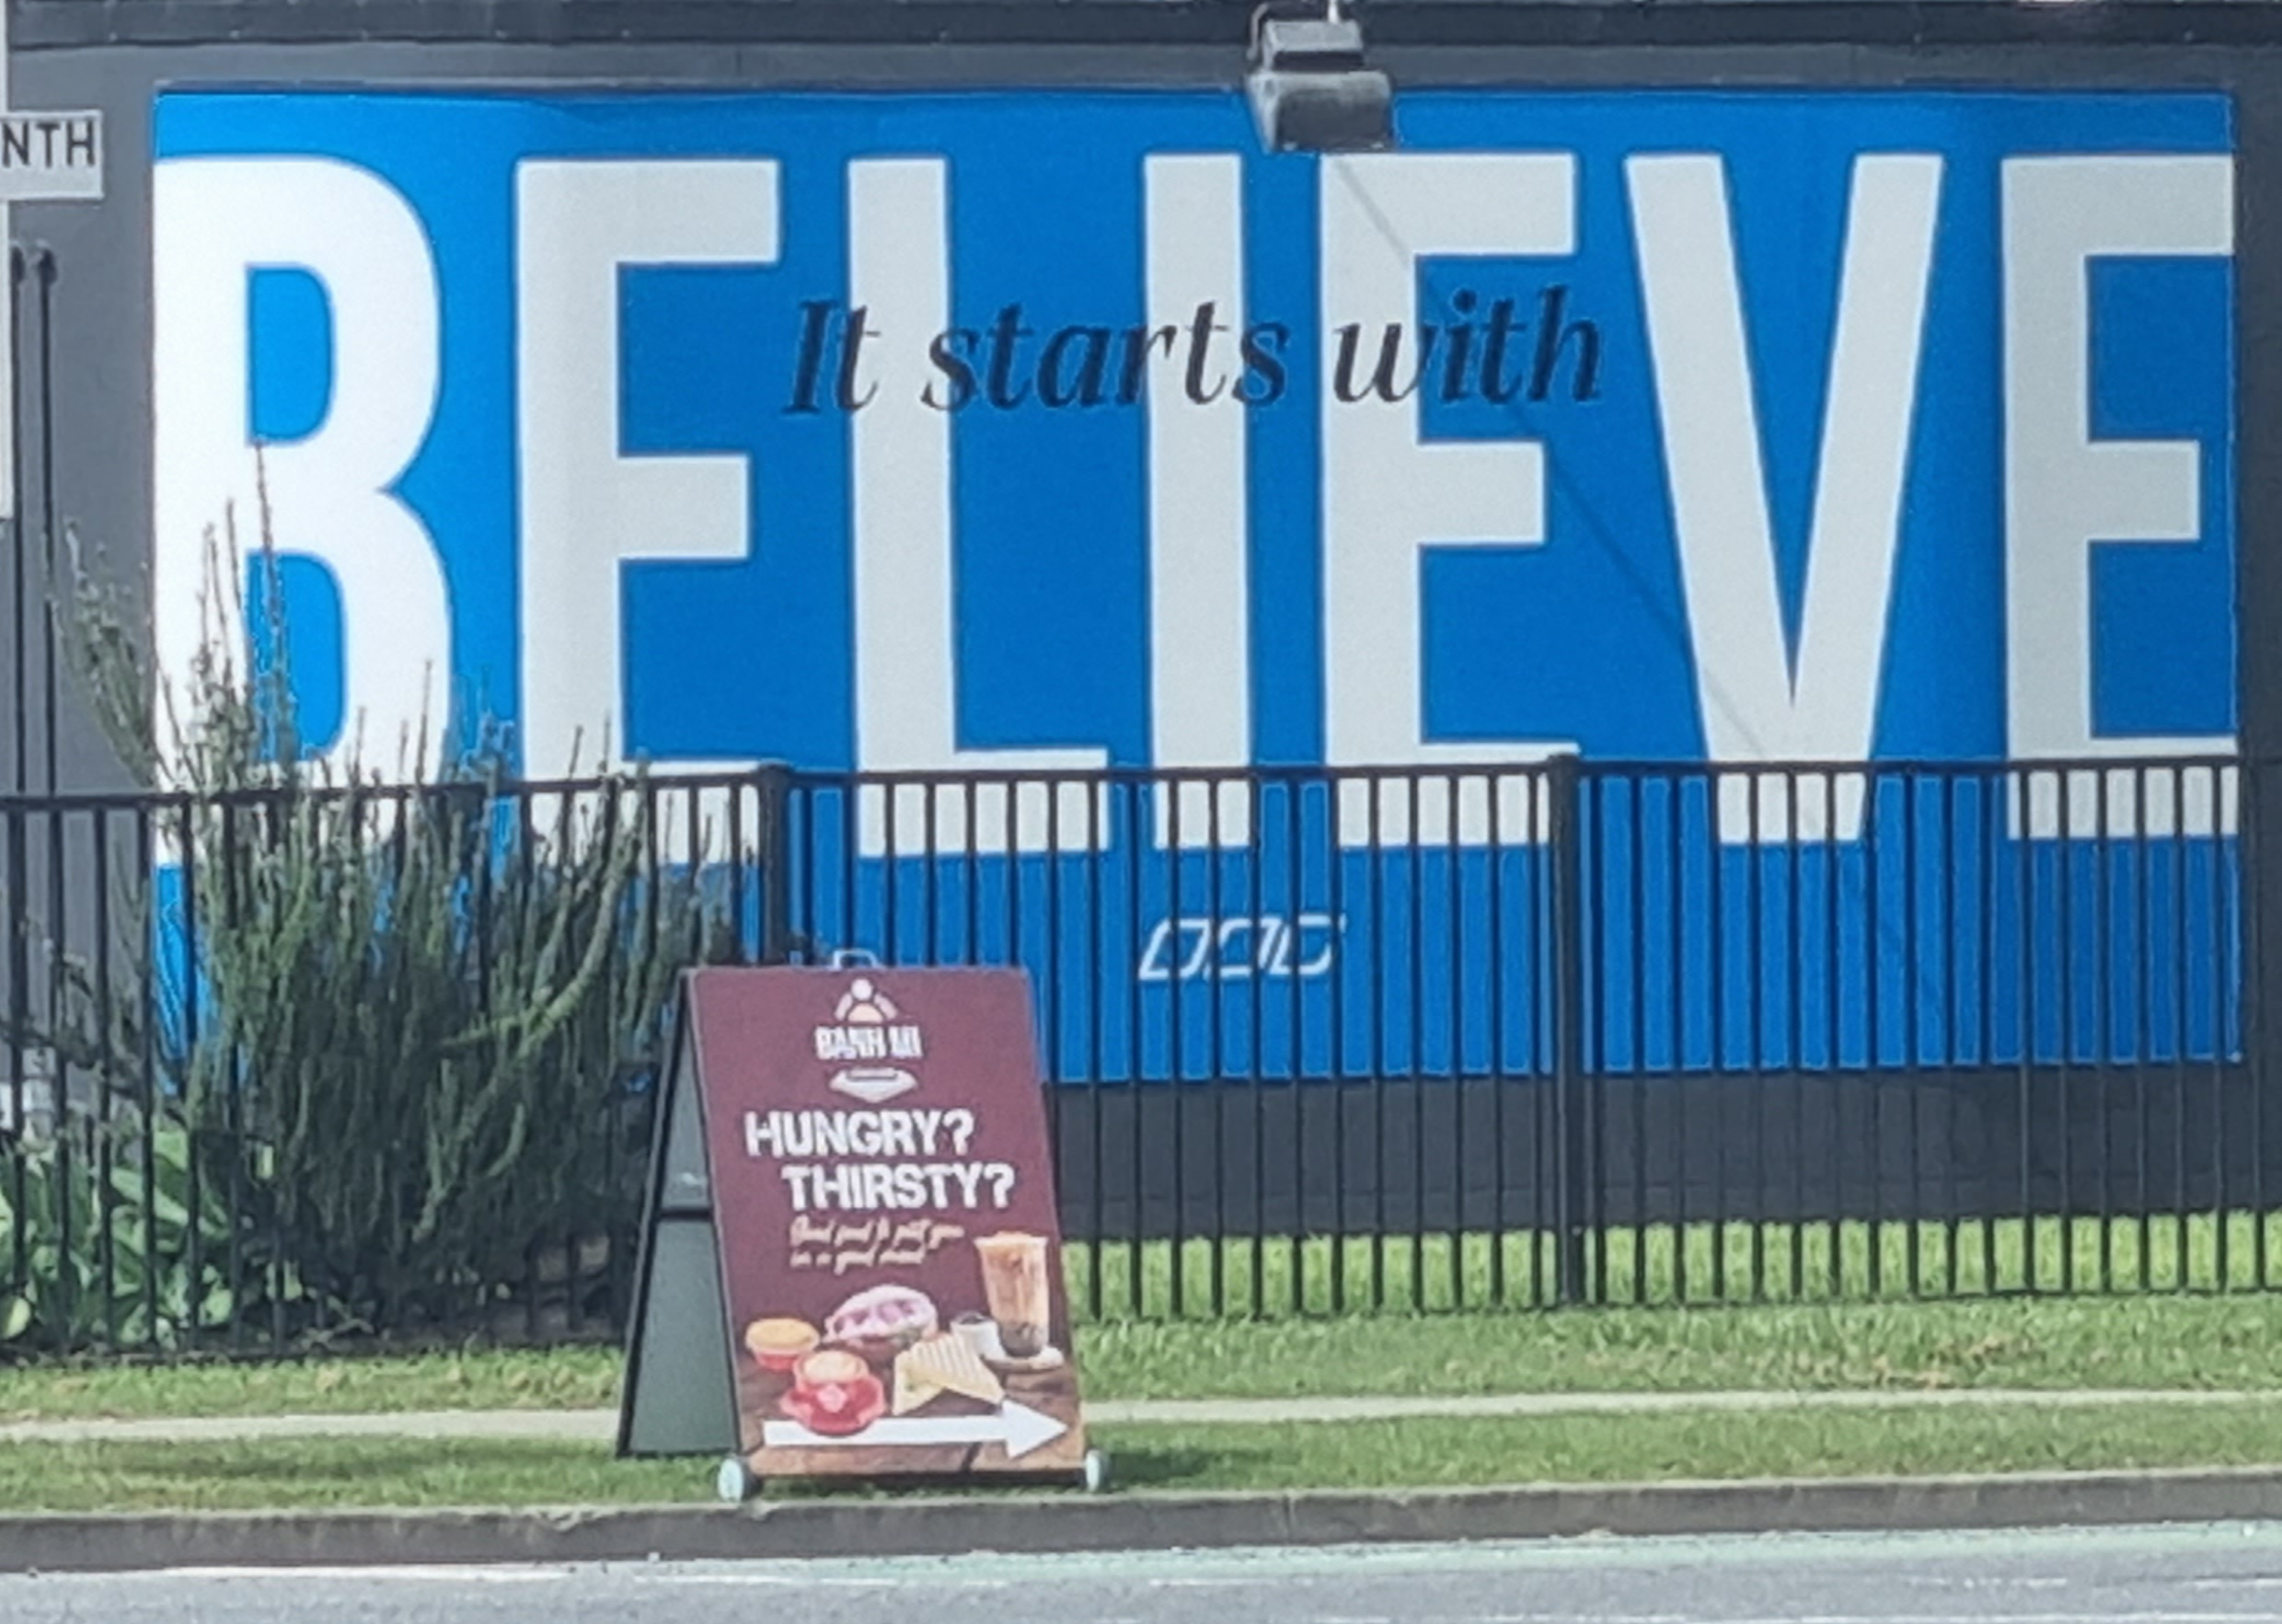
First we Believe. Then we Bear Fruit of Repentance.
Believing in Jesus involves receiving him as your greatest desire, your most trusted treasure.
John 1:12 “But to all who did receive him, who believed in his name, he gave the right to become children of God”
John 6:35 “I am the bread of life. Whoever comes to me will never be hungry; whoever believes in me will never be thirsty.”
Phil 3:8 “I count everything as loss for the surpassing worth of knowing Christ Jesus my Lord.”

