Slide 1
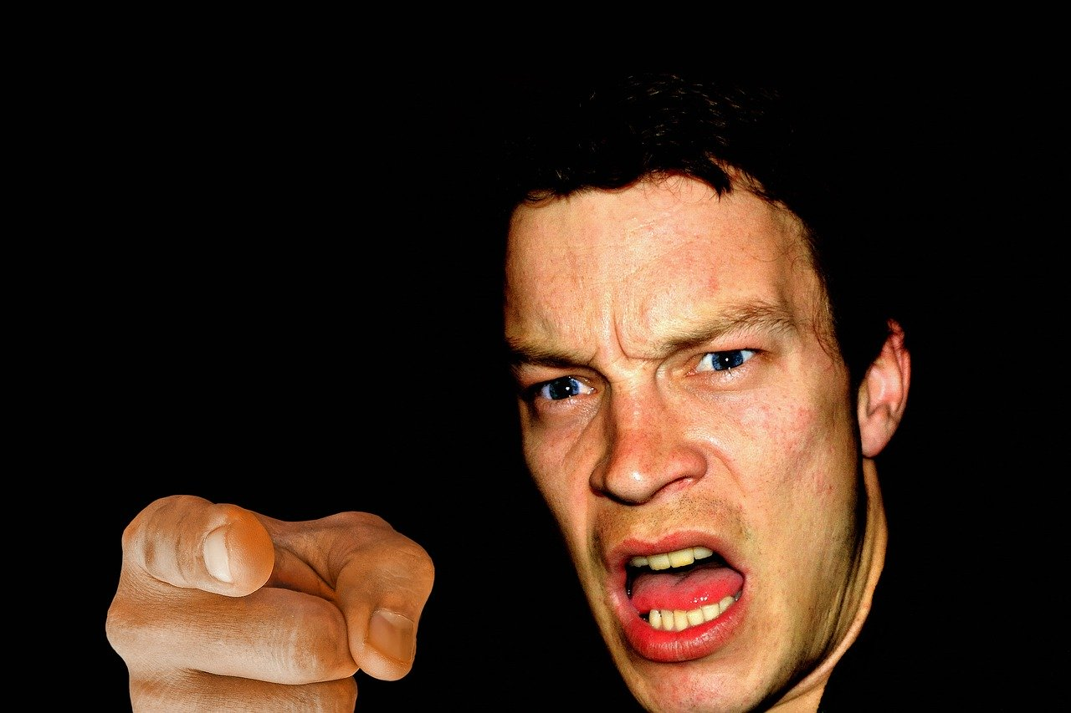
Anger Management
Matthew 5: 21-26

Slide 2
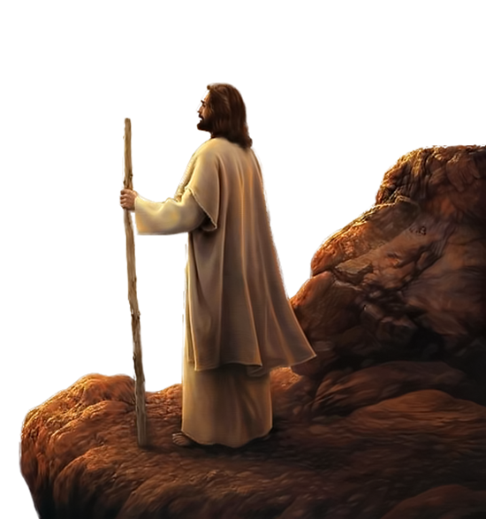
20 “For I tell you that unless your righteousness surpasses that of the Pharisees and the teachers of the law, you will certainly not enter the kingdom of heaven.”
Three sections:
1) When people have wronged us.
2 & 3) When we have wronged others

Slide 3
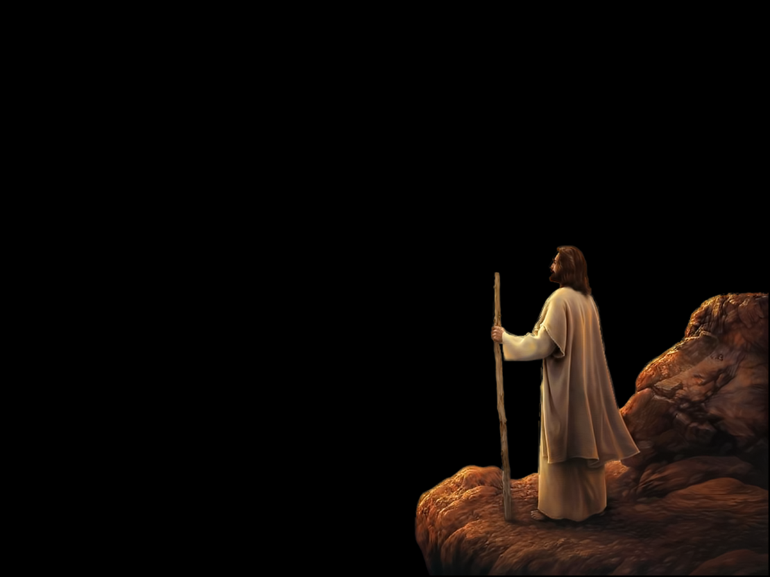
This is the first of 6 misunderstandings about the Law that Jesus is about to correct
²¹ “You have heard that it was said to the people long ago, ‘You shall not murder, and anyone who murders will be subject to judgment.’
22 “But I tell you…”
“anyone who is angry with a brother or sister will be subject to judgment.”
‘out of the heart comes all of the issues of life’ (Proverbs 4:23)

Slide 4
HEART
SITUATION
THOUGHTS
FEELINGS
BEHAVIOUR
Just missed the lights and now I have to stop on a steep hill
NOT FAIR, HE MADE ME MISS THE LIGHTS
STOP THE CAR AT THE LIGHTS AND HONK THE HORN
ANGRY AND ANNOYED
GREAT, I CAN GET A DRINK WHILE I WAIT
STOP THE CAR AT THE LIGHTS AND GET A DRINK
I NEED A DRINK OF WATER

Slide 5
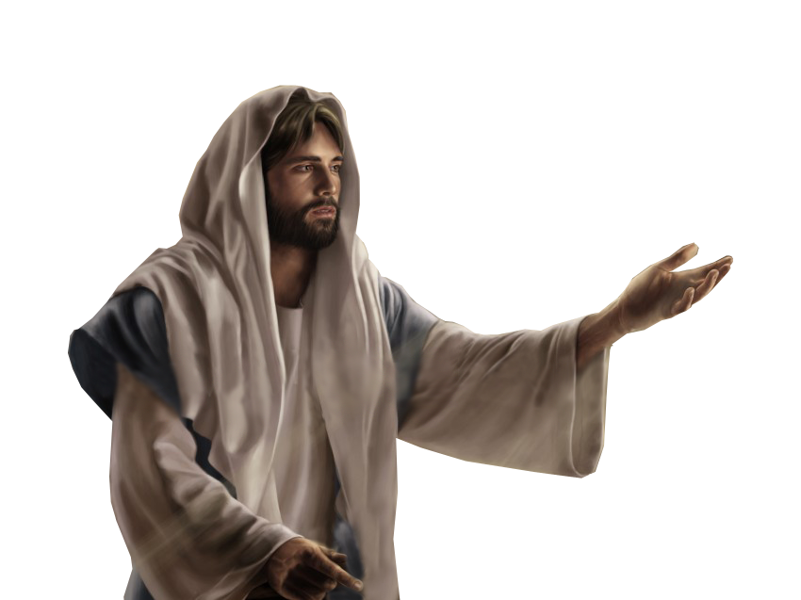
22 “Again, anyone who says to a brother or sister, ‘Raca,’ is answerable to the court.”
The word Raca is an Aramaic word that literally means empty, worthless or contemptuous
And anyone who says, ‘You fool!’ will be in danger of the fire of hell.
The word used for fool can be translated as graceless wretch or rebel
Judging a person as not being fit for the Kingdom of God

Slide 6
GRACE
The heart of the matter is…
the matter is the heart!

Slide 7
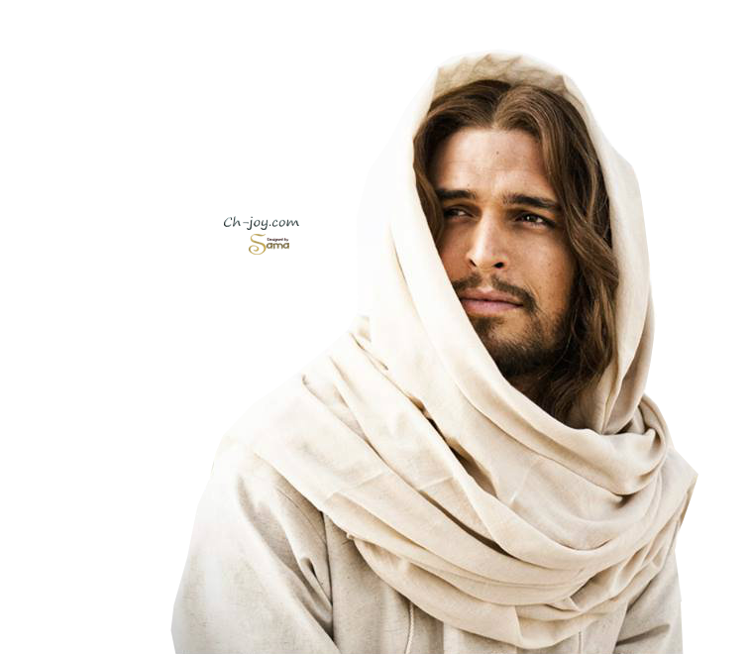
23 “Therefore, if you are offering your gift at the altar and there remember that your brother or sister has something against you, 24 leave your gift there in front of the altar. First go and be forgiven by them; then come and offer your gift.
FORGIVENESS
There is no use trying to come righteously before God if we know we have wronged someone else.
Doing nothing about it just lets it simmer in our hearts through guilt or anger
“Don’t sin by letting anger control you. Don’t let the sun go down while you are still angry” Ephesians 4:26

Slide 8
25 “Settle matters quickly with your adversary who is taking you to court. Do it while you are still together on the way, or your adversary may hand you over to the judge, and the judge may hand you over to the officer, and you may be thrown into prison. 26 Truly I tell you, you will not get out until you have paid the last penny.
RETRIBUTION
Spiritual lesson Jesus began in earlier verses
The proper response is to make things right quickly— both to have a pure heart and to avoid judgment for wrongdoing

Slide 9
Summary
Jeremiah 17:9 “The human heart is the most deceitful of all things, and desperately wicked. Who really knows how bad it is?”
GRACE
1 Samuel 16:7 “People judge by outward appearances, but the LORD looks at the heart.”
But if our heart is the most deceptive thing then how can we ever be right before God?
“Create in me a clean heart and renew a right spirit within me” Psalm 51:10

Slide 10
We must repent of our sinful heart
1 John 1:9 - If we confess our sins, he is faithful and just and will forgive us our sins and purify us from all unrighteousness
REPENTANCE
Jesus wants to cleans you and give a new start in life
Jesus said “Come to Me and I will give you rest

Slide 11
Hebrews 10:22 “let us go right into the presence of God with sincere hearts fully trusting him. For our guilty consciences have been sprinkled with Christ’s blood to make us clean”
RETRIBUTION
Colossians 1:14: “God's Son, Jesus, paid the price for our sins and made us free”

Slide 12
But how does a Christian, maintain a clean heart?
We must ensure that are hearts are right before God and then the actions we do will follow from a clean heart
Every day we must ask the Holy Spirit to fill us and make us more and more like the Lord Jesus
SANCTIFICATION
We will exhibit the fruit of the Spirit - love, joy, peace, forbearance, kindness, goodness, faithfulness, gentleness and self-control

