Slide 1
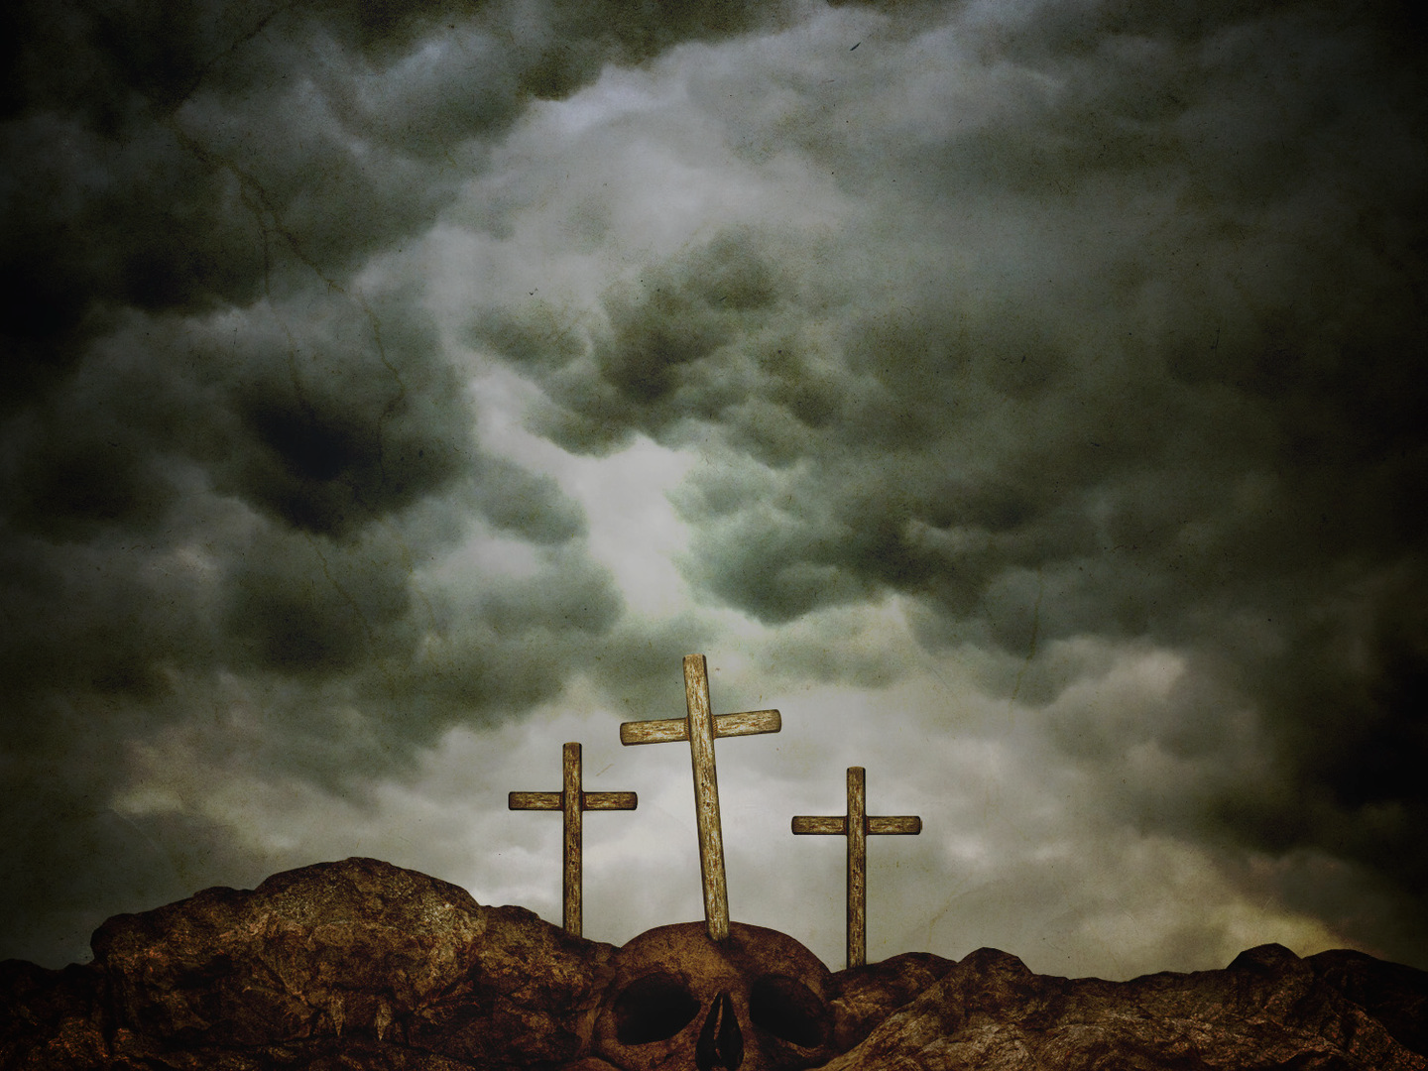
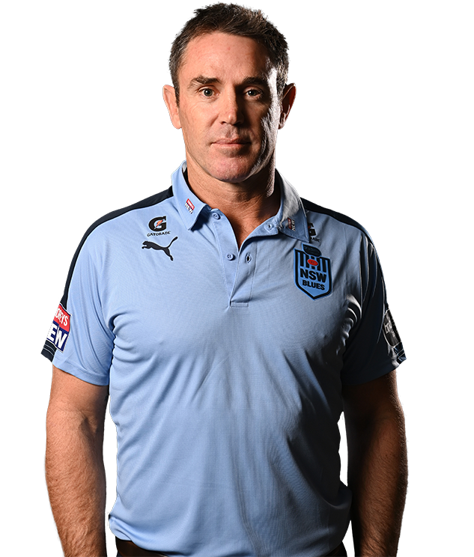
“What happened at easter in the Bible?” (Andrew Johns)
TODAY YOU WILL BE WITH ME IN PARADISE
“Jesus died on Friday & came back to life on Monday… And you can’t eat meat.” (Brad Fittler)
Luke 23:32-43
THE WORST MISTAKE EVER
“No, I am pretty sure he rose from the dead on Sunday.” (Matt Thompson)
THE HARDEST ADMISSION EVER
“So, what happened on Monday?” (Johns)
THE GREATEST GIFT EVER
Notes:
In this week’s episode of Wide World Of Sports show, Freddy and The Eighth, NRL legends Andrew Johns and Brad Fittler were being interviewed by sports journalist Matt Thompson (three men at Easter). At the start of the program Andrew Johns surprised everyone by asking a question about the meaning of Easter. Brad Fittler replied Jesus died on Friday and came back to life on Monday. And you can’t eat meat. Matt Thompson seemed shocked by their lack of knowledge and hesitantly corrected Fittler by telling him Jesus rose on Sunday. That seemed to confuse Andrew Johns because he then wanted to know why Monday was a holiday. As we come to another Good Friday in Australia I am sure these men are not alone in understanding what Easter is all about. The reality is, even as the real Easter story was unfolding and Jesus was being put to death, there were many people who also didn’t understand what was happening. And even if they sort of knew what was happening, they didn’t let it change their lives. So in order to help us to understand what happened at Easter, I want to look at three different men on the three different crosses – one of them made the worst mistake ever, the other made the hardest admission ever and the third gave us the greatest gift ever.

Slide 2
THE WORST MISTAKE EVER (vs 39) = Missing the message of the cross - who Jesus is and the meaning of his death.
1. Because of the crowd – “So, you are the Messiah, are you?” = same mocking as the Jewish crowd (v35) & Roman soldiers (v36).
“When we preach that Christ was crucified, the Jews are offended (he can’t be our Saviour) and the Gentiles say it’s all nonsense
(he can’t be a mighty king).” (1 Cor 1:23)
Cross is offensive & stupid = weakness, shame, defeat and puts an end to salvation by works (who I am & what I do).
Understanding the message of the cross & accepting Jesus = going against the flow & looking like an ‘idiot’.
Notes:
The first thief in verse 39 totally misses the message of Easter, the message of the cross – he totally misses who Jesus is and the meaning of his death. He misses it because of two reasons – these same reasons
Firstly, because of the crowd – its easy to go with the crowd, to be swayed by public opinion. He was mocking Jesus just like the Jewish crowd and soldiers. They usually didn’t agree on anything – but on this they had common ground. So you are this mighty rescuer are you? You are this mighty king that God has promised. It made no sense to any of the crowd. Dying on a cross = no Saviour, no king (can’t be killed, defeated by the enemy, can’t die an embarassing death like public crucifixion – no honour in that). The cross offends the world = why would I want a King like that? Why would I want a Saviour like that? Why do I even need a Saviour anyway? The cross = weakness, shame and defeat and it puts an end to our pride and the world’s preferred idea of salvation by merit. Who I am, my heritage (Jews), my actions, my obedience (works based salvation is source of all other religions – Islam, Buddhism, Hindus) The only way to be a Christian, to understand and accept Jesus is by going against the flow, being an independent thinker – humbly willing to look like an idiot in the world’s eyes.

Slide 3
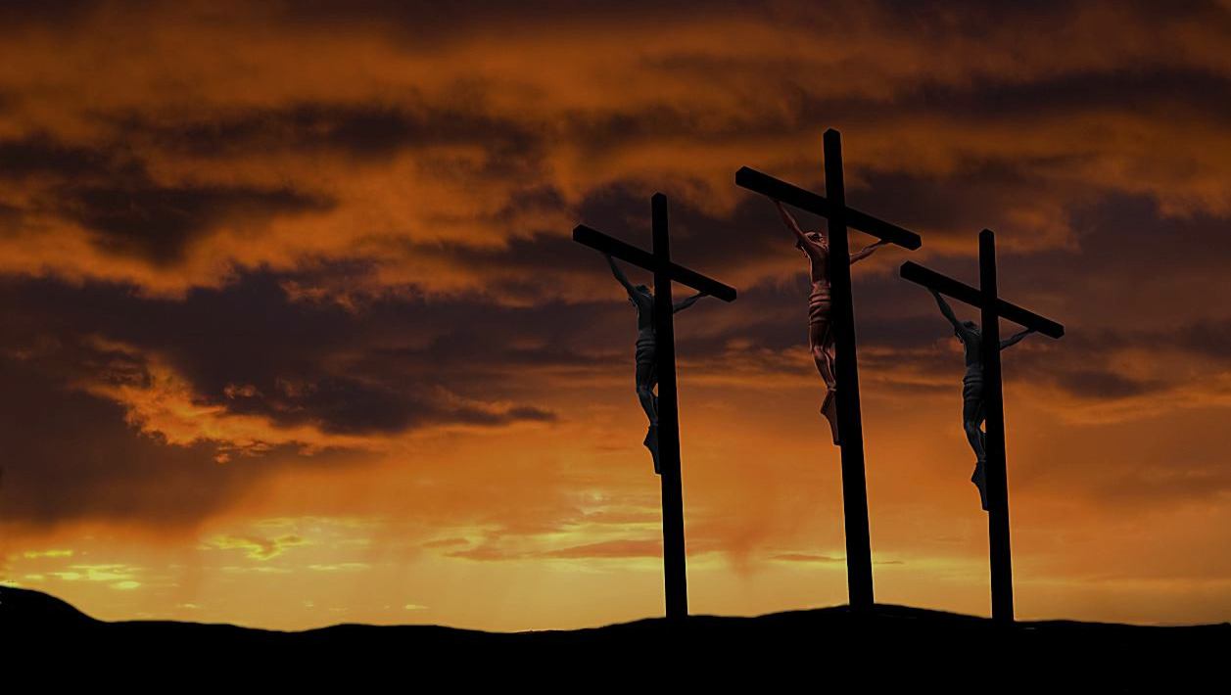
2. Because of his ‘standard’ = “Prove it by saving yourself, and us too while you are at it.” = do what I ask, meet my need and agree with me and then I will know you are God.
If we only want Jesus as a personal assistant or a ‘wish granting genie’ & not as a Saviour who came to ‘seek and save the lost’ (Luke 19:10), then we will never find Him.
Give me my ‘want’ first and then I will love and worship you = your ‘want’ is your first love and the source of your hope and joy, not God = idolatry.
God is either truly greater than you in all areas (power and wisdom) or He’s not worthy of our worship.
Notes:
The second reason is because of his standard. The thief put Jesus to a test – prove that you’re the Messiah, that you’re my Saviour. Do this and I will believe. In his ministry (teaching, miracles, character, claims, love) Jesus had already given enough proof to make an assessment as to whether he was the son of God, the Saviour of the world – whether he was ‘the one’. Not enough for this man – essentially saying yeah I know all about the stuff you did and said but I don’t care, it doesn’t matter to me. I have a need (to stop my pain and immediate death) and I want you to get me out of this. I don’t care that I am getting my just rewards, I just want you to meet my urgent need and get me out of this situation. Often in difficult times people will say do this for me and I will admit you are real. Meet my need and then I will believe. Agree with me, get on board with my plan, help me get what I want and I will know you are God. Essentially wanting a powerful God who is no smarter than he is. If we believe that God’s greatness and power is capable of doing the things we can’t and meeting all our needs then it means his wisdom, knowledge and plans must be greater than ours too. We may not understand them but they are great and good. To pray with confidence asking God to help us but at the same time thinking that you know better than God doesn’t make sense. He’s either truly greater than you in all areas or He’s not worthy of worship.

Slide 4
THE HARDEST ADMISSION EVER - “Don’t you fear God, even when you have been sentenced to die? We deserve to die for our crimes but this man has done nothing wrong … Jesus remember me when you come into your kingdom.” (vs 41-42)
Sees God as an end and not a means = not asking for the life he wants (self-centred) but for Jesus to be his life (Jesus centred).
“Jesus remember me…” = I have nothing to offer. My record = guilt & death. I need you to save me from God’s judgment & wrath – to take my guilt & give me your righteousness = pardon & life.
“If we claim we have no sin, we are fooling ourselves & not living in the truth. But if we confess our sins to him, he is faithful & just to forgive us our sins & cleanse us from all wickedness.” (1 Jn 1:8-9)
Notes:
The second man shows us how to find Jesus – by making the hardest admission in the world. Confessing our sin and falling on the mercy and grace of God is impossible to admit without the help of God and the Holy Spirit. First man missed Jesus because of his pride and idols that he wasn’t willing to give up. This man knew he was guilty of sin and he deserves to die because of his sins – wants to have his life centred on Jesus not on himself. No doubt he would have wanted to be saved from pain and suffering he was having and which was to come. But he realised there was something much better to look for. He understood that he had nothing to offer. (religious people struggle with that). Remember me = a plea for forgiveness, claiming the promises of God’s mercy and grace. He is claiming the truth of 1 John 1:8-9. Not easy to do as our natural heart doesn’t want to seek God – naturally focused on self.

Slide 5
THE GREATEST GIFT EVER - “I tell you the truth, today you will be with me in paradise.” (v43) = I am getting what you deserve (rejection & death) & you will get what I deserve (acceptance & life).
You are never too bad or too late for the gift of God’s amazing grace.
Jesus & the power of His salvation are with you from that moment & forever – not just when you die.
‘You will be with me’ = I will be your advocate, substitute, power, victory = God’s presence, forgiveness, love, joy, favour & glory forever (Romans 8).
“Our highest hope and joy (paradise) is being with Jesus. Nothing else can compare.” (Mike McKinlay)
Notes:
There are two amazing things to remember about the gift of God’s amazing grace. Firstly, when you ask Jesus to ‘remember me’ he will never respond by saying you are too late or I would like to but you have just sinned way too much for my grace to cover you. Secondly when we confess our sins and claim the grace and righteousness of God then we receive his gift of salvation and ultimate life immediately – not just after we die. Yes he says to the criminal that he will be in paradise today but that’s because they were both going to die that day. When we come to Jesus he says today I will be with you and from now forever – from this life on earth to my eternal life in paradise. I am your advocate, I am standing in your place. I am taking what you deserve so you can get what I deserve. Romans 8 tells us that all who are justified (forgiven and made right with God through Christ) will be glorified (made perfect, glorious and brought into the presence of God in his eternal kingdom) – nothing can separate us from that promise of God’s presence, love, favour. We have a guaranteed happily ever after ending.

Slide 6
In Luke 10 Jesus sends out 72 disciples & they have a great day in ministry (v17).
“Do not rejoice because you have had a good day, but rejoice that your names are written in heaven.” (v20)
The message of the cross = if you have surrendered your life to Jesus then your eternal forgiveness, hope and joy is not found in your circumstances or efforts, but in Christ alone.
The message of the cross is also = judgment and death are deserved + God is gracious and forgiving + paradise is offered to all who humble themselves, admit their sin and confess their need for Jesus as their Saviour & Lord.
Notes:
In highlighting the power of the cross I want to finish by going back a few chapters. In Luke 10 Jesus sends out 72 disciples to do ministry – in verse 17 they come back filled with joy and excitement after an amazingly successful day proclaiming that even the demons were obeying us. Jesus is happy for them and essentially says that’s great you have had a good day. I am glad you are filled with joy and confidence as you live for me. But maybe tomorrow won’t be such a great day – there will be tough days. Don’t find your daily joy and confidence in what you do and how much success you have. But rather rejoice because your names are written in heaven. Rejoice that the verdict is in – you are pardoned, loved and glorified – rejoice because you are with me. The world is looking for the secret to daily joy – to living happily ever after – and Jesus and the cross is the answer. May we not miss that because of our misplaced pride and priorities. May we be willing to surrender our lives to Jesus and rest in what he has done and not what we can do. And may we look to the cross and the promise that Jesus is with us to live happliy ever after. The message of Good Friday is unchanged – I trust you choose well.

