Slide 1
WHAT’S THE BIG DEAL?
1 Peter 1:3-9
Notes:
Good morning everyone, today I have the great privilege of being able to preach to you all on the resurrection of Jesus
Some of you might be wondering if the Bible passage that was just read is correct, and I can assure you it is, but there’s a story
Last Sunday evening, I thought I would get a head start on my sermon, so I came into the office just after the kids were asleep to get started
After spending about an hour and half at church, I went home and went straight to bed, where Jess asked me how I went?
My response was, “Terribly, all I managed to do was pick the passage I am preaching on”
I kept thinking for the next couple days that perhaps this was the wrong passage, but through prayer and the assurance of my wife and dad, I pressed on in this particular passage
This passage in Peter is a great reminder as to what the resurrection accomplishes for God’s people.
I think sometimes we know, in our minds, that the resurrection is important, but sometimes we may find ourselves asking why? What’s the big deal? Why does Paul say that without it our faith is useless?
It is my prayer today that all of us who are followers of Jesus will walk away confident in the gospel and walking closely with our resurrected Saviour, truly knowing in our hearts why it is such a big deal
And if you do not know Jesus Christ as Lord and Saviour, I pray that today would be the day that you surrender your life to him
So, let’s get into what the Bible has to say about the resurrection

Slide 2
WHAT DOES THE BIBLE SAY?
“… I went down to the land whose bars closed upon me forever; yet you brought up my life from the pit, O Lord my God” (Jonah 2:5-6)
Jesus said to her, “I am the resurrection and the life. Whoever believes in me, though he die, yet shall he live, and everyone who lives in me shall never die” (John 11:25-26)
Notes:
“… I went down to the land whose bars closed upon me forever; yet you brought up my life from the pit, O Lord my God” (Jonah 2:5-6) - We know that the story of Jonah is a foreshadowing of Jesus death, burial and resurrection, because Jesus points people back to the story of Jonah in telling them what will happen to him - Or we also have the famous passage in Isaiah 53, which is all about Jesus death upon the cross, but in verse 10 we read, “Yet it was the will of the Lord to crush him; he has put him to grief; when his soul makes an offering of guilt, he shall see his offspring; he shall prolong his days…” - And we find more evidence in the Scriptures of the Old Testament to suggest that there is a resurrection of the body, a resurrection hope, which can only exist if the one whom we have placed our faith in, is resurrected from the grave and now lives - Then we move to the New Testament
Jesus said to her, “I am the resurrection and the life. Whoever believes in me, though he die, yet shall he live, and everyone who lives in me shall never die” (John 11:25-26) - Jesus himself declares that HE IS THE RESURRECTION. He predicted, that is, he told them that his death and resurrection was going to happen multiple times through out each of the gospel accounts - And each of those gospel accounts, written by four different people, from four different perspectives state that Jesus is now alive - And then as if that wasn’t enough, we move on to what Paul has to say

Slide 3
“For I delivered to you as of first importance… that Christ died for our sins in accordance with Scriptures, that he was buried, that he was raised on the third day in accordance with Scriptures” (1 Cor 15:3-4)
The testimony of all of Scripture is that the resurrection of Jesus is a real historical event
Notes:
“For I delivered to you as of first importance… that Christ died for our sins in accordance with Scriptures, that he was buried, that he was raised on the third day in accordance with Scriptures” (1 Cor 15:3-4) - Let us open to this passage and have a read of what Paul says about the resurrection - Read 1 Corinthians 15:3-8
The testimony of all of Scripture is that the resurrection of Jesus is a real historical event - The Old Testament, Jesus himself, the New Testament along with over 500 eyewitnesses all say the same thing, that JESUS HAS CONQUERED THE GRAVE! - But some of you may be wondering, what’s the big deal? What does it mean for me if Jesus really did walk out of the tomb? - Well, I’m glad you asked, because I believe Peter gives us just a few reasons as to why it matters and why it is a central doctrine of the Christian faith

Slide 4
HOPE OF AN INHERITANCE (vs 3-5)
“According to his great mercy, he has caused us to be born again” (1 Pet 1:3b)
“To a living hope through the resurrection of Jesus Christ from the dead” (1 Pet 1:3c)
“To an inheritance that is imperishable, undefiled, and unfading” (1 Pet 1:4a)
Notes:
“According to his great mercy, he has caused us to be born again” (1 Pet 1:3b) - The whole story of easter, the good news of gospel, is one of great mercy - God in His holiness and righteousness cannot stand sin, He will not tolerate sin - In His Word He tells us that the wages of sin is death - So someone had to pay it, because of God’s justice He could not let sin go unpunished, it had to be paid for - So the crucifixion is the death that each and everyone of us deserved, because it us who have gone astray, it us who are the sinners - But God, in His mercy, and His goodness, sends Jesus to take our place, He sends Jesus to pay the debt that we should have paid, He sends Jesus to die that we might live - But not only is God great in mercy, but that it is Him who causes us to be born again. - Just as God speaks and thus creation exists, so too when God speaks to our hearts new life begins, we are born again - The old has passed away but the new has come. - But what is this new life, what is it that we are born to?
“To a living hope through the resurrection of Jesus Christ from the dead” (1 Pet 1:3c) - And this is where all the promises in the rest of this passage stem from - We have been born again to a living hope. Now we are not talking about the kind of hope that we have here on earth - Where some might hope that they win the lottery, or that we may hope that something becomes of our children, or that we may hope that things work out for us in our job - There is no certainty in that hope. This is a certain living hope. For as surely as Jesus Christ lives, such is the certainty of our hope. - Our Christian hope is not grounded in the temporary things of this world, but in the reality of Christ and his resurrection, so it is a hope that we know will come to pass.
“To an inheritance that is imperishable, undefiled, and unfading” (1 Pet 1:4a) - Once we have repented of our sins and believed in Jesus Christ as our only source of hope for salvation, as the only way we can be saved from death - We receive our inheritance. Having been born again, we are now adopted as children of God - Just as many of us either have, or maybe will one day, are given an inheritance from our parents - So too is it with God, that as children of God, we receive the certain promise of an inheritance for when we pass from this life into eternal glory - And I love the way Peter describes this inheritance, he can only describe it by saying what it is not - It is imperishable. Meaning that it is unable to be destroyed - That it is undefiled, that it is not polluted, it is undefiled by sin. Everything in this world is polluted and defiled by sin, but not the inheritance that awaits those who believe in Jesus Christ, it is perfect - And it is unfading, it is not subject to decay, the human body fades, the flowers wither, but the inheritance found in Jesus Christ is incorruptible

Slide 5
“Kept in heaven for you, who by God’s power are being guarded through faith…” (1 Pet 1:4b-5)
“For a salvation ready to be revealed in the last time” (1 Pet 1:5b)
Because of Jesus’ resurrection, you have a promised, certain hope of an imperishable, eternal inheritance
Notes:
“Kept in heaven for you, who by God’s power are being guarded through faith…” (1 Pet 1:4b-5) - I love this verse. That our inheritance is safe and secure in heaven, that the promise of your eternal life spent in God’s presence is not buried here on earth, but in heaven with God - Where there is no sin. Heaven is a place where “neither moth nor rust destroys, and where thieves do not break in and steal” - And not only is our eternity made secure through the finished work of Jesus Christ on the cross and rests secure in heaven - But as we journey through this earth as pilgrims, as foreigners, we are, by God’s power, being guarded - The word here for guard is the Greek verb for protected. It is a military metaphor which describes a fortress with strong walls being guarded by a battalion of soldiers - Listen to me! If you are a child of God, you will go through tough times in this life, we are called to count the cost, to carry our cross. - Jesus tells us that the world hates him so it will hate us also - You will be out in the world as a sheep amongst wolves - But you go out, trusting in Jesus Christ, your faithful bridegroom, and he will not let hell take his bride. Satan cannot have you. - Jesus crushed the head of Satan, and trampled on the grave by defeating it - We must remember, that in Christ we have already won
“For a salvation ready to be revealed in the last time” (1 Pet 1:5b) - By God’s power we are being guarded for the day of Jesus second advent. On that day, when Jesus comes again, he will come to claim his bride and call us home - Where we will receive Christ Jesus himself, for he is the prize, the inheritance that we press on towards - And that which has been kept, guarded, and stored up for us will be bestowed upon us, and God, with open arms, will declare “well done good and faithful servant, enter into the joy of your master”
Because of Jesus’ resurrection, you have a promised, certain hope of an imperishable, eternal inheritance - If you know Jesus Christ as Lord and Saviour today, then you must go to great lengths to settle this promise, this inheritance, this living hope in your minds and hearts, that it may permeate every aspect of your life - When we truly understand this and live this, this promise of God, this certain, incorruptible, living hope will be a source of great comfort when the trials of this life come our way

Slide 6
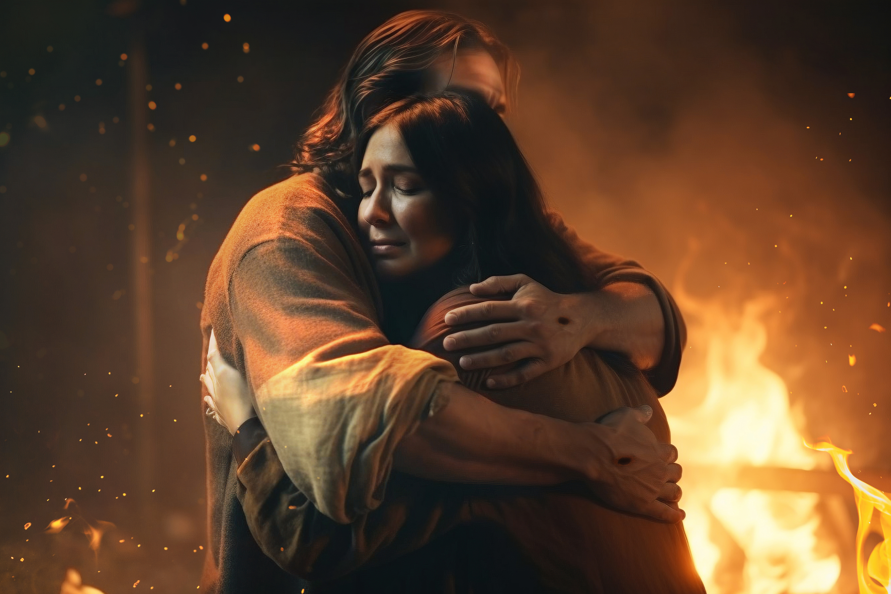
HOPE THROUGH TRIALS (vs 6-7)
“In this you rejoice, though now for a little while, if necessary, you have been grieved by various trials” (1 Pet 1:6)
“So that the tested genuineness of your faith” (1 Pet 1:7a)
“… more precious than gold that perishes, though it is tested by fire” (1 Pet 7b)
Notes:
“In this you rejoice, though now for a little while, if necessary, you have been grieved by various trials” (1 Pet 1:6) - One of the central themes in this letter is suffering and trials. Peter is writing to believer’s who have been dispersed and have been going through a great deal of trials - They are Christians, people of the light, living in a world of darkness, and so it is to be expected that they will be persecuted and suffer - But just because it is expected doesn’t make it easy, Peter acknowledges their grief in these trials, that it can be hard and yet even in these tough times they ought to rejoice. - Christians can always find joy even in the darkest of times because there is no trouble to be found in this life that the grace of God cannot supersede - But we must have our joy rooted in Christ. When our joy is rooted in money, our joy rises and falls depending upon the amount of money in the bank - When our joy is rooted in a relationship, our joy will rise and fall depending on how that person responds to us - When it is rooted in present circumstances, it will rise and fall depending on whether it is a good day or a bad day - But if our joy is rooted in Christ alone and the salvation that is found only in him - Whilst you may be greatly distressed by your present and temporary sufferings, you will always find a reason to rejoice - We do grieve, but we grieve with hope, a living hope. And so, we can smile as we cry - And know this, our trials in this life are not random or accidental – but are allowed by God to accomplish His purposes for us, to prepare us for His will and our future salvation
“So that the tested genuineness of your faith” (1 Pet 1:7a) - This is the purpose of trials in our life, that the genuineness of our faith may be tested. Not for God’s sake, but for our own sake - It is through suffering that God produces perseverance and assurance in us - That as we faithfully endure through various trials, we see that our faith is real, we see the priority that God has in our life - That God really will never leave us nor forsake us, and that in His power, there really is nothing that cannot be overcome - It is in suffering that Christ becomes our all in all, and we cling to him, and we come to the knowledge that in Christ, we find all that we need - A Christian minister from the 1600’s by the name of Samuel Rutherford once wrote a letter to a lady who had lost her husband and 5 children -He wrote this, “Oh, how Christ must love you! He would take every bit of your heart to himself. He would not permit you to reserve any of your soul for any earthly thing” - In the great sufferings and trials of this life, turn your eyes upon Jesus, run to the cross - For it is there that you will be warmly embraced by the grace and mercy of God, giving you all the comfort you need
“…more precious than gold that perishes, though it is tested by fire” (1 Pet 7b) - The way that gold is purified is firstly by being placed in a crucible and brought to boiling point - Then, all the impure elements that were mixed in with the ore are brought to the surface, which is then finally skimmed off the top by a gold smith - Our faith is much more precious than gold, and so God, the consuming fire, allows suffering and adversity to become the crucible of life - Which forces all the impure sinful elements to the top, so that God can purify us - This process is what we call sanctification, suffering plays a vital role in making us more like Jesus Christ

Slide 7
“May be found to result in praise and glory and honour at the revelation of Jesus” (1 Pet 1:7c)
“Just beyond these restless waters There's a land where peace will reign Sin and sadness there are swallowed In a sea of sovereign grace” – Jesus Fount of Joy Eternal
Because of Jesus’ resurrection, all who believe, can and will persevere through trials
Notes:
“May be found to result in praise and glory and honour at the revelation of Jesus” (1 Pet 1:7c) - We are tested, and purified, and made more like Jesus that our faith may be found to result in praise and glory and honour when Jesus returns for his people - True saving faith and its resulting good works, by the power of God at work in us, will always receive a divine commendation, a, “well done good and faithful servant” - It will result in glory, eternal glory and perfect Christlikeness when Jesus comes again - But we cannot and dare not take any of the credit for any of this, for we know that apart from the grace of God - And the same power that brought Jesus out of the grave, we can do no good, or accomplish anything worthy of the glory of God - All the glory, rightfully belongs to God, the Father of our Lord and Saviour, Jesus Christ
“Just beyond these restless waters, There’s a land where peace will reign. Sin and sadness there are swallowed, in a sea of sovereign grace” – Jesus Fount of Joy Eternal - If we find ourself on the anvil of suffering, know that God is at work - Our present day sufferings are but a light and momentary affliction in the grand scheme of eternity, and yet when it seems like you can take no more, I urge you to remind yourself of the gospel - Throw yourself before the throne of grace, and in your time of need, He will not turn you away, but He will be your great comforter and encourager - And He will tend to and dress your wounds with His mercy, His grace, and His compassion, so that you can carry on and keep fighting the good fight of faith, so that you can keep defending and preserving and suffering for the sake of gospel
Because of Jesus’ resurrection, all who believe, can and will persevere through trials - It is in trials and suffering that the resurrecting power of God is at work in us, sanctifying us, and conforming us to the image of the Son, Jesus Christ - Charles Spurgeon, a man who was known to have many great trials in his life said this, “Suffering saints are living seed. Oh, that God might help us to such faith, that when we come to suffer in life, or to expire in death, we may so glorify God that others may believe in him! May we preach sermons by our faith in suffering which shall be better than sermons in words” - Though we suffer in present, let us be faithful in our suffering and may we look forward to the joy of the future where there will be no more suffering, no more sickness, and no more tears, but we will be with Christ in eternal glory

Slide 8
FAITH IN THINGS UNSEEN (vs 8-9)
“Though you have not seen him, you love him. Though you do not now see him, you believe in him” (1 Pet 1:8)
“And rejoice with joy that is inexpressible and filled with glory, obtaining the outcome of your faith, the salvation of your souls” (1 Pet 1:8b-9)
Because of Jesus’ resurrection, that which we long, to see will forever be before our eyes, in eternal glory
Notes:
“Though you have not seen him, you love him. Though you do not now see him, you believe in him” (1 Pet 1:8) - This verse should cause us to throw our minds back to when Jesus is talking with Thomas, who doubts the resurrection of Jesus, and after touching the wounds and holes of Jesus, he now believes it really is Jesus - Jesus says to him, “Have you believed because you have seen me? Blessed are those who have not seen and yet believe” - Peter’s readers must have wished to see Jesus just as Peter had, and so he encourages them on their faith even though we are never able to see Jesus just as he had - How many of us have ever wished to have been around to see Jesus? I know that I have - But Peter’s words here are a great reminder that God has given us all that we need through the gift of the complete and sufficient Word of God, the gift of prayer, and the indwelling presence of the Holy Spirit - None of us have seen Christ, but believing in him is better than merely seeing him. Many saw Jesus while he walked upon the earth, and yet perished, but no person has ever truly believed upon Jesus Christ, and then perished
“And rejoicing with joy that is inexpressible and filled with glory, obtaining the outcome of your faith, the salvation of your souls” (1 Pet 1:8b-9) - Once again Peter tells us to rejoice, to be joyful in a way that is inexpressible, that is indescribable - That’s the kind of joy that fills our soul as we keep our eyes fixed on the cross, as we remember what it cost Jesus, what it cost our holy God, to pay for our sin - And yet we remember also that death could not keep him, and so we can know without a doubt in our minds, that because Jesus paid the debt of sin, and he satisfied the wrath of God, and rose again, declaring victory over sin and the grave - So that even amidst the darkest times of our life, we can and should rejoice, because there will come a day, when all that we know by faith will be revealed before our eyes - Look away from yourself, for we are but wretched sinners. Look to the cross, there you will find mercy, there you will find grace, there you will find the love of the heavenly Father. - And it is there, in Christ alone, that you find the salvation of your souls - That is something worthy of joy that is inexpressible
Because of Jesus’ resurrection, that which we long to see, will forever be before our eyes, in eternal glory - We do not know, nor have we ever seen a world that is not tainted by sin, but one day we will witness and experience what that is like, for we will have been delivered from the very presence of sin - We do not know nor have we ever seen what it is like to have a body, a resurrected body that is not marred by sin, but one day that will be a reality - We do not know nor have we ever seen the face of almighty God, but one day we will dwell in His very presence for the rest of eternity - Because Jesus walked out of that tomb, once dead, but is now alive, all who have believed in Jesus Christ will experience an eternity where sin cannot exist

Slide 9
WHAT’S THE BIG DEAL?
If you have believed in the gospel of Jesus Christ…
You have an inheritance that is imperishable, undefiled, and unfading because Jesus Christ lives
You have a heavenly Father who will carry you through and use the trials of life to make you more like His Son, Jesus Christ
You will one day walk, for all the days of eternity in the very presence of God, in His eternal glory
Notes:
You have an inheritance that is imperishable, undefiled, and unfading because Jesus Christ lives - If you are a believer, right now, you have an inheritance in Jesus Christ, and it is being kept secure for you in a place where sin cannot touch it - If Jesus Christ is your Lord and Saviour, there is nothing that Satan can do to snatch your inheritance away from you, because your salvation rests in the hands of Almighty God
You have a heavenly Father who will carry you through and use the trials of life to make you more like His Son, Jesus Christ - Not only is your eternal life secure because it rests in Jesus Christ, but He will protect you on your pilgrimage through this world - He has given you His armour, and He tests you, and knows that in this life you will suffer, but He sent His one and only Son to go before you, so that he can sympathise with you and intercede for you. - Not only did He send Jesus, to go before us, but He promises to always be there with us in the furnace, and to use the struggles of this life to conform us to the image of His Son
You will one day walk, for all the days of eternity in the very presence of God, in His eternal glory - We walk by faith and not by sight. And yet that which we cling to by faith, will one day become a visible reality - We see in this passage, that because of Jesus Christ’s life, death and resurrection, that all who have believed in Jesus Christ have been set free from the penalty of sin, which is death, and are promised eternal life, that’s our great inheritance - Through trials we are being set free from the power of sin, trusting not in the flesh but in the power of God, that we might become more like Jesus - Until one day, when Jesus returns, the power of sin loses any hold it has over God’s chosen people - And all who have believed in the gospel, will have been set free, not only from the penalty of sin, and not only the power of sin, but also the very presence of sin - THAT’S WHY THE RESURRECTION IS SUCH A BIG DEAL

Slide 10
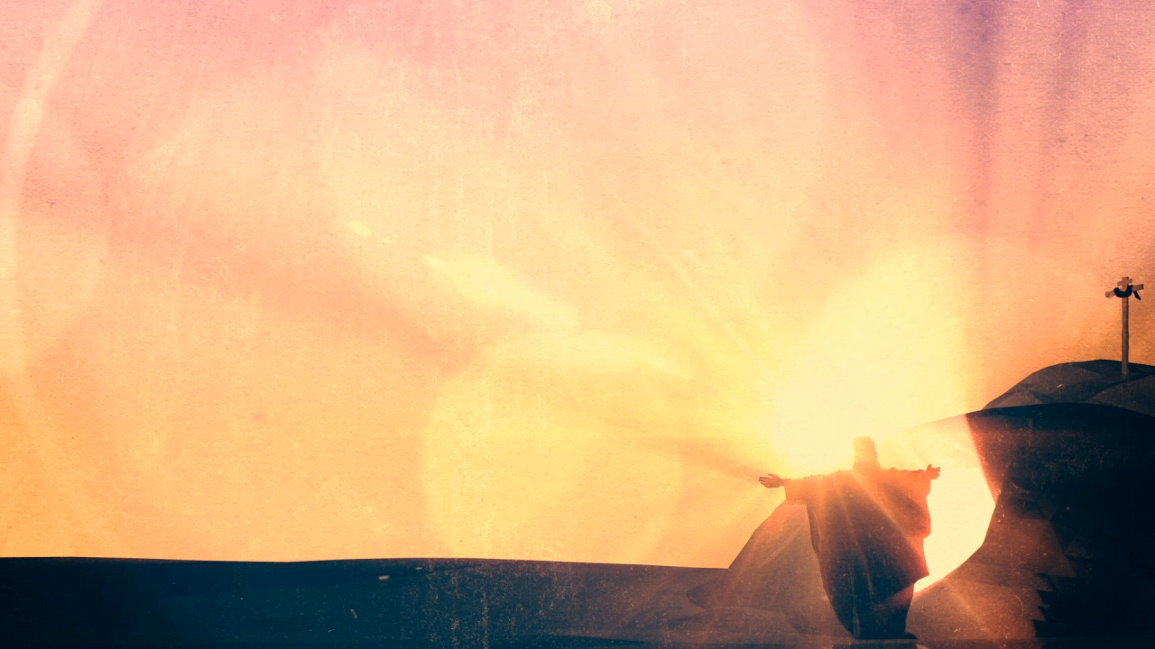
“No, doctor,” she exclaimed, “my best days are yet to come, when I shall see the King in His beauty.”
Notes:
A bright young girl of fifteen was suddenly cast upon a bed of suffering, completely paralysed on one side and nearly blind.
She heard the family doctor say to her parents as they stood by the bedside: “She has seen her best days, poor child!”
“No, doctor,” she exclaimed, “my best days are yet to come, when I shall see the King in His beauty.”
Christians, brothers and sisters in Christ, this is your reality, that because of the good news of the gospel, because Jesus paid it all and conquered the grave, your best days are yet to come!
But, if you have not believed in Jesus Christ, then death awaits you, an eternity in hell awaits you. But God calls, He is still welcoming all who will come, but there is only one, narrow way, and it is through His one and only son, Jesus Christ
And so I pray, and I would urge you to believe in the true story of easter, believe in the gospel, and you will be saved. Jesus Christ, the resurrected Saviour, is your only hope.
Will… you… believe?
Let’s pray

