Slide 1
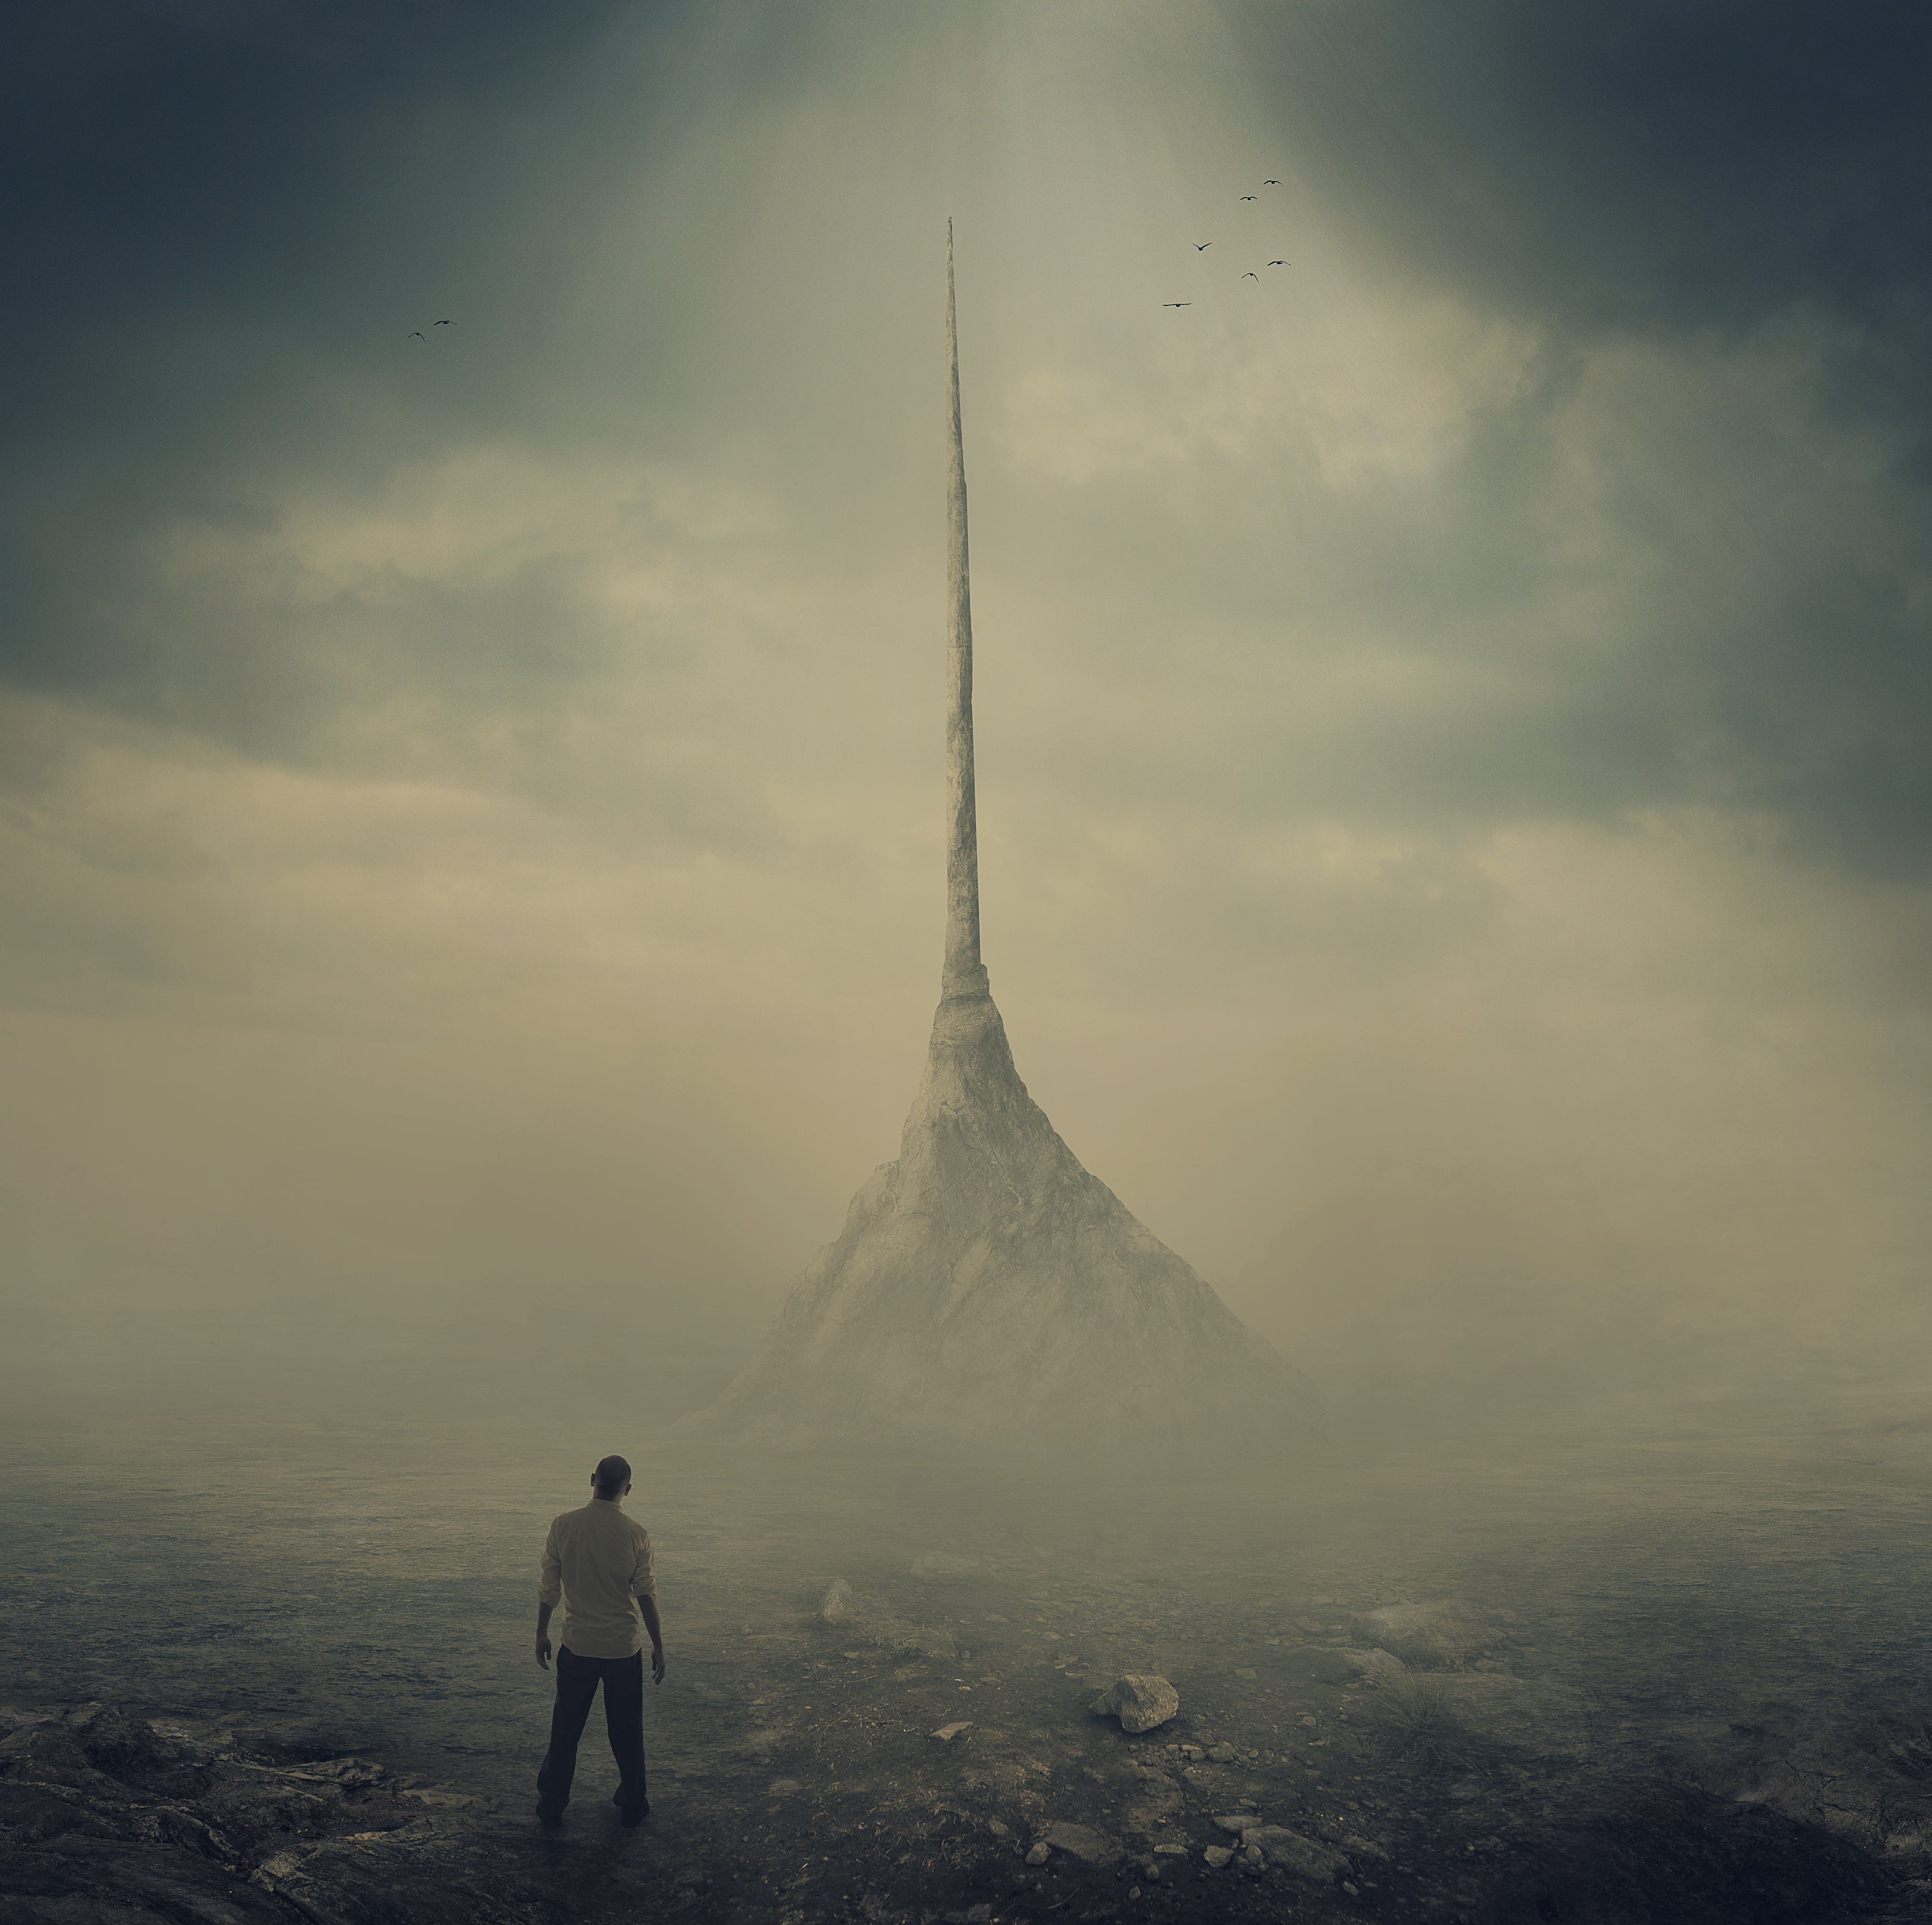
THE TOWER OF BABEL
"I have found within myself all I need and all I ever shall need. I am a man of great faith, but my faith is in George Gordon Liddy. I have never failed me."
Genesis 11:1-9
Notes:
Good morning everyone. Today I have the great privilege of being able to preach the final sermon in our series on Genesis 1-11
As I was studying this passage this week, I couldn’t help but smile at the cleverness and the wit of this story
It is a short but brilliant example of storytelling. God has taught me so much in preparing this message, and I had many of my Sunday School interpretations of this story broadened and deepened
And so I pray that as we look at what I’m sure is a very familiar passage to many of you, you will have open hearts and minds as to what God might be saying to us today
Let me begin today by sharing a quote from a man by the name of George
There once lived a man by the name George Gordon Liddy, and he was a Watergate conspirator - When he had been recently released from prison he stated this - "I have found within myself all I need and all I ever shall need. I am a man of great faith, but my faith is in George Gordon Liddy. I have never failed me."
I think that this not only represents the tower-builders in today’s story quite well, but reflects the sinful hearts of many people in the world today
They want nothing to do with God, because they think they can find all that they need within themselves and they can accomplish all things in their own strength
But much like the people in today’s passage, whether they find out now or when Christ returns, either way they will discover that apart from Christ they have nothing and can do nothing

Slide 2
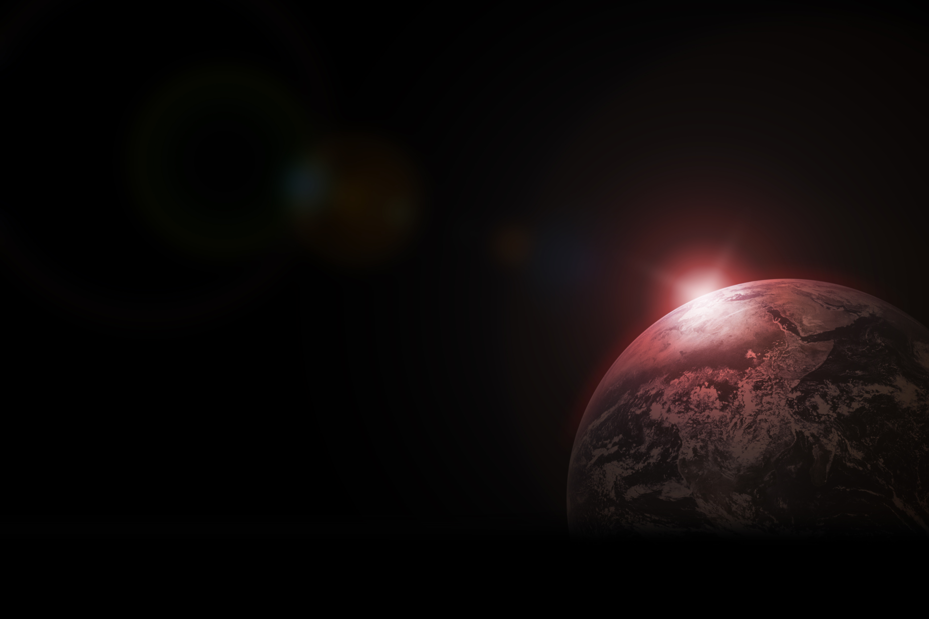
MANKIND DISOBEYS
“Now the whole earth…” (Gen 11:1a)
“Had one language and the same words” (Gen 11:1b)
“And as people migrated from the east, they found a plain in the land of Shinar” (Gen 11:2)
Notes:
“Now the whole earth…” (Gen 11:1a) - When it says the whole earth, I believe it literally means everybody. I don’t believe that Moses in writing this section is using hyperbole or writing poetry to convey a moral message - The story beginning this way stresses that the picture is universal, including all of humanity in its original linguistic solidarity - It is in the next part of this verse that we discover that Moses has to mean the whole earth, and everyone in it
“Had one language and the same words” (Gen 11:1b) - If we turn back to Gen 10:5 it says, “From these the coastland people’s spread in their lands, each with his own language, by their clans, in their nations” - And you will then find similar wording after the next two sons of Noah stating that each had their own language, so logically, the Tower of Babel must be the cause, and the Table of Nations account in Genesis 10 must be the effect - We see this being done earlier in Genesis when God made mankind and then concludes day 6, but then Genesis 2 rewinds and walks us through exactly how God created Adam - Therefore we can conclude that all of humanity really is gathered at Babel - In Hebrew the word here used for language is literally lip. So they had one lip, and the same words. - It is not saying that they had a limited vocabulary but Moses is being very intentional and making it very clear that there was unity, a oneness in their language and speech - Now you would think that this communion of language ought to have promoted a godly oneness of faith, but sin was alive and well among Noah’s descendants - Time and time again, sin rears its ugly head. Humanity’s depraved heart is always looking to rebel against God. - As Ephesians 2 puts it, we are dead in our trespasses, we are dead to God and the things of God, and we are constantly in rebellion against our Creator God, as we are going to see
“And as people migrated from the east, they found a plain in the land of Shinar” (Gen 11:2) - This whole idea of migrating from the east is probably both a statement about their location, and also a theological statement - Location wise, the people were literally travelling east toward a place called Shinar. - It is often said that this idea of east, or from the east suggests away from God and away from the covenant obligations of God - We have seen this when Adam and Eve were kicked out of the garden the Cherubim guarded the entry on the east side. - In just a few chapters after today’s passage, we read how Lot left Abraham and chose Sodom and Gomorrah, and in doing so travelled east, away from God’s covenant people that would be established through Abraham - But it is in these next 3 words where the trouble really begins

Slide 3
“…and SETTLED there” (Gen 11:2)
“Be fruitful and multiply and fill the earth and subdue it, and have dominion over…” (Gen 1:28)
The tower-builders’ great sin was in their disobedience to God’s mandate to fill the earth
Notes:
“…and SETTLED there” (Gen 11:2) - The first thing to note is that at the very end of this chapter, Terah settles down in Haran when he was meant to go to Canaan. But then we read in the first verse of chapter 12 that God tells Abram to go from his country - Settling was followed by great upheaval. - You see, God is sovereign, and you can try to fight His will and go against His will, but ultimately God’s plans will always come to pass - The second thing to note is that often in Sunday School, or even with a very shallow reading of the text, it is often the building of the tower that is portrayed as the main sinful act - But it is actually right here, right here in this settling that they defied the command of God, - What is it that God commanded Adam and Eve when He first created them way back in Genesis
“Be fruitful and multiply and fill the earth and subdue it, and have dominion over…” (Gen 1:28) - And then again, after God had wiped out the world with the great flood, God said to Noah and his sons, “Be fruitful and multiply and fill the earth”. - Given that the tower-builders come from the line of Noah’s sons, they would have known and yet chose to defy God’s order - God had commanded and given the crown jewel of His creation the great privilege of spreading His glory, His image, across the earth - But instead, in defiance, they chose to settle!
The tower-builder’s great sin was in their disobedience to God’s mandate to fill the earth - Now don’t get me wrong, the acts that follow on from this are sinful, and full of pride, trying to play the role of God - But it is this sin here that is the sticking point for God, it goes against God’s plan for humanity to fill the earth - And so it is this act that God mostly addresses in His judgement at the end of this passage - But it doesn’t stop here, we see that unrepentant sin leads to more sin

Slide 4
MANKIND’S GREATEST FEAR
“And they said to one another, “Come, let us make bricks, and burn them thoroughly” (Gen 11:3a)
“Then they said, “Come, let us build ourselves a city and a tower with its top in the heavens” (Gen 11:4a)
“and let us make a name for ourselves” (Gen 11:4b)
Notes:
“And they said to one another, “Come, let us make bricks, and burn them thoroughly” (Gen 11:3a) - And so, they had brick for stone, and bitumen for mortar - Sun-dried bricks set with tar was a Babylonian invention. We see here the ingenuity of mankind, the creativeness and sheer brilliance that God has set into humanity - There are Babylonian poems that describe gods as molding the bricks for a year to make the ziggurat, basically a step-pyramid that was to be a ‘gate to the gods’ - But we see here it is no immortal gods building, but it is mortal man. - The vast potential we see here was placed in us to glorify God, but these tower-builders expressed their ingenuity without any reference to God, wanting to take all the glory for themselves
“Then they said, “Come, let us build ourselves a city and a tower with its top in the heavens” (Gen 11:4a) - They want to continue in their rebellion. They have no intention of ever leaving. They are building a city, probably with homes, they want security - This great endeavour is all about them, they state “let us” build, “let us” make. - This tower that was to reach into the heavens was in Babylonian literature called a ziggurat, a solid brick structure, that was multi-staged up to heaven, so that they could have access to the gods and vice versa - Like all false religions, they thought they could work and build their way to heaven, that if they could just make enough bricks, and build a great city, and construct a great tower then immortality would be theirs, eternity would be within their reach
“And let us make a name for ourselves” (Gen 11:4b) - Are you getting the picture? This was all about their glory, and nothing to do with God - And again we see “let us”. Which causes us to cast our minds back to the creation of mankind when God said as the triune God, “Let us make mankind in our image” - God did this so that people could see God and see how amazing He is, how awesome He is - At Babel it was “let us make a city, and a tower and a name, in our image” so that people could see how amazing we are - God makes a people so that His name could be great and they would disperse over the earth, instead people stop and do the exact opposite, wanting to make a name for themselves and not disperse - There was a study done with American youths that showed that the youth of today would rather share a dinner with a celebrity rather than Jesus Christ, because what they most crave in life is to be famous, is to be known - But what the world fails to see is that what they most crave in life, is not evil, but it was built into us to point us to Jesus Christ, and to believe in the gospel - In Genesis 12, God says to Abraham, that He would make Abraham’s name great, but it would be done God’s way and not Abraham’s way - God says, you want to be known and loved like you never have been before, there is only one way, and it is found in the gospel of Jesus Christ

Slide 5
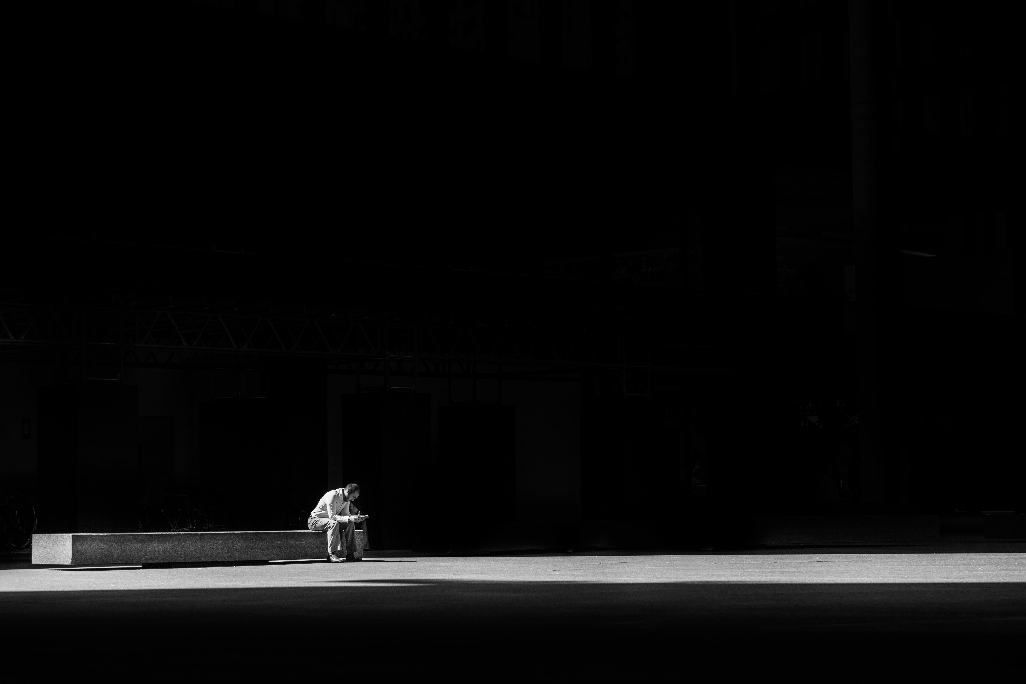
“lest we be dispersed over the face of the whole earth” (Gen 11:4c)
The tower builders craved security (building a city), significance (make a name and fear of dispersion), and eternity (build to the heavens)
The world today goes searching far and wide for this, but like the tower-builders, they will not look to Jesus Christ, the only source of these blessings
Notes:
“Lest we be dispersed over the face of the whole earth” (Gen 11:4c) - It’s rather ironic that their greatest fear, was the very thing they ought to have done in the first place - But if they dispersed, they feared they would be anonymous - How would anyone remember their name, and make a legacy for themselves if people weren’t around to witness the great city and tower - But we see in these first four verses that the tower builders, were in one place, with one language, as one people, with one city, and one goal… to glorify themselves.
The tower builders craved security (building a city), significance (make a name and fear of dispersion), and eternity (build to the heavens) - The things that they craved are not sinful or evil, they are things that every human being craves - And that’s what makes this story so frustrating in a sense, is that the very things that they craved could only be found in God, the very person they were walking away from - Their identity and significance could never be found in the applause of this world
The world today goes searching far and wide for this, but like the tower-builders, they will not look to Jesus Christ, the only source of these blessings - We see that the search for security, significance and eternity did not stop with Babel, but is perhaps even more prevalent today - The western world is having an identity crisis, we have boys wanting to be girls, and girls wanting to be boys, and men who want to birth babies, and woman who don’t want to have babies - Why, why do so many people seem so lost and seem to have no idea who they are? Why is the problem with identity running rife through our young people? - Because they look to be satisfied in everything else but Jesus Christ - There is no place more secure than in the arms of our heavenly Father - You want to know how much you are worth, you want to discover your significance - Look to the cross and see how God sent His one and only Son to die the death you deserved so that you might live and be adopted into the family of God - And if you are looking for eternity, eternal life, there is no other way than through Jesus Christ, by believing in his finished work - That he died for your sins, and so if you will repent and believe in Jesus, you will have eternal life

Slide 6
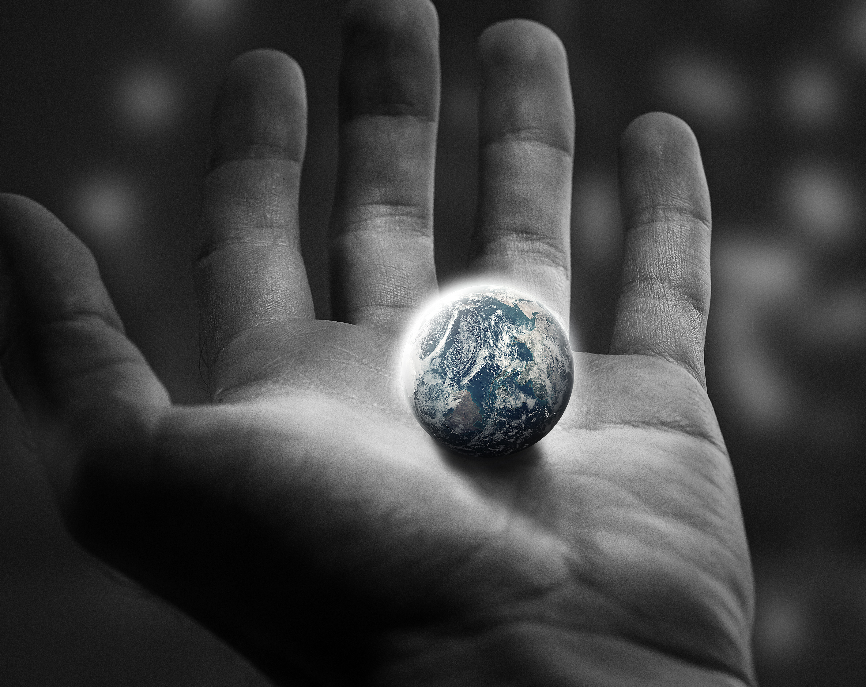
GOD INSPECTS
“And the Lord came down to see the city and the tower, which the children of man had built” (Gen 11:5)
“And the Lord said, “Behold, they are one people, and they have all one language” (Gen 11:6a)
“This is only the beginning of what they will do. And nothing that they propose to do will now be impossible for them” (Gen 11:6b)
Notes:
“And the Lord came down to see the city and the tower, which the children of man had built” (Gen 11:5) - This verse sits smack bang in the middle of the story, and you can see the satire that Moses has written into this, you can almost imagine Israel chuckling as this story is read aloud to them - That in spite of all the people of Babel’s gigantic efforts to build this city, and build this tower into the heavens. - It’s as though God has to get out His magnifying glass, and He’s squinting, and decides that in order to see this tower, He simply must come down to see it - In God’s eyes, nothing we can ever do will impress Him in His genius and infinite power
“And the Lord said, “Behold, they are one people, and they have all one language” (Gen 11:6a) - God’s first comment about what He sees is not about the tower but about their unity and peace which is not from God, but of the world - The one people, in one city is what concerns God, that they have defied His command to fill the earth “This is only the beginning of what they will do. And nothing that they propose to do will now be impossible for them” (Gen 11:6b) - This verse is not speaking of God feeling threatened by mankind as if to say “Oh no, if they bond together what ever shall I do?” I mean if anyone thinks that, can I encourage you to go and reread the flood narrative - The Creator is not feeling threatened by His creation. Nor is He admiring their works, but rather noting the perversity of their unbelief - This verse is the voice of a concerned Father for His creation. He sees the depravity, the wickedness of their hearts and is troubled by what might happen to humanity if they are left unchecked - He is concerned not what they might do to Him, but what they might do to themselves in their unbelief - The good news, which is a great reminder for us today, is that God is sovereign and He will intervene

Slide 7
GOD PUNISHES WITH PURPOSE
“Come, let us go down and there confuse their language, so that they may not understand one another’s speech”
(Gen 11:7)
“So the Lord dispersed them from there over the face of all the earth” (Gen 11:8)
“Therefore its name was called Babel, because there the Lord confused the language of all the earth” (Gen 11:9)
Notes:
“Come, let us go down and there confuse their language, so that they may not understand one another’s speech” (Gen 11:7) - So now, we see that the language used is similar to that at the start of the narrative where mankind was saying “let us”, and so now as if to mock them we read of God saying, “Let us go down” - The first thing that we see about God’s judgement is how wise and effective God’s intervention is. - God could have toppled the tower with simply a word, but He knew that if He did that, they most likely would have just started all over again, rather than dispersing - But by confusing their language they would have no choice but to face their greatest fear
“So the Lord dispersed them from there over the face of all the earth” (Gen 11:8) - Back in verse 4 we read that what they were most scared of was being scattered, and yet this was the very thing God commanded mankind to do - And so in confusing their language they were forced to find those who spoke the same as them and go their separate ways - Humanities plans will never usurp God’s plans. It is God who is sovereign and to try and thwart His plans or run away from them is pointless, because in the end He will have the last word - Many people hate the idea that God gets His way. But we live in God’s world, and play out our lives in His story, with a plot and an ending that He penned before the foundations of the world - And so we see that God achieved what He had planned all along in judgement, that His creation would be fruitful, multiply and fill the earth
Therefore its name was called Babel, because there the Lord confused the language of all the earth” (Gen 11:9) - The tower-builders were wanting to make a name for themselves, and as it would turn out, they did – But it was not name to wear around with honour, or in pride. - Instead they would be remembered in history as the people who got confused - They went from 1 language to many, from 1 place to every place, from 1 people to many peoples, and from one goal, to make a name for themselves and build a tower that reaches to the heavens, to a name of humiliation and an inadequate tower - But judgement would not be God’s final word

Slide 8
“And at this sound the multitude came together, and they were bewildered, because each one was hearing them speak in his own language” (Acts 2:6)
The miracle of Pentecost shows that what man sought vainly through rebellion would be achieved by grace through faith in Christ
In Genesis they were given the great mandate to fill the earth. We have been given the great commission to take the gospel to the ends of the earth
Notes:
“And at this sound the multitude came together, and they were bewildered, because each one was hearing them speak in his own language” (Acts 2:6) - In Acts 2 we witness the great reversal of Babel - Let us read Acts 2:5-12 - Once again, people were gathered in one place, all who spoke many different languages, which is a direct result of Babel, now hearing, by the power of the Holy Spirit, the Apostles speaking as though it was one language, in the tongues of men - This time it is not language that unified these people but the Spirit of God - And then straight after this Peter preaches a sermon that would see thousands saved and brought into the church. - How? Did this happen because it was as though Peter was speaking in one language? - Absolutely not! It happened because of a mighty movement of God upon the preaching of God’s Word
The miracle of Pentecost shows that what man sought vainly through rebellion would be achieved by grace through faith in Christ - The unity that the tower-builders were looking for can only be found in Jesus, where all who believe in Jesus Christ become one - As a child of God, you need not fear anything in this world, not even death, because to live is Christ and to die is gain - And in Jesus Christ you receive the approval of God, because He no longer sees your dirty, unworthy record, but sees Christ’s perfect, spotless record - And so we love God because He first loved us by sending Jesus Christ to die for us while we were still sinners - All of the things that the soul of every human being on this planet craves can be only be found by grace, through faith, in Christ alone
In Genesis they were given the great mandate to fill the earth. We have been given the great commission to take the gospel to the ends of the earth - I do believe that as humans, we are still to be fruitful, and multiply, and fill the earth - But God has given those who belong to Jesus Christ, a greater command, a greater privilege and that is to go out and share the gospel to the ends of the earth - And unlike the tower-builders, we do not stop, there never comes a time when we settle and think we have heard the gospel enough, or that we have shared the gospel enough - Don’t stop, go everywhere. “Go therefore and make disciples of all nations, baptising them in the name of the Father and of the Son and of the Holy Spirit”

Slide 9
SUMMARY
God is sovereign over all
The tower of Babel, and Genesis 1-11 shows us that the problem of sin is not a new development but as old as time itself
God is not impressed by us or our works, or our buildings. God has only ever been impressed with one man
Notes:
God is sovereign over all - Over the course of our time spent in Genesis if there is one thing that you should take away it is that God is sovereign, that nothing happens apart from His will - God will bring His purposes to pass in spite of man’s sinful hearts and sinful plans - The only plan that will ever succeed in achieving salvation is God’s redemptive plan that is centred on the reign of His Son, the Lord Jesus Christ - Rather than fight God’s plan let us embrace God’s plan and vision both for the world and for our own lives
The tower of Babel, and Genesis 1-11 shows us that problem of sin is not a new development but as old as time itself - As Christians we often look around at the world we live in and become despondent, and depressed, and we should be grieved by sin, just as God is - But also we must be reminded that while sin may be a part of this world that we live in now - There will come a day when there will be a new heavens and new earth, and all will be united under one king, the king of kings, Jesus Christ - And in this place, sin will be no more - And we will stand with our fellow brothers and sisters in singing praise to our sovereign God who has vanquished sin once and for all
God is not impressed by us or our works, or our buildings. God has only ever been impressed with one man - God looks down upon earth and sees that none is righteous and none do what is good. We are dead in our sins, and our works are but filthy rags - But Jesus Christ, God’s only Son, this is the one with whom God is well pleased. - And so the only way to receive God’s favour, His mercy is to repent of your sins and believe in Jesus Christ - Our hope is not some utopian world, our hope rests in Christ alone - For it is only in him that we find all that our souls long for, we find unity, we find peace, we find significance, and we find eternal life

Slide 10
“There was a day when I died, utterly died; died to George Mueller, his opinions, preferences, tastes, and will; died to the world, its approval or censure; died to the approval or blame even of my brethren and friends; and since then I have studied to show myself approved only to God.” George Mueller
Notes:
At the beginning of this sermon, I shared a quote from a man named George stating, "I have found within myself all I need and all I ever shall need. I am a man of great faith, but my faith is in George Gordon Liddy. I have never failed me."
Let me share with you a quote from another man by the name of George
When a man asked George Mueller the secret of his service, Mueller responded: - “There was a day when I died, utterly died; died to George Mueller, his opinions, preferences, tastes, and will; died to the world, its approval or censure; died to the approval or blame even of my brethren and friends; and since then I have studied to show myself approved only to God.”
Let us not be like George Gordon Liddy, but like George Mueller
Let us not place our trust in our own sinful selves
And let us not work for the applause of the world
But let us be a church filled with men women who will die to self and live for Christ, that we might show ourselves approved only to God

