Slide 1
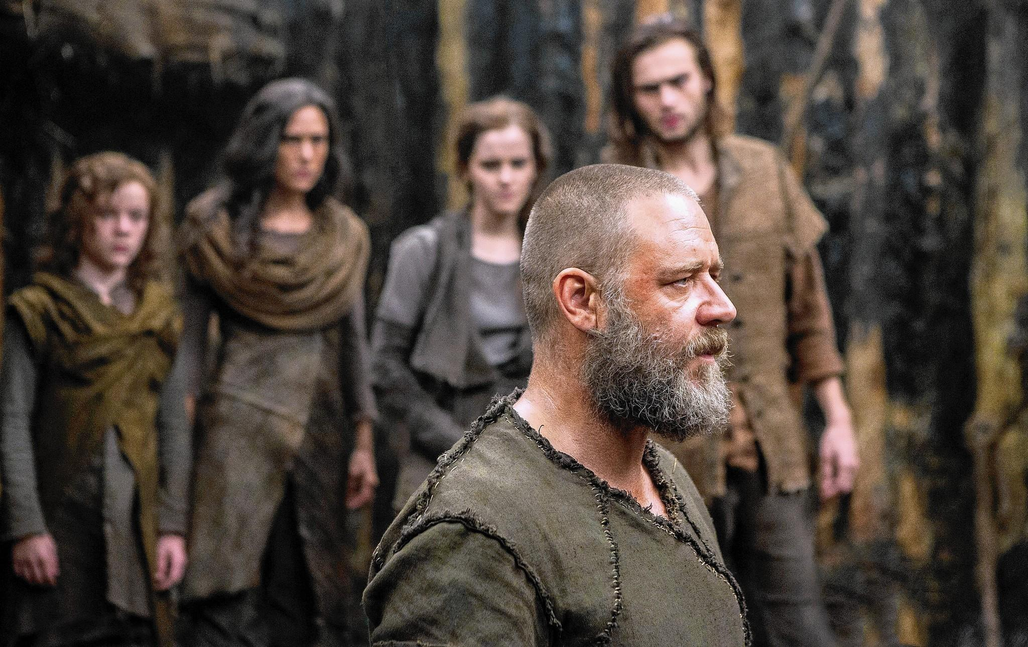
The Sons of Noah
Blessings and Curse
Genesis 9:18-29

Slide 2
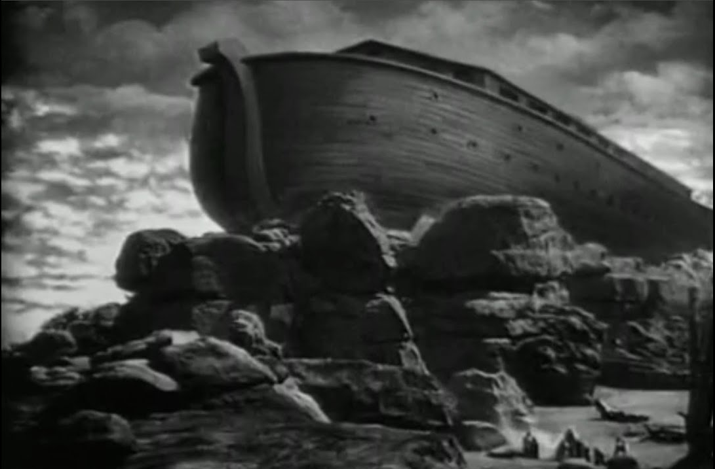
There are a number of similarities between Adam and Noah:
Both were made responsible by God for populating the Earth
Both shared the same profession (farmers who worked the ground)
Both involved a curse or prediction
Both involved strife with their descendants
When their nakedness was uncovered, Noah’s other two sons covered him, just as God covered Adam and Eve

Slide 3
Noah is a type of a “2nd Adam” acting both as a recipient of blessings and the father of a sinful child
Noah lived for an additional 350 years after he left the ark – Genesis 9:28
He had time to settle down, to plant a vineyard and to abuse the fruit of the vine. This story may have been 200 years after the ark
Noah doesn’t cover himself in glory in this story
Noah had gone from a man who found favour in the eyes of God to a man who found shame in the eyes of other men

Slide 4
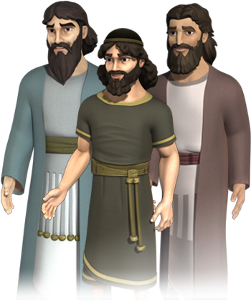
Noah had 3 sons
Shem
Japheth
Ham
What was Ham’s transgression?

Slide 5
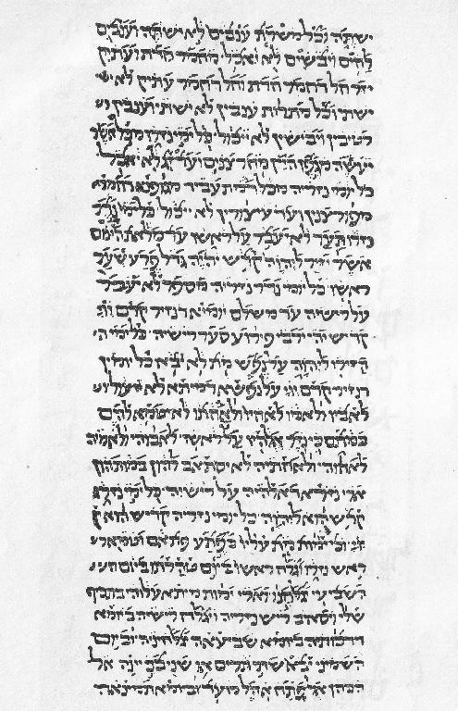
Why did God curse Canaan and not Ham?
The Targum Onkelos
Gossiping "in the street"
It was the gossiping and being held up to public mockery that had
angered Noah
Whoever goes about slandering reveals secrets, but he who is trustworthy in spirit keeps a thing covered (Proverbs 11:13)

Slide 6
What were the Blessings and Curse?
Ham
Japheth
Shem
Canaan would be a slave to his brothers and to the families of Shem and Japheth
Japheth would have his territory extended by God
Shem would be blessed by God as His people

Slide 7
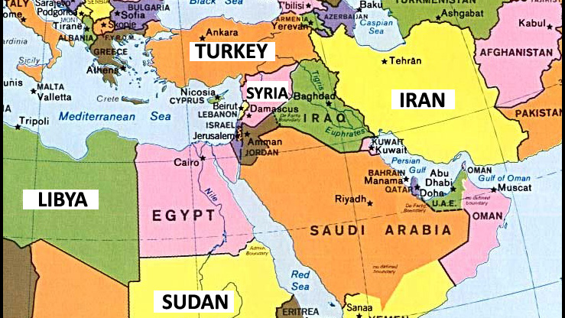
JAVAN
TARSHISH
JAPHETH’S SONS
TUBAL
ARAM
CANAAN
ARPHAXED
SONS OF SHEM
EBER
LEHABITE
MIZRAIM
HAM’S SONS
CUSH

Slide 8
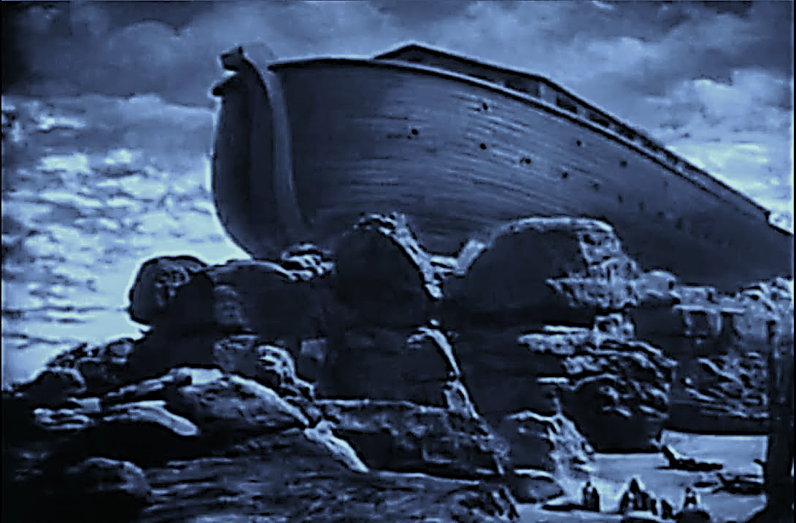
What Warnings and Blessings can we take from
the story of the Sons of Noah?
Warnings
1) God hates gossip and slander
‘Notice, we never pray for folks we gossip about, and we never gossip about the folk for whom we pray!
For prayer is a great deterrent.’ — Leonard Ravenhill
Psalm 101:5
‘Whoever slanders his neighbour secretly I will destroy. Whoever has a haughty look and an arrogant heart
I will not endure.’

Slide 9
2) We are all just one step away from disgrace if
we take our eyes off following God
A clean slate does not guarantee a long-term healthy spiritual journey.
‘And now, dear children, remain in fellowship with
Christ so that when he returns, you will be full of
courage and not shrink back from him in shame.’
1 John 2:28

Slide 10
3) Our sin will always have its consequences
3) Our sin will always have its consequences
Galatians 6:7-8 ‘Do not be deceived: God cannot be mocked. A man reaps what he sows. Whoever sows to please their flesh, from the flesh will reap destruction; whoever sows to please the Spirit, from the Spirit will
reap eternal life.’

Slide 11
Blessings
1) God knows that we are not perfect
Romans 3:23 ‘for we all have sinned and fallen short
of the glory of God’
Ephesians 4:32 ‘Be kind to one another, tender-hearted, forgiving each other, just as God in Christ
also has forgiven you.’

Slide 12
3) No matter how hard we fall, God still loves us and desires for us to come back to Him
1 John 1:9 ‘If we confess our sins, he is faithful and just
and will forgive us our sins and purify us from all unrighteousness.’
Hebrews 11:7 ‘Noah became heir of the righteousness that is in keeping with faith.’

Slide 13
3) God knows the end from the beginning
‘For I know the plans I have for you,” says the LORD. “They are plans for good and not for disaster, to give you a future and a hope.’ Jeremiah 29:11

Slide 14
God’s desire is to bless you and not curse you
Isaiah 30:18
Therefore, the Lord waits to be gracious to you, and therefore, he exalts himself to show mercy
to you. For the Lord is a God of justice; blessed are all those who wait for him.

