Slide 1
Mitch – “I am feeling like this is the best that life
will ever be. This is the best I am ever going to feel. And it’s not great.”
Barbara – “Go away with Ed and Phil for two weeks. Go and find your smile.”
Notes:
As we prepare to move out to Biloela, I thought it would be wise to do some research by watching some western movies and some cowboy films. One of the obvious movies that came to mind was City Slickers which came out in 1991. Focuses on the story of three friends who are having a midlife crisis – what is the purpose of their life. The main character Mitch is played by Billy Crystal who laments to his wife about his life. She encourages Mitch and his two friends to go on a weekend adventure in the wild west. On this adventure they meet an old cowboy named Curly who gives them lots of advice.

Slide 2
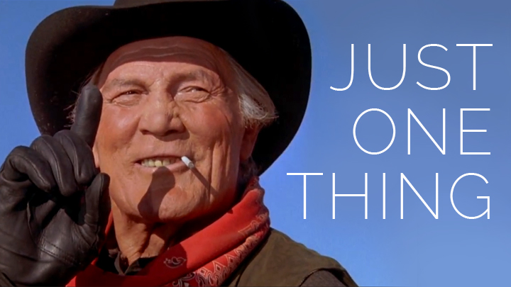
PHILIPPIANS 3:12-14
DIVIDED INTO SIX VITAL TRUTHS
Notes:
Curly tells Mitch that the secret to life is one thing – but doesn’t tell him what it is. And the movie never gives that answer. But thankfully, like so many other big questions in life, the Bible tells us what that one thing is. Paul gives us the answer in Philippians 3:12-14 and it turns out that the one thing is made up four vital truths. I want us to look at these truths and leave them with you – to encourage and challenge you as you seek to live for Jesus. Just as Mitch and his friends went into the great outdoors to find the meaning of life, Paul takes us into the world of sports to help us understand this wonderful truth - this one thing.

Slide 3
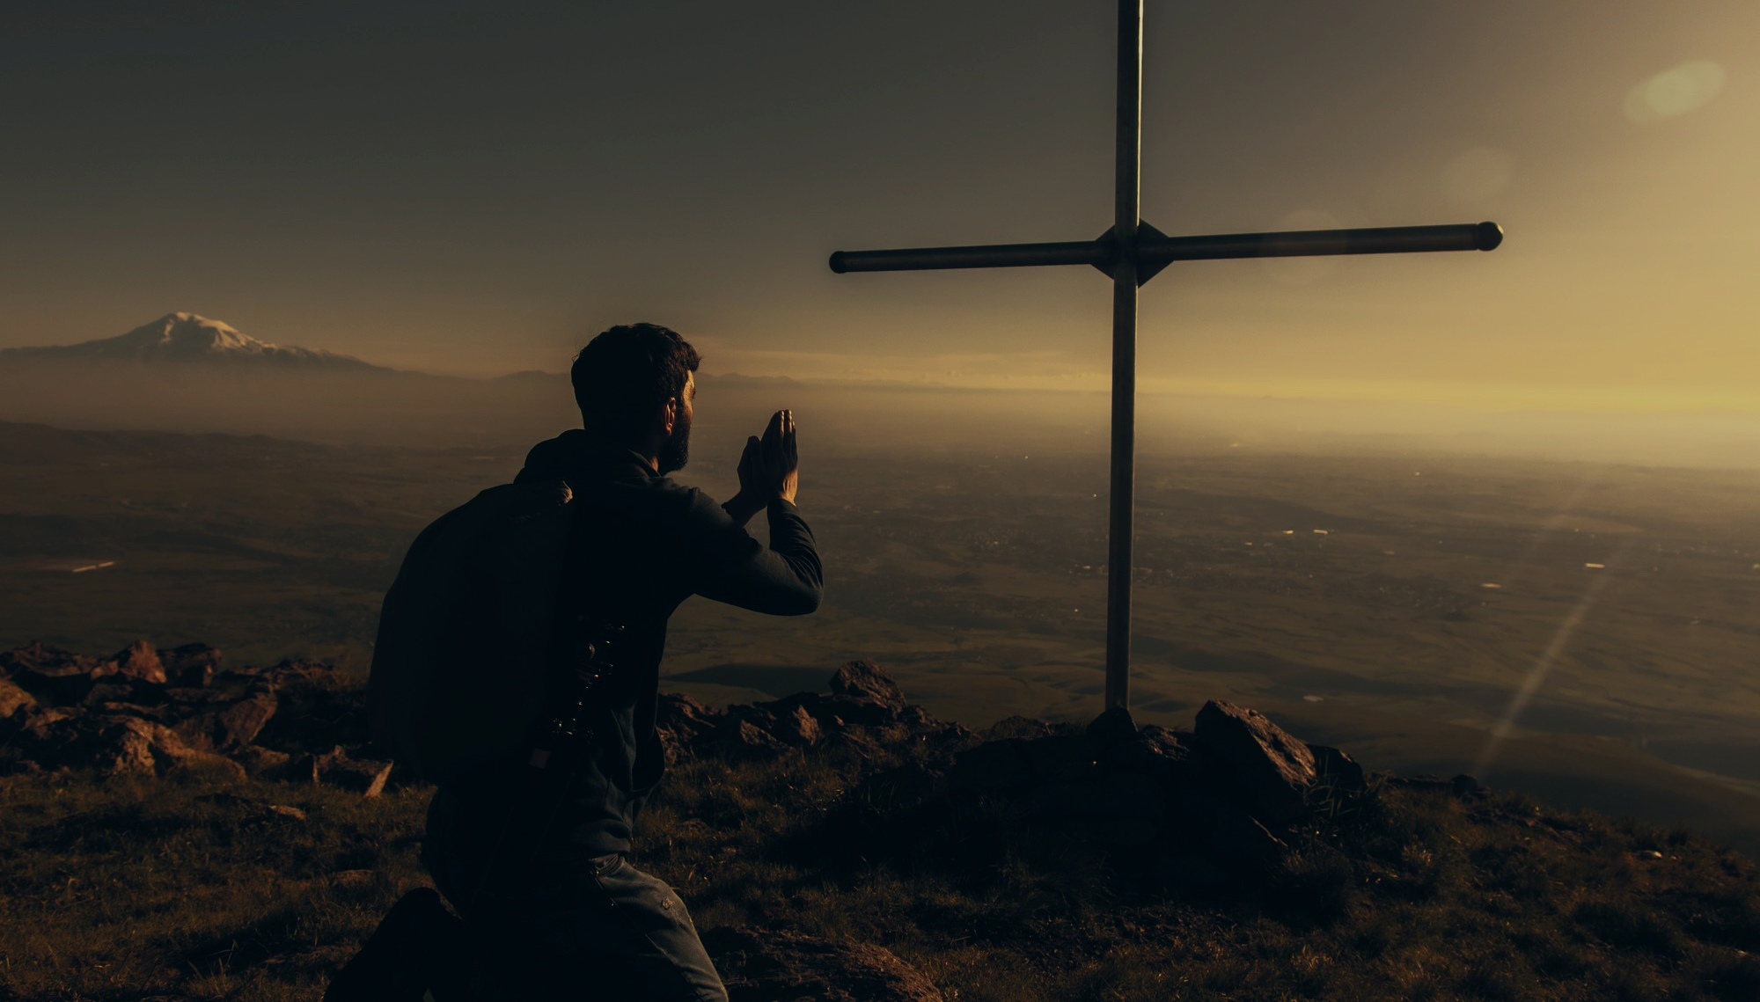
1. THE MOTIVATION OF THE NOW AND NOT YET – “I don’t mean to say that I have achieved these things or reached perfection… I have not achieved it.” (vs 12-13)
“We are already God’s children, but he has not yet shown us what we will be like when Christ appears..” (1 John 3:2)
As Christians, God has loved, accepted and changed us. But we are not yet completely changed. We are not yet perfect, like Christ.
“Because of God’s promises let us cleanse ourselves from everything that can defile us. Let us work toward complete holiness because we fear God.” (2 Cor 7:1) = we can’t neglect our sanctification (getting rid of sin) if we truly want to honour God.
Notes:
The first truth we need regarding the one thing is the motivation to strive to get it. Paul knew that even though he was a Christian, even though he had repented of his sin and surrendered his life to Jesus as his Lord and Saviour, he still was not perfect – he still had a long way to go. It was this holy dissatisfaction that motivated Paul to continually strive to be like Jesus – for perfection. And as Christians that’s what God calls us to do – to strive to be holy. Just because we are saved by grace doesn’t mean we can just rest on our past decision

Slide 4
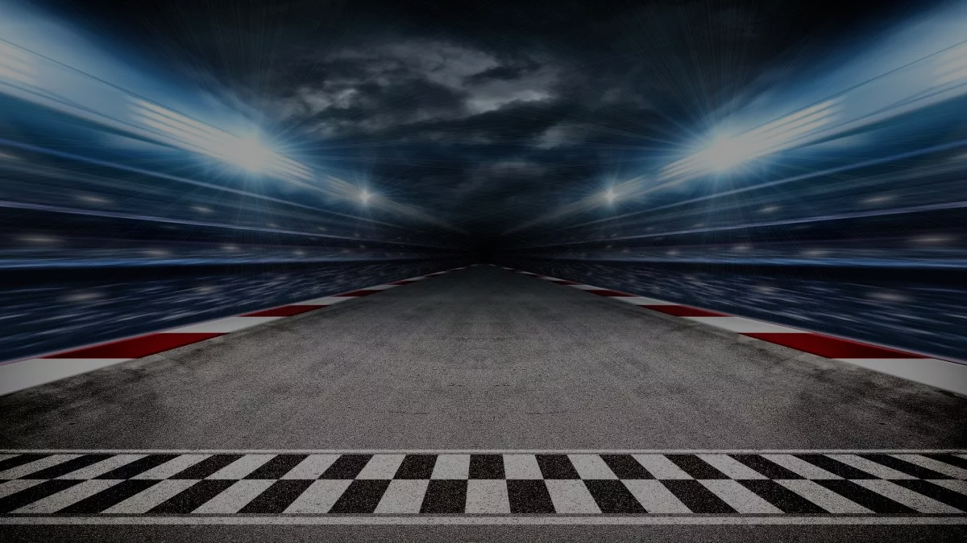
‘Saved by grace’ doesn’t = we can just rest on our past decision to follow Jesus, and be complacent in how we live for him.
Be wary of getting stuck in neutral – stagnant in your faith. Your ‘progress’ depends on your situation.
Be wary of only moving forward in cruise control – not paying much attention. Your speed & progress depends on those around you.
Be wary of staying in Park – seeing no need to accelerate, content with who & where you are.
‘Just one thing’ starts with our ‘holy dissatisfaction’ – a daily commitment to enter the race we have been called to run.
STREET EATER
Notes:
There are many who would not see the need for this motivation. They would say we are saved by grace and all I have to do is just wait until Jesus comes again. Christ + nothing. While its true Christ + nothing = salvation, the Bible tells us that once we are saved we will seek to get rid of sin and aim to be like Jesus. So the Christian life can never be a complacent life. God is still working in our life to reveal his glory and the gospel to the world. Not having this motivation to be holy brings to mind some car driving analogies. In the world of sports racing there is no bigger ‘beast’ on the road then the Tucson – we recently bought one. We need to be cautious of being stagnant in our Christian life – getting stuck in neutral. The only way you get movement and progress in neutral is if you are on a slope – if the situation is right. If our circumstances are not good then we can stagnate in our faith. Angry, fearful, anxious. But even if we are moving forward (out of Neutral into Drive) we can be content to just put the car on cruise control. This makes it comfortable, predictable Christian life – not requiring much effort or attention. But with adaptive cruise control (which we have on our new vehicle) your speed and progress on the journey is determined by those around you. If all depends on the pastor’s sermon, the quality of worship, the friendships at church, the example of Christian leaders and influencers (authors, podcasters etc.). If they don’t move and motivate you, then nothing much happens. Our prayer life is limited to listening to others pray, or others read the Bible or other people answers at Bible study. No personal intentionality in any of those areas. Or we can get stuck in Park – content with where we are and what we have done – can just sit and wait for Jesus to return. Nothing more to do.

Slide 5
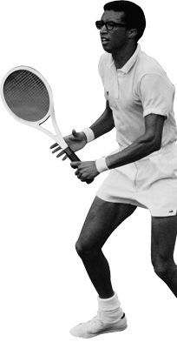
2. THE DISCIPLINE TO FOCUS – “But I focus on this one thing.”
“I run with purpose in every step..” (1 Corinthians 9:26) = intense concentration & absolute confidence.
In the sporting world this is called ‘being in the zone.’
Such a focus doesn’t come naturally – only developed through disciplined training and intentional effort + trusting in the example & power of Christ.
“Let us strip off every weight that slows us down, and the sin that so easily trips us up. And let us run with endurance the race God has set before us. We do this by keeping our eyes on Jesus, the champion who initiates and perfects our faith.” (Heb 12:1-2)
Notes:
The phrase ‘being in the zone’ refers to the TV show the Twilight Zone (being in another world). It originated in 1973 when Arthur Ashe recalled a game he played against Bjorn Borg (can you name these two players). He described Borg as being in the zone (there was nothing I could do to stop him)– playing out of this world, where nothing could distract him or stop him from doing what he wanted to do. To be in the zone is to be able to block out distractions from the opponent (opposition – those seeking to defeat you) , the crowd noises, the media (community) perspective, commentary and opinions. This sort of focus needs discipline to develop and it can’t be achieved without the power of Christ helping and equipping us (prayer and Bible study – knowing his will and purpose = the steps, path he wants you to take. Disciplined focus = stripping off distractions and hinderances and striving to get rid of the sin that weighs us down and trips us up (sanctification).

Slide 6
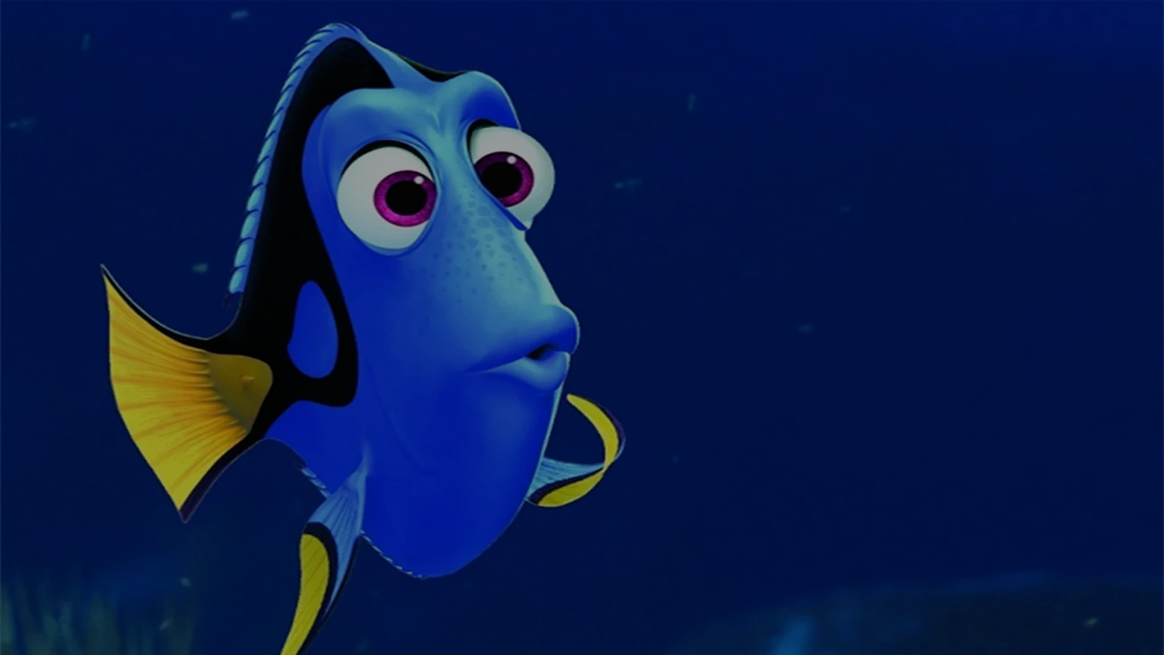
3. THE DISCIPLINE TO FORGET – “Forgetting the past…” (v13).
Looking back in a race = losing speed & direction = risk of losing.
‘Forgetting the past’ = selective forgetfulness. It’s right & good to remember God (Psalm 77:11-12) & Jesus (1 Cor 11:25).
Forget failures - let them teach you, but don’t let them terrorise you. Don’t wallow in past defeats & sins (forgiven – Ps 103:10-12).
Forget successes – forget them if they make you proud. Remember them if they make you grateful. Boast only in Jesus (3:5-8)
Forget hurts – don’t dwell on being a victim. Don’t be held captive by anger & revenge.
Forget the ‘good old days’ – celebrate the past, but don’t live in it.
Notes:
Looking back cost John Landy in the final of the mile race at the 1954 Commonwealth Games. He looked back to see where Roger Bannister was and lost momentum – Roger won. Forgetting the past can’t mean obliterating or erasing from our mind all memory of the past. Its good for us to remember God’s mercy, great deeds, answered prayers, promises, goodness etc. And the primary purpose of communion is to remember Jesus and what he accomplished for us on the cross. Paul is talking about selective forgetfulness. Forget failures – missed opportunities, mistakes made and sins committed. Satan will love to accuse you and fill you with guilt, make you feel disqualified, but God has forgiven our sins if Jesus is our Lord and Saviour – removed them as far as east is from the west. No condemnation to those in Jesus (Romans 8:1). Don’t live in bondage to past sins. Forget past successes – if they make you proud and make you think that nothing else needs to be done. In 3:5-8 Paul himself refers to the reasons why he could have boasted – 7 reasons based on who he was and what he had done. But nothing compared to Christ and what He had done. Successes all = rubbish, poo compared to Jesus. Forget hurts – where people have hurt you, broken promises, broken confidence, let you down, betrayed you, lied about you, stolen from you…don’t be held captive by it.

Slide 7
4. THE DISCIPLINE TO LOOK FORWARD – “… and looking forward to what lies ahead.” (v13)
Looking forward = all out effort and intense focus. Not looking from side to side = worldly distractions or Satan’s temptations.
Looking forward = living in the present, but not for the present. Working hard in the present, but living for the future.
Looking forward = everything is focused forward. You are not thinking about how well you started or how well you ran the last 10 metres. It’s all about the finish - the goal and the prize.

Slide 8
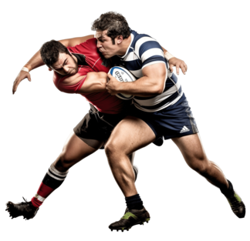
5. THE DISCIPLINE TO PURSUE – “I press on to possess that perfection…. I press on to reach the end of the race..” (vs 12 & 14)
Press on = running without swerving off course, straining with all you have.
Possess = chase down apprehend, take hold of firmly. Eager to grab hold of what God has promised.
6. THE ULTIMATE PRIZE – “.. The heavenly prize for which God, through Christ Jesus is calling us.” (v14)
The joy of everlasting fellowship with Jesus, in a glorified body on a glorified earth = “knowing + gaining Christ + experiencing the love & power of Christ” (3:7-11).
Notes:
Pursuing – press on and possess are an image of a rugby league player chasing down the opposition player to tackle him. This is more related to hunting – to pursue and hunt down.
The prize – its not mentioned specifically in these verses. Some say it’s the words of commendation from Jesus – well done good and faithful servant (Luke 19:17). Some suggest the crown of righteousness which Jesus gives us when he returns (2 Tim 4:8) or the crown of glory and honour that will not fade away (1 Peter 5:4). Its true that a heavenly prize will not fade – eternal. But I think its what Paul mentions earlier in this chapter (vs 7-11) – gaining the presence of Christ for eternity. Christ is our prize.

Slide 9
Just one thing = the motivation of ‘NOW AND NOT YET’ + the discipline of FOCUS + the discipline of NOT LOOKING BACK + the discipline of LOOKING FORWARD + the discipline of PURSUING = THE PRIZE (experiencing ‘unspeakable joy’ forever with Jesus).
“Winning is a habit. It is not a some-time thing; it’s an all-the-time thing. If you want to win the prize, you have to be willing to pay the price. You have to be striving for perfection. You have to enjoy the grind and the discipline of training. You have to play with all you have – from your feet to your head. And you have to focus on what lies ahead, not on what you left behind. If you find a player who can do all that, he’s never going to come off the field second best.”
WAYNE BENNETT
Notes:
You may feel that the cost is more than you can pay, the energy more than you desire to put in. Let me remind you that the prize of Jesus Christ is worth more than you could ever give. In case Paul’s or Curly the cowboy or my word is not enough I will leave you with the wisdom of another old experienced mentor – started with Curly and we will finish with this guy – Wayne Bennett (who looks a bit like Clint Eastwood, another western hero). The prize = finding your smile – the unspeakable joy that comes from a purpose driven life – from just one thing

