Slide 1
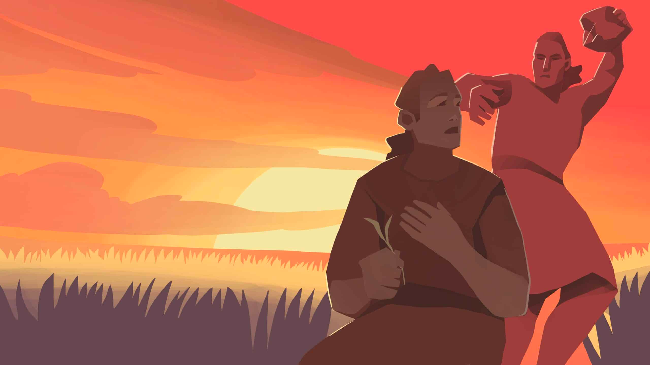
AND
GENESIS 4:1-26
THE SERIOUSNESS OF SIN
THE RUIN OF CAIN
THE CULTURE OF DEATH
THE CITY OF GRACE
Notes:
Genesis 4 – Often gets the questions, why would someone have kids called Jabal, Jubal and Tubal-Cain (I bet the grandparents got those mixed up!). Or where did Cain get his wife, what was the mark that God put on Cain – good questions that God doesn’t deem fit to tell us the answer (although I would think Cain’s wife would have been sister – incest not condemned by God until law in Exodus.) But there is a powerful story God wants us to see in this story. The expansion and worsening of sin and the continuation of God’s grace and promises being kept – even in the rubble of rebellion and murder. This is the first time sin is mentioned in the Bible. In tragedy there is still grace and hope – God does not abandon His creation – does not abandon Adam and Eve.

Slide 2
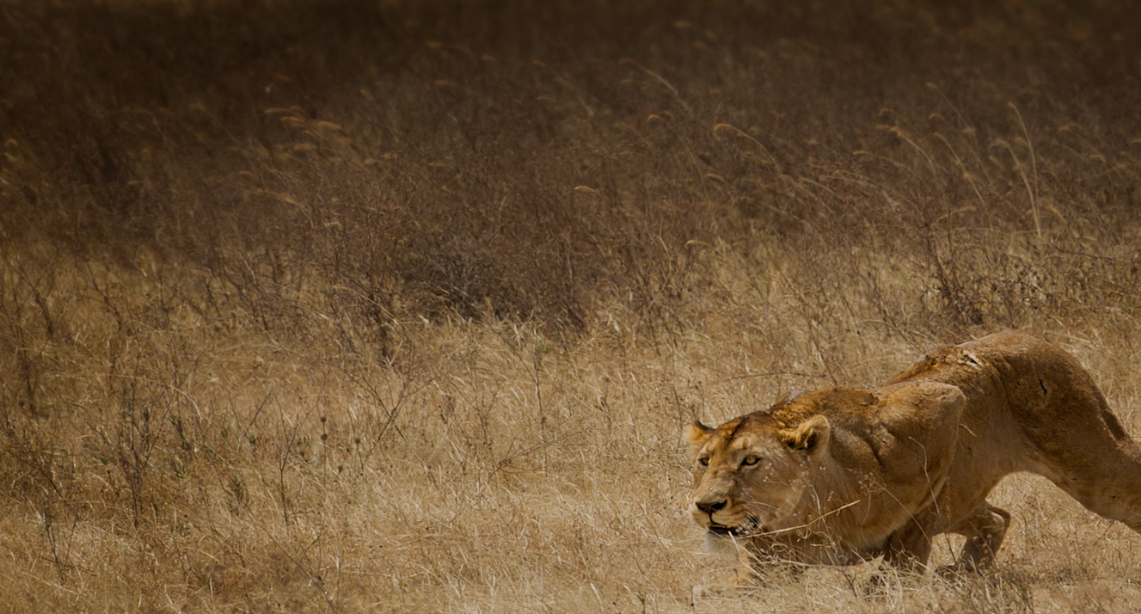
THE SERIOUSNESS OF SIN – “You will be accepted if you do what is right. But if you refuse to do what is right, then watch out! Sin is crouching at the door, eager to control you. But you must subdue it and be its master.” (v7)
A. HIDDENNESS – ‘crouching at the door’ = trying to stay out of view. Satan convinces the world to replace ‘sin’ with error of judgment, character flaw or product of our environment.
“We refer to mistakes, instead of sins, because we want to get rid of every obstacle that gets in the way of good news.”
(Rod Plummer, Senior Pastor at Jesus, Lifehouse Church, Tokyo)
B. DECEPTIVENESS – ‘crouching’ = looking small, not a threat.
Notes:
This is the first time the word sin is mentioned in the Bible – and God makes it very clear that it is a serious thing. He is trying to do His best to stop the impact of sin spreading and taking control of all of mankind.
Hiddenness – its there, but likes to stay out of view. See this in the world today where we no longer even refer to sin. To talk about sin is to be laughed at or dismissed as being old fashioned.
Deceptiveness – a predator comes into the clearing (no longer hidden) but gets down low to make itself look smaller than it is. It is trying to deceive its prey into thinking that it is not a threat.

Slide 3
Deceptiveness = it’s in the corner (of our life) and we justify it, dismiss it & turn our back on it – it’s not a problem in my life.
Caring, not a gossip.
Productive, not a workaholic.
Prudent, not stingy.
Just & fair, not vindictive.
C. DOMINANCE – ‘eager to control you’ (never just stays in the corner) = a powerful predator wanting to totally consume us and makes us do what we shouldn’t do.
“I want to do what is right, but I can’t. I want to do what is good, but I don’t. I don’t want to do what is wrong, but I do it anyway.” (Rom 7:18-19)
Notes:
Sin is in the room (of our life), crouching in the corner and trying to deceive us. We know its there but think its not a problem – we are bigger and have control. Yes I have a grudge but its not making me bitter. I’m not materialistic, I am just prudent or a good steward of God’s money. I am not a gossip, I am just interested in caring for people, I am not a workaholic, just productive. I know it’s not a great place to be, but I can control it. I know we shouldn’t do that but Paul admits to this constant battle for control in his own life. It always starts as a choice but then sin takes over.

Slide 4
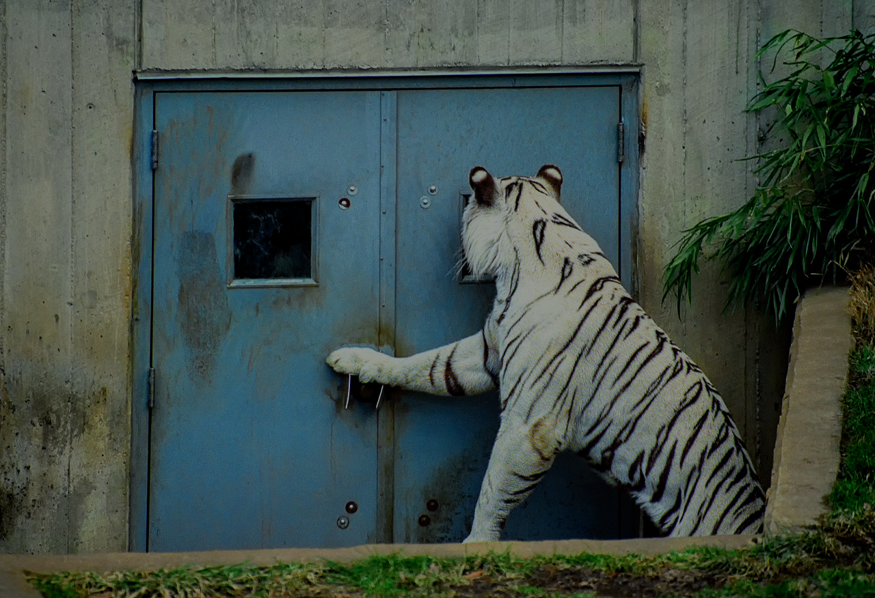
D. THERE IS A SOLUTION - “You will be accepted if you do what is right. …. But you must subdue it and be its master.”
Repent, confess & rely on God’s power – “How can I know all the sins lurking in my heart? Cleanse me from these hidden sins. Keep your servant from deliberate sins! Don’t let them control me. Then I will be free of guilt and innocent of great sin.” (Ps 19:12-13)
Have trusted Christian friends – “You must warn each other every day, while it is still “today,” so that none of you will be deceived by sin and hardened against God.” (Hebrews 3:13)
Assume their warnings are at least ‘partly’ right – “Rejecting discipline, will only harm yourself; but if you listen to correction, you grow in understanding.” (Proverbs 15:32)
Notes:
Do the right thing -
Starts with repentance and confession – we all need to do that, If we claim we have no sin then we are deceiving ourselves (1 John 1:8) Paul confessed the power of sin and David does too. We must be honest with ourselves. Confess the unknown and known sins.
Have trusted Christian friends who can see the sins that are hidden from you. This needs to be quality time (which means quantity of time). Can’t build trusted friendships without regularly gathering together and spending time in the company of Christian friends – investing into those relationships. We are not good at confessing sins and struggles or talking about them. We need to – we are commanded to. Humble ourselves and value each other.
Value Christian correction – don’t lash out at criticism or correction. If it doesn’t seem true, then pray about it.

Slide 5
THE RUIN OF CAIN - “Where is your brother? Where is Abel?” “I don’t know,” Cain responded. “Am I my brother’s guardian? ”But the Lord said, “What have you done?...” (vs 9-10)
Cain has been mastered by sin = always choosing yourself over God and others = no true sorrow or repentance.
“My punishment is too great for me to bear! You have banished me from the land & from your presence; you have made me a homeless wanderer. Anyone who finds me will kill me!” (vs 13-14)
“The kind of sorrow God wants us to experience leads us away from sin and results in salvation… But worldly sorrow, which lacks repentance, results in spiritual death.” (2 Cor 7:10)
Notes:
Why does God ask Cain where is your brother, what have you done? God knew what Cain had done. He was giving Cain time to repent – but it was too late for Cain was under the control of sin, it was mastering him. When sin is our master we relate to God and others only in a way that furthers our agenda. Even after he hears God’s punishment his sorrow is only in regard to the consequences that would impact him, not the sin. It was saddened by the cost, pain and suffering he would experience, there was no sorrow regarding the cost, pain and suffering of Abel (his brother, his parents or God.) This is the worldly sorrow that Paul refers to in 2 Corinthians 7:10.

Slide 6
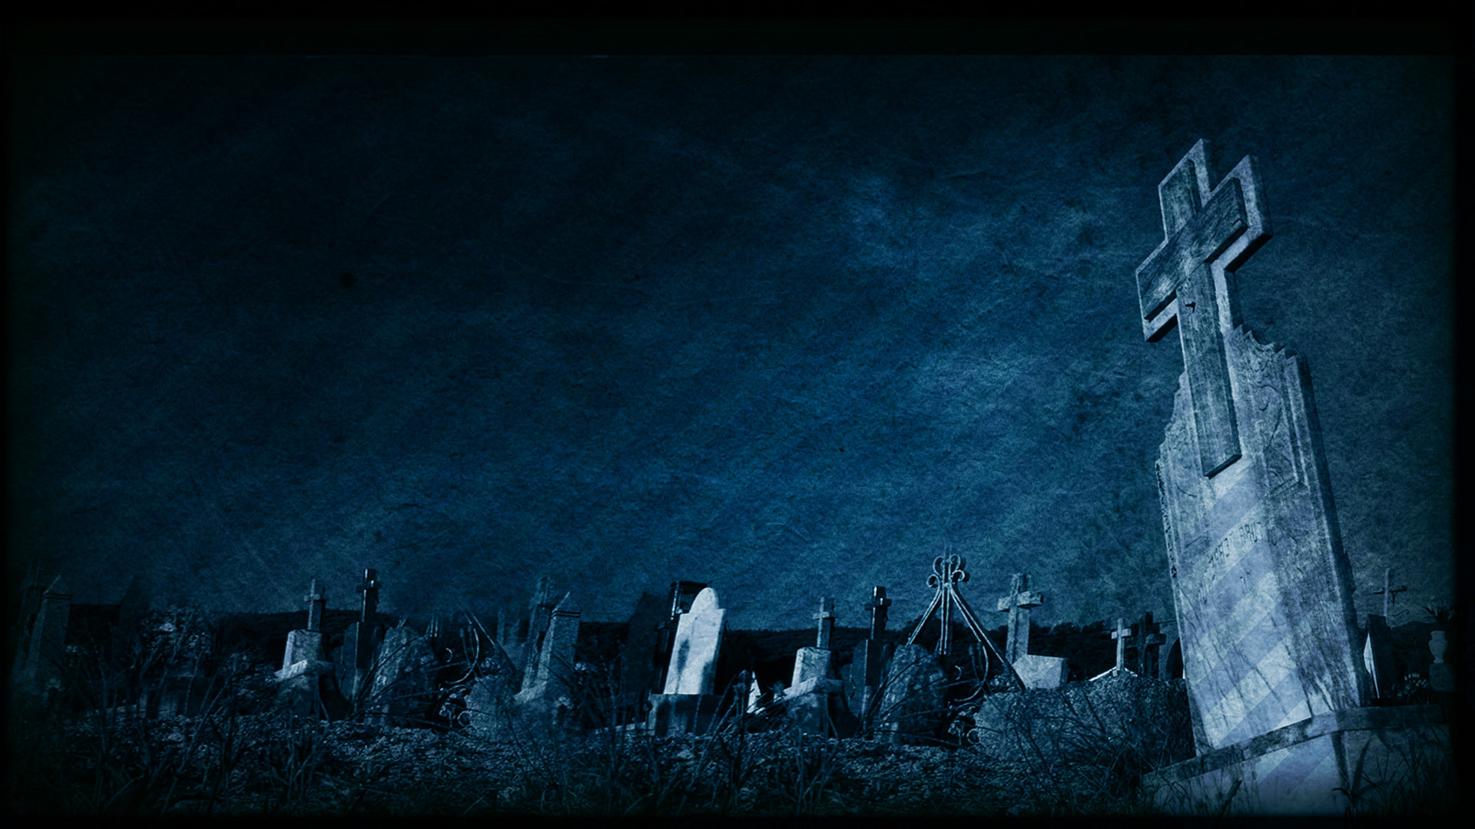
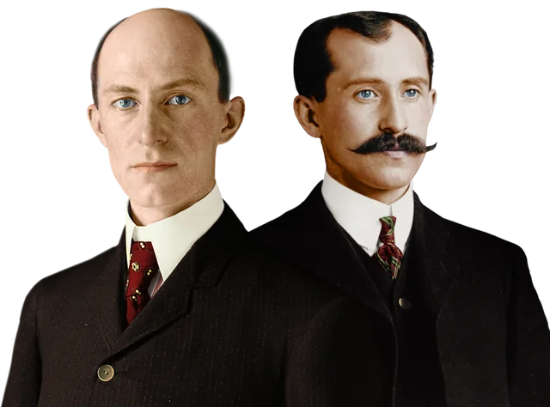
CULTURE OF DEATH – sin doesn’t just ruin Cain’s life, it spreads and infects his family & the community (vs 17-24) – all about me!
A. CULTURE OF DISOBEDIENCE – “Then Cain founded a city..” – a fortified settlement = not trusting God’s provision & the ‘mark’ of protection he gave Cain (v15).
B. CULTURE OF ARROGANCE – I can reverse God’s curse and solve all of my problems. I don’t need God to do something about being “a homeless wanderer on earth.”
“We dared to hope that we had invented something that would bring lasting peace and hope to the world. But we were wrong.”(Wilbur Wright)
Notes:
Let’s see what it looks like when sin impacts the culture – it just keeps spreading across the creation.
Culture of disobedience and arrogance – In 1903 Orville and Wilbur Wright were responsible for the first manned flight at Kitty Hawk, North Carolina. The world was stunned and the Wright brothers thought they had changed the world. But after two world wars, seeing the destruction that planes bought to the world – in 1948 on his death bed Orville Wright was devastated by the fact they couldn’t change the world.

Slide 7
C. CULTURE OF PRIDE – “He founded a city which he named Enoch, after his son.” = making a name for himself (Babel – 11:4)
D. CULTURE OF OPPRESSION – “Lamech married two women.” Not God’s plan for marriage (2:24) – disempowers women.
E. CULTURE OF VIOLENCE – “Lamech said to his wives… I have killed a man who attacked me, a young man who wounded me.”
F. CULTURE OF ANGER AND REVENGE – “If someone who kills Cain is punished seven times, then the one who kills me will be punished seventy-seven times.” = endless anger and revenge, ‘cancel’ anyone who attacks or offends me.
Notes:
Culture of oppression – God’s plan for marriage was one man leaves his parents and joined to his wife, not wives.
Culture of violence – boasts of murdering a young man – adolescent. Why? Because he wounded him slightly – word for wound = bruise or scratch.
Culture of anger and revenge – I don’t deserve to be offended. No one has the right to do that –if they do they should be cancelled.

Slide 8
CITY OF GRACE – “Eve gave birth to another son, and she named him Seth, for she said God has granted me another son in place of Abel, whom Cain killed.” (v25) – acknowledging grace of God.
“When Seth grew up, he had a son and named him Enosh (frail and feeble). At that time people first began to worship the Lord by name.” (v26) – glorifying God, trusting in Him alone.
“Cain’s firstborn and successors pioneered a culture of power, achievement, rebellion and arrogance. Seth’s firstborn and successors pioneered a culture of worship, with no mention of their power or achievement.” (Kenneth Matthews)
Seth’s line = believers in God = believers in Christ, and we are called to be an alternative ‘city’ in the culture of death around us.
Notes:
At the same time that Cain and this culture of death is growing, God is also working – keeping his promise to Eve. In the midst of sorrow, pain, and suffering God is still true to his word. Eve acknowledges the grace of God and Seth acknowledges the power and name of God (not his own power and name). Even calling his son Enosh was a statement of surrender and dependance on God – not on human effort.

Slide 9
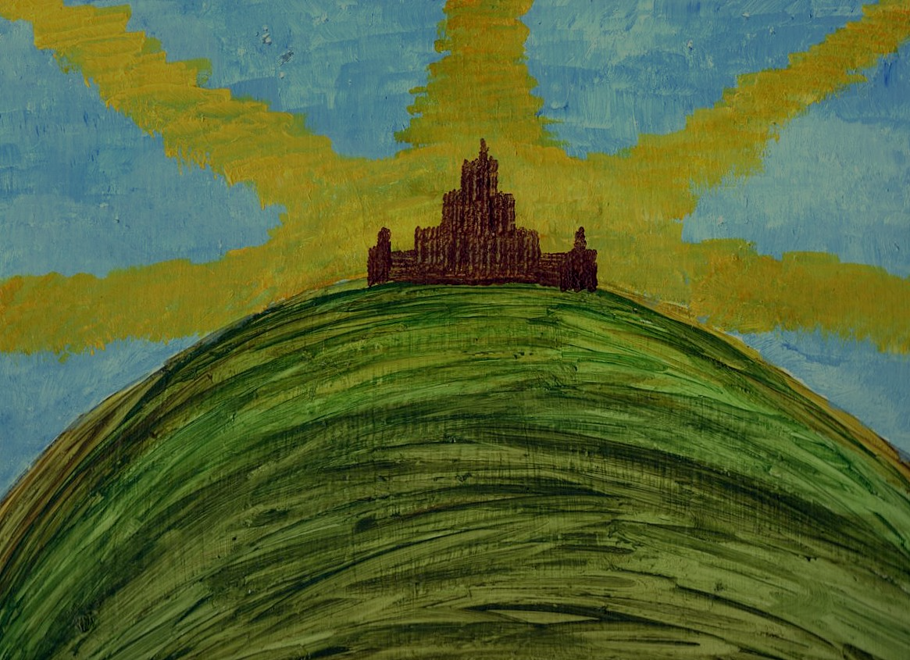
“You are the light of the world - like a city on a hilltop that can’t be hidden…. let your good deeds shine out for all to see, so that everyone will praise your heavenly Father.” (Matthew 5:14)
Sing a different ‘anthem’, where the endless anger of man (punish 70 x 7 times) is replaced by the endless grace of God (forgive 70 x 7 times) - Matthew 18:21-22.
Live differently - use sex, money, power & achievement differently. Serve & love those who are lost in the darkness. Be filled with the joy & hope we have through Christ. Live & share the gospel.
How can God give Cain and all who rebel against Him (including us) mercy & salvation?
Notes:
Jesus turns Lamech’s song on its head. The only one who has the right to be endlessly angry with mankind is God – he commands us to show endless grace.

Slide 10
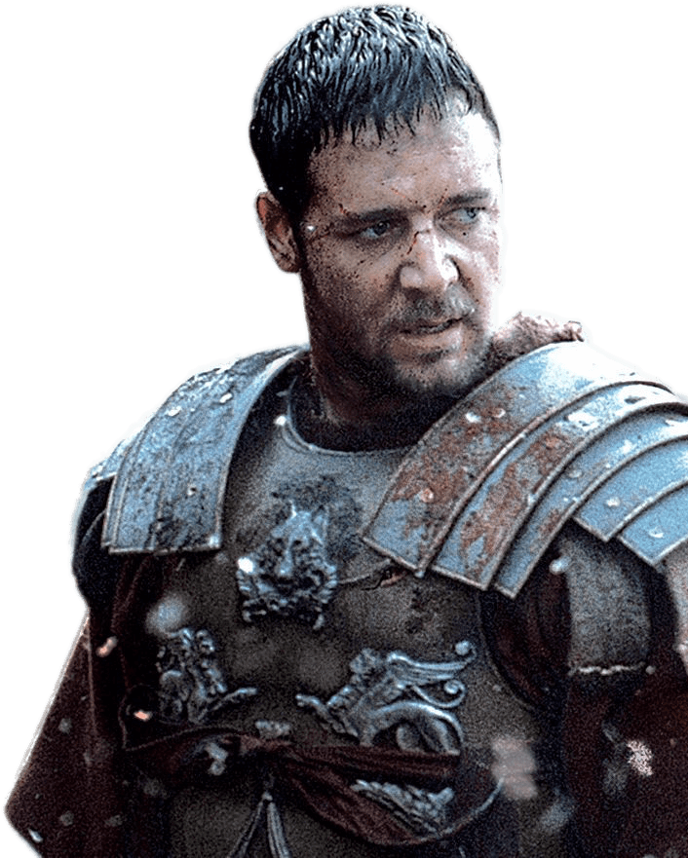
Because Jesus took on the three curses that Cain dreads (v14) –
I will be banished from your presence (Matt 27:46)
I will be a homeless wanderer (Matt 8:20)
Anyone who finds me will kill me.
Because our salvation and righteousness is based only on the grace of God and not the ‘good things’ you have done (Eph 2:8-9) = you don’t have to prove yourself or make a name for yourself.
“What you do in life echoes in eternity.” (Marcus Aurelius)
One big choice in this life impacts our eternity = repent & boast in the name of Christ (not your own name) – “For everyone who calls on the name of the Lord will be saved.” (Rom 10:13)
Notes:
Jesus lost the presence of God on the cross – why have you forsaken me (Matt 27:46)
Jesus was a homeless wanderer - “Foxes have dens to live in, and birds have nests, but the Son of Man has no place even to lay his head.” (Matt 8:20)
Jesus was found by the soldiers in the garden and taken away to be crucified. Your choice in this life decides your eternity. Choose to live in the city of darkness = eternity of suffering and separation from God. Choose to live in the city of grace = an eternity of an abundant, joyful life in the presence of God.

