Slide 1
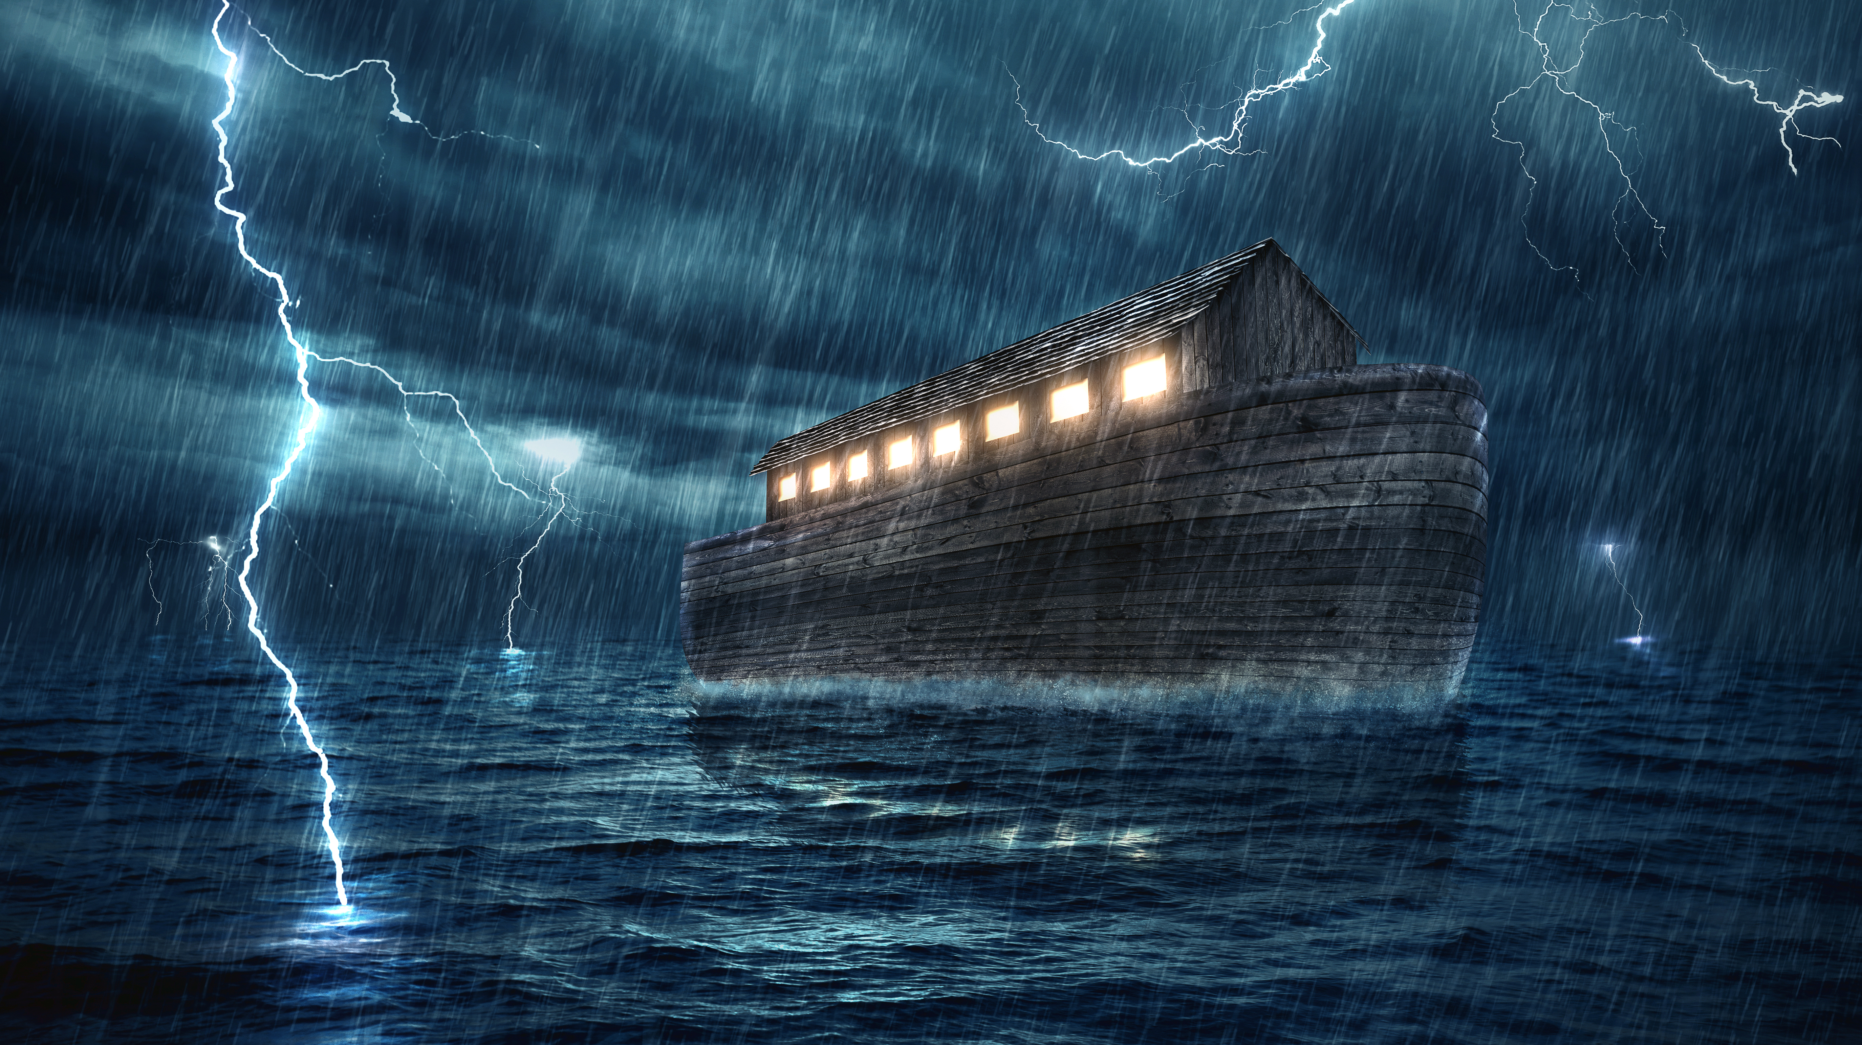
NOAH AND THE ARK
Genesis 6:5-22
Notes:
Good morning everyone.
As you may have gathered from the Bible reading, this morning’s sermon is quite dark and depressing in a lot of ways
Over the past couple weeks in our sermons on Genesis we have seen the effects of the fall upon the human race
We have seen how Adam and Eve fell out of close communion with God and how one of their sons, Cain, killed his own brother. And last week we saw the evil and arrogance of Lamech in bragging about killing a man and all the implications of that
And today we are going to see what happens when sin runs rampant. In this passage the evil and corruption as a result of sin, had hit an all time high
And yet even in these dark days we see hope found in almighty God, who in His faithfulness and grace, calls a man out of this generation unto Himself
And that’s my prayer and hope for us today, that we would see our need to be a people completely committed and surrendered unto God and His Word, for He has broken the chains of sin and death upon all who have believed in Jesus Christ and called us to Himself

Slide 2
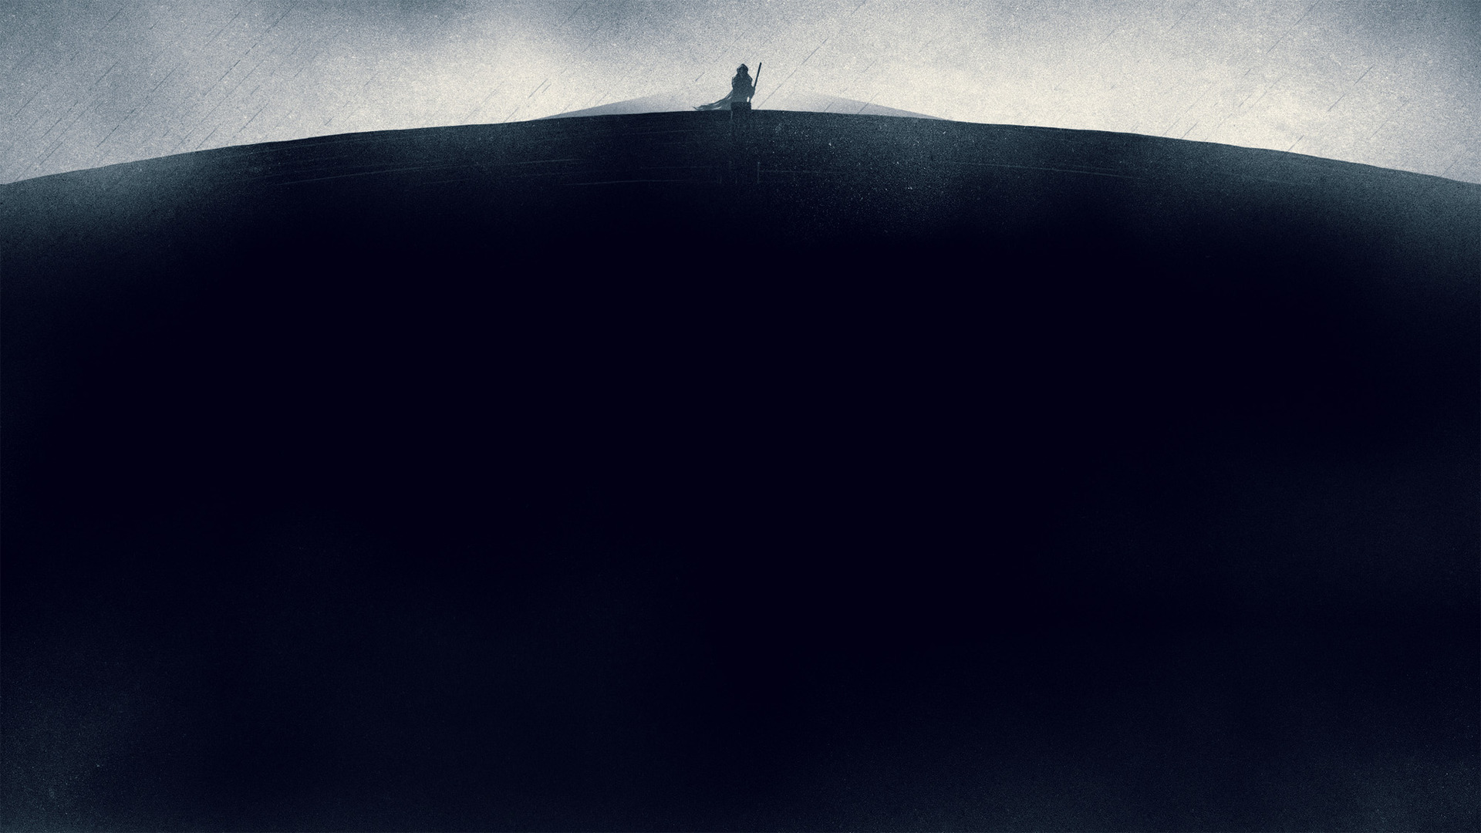
A world of nice people, content in their own niceness, looking no further, turned away from God, would be just as desperately in need of salvation as a miserable world – and might even be more difficult to save. C.S. Lewis
Notes:
I share this quote with you at the beginning not to make you despair, but so that we might not become arrogant or prideful in our thinking. - Or breath a sigh of relief because we think the world we live in is nothing like Noah’s day, so everything is okay
Our world proclaims tolerance, and niceness, and freedom, and yet I believe the world is walking further and further away from God, wanting nothing to do with His ways - And I know that a day is coming when they will be judged by an infinitely holy God, like in the days of Noah, for their wickedness and corruption

Slide 3
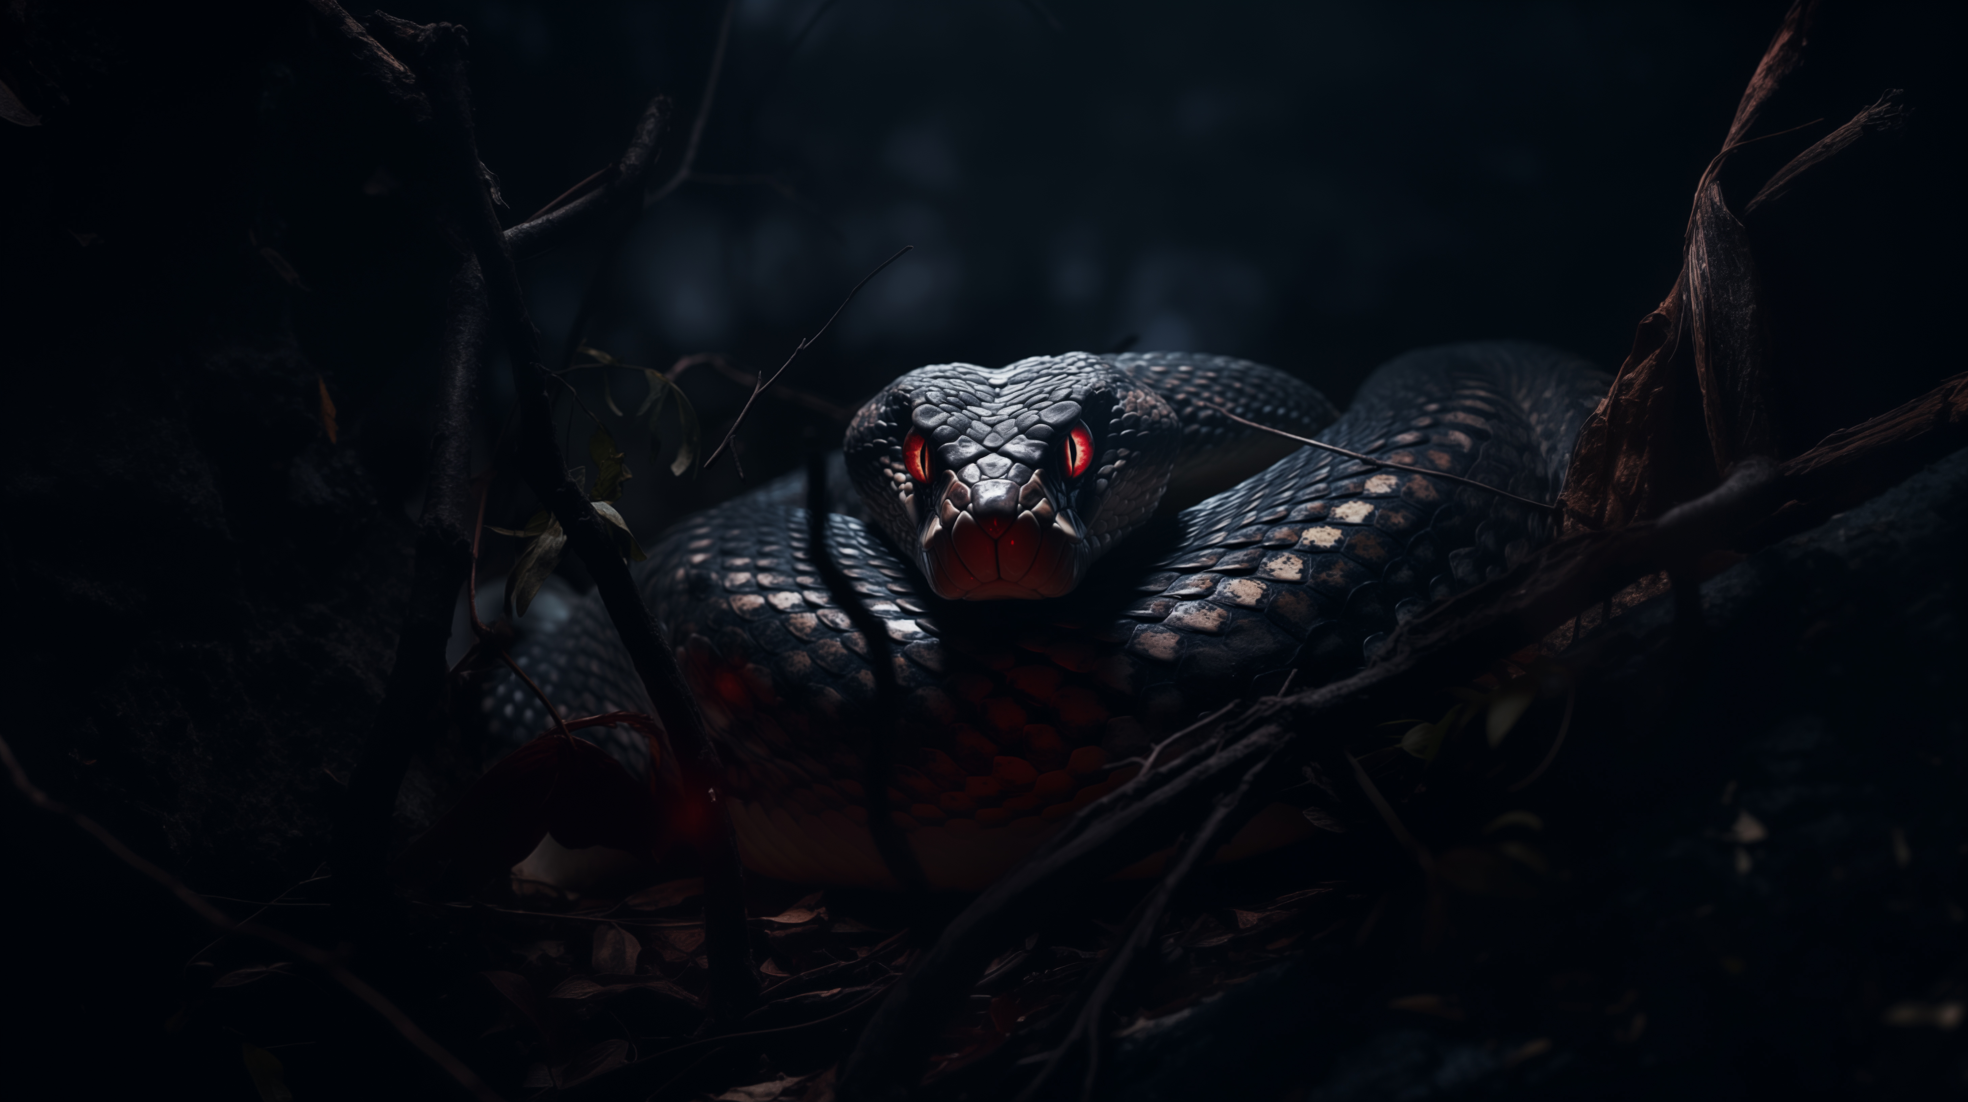
DEPRAVITY AND DIVINE JUDGEMENT
“The Lord saw that the wickedness of man was
great in the earth” (Gen 6:5a)
“and that every intention of the thoughts of his heart was only evil continually” (Gen 6:5b)
”And the Lord regretted that he had made man… it grieved him to his heart” (Gen 6:6)
Notes:
”The Lord saw that the wickedness of man was great in the earth” (Gen 6:5a) - By stating that ”The Lord saw” the author, Moses, is calling us back to Gen 1:31. - “And God saw everything that he had made, it was very good” - Moses is inviting us to a bitter comparison, he is displaying the full effects of the fall - That because of Adam and Eve’s disobedience, because they gave into temptation, no longer is the earth good, or is mankind walking closely with God - Rather, “the wickedness of man was great in the earth”.
“And that every intention of the thoughts of his heart was only evil continually” (Gen 6:5b) - The knowledge of good and evil has led humanity to this very low point in history - Every… only… continually. This leaves nothing out. This right here is the very definition of total depravity - You see the situation described here pertains not only to the world before the flood but to the entirety of the human race apart from God’s regenerating grace in Jesus Christ - God saw the corruption and wickedness of mankind in Noah’s day, and He sees it today. - All those hate-filled thoughts, or little white lies, or lust-filled fantasies, that may never see the light of day. God sees them - And it troubled God greatly to see the crown-jewel of His creation, those made in the image of God to have fallen so far away from Him
“And the Lord regretted that he had made man… it grieved him to his heart” (Gen 6:6) - Men and women were so wicked, so filled with sin, so utterly against God, that God was grieved - He was grieved because they were created to reflect Him and His glory in the world, but they wanted nothing to do with Him - He was grieved because they had turned their backs on Him. Because we were once this beautifully crafted, untainted, pristine creation, created in the image of the eternal, Triune God

Slide 4
“So the Lord said, “I will blot out man whom I have created… for I am sorry that I have made them” (Gen 6:7)
“But Noah found favour in the eyes of the Lord” (Gen 6:8)
In Noah’s life, the sinful nature of humankind did not have the last defining word
Notes:
“So the Lord said, “I will blot out man whom I have created… for I am sorry that I have made them” (Gen 6:7) - Humanity had fallen so far, were so wicked, and so corrupt that they grieved God’s heart, to the extent that, rather than comfort them, God would destroy them - God would blot out, His creation. There were no half measures in dealing with sin. For such is the holiness of God - He cannot and will not tolerate sin, it goes against His very nature - As Creator, God is Lord over both life and death, and so it is to the praise of His holy name, and His holy will, that He resolved to remove evil from the earth - How can we praise His holy name for this, why should this fill me with praise? Well, for all of those who are children of God, it should fill us with praise because God will not tolerate sin - Because God has dealt with sin completely through the death and resurrection of Jesus Christ, you can be certain that when you go to be with God in glory, there will be no corruption, no evil, and no more sin, and that is certainly something worthy of praise
“But Noah found favour in the eyes of the Lord” (Gen 6:8) - We must read this verse and get this verse right before we go on to the read the next one - Noah is the recipient of God’s sovereign grace - Noah was a sinner, for Noah was born from the line of Adam through whom death entered this world, and was deserving of God’s wrath like everyone else - But God reaches down, and extends open arms of grace to Noah, and it is in this grace that Noah finds salvation - Noah FOUND favour. He did not earn it, he did not achieve it, for grace is by definition, unmerited, undeserved - Because of God’s grace here, the promise of an offspring of Eve who would crush Satan, and the power of sin once and for all, still holds true, He will not fail in keeping His Word
In Noah’s life, the sinful nature of humankind did not have the last defining word - Verse 8 is a shout of hope even though the earth is drenched in sin, and the human race is wicked and corrupt and it is as though the earth has been covered in darkness - The situation seems hopeless, it seems as though this might be the end, that Satan had won, that God would not fulfill His promise of bringing forth a Saviour - It as though God holds up a candle in the shape of a man named Noah and says, - “I am God, I am the sovereign Creator, and I know the beginning from the end, I am the faithful God - And I will not break even one of my promises, for my Word is final!” - Christians, the Word of God tells us that God will not fail us, and that all of God’s promises find there yes in Christ. So let us cling tight and stand on the firm foundation of Scripture

Slide 5
RIGHTEOUS VS. WICKED
“Noah was a righteous man, blameless in his generation.” (Gen 6:9)
“Noah walked with God” (Gen 6:9b)
“Noah had three sons, Shem, Ham, and Japheth” (Gen 6:10)
Notes:
“Noah was a righteous man, blameless in his generation” (Gen 6:9) - The reason why I said before that we must understand verse 8, before we get to verse 9, is because people will read this verse and say that Noah was saved because he was a good man - I mean read it, it says he was a righteous and blameless man - But if we read the text, verse by verse, we see that would be an incorrect interpretation. - We know that a person is saved by grace through faith and it is only by believing upon the Lord Jesus Christ that we inherit his righteousness and become blameless in the sight of God - And it is then Christ that produces the good works in us - So, to be righteous is to be accepted in God’s holy sight. Noah believed in the gospel as it was proclaimed to him in his time, and was thus deemed righteous, he was deemed good. - So we see that this verse does not contradict the fact that we are saved by grace alone through faith alone - The word blameless here is referring to his moral conduct. The wicked, demonised culture did not divert or pervert him, nor could it indict him - Because of the grace of God, because he found favour in the eyes of the Lord, Noah was declared righteous, and by the working of God upon his life, was blameless - Noah would have been described as a good and honest man in the current day and age. - What he professed to believe is actually how he lived his life, as is the way of every genuine Christian, because the Holy Spirit will bear fruit - He was not sinless, as we see very clearly later on in a couple chapters. He was not perfect, but by God’s grace, he was righteous and blameless. - God’s grace worked a biblical reformation in Noah’s life, as it does for us today, if we will believe in the gospel of our Lord Jesus Christ
“Noah walked with God” (Gen 6:9b) - This means that Noah knew God intimately. That he walked in dependance upon the Lord - That if he was to do anything of eternal value, it would only be by solely trusting in God and His spoken word - There was only one other man that was said to have walked with God and that was Noah’s great grandfather, Enoch. Who was translated into heaven. He never tasted death - And yet here, whilst Noah walked with God, he would witness and walk with God through one of the darkest times in human history, but God would sustain him and his family - So by the grace of God, Noah was a righteous, blameless man, who walked with God
”Noah had three sons, Shem, Ham, and Japheth” (Gen 6:10) - That’s it, that is all that this verse says, and it almost feels out of place - But we know God blesses His people. God not only saves Noah, and makes him righteous, but blesses him with a family, and saves this family from the coming judgement - And we see that through blessing Noah, God is also demonstrating his faithfulness - That even though, as we are about look at, the world is filled with sin and corruption, God has not forgotten His promise of an offspring who would come and crush sin once and for all - Because thousands of years later we see in the gospel of Luke that through the line of Shem, Jesus, through the virgin Mary, would one day be born. God will not go back on His Word

Slide 6
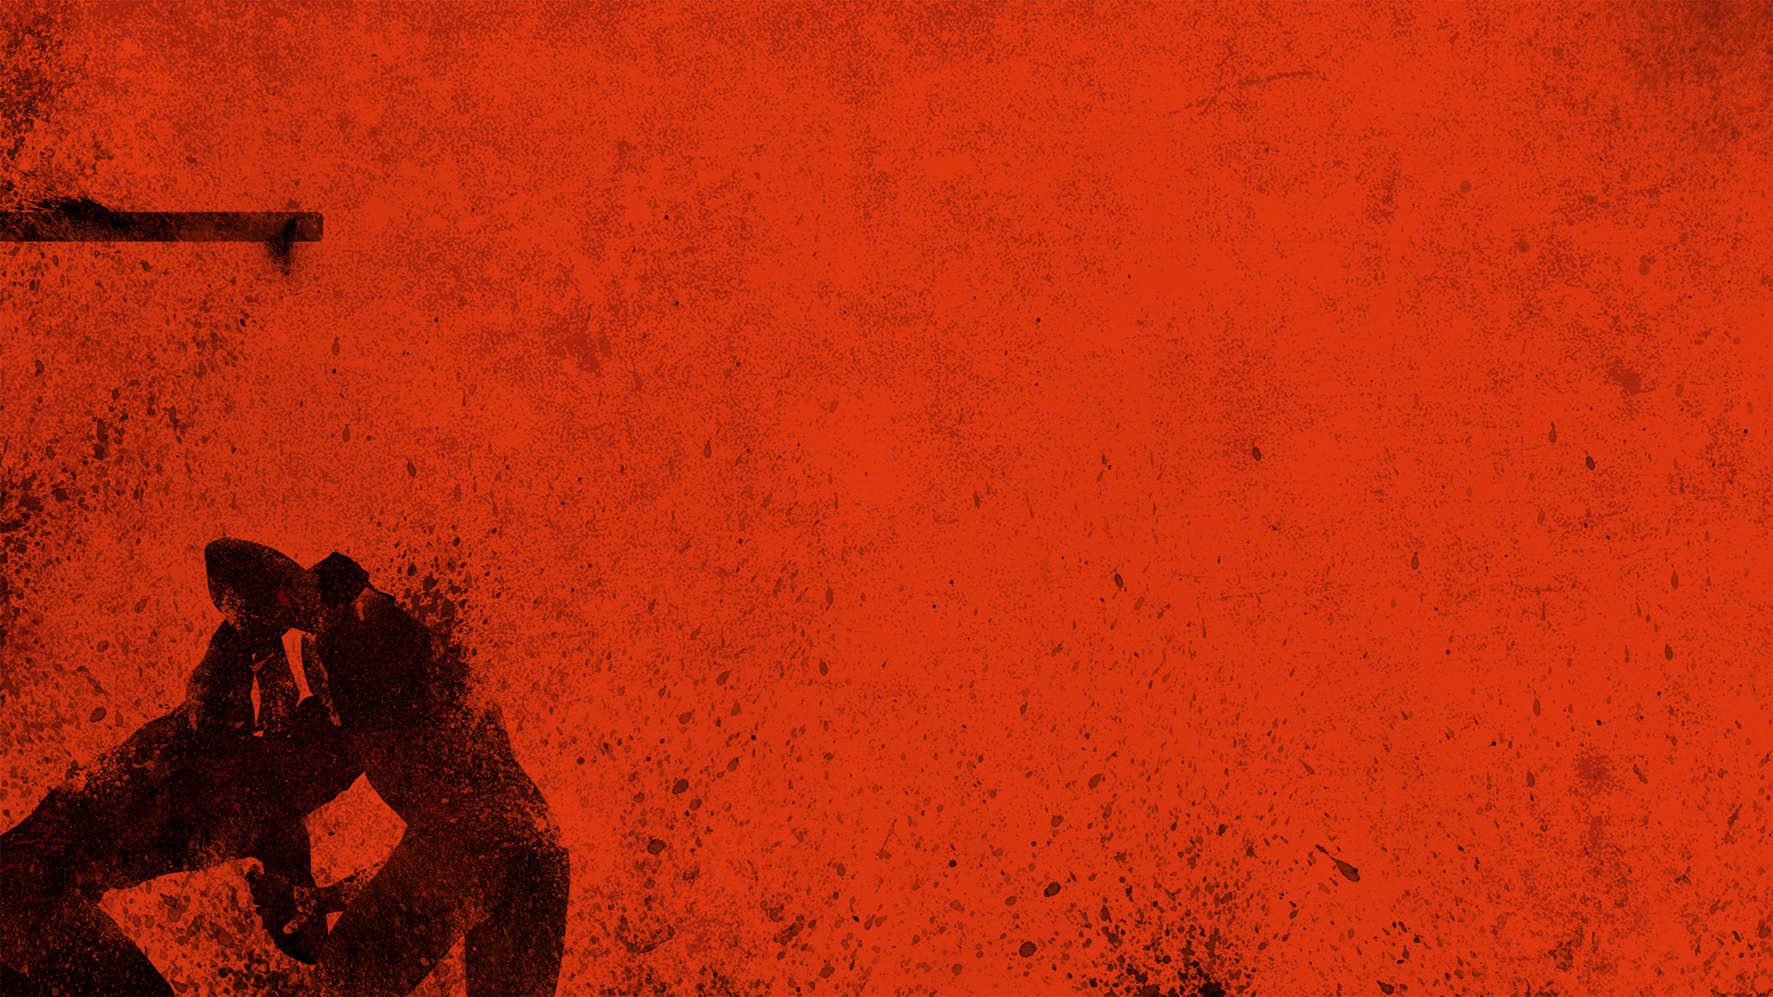
In verses 11-13, 6x the earth is mentioned, and 5x verb ‘to ruin’ is used
“And God saw the earth, and behold, it was corrupt…” (Gen 6:12)
“And God said to Noah “I have determined to make an end of all flesh…” (Gen 6:13)
Notes:
In verses 11-13, 6x the earth is mentioned, and 5x the verb ‘to ruin’ is used - Let’s read those verses again, and listen for the way humanity has defiled itself, just how wretched the human race has become - Read 11-13 - If we compare this with the 2 previous verses, we see that the righteous walk with God, but the wicked corrupt the earth
“And God saw the earth, and behold, it was corrupt…” - Once again, Moses is wanting us to cast our minds back to Genesis 1, where God finished His creation with creating man and woman in His own image, and He declared that it was very good - But now, once again, God looks and He sees nothing but corruption. - With God, the earth was good, it was complete, it was perfect - But since the eating from the tree, through one man’s disobedience came death, came sin - And sin corrupts, it eats away at the heart, it destroys lives, and if left to our own devices, there is one thing that awaits us at the end of the line… death. - An eternity apart from God, and cast away into eternal torment, into what is called hell
“And God said to Noah “I have determined to make an end of all flesh…” (Gen 6:13) - As God gazes across the vastness of the earth, and sees a world corrupted by sin, filled with violence, a holy and righteous God will only do one thing - He calls to Noah, draws him into His confidence and reveals His plan for mankind. He must destroy it, He must wipe them out and make an end to it all - This is the first time that Noah is given insight into God’s plan, we knew about it a couple verses earlier, but here, God makes His plans clear with His elect, Noah - But He doesn’t say exactly how He will destroy them, that comes later - And so you can imagine, Noah is probably starting to get a bit worried at this point, thinking, okay God, you are Lord and I am not, but what does all of this mean for me and my family - Well, God already had that planned out too.

Slide 7
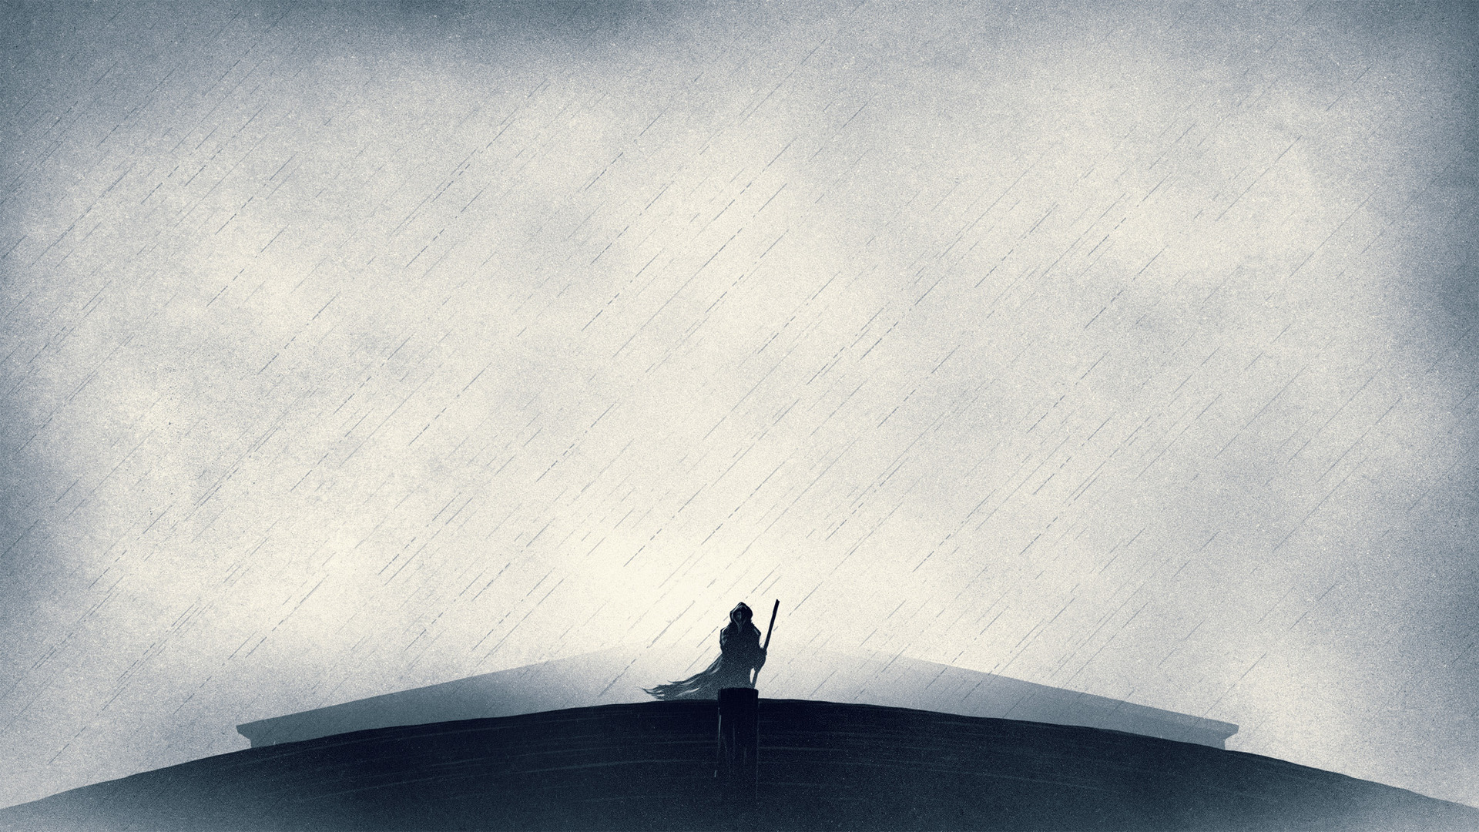
THE ARK IS COMMISSIONED
“Make yourself an ark of gopher wood. Make rooms in the ark, and cover it inside and out with pitch” (Gen 6:14)
During this time of building, Noah was a herald of righteousness (2 Peter 2:5)
“For behold, I will bring a flood of waters upon the earth to destroy all flesh” (Gen 6:17)
Notes:
“Make yourself an ark of gopher wood. Make rooms in the ark, and cover it inside and out with pitch” (Gen 6:14) - It is said that ark is a word that often meant chest, or box, or coffin. So essentially, Noah was to build a floating barge - But this barge would be massive. It was 450 feet long. Which is close to 150 metres. - Meaning that Noah and his family were to build an ark that was 1 ½ football fields in size. - No trucks to bring a haul of wood in, no cranes, no chainsaws, no tradies. Just Noah and his family, trusting in the word of God - The trust that Noah had is astounding. There was no ocean nearby, probably not even a river, and here is Noah with this big boat, and Noah doesn’t even know why yet.
During this time of building, Noah was a herald of righteousness - It is estimated that the building of the ark took somewhere from 50-75 years - Between looking after his family and building a boat the size of 1 1/2 football fields, he went out preaching to this wicked generation. - The persecution, and ridicule, and mocking this man would have faced is unimaginable - But still he would go out and call them to repentance, telling them of the fate that awaited, and in 70 odd years, when the time came for the great flood, there was not one single person who believed in God - When preaching on this particular passage, Charles Spurgeon, tells of how in the month of May, they had 69 converts, and yet he says the utter despair he would have felt, to go a whole lifetime, with not one single person calling upon the name of the Lord, would have been almost unbearable. - Yet here is Noah, a man committed to God, and His will, no matter the disappointment and rejection, and persecution that came his way - Today, we need more people who will stand up and lead with a heart committed only unto doing God’s will. - We need churches committed only to sharing God’s Word and His truth as it is written. - No matter what the culture may say, no matter what Satan may try to throw our way, let us have such a love for God and such a steely resolve that we would always preach Christ and him crucified
“For behold, I will bring a flood of waters upon the earth to destroy all flesh” (Gen 6:17) - So just when Noah is starting to wonder, “what’s with this big boat”, God reveals the fullness of His plan for divine judgement, that the blotting out would come in the form of a great flood - We see that God is the author of the flood. In Psalm 29, it says that the Lord sits enthroned over the flood. He is sovereign over it - God the giver of life is about to take it away - The flood is anti-creation. God is now the earth’s adversary. But He must destroy it to renew it

Slide 8
“But I will establish my covenant with you…” (Gen 6:18)
It was through one man, that the human race passed through the flood, which was God’s judgement upon the earth
“For God so loved the world, that he gave his only Son, that whoever believes in him should not perish but have eternal life” (John 3:16)
Notes:
“But I will establish my covenant with you…” (Gen 6:18) - Once again, in the face of hopelessness and destruction, God holds up Noah - Through Noah and his family, life would begin again on the earth - This is the first time that the word covenant is used in the Bible - Because of Noah’s faithful witness, his whole household would be blessed, and would partake in this covenant - Noah entered this covenant by the grace of God
It was through one man, that the human race passed through the flood, which was God’s judgement upon the earth - Noah, entered the ark, not merely as a survivor, but as a bearer of the promise of the new age, of a new human race - And by entering into the ark, and entrusting his life to God, he was saved and delivered from the wrath of God
“For God so loved the world, that he gave his only Son, that whoever believes in him should not perish but have eternal life” - Christ bore our sins on a cross. He was obedient even unto death. He satisfied the wrath of God, as a sacrifice, once for all, the just for the unjust - So that all who would believe in Jesus Christ. So that all who would enter into Christ, will also be saved from the judgement that is to come - When judgement comes, God will welcome all His children home with open arms, and because of what the Son of God has done for you, you will not perish, but have eternal life

Slide 9
THE OBEDIENCE OF NOAH
“Noah did this; he did all that God commanded him” (Gen 6:22)
God challenged Noah to a faith in things unseen
Noah’s actions model for us today the obedience and the efficacy of faith when it is placed in the truth of God’s Word
Notes:
“Noah did this; he did all that God commanded him” (Gen 6:22) - Noah is a primary biblical model for a faith that believes and works - Here was a man who knew who God was, and obeyed God’s Word - Even with all of the opposition and persecution that came his way, still he would boldly declare, “not my will, but your will be done” - A righteous person, a person saved by the grace of God rests everything on the bare Word of God, and obeys it. And that’s exactly how Noah lived his life
God challenged Noah to a faith in things unseen - Some of us struggle to put our trust in God when God doesn’t come through in a day, a month or a year - God’s promise to flood the earth took about 70 years. - Noah built a boat in obedience and in trusting that God would hopefully bring forth a great flood, hoping that God would not embarrass him - Noah went out as a sheep amongst wolves to preach to them, to call them out on the error of their ways and back to God - He would have been putting his life on the line and trusting that God would protect him - And it was by his faith demonstrated through obedience to God’s Word, and trusting in the promises of God that would take 70 years to be fulfilled, that the book of Hebrews calls Noah an ‘heir of the righteousness that comes by faith’
Noah’s actions model for us today the obedience and the efficacy of faith when it is placed in the truth of God’s Word - When we allow the Word of God to go to work on our hearts, we will see the power of God humble us and bring us before the cross in humble submission to the will of our heavenly Father - We will hate sin because of how much it hurts God, and we will love the things of God because it is Christ who now reigns supreme in our lives and we now live and love to please Him - The Holy Spirit will be shaping us and conforming us to the image of Jesus Christ, who saved us FOR good works - Satan will throw everything he has at us, our sinful nature will try to tear us away from God, but in Christ we have won, in Christ, Satan has been defeated and sin has been crushed - We must cling tight to the cross while we are here awaiting the day when our King returns to blot out sin once and for all - But know this, that whatever God says, will happen, for we serve a faithful God

Slide 10
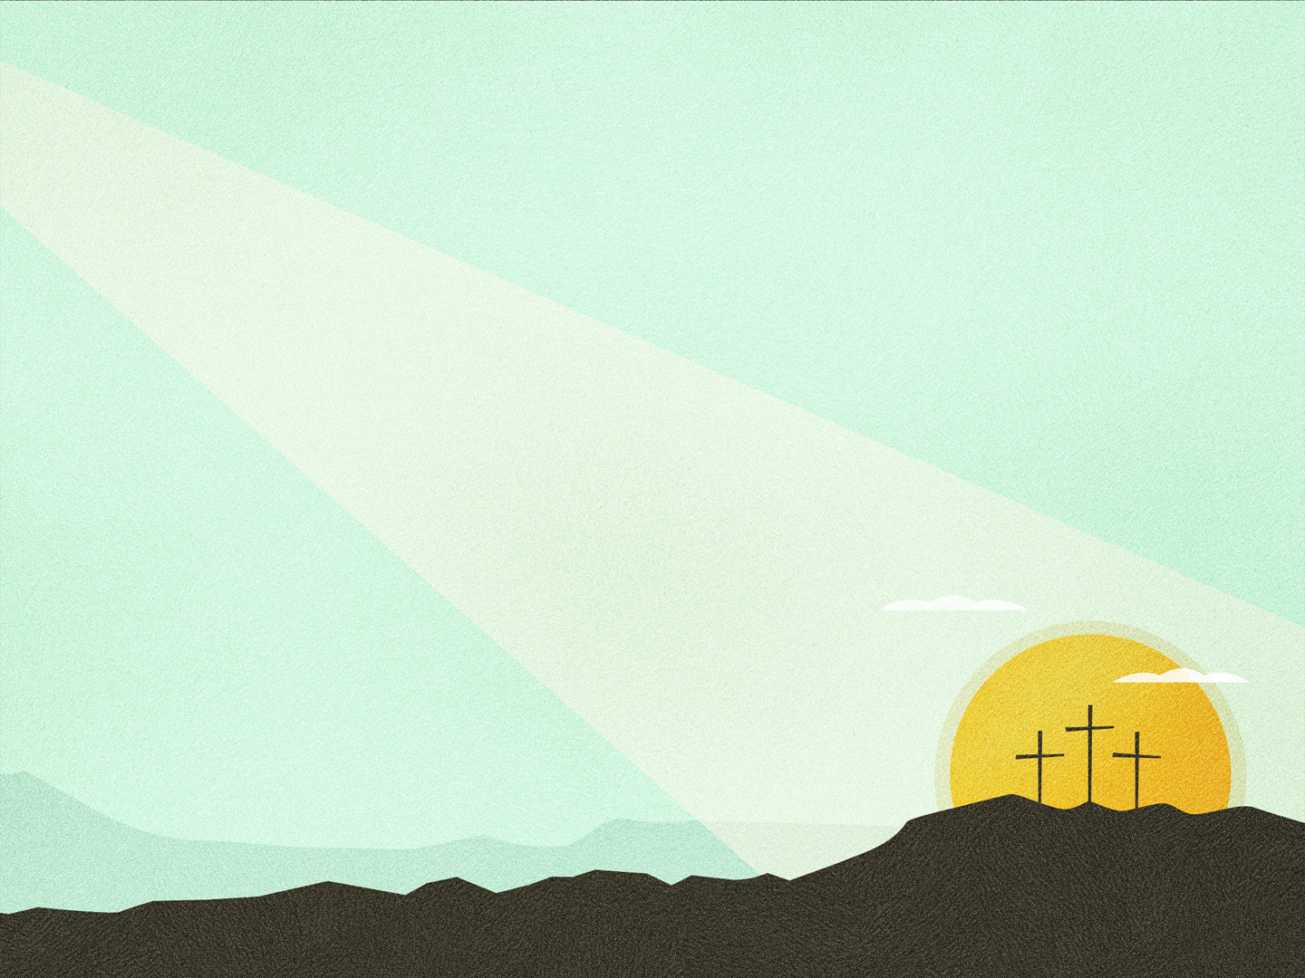
SUMMARY
God now looked at the world, and it was corrupt, and so in His holiness would put an end to life on the earth
And yet in God’s grace and faithfulness, Noah was saved
The same grace that saved Noah, worked in him obedience unto God
Notes:
God now looked at the world, and it was corrupt, and so in His holiness would put an end to life on the earth - As humans we are inclined to walk away from God. No one is righteous and everyone does what is right in their own eyes - Apart from God there is only one thing that awaits us, and that is destruction, which is exactly what we see unfolding before us in this chapter
And yet in God’s grace and faithfulness, Noah was saved - By God’s sovereign grace and by believing in the gospel we are called children of God, heirs to the righteousness that comes by faith - If we will believe in Jesus Christ and his once for all sacrifice we too will be saved
The same grace that saved Noah, worked in him obedience unto God - Noah’s salvation and obedience were of no credit to him, he could not take the glory - Noah’s obedience was to be a testimony of God’s grace - For we were saved by grace that none may boast, we were not saved by good works, but for good works, that we may be examples of God’s grace - For it is only by the power of God that we do anything that is worthy of being called ‘good' - So let us continue to trust in God, day in and day out

Slide 11
Resolution one: I will live for God
Resolution two: Even if no one else does, I still will
Notes:
Jonathan Edwards was one of America’s greatest revivalist preachers during the 18th century
And beginning in 1722, at the age of 19, Jonathan put together 70 resolutions to help him live a holy life
After having been read many times over the past centuries, scholars have summarised these 70 resolutions by reducing them to two. It is these 2 resolutions that I believe encapsulated Noah’s life and the way in which he lived his life
Resolution one: I will live for God.
Resolution two: Even if no one else does, I still will
I pray that these would be our resolutions for each of us individually, and collectively as a church
Let’s pray

