Slide 1
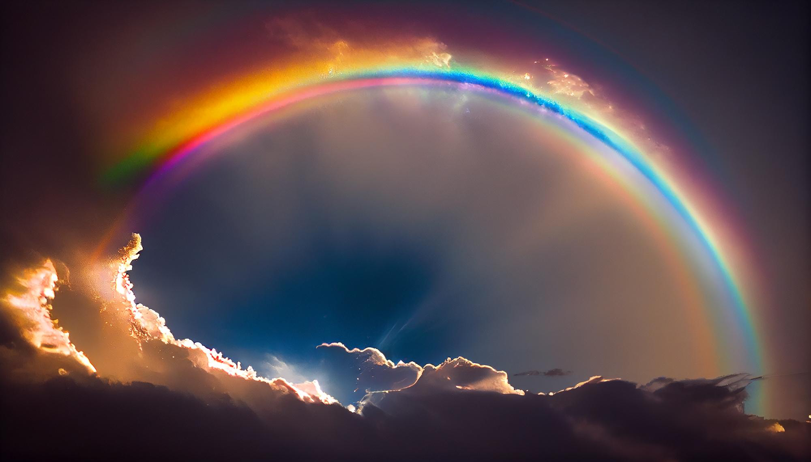
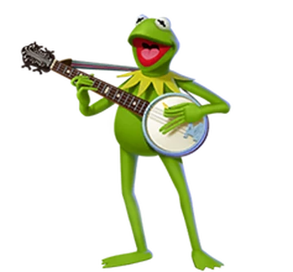
“Why are there so many songs about rainbows?” (Kermit the Frog)
Norse mythology = bridge to heaven for the virtuous & victorious.
Bulgarian legend = you can change genders by jumping over it.
Irish legend = good fortune (pot of gold).
Japan = bridge for ancestors to return to earth.
Buddhism = highest state available before Nirvana.
Karen (Myanmar) = a child eating demon.
Indigenous Australians = a genderless, serpent creator.
LGBT community = diversity & inclusion.
Notes:
The rainbow is one of the great wonders of nature. In 1979, one of history’s greatest singer/songwriters, Kermit the Frog, released a world-wide hit called Rainbow Connection. One of the questions he asked in that musical masterpiece was, “Why are there so many songs about rainbows?” And he is right. All over the world the rainbow is seen as a powerful symbol in almost every major belief system and in many different cultures. Here are just a few.

Slide 2
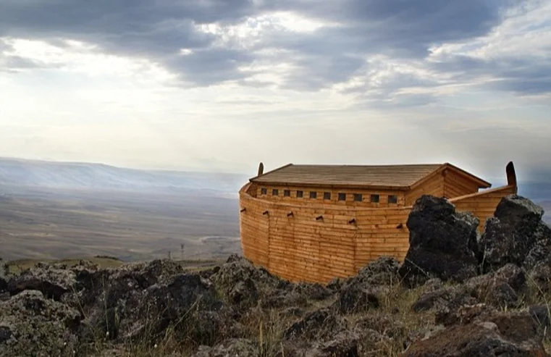
“Then God blessed Noah and his sons and told them, “Be fruitful and multiply. Fill the earth.” (Genesis 9:1)
GENESIS 9:1-17
GOD’S ETERNAL PROMISE TO NOAH & ALL CREATION
PROTECTION FROM ANIMALS
PROTECTION FROM MANKIND
PROTECTION FROM GOD
Notes:
But it is God who created the rainbow and he gave it as a symbol for all of mankind and creation – for eternity (until Christ comes again). As we continue our journey through the first 11 chapters of Genesis, we have come to the point where Noah and his family and all the animals have just disembarked from the ark after the world had been destroyed by flood – God’s wrath against the sin of mankind. This is a new beginning and God gives Noah and his family a very similar command that he gave Adam and Eve in Genesis 1:28. But this is a very different world to the paradise that Adam and Eve were in. Noah and his descendants (which ultimately includes us) face three very serious threats to carrying out the mission God has given him. So God made an eternal and universal promise and the symbol of that promise was a rainbow. It reminds God and us that God will provide protection for Noah and his descendants from three very real threats to living in this new world and serving God. As we get into the detail of this promise we will see God’s protection from animals, mankind and himself. We will see God’s amazing grace and mercy.

Slide 3
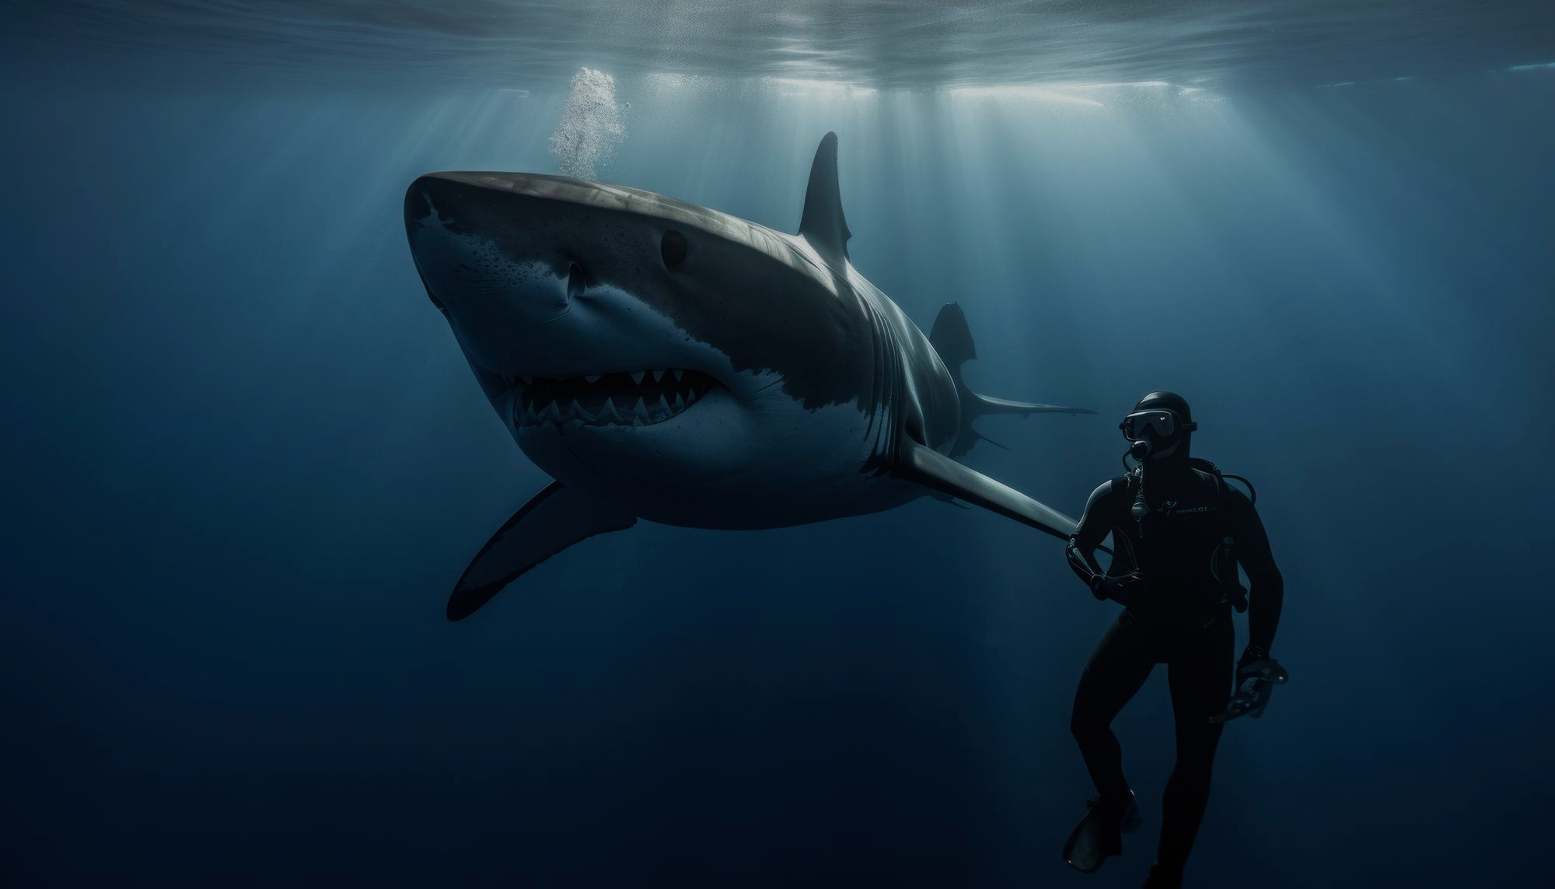
PROTECTION FROM ANIMALS – “All the animals of the earth, all the birds of the sky… and all the fish in the sea will look on you with fear and terror. I have placed them in your power. I have given them to you for food, … and grain and vegetables. But you must never eat any meat that still has the lifeblood in it.” (vs 3-4)
Peace, trust & harmony between man & animals (2:19-20) is now fear & terror.
Meat is now on the menu for mankind & animals – it was only plants & fruit (1:29-30).
Fear, death & consumption = increasing impact of sin in our world. Rife in our marriages, families & communities today.
No eating blood (v4) = it belongs only to God. Blood = life & atoning sacrifice (Lev 17:11).
Notes:
Mankind’s relationship with animals is now very different after the flood. In Genesis 2:19-20 we read that the animals came to Adam to be named ((Gen 2:19-20) = image of peaceful co-existence and mutual trust. But now there is fear and dread – animals and mankind are now a threat to each other. God still gives man the right to rule over animals (which Adam had too) – but we can now eat animals. Death and consumption is now a daily part of life. Why meat? Some claim because the flood wiped out the plants and fruit trees = lack of food supply. Some say because the ground was cursed by God it no longer provided mankind with the nutrients and protein they needed – thus meat was needed. The reality is we are told why and we need to be careful in making assumptions. I suspect it was God’s way of allowing the world to feel the increasing impact that sin has on the world. consequences of sin. God gave an important prohibition in verse 4 – eat the meat but not the blood. Why? Because it belonged to God alone. Leviticus 17:11 tells us the reason. It is symbolic of life and would become the symbol for atoning sacrifices = life given in exchange for another = purification possible.

Slide 4
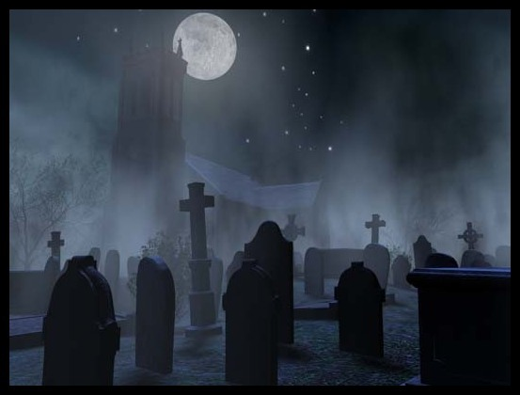
PROTECTION FROM HUMANS – “I will require the blood of anyone who takes another person’s life. If a wild animal kills a person, it must die. …If anyone takes a human life, their life will also be taken by human hands. For God made humans in his own image.” (v 5-6)
Before the flood, only God had the right to take a life (protects Cain in 4:15). Now God gives humans (not animals) that right. Why?
Humans have authority over animals and only humans are made in God’s image = every person is priceless to God. Any presumption to dismiss and/or take human life is an attack on God.
Image of God = we alone reflect the glory & dignity of God & reveal His attributes = rational, personal, loving, relational, creative…
Notes:
These verses once again highlight a big change since creation. Before the flood kept to himself the right to take human life. In 4:15 God threatened sevenfold vengeance on anyone who killed Cain, even though he was a murderer himself. God now gives that right to human beings – not as individuals but as a community. Notice how he doesn’t give animals that right. Notice how God commands that any animal that kills human being is themselves killed. This is not about blaming animals or thinking that it will deter other animals not to kill. Its about valuing human life – a reminder of how priceless each person is. Why not? Because he wants the world to value human life – only they are made in his image. Separates us from the animals, plants and nature. We reflect the glory and grandeur of God more than the most beautiful landscape.

Slide 5
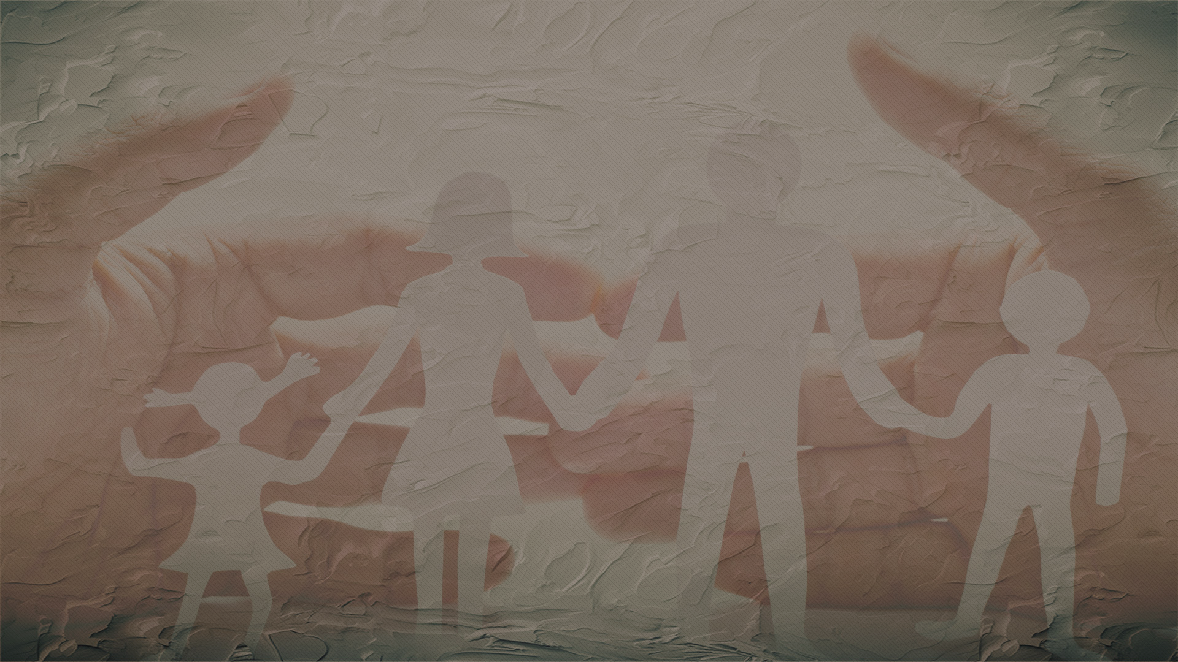
Some important issues to think about =
a) We must value and care for each person - no matter their status or how they smell, look or behave = social justice not optional.
“Our neighbour bears the image of God. To use, abuse or misuse one of them is to do violence to God himself.” (John Calvin)
b) God’s requirement of a reckoning for murder = the institution of human government and the establishment of capital punishment. Reinforced in Romans 13:1-4 and supported by Paul (Acts 25:11).
c) The ‘taking of life’ that God forbids includes – intentional murder, reckless/negligent homicide, suicide (self murder), abortion and euthanasia (assisted suicide).
Notes:
Opposition to capital punishment (even from Christians) is “What about an innocent person?”, “It doesn’t really deter anyone.” Although that may tragically happen it doesn’t mean that we use emotion to override God’s Word. Taking of life = intentional murder (Ex 20:13), reckless homicide (dying because of no handrail –WHS or because of a known dangerous bull not being kept in a fence).

Slide 6
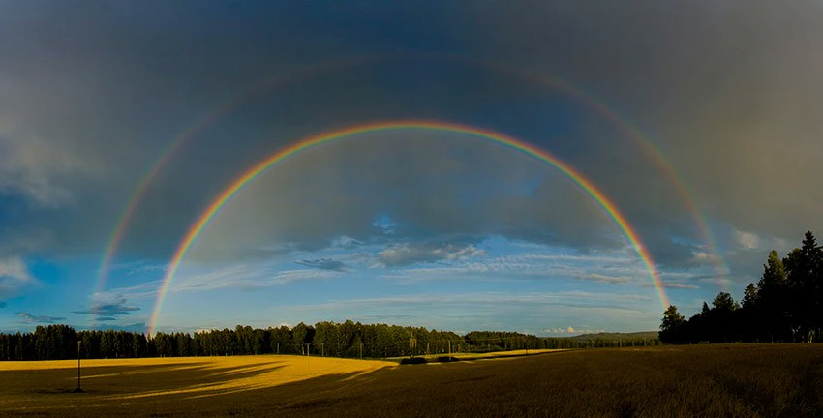
PROTECTION FROM GOD – “I confirm my covenant with you.. your descendants … & every living creature on earth…. Never again will a flood destroy the earth…. I have placed my rainbow in the clouds. It is a sign of my covenant with you & all the earth….” (vs 8-17)
This is an eternal and universal promise which is valid until Christ returns and inclusive of all people and nature.
This covenant is God saying, “You are in danger because of sin. But because of my amazing grace, I am choosing to save you from that danger.” THIS IS THE GOOD NEWS OF THE GOSPEL.
Knowing the Good News = looking at the clouds + looking at the rainbow + looking at where the clouds & rainbow meet.
Notes:
Because we are sinful God could justify another world-wide flood and stop us from being fruitful, multiplying and filling the earth. Also, note that this is an eternal promise – still current for us today (we are all Noah’s descendants from his sons). It also includes all nature so we must care for animals and nature – not just consume for our sake but be good stewards as God asked us to be. In verse 13 (which I have underlined) is the wonderful truth of the gospel.

Slide 7
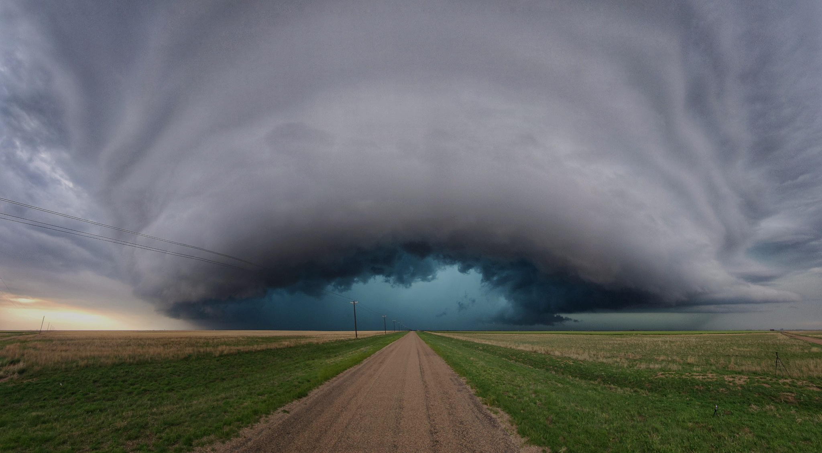
a) You have to look at the clouds – there can never be a rainbow without dark clouds, without a storm and rain.
When Noah came out of the ark there was still ‘dark clouds in the sky’ = “… everything they think or imagine is bent toward evil from childhood.” (8:21) = the sin & evil that a holy God must deal with.
“God looks down from heaven on the entire human race; he looks to see if anyone is truly wise, if anyone seeks God. But no, all have turned away; all have become corrupt. No one does good, not a single one!” (Psalm 53:1-3, Romans 3:10-17)
Our sin is the problem = the ‘clouds’ that cause us grief, guilt, despair and sorrow. Our sin separates us from God & brings his wrath = WE DESERVE JUDGMENT.
Notes:
You have to look at the clouds – a rainbow will never appear on a clear sunny day. It wasn’t just Noah, his family and the animals in the ark. There was also sin – the flood never fully destroyed sin because it was still in the hearts of those on board. We will look at that in our next message after Easter holidays – where Noah gets drunk and is disrespected by his son Ham, which leads to cursing and sorrow. God repeats this horrible truth about the darkness of the human heart in Psalms and Romans. Its confronting – we are the problem with this world. We are the reason there is death, sorrow, guilt and grief and despair and separation from God. All other religions say that bad people are the problem. That if you are good enough you go to heaven and if you are bad enough you will go to hell. Its up to you – you can be good or bad. We like to justify ourselves and say its only the bad people who are the problem too. But the gospel says we are all bad – that you and I are the problem. We all deserve the flood and the curse of God. There is nothing we can do to save ourselves. By ourselves we deserve to get the flood and the curse.

Slide 8
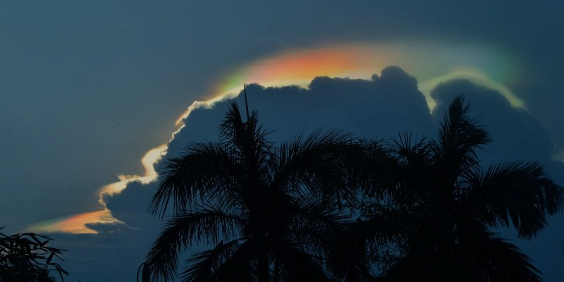
b) You have to look at the rainbow – which only comes after the storm is in retreat.
Hebrew word for rainbow = bow. 75 times it is used in the OT and it = a war bow, a weapon to kill.
“I have placed my bow in the clouds..” = I have put my wrath and judgment aside. I am not going to use it on you = WE GET MERCY.
c) You have to look at where the clouds (God’s judgment) and the rainbow (God’s mercy) meet – rainbows only appear when the sunlight penetrates the clouds and the darkness.
You have to look at another ‘storm event’ where the ‘light of the world’ penetrated the darkness of sin and God’s wrath = the cross of Christ where God’s judgment and mercy came together.
Notes:
How can a holy God give us mercy instead of death?

Slide 9
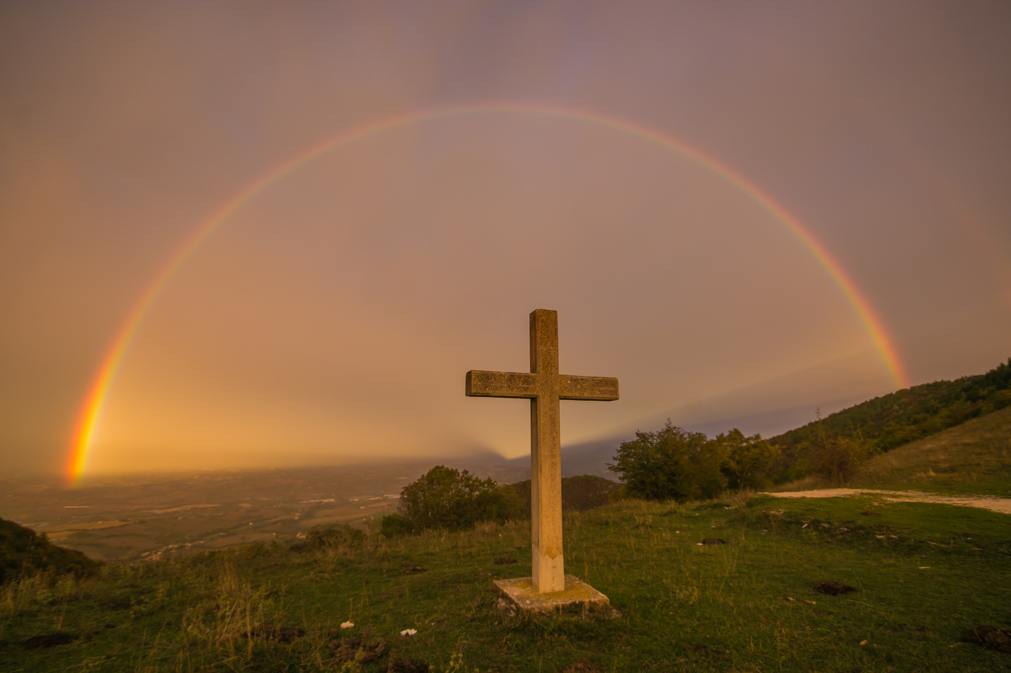
When God’s placed his bow (rainbow) in the sky, he aimed it towards himself, not us = Jesus “..was pierced for our rebellion and crushed for our sins. He was beaten so we could be whole. He was whipped so we could be healed... The Lord laid on Him the sins of us all. (Isaiah 53:5-6)
“For this is how God loved the world: He gave his one and only Son, so that everyone who believes in him will not perish but have eternal life.” (John 3:16) = the eternal peace, joy and hope of God.
That should excite your heart and fill you with wonder, just as much as a rainbow does.
That should encourage us to destroy the idols in our life & stop trusting in anything/anyone else to bring us lasting peace, joy and hope.
Notes:
Excitement and wonder – its not up to us. It doesn’t matter how big a sinner I am, how bad I am, Jesus’ death covers it all. Stop trusting in our own goodness – leads to guilt and despair.

Slide 10
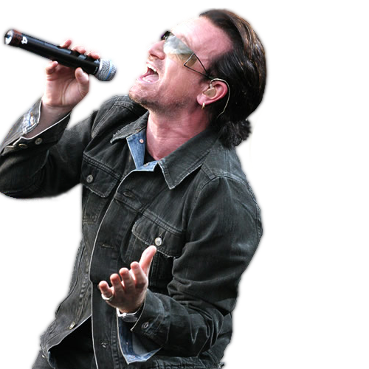
In the darkness and clouds of life look for the rainbow – look to & rejoice in Jesus, God’s only source of lasting peace, joy & hope.
“You fearless saints, fresh courage take. For the clouds you so much dread, are big with mercy and shall break, In blessings on your head.” (William Cowper)
“All religions are big on karma. You know, what you do comes back to you. And physics says that every action is met by an equal or opposite reaction. But then along comes this idea of God’s grace and it changes everything. God’s love interrupts the consequences of your actions and gives you peace. Which in my case is very good news, because I have done a lot of stupid stuff.” (Bono)
Notes:
I started my message with a quote from a famous songwriter (Kermit). In keeping with that theme I would like to close with quotes from two other songwriters. One from history and the other a little more contemporary. William Cowper was an English poet and hymn writer who lived in the 18th century – he wrote over 68 hymns, including O For A Closer Walk With Thee. He was a man who struggled with the clouds of despair and depression all his life. He tried to commit suicide three times and spent 18 months in mental health asylum. While he was in the asylum he wrote another of his most famous hymns called God Moves In A Mysterious Way. It was all about finding and rejoicing in the promises and grace of God – seeing the rainbow. In the third verse of the hymn it says: ….Moving forward in time I want to share how another songwriter celebrates the grace of God. Bono is the lead singer of Irish super group U2 and by his own admission his life has been filled with doubt, guilt and fear. The only solution he knows for his fear, guilt and doubt is the grace of God. Like these two men we all struggle with despair, depression, fear, guilt and doubt – the product of living in a fallen world. But we need to look at the rainbow – the eternal symbol of peace joy and hope.

