Slide 1
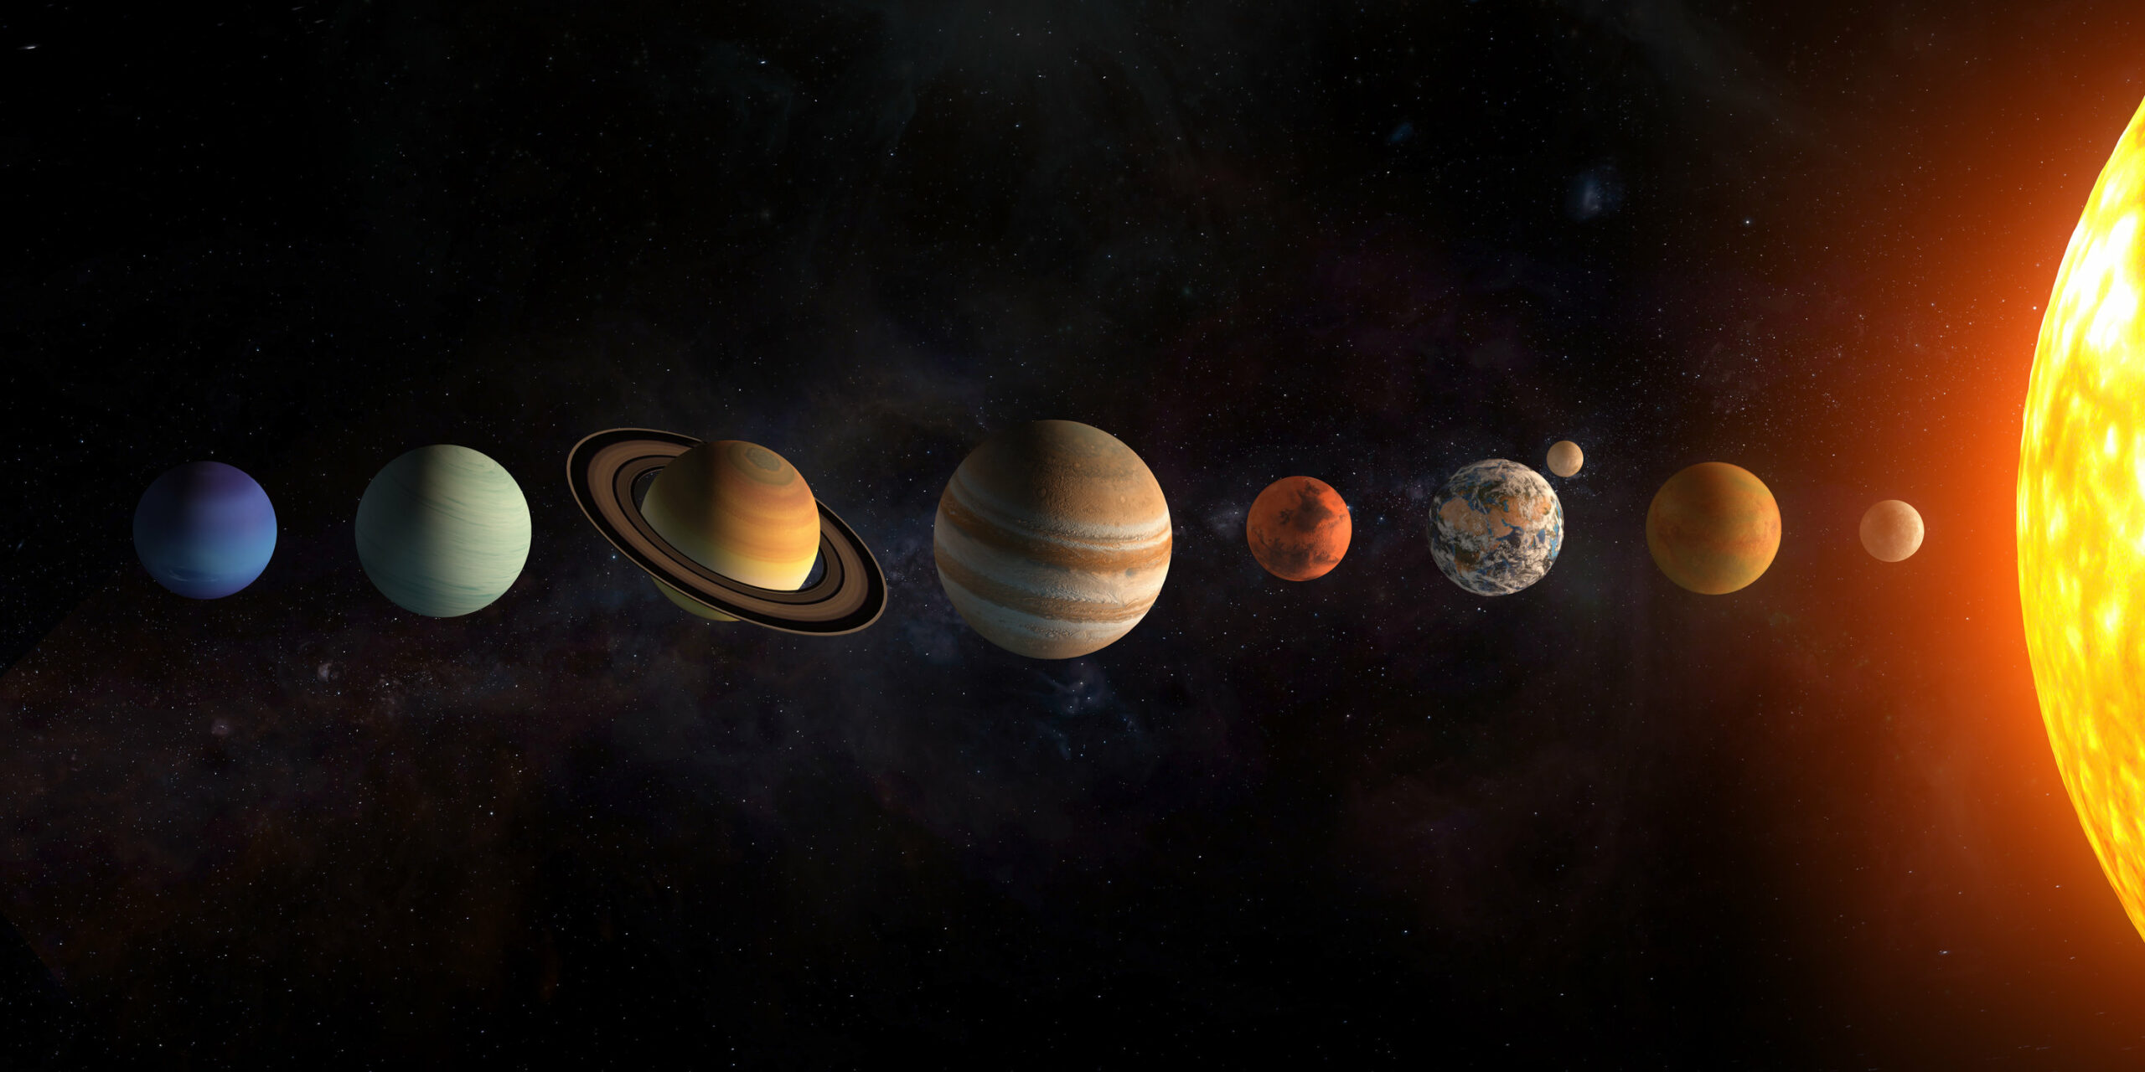
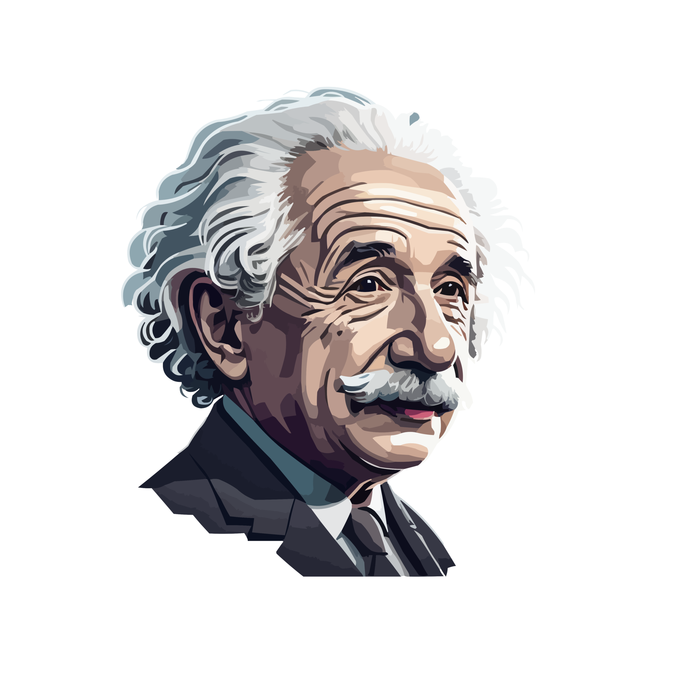
“I have no problem with the idea of God being the creator. But I do struggle with resolving the existence of evil and suffering with a good God.” (Albert Einstein)
“Yes, the world is splendid, but why did God create a world in which there is so much suffering, pain, injustice and misery that is not our fault? He could easily have made a world in which that didn’t exist. It is simply not acceptable. It’s perfectly apparent that he is utterly selfish, mean-minded and stupid and deserves no respect whatsoever. The moment you banish him, life becomes simpler, purer and more worth living in my opinion.” (Stephen Fry)
Notes:
As we journey through the Creation Story we are reminded that many people just struggle/refuse to believe (they know the truth but suppress it – Rom 1:18-20) that God created the world. They do that because they don’t want to admit that God is Creator and we must worship and obey him. So they set about deluding themselves that the answer lies in science. But as we enter into chapter 3 of Genesis, the saddest episode in human history = where sin, suffering and death enters the perfect world God had created. And it is this introduction of death, decay and suffering that offends many people – more than the concept of God being the creator. Albert Einstein was not stumped by the idea of God the creator, but more by the fact that a loving God would allow evil and suffering to come into existence. More recently, Stephen Fry (English actor, comedian and writer) shared the same thoughts. God can’t be real and loving and worthy of worship because he created a world with suffering and injustice etc. People struggle with the concept of a god who allows bad things to happen to good people. But did God do that? What is the origin of evil, suffering, injustice, pain and misery? Genesis 3 tells us the answer.

Slide 2
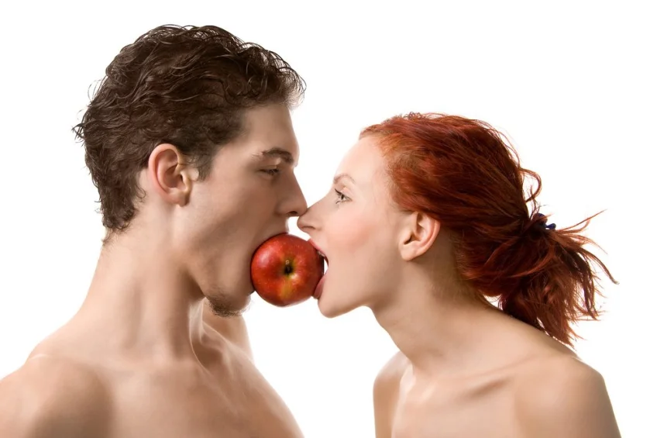
THE
AND THE LOSS OF PARADISE
GENESIS 3:1-15
WHO - is responsible?
HOW - does it happen?
WHY - did God allow it?
CRUSHED – God’s solution.
WHAT – does it mean for us?
Notes:
Genesis 3 is the saddest story in the history of the world. It is the where we see sin, death, suffering come into the perfect world that God created and where human beings (the pinnacle of his creation – made to be in daily fellowship with him, in his presence forever) are separated from God. At the beginning of chapter 3 God was looking on Adam and Eve and his completed, glorious creation and had declared it very good. Yet by the end of chapter 3 God is tragically forced to curse them and banish them from the garden. In Genesis 3 we are also introduced to the serpent who makes a big difference to the story and we are told, plays a big part in the loss of paradise. So as we unpack this tragic passage this morning I want to look at who is responsible for bringing sin, death, decay and suffering into the world. As we look at verses 1-15 we will look at a number of things. Who, How, Why and Crushed and What.

Slide 3
WHO IS RESPONSIBLE FOR SIN & SUFFERING? (vs 1a)
It’s not God. He takes no pleasure in wickedness & evil (Ps 5:4), He can’t look on evil (Hab 1:13), He is never tempted to do wrong (James 1:13), He is light & has no darkness in Him (1 Jn 1:5).
If God was author of evil there would be no need for Jesus, salvation or the cross – there would be no condemnation.
Sin & suffering come from the created (serpent), not the creator.
“This great dragon, the ancient serpent called the devil (slanderer), or Satan (accuser), the one deceiving the whole world, was thrown down to the earth with all his angels.” (Rev 12:9)
Notes:
God is not the author of evil – if he was OK with evil then there would be no need for salvation, Jesus or the cross. The origins of sin and suffering come from the serpent – so who is he? Revelation 12:19 gives us the best answer.

Slide 4
“And I remind you of the angels who did not stay within the limits of authority God gave them but left the place where they belonged.” (Jude 1:6) = the fallen angels desired more power & authority = they craved self-exultation and self determination.
Jesus calls him the evil one (Matt 13:19), a murderer from the beginning and the father of lies (John 8:44) and the ruler of the world (John 12:31).
The Pharisees call him Beelzebub – prince of demons (Matt 12:24).
Satan the serpent is evil and viciously opposed to God and humanity. He doesn’t want to serve us (Heb 1:14) he wants to plunge us into the same misery he is in.
Notes:
Somewhere in between the end of Genesis chapter 2 (creation was all very good) to Satan appearing in Genesis 3 the angels rebelled against God. They sinned and rejected God because they desired more power and authority than God had given them. They wanted to be the masters of their own lives. In order to find out more about his character I want you to hear from some of his referees. Jesus and the Pharisees describe him to perfection – a wicked character. Even as he appeared to Adam and Eve he was a liar, murderer and the ruler of the world.

Slide 5
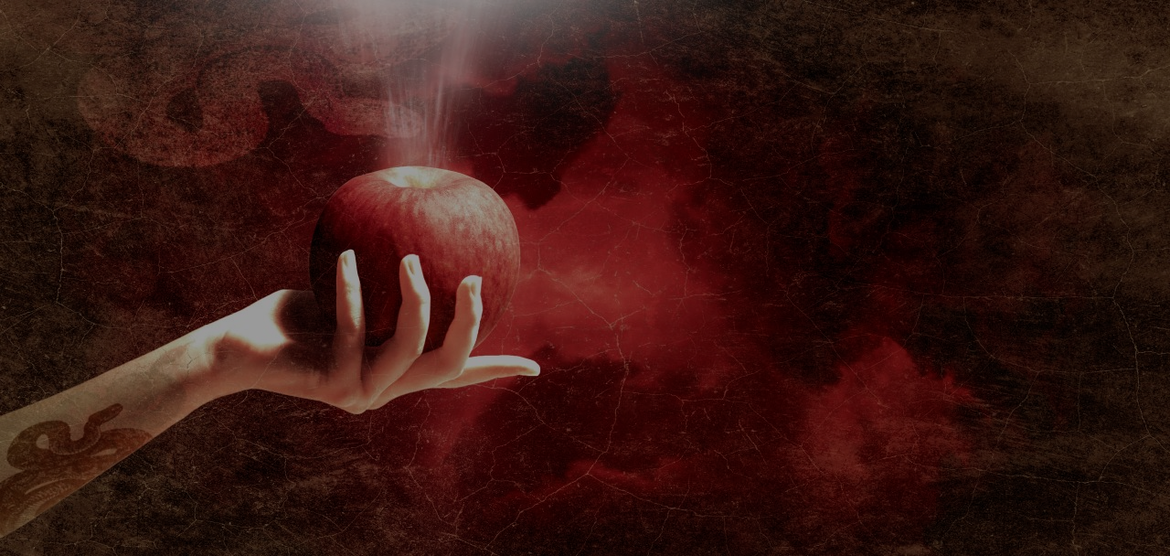
HOW DOES HE DECEIVE US, SEPARATE US FROM GOD AND PLUNGE US INTO MISERY? (vs 1b-5)
1. DOUBTS GOD’S WORD – “Did God really say…” = you should question what God commands & provides. Your way is better.
2. DIMINISHES GOD’S CHARACTER – “He knows you will be like Him..” = God is withholding the best things from you. God is restrictive, jealous, selfish and cruel – not generous & good.
“To listen to Satan is to assume the worst of God.” (Tim Keller)
3. DENIES THE SERIOUSNESS OF SIN – “You won’t die.” = Satan presents the bait & hides the hook = highlights the pleasure and profit of sin, but hides the misery, wrath & judgment that will come.
Notes:
He gets us to doubt God’s word, diminish God’s character and deny the seriousness of sin – God’s bark is worse than his bite. Sin is not that bad. Satan will always say the opposite of God.

Slide 6
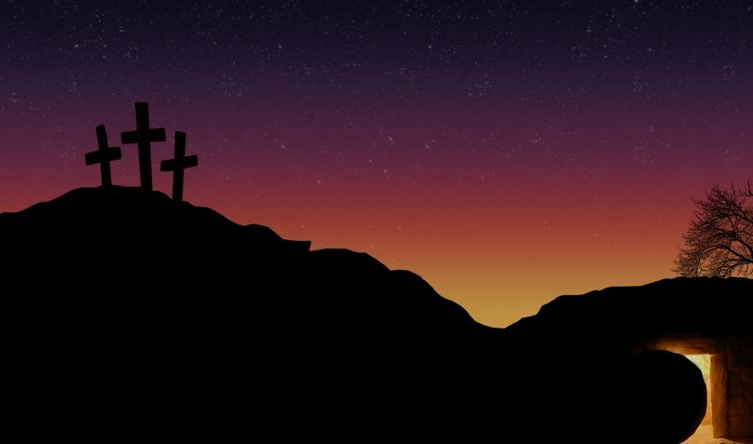
WHY DOES GOD ALLOW SATAN, TEMPTATION, SIN & SUFFERING?
God wasn’t caught off guard, nor was He helpless to prevent this tragedy from happening. Satan serves his eternal purposes.
1. To bring about the salvation of sinners and to display more of His divine nature that we wouldn’t have seen without sin = God is more glorified.
“Satan ultimately serves to magnify the power, love, grace, mercy, patience, holiness, wrath & justice of Jesus Christ.” (John Piper)
2. To test our willingness to love & obey Him. “To do right where there is no opportunity to do wrong is not moral behaviour.” (H.C Leupold) – God doesn’t want ‘robots’.
Notes:
We don’t know why sin arises in Satan’s heart – God doesn’t tell us that. But I believe God permitted Satan’s fall and then his temptation of Adam and Eve and their subsequent fall. Why? Because he had a Plan and it suited his purposes. Some ask why God didn’t just wipe him and the other fallen angels out? But reality is if God did that he would have to do the same to us. But God had good reasons for allowing Satan into his plan.
1. To reveal to a greater extent his awesome attributes. Without sin and Satan we wouldn’t see or understand God’s grace etc. as much as we do now.
2. To test our love and obedience. God wants freewill followers – he created us and the angels with the ability to think, reason, discern and make decisions. He doesn’t want robots who only do what they are programmed to do. Who wants to be loved like that?

Slide 7
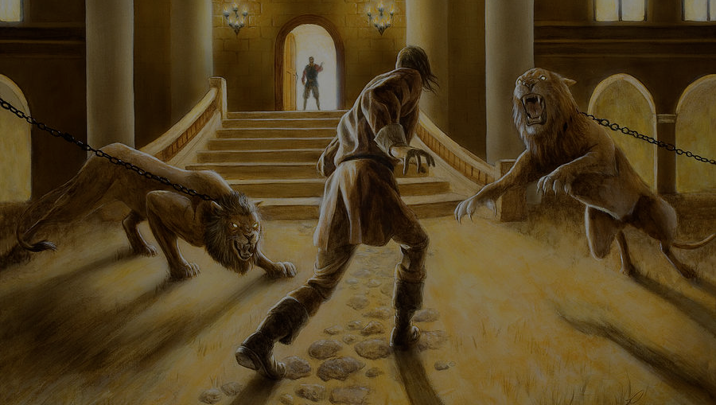
3. Because ‘safe’ is not the pathway to strengthening our faith and growing our understanding. God’s intention for us is to always come through trials and temptations more equipped and mature than we were before (James 1:2-4).
4. To prove that He is sovereign over Satan and to demonstrate the futility in trying to oppose Him – God always wins.
Satan, ruler of the world (Jn 12:31) < God, the ruler over all the kingdoms (Dan 4:17).
Evil spirits do wicked things in this world < Christ has authority over them all (Mk 1:27)
Satan, the prowling lion
(1 Peter 5:8) < God who has him on a leash (Job 1:12).
Satan, the murderer (Jn 8:44) < God who has the gift of healing & life in His hands (Deut 32:39).
Notes:
Our spiritual muscles and capacity to endure (go harder and further) are only made larger when they are stretched.

Slide 8
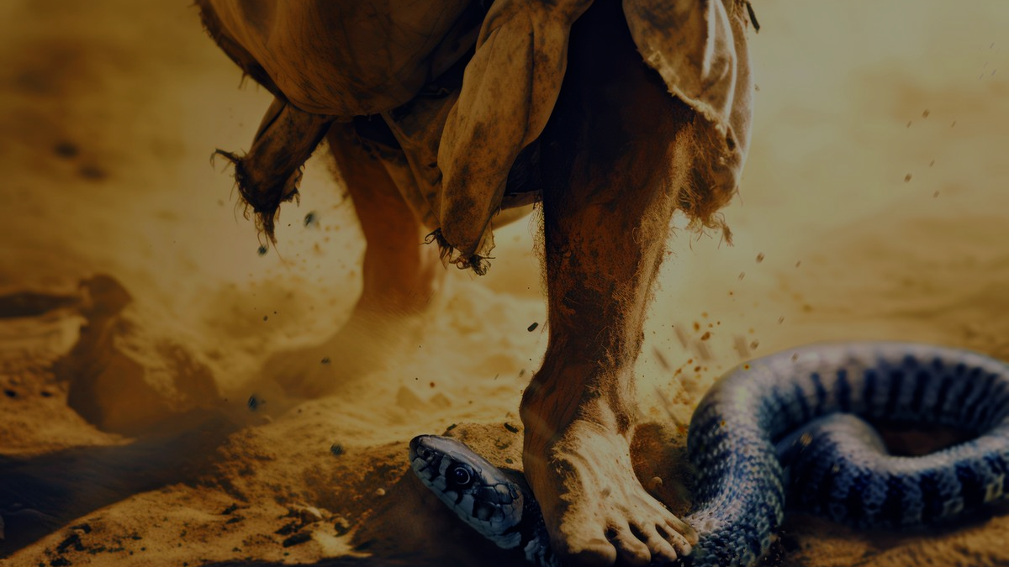
CRUSHED (GOD’S SOLUTION) – “And I will put enmity between you and the woman, and between your offspring and hers; he will crush your head, and you will strike his heel.” (vs 15)
Satan’s one eternally destructive weapon = his accusations to God that we are guilty, deserve condemnation & should perish with him.
“He cancelled the record of the charges against us and took it away by nailing it to the cross. he disarmed & shamed the spiritual rulers & authorities… by his victory on the cross.” (Col 2:14-15)
“There is no condemnation for those who belong to Jesus Christ… Neither death nor life… even the powers of hell can never separate us from the love of God revealed in Christ.” (Rom 8:1, 38-39)
Notes:
As God curses Satan he reminds him of the futility of starting a war with God – God wins and a day will come when Satan will be defeated and removed from this earth. This is the first promise of the gospel – the promise that a man will rise against Satan and while Satan will strike a horrible blow to his foot, the man will strike a fatal blow to Satan – crush his head. Jesus does this on the cross. Satan is an accuser – that is his one big destructive weapon. He loves to see us suffer the same fate that he will suffer – eternal condemnation and separation from God = destruction. But Jesus destroys his weapon by dying for our sins on the cross. Death is defeated and there is no condemnation – no separation from God, no banishment from the garden is needed. Death is defeated because we have been made friends with God through the righteousness of Christ.

Slide 9
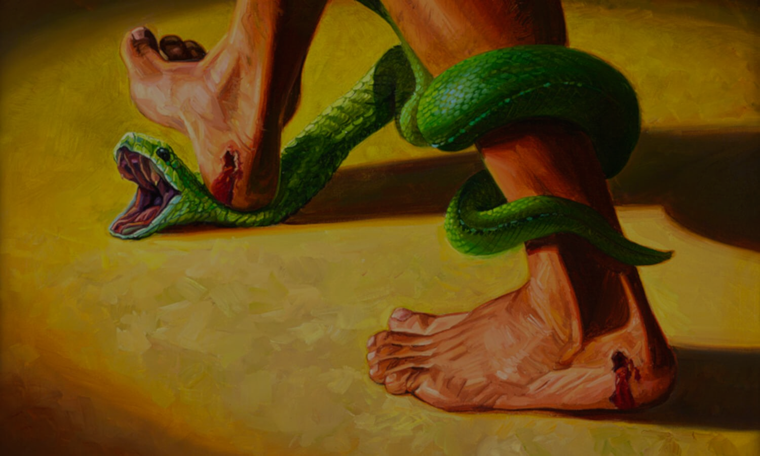
WHAT DOES IT MEAN FOR US (WHO BELONG TO CHRIST)
7 things WE SHOULD DO with evil, suffering & temptation.
1. EXPECT EVIL – “Don’t be surprised at the fiery ordeals that come to test you…” (1 Pet 4:12)
2. HATE EVIL – “Hate what is evil; cling to what is good.” (Rom 12:9)
3. RESIST EVIL – “So humble yourselves before God. Resist the devil, and he will flee from you.” (James 4:7)
4. PRAY FOR ESCAPE FROM EVIL – “And lead us not into temptation, but deliver us from the evil one.” (Matt 6:13)
5. EXPOSE EVIL – “Take no part in the worthless deeds of evil and darkness; instead, expose them.” (Eph 5:11)
Notes:
Seven things we should do with evil.
Don’t be surprised that it comes into our life. We live in a fallen world, that is filled with death and decay. Also, if we are on Jesus side, we can expect Satan to hate us and come at us.
Hate evil. Don’t think you can live amongst it and that it won’t affect you. Fill your life, thoughts, reading, watching, drinking, eating , entertaining with good things, not questionable things.
Resist evil, don’t embrace it. Fight against it in the power of God – can’t do it on your own. Best resistance is humility – pride is what brings about fall.
Ask God to help you in times of suffering – need his power and strength and truth to win.
While evil is rampant in this world and a promised result of sin. Doesn’t mean we should just accept it and do nothing.

Slide 10
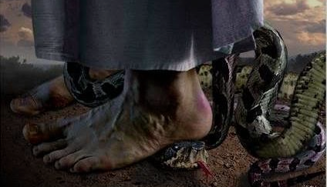
6. GIVE THANKS FOR THE REFINING EFFECTS OF EVIL – “… perseverance, character and hope.” (Rom 5:3)
7. OVERCOME EVIL WITH GOOD – (Rom 12:21)
3 things WE SHOULD NEVER DO with evil, suffering & temptation.
1. NEVER DESPAIR THAT THIS WORLD IS OUT OF GOD’S CONTROL – “.. works everything according to His plan.” (Eph 1:11)
2. NEVER THINK THAT GOD IS UNJUST IN THE WAY HE GOVERNS THE UNIVERSE – “The Lord is righteous in all that he does…” (Ps 145:17)
3. NEVER DOUBT THAT GOD IS FOR YOU – it’s not an expression of his wrath & condemnation. That fell on Jesus, not you. (Rom 8:1)
Notes:
6. Hebrews 12:6 tells us that God uses trials and suffering to discipline us – the discipline of a loving Father, not a vengeful God.
7. Don’t let evil overcome good. Strive to overcome evil with good.
Three things we should never do with evil…
Even though the world may seem chaotic and evil seems to be winning, never think that God has lost control or that he is unprepared.
We can’t always understand what God is doing, and in our pain and suffering (Just like Stephen Fry) but we must never be deceived into thinking God is unjust, selfish, mean minded and stupid. He is righteous in all he does.

Slide 11
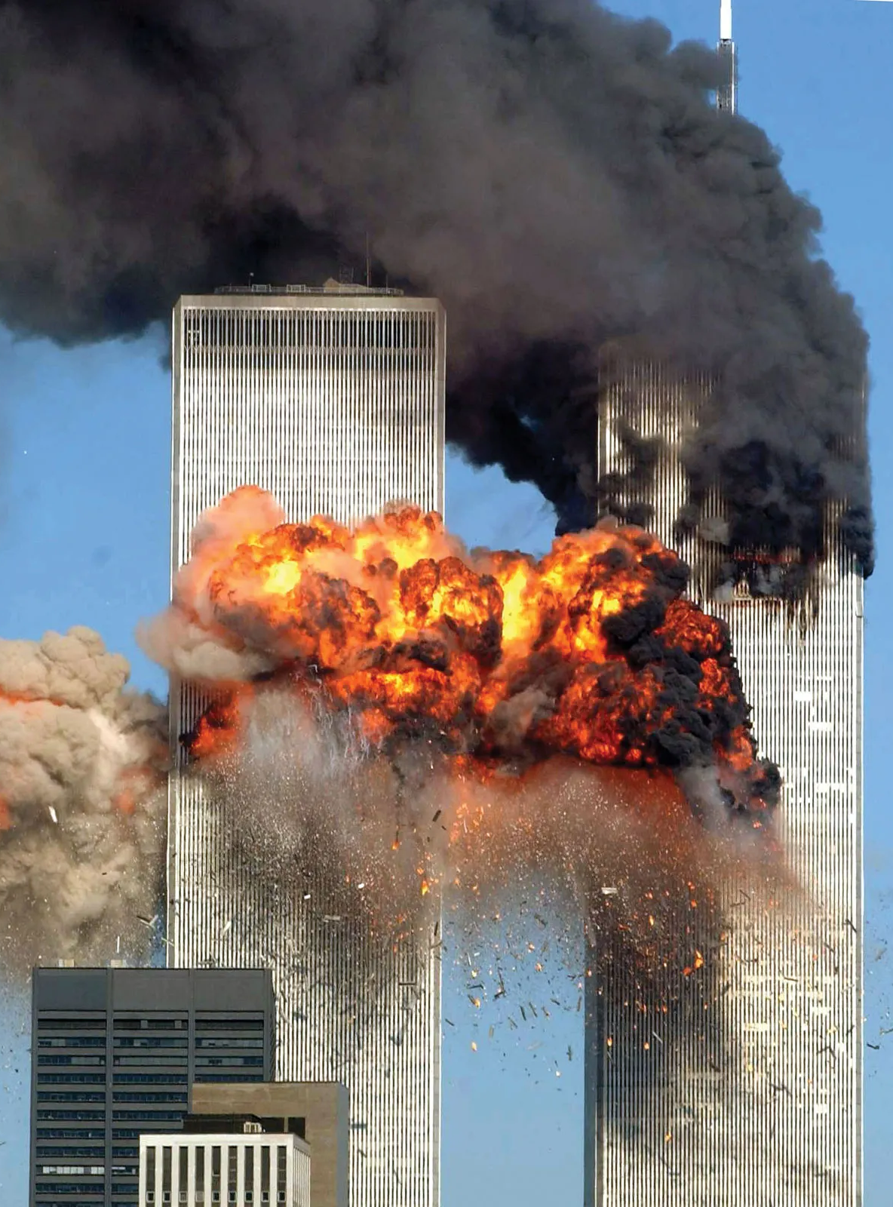
September 11, 2001 – the World Trade Centre falls in death and ruin.
The cross of Christ stands out from our world ruined by evil, sin & death.
“Believe in the Lord Jesus Christ and you will be saved.”
(Acts 16:31)
The good news promised in the suffering & despair of the garden is the same good news for the suffering & despair of the world today.
Notes:
On September 11, 2001, the twin towers of the World Trade Centre were struck by planes (used by terrorists) and millions of people across the world looked on in horror as the towers fell in death and ruin. It was a tragedy that changed the world and filled the American people with fear and despair. Amazingly, as the dust settled and the wreckage was being cleared, workers discovered something amazing sticking up out of the ruins. Two massive steel girders had been fused together in the shape of a cross. In the middle of their grief and despair, the workers, the people of New York and America gained hope as they looked on this cross – hope that life would go on and that good would prevail. Just as that steel cross stands out from the ruins of the Trade Centre, the cross of Christ stands out from the ruins of this world. Hope wins – hope in Christ and his defeat of Satan.

