Slide 1
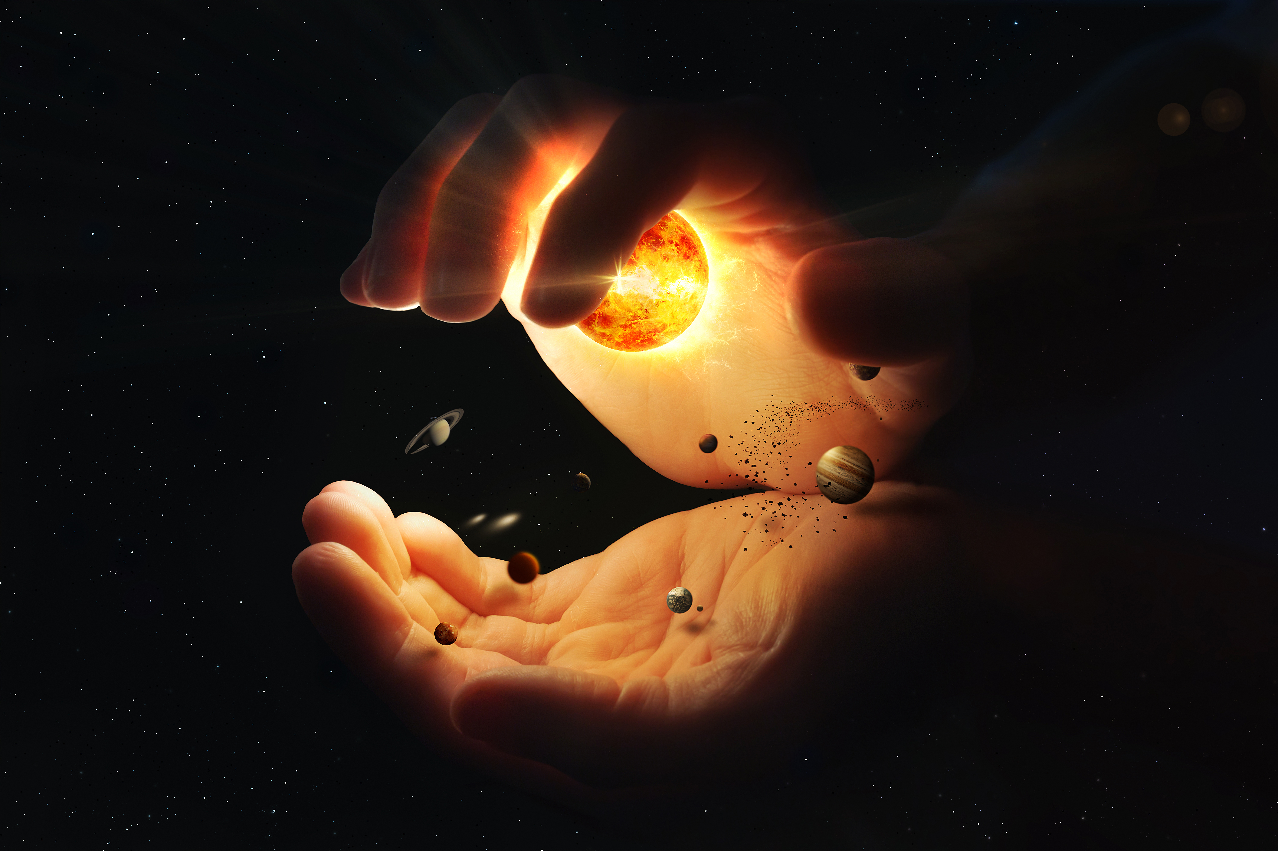
THE IMAGE OF GOD Genesis 1:26-31
Notes:
Good morning everyone. I trust you are all enjoying your time fellowshipping with us this morning
Well, this morning I have the privilege of being able to preach to you from God’s Word about the image of God
It’s a theme that is central to Scripture and our understanding of what the gospel accomplishes
It’s foundational in our understanding of the human race and how we should view ourselves and others
But before we jump into that. I want to do a little exercise with you all
Every night at around about 7 o’clock, just before Elijah goes to bed, (soon we will have Ewan doing this), Jess and I will sit down with Elijah, and read a series of questions to him, in which we get him to answer. Now he can’t read so we have to read the answers out aloud to him until he has memorised the answers.
But this morning I’m wanting to take you all through the first 5 questions that we ask Elijah. How this is going to work, is I am going to read the question, which is in black and then together, I want you all to respond with the answer, which is written in red

Slide 2
Q. Who made you? A. God made me
Q. What else did God make? A. God made all things
Q. Why did God make you and all things? A. For His own glory

Slide 3
Q. How can you glorify God? A. By loving Him and doing what He commands
Q. Why should you glorify God? A. Because He made me and takes care of me
Notes:
The answers to these questions tell us that God made us, that we should live a life that glorifies Him, and that we accomplish this by loving Him and doing what He commands
And we glorify Him in all that we do because He is our Creator and He takes care of us
All of that combined is basically my sermon in a nutshell
So let’s get into today’s text

Slide 4
THE GODHEAD IN CREATION
Then God said, “Let us make man in our…” (Genesis 1:26a)
Christian tradition believes that this verse is referring to the Trinity
We have already been introduced to the Spirit of God in Gen 1:2, and we know from the New Testament that Jesus is present as well
Notes:
Then God said, “Let us make man in our…” (Genesis 1:26a) - Over the years many people have discussed and written on what the ‘us’ and ‘our’ in these verses is referring too - Jewish commentators have generally held that the plural of ‘us’ and ‘our’ is God addressing the heavenly court, that God is talking to the angels - And yet we know from Scripture that we are not made in the image of angels, but in the image of God, so it couldn’t be referring to them
Christian tradition believes that this verse is referring to the Trinity - And I believe that this is exactly what God intended in this passage as well - You see, one of the arguments against this interpretation is that the audience reading this during Old Testament times would not have understood it that way, and Moses wouldn’t have understood the Trinity quite like this. - And yet we know from Scripture that the Bible was written by many men, who were taught by the Holy Spirit - Moses may have been the writer, but God is the author, and we know that all of Scripture is inspired by God, that it is God-breathed - And there are many things in the Bible that rely on what we call progressive revelation – that a greater and fuller understanding of this truth is revealed as the Bible progresses - And so here, it is as though God is just lifting the veil back ever so slightly to show us a glimpse of the Godhead at work
We have already been introduced to the Spirit of God in Gen 1:2, and we know from the New Testament that Jesus is present as well - Hebrews 1 and Colossians 1 discuss how Jesus Christ, the Son of God, the second member of the Trinity, is the Creator and Sustainer of the universe - In order for that to possible, he has to have been present - One God, three persons, who are co-equal in essence and attributes and are co-eternal - So, the plural pronoun used here is what we call divine deliberation, it is the Godhead consulting. - It is important to understand this because it also demonstrates just how special, just how unique the human race is, and exactly the kind of relationship God shares with us

Slide 5
GOD’S IMAGE
“Let us make man in our image after our likeness…” (Gen 1:26)
Rulership – “let them have dominion over the fish… and over all the earth (Gen 1:26)
Relationship - God made us with the capacity for relationship with Him, and with others
Notes:
“Let us make man in our image after our likeness…” (Gen 1:26) - The first thing I want you to notice here is, if you go back and search through all the other days of creation you will notice that God said… - “Let there be light…”, ”let the earth sprout vegetation… each according to its kind” - “Let the waters swarm with swarms of living creatures, and let birds fly above the earth” and God created them “according to its kind” - “Let the earth bring forth living creatures according to their kinds” - Everything else that was created, was created according to it’s kind. But that would not be case for humanity - When it came to God and creating mankind, He says “Let us make man in our image” - It’s personal, God made us like Him, He was directly, and personally, and intimately involved with the making of mankind - There was something special about mankind, but just exactly what is it that makes us ‘in the image of God’?
Rulership - ”let them have dominion over the fish… and over all the earth - Now, we know that God is the ultimate, sovereign, ruler over everything and it states here that He created mankind for the earth, and not the other way around - He created it for us, for our good pleasure, for us to rule over it well. To look after it, to name every creature - We are to govern the world and its creatures on God’s behalf
Relationship – God made us with the capacity for relationship with Him, and with others - We were created by God and for God. For mankind’s chief purpose is to glorify God, to honour Him and walk closely with Him - But He also created us with the capacity to demonstrate this love within community and towards others - This is a reflection of the Trinity itself, because within the Trinity exists perfect community, relationship, and love - This privilege of knowing and loving God, is a unique privilege given to mankind alone - The rest of creation does not share this same capacity. God made the world for you, and you for Him

Slide 6
Rationality – God has given us an intellectual capacity that He has not given to the rest of creation
Righteousness – We were created with right standing before God
Because of sin the Imago Dei has been greatly tarnished but it remains in us
Notes:
Rationality – God has given us an intellectual capacity that He has not given the rest of creation - God has created us with the capacity to think logically, to think critically, to analyse and to draw conclusions - He has given us memory, and the capacity for creativity and language and verbal skills - We do not know all things, for that lies in God alone, but with all the knowledge necessary for life and godliness - He created us with a capacity to choose between what is right and wrong - This is all from God, for our God is the genius creator, a God of infinite wisdom
Righteousness – We were created with right standing before God - In the beginning, Adam and Eve walked in the cool of the day with God - They stood before God innocent, and blameless as His creation - Ecclesiastes tells us that God made man upright. That we had a disposition to do every good thing, to do what pleased God - All that was done was pure and holy. Adam and Eve loved what God loved, and hated what He hated - And yet God gave them a command, and held them to obedience and promised them life if they kept it, and death if they didn’t, and they didn’t, Satan lured them in, and Adam and Eve chose death
Because of sin the Imago Dei has been greatly tarnished but it remains in us - Now we no longer have right relationship with God, now we do what God hates, now we can longer be in God’s presence - We are now totally depraved, sinners who are not able to make our way back to God in our own strength - We are a wicked and sinful race, who deserve nothing but the wrath of God - And yet, by the grace of God, the image of God still remains in every single human, we see elements, little fragments of the image that still remain. - Salvation is the restoring of this image of God in us. Sanctification is the restoring of the image of God in us, that we would once again be like God. - And so the gospel is trusting in Jesus Christ, who is so like God that the Word of God declares him to be one with God. - And so we must repent of sin, the very thing that has tarnished our image, and trust in Jesus Christ. - And as we do this, we allow the power of God to transform us and conform us to the image of Jesus Christ

Slide 7
GOD’S CREATION
“So God created man in his own image, in the image of God he created him; male and female he created them” (Gen 1:27)
God is a personal God, who created us in a very personal way
There is 1 human race, 2 genders, created equally
Notes:
“So God created man in his own image, in the image of God he created him; male and female he created them” (Gen 1:27) - This is the first time that we see poetry used in the Bible - But I have underlined the word created, because in the space of 1 verse, the word created is used 3 times - I don’t think this was put in there by accident. God wants us to understand something here - Mankind did not evolve over millions of years, He did not create us as apes, or monkeys, or gorillas, or as atoms or molecules or some lower life form - He intentionally, and deliberately created us as humans
God is a personal God, who created us in a very personal way - If we flick over to Genesis 2:7 we see that God created man face to face for a covenantal relationship of fellowship, communion, and love - God MAKES man. You can almost picture it, first he raises the walls of flesh, builds the house of the body with all its organs, all its rooms - And then He doesn’t stop there, He breathes the breath of life into our nostrils and mankind becomes a living creature. - Inside this shell that God has built for mankind He puts in a noble and divine guest to dwell in it, our souls - You see this verse is so needed in today’s day and age where everyone thinks that they are what they make of themselves, everyone wants to be a self-made person - But the gospel, the living Word of God has a much greater truth for us. - The sovereign Creator of the universe, stooped down to make mankind different from every other thing that exists anywhere in the universe. He makes us in the image of the Godhead, and breaths the breath of life into us - God says, “if you want a life filled with purpose, filled with meaning, filled with joy and contentment. Then stop looking around you at the things I created, and look up at the one who created you, you will only find purpose and true contentment in me, because I created you for me”
There is 1 human race, 2 genders, created equally - Male and female He created them. 1 human race, 2 genders, created equally in the image of God, but with functional differences - God created a male to be a male and a female to be a female - In an age of incredible confusion around gender, where people say it is just a social construct or personal choice based on how they feel, in spite of all the irrefutable biological evidence to say otherwise - The Bible, and therefore God, is declaring here that sexual identity is determined by God and God alone - A man may deny his gender, put on a dress, take hormone treatments to violate himself chemically, but he will never be a woman, or vice versa. - A person’s gender is fixed at conception. It is not determined by preference or feelings - And to try and change our gender is to spit in the face of God as though we know better than Him, as if He made a mistake when He made us

Slide 8
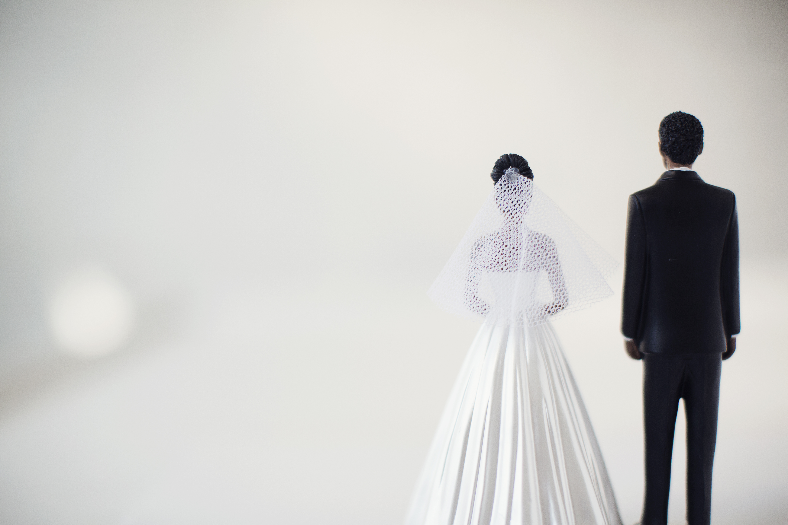
We also see God’s design for marriage - one man and one woman
To glorify and honour God with our lives is to embrace His design for our lives and relationships
The creation of humanity is God’s crown jewel of creation. Yet God is not finished in showering us with His love
Notes:
We also see God’s design for marriage – one man and one woman - Anything else is a rebellion against God and His creation order that He established - Leviticus calls it an abomination a perversion of the natural order - Marriage is a sacred covenantal relationship that God established between one man and one woman - And it was created to point us to an even greater marriage, the marriage between Christ and his bride, the church - The pinnacle of creation was not merely man as male and female, but as husband and wife. God’s creation of the human race took place in the form of marriage
To glorify and honour God with our lives is to embrace His design for our lives and relationships - In everything that we do we are to remember who it is that made us and how He intends for us to live - Whilst we are the most important part of God’s creation and we look down over the rest of creation, we are still below God, we are still made in His image, and it is still Him that we serve - Those who bear the image of God are to have their faces and hearts directed upward to Him. We look up in humility and bow before God acknowledging that it is from Him that our help comes - It is by His mercy that we are breathing today, and it is by His grace, through faith, in His one and only Son, whom He sent, that we may enjoy a relationship with Him that will last forever
The creation of humanity is God’s crown jewel of creation. Yet God is not finished in showering us with His love - R. Kent Hughes, a pastor and Bible commentator says this, “Though you could travel 100x the speed of light past countless yellow orange stars, to the edge of the galaxy, fly past the Milky Way. Though you could witness a star’s birth, in all your stellar journeys, you would never see anything equal to the birth and wonder of a human being” - God made us in His image. Who are we that God should be mindful of us, should bestow such an incredible privilege upon us? - And yet the following verses depict that God wants to bless us MORE for such is the grace of God. And there are 3 blessings that God gives to mankind

Slide 9
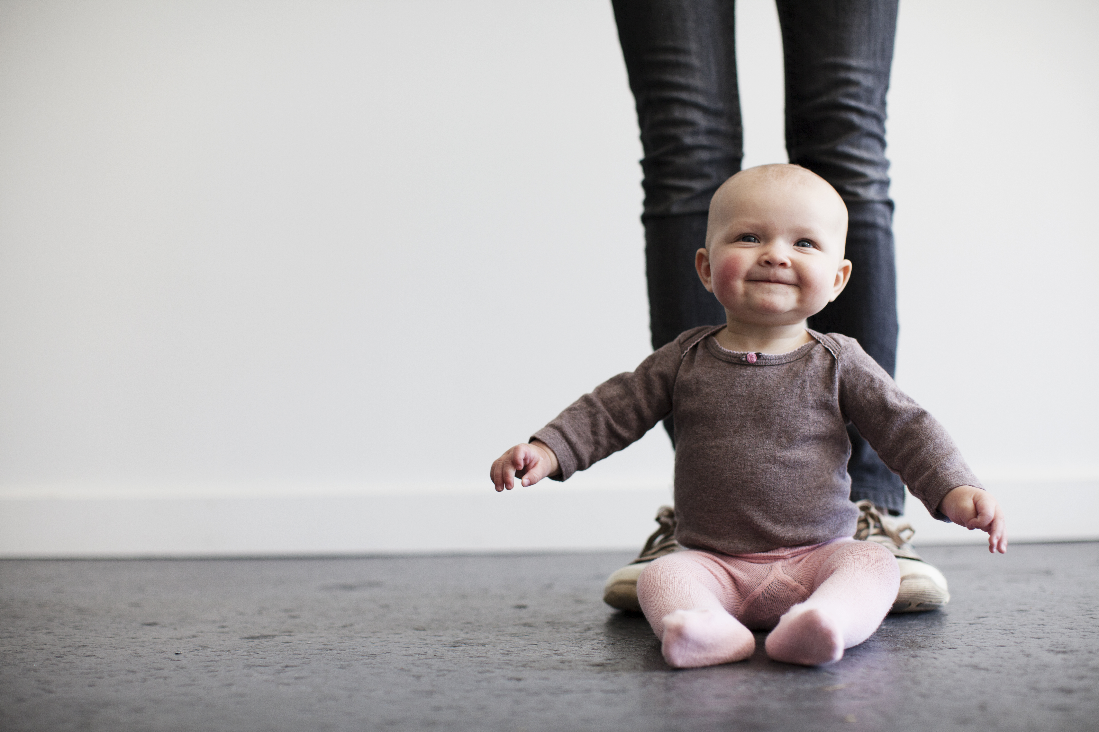
GOD’S BLESSINGS
Blessing of procreation – ”Be fruitful and multiply and fill the earth” (Gen 1:28a)
Blessing of vocation – “… subdue it, and have dominion over” (Genesis 1:28b)
Blessing of provision – “Behold, I have given you every plant yielding seed that is on the face of all the earth, and every tree with seed in its fruit” (Gen 1:29)
Notes:
Blessing of procreation – “Be fruitful and multiply and fill the earth” (Gen 1:28a) - We are commanded to fill the earth, within the covenant of marriage, with His image-bearers - We have the privilege, as men and women to be involved in bringing life into this world - Children are a blessing from God, and we get to experience that unique relationship and love that exists between a parent and their child - It is the goodness of God that establishes the family unit. It is the goodness of God that allows children to be born - Our children are a blessing and joy bestowed upon us by God
Blessing of vocation – “…subdue it, and have dominion over” (Genesis 1:28b) - Work was given as a blessing, not a burden. It was the fall, it was Satan, it was our sin that caused work to be hard, that caused the ground to be hard to work - But God blessed us with work that we would have the privilege of accomplishing something with our hands and our minds - That we would have the satisfaction of starting a project and finishing it - God has blessed us with work
Blessing of provision – “Behold, I have given you every plant yielding seed that is on the face of all the earth, and every tree with seed in its fruit” (Gen 1:29) - The very food that they eat was provided for them by God - And God would provide for all their needs that would enable them to live a fulfilling, purposeful, God-glorifying life - God did all of this for our good pleasure, so that we would look around and see the handiwork of our Sovereign Creator, and be reminded of His goodness to us - And in return, how can we do anything but consider it pure joy to live a life of service to Him

Slide 10
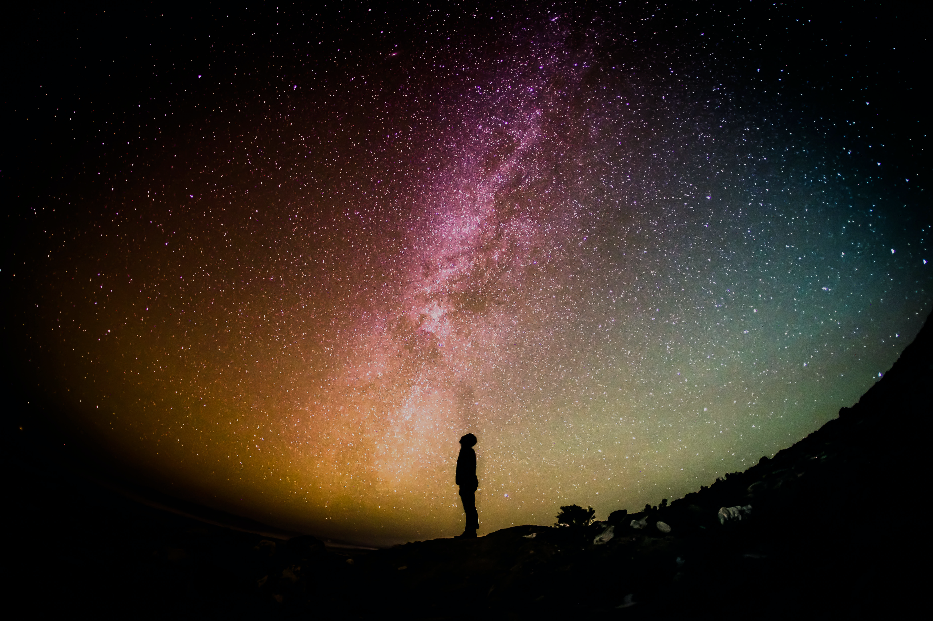
GOD’S PERCEPTION
“And God saw everything that he had made, and behold, it was very good.” (Gen 1:31)
“For we know that the whole creation has been groaning together in the pains of childbirth until now” (Rom 8:22)
One day sin’s penalty, power and presence will be done away with, and all things will be made new (Rev 21-22)
Notes:
“And God saw everything that he had made, and behold, it was very good.” (Gen 1:31) - God looked at, He inspected everything that He had made and saw that it was very good - The word here for behold, is God basically, going WOW! Look at what I have made - When God comes to creating male and female, and looks at the environment that He has created for them, and the stage upon which redemptive history will unfold, He sees that it is very good
“For we know that the whole creation has been groaning together in the pains of childbirth until now” (Rom 8:22) - Sin has tarnished and warped not only the image of God in us, but also the very creation in which we exist in - Sometimes when I have travelled or even as I am walking around the Sunshine Coast, I think of this verse - Because even in this sin tainted, fallen world, I still can’t help but feel a sense of wonder come over me at what God has created, and yet this isn’t even the final product!
One day sin’s penalty, power and presence will be done away with, and all things will be made new (Rev 21-22) - One day Jesus will return and all those who have believed in him will be raised to life and taken to be with him in an eternal state in the new heavens and the new earth - All of that which was evil, and sinful will be cast away into the very pits of hell, and only that which is pure and perfect will exist in heaven - And we will dwell forever in the glory of our Lord and Saviour Jesus Christ, where we will be free from the penalty, power, and presence of sin - Not because of anything that we have done, but because the finished work of Jesus Christ - And on that day, all those who have believed in Jesus Christ as Lord and Saviour will receive their glorified bodies, and be perfectly conformed to the image of Jesus Christ

Slide 11
SUMMARY
We were all created by God and for God
Sin warped the image of God in us
Jesus Christ came to renew and restore the image of God in us
Notes:
We were all created by God and for God - These verses in Genesis are foundational to understanding just who we are. - They tell us how we are the pinnacle of His creation, and how He has showered us with blessing after blessing - They tell us that we were made with a mind to know God, and a heart to love God - Our affection is to be towards the one in whose image we were made - For we were intentionally created by a personal God for His glory.
Sin warped the image of God in us - Because of sin we no longer walk closely with God - Because of sin we stand guilty before a holy and righteous God - Because of sin we have twisted and distorted God’s beautiful image and creation - Because of our depravity we shake our fists at our Creator
Jesus Christ came to renew and restore the image of God in us - Even though we shake our fists at God - And even though we are enemies of God and we are filled with sin and doing only what pleases ourselves - God still chose to send Jesus Christ who willingly came to this earth as a man, as the perfect, visible image of the invisible God - Why? So that he could live the life you and I never could, and pay the penalty for our sins by being crucified upon a cross, and on that cross, he would experience the full wrath of God in our place - And then he rose again for our justification. So that all those who have believed in Jesus Christ as Lord and Saviour could stand before God once again and be declared righteous - How? How can we now be declared righteous? - Because of what Jesus did on the cross, and because He rose again, God now looks at the record of the believer, and he no longer sees the word ‘SINNER’, but the perfect record of our Lord and Saviour - And now all our sins have been erased by the blood of Jesus Christ and it now reads ‘SAVED’ - And the same gospel that saved sanctifies us and gradually makes us more like Jesus Christ - And continues to do so until the day when Jesus comes back and we are glorified and made perfect and we are welcomed into the glory of God with open arms by our heavenly Father, our Creator God, where the power and presence of sin will be no more

Slide 12
“Man was made in the image of God, and nothing will satisfy man but God, in whose image he was made.” Charles Spurgeon
Notes:
There is only one way to God, and it is through His one and only Son Jesus Christ.
There is no true satisfaction to be found in this life or the next apart from a life in Christ, the perfect image of God
Let us continue to trust in Jesus Christ for all the days of our life, as we travel through this world as pilgrims, looking onward and upward to the glory and eternity that awaits all those who have believed in Jesus Christ as Lord and Saviour
Let’s pray

